Slide 1


Rework in construction projects
By:
Bara’ Khateeb
Noor Shaer
Hoor Aqra’
Ali Saed
Under supervision :
Dr Reema Nassar

Slide 2
Outline:
Introduction
Objectives
Methodology
Analysis
Discussion
Recommendations

Slide 3
Introduction
Construction industry faces numerous restrictions and challenges that have an impact on its outcomes. This study was done in an effort to address the issues with construction contracting in Palestine. The rework in construction projects is one of the most important issues that face the construction sector.

Slide 4
Construction Management
Construction management refers to the professional process of planning, coordinating, and overseeing construction projects from start to finish. It involves the management of various aspects, such as budgeting, scheduling, resource allocation, quality control, and ensuring the project's successful completion within the specified timeframe.

Slide 5
Poor construction management effects:
Poor construction management can have several negative effects on a construction project one of the most important effects is cost overrun and time delay that has been mentioned in graduation project1

Slide 6
Related to graduation project 1 “cost and time delay”
Construction and design rework can have a significant impact on both time and cost overruns in a project. Here's how:
Time Overrun:
Extended Construction Duration, Sequential Disruptions, Repeated Inspections and ApprovalsResource Reallocation and Coordination Challenges

Slide 7
Cost Overrun:
Additional Materials
Labor Expenses
Equipment and Tools
Change Orders
Financial Penalties

Slide 8
Objectives
This project aims to describe the difficulties and problems that this industry faces and offer solutions to issues that contractual parties and organizations can use to prevent and solve them in order, to enhance the performance of the construction industry.

Slide 9
Rework Management:
Rework management is the process of identifying, managing, and mitigating the impact of rework in construction projects. Effective rework management involves identifying the root causes of rework, developing strategies to prevent rework, and implementing procedures to manage rework when it does occur.

Slide 10
Rework:
Rework in construction projects refers to any work that needs to be redone or corrected due to errors or defects in the original construction work. Rework can arise from a variety of reasons, such as design changes, errors in measurements or calculations, defective materials, or poor workmanship.

Slide 11
The following are some key steps involved in effective rework management:
Identifying the causes of rework
Developing preventive strategies
Implementing measures to manage rework
Continuously improving the rework management process

Slide 12
design rework and construction rework :
Design rework refers to the need to revise or modify the project design during the planning or design phase of the project. This could happen due to changes in project requirements, mistakes or oversights in the original design, or other factors. Design rework can have a significant impact on the project timeline and cost, as it requires additional time and effort to revise the design and update construction plans and documents

Slide 13
Construction rework, on the other hand, refers to the need to redo or correct work that was already completed during the construction phase of the project. This could be due to errors or mistakes made during the original construction, changes in project requirements or specifications, or other factors. Construction rework can also have a significant impact on the project timeline and cost, as it requires additional time and resources to correct the mistakes and redo the work.

Slide 14
The different between design rework and construction rework:
The key difference between design rework and construction rework is the timing of the rework - design rework occurs during the planning and design phase of the project, while construction rework occurs during the construction phase. Another difference is that design rework can often be avoided or minimized through effective planning and communication, while construction rework is often the result of errors or oversights that occur during the construction process.

Slide 15
Sources of Rework:
Reworks frequently occur as a result of main sources like:
mistakes: it’s impacted by errors committed in the design phase that later surface in the procurement phase
Changes :The scale and type of the work, as well as the aesthetics and other characteristics of the structure, can all be impacted by a change in the design. Rework resulting from revisions can have a detrimental effect on productivity and the success of the project as a whole. The primary cause of rework in construction projects is design-related rework in the form of change orders
Omissions :Due to stress or distraction, omission mistakes occur, which creates error-provoking circumstances inside the project. Time restraints, inadequate personnel, exhaustion, and inexperience are a few of the causes, which show themselves in dysfunctional interactions and practices that cause rework.

Slide 16
Effect of rework on organizational productivity and performance:
Rework negatively impacts organizational productivity and performance through time and resource waste, increased costs, lower employee morale, customer dissatisfaction, quality control challenges, and inefficient resource allocation. To mitigate these effects, organizations should focus on quality assurance, employee training, effective project management, and continuous improvement.

Slide 17
Methodology
This study will be carried out through the following:
interviews with consultants and contractors
designed a questionnaire that have been filled contractors and consultants

Slide 18
Procedure:
Conducting interviews
targeted local contract parties had been selected to get information about their claim of the most important challenges that they encounter in the current circumstances
Analyzing the outcomes of the questionnaire; discussing the questioner's extreme results with some contract parties for further information and arguments.

Slide 19
The questionnaire:
part One “General Information”
This part contains general information about the contract parties
Work nature (Contractor , First Class Consultant (A) , second Rating Consultant (B) , first rate consultant (A))
Position in the company(Institution director/deputy director of the institution , Project Manager/Deputy Project Manager, Site engineer/office engineer )

Slide 20
General information about the company:
The year of establishment of the company.
The number of fixed employees.
Number of projects implemented during the past five years.

Slide 21
Part two:
Contracting Sector Problems:
Below are a number of problems facing the contracting sector in the West Bank.
The numbers stand for (1) unimportant, (2) slightly important, (3) moderately important, and (4) extremely important.

Slide 22
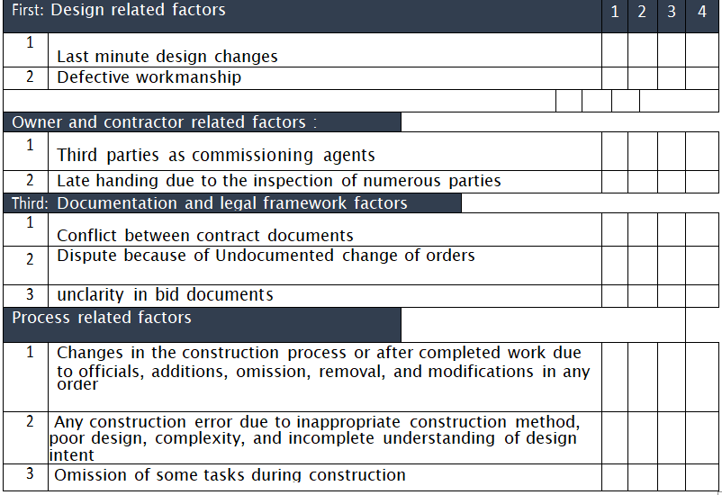

Slide 23
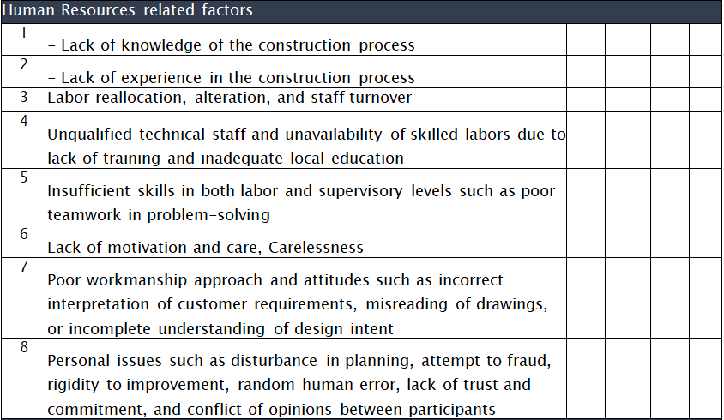

Slide 24
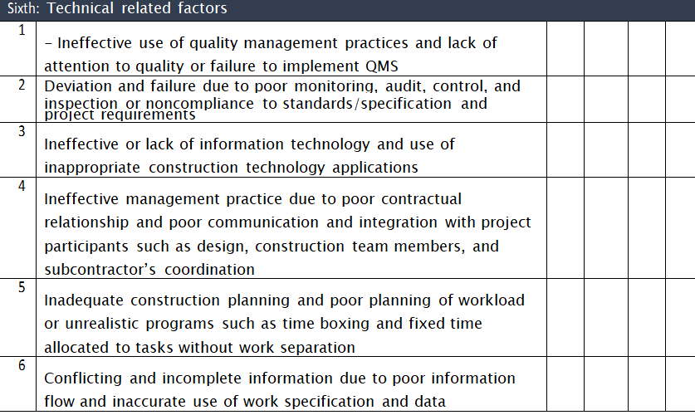

Slide 25
Part three:
This part includes
the methods that the contract parties follow in estimating the estimated cost of the project or pricing bids when submitting for bids(from your previous experience, Follow-up the Palestinian index , Through a specialized staff in the institution)
The most frequent causes of claims and disputes?
Variation orders, Price change, Changing laws , Currency exchange rate change Adverse, weather conditions Adverse political.

Slide 26
Discussion:
Relative Importance Index (RII):
The RII value ranges from 0 to 1 with 0 not inclusive. It shows that higher the value of RII, more important was the sustainable criteria and vice versa. The comparison of RII with the corresponding importance level is measured from the transformation matrix as proposed by Chen et al. (2010).
It’s values Regarding as follows :
1Low (L) 0.0 < RII < 0.25
2Medium-Low (M-L) 0.25 < RII < 0.5
3High-Medium (H-M) 0.5 < RII < 0.75
4 High (H) 0.75 < RII < 1.0

Slide 27
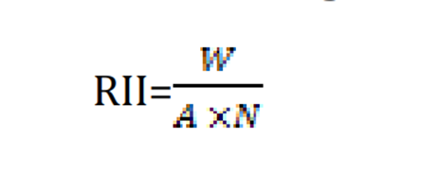
W = weighting that is assigned to each variable by the respondent
A = highest weight
N = total number of respondents

Slide 28
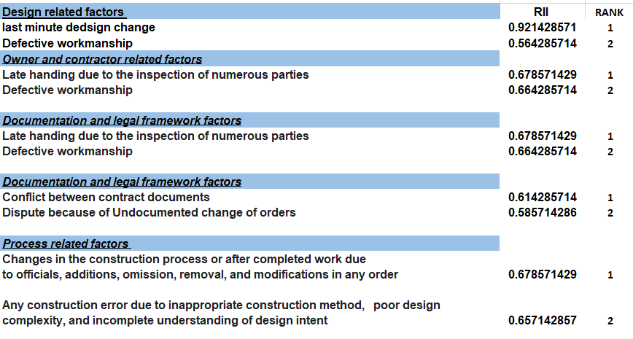
RII analysis and ranking :

Slide 29
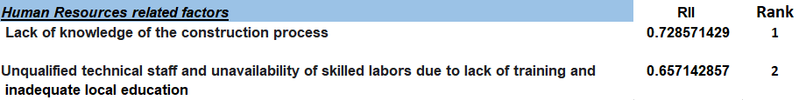

Slide 30
These recommendations must be taken into account in order for the project to proceed as required:
Part 2: Documentation and legal framework factors:
Should focus on Contracts to be clear and There are no legal loopholes , Project Documentation should be detailed and understandable for all parties , Permits and Approvals must be taken accurately , Quality control and testing in rework for construction projects involves ensuring that corrective activities meet required standards .
part 3 : Process-related factors in construction rework include planning and coordination, communication, skill and expertise, safety considerations, workflow optimization, quality control and testing, and documentation.

Slide 31
part 4 : human resources factors : Human resources factors in construction rework include skills and expertise, training and development, workforce availability, team collaboration, health and safety, and staffing considerations
Part 5 : Technical-related factors in construction rework include design modifications, material selection and compatibility, construction techniques, coordination with existing infrastructure, testing and inspections, workmanship, and quality control and documentation.

