Slide 1
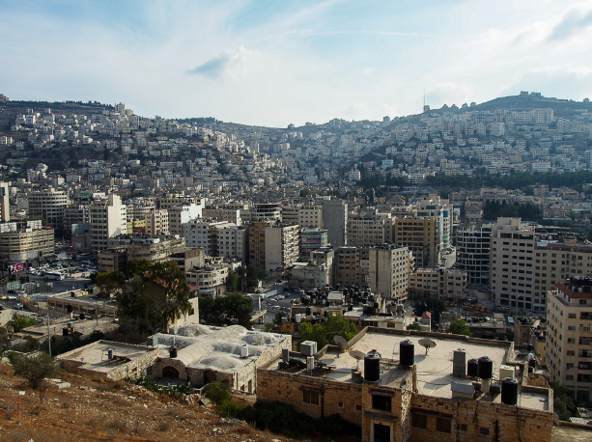

Air Quality in Nablus
By
Roa Zetawi
Sadeq Nuirat
Under supervision of: Dr. Abdelhaleem Khader

Slide 2
Significance of the work
The purpose of this research is to define the dangers of these pollutants to healthy life and to verify the presence of high concentrations of particulate air pollutants in the city of Nablus in Palestine and to know their potential sources

Slide 3
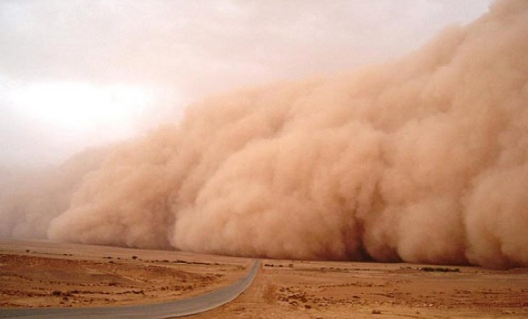
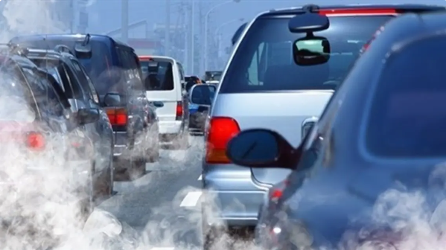
Air pollution and its sources

Slide 4




Slide 5
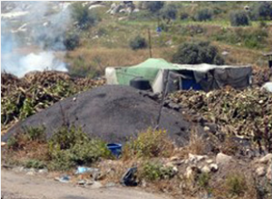
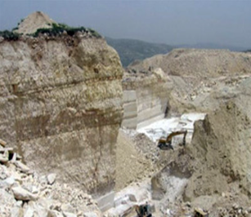
Air pollution in Palestine
Some of the main sources of air pollution in Palestine
Coal plants in Jenin.
Quarries and stone crushers and the resulting rising dust.

Slide 6
.
Indiscriminate burning of solid waste in some areas and the resulting smoke harmful to public health
Agricultural activities such as the use of agricultural pesticides, such as: methyl bromide, which affects the ozone layer.
The fumes, dust, and fumes from Israeli factories, which are blown by the winds into the west Bank

Slide 7
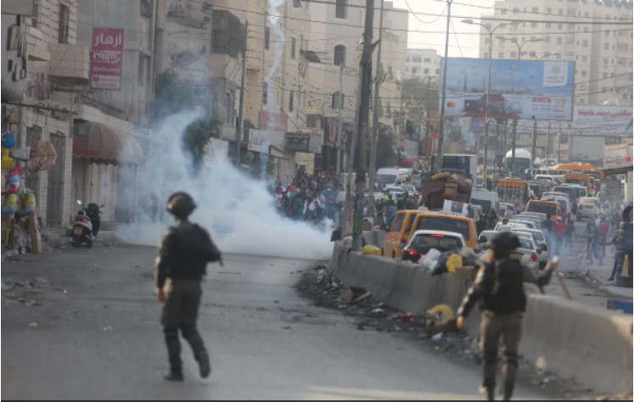

Slide 8
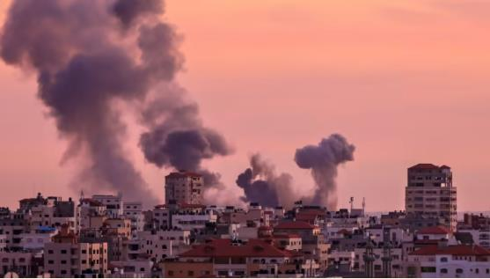

Slide 9
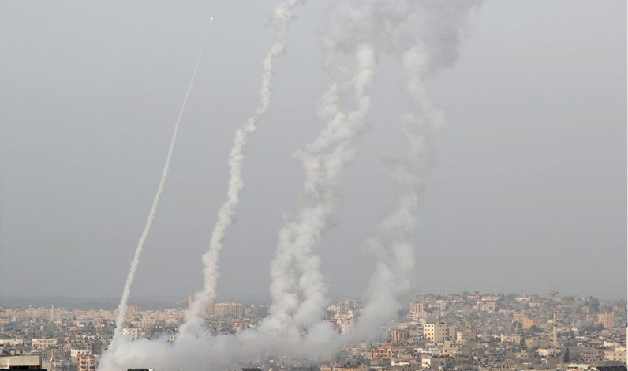

Slide 10

Particulate matter
the term for a mixture of solid particles and liquid droplets found in the air. Some particles, such as dust, dirt, soot, or smoke, are large or dark enough to be seen with the naked eye

Slide 11
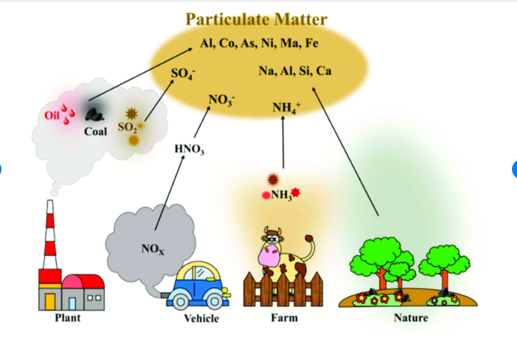

Slide 12
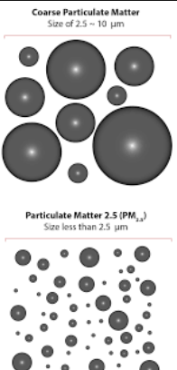
Main categories of particle pollution.
Coarse particles:(Also known as PM10-2.5)
Fine particles:(Also known as PM2.5)

Slide 13
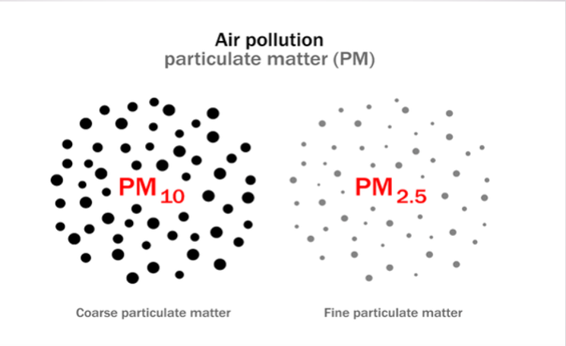
What’s The Difference Between PM10 and PM2.5?

Slide 14
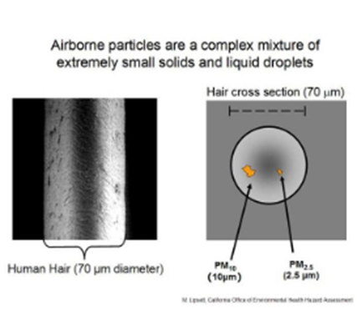
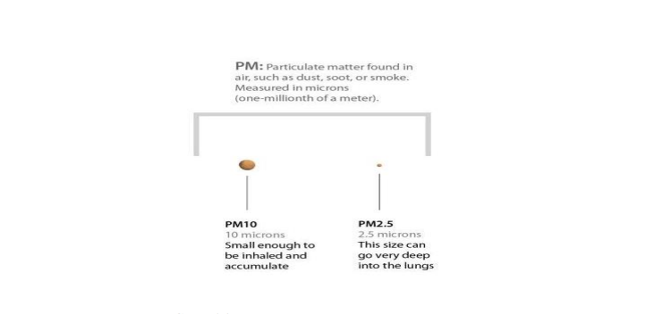

Slide 15
Main composition of PM2.5
The seven chemical components of PM_{2.5}, including sulfate, nitrate, ammonium, elemental carbon, organic carbon, silicon, and sodium ion

Slide 16

How can particle pollution affect my health
People most likely to experience health effects caused by particle pollution include:
People with heart or lung diseases (for example, asthma).
Older adults.
Babies and children.

Slide 17

Diseases caused by PM2.5

Slide 18
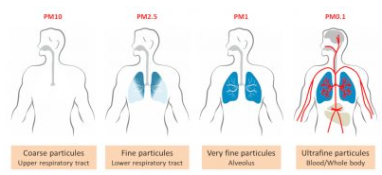

Slide 19


Slide 20
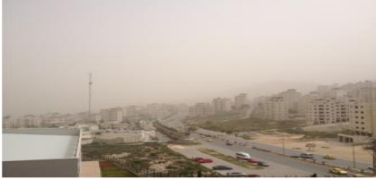
POSSIBLE SOURCES OF PARTICULATE MATTER IN NABLUS
Transportation
Quarries and stone cutting industry
Industrial activities to the west
Seasonal dust storms

Slide 21
Objectives
A comparison between the values of PM2.5 measured from Air U devices in terms of:
The height of the point above sea level.
The distance and proximity to the main streets.
It is close to industrial areas.

Slide 22
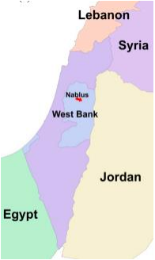
METHODOLOGY

Slide 23
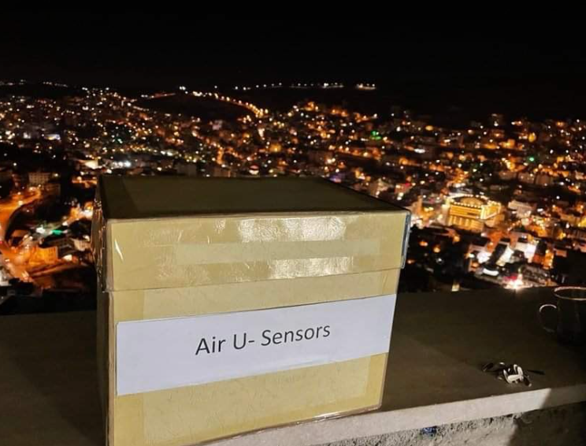

Slide 24

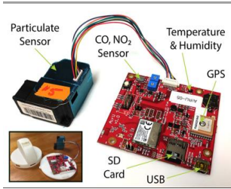

Slide 25
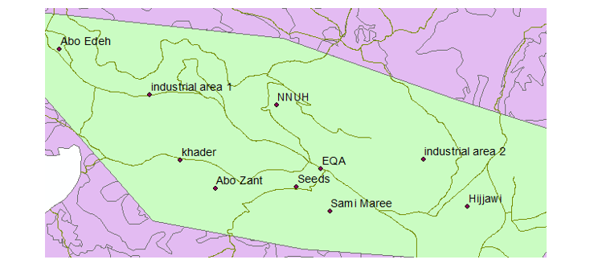

Slide 26
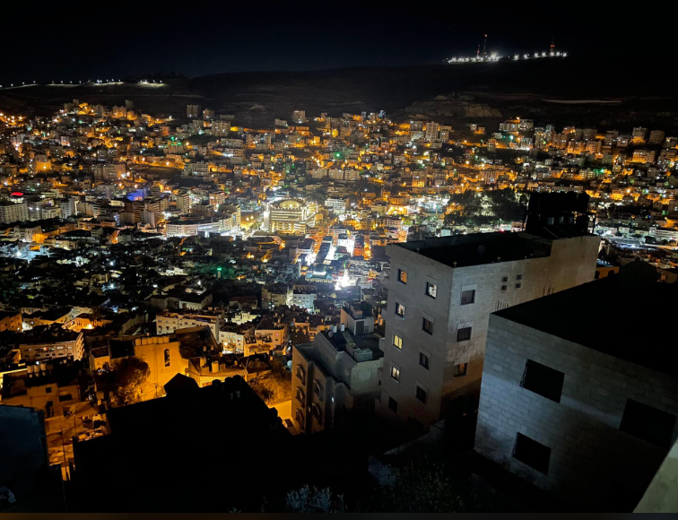

Slide 27
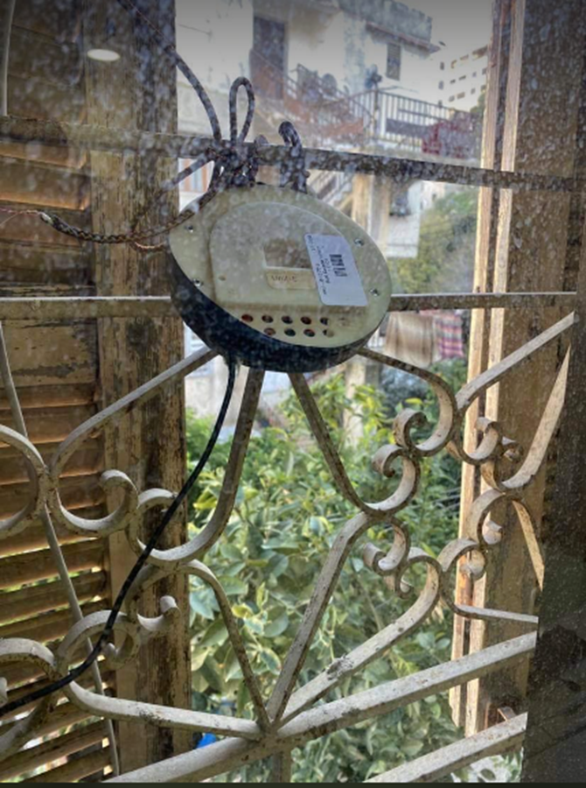
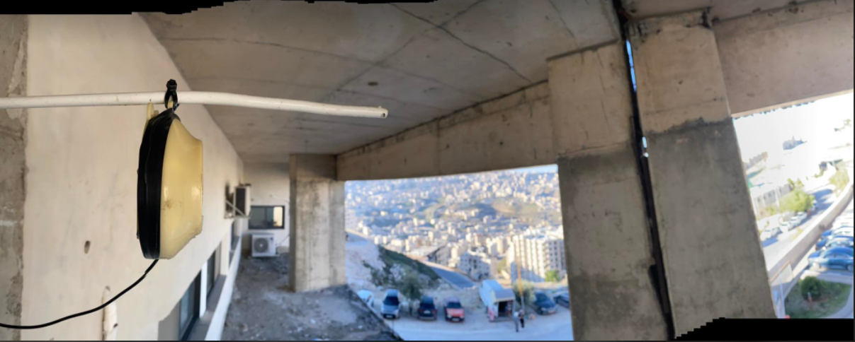

Slide 28


Slide 29
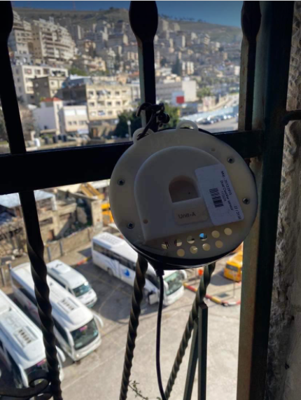
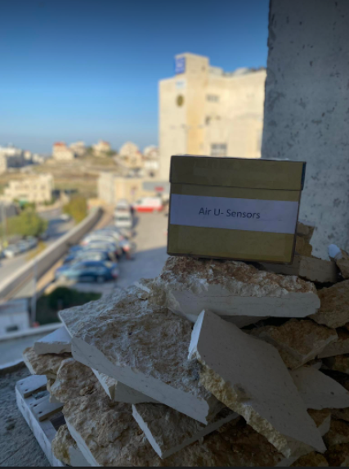

Slide 30
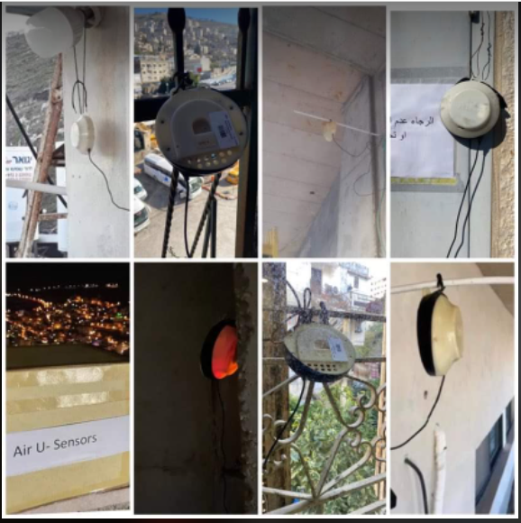

Slide 31
Data calibration equations
Calibration equation for “84” device=13.799*(X)^{0.4368}
Calibration equation for “UNIT A” device= 6.7747*(X)^{0.6619}
Calibration equation for “UNIT B” device= 6.4784*(X)^{0.6251}
Calibration equation for “UNIT C” device= 9.8544*(X)^{0.5105}
Calibration equation for “UNIT D” device= 6.3958*(X)^{0.6437}
Calibration equation for “UNIT E” device= 7.9461*(X)^{0.6297}
Calibration equation for “UNIT F” device= 7.4107*(X)^{0.6389}

Slide 32
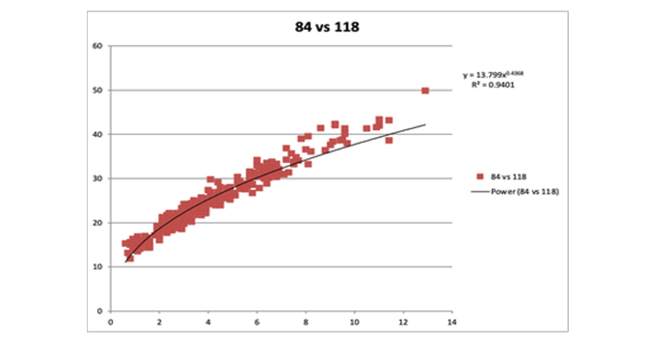
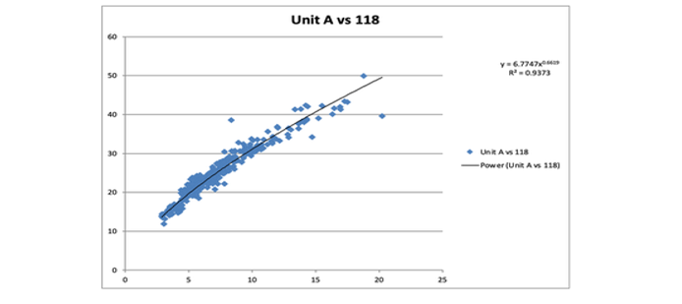

Slide 33
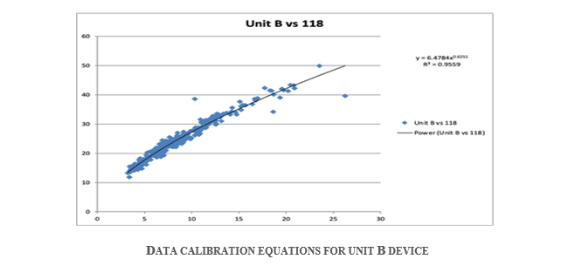
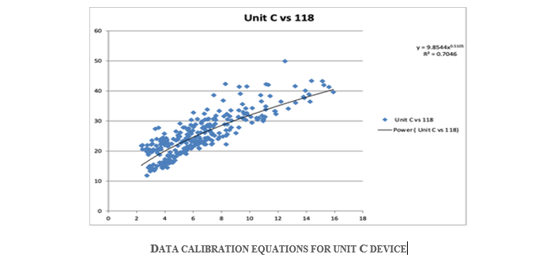

Slide 34
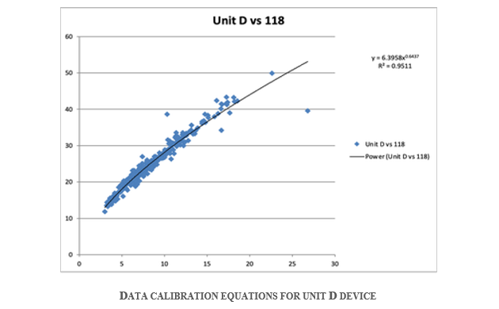
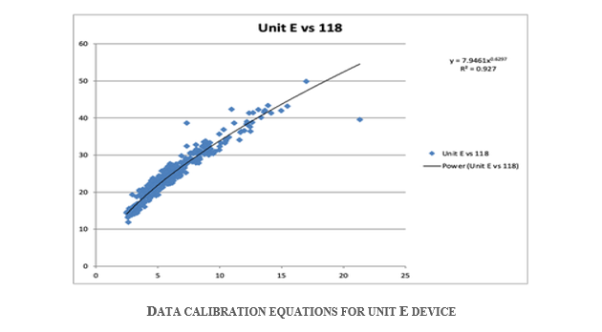

Slide 35
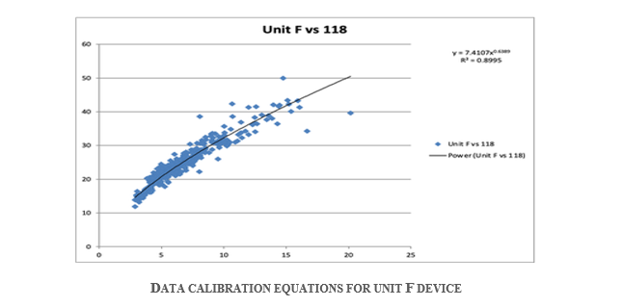

Slide 36
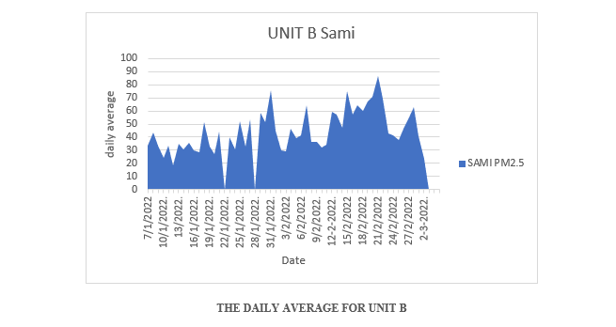
.
The following graphs show the daily average for each device:

Slide 37
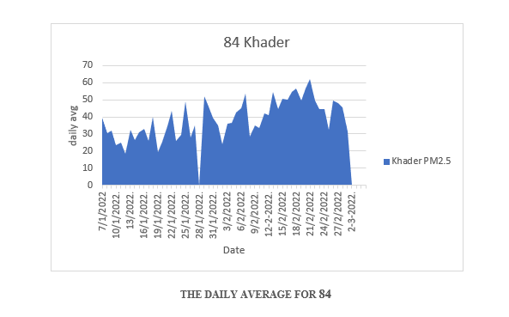

Slide 38
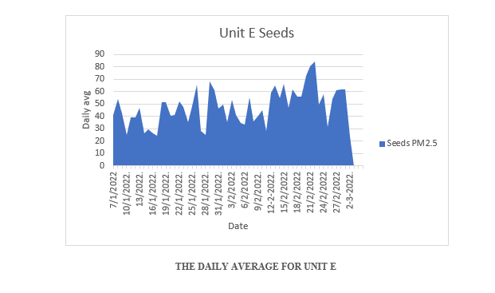

Slide 39
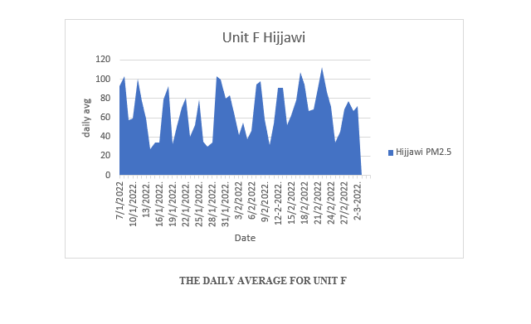

Slide 40
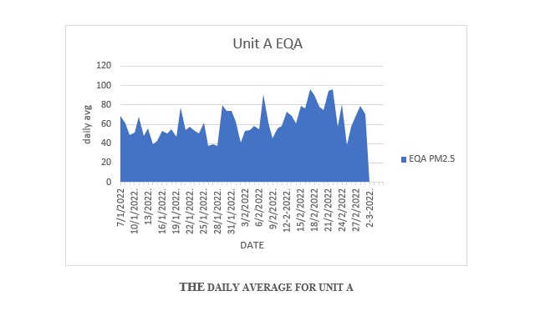

Slide 41
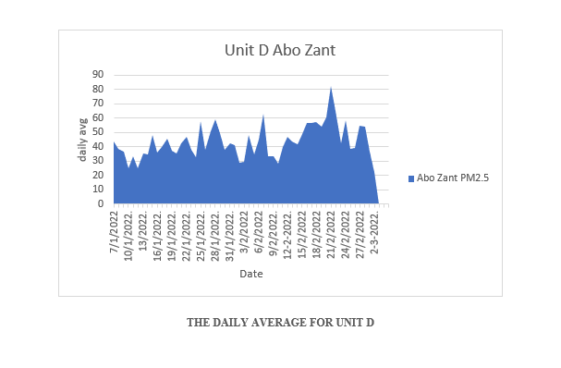

Slide 42
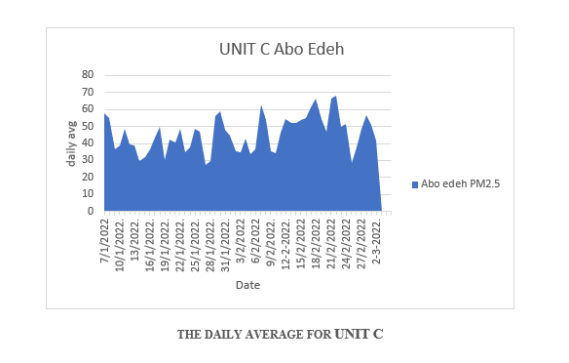

Slide 43
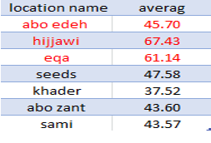
the general average of the readings of each device

Slide 44
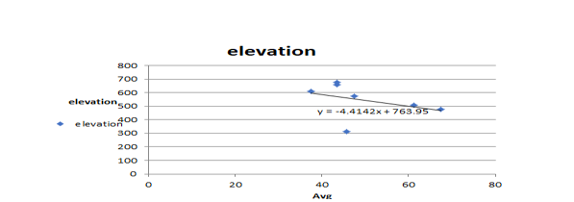
Results
The following graphic shows the relationship between the point's height above sea level and the value of PM2.5

Slide 45
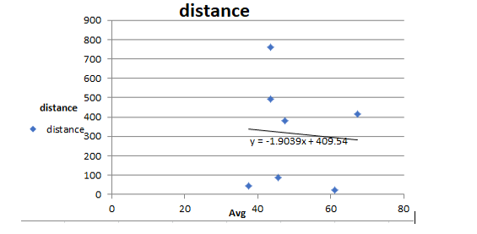
The following graphic shows the relationship between the point's distance from the street and the value of PM2.5.

Slide 46
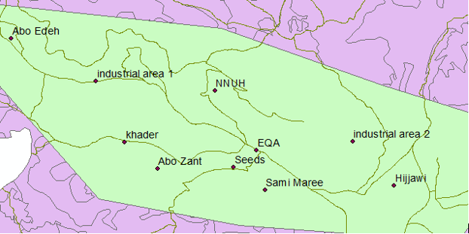
The following pictures show the location of each device relative to the Nablus Industrial Zone, as well as the general average of the readings of each device

Slide 47

Our Recommendations

Slide 48


