Slide 1

AN-Najah National University
Faculty of Engineering & Information Technology
Building Engineering Department
Graduation Project – II
Redesign Al-Nabali and Al-Fairs residential building
Prepared by:
Bara Raed Faqeeh
Asmaa Kokash
Shahd Hijab
Rakan Ayyoub
Supervised by:
Eng. Alaa Shaheen

Slide 2
TABLE OF CONTENTS
01
02
03
Introduction
Architectural Aspects
Enviromental Aspects
04
05
06
Structural Aspects
Eloctro-Mechanical Aspects
Quantity Survaying and Cost Estimation

Slide 3

Introduction
Project Description
Methodology
Project Location
Redesign Al-Nabali and Al-Fairs residential building

Slide 4
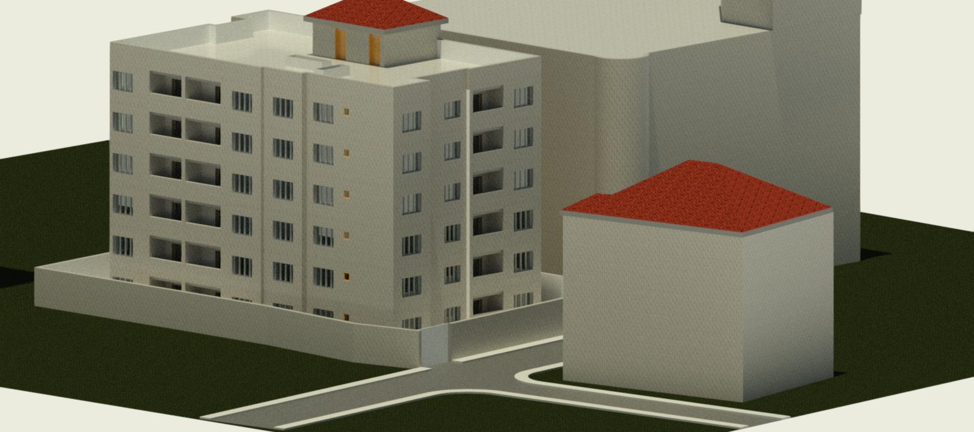
Introduction – Project Description
In this graduation project, a public library consisting of residential building with a total area of 4539.57 square meters was analyzed and re-designed.

Slide 5
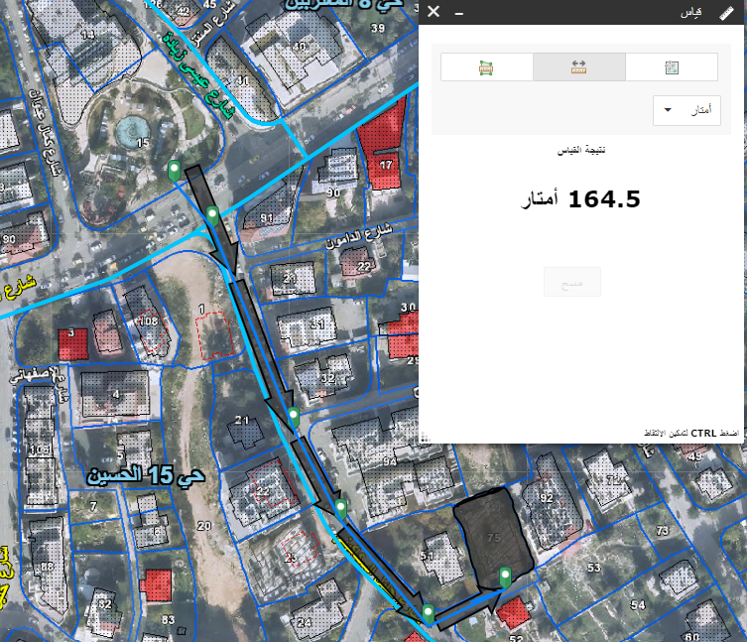

Introduction – Site Location
The project is located in the center of Ramallah
The project is situated on Khalil Al-Sakakini Street is located just 160 meters from the Ramallah Municipality.
The site is located in a classification area B
The Al-Nabali and Al-Faris residential building features a strategic location close to public services and amenities in the heart of the Al-Nuzha neighborhood, making it an ideal choice for residence.

Slide 6
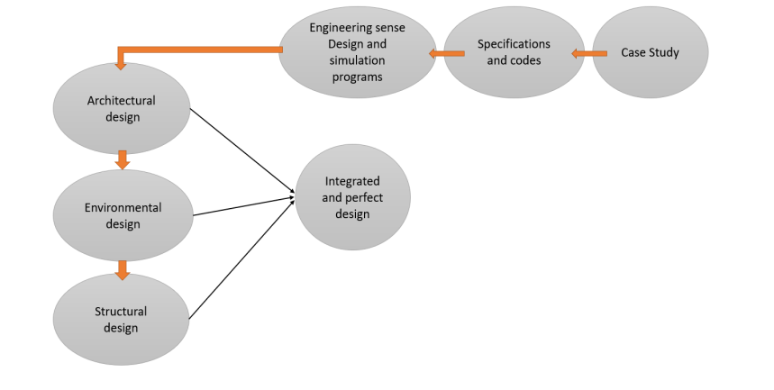
Introduction - Methodology

Slide 7
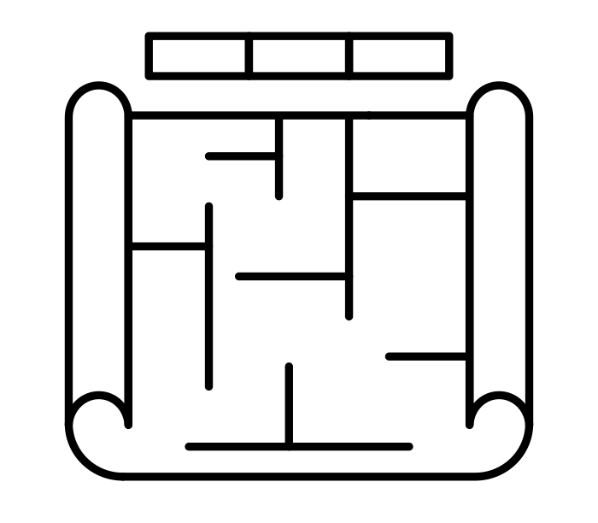
Architectural Aspects
Site Analysis
Architectural Plans
Rendered Shots

Slide 8
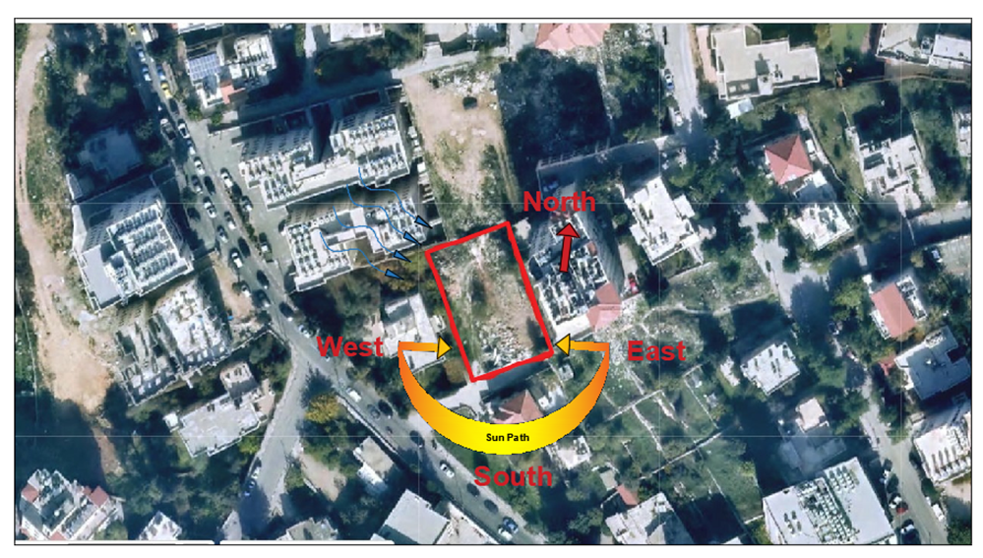
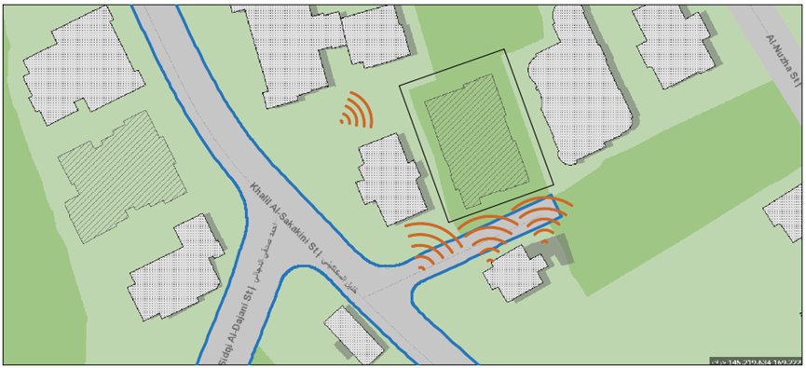
Site Analysis – Environmental Effect
Wind Direction
Noise Sources
Sun Path

Slide 9
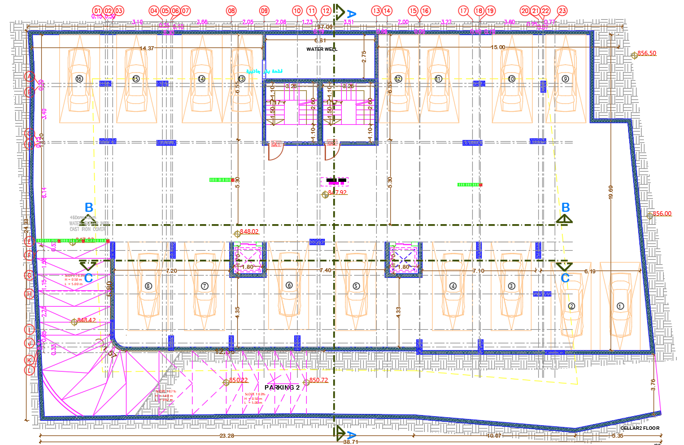
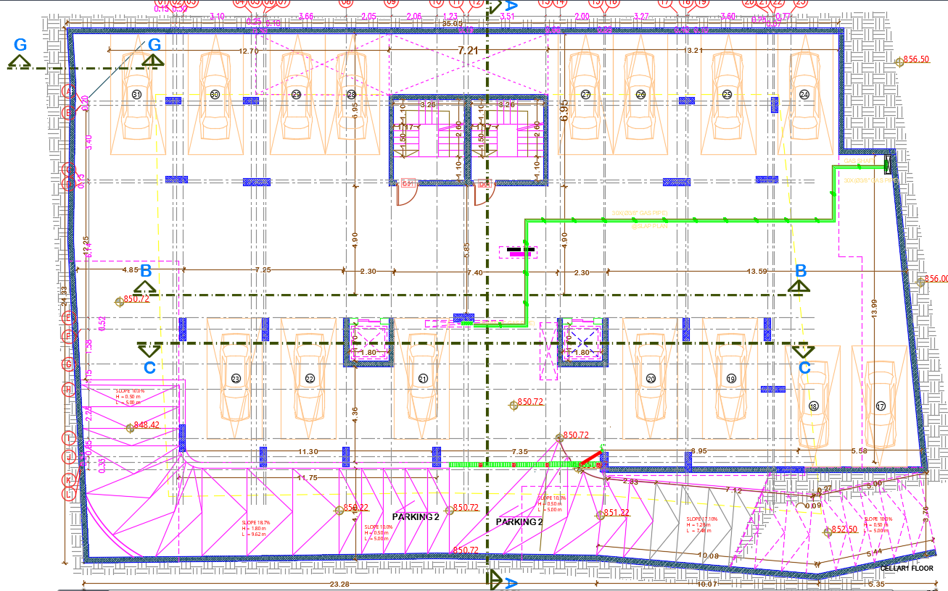
Architectural Aspects – Architectural Modifications
1. Parking Modifications
CELLAR2 FLOOR
CELLAR1 FLOOR
Before Modifications
Before Modifications

Slide 10
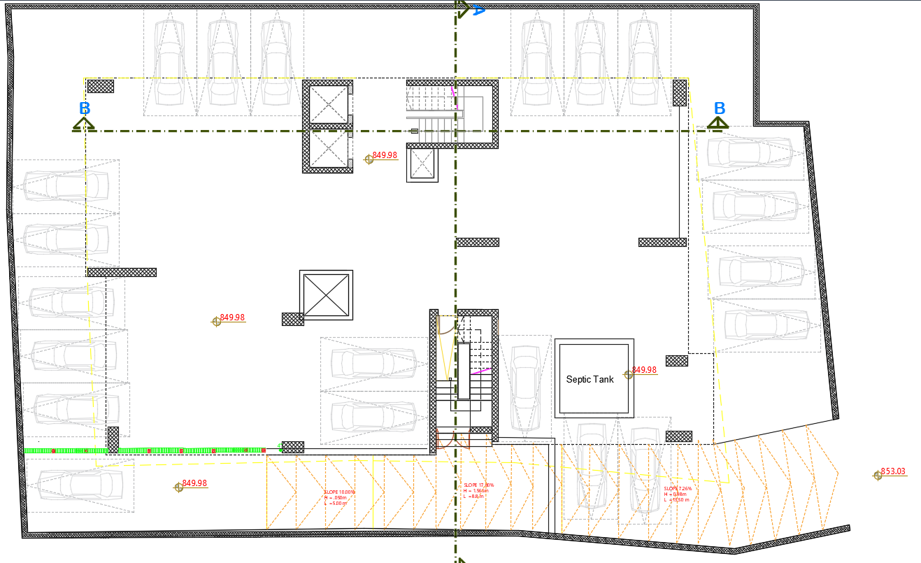
Architectural Aspects – Architectural Modifications
1. Parking Modifications
CELLAR1 FLOOR
After Modifications

Slide 11
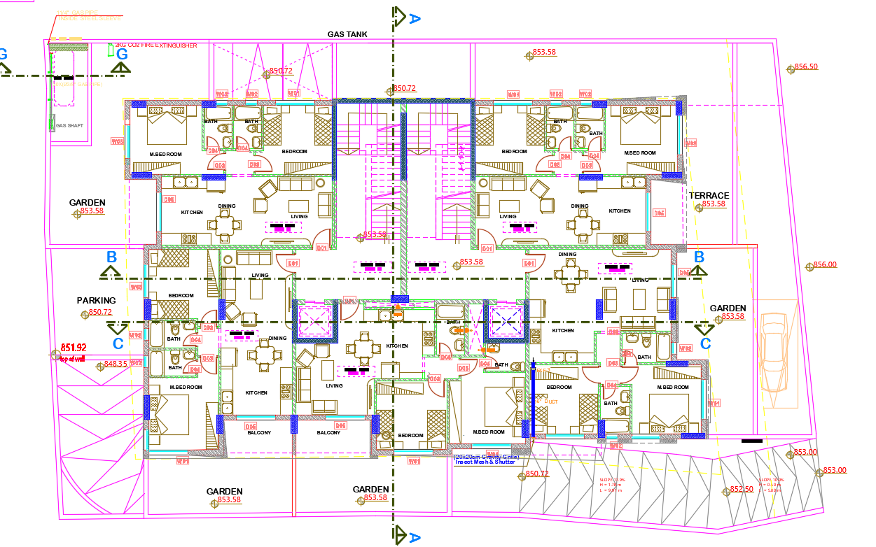
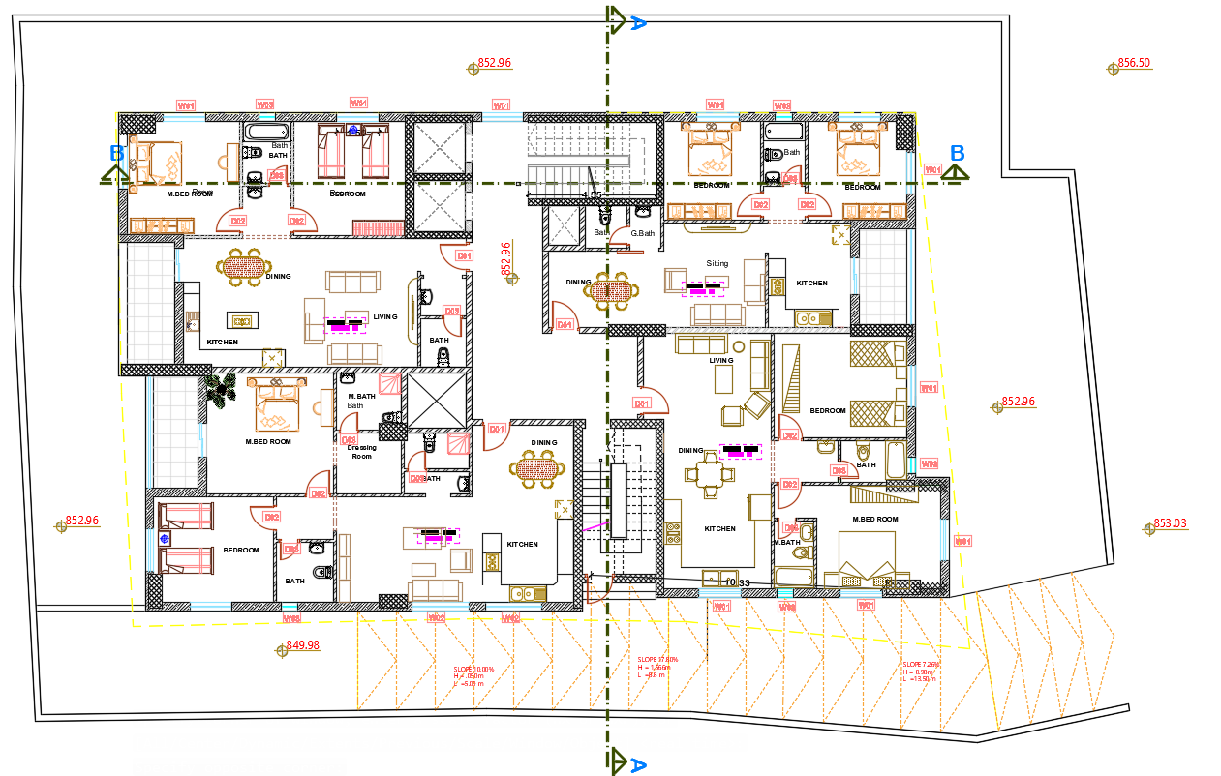
Architectural Aspects – Architectural Modifications
2. Basement Floor Modifications
Before Modifications
After Modifications

Slide 12
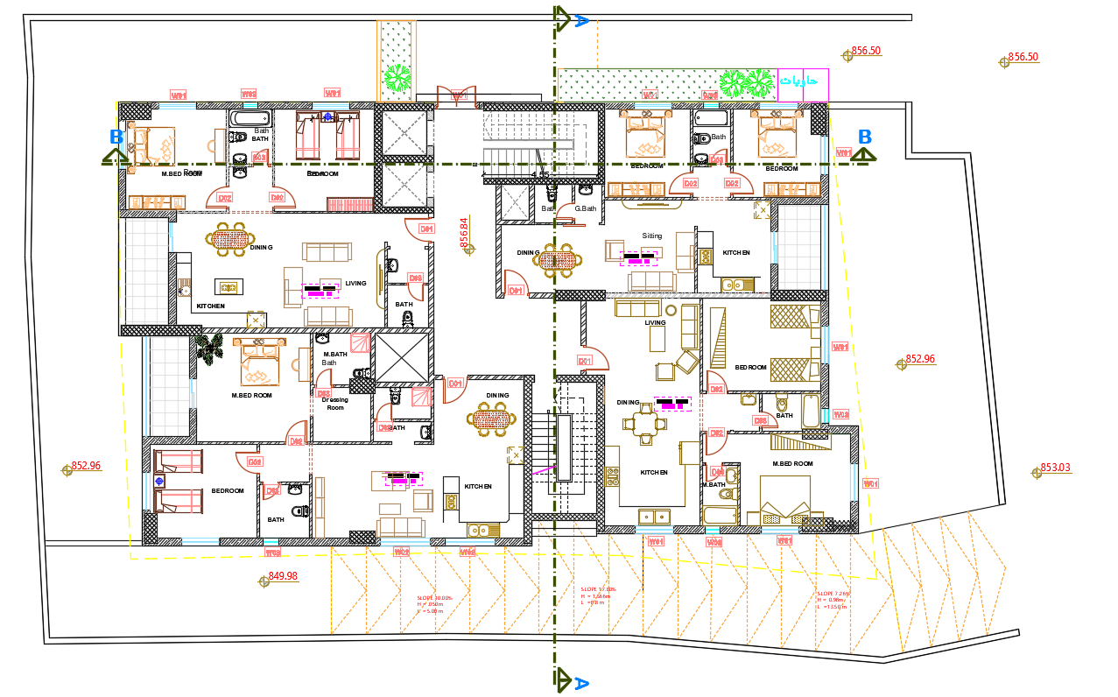
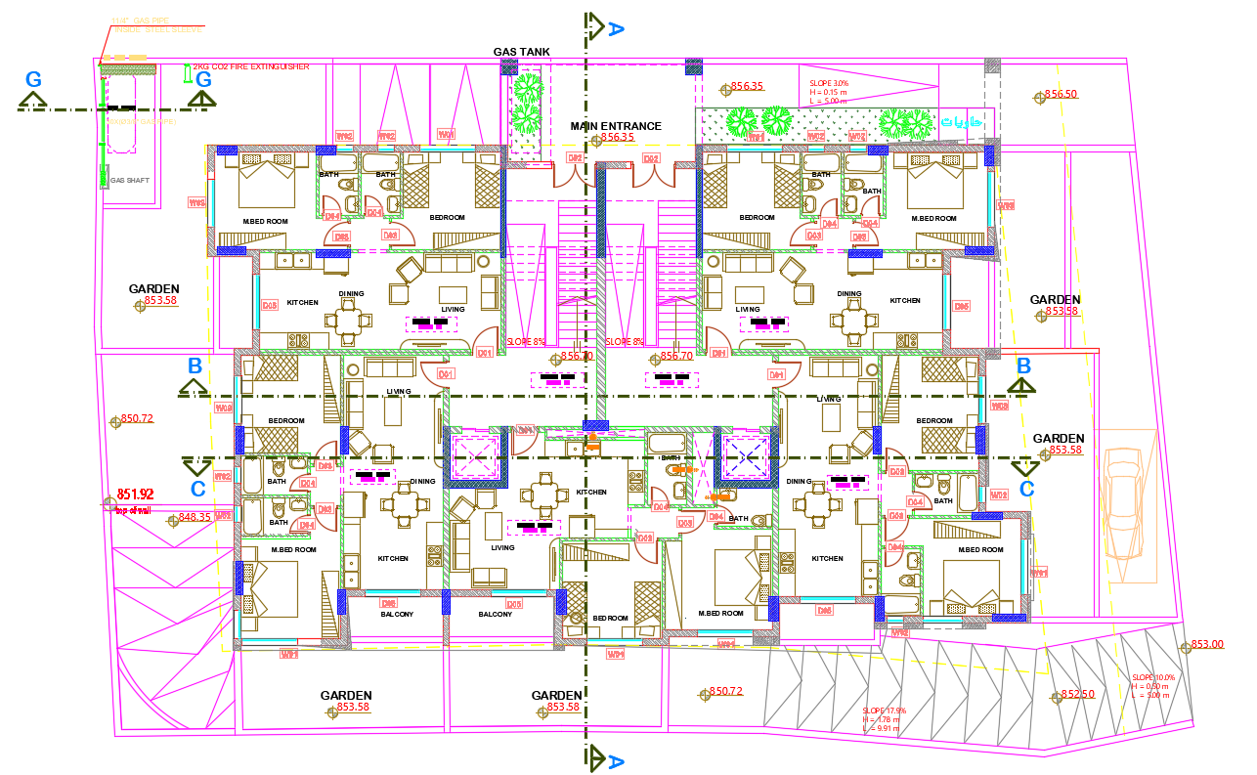
Architectural Aspects – Architectural Modifications
3. Ground Floor Modifications
Before Modifications
After Modifications

Slide 13
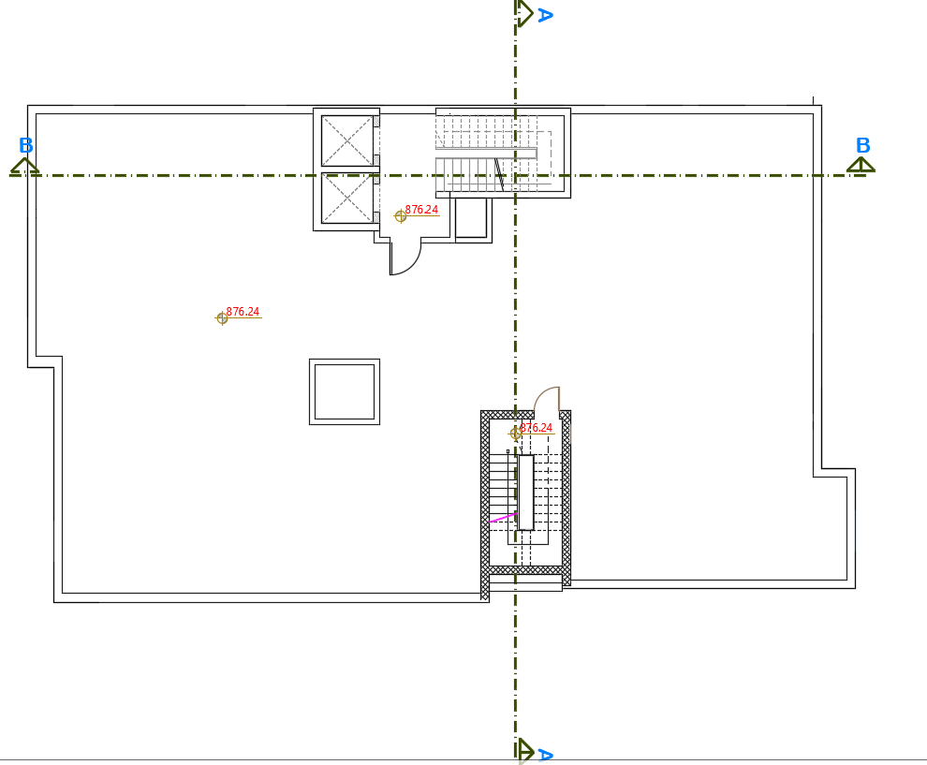
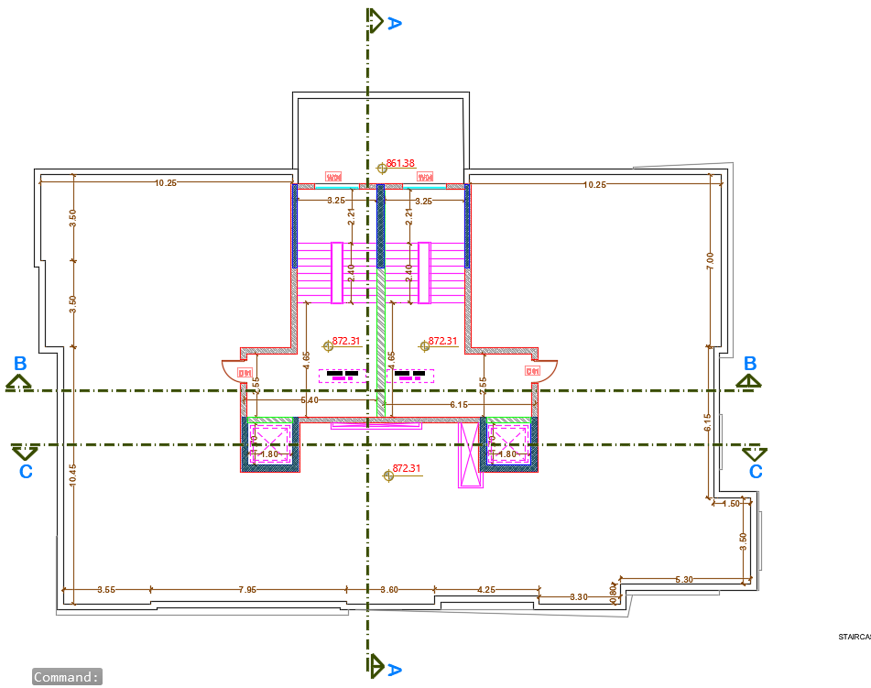
Architectural Aspects – Architectural Modifications
4. Roof Floor Modifications
Before Modifications
After Modifications

Slide 14

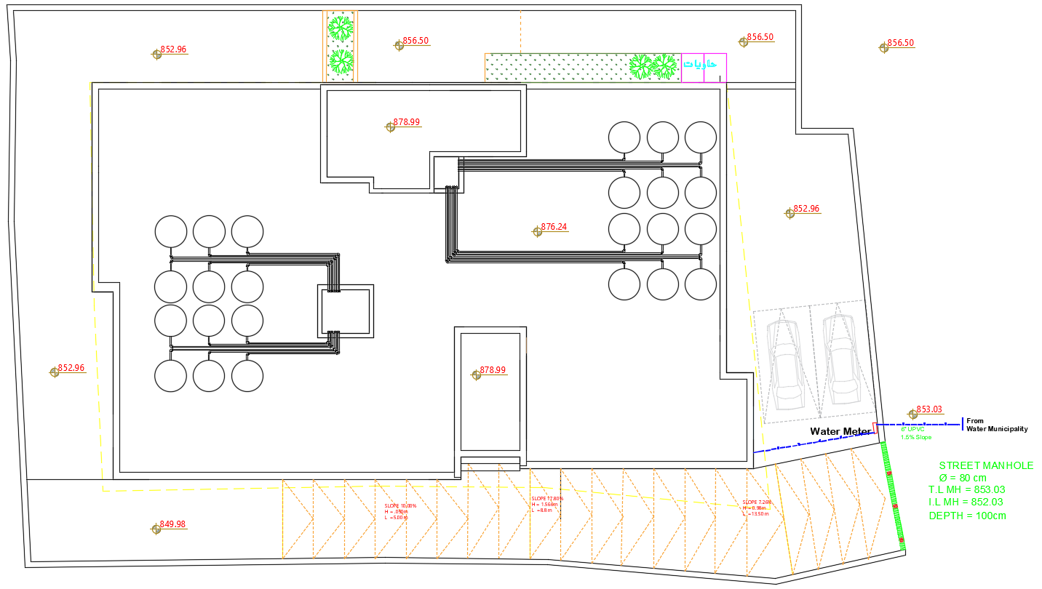
Architectural Aspects – Architectural Modifications
5. Site Plan

Slide 15
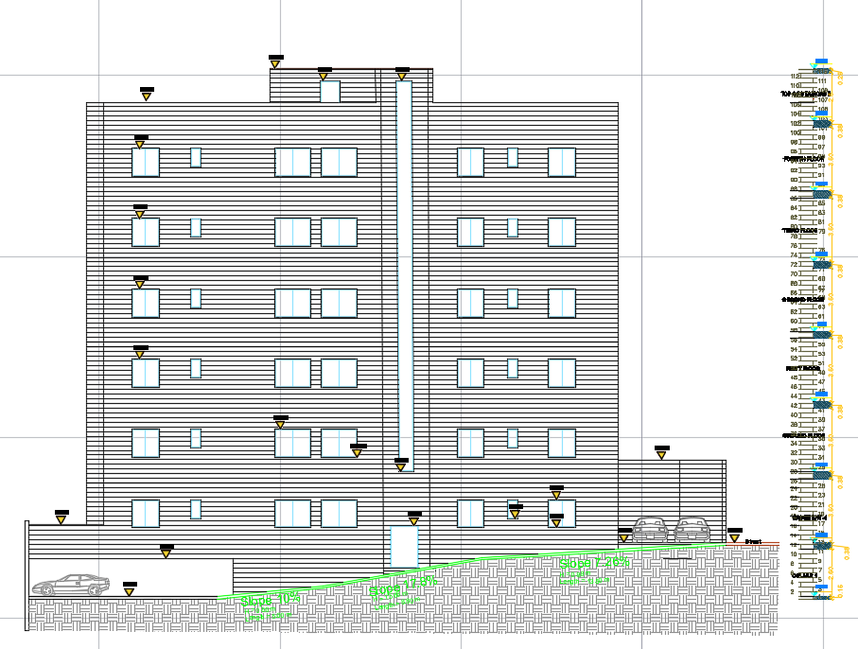
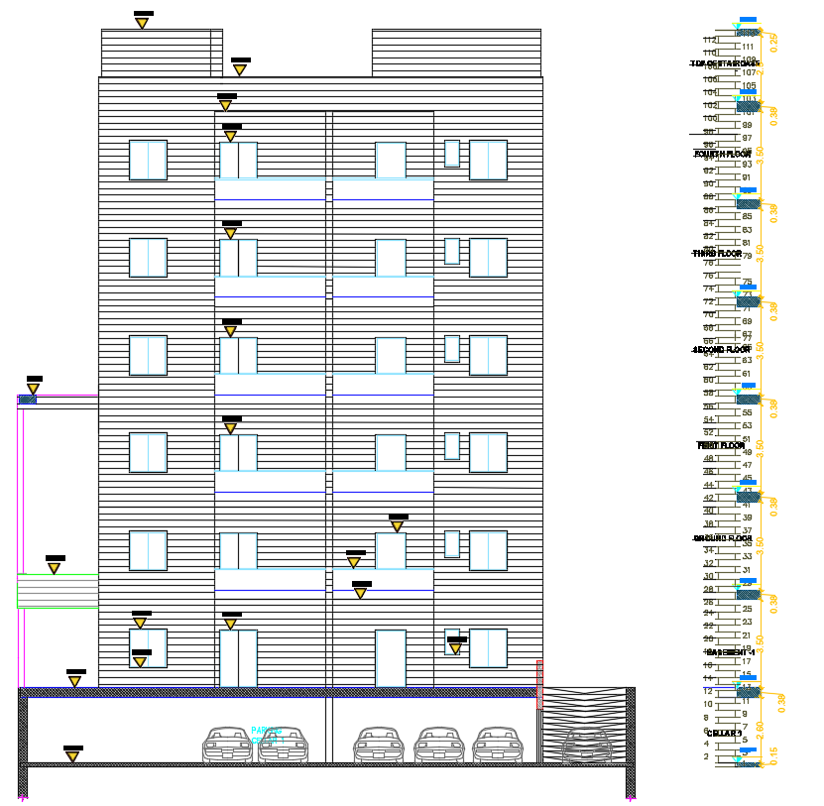
Architectural Aspects – Elevations
SOUTHWEASTERN ELEVATION
NORTHWESTERN ELEVATION

Slide 16
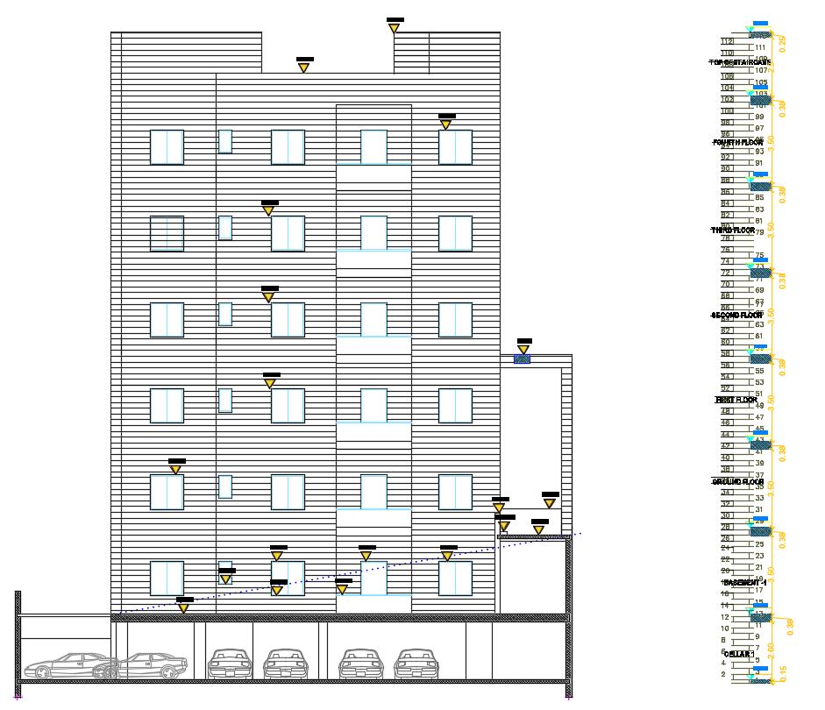
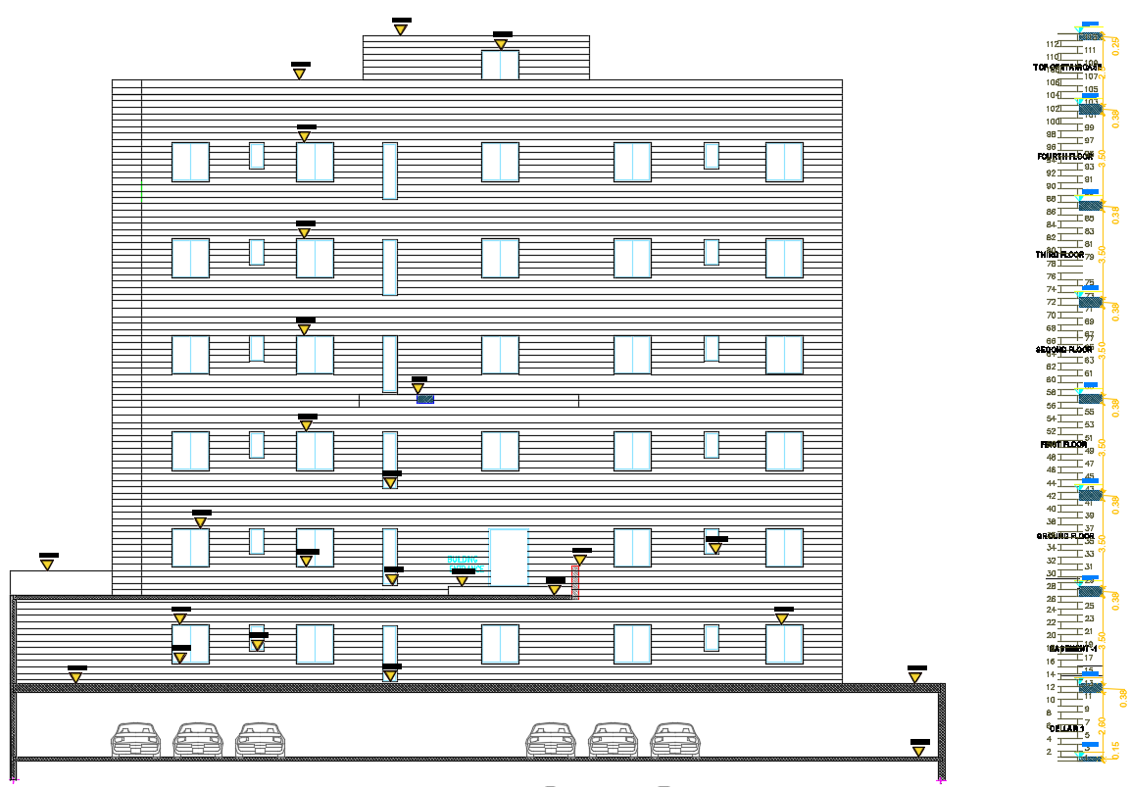
Architectural Aspects – Elevations
SOUTHWESTERN ELEVATION
NORTHWESTERN ELEVATION

Slide 17
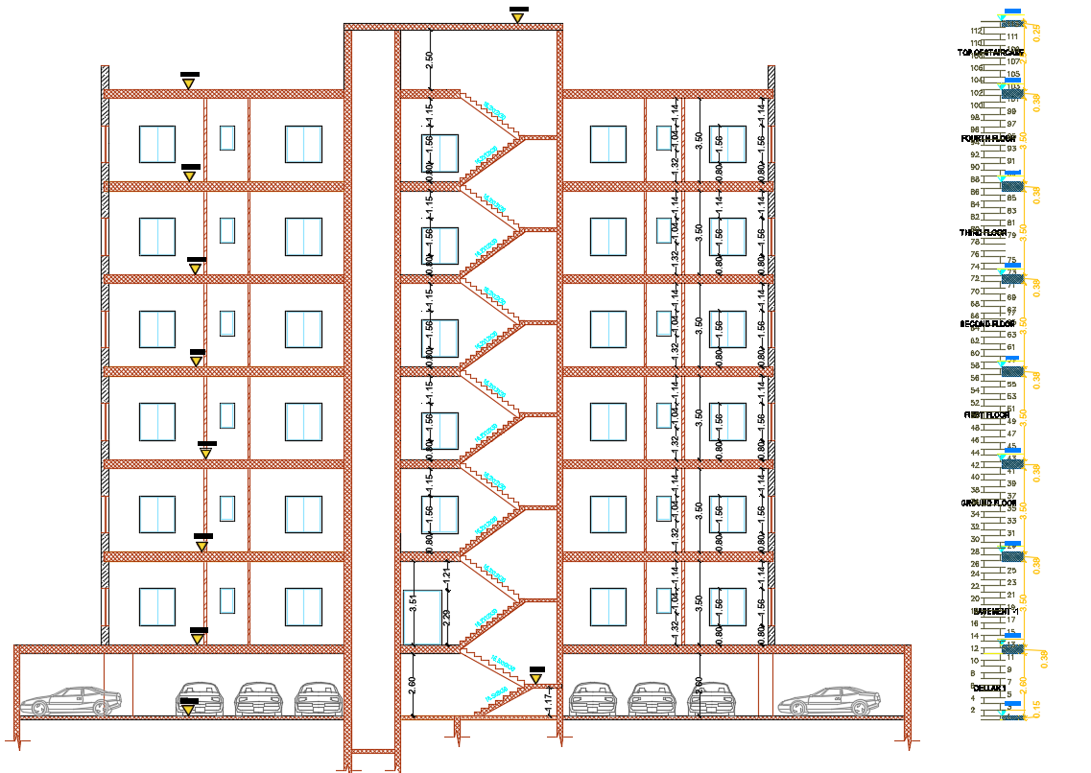
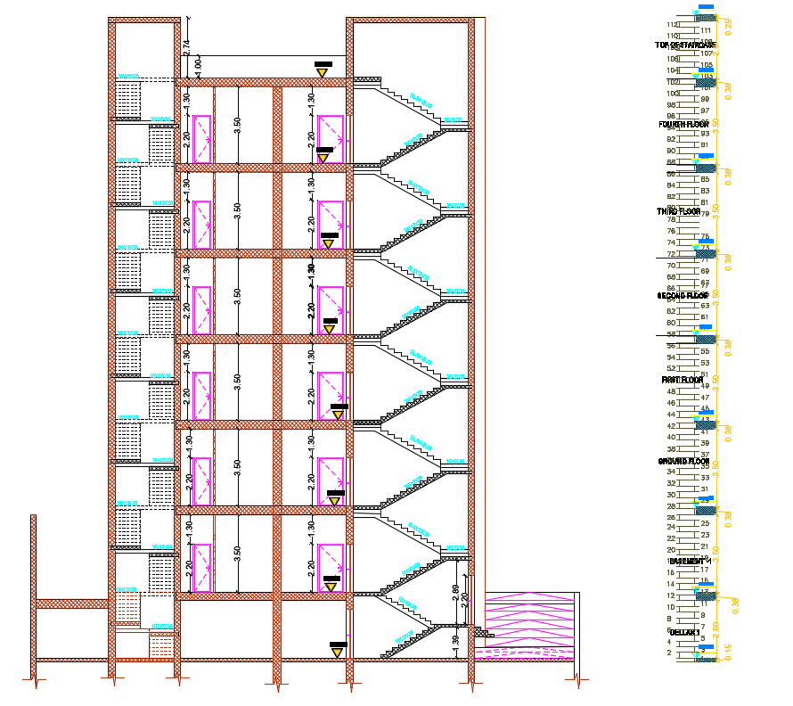
Architectural Aspects – Sections
Section B-B
Section A-A

Slide 18
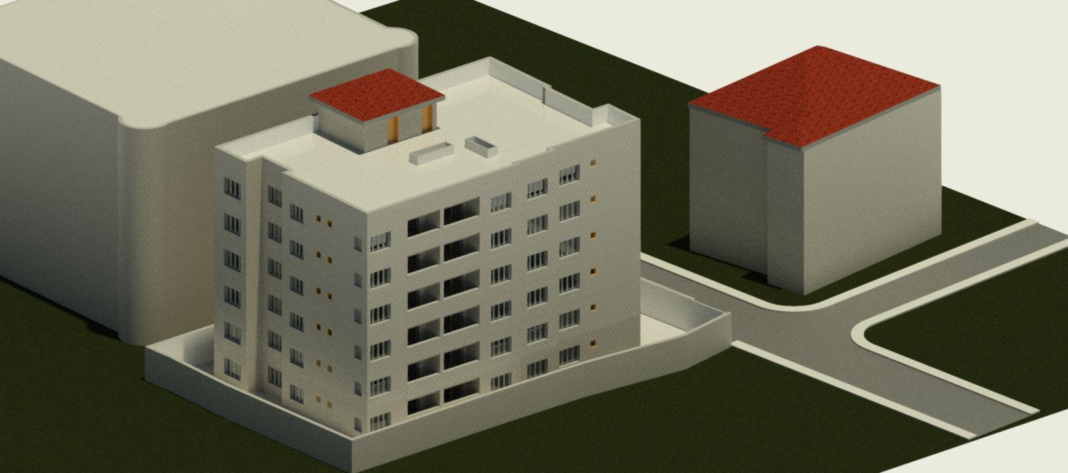
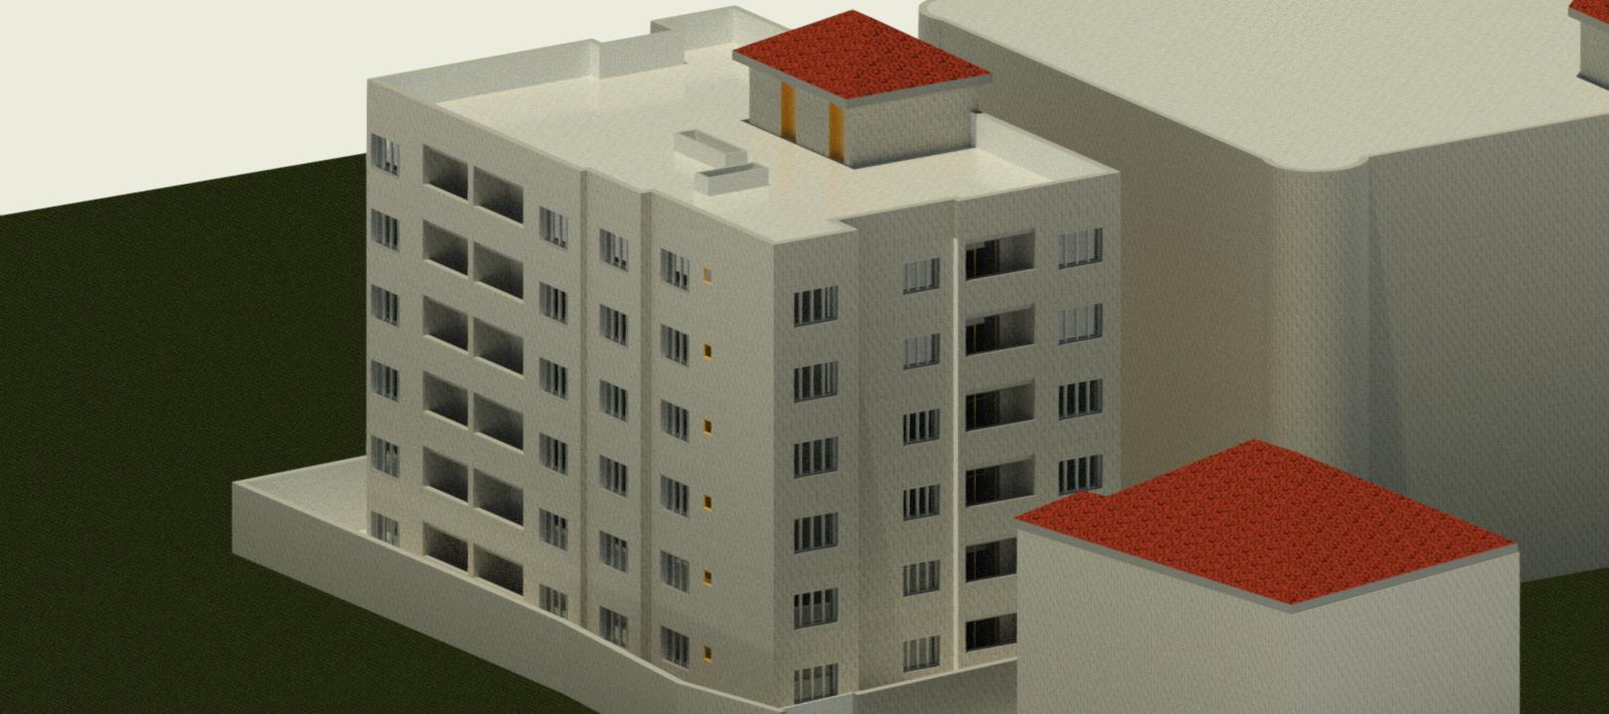
Architectural Aspects – Rendered Views

Slide 19

Environmental Aspects
Design Builder Simulation and Results
Daylight Factor Analysis
Shading System
Heating & Cooling load

Slide 20
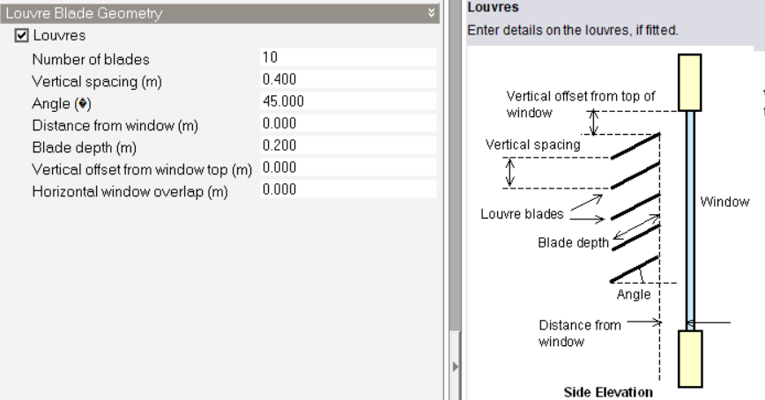
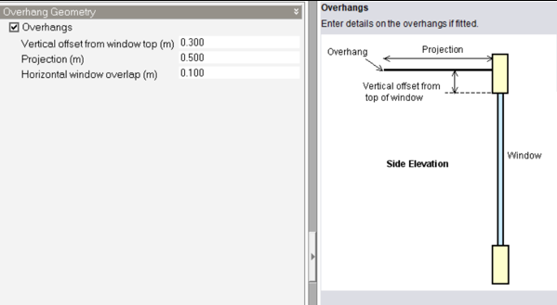
Environmental Aspects– Daylight Factor
Modifications
We put insulation in the external wall and roof slab.
Added louvers in each of the glass on east and west elevation with 45 °angles.
Added Cantilever on south elevation to prevent glare.

Slide 21
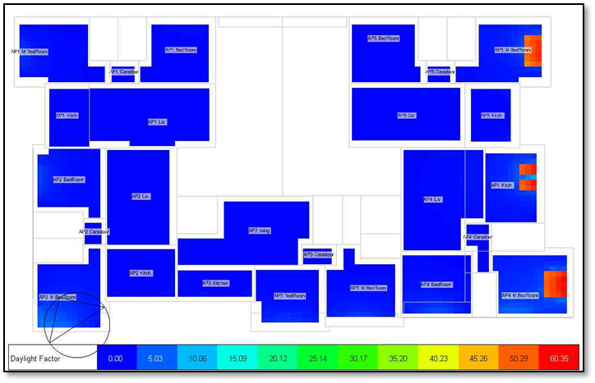
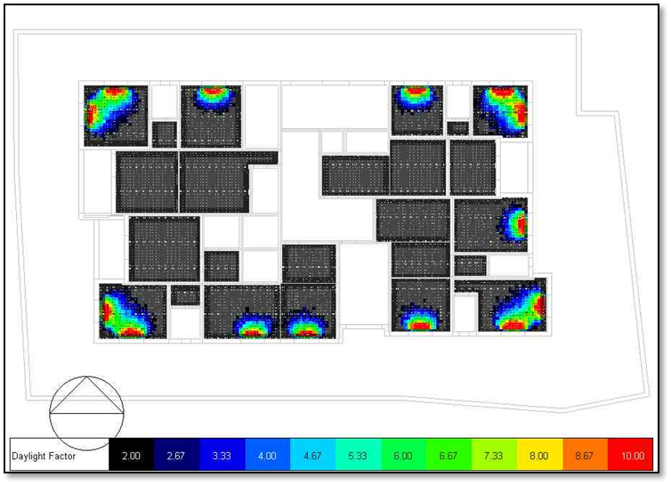
Environmental Aspects– Daylight Factor
Daylight Factor Analysis Basement Floor Plans
Before Modifications
After Modifications

Slide 22
Environmental Aspects– Daylight Factor
Daylight Factor Analysis all 5th floor Plans
Before Modifications
After Modifications

Slide 23
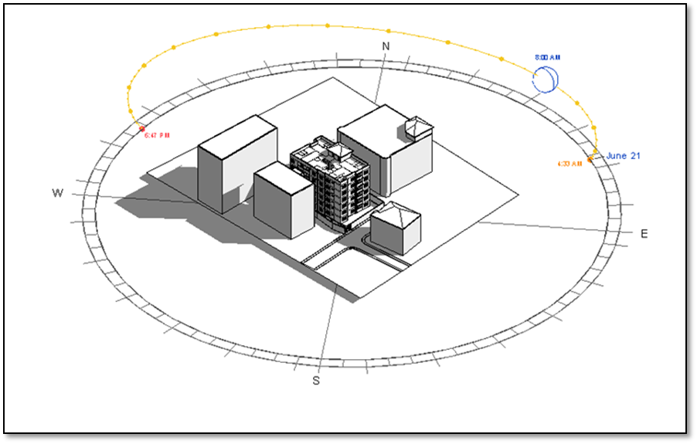
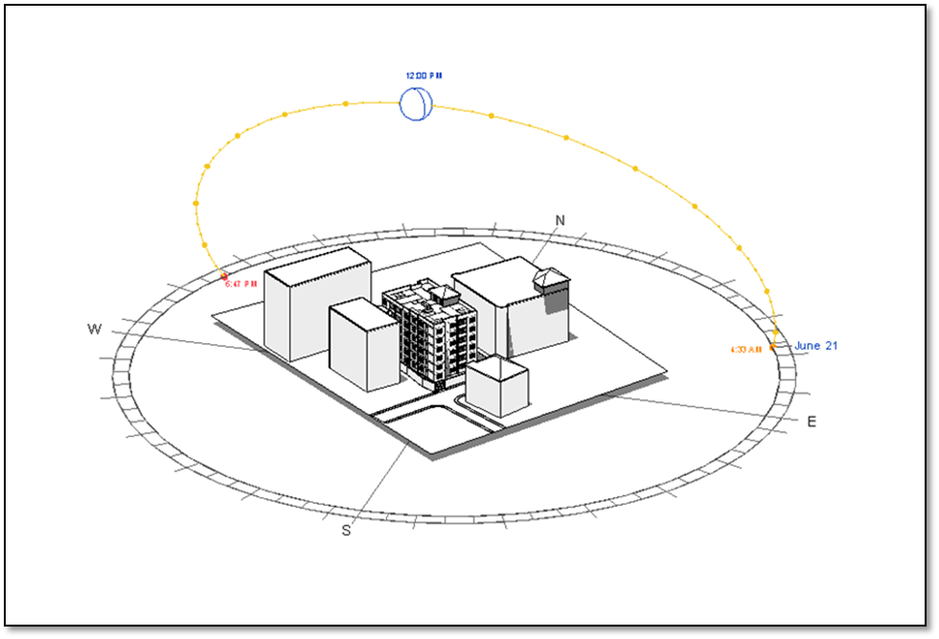
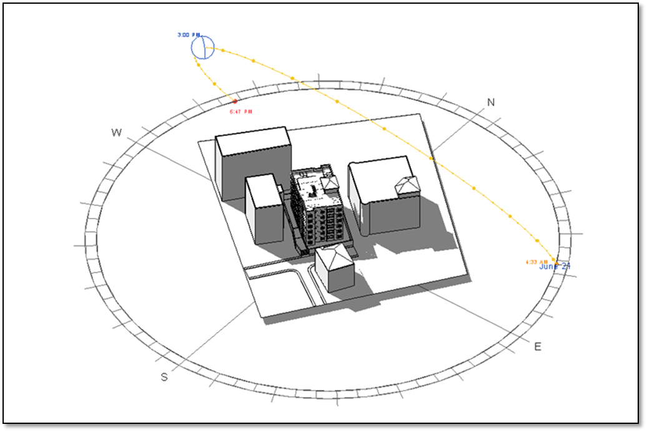
Environmental Aspects – Shading Analysis
Shading in summer
At 8:00 am
At 12:00 pm
At 3:00 pm

Slide 24
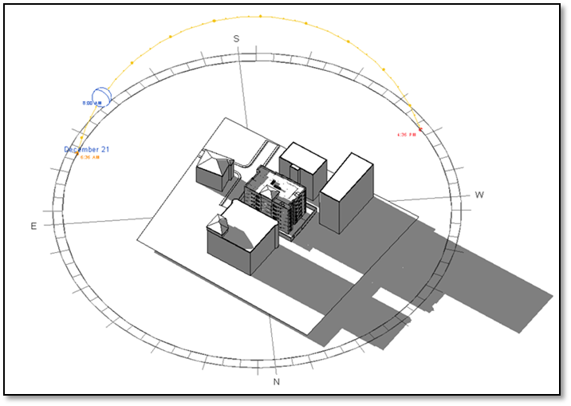
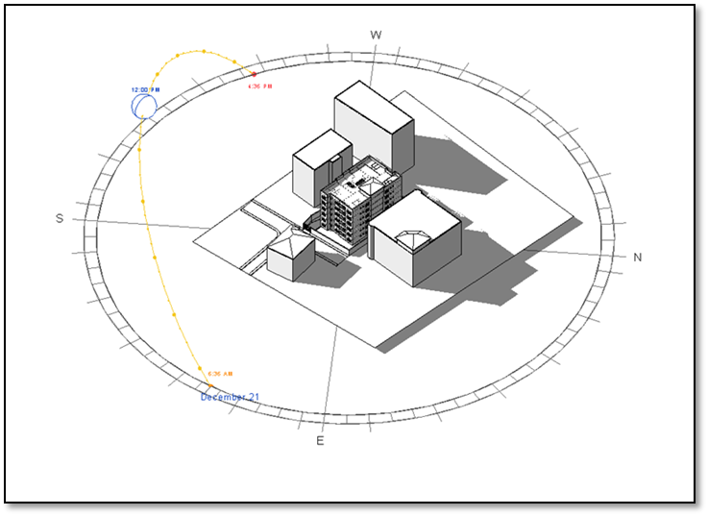
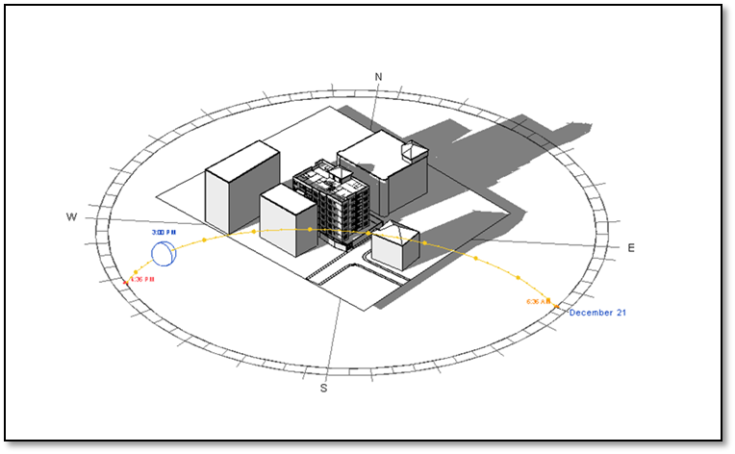
Environmental Aspects – Shading Analysis
Shading in Winter
At 8:00 am
At 12:00 pm
At 3:00 pm

Slide 25
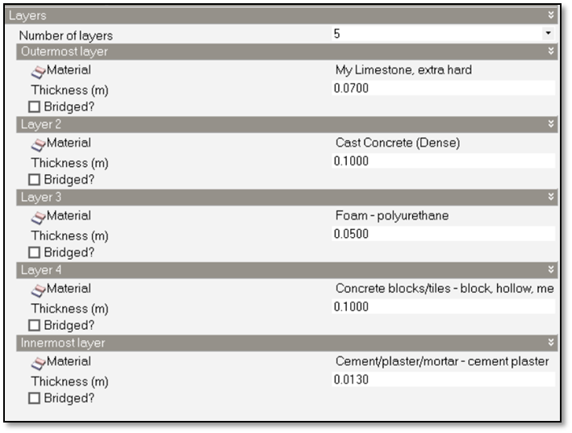
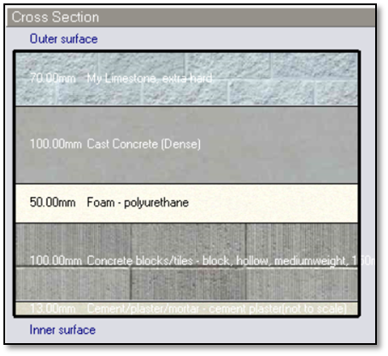

Environmental Aspects– Design Builder Analysis and Results
Design Builder Simulation Analysis
Wall Layers
Wall Section U-Value

Slide 26
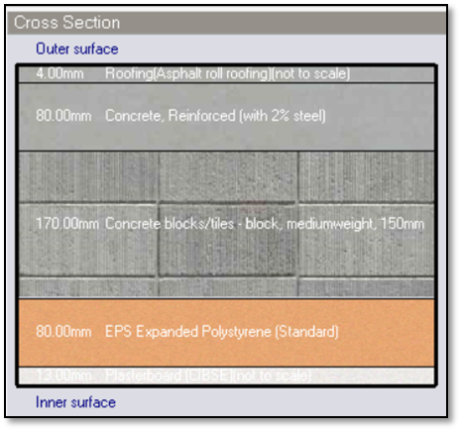
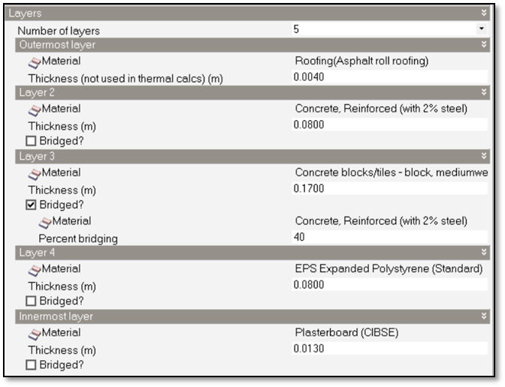

Environmental Aspects– Design Builder Analysis and Results
Roof Layers
Roof Section -Value

Slide 27
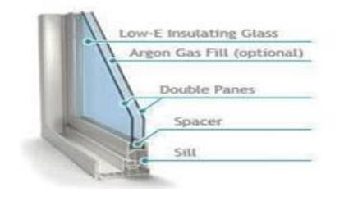
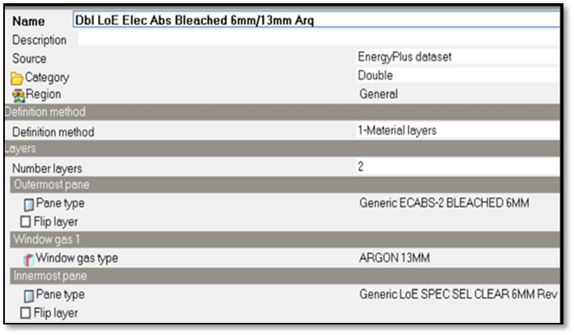
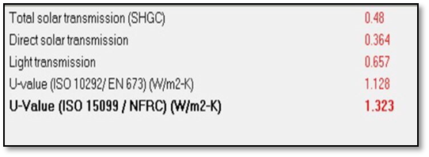
Environmental Aspects– Design Builder Analysis and Results
Window Section
Glass U-Value
Window Definition

Slide 28
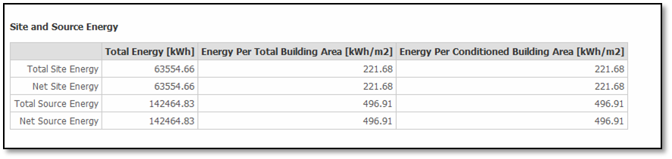
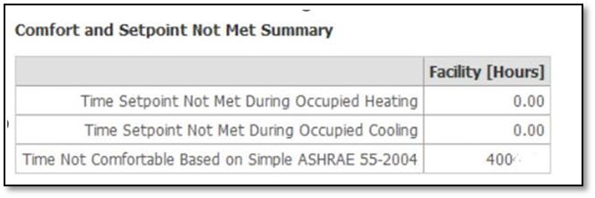
Environmental Aspects– Design Builder Analysis and Results
Design Builder Simulation Results

Slide 29
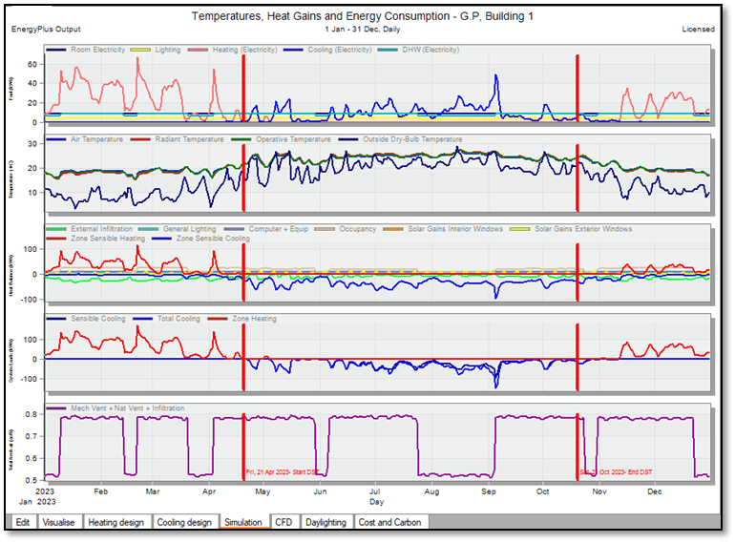
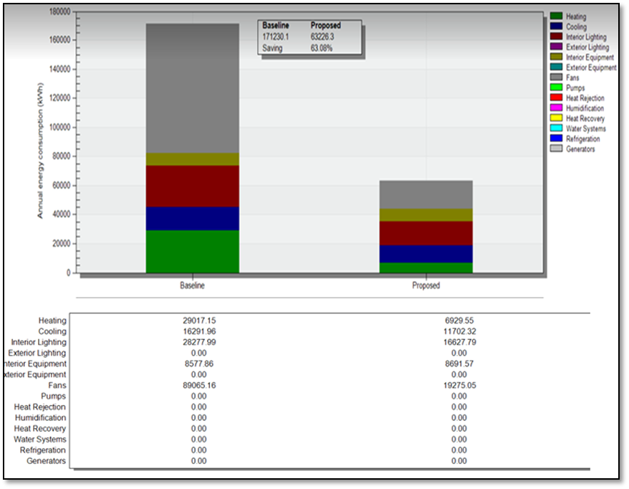
Environmental Aspects– Design Builder Analysis and Results
Predicted Mean Value
Energy Baseline Comparison

Slide 30
Environmental Aspects– Design Builder Analysis and Results
The total design heating capacity for the building equal 131.4 KW
 | Design Capacity (kW)
Total for one floor | 21.9
Total for all floors | 131.4
The total design cooling capacity for the building equal 172.38 KW
 | Design Capacity (kW) | Design Flow Rate (m3/s)
Total for one floor | 28.7 | 2.14
Total for all floors | 172.4 | 12.84

Slide 31
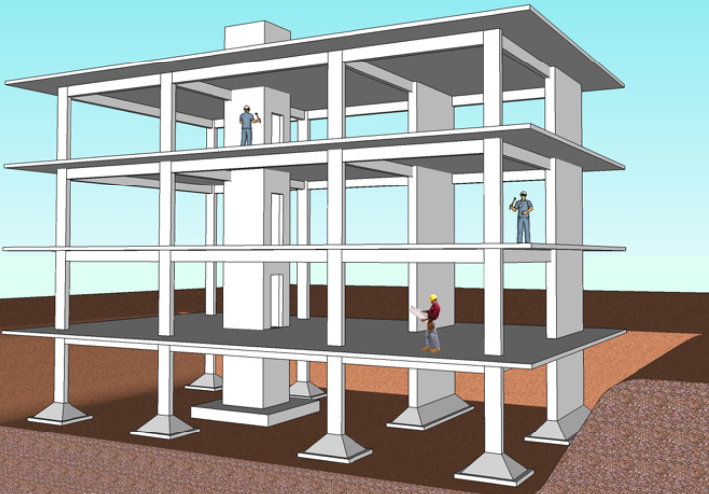
Structural Aspects
Preliminary Checks
Seismic Checks
Design Details

Slide 32
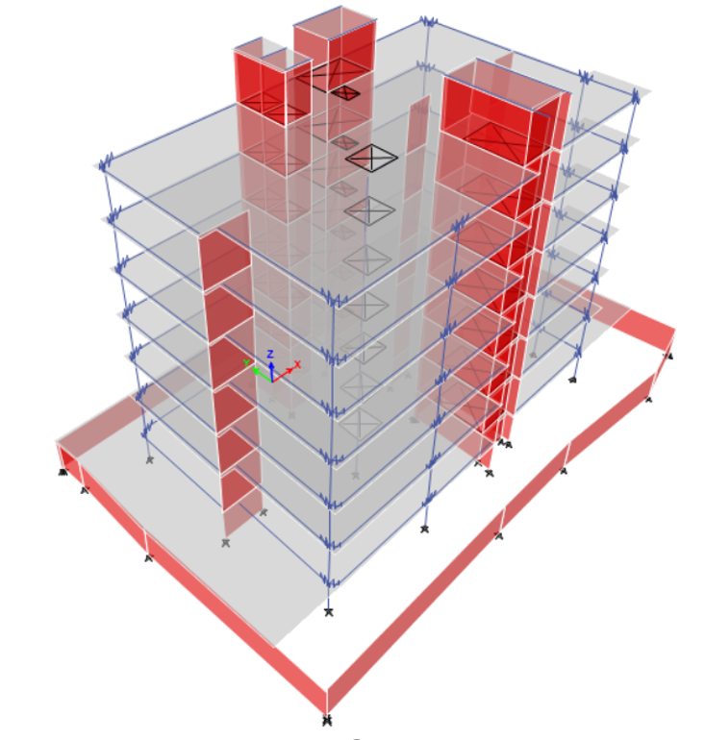
Structural Aspects – Structural System
The following specific codes were used in the structural design:
ACI318-14 for reinforced concrete structural design
ASCE 7 2010 for loads and combinations.
UBC-97 for seismic design.
ACI 350 For septic tank design.

Slide 33
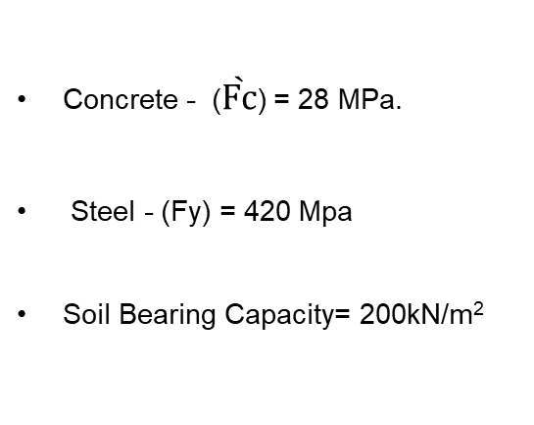
Structural Aspects – Design Data
Design Data
Loads
Materials
Dead load
Superimposed Loads (SID) = 4.50 kN/m²
Live Loads = 2 kN/m²
Wall load = 20kN/m
Concrete - ($\grave{Fc}$) = 28 MPa.
Steel - (Fy) = 420 Mpa
Soil Bearing Capacity= 200kN/m²

Slide 34
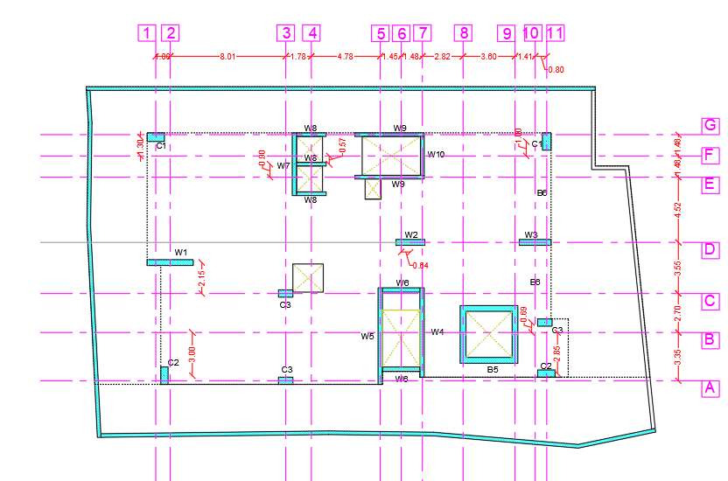
Structural Aspects – Design Data
Columns centers

Slide 35
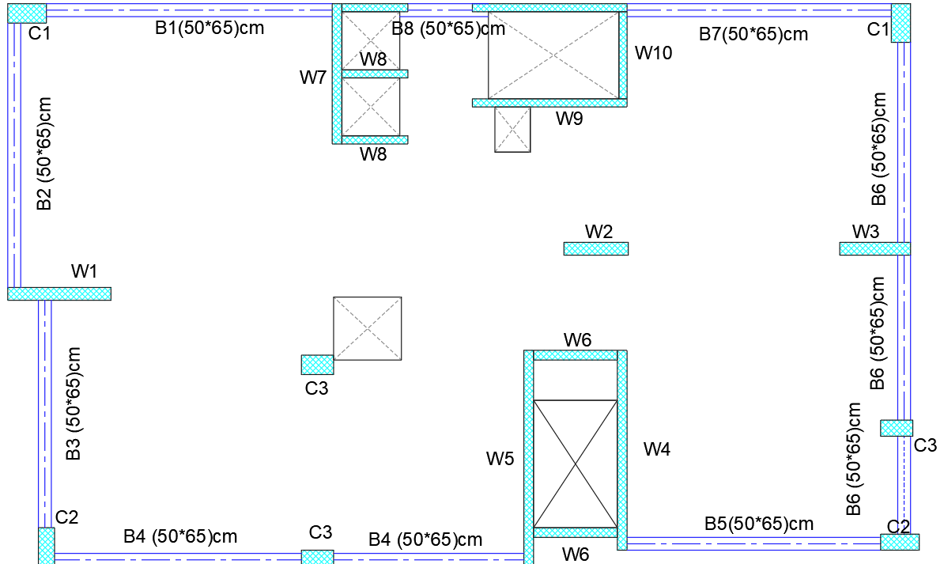
Structural Aspects – Design Data
Beams

Slide 36
Structural Aspects – Design Data
Preliminary dimensions of the Beams
Preliminary dimensions of the Walls
Beams | Thickness, mm | Width, mm
B1 | 650 | 400
B2 | 650 | 400
B3 | 650 | 400
B4 | 650 | 400
B5 | 650 | 400
B6 | 650 | 400
B7 | 650 | 400
B8 | 650 | 400
Walls | Thickness, m | Height, m
For Stair | 0.25 | 27.10
For elevator | 0.25 | 27.10
For emergency stair | 0.30 | 27.10
internal shear wall | 0.40 | 23.60
retaining wall | 0.25 | 2.60
Preliminary dimensions of the Slabs
Slabs | Type | Area, m² | thickness, m
Parking ceiling | Voided slab | 774.84 | 0.38
Residential floor ceiling | Voided slab | 478.93 | 0.38
Stair Slab | solid slab | 13.76 | 0.25
Elevator slab | solid slab | 10.22 | 0.25
Emergency ceiling | solid slab | 18.56 | 0.25
Preliminary dimensions of the column
Columns | Number | Width, mm | Depth, mm
C1 | 2 | 600 | 1200
C2 | 3 | 500 | 1200
C3 | 2 | 500 | 1000

Slide 37


Structural Aspects – Design Data
Slab Thickness
for large span (Ln) = 10m.
solid slab thickness = Ln/33 = 10/33=0.303m.
equivalent Flat voided slab thickness = 0.303*1.10=0.33m, take 38cm.

Slide 38

Structural Aspects – Structural Checks
Compatibility Check
This check is performed to ensure that all elements are interconnected and moving together (They move as one group). OK

Slide 39

Structural Aspects – Structural Checks
Equilibrium Check
Result from ETABS

Slide 40
Structural Aspects – Structural Checks
Manual Live load calculation
Slab | Area, m² | Open's area m² | Total area, m² | LL (kN/m²) | Total LL, kN
Slab1 | 774.84 | 34.66 | 740.18 | 2 | 1480.37
Slab 2 | 478.93 | 34.66 | 444.27 | 2 | 888.55
Slab 3 | 478.93 | 34.66 | 444.27 | 2 | 888.55
Slab 4 | 478.93 | 34.66 | 444.27 | 2 | 888.55
Slab 5 | 478.93 | 34.66 | 444.27 | 2 | 888.55
Slab 6 | 478.93 | 34.66 | 444.27 | 2 | 888.55
Slab 7 | 478.93 | 34.66 | 444.27 | 2 | 888.55
Solid 1 | 13.76 | 0 | 13.76 | 2 | 27.52
Solid 2 | 18.56 | 0 | 18.56 | 2 | 37.12
Solid 3 | 10.22 | 0 | 10.22 | 2 | 20.44
 |  | Summation of Live Load, kN |  |  | 6896.74
Live load manual
Result of live load and error
Results | ETABS | Manual | Error% | Comment
Live load, kN | 6885.882 | 6896.74 | 0.157 | OK

Slide 41
Structural Aspects – Structural Checks
Manual SID load calculations for walls
Walls | Parameter, m | # Of floors | Load, kN/m | Total load, kN
 | 71.91 | 7 | 20 | 10067.4
Manual SID load calculations for slabs
SID manual
Slab | Area, m² | Open's area m² | Total area, m² | SID (kN/m²) | Total SID
Slab1 | 774.84 | 34.66 | 740.18 | 4.5 | 3330.83
Slab 2 | 478.93 | 34.66 | 444.27 | 4.5 | 1999.23
Slab 3 | 478.93 | 34.66 | 444.27 | 4.5 | 1999.23
Slab 4 | 478.93 | 34.66 | 444.27 | 4.5 | 1999.23
Slab 5 | 478.93 | 34.66 | 444.27 | 4.5 | 1999.23
Slab 6 | 478.93 | 34.66 | 444.27 | 4.5 | 1999.23
Slab 7 | 478.93 | 34.66 | 444.27 | 4.5 | 1999.23
Solid 1 | 13.76 | 0 | 13.76 | 4.5 | 61.92
Solid 2 | 18.56 | 0 | 18.56 | 4.5 | 83.52
Solid 3 | 10.22 | 0 | 10.22 | 4.5 | 45.99
 |  | Summation of SID on slabs, kN |  |  | 15517.66
Result of SID and error
ETABS | Manual | Error
25561.03 | 25585.06 | 0.094

Slide 42


Structural Aspects – Structural Checks
Manual dead load calculation for columns
Column | # Of columns | Length, m | Width, m | height, m | $$γ_{C}$$ | Weight, kN
C1(120*60) | 2 | 1.2 | 0.6 | 23.6 | 25 | 849.6
C2(120*50) | 3 | 1.2 | 0.5 | 23.6 | 25 | 1062
C5(100*50) | 2 | 1 | 0.5 | 23.6 | 25 | 590
 |  |  |  | Total columns weight, kN |  | 2501.6
Dead Load Manual
Manual dead load calculation for Beams
Beams | # Of floors | Length, m | Width, m | height, m | $$γ_{C}$$ | Weight, kN
Main beams 1 | 7 | 71.91 | 0.4 | 0.65 | 25 | 3271.905
Main beams 2 | 1 | 27.65 | 0.4 | 0.5 | 25 | 138.25
 |  |  |  | Total Beams weight, kN |  | 3410.155

Slide 43


Structural Aspects – Structural Checks
Manual dead load calculation for Walls
Shear walls | Height, m | length, m | width, m | $$γ_{C}$$ | weight, kN
Wall 1 | 23.6 | 7.4 | 0.4 | 25 | 1746.40
Wall 2 | 27.1 | 17.45 | 0.25 | 25 | 2955.59
Wall 3 | 27.1 | 22.45 | 0.3 | 25 | 4562.96
Wall 4 | 2.6 | 126.88 | 0.25 | 25 | 2061.80
 |  | Total weight of shear walls, kN |  |  | 11326.76
Dead Load Manual
Slabs Weight

Slide 44
Structural Aspects – Structural Checks
Manual dead load calculation for Slabs
Slab | Area, m² | Open's area m² | Total area, m² | DL (kN/m²) | Total DL
Slab1 | 774.84 | 34.66 | 740.18 | 6 | 4649.06
Slab 2 | 478.93 | 34.66 | 444.27 | 6 | 2873.60
Slab 3 | 478.93 | 34.66 | 444.27 | 6 | 2873.60
Slab 4 | 478.93 | 34.66 | 444.27 | 6 | 2873.60
Slab 5 | 478.93 | 34.66 | 444.27 | 6 | 2873.60
Slab 6 | 478.93 | 34.66 | 444.27 | 6 | 2873.60
Slab 7 | 478.93 | 34.66 | 444.27 | 6 | 2873.60
Solid 1 | 13.76 | 0 | 13.76 | 6.25 | 86.00
Solid 2 | 18.56 | 0 | 18.56 | 6.25 | 116.00
Solid 3 | 10.22 | 0 | 10.22 | 6.25 | 63.88
 |  | Summation of SID on slabs, kN |  |  | 22156.56
Dead Load Manual
Result of Dead load and error
Results | ETABS | Manual | Error | Comment
Dead load, kN | 39439.89 | 39395.75 | 0.11 | OK

Slide 45

Structural Aspects – Structural Checks
Stress-Strain Check – Columns
For column (From LL)
From ETAB'S = 377.88kN.
Manual = (44.08 * 1 * 2) + (24.42 * 6 * 2) = 381.20kN.

Slide 46


Structural Aspects – Structural Checks
Stress-Strain Check – Columns
For column (From LL)
Result for columns and differences
Results | ETABS, kN | Manual, kN | Differences % | Comment
 | 377.88 | 381.20 | 0.87 | OK

Slide 47

Structural Aspects – Structural Checks
Stress-Strain Check – Beams
For Beam (From 1.2DL+1.6LL)
Load transferee |  | Manual Beams load | Result | Unit | Moment | Unit
Wu from slab |  | 1.2 (6+4.5) +1.6(2) *4.45 | 70.31 | kN/m | 342.89 | kN.m
Wu from self-weight |  | 0.40*0.65*25*1.2 | 7.80 | kN/m | 57.06 | kN.m
Wu from wall |  | 1.2*20 | 24.00 | kN/m | 175.57 | kN.m
 |  |  | Total moment |  | 575.52 | kN.m

Slide 48

Structural Aspects – Structural Checks
Moment From ETAB'S |  | Unit
M1(-) | -286.39 | kN.m
M2(-) | -236.5 | kN.m
M3(+) | 124.24 | kN.m
Total moment | 529.42 | kN.m
Result | From ETAB'S, kN.m | From Manual, kN.m | %Difference | Comment
 | 529.42 | 575.52 | 8.01 | OK

Slide 49



Structural Aspects – Structural Checks
Deflection Checks
Deflection from dead load
Deflection from SID load
Deflection from Live load

Slide 50

Structural Aspects – Structural Checks
Deflection Checks
Deflection limits (extract from ACI318-14)
Manual deflection calculation
L(mm) | State | deflection (mm) | Comment
 | L/180 | 55.56 | Ok
10000 | L/360 | 27.78
 | L/480 | 20.83
 | L/240 | 41.67

Slide 51

Structural Aspects – Structural Checks
Seismic Checks
Result of Factors for seismic design
Factor | Value
Z | 0.15
Soil profile type | Sd
I | 1.00
R | 5.50
Ca | 0.22
Cv | 0.32
Ramallah is located in the zone 2A and Z= 0.15

Slide 52


Structural Aspects – Structural Checks
Seismic Checks
Define EQx in ETAB'S
Diaphragm is a horizontal or nearly horizontal system acting to transmit lateral forces to the vertical-resisting elements

Slide 53

Structural Aspects – Structural Checks
Period Check
      Time period check
$T=C_{t}∗h_{n}^{(\frac{3}{4})}$
$$h_{n}: Building height (m)$$
$$C_{t}:numerical coefficient=\left(0.0853\right)for steel moment resisting frames,=\left(0.0731\right)for reinforced concrete moment resisting frames and=\left(0.0488\right)for all other buildings.$$
The value of T from Method B shall not exceed a value 30 percent greater than the value of T obtained from Method A in Seismic Zone 4, and 40 percent in Seismic Zones 1, 2 and 3 [9].
T obtained from method B = T obtained from ETAB'S
$$T_{ETAB^{′}S}≤1.30 T_{A} for seismic zone 4.$$
$$T_{ETAB^{′}S}≤1.4 T_{A} for seismic zone 1,2 and 3.$$
period check and result
Term | Result | Note
seismic zone | 2A | Ramallah
Ct | 0.0488 | Other building
hn (m) | 27.1 | ***
Ta (sec) | 0.579 | ***
(1.40-1.45) Ta | (0.812-0.839) | ***
Tmax (sec) | 0.829 | Mode 1
Tx, etab (sec) | 0.709 | Mode 2
Ty, etab (sec) | 0.587 | Mode 3
Code requirement | Tetab < 1.45Ta | UBC-97
Verification | OK | Tx, Ty, Tmax

Slide 54


Structural Aspects – Structural Checks
Base shear check
W = DL + SID + 0.20LL = 39699.80 + 25561.03 +
(0.20*6885.88) = 66638.006 kN.
$$V_{X}=\frac{C_{v}I}{R.Tx}.W= \frac{0.32∗1}{5.50∗0.709}∗66638$$
$$=5468.43kN.$$
$$V_{y}=\frac{C_{v}I}{R.Ty}.W= \frac{0.32∗1}{5.50∗0.585}∗66638$$
$$=6627.56kN.$$
$$V_{min.}=0.11C_{a}IW=0.11∗0.22∗1∗66638$$
$$=1612.64kN.$$
$$V_{max.}=\frac{2.50C_{a}I}{R}.W= \frac{2.50∗0.22∗1}{5.50}∗66638$$
$$=6663.80kN.$$

Slide 55
Structural Aspects – Structural Checks
Base shear check
manual Base shear calculation and result
Dead Load (kN) | 39699.80 | Cv | 0.32 | I | 1
SID (kN) | 25561.03 | Ca | 0.22 | R | 5.5
Live load (kN) | 6885.88 | Tx (sec) | 0.709 | Vx | 5468.43
Weight (kN) | 66638.00 | Ty (sec) | 0.585 | Vy | 6627.56
Vetab-x | 5417.64 | Vmanual -x | 5468.43 | Error | 0.93
Vetab-y | 6566.99 | Vmanual -y | 6627.56 | Error | 0.93
%Error > 5% it's OK.

Slide 56

Structural Aspects – Structural Checks
Drift Check
Displacement for first story from ETAB'S
Story drifts shall be computed using the Maximum
Inelastic Response Displacement ΔM.
The Maximum Inelastic Response Displacement, ΔM,
shall be computed as follows:
ΔM = 0.70RΔS.
ΔS = Design Level Response Displacement, which is the
total drift or total story drift that occurs when the structure is
subjected to the design seismic forces.
Calculated. Calculated story drift using M shall not
exceed 0.025 times the story height for structures having a
fundamental period of less than 0.7 second.
For structures having a fundamental period of 0.7 second
or greater, the calculated story drift shall not
exceed 0.020 times the story height

Slide 57
Structural Aspects – Structural Checks
Drift Check
Drift check calculation and result
Story | Height | DIS_X | DIS_Y | Drift_X | Drift_Y | ∆M_X | ∆M_Y | ∆Limit | State
 | mm | mm | mm | mm | mm | mm | mm | mm | *
0 | 0 | 0 | 0 | * | * | * | * | * | *
1 | 2600 | 0.439 | 0.429 | 0.438 | 0.429 | 1.69 | 1.65 | 52 | OK
2 | 3500 | 2.104 | 1.885 | 1.666 | 1.456 | 6.41 | 5.61 | 70 | OK
3 | 3500 | 4.523 | 3.968 | 2.419 | 2.083 | 9.31 | 8.02 | 70 | OK
4 | 3500 | 7.349 | 6.413 | 2.826 | 2.445 | 10.88 | 9.41 | 70 | OK
5 | 3500 | 10.351 | 9.035 | 3.002 | 2.622 | 11.56 | 10.09 | 70 | OK
6 | 3500 | 13.478 | 11.687 | 3.127 | 2.652 | 12.04 | 10.21 | 70 | OK
7 | 3500 | 16.235 | 14.243 | 2.757 | 2.556 | 10.61 | 9.84 | 70 | OK
8 | 3500 | 19.902 | 15.397 | 3.667 | 1.154 | 14.12 | 4.44 | 70 | OK
DIS_X from ETAB'S.
DIS_Y from ETAB'S.
Drift_X = Summation of (DIS_X)
for pervious stories.
Drift_Y = Summation of (DIS_Y)
for pervious stories.
∆M_X = 0.70 * R * Drift_X
∆M_Y = 0.70 * R * Drift_Y
∆Limit = If T > 0.70 = 0.025*h(mm) and If T< 0.70 = 0.020*h(mm)

Slide 58

Structural Aspects – Structural Elements Design
Slab Design
Slabs Main Top Reinforcement

Slide 59

Structural Aspects – Structural Elements Design
Slab Design
Slabs Main Bottom
Reinforcement

Slide 60

Structural Aspects – Structural Elements Design
Slab Design
Slabs additional top Reinforcement

Slide 61

Structural Aspects – Structural Elements Design
Slab Design
Slabs additional
Bottom Reinforcement

Slide 62



Structural Aspects – Structural Elements Design
Columns Design
Columns C1

Slide 63



Structural Aspects – Structural Elements Design
Beams Design
Beam -B6

Slide 64

Structural Aspects – Structural Elements Design
Beams Design
Beam -B6

Slide 65

Structural Aspects – Structural Elements Design
Beams Design
Beam -B6

Slide 66

Structural Aspects – Structural Elements Design
      Basement Retaining walls
Concrete compressive strength Fc = 28Mpa
Steel yielding strength Fy = 420Mpa
soil bearing capacity 200kN/m².
Soil unit weight 𝜸= 18kN/m³.
Soil friction internal angle 𝞍 =30⁰.
Base Friction coefficient F1 = 0.50
For surcharge w = 20 kN/m².
Surcharge load is live load.
Soil Pressure is live load.

Slide 67


Structural Aspects – Structural Elements Design

Slide 68

Structural Aspects – Structural Elements Design
h = 250mm, d =200mm
$$ρ=\frac{0.85×28}{420}\left(1−\sqrt{1−\frac{2.61×{10}^{6}×49.20}{28×1000×{200}^{2}}}\right)=0.00335$$
$$A_{s}=0.00335×1000×200=670{mm}^{2}/m , Use 5Φ14/m$$
$${Vertically A}_{smin}=0.0015bh=0.0015∗1000∗250=375 {mm}^{2}/m$$
$${Horizontally A}_{smin}=0.0025bh=0.0025∗1000∗250=625 {mm}^{2}/m$$
For Mu = 23. 34kN.m
$$A_{s}=0.00156×1000×200=313{mm}^{2} /m$$
$${Vertically A}_{smin}=0.0015bh=0.0015∗1000∗250=375 {mm}^{2}/m,use 4Φ12/m$$
$${Horizontally A}_{smin}=0.0025bh=0.0025∗1000∗250=625 {mm}^{2}/m$$
V=72kN Vu = 108.27 = 115.20kN.
$$∅V_{c}=∅∗\frac{1}{6}∗λ∗\sqrt{F’c}∗b_{w}∗d=\frac{0.75}{6}∗1∗\sqrt{28}∗1000∗200∗{10}^{−3}=133kN.$$

Slide 69

Structural Aspects – Structural Elements Design
      Basement Retaining walls - Detailing

Slide 70



Structural Aspects – Structural Elements Design
      Cantilever Retaining walls
$$K_{a}=\frac{1−\sin{∅}}{1+\sin{∅}}=\frac{1−\sin{30}}{1+\sin{30}}=0.333$$
Surcharge Load = Ka * q = 0.333 * 20 = 6.66kN/m².
Soil Load = Ka * Ɣs * Hs = 0.333*18 * 2.60 = 15.60kN/m².
Water Load = Ɣw * Hw = 10 * 2.60 = 26kN/m².

Slide 71

Structural Aspects – Structural Elements Design
      Cantilever Retaining walls
M= 70 kN.m
Mu = 1.6 * 70 = 112kN.m
h = 250mm, d =200mm.
$$ρ=\frac{0.85×28}{420}\left(1−\sqrt{1−\frac{2.61×{10}^{6}×112}{28×1000×{200}^{2}}}\right)=0.00795$$
$$A_{s}=0.00795×1000×200=1591{mm}^{2}/m , Use 8Φ16/m$$
$${Vertically A}_{smin}=0.0015bh=0.0015∗1000∗250=375 {mm}^{2}/m$$
$${Horizontally A}_{smin}=0.0025bh=0.0025∗1000∗250=625 {mm}^{2}/m$$
V=72kN. Vu = 1.60*72 = 115.20kN.
$$∅V_{c}=∅∗\frac{1}{6}∗λ∗\sqrt{F’c}∗b_{w}∗d=\frac{0.75}{6}∗1∗\sqrt{28}∗1000∗200∗{10}^{−3}=133kN.$$
Thickness of wall = 250mm, two layers of steel are to be used
Vertically use 8𝞥16/m on soil side and use minimum steel 4𝞥12/m on the other side.
Horizontally use 4𝞥10/m (1/2 As,min. Horizontally) for each side. Use 5𝞥10/m for spacing requirements.

Slide 72

Structural Aspects – Structural Elements Design
      Cantilever
      Retaining walls –
      Detailing

Slide 73

Structural Aspects – Structural Elements Design
Foundations Design
Mat Foundation
Final trial thickness = 1000mm.
Soil Pressure for final trial

Slide 74

Structural Aspects – Structural Elements Design
Foundations Design
Mat Foundation
Final trial thickness = 1000mm.
Punching shear check for final trial

Slide 75

Structural Aspects – Structural Elements Design
Foundations Design
Mat foundation detailing

Slide 76

Structural Aspects – Structural Elements Design
Foundations Design
Mat foundation detailing

Slide 77

Structural Aspects – Structural Elements Design
Foundations Design
Mat foundation Additional reinforcement

Slide 78

Structural Aspects – Structural Elements Design
Foundations Design
Mat foundation detailing

Slide 79


Structural Aspects – Structural Elements Design
Staircase Design
LL = 2.50kN/m².
SID = 6kN/m².
Thickness (Ht) = 200mm.
d = 200-30 = 170mm

Slide 80


Structural Aspects – Structural Elements Design
Staircase Design
$$ρ=\frac{0.85×28}{420}\left(1−\sqrt{1−\frac{2.61×{10}^{6}×4.55}{28×1000×{170}^{2}}}\right)=0.000417$$
$$As=0.000417×1000×200=84 {mm}^{2}$$
$$A_{smin}=0.0018×1000×200=360 {mm}^{2}$$
Use minimum area of steel (4𝞥12/m). in both directions.

Slide 81


Structural Aspects – Structural Elements Design
Staircase Design

Slide 82

Structural Aspects – Structural Elements Design
Septic tank Design
The quantity of water supplied = per capita rate * #of users
Per capita rate = 95 – 120 Litter /person. Use max. = 120litter/person.
Number of persons = #Of floors * #of apartments * #of person in each apartment.
= 6 * 4 * 4 = 96person (user).
The quantity of water supplied = 120 * 96 = 11520litters.
Assumed that 80% of water supplied becomes sewage
The quantity of sewage produced = 0.80 * 11520 = 9216litters.
Assumed the detention time = 3days.
So, the sewage quantity = 9216 * 3 = 27648litter.
Consider the deposited sludge rate as 25 litter/person/year and the cleaning period each one year.
Sludge quantity = 25 * 96 * 1 = 2400litter.
Total required capacity of tank = sewage + sludge = 27648 + 2400 = 30.048litter = 30m³.

Slide 83


Structural Aspects – Structural Elements Design
Septic tank Design
Length = 3.20m, width = 3.20m and height = 3m (Volume = 3.20*3.20*3 = 30.72m³)
Water pressure = Ɣw *Hw = 10 * 3 = 30kN/m².
Soil Load = K/o * Ɣs * H/s = 0.5*18 * 3 = 27kN/m².
Sewage pressure = Ɣw *Hw = 10 * 3 = 30kN/m².
Soil considered as live load.
Water and sewage considered as Dead load.
$\grave{Fc}=28MPa ,Fy=420Mpa$.
Load combination:
    1.2DL +1.60LL 2) 1.40 DL
Underground tanks are designed for the worst of the following cases:
The presence of external water and soil on the walls (the condition of backfilling behind the walls).
Presence of internal water only (tank test condition).
The presence of water from the inside and soil and water from the outside.

Slide 84


Structural Aspects – Structural Elements Design
Septic tank Design

Slide 85


Structural Aspects – Structural Elements Design
Septic tank Design
Check thickness for vertical shear:
$$V23=Vertical shear \left(Vu\right)=\frac{261.53+259.03+251.11+231.58+219.54}{6}=244.60kN/m$$
$$∅V_{C}=0.75∗\frac{1}{6}∗\sqrt{28}∗1000∗350∗{10}^{−3}=298kN/m$$
$$∅V_{C} >Vu →→298>203.97 OK.$$
Check thickness for Tension
$$F11=Ultimate Horizontal tension=\frac{446+398+357+321+297+240}{6}=343.16kN/m$$
$$F22=Ultimate Vertical tension=\frac{571+483+445+404+366+332}{6}=433.50kN/m$$
$$upper limit on stress in steel \left(Fs,max.\right)=119Mpa. (Severe Condition)$$

Slide 86


Structural Aspects – Structural Elements Design
Septic tank Design

Slide 87


Structural Aspects – Structural Elements Design
Septic tank Design
Vertical Reinforcement (Outside and Inside Surface).
M11 = Horizontal moment = 74 kN.m/m
$$M22=Vertical moment=\frac{330+284.7+212.31+185+145+132}{6}=215kN.m/m$$
S = 200mm, thickness = 400mm so, Fs,max = 145Mpa (Two way-severe exposure).
$$durability factor \left(Sd\right)=\frac{∅∗Fy}{γ∗Fs,max}=\frac{0.90∗420}{1.4∗144}=1.80$$
$$M_{udesign}=1.06×1.86×215=410kN.m/m$$
$$ρ=\frac{0.85×28}{420}\left(1−\sqrt{1−\frac{2.61×{10}^{6}×410}{28×1000×{350}^{2}}}\right)=0.009663$$
$A_{s}=0.009663×1000×350=3382.05 {mm}^{2}/m→→→7∅25/m$
$$A_{smin}=0.003×1000×400=1200 {mm}^{2}/m$$

Slide 88

Structural Aspects – Structural Elements Design
Septic tank Design

Slide 89


Structural Aspects – Structural Elements Design
Septic tank Design
Horizontal Reinforcement
M11 = Horizontal moment = 74 kN.m/m
$$durability factor \left(Sd\right)=\frac{∅∗Fy}{γ∗Fs,max}=\frac{0.90∗420}{1.4∗144}=1.80$$
$$M_{udesign}=1.06×1.80×74=142kN.m/m$$
$$ρ=\frac{0.85×28}{420}\left(1−\sqrt{1−\frac{2.61×{10}^{6}×142}{28×1000×{350}^{2}}}\right)=0.00315$$
$A_{s}=0.00315×1000×350=1102.50 {mm}^{2}/m$
suppose distance between movement joints less than 6m.
$$A_{smin}=0.003bh=0.003×1000×400=1200{mm}^{2}/m→→→8∅14/m$$

Slide 90


Structural Aspects – Structural Elements Design
Septic tank Design
Horizontal reinforcement distribution
Nearby the corner: (Tension and moment)
$$Outside surface: \frac{As from T}{2}=\frac{2591.82}{2}=1295.91{mm}^{2}/m→→→6∅18$$
$$Inside surface: \frac{As from T}{2}+As from H.M=\frac{2591.82}{2}+1102.5=2398.41{mm}^{2}/m→8∅20$$
Far away from the corner: (Only tension)
$$Outside surface: \frac{As from T}{2}=\frac{2591.82}{2}=1295.91{mm}^{2}/m→→→6∅18$$
$$Inside surface: \frac{As from T}{2}=\frac{2591.82}{2}=1295.91{mm}^{2}/m→→→6∅18$$

Slide 91


Structural Aspects – Structural Elements Design
Septic tank Design

Slide 92

Structural Aspects – Structural Elements Design
Septic tank footing Design
Soil Pressure for tank foundation

Slide 93


Structural Aspects – Structural Elements Design
Septic tank footing Design
$$A_{smin}=0.0018×1000×400=720\frac{{mm}^{2}}{m}$$
$$→→→ 7∅12/m$$
No additional reinforcement.

Slide 94





Electro-Mechanical Aspects
Artificial Lighting
Power Design
HVAC System
Water Supply and Drainage
Firefighting system

Slide 95
Electro-Mechanical Aspects – Artificial Lighting
Indoor lighting design:
Limitation:
All lighting element luminaires is LED with step control elements.
The daylight factor should be in between this ringing (2-6) present
Light Levels (Illuminance) for indoor area as levels of Residential building standard.
The reflection percentage it’s for floor its 0.6, ceiling its 0.75 and wall its 0.3

Slide 96
Electro-Mechanical Aspects – Artificial Lighting
DIALux has been used for this Analysis and Design.
Designed Spaces:
Living room
Kitchen& Dinning room
Bathroom
Bedroom
Corridor
Parking

Slide 97





Electro-Mechanical Aspects – Artificial Lighting
Living room
The parameter for design this room is 200 lux min as standard.

Slide 98





Electro-Mechanical Aspects – Artificial Lighting
Kitchen
The parameter for design this room is 300 lux min as standard.

Slide 99




Electro-Mechanical Aspects – Artificial Lighting
Bathroom
The parameter for design this room is 200 lux min as standard.

Slide 100






Electro-Mechanical Aspects – Artificial Lighting
Bedroom
The parameter for design this room is 200 lux min as standard.

Slide 101






Electro-Mechanical Aspects – Artificial Lighting
Corridor
The parameter for design this room is 100 lux min as standard.

Slide 102



Electro-Mechanical Aspects – Artificial Lighting
Parking
The parameter for design this room is 75 lux min as standard.

Slide 103


Electro-Mechanical Aspects – Artificial Lighting
Lighting Plans
Basement floor – 5th floor
Parking

Slide 104

Electro-Mechanical Aspects – Power Design
Socket and Distribution Boards Plans
Basement floor – 5th floor
Parking

Slide 105


Electro-Mechanical Aspects – Power Design
After designing wire for the worst case for each floor

Slide 106


Electro-Mechanical Aspects – Water Supply and Drainage
Water Tanks
Boiler Electricity
We Used 24 tank to all Building
1 Apartment → → → 3000 Liter
48 water heater devices in all building

Slide 107

Electro-Mechanical Aspects – Water Supply and Drainage

Slide 108


Electro-Mechanical Aspects – Water Supply and Drainage
Water Supply Plans
Floor Plan
Roof Plan

Slide 109
Electro-Mechanical Aspects – Water Supply and Drainage
Drainage System
Used Diameters
W.C Horizantal Pipe = 4″ at slope of 1%
Lavatory Horizantal Pipe = 2″ at slope of 2%
Kitchen Sink Horizantal Pipe = 2″ at slope of 2%
Main Manhole’s Pipe = 6″ at slope of 1%
Branch Manhole’s Pipe = 4″ at slope of 1%

Slide 110


Electro-Mechanical Aspects – Water Supply and Drainage
Drainage System Sample Plans

Slide 111

Electro-Mechanical Aspects – Water Supply and Drainage
Rainwater System and Manholes Plan

Slide 112
Electro-Mechanical Aspects – HVAC Design
VRF System has been considered.
A VRF system is an excellent choice for cooling and heating large commercial and residential buildings.
HVAC System Used Components:
Outdoor Unit
Fan coil Unit
Ducts
Diffusers

Slide 113


Electro-Mechanical Aspects – HVAC Design
Design Capacity = 172.4 kW
Total Design Flowrate = 12.84 m³/sec.
Outdoor Unit Catalogue
Outdoor Location in building

Slide 114


Electro-Mechanical Aspects – HVAC Design
Indoor unit – Fan coil unit
In our project - chose fan coil units
• Capacity zone1 = 7.19KW → chose FCU capacity= 7.57KW
• Capacity zone2 = 8.25KW → chose FCU capacity= 8.49KW
• Capacity zone3 = 7.19KW → chose FCU capacity= 7.57KW
• Capacity zone4 = 6.02KW → chose FCU capacity= 6.65KW
Intdoor Unit Catalogue
Zone location

Slide 115


Electro-Mechanical Aspects – HVAC Design
Duct sizing
Using the airflow per zone and the airflow per diffuser, the duct size is calculated
Duct size calculation

Slide 116



Electro-Mechanical Aspects – HVAC Design
Diffusers.
In our project - chose Ceiling Diffusers.
Diffusers calculation
Diffusers Unit Catalogue

Slide 117

Electro-Mechanical Aspects – HVAC Design
Ventilation
CFM ehaust =10681.4 cfm
CFM fresh = (0.85-0.9) CFM ehaust =9613.3 cfm
max. Air flow = 5080/1.699 = 2990 cfm
Number of exhaust fan = 10681.4/2990 = 4
For one exhaust fan = 10681.4/4 = 2670.4 cfm
Number of fresh fan = 9613.3/2990 = 4
For one fresh fan = 9613.3/4 = 2403.3 cfm
fresh air intake calculation
fresh air intake Catalogue

Slide 118


Electro-Mechanical Aspects – HVAC Design
HVAC Plans
Parking
Basement

Slide 119


Electro-Mechanical Aspects – HVAC Design
HVAC Plans
1St – 5th Floor
Basement

Slide 120





Electro-Mechanical Aspects – Fire Fighting System
Used Fire-fighting System
Heat & Smoke detectors
Fire Hose Stations Class III Cabinets
Fire alarm System
Dry Powder – Standard extinguisher
Fire-fighting Signs

Slide 121


Electro-Mechanical Aspects – Fire Fighting System
1St – 5th Floor Fire Hose Stations&detectors

Slide 122


Electro-Mechanical Aspects – Fire Fighting System
1St – 5th Fire-Fighting Plan
Fire-fighting Symbols

Slide 123

Quantity Surveying & Cost Estimations
Preliminary Cost Estimation of the Library has been conducted based on the Unit base method.

Slide 124

Cost Estimation
Columns cost calculations

Slide 125

Cost Estimation
Columns cost calculations

Slide 126
Cost Estimation

Slide 127

Cost Estimation
Project area, S.M | Total Cost, ILS | ILS/S.M
3649 | 5,929,990 | 1625.1

Slide 128
THANKS
Does anyone have any questions?

