Slide 1
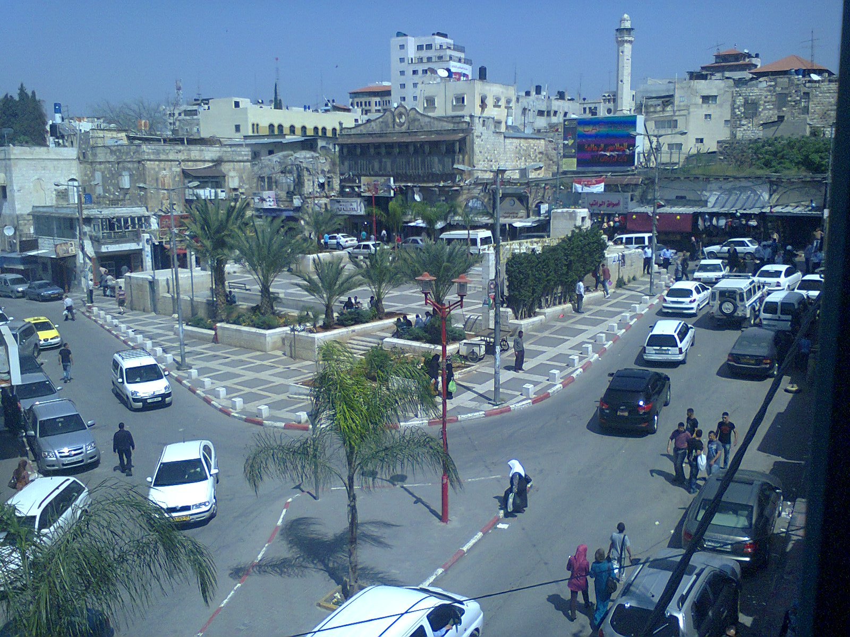

An – Najah National University
Engineering College
Civil Engineering Department
Traffic and Safety study for Tulkarem City 2012 supervisor: Dr. Wael AL-Haj Yaseen.
Prepared by:
Malek Solyman.
Mohammad Abu younes.
Fadi Khalil.

Slide 2
Project
Introduction
Methodology
Data Collection
Data Analysis
Counter Measure for Improving Quality of Traffic
Counter Measure for Improving Safety Performance

Slide 3
Introduction
General Background
Current problems
Objective
Study area
Literature review

Slide 4
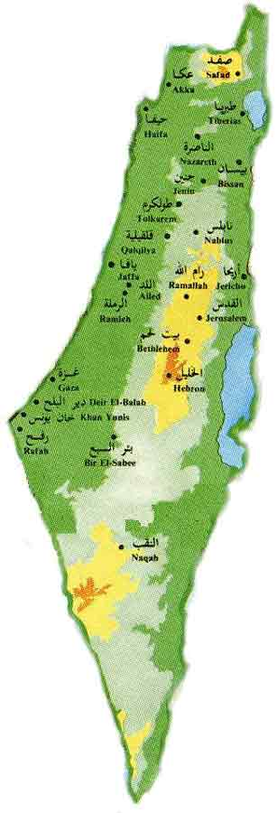
  General Background
Tulkarem city is located at the north-west part of the Westbank; as shown in Figure. It had a population of approximately 50,912 inhabitants in 2007 survey.

Slide 5

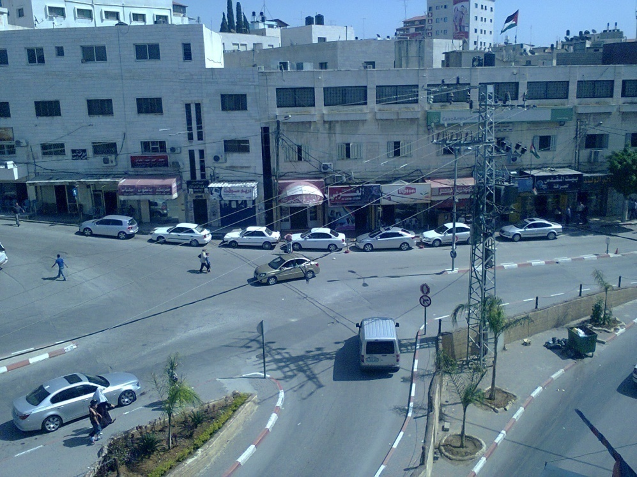
Current problems
Congestion 2. Illegal Parking
3. Travel time and delay
4. High number of crashes

Slide 6
Objective
The main objective of this project is analyze and proposes some countermeasures to improve the safety performance of the road network in Tulkarem City especially at intersection by using the data collected from the count and police center.

Slide 7
Study area
The main problem in the Tulkarem city is congestion and high pedestrian demand so the area that selected the CBD area and surrounding intersections and links that shown in the Figure below.

Slide 8
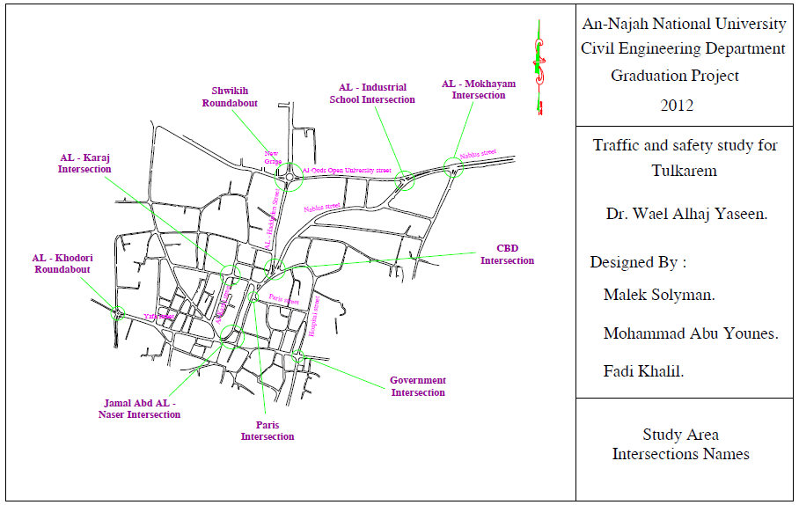

Slide 9
Literature review
There are several traffic studies conducted in the Tulkarem city, all these studies concentrated upon the congestion in the CBD area as resulting the increasing in the population and vehicle demand. It also analyzes parking and pedestrian problems and suggests solutions for these problems. One of these studies is the study done by Jalad et al. (2010), entitled "Traffic System Management for Tulkarem 2010".

Slide 10
Methodology
Identifying problem statement
Data collection
Data analysis

Slide 11
Identifying problem statement
Congestion problem attributed to the high traffic volume and the limited capacity of road network, and the high experienced delay especially at intersections are the main problems that face Tulkarem city. Simultaneously, safety problems clearly appear throughout the network especially at the intersections along Nablus-Tulkarem Street. All of the previous problems needed to be studies and proper solutions must be proposed.

Slide 12
Data Collection
we start by the collection of the information in the existing geometry which were taken from Tulkarem municipality and field trips, this data include primarily maps for Tulkarem.
Also we collected data related to traffic crashs, these data was obtain from Tulkarem police department (TPD).

Slide 13
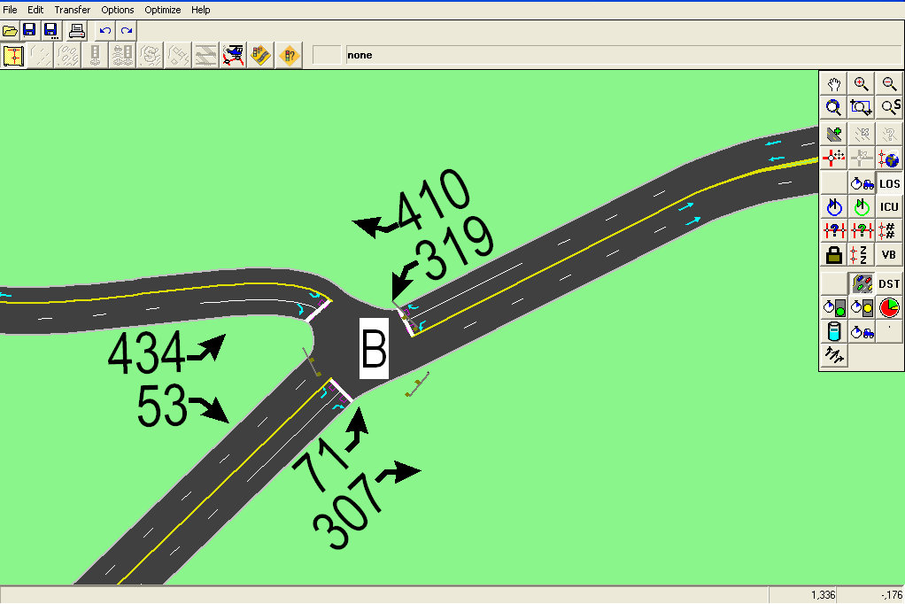
Data analysis
From the obtained traffic volume count. We can estimate peak hour volume, peak hour factor, design hour volume and Average daily.
By using the synchro program we estimate the level of service for the each lane of intersections.

Slide 14


For the safety performance evaluation, crash rates will be estimated to verify hazardous locations with high accident rates (intersection or link). This is followed by allocating all the crashes during 2010 and 2011 on the study area map using GIS software program. Crash rates are estimated using the following equations:
RMEV =
RMEV =

Slide 15
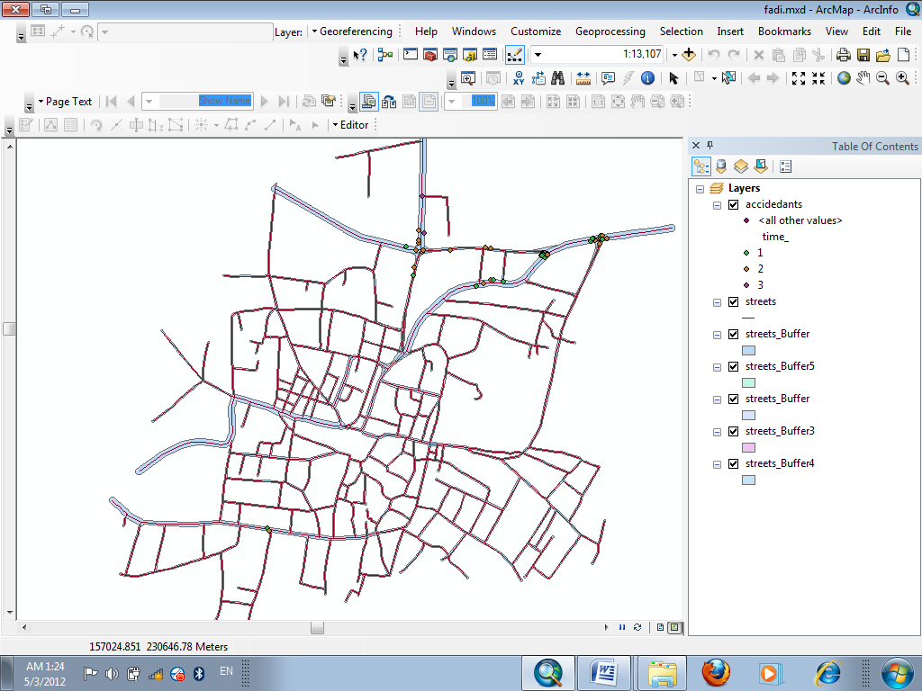
accident in Tulkarem city by GIS program

Slide 16
Data Collection & Analysis
Maps
Physical inventory study.
Traffic crashes data.
Turning movement counts.
Pedestrian Counts.
LOS & Delay.
Crashes Rate

Slide 17
Maps
The required scaled maps and other needed information needed is obtained from the Municipality of Tulkarem and from students who previously performed a study on the city.

Slide 18
Physical inventory study.
Physical inventory studies items defining the existing streets characteristics and condition include:
Number of lane and existing of median
Speed limit and speed limit signs
Identify major corridors to be studies
Parking condition
Pavement and side walk condition

Slide 19
  Crash data
Crash data in two years, 2010 and 2011 is obtained from traffic police center.
This data includes crash records, location and degree of severity.

Slide 20
Traffic count collection and analysis
The Tulkarem CBD& AL-Industrial school intersections are counted over them from 12pm to 3pm to find the peak hour and compare it with the traffic count in 2010, it was found that the peak hour are the same which is (1:15-2:15).
From the new count and the count in 2010, it was founded that the expansion factor is 1.12

Slide 21
Pedestrian count
The volume of pedestrian is obtained from counting on paris intersection, Al-karaj intersection &Jamal Abd Al-Nasser, which is considered as the most crowded places in the CBD.

Slide 22
Analysis Data
By using the synchro 7 program we found the Level of service and delay for intersections.
Intersections | LOS (or V/C)
 | WB |  |  | EB |  |  | NB |  |  | SB
 | LT | TH | RT | LT | TH | RT | LT | TH | RT | LT | TH | RT
Al – Mokhayam | A | A | - | - | A | A | C | - | B | - | - | -
Al – Industrial School | - | A | A | A | A | - | - | - | - | E | - | B
Shwikih roundabout | 1.05 |  |  | 0.84 |  |  | 0.78 |  |  | 1.06
CBD | A |  | - | - | A |  | - | - | - | F |  | -
Al – Karaj | - | - | - | C |  | - | F |  |  | - | - | -
Paris | - | - | - | - | B |  | - | B |  | - | - | -
Al – Khodori rounabout | 0.98 |  |  | 0.09 |  |  | 0.31 |  |  | 0.63
Al – Moqata’a | - | A |  | A |  | - | F |  |  | - | - | -

Slide 23
And we found the crashes rate by the equation which is listed in the methodology part.
Intersection No. | Name of Intersection | DHV | ADT | Crashes NO. in 2011 | Crash Rate
1 | Al - Industrial | 1594 | 15940 | 9 | 1.55
2 | Al - Mokhayam | 1481 | 14810 | 6 | 1.11
3 | Shwikeh roundabout | 2653 | 26530 | 8 | 0.83
4 | Paris | 659 | 6590 | 1 | 0.42
5 | Government | 919 | 9190 | 1 | 0.3

Slide 24
Link No. | Name of Link | Length of Link (m) | DHV | ADT | Crashes NO. in 2011 | Crash Rate
1 | Yafa street | 470 | 365 | 3650 | 3 | 0.48
2 | Paris street | 254 | 710 | 7100 | 2 | 0.31
3 | Nablus street 1 | 170 | 1560 | 15600 | 2 | 0.21
4 | Al – Qods Open University street | 460 | 1014 | 10140 | 3 | 0.18
5 | Al – Karaj street | 215 | 858 | 8580 | 1 | 0.15
6 | Nablus street 2 | 665 | 863 | 8630 | 2 | 0.1
7 | Al – Haddaden street | 370 | 1148 | 11480 | 1 | 0.07

Slide 25
Counter Measure for Improving Quality of Traffic
This chapter will demonstrate the individual problems of each intersection in the study area. It also tries to find appropriate solutions to improve the level of service. Since the period is short, solutions are part of the redesign of the intersection as will as signal. It is possible that these solution to improve the level of service to fail after a period of five years after opening.

Slide 26
Signal timing and other improvements will be required to maintain a minimum intersection level of service. The improvement will include the design of signals, stop – yield signs and channelization.

Slide 27
Warrant Program
Warrant 3 (W3): Peak Hour Delay / Volumes.
Warrant 4 (W4): Pedestrian Volume.
Warrant 5 (W5): School Crossing.
Warrant 6 (W6): Coordinated Signal System.
Warrant 7 (W7): Crash Experience.
Warrant 8 (W8): Roadway Network.

Slide 28
Warrant Checking Summarize
Intersection | W3 | W4 | W5 | W6 | W7 | W8 | Sig. Warrant
AL - Mokhayam | Not | Not | Not | Not | Not | Met | Yes
AL – Industrial School | Met | Not | Not | Not | Not | Not | Yes
Shwikih Roundabout | Met | Not | Not | Met | Not | Not | Yes
City Center | Met | Not | Not | Not | Not | Met | Yes
AL – Karaj | Met | Not | Not | Not | Not | Not | Yes
Paris | Not | Not | Met | Not | Not | Not | Yes
Jamal Abd AL - Naser | Not | Not | Not | Not | Not | Not | No
AL – Khodori Round about | Met | Not | Not | Not | Not | Met | Yes
AL – Moqataa | Met | Not | Not | Met | Not | Met | Yes

Slide 29
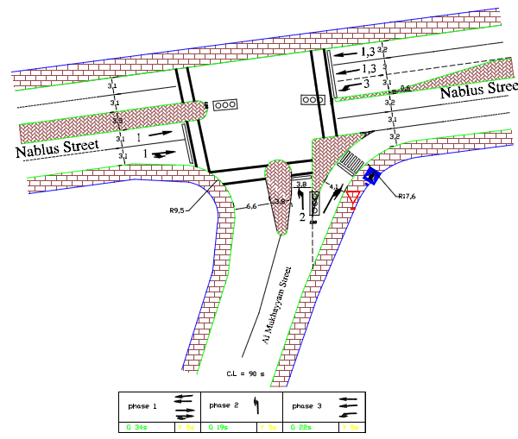
Al – Mokhayam Intersection

Slide 30
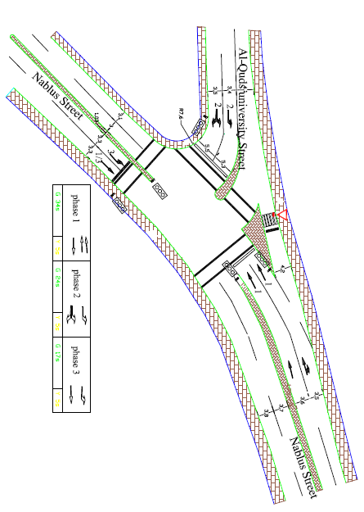
AL – Industrial School Intersection

Slide 31
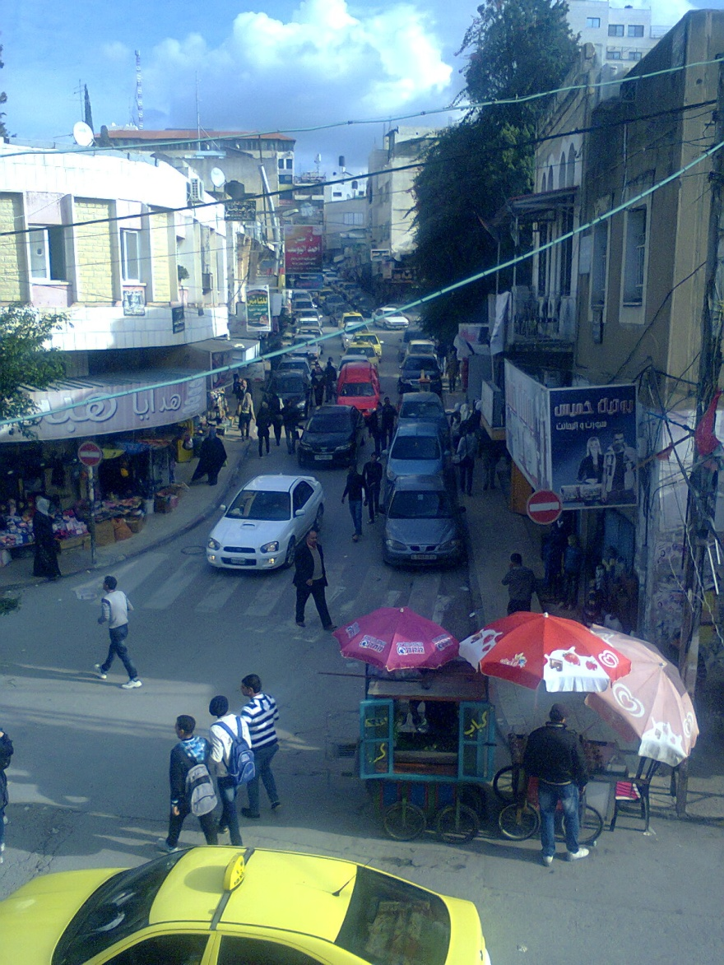
For the safety analysis there is no high crash rate in the CBD area due to congestion and low speeds. The crashes rates are along Nablus Street. The high crash rate is on AL – Mokhayam and AL – Industrial School intersections. These intersections are first priority to modify

Slide 32
This chapter will concentrate in intersections and links with high crash rate to suggest possible solution in safety on them, the intersection and links are:
Al – Industrial School Intersection.
Al – Mokhayam Intersection.
Shwikih Roundabout.
Yafa Street.
Paris Street.
Nablus Street .
Al – Qods Open University street.

Slide 33
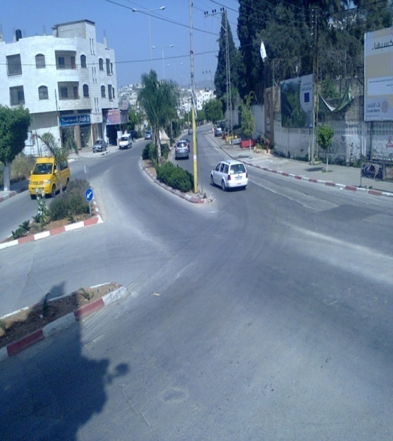
(9 crashes/year) and crash rate (1.55 C/MV).
angle crashes .
high speed and the feasible is not clear.

Slide 34
Conclusion and recommendations
High pedestrian volume in Paris, King Husseen and Jamal Abd Al – Naser streets cause delay for movements of vehicles and safety problems for pedestrian itself. So in the future prevent entrance vehicles to this area is a possible solution without affect on the movement of vehicles in the city.

Slide 35
The improvements include designing signals for the intersections which are required to minimize the crashes and to improve the LOS in the lanes with low LOS, redesign geometry for the intersections and marking on the pavement.

Slide 36
The two roundabouts in the study area are improved by signal because V/C ratio is more than one before putting signal and after improvement the LOS become well.

Slide 37
Thank You

