Slide 1














Introduction
Introduction
Study Area
Significance of the Project
Existing Problems
Methodology

Slide 2


Slide 3

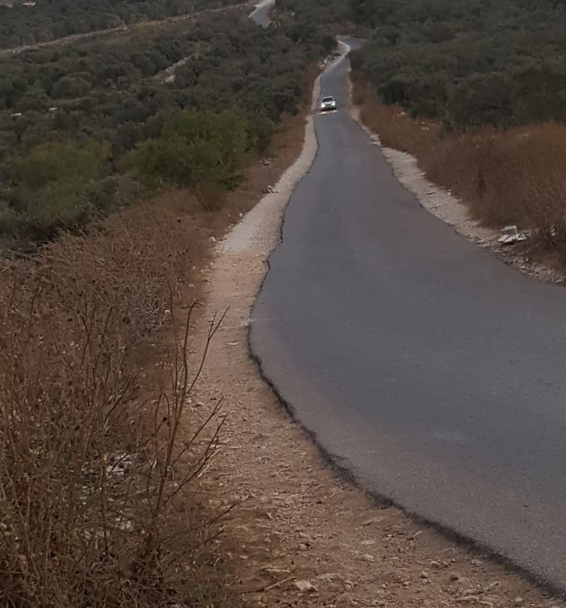
Existing Problems
Sight distance
The right of way is limited
width of shoulder not enough
Geometric characteristics
Surface and Subsurface
Sharp curve and high grade
Lack of drainage facilities
Pavement distresses as ( alligator, block,longitudinal, linear and edge cracks)
For the proposed road its about the deflect mountainous terrain & a valley

Slide 4
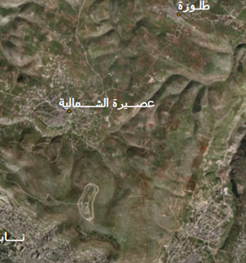
Significance of the Project
Trip travel time is shorter
Al-Badhan road is suffering from several traffic accident
Enhance the mobility and encourages the driver and public
Both governments Nablus and Tubas will benefit from the road

Slide 5
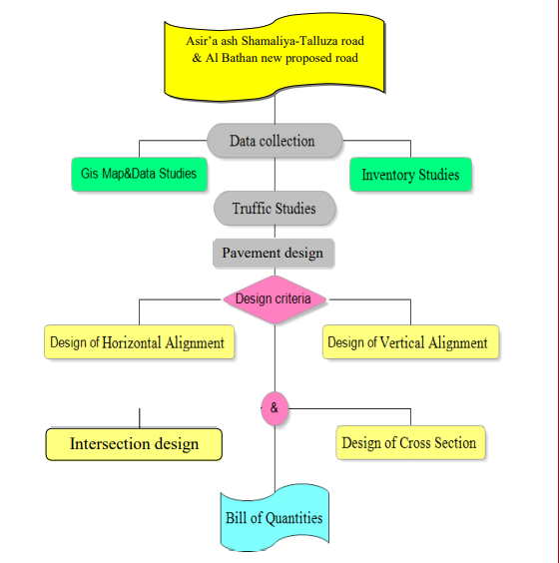

Slide 6






DATA COLLECTION AND TRAFFIC STUDEIES
DATA COLLECTION
Data Collections
California bearing ratio test
(CBR)
Traffic Volume Studies
Counting Period

Slide 7
Data Collections
Visiting the site of the project
Collect contour lines and
Approved Urban Master
GIS Geographic information system and
Geomolg for contour maps and
aerial photography.
Taking the soil samples in
order to design pavement.
Using traffic counting data to estimate the
project future traffic

Slide 8
Traffic Studies
Traffic volume studies are conducted to collect data related to the number and classification of vehicles during a specified time period.
This time period is taken every 15min by manual method for recording observed
vehicles using counter.
In this project, ADT, PHV, PHF and vehicle classification were calculated

Slide 9
proposed road | Normal case
77 veh/hr | 154 veh/hr | PHV
0.92 | 0.94 | PHF
82 veh/hr | 164 veh/hr | DHV

Slide 10
(CBR)
The California Bearing Ratio (CBR) is a penetration test for evaluation of the mechanical strength of road sub grades which is very important because it determines the proper use of soil and bearing capacity of soil. It is used to determine the thickness of the asphalt layer, to measure the swelling of soil and to study the behavior of soil in different conditions.
CBR Test
A'sira Ash-Shamaliya-Talluza Road | 5 | Stabilization
The CBR value for the second sample | 5 | Stabilization
The CBR value for the Al-Bathan road sample | 3 | Replacement

Slide 11



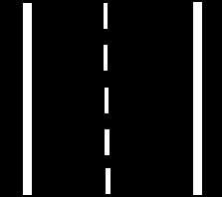

PAVEMENT DESIGN & INTERSECTIONS
Introduction
Introduction
Pavement
Intersections
Pavement design
structure
Intersections
Design

Slide 12
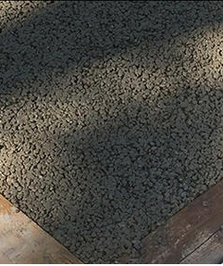
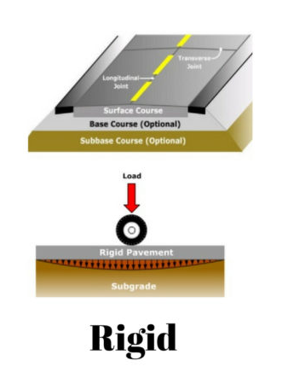
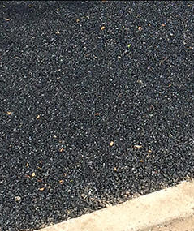
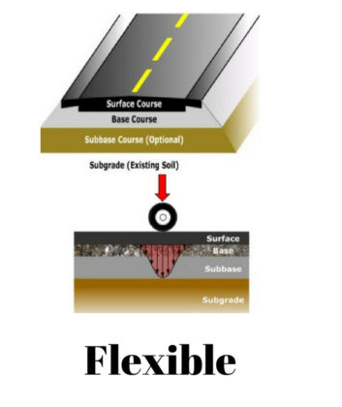
Introduction
Pavement
The last construction work in the project and there is two type of pavement:

Slide 13
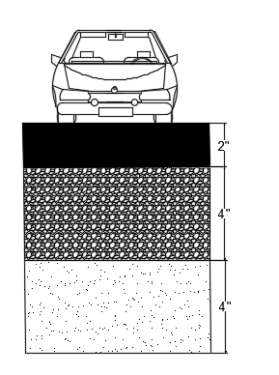
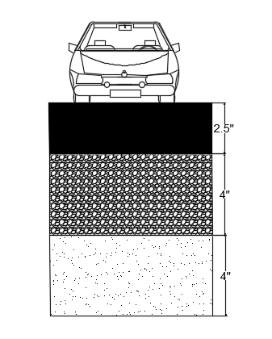
Pavement Design
Structure
The pavement design for (Asira- Ash-Shmalia-Tullzaraod) depends on AASHTO 1993 method.
The ESAL is calculated based on the traffic counts.
The design period is 20 years, and the growth rate is 3%.

Slide 14




DESIGN CONTROL & GEOMETRIC
Basic criteria
Vertical Alignment
Design control
Cross section
Horizontal Alignment

Slide 15
Basic criteria
Functional classification of the highway being designed
- Design vehicle
- Design speed
- Expected traffic volume
- Safety

Slide 16
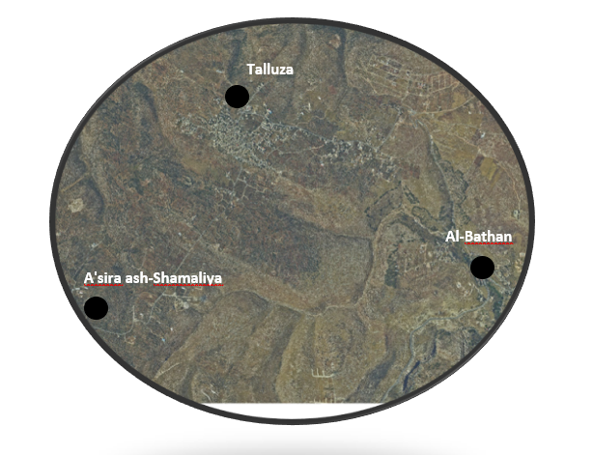
Horizontal Alignment
Horizontal Alignment

Slide 17
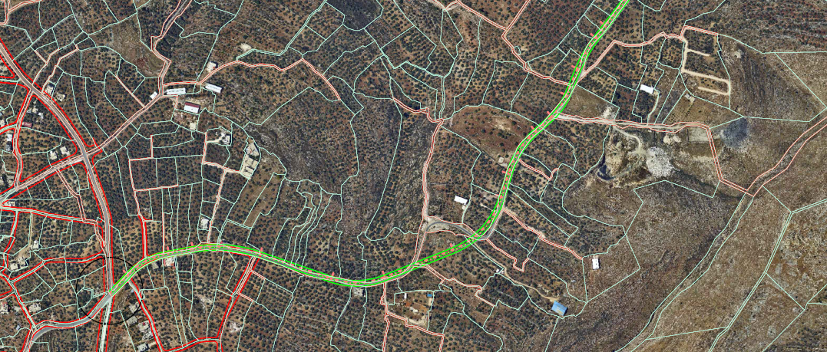
Horizontal Alignment
Horizontal Alignment
Horizontal Alignment

Slide 18
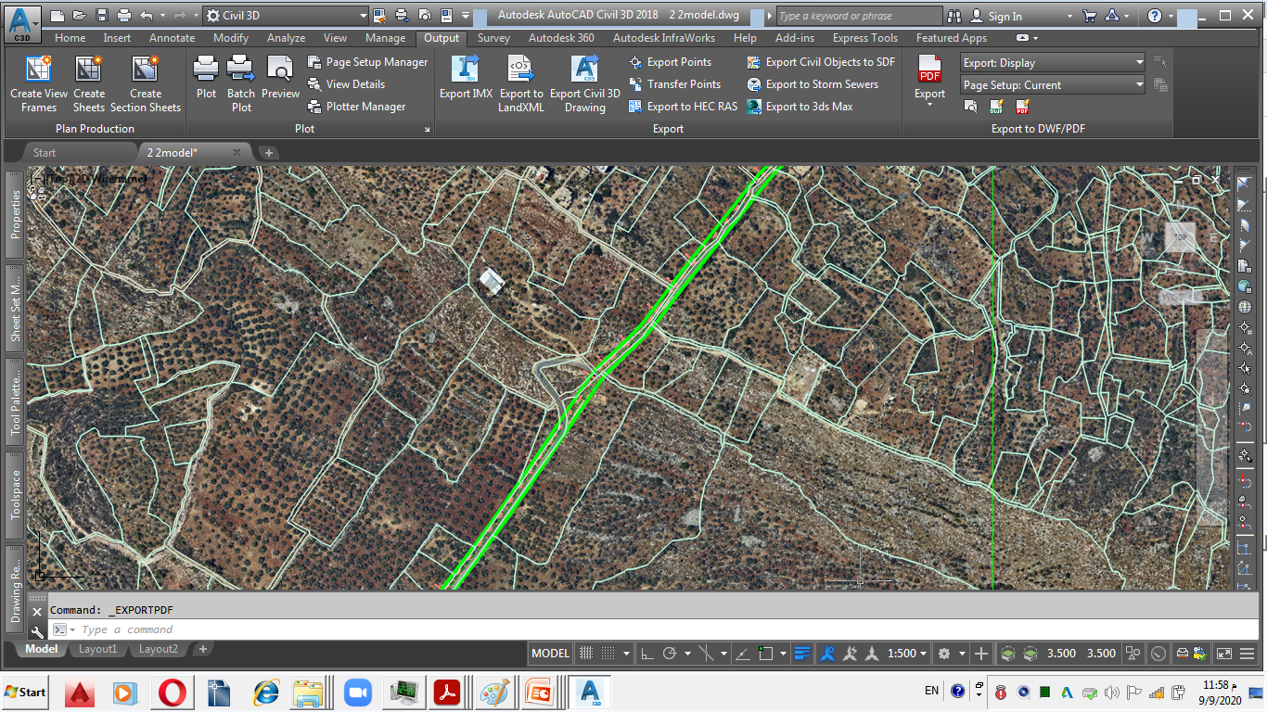
Horizontal Alignment
Horizontal Alignment
Horizontal Alignment

Slide 19
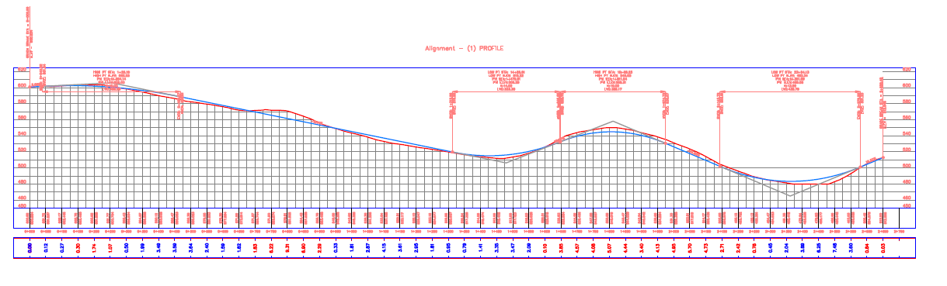
Horizontal Alignment
Vertical Alignment
2.05%
Horizontal Alignment
-8.14%
15.6%
16.9%

Slide 20
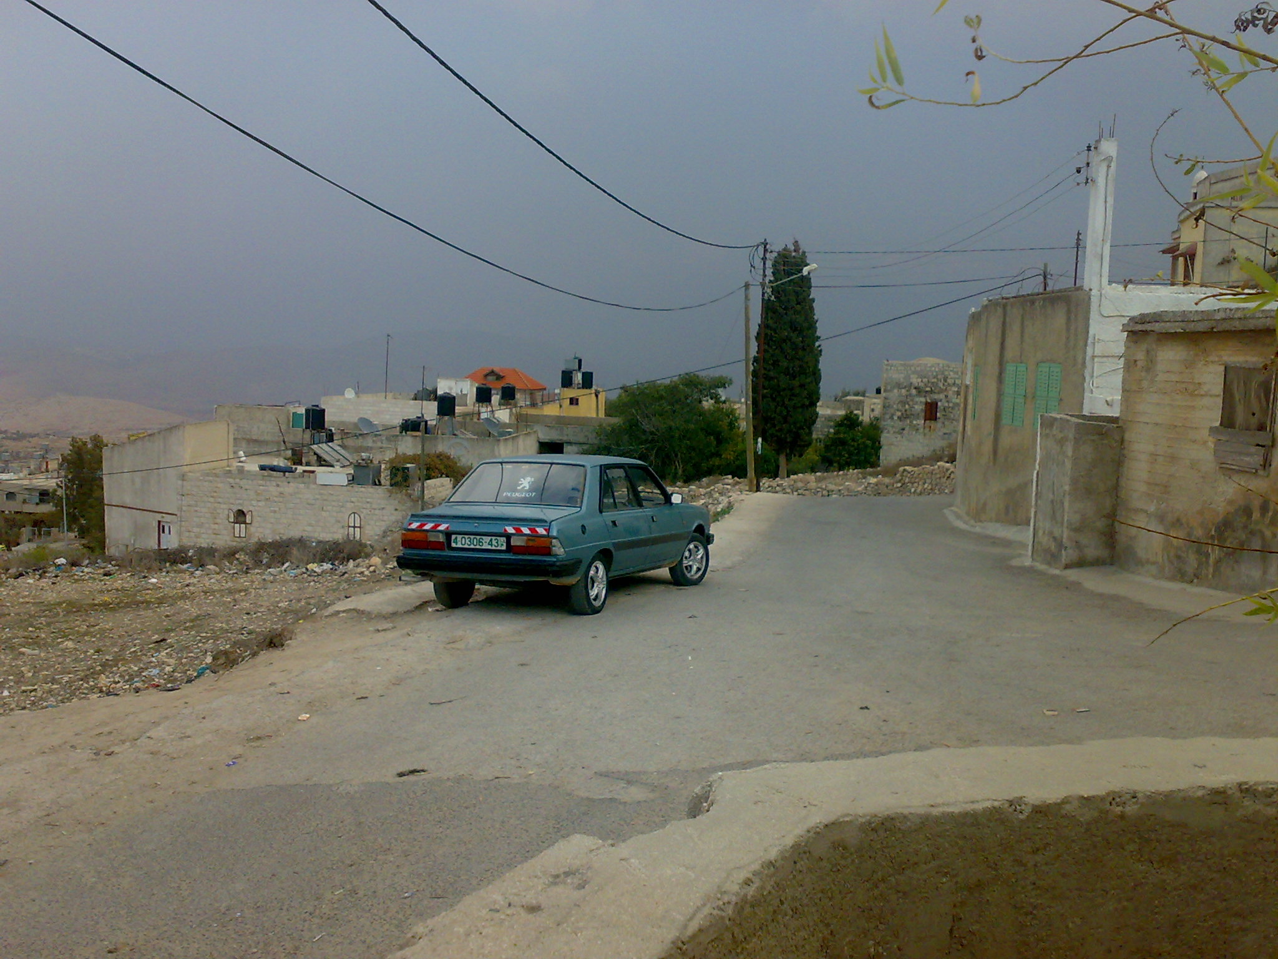
Horizontal Alignment

Slide 21
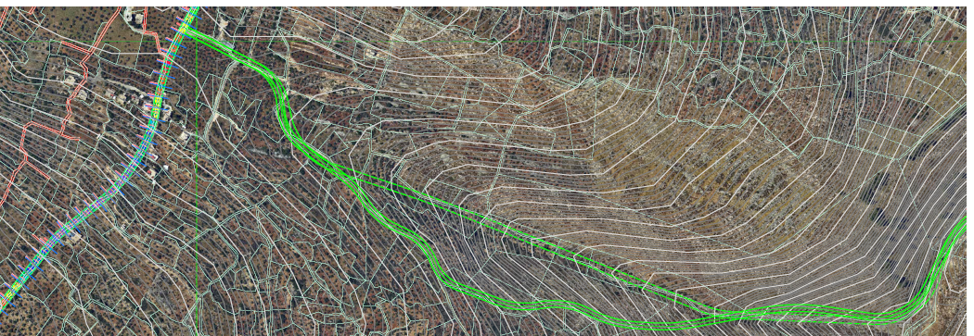
Horizontal Alignment
Horizontal Alignment
1
2

Slide 22
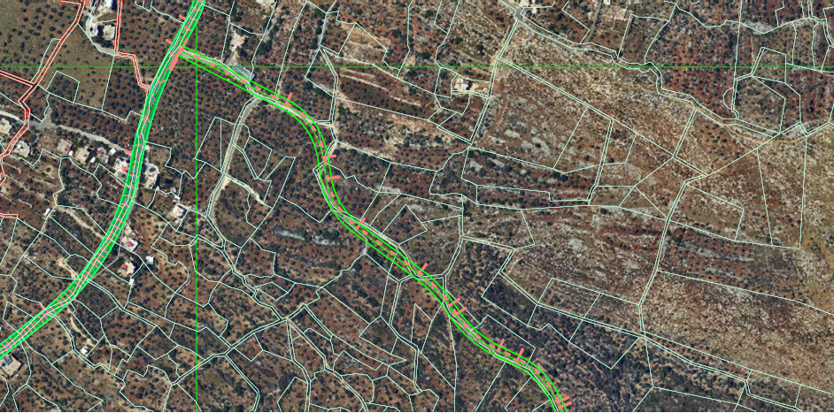
Basic criteria

Slide 23
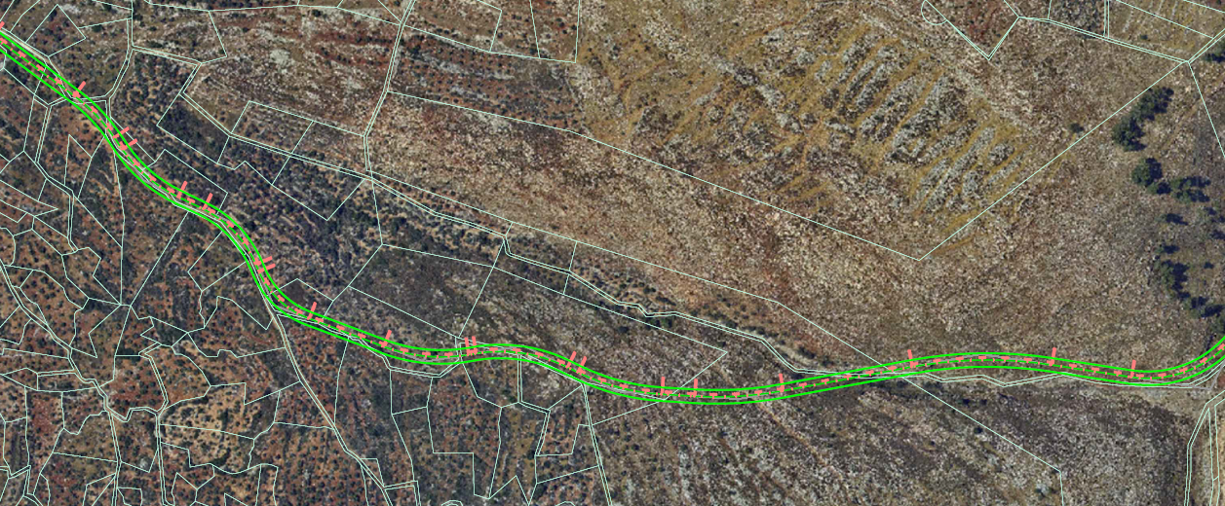
Horizontal Alignment

Slide 24
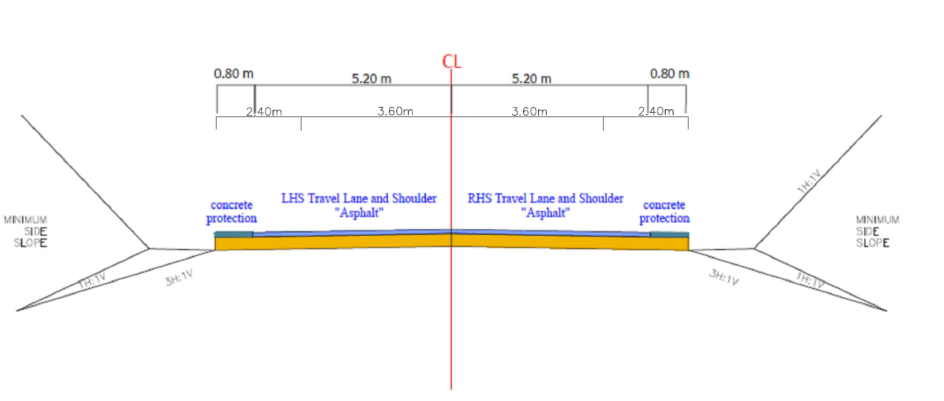
Cross section

Slide 25
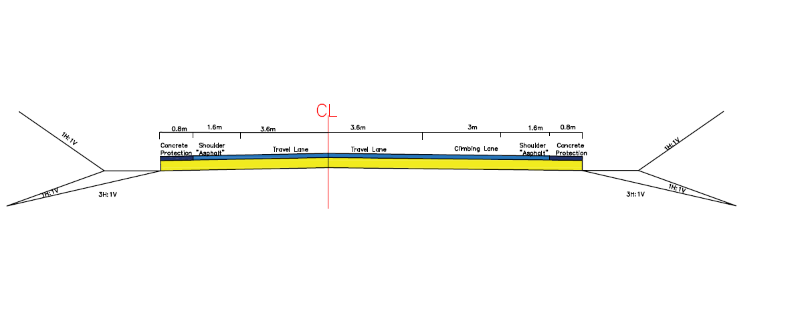
Cross section

Slide 26
Vertical Alignment

Slide 27
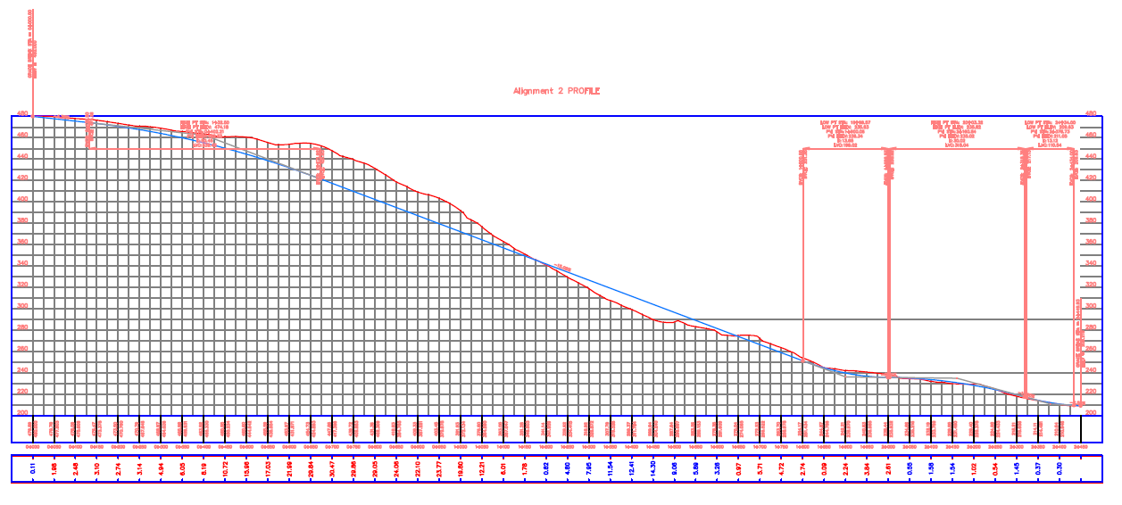
-4.3%
Vertical Alignment
15.06%
-0.5%
-11%
-2.58%

Slide 28
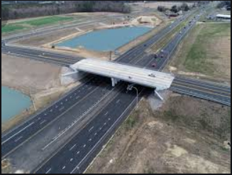
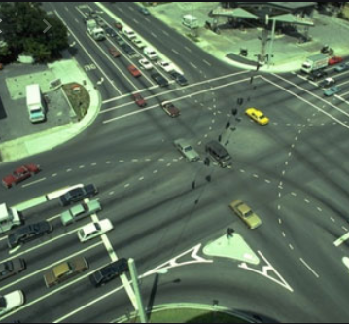
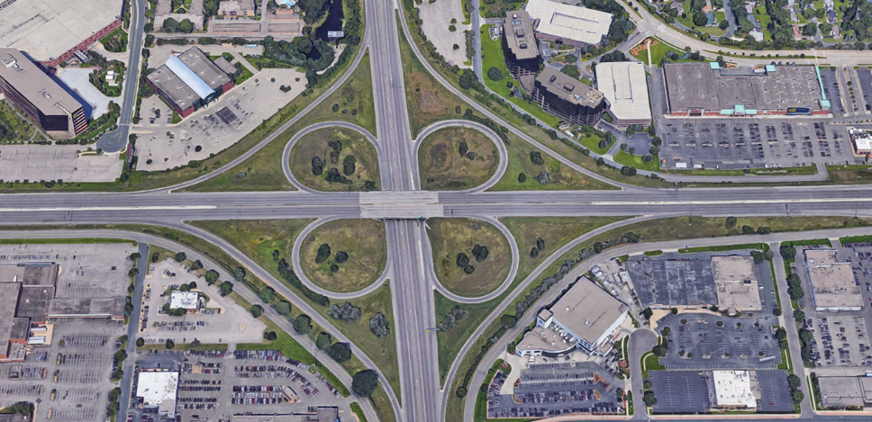
Introduction
Intersections
An intersection is an area, shared by two or more roads, whose main function is to provide for change of route direction, intersection vary in complexity from a simple intersection.
Intersection is one of the main sources of traffic conflict.
Intersection is also critical segments of highway in that they can affect the operational characteristics and safety of the highway.
Types of Intersections

Slide 29
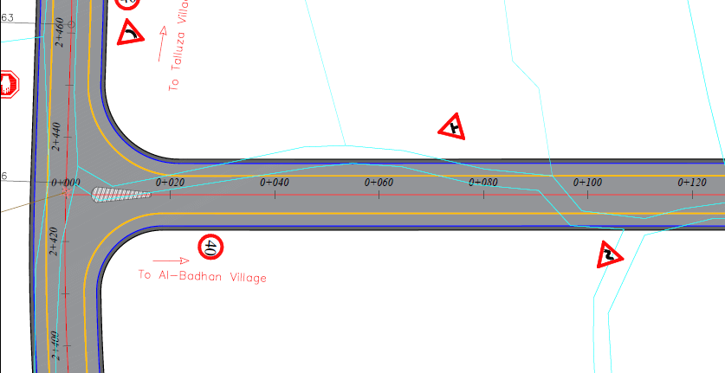
Intersections
Design
There is three types of at grad intersection:
Three leg intersection
Four-leg intersection.
Multi-leg intersection.

Slide 30





CONCLUSION AND RECOMMENDATIONS
Cost Estimation
Recommendations
Conclusion
Graduation
Project

Slide 31
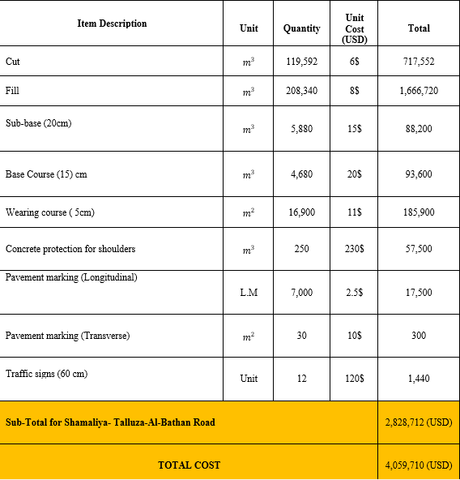
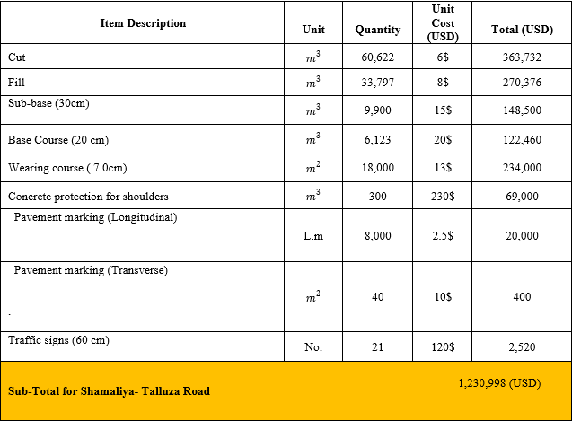
Cost Estimation

Slide 32
Conclusion
The design and construction of Asira Ash-Shamaliya-Talluza Road is expected to reduce traffic jam in Al-Badhan-Nablus road.
The design and construction of the target road will contribute in enhancing the safety of the people and minimizing the traffic accidents at Al-Badhan-Nablus road.
The design and construction road will encourage people from surrounding governorate to use as it will minimize travel time.

Slide 33
Recommendations
The main recommendations are:
Enhancing and encouraging the benefit LGUs to make every effort possible to obtain fund for reconstruction the road through intensive communications with the MOPWH.
Design a proper drainage system in order to avoid future problems in the road pavement layers.
Design the proposed retaining walls along the road where required.
The new proposed alignment will as an alternative to avoid entering the village of Talluza.

