Slide 1





FIRE AND SMOKE DETECTION SYSTEM
Mohammad Ammar Jararrah
Amr Adnan Badran
Dr Adnan Salman

Slide 2








THE PROBLEM
FIRES SPREAD FAST!
01
02
03
Rapid Spread
Fatal Smoke
Delayed Detection
A small fire can engulf a room in 3 minutes ⏳
Smoke inhalation causes more deaths than burns
Traditional alarms detect fire too late
💡 SOLUTION? AI-BASED EARLY DETECTION!

Slide 3

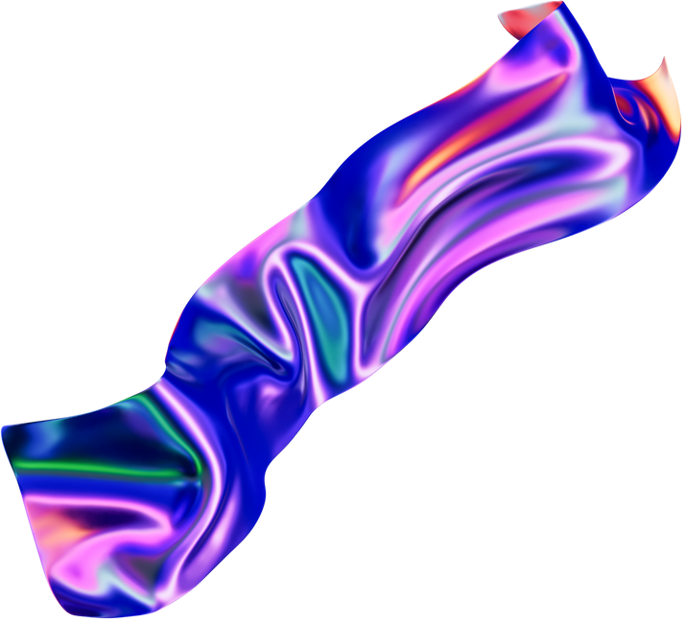
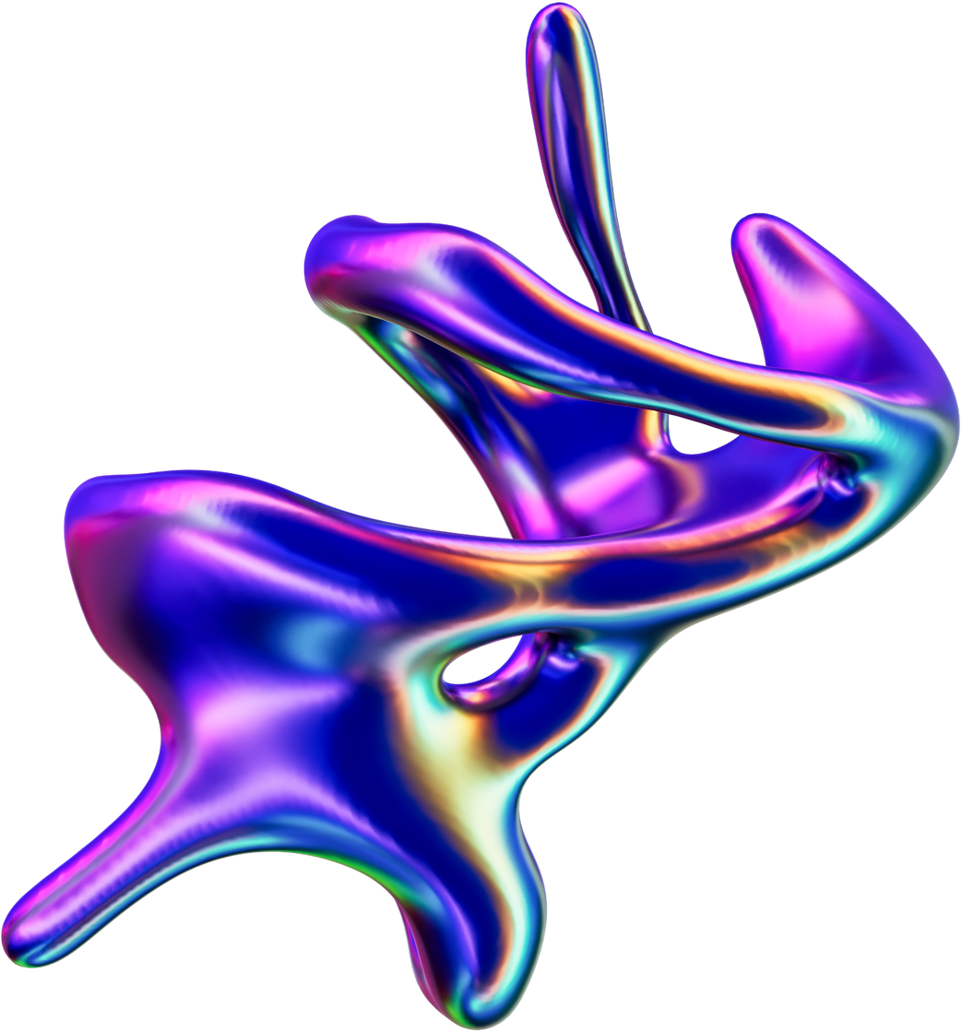
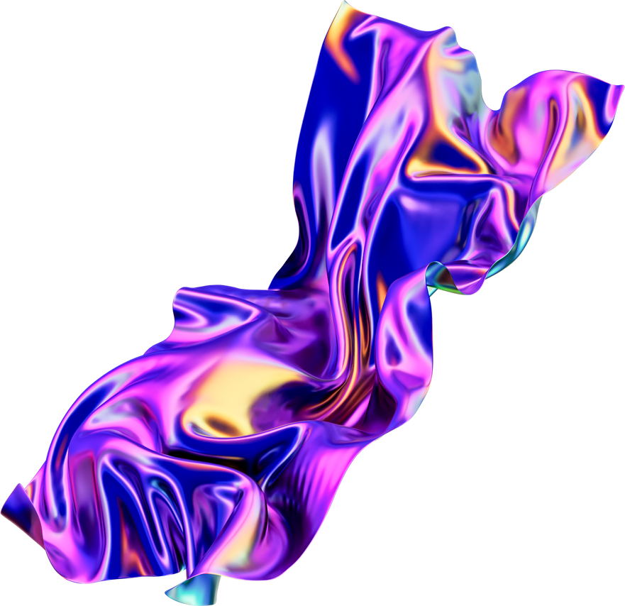
WHAT IS OUR SYSTEM?
Fire & Smoke Detection, Powered by AI
✅ Detects fire & smoke in real-time 🎥
✅ Uses YOLO-based AI model ⚡
✅ Alerts users instantly via a mobile app 📲

Slide 4
WHY YOLO?
You Only Look Once – Perfect for Fire Detection!
It’s a popular type of object detection model that processes images in a single pass, making it fast and efficient.
✅ Real-Time Speed – Essential for live video feeds 🎥
✅ High Accuracy – Detects fast-moving smoke/fire
✅ Proven & Reliable – Strong community support 🤝

Slide 5
HOW YOLO WORKS?
YOLO is a single-stage object detection model.
It divides the image into a grid and predicts bounding boxes, class probabilities, and confidence scores in one pass.
This makes it much faster than two-stage detectors (like Faster R-CNN).
Model | Type | Speed (FPS) | Accuracy
YOLO | Single-stage | 🚀 Fast (real-time) | High
SSD | Single-stage | ⚡ Fast | Medium-High
Faster R-CNN | Two-stage | 🐢 Slow | 🏆 Highest

Slide 6
HOW WE TRAINED THE AI
📸 Dataset: 8,687 images of fire/smoke
Training Set: 6,095 images
Validation Set: 1,725 images
Testing Set: 867 images
We used YOLO11m version , balancing speed and accuracy.
Dataset Preparation:
handle image resizing (to 640×640)
Orientation fixes.

Slide 7
TRAINING THE MODEL
Training Setup:
Fine-Tuning:
Exporting the Model:
Optimizer: AdamW
Batch Size: 16
Epochs: We trained up to ~60 epochs .
We reduced the learning rate to 0.0001 for more precise adjustments.
We froze/unfroze some layers gradually to avoid destroying what the network had already learned.
The final weights were saved as Fire&smoke.pt, ready to be used in our next steps.
Final accuracy: mAP@0.50 = 0.898 🎯

Slide 8
THE SERVER – BRAIN OF THE SYSTEM
Built with Python + Flask framework
01
02
03
Gets video from camera 🎥
Passes frames through YOLO AI model 🤖
Draws bounding boxes around fire/smoke 🚨
🌍 Network Connection:
LAN mode:
Auto-detect server 📡
WAN mode:
Connect remotely via QR code 📱

Slide 9
THE SERVER – BRAIN OF THE SYSTEM
Provides Two Key HTTP Endpoints:
01
02
/video_feed:
Streams the annotated video as MJPEG .
/status:
Returns an integer (0, 1, 2, or 3) to indicate the detection status .
🌍 Network Discovery:
Uses UDP broadcasts on port 9999.
Sends out a special message (“FIRE_DETECTION_SERVER_DISCOVERY”) so that clients on the local network can find the server automatically.

Slide 10
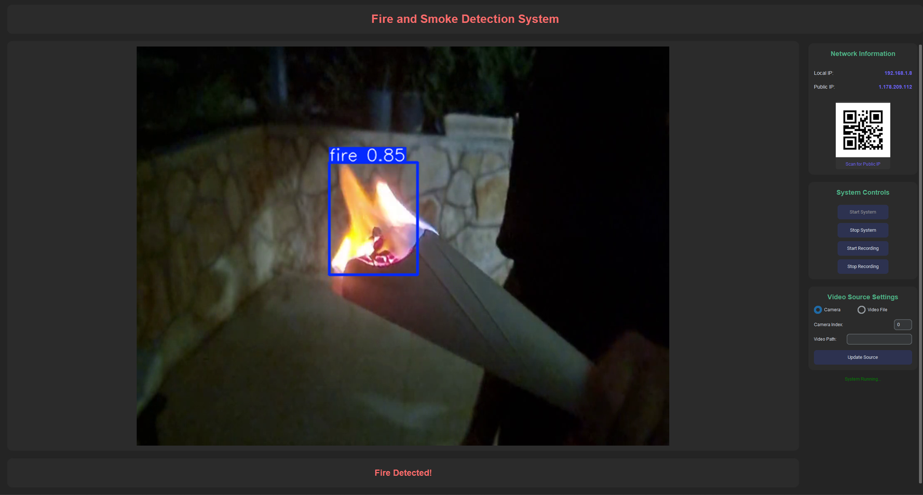
THE SERVER – BRAIN OF THE SYSTEM
GUI with CustomTkinter :
Lets the user start/stop detection, choose a camera or file, record videos, and see detection status.

Slide 11
THE CLIENT APP – USER'S INTERFACE
Built with .NET MAUI
User Interface (MAUI Pages):
Monitor Page: Start/Stop streaming, view live detection.
Status Page: Check last detection and see if notifications are running.
Settings Page: Switch between LAN or WAN, scan QR codes, and save preferences.
🎥 Real-Time Video Streaming
Detection Status Updates:
The app constantly checks the /status endpoint
If it sees “Fire Detected,” the app can show a red warning banner or pop-up.
When detection occurs:
🔴 Fire Detected!
🔵 Smoke Detected!
⚠️ Both Detected!
🔔 Notification System
The app runs in the background using a Foreground Service to ensure users are alerted even when the app is minimized.
📢 Sound Alert – Beeping alarm 🔊

Slide 12
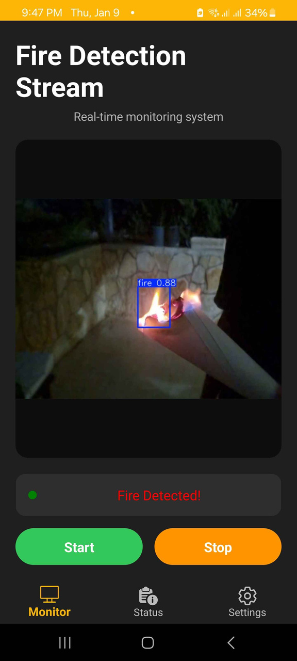
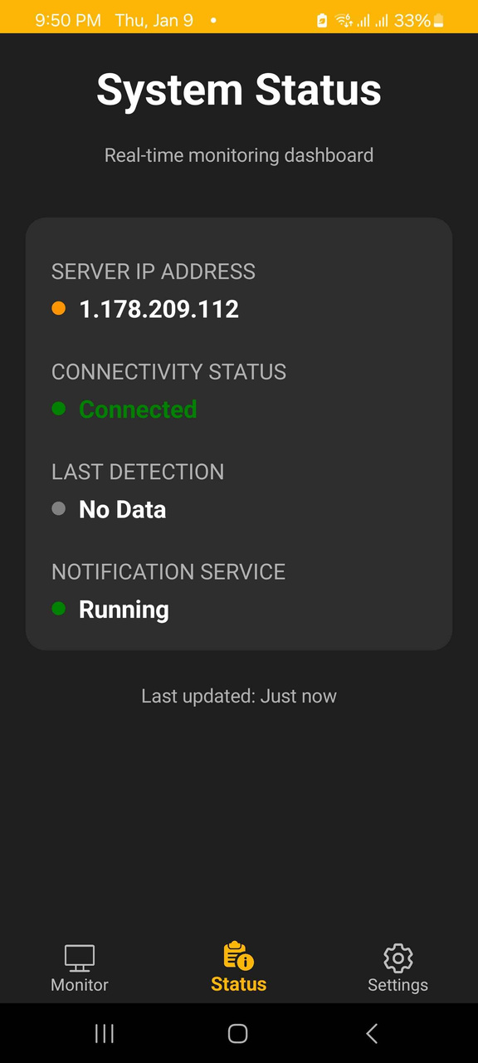
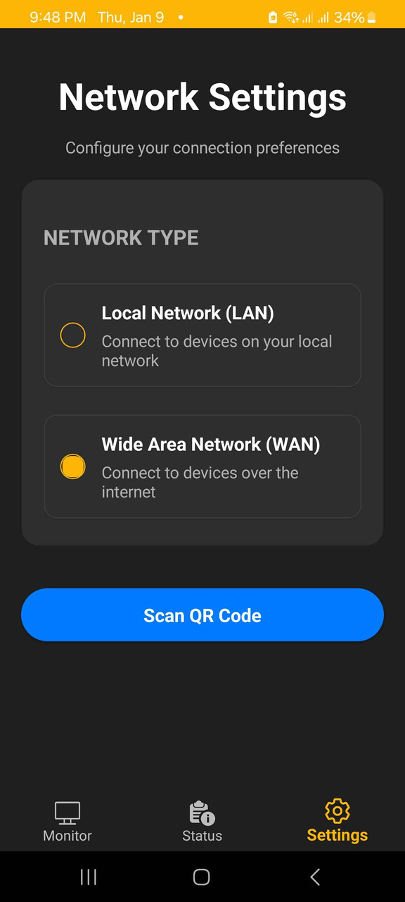
THE CLIENT APP – USER'S INTERFACE
Built with .NET MAUI

Slide 13
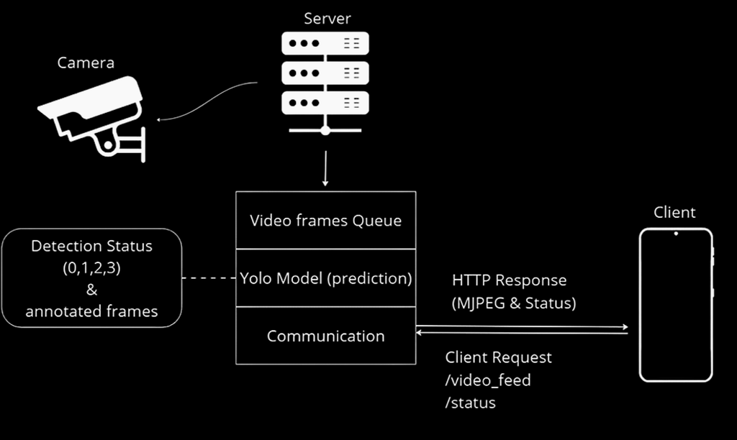
HOW IT ALL WORKS
1️⃣ Camera Captures Video 🎥
2️⃣ Server with YOLO detects fire/smoke 🔥
3️⃣ Annotated frames + status codes sent 💾
4️⃣ Client App receives video & alerts user 📲

Slide 14
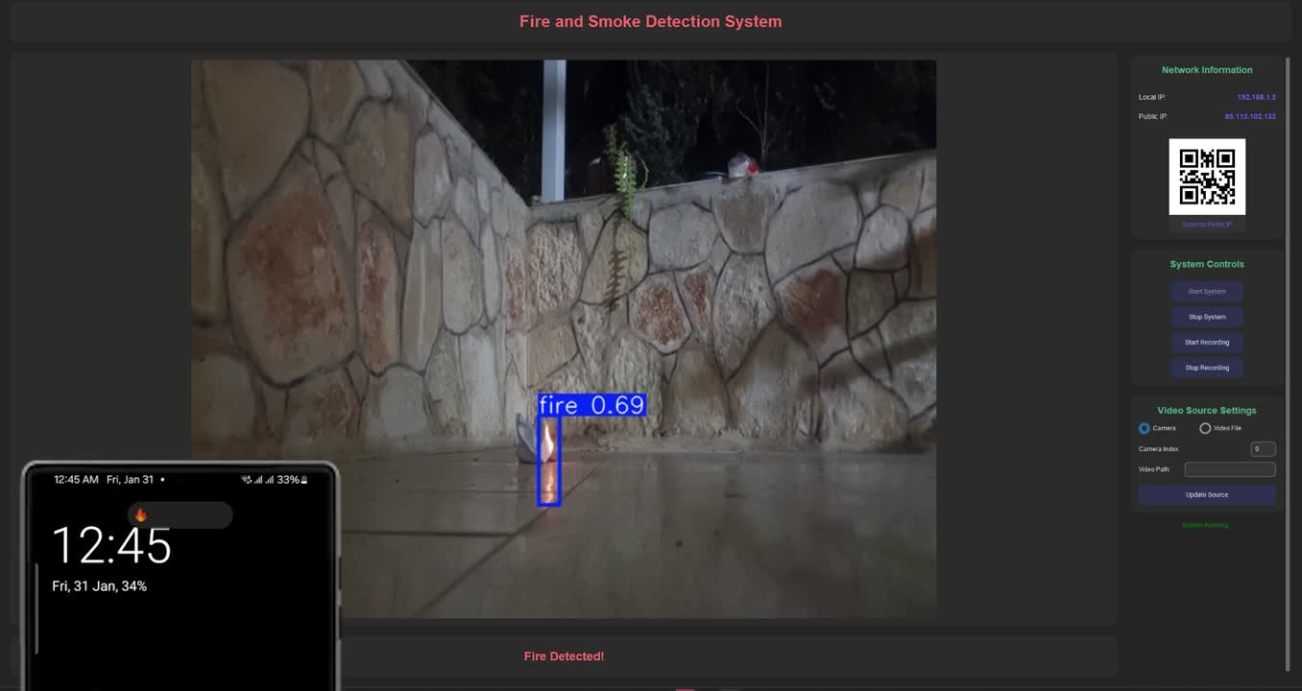
LIVE DEMO
🔴 See the system in action!

Slide 15
THANK YOU!

