Slide 1
Team Allocation System
By: Loay Zawyani & Manal Lubbadeh
Supervisors: Dr. Ashraf Armoush & Dr. Haya Sama’aneh

Slide 2
Outline
  What is Team Allocation System?
  Our Methodology.
  Features and Demo.
  Future work and Conclusion.

Slide 3
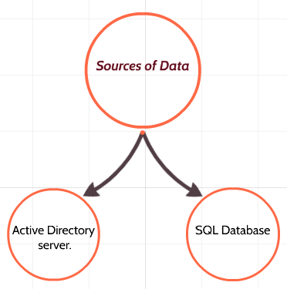
What is Team Allocation system?
  You don’t need to login to the active directory sever anymore to view and manage information.

Slide 4










Our Methodology

Slide 5
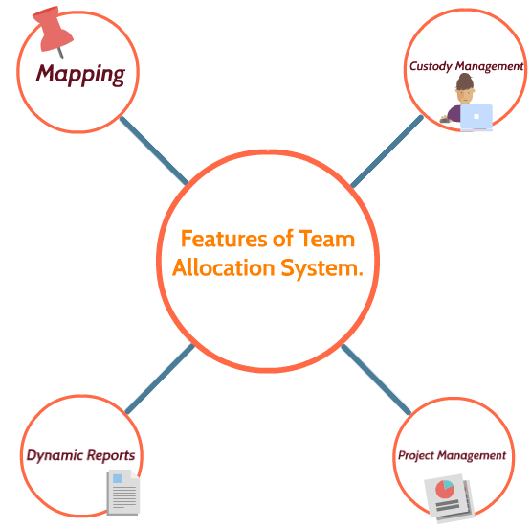

Slide 6
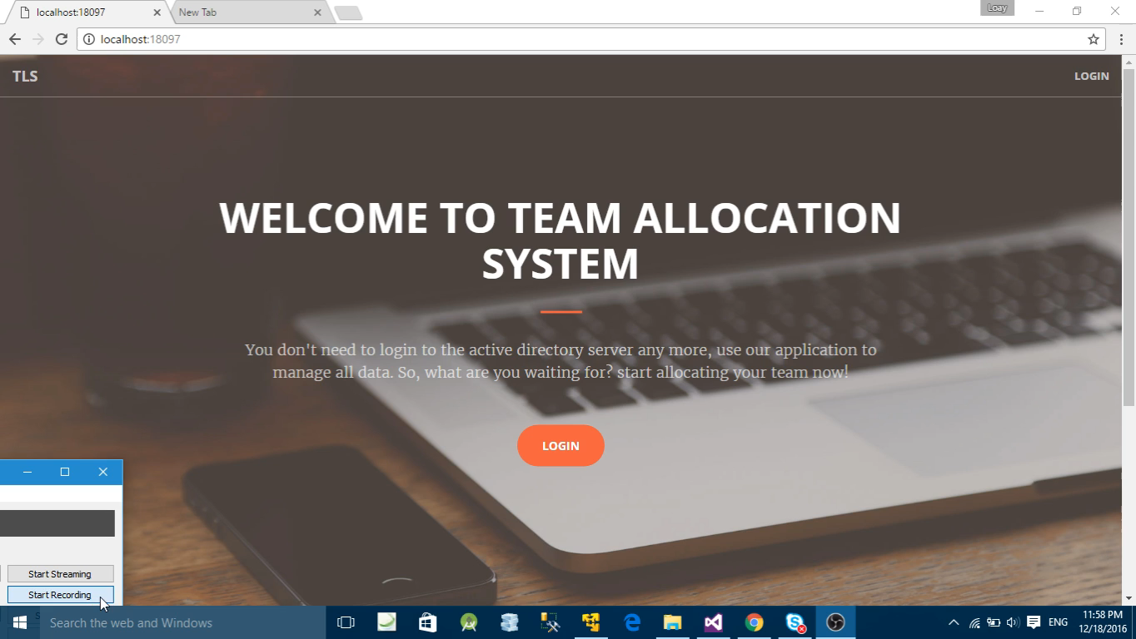

Slide 7
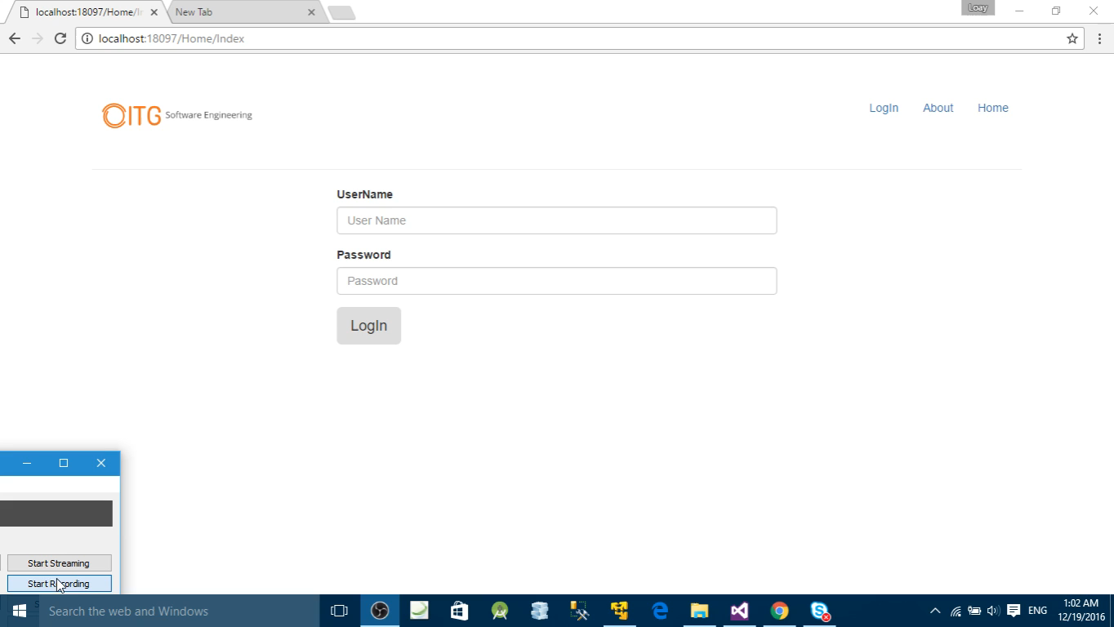

Slide 8
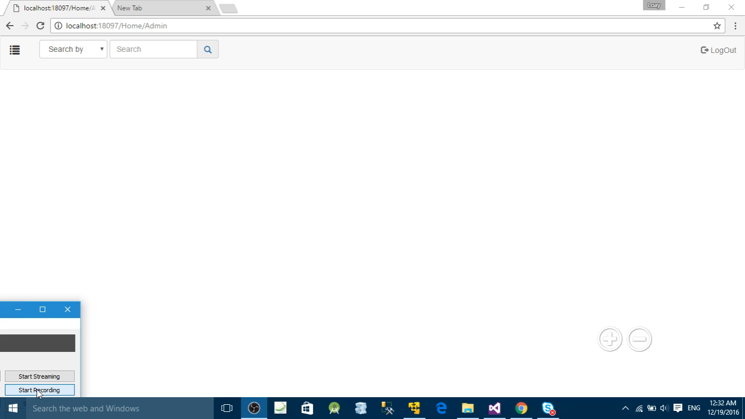

Slide 9


Slide 10
Conclusion
  Team Allocation System meets the needs for nowadays companies.
  Our future work is:
      Attendance.
      Meeting rooms booking.

