Slide 1
Graduation Project
SMART CAR
Tariq Salameh
Mohamed Qamhieh
Introduction
Tools And Equipments
Project Schedule
AI Algorithm Description

Slide 2
Introduction
SMART CAR Project : a car that uses artificial intelligence algorithms to think about solutions to get out of certain situations.
SMART CAR Project : an artificial intelligence project depends on algorithms developed to make this car get out of any maze and then save the exit path so that it could choose the optimal path to the exit next time it faces the same maze.
Why SMART CAR ?
  The main idea is to use artificial intelligence.
  Same Algorithms can be used to control much more complicated robots.
  Using of new technology based on a new microcontroller.

Slide 3
Tools and Equipments
In SMART CAR we used the following:
  Arduino Pro. Development Board based on Atmel (ATmega328) microcontroller.
  Infrared Proximity Sensor (Short Range) Sharp GP2D120XJ00F.
  A Step Up to 5 Volt.
  2 Micro Motors.
  Ball Caster Metal.
  Lithium Ion Batteries (1000 mA , 3.7 Volt).
Why these tools?

Slide 4
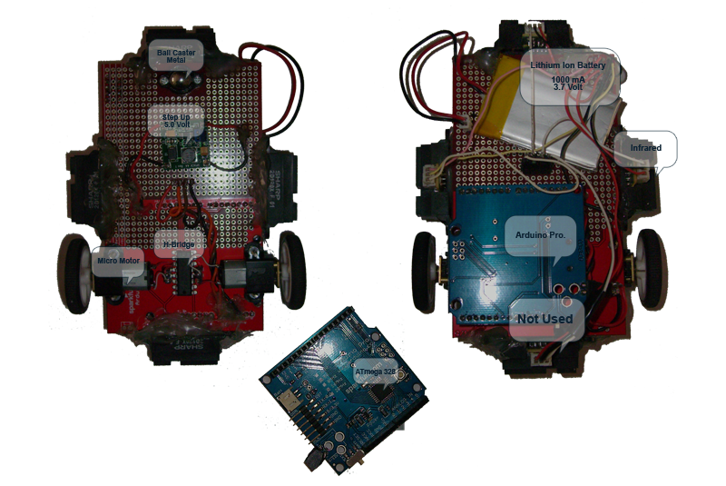
Top & Back View

Slide 5
Project Schedule
First of all, we had to decide what tools do we need? How to get them? How to make sure that everything we need is available?
Then, after the tools came home safely, we had to think of the appropriate way of connecting these tools together to get our project the prefect portability. So that, changing everything easily.
Testing, Step by Step.
Hazards (Next Slide).
Designing a trial maze.

Slide 6
Hazards How to get all these features connected together??!!!
Getting out of the maze
Distances
Walls Detection
Small Angles Detection
Angles
When it is out?
Tilt of the Ground
Saving
Best Decisions
Retrieving Saved Things

Slide 7
AI Algorithm Together Step By Step
What situations could our algorithm face?
Why our algorithm relatively powerful?
How could this algorithm do the right thing at the right time?
Why it was not easy to develop this algorithm?

Slide 8
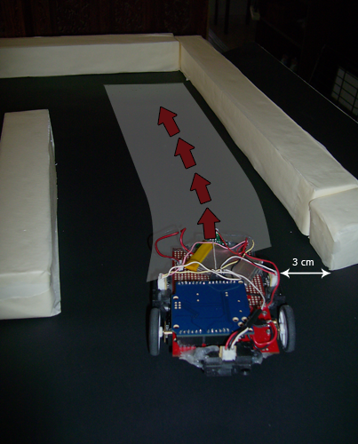

AI Algorithm – Case 1

Slide 9
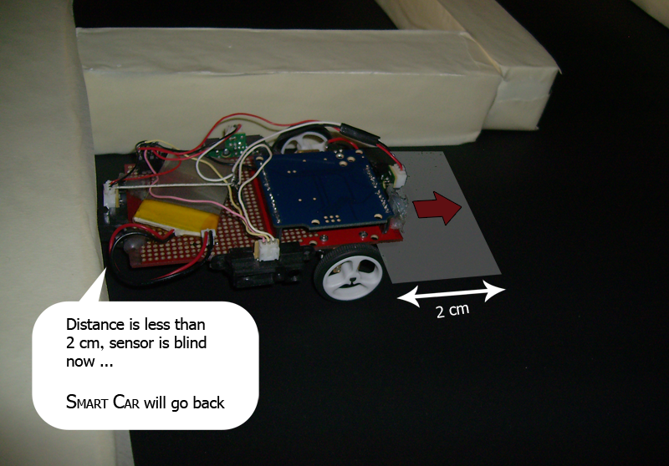
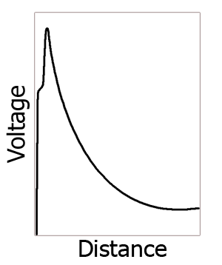
AI Algorithm – Case 2

Slide 10
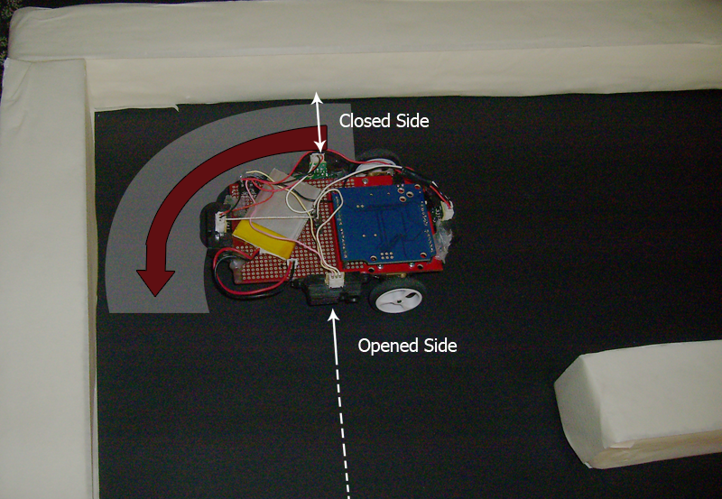
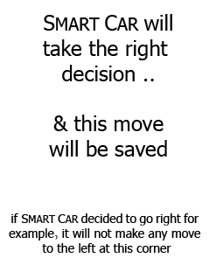
AI Algorithm - Case 3

Slide 11
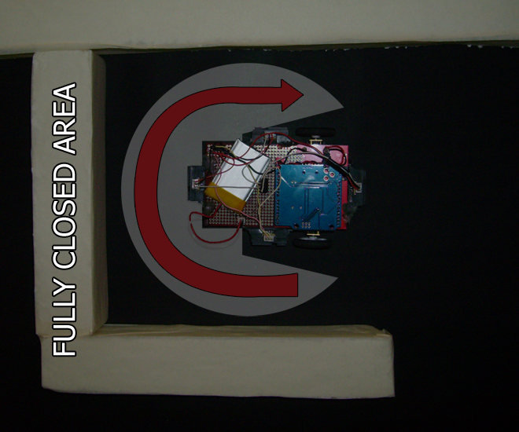

AI Algorithm – Case 4

Slide 12
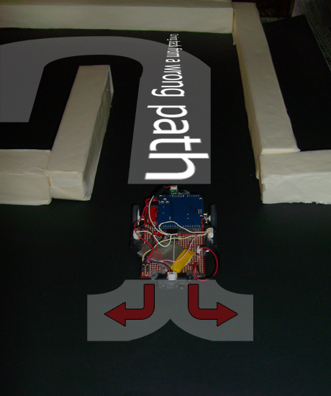

AI Algorithm – Case 5

Slide 13
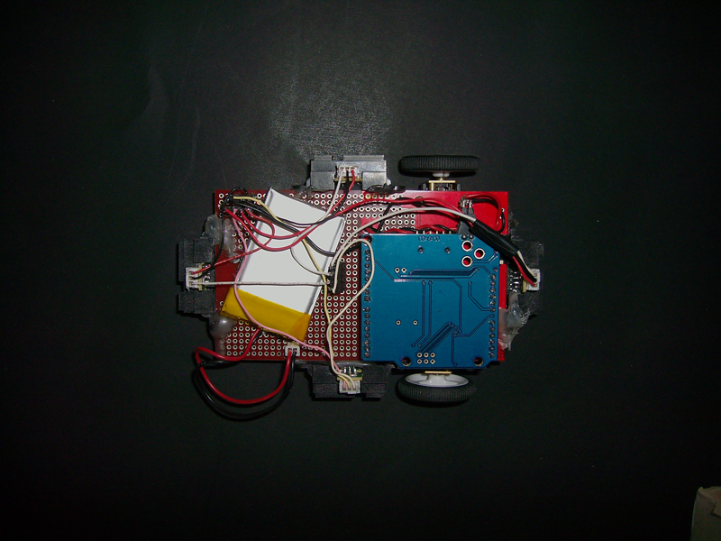
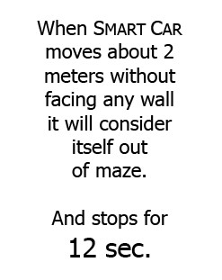
AI Algorithm – Case 6

Slide 14
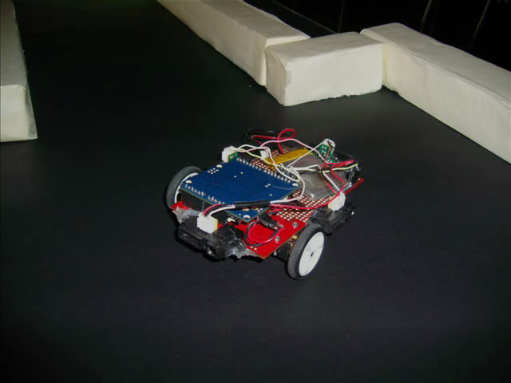
AI Algorithm – DONE

Slide 15
Is our Project 100% Perfect?
SMART CAR can get out of any maze successfully?
True 100% .
SMART CAR can save the exit path of any maze successfully? mmm it needs a little thinking …
its 90% True. Why?

Slide 16
Thanks for Your Attention
Enjoy Our Practical Test Now
Regards,
Mohamed Qamhieh
Tariq Salameh

