Slide 1

Automated Irrigation System
AIS
Made by:
Firas Abdulhaq
Gina Kadri

Slide 2
Contents
Motivation
Solution
Introduction
Hardware Components
Software
Workflow
Problems/Solutions
Future work
Video

Slide 3

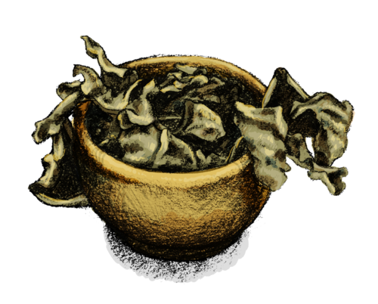

Motivation
The death of plants caused by the long absence of their owners.

Slide 4
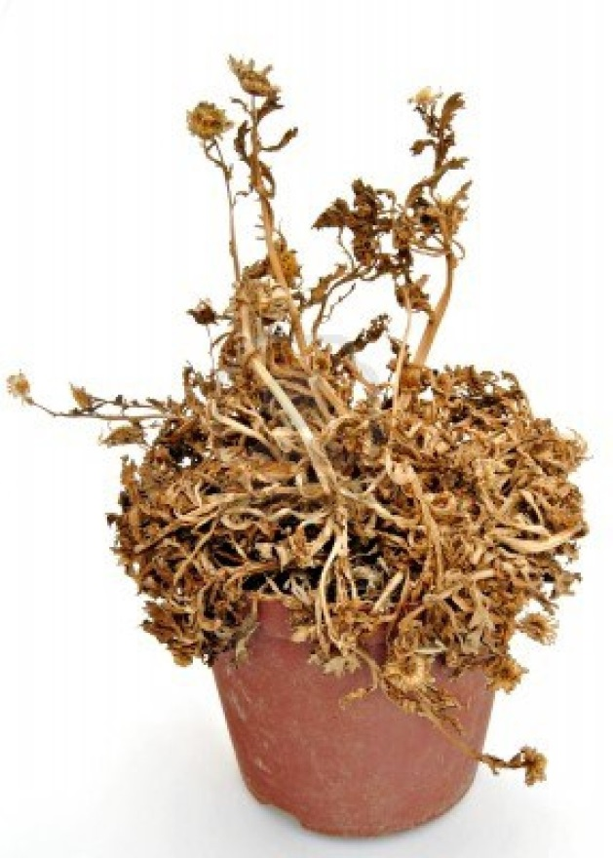
Motivation
The exhausting boring process of irrigation.
The expensive available
irrigation systems.

Slide 5

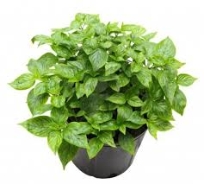
Solution
Our irrigation system
AIS

Slide 6

Introduction
What is AIS?
AIS is an automatic irrigation
system which eliminates the
manual irrigation intervention
of humans in a manner that
is extremely user friendly.

Slide 7
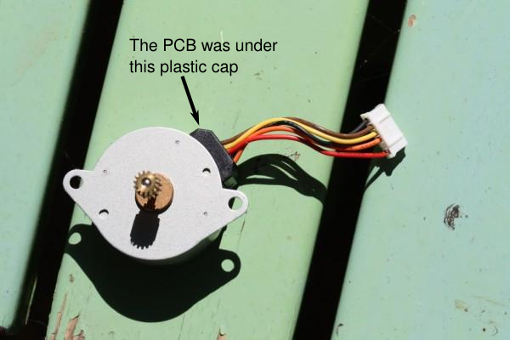
Hardware Components
Unipolar Stepper Motor
The Unipolar stepper is used to control the
Movement of the water hose in y-axis.

Slide 8
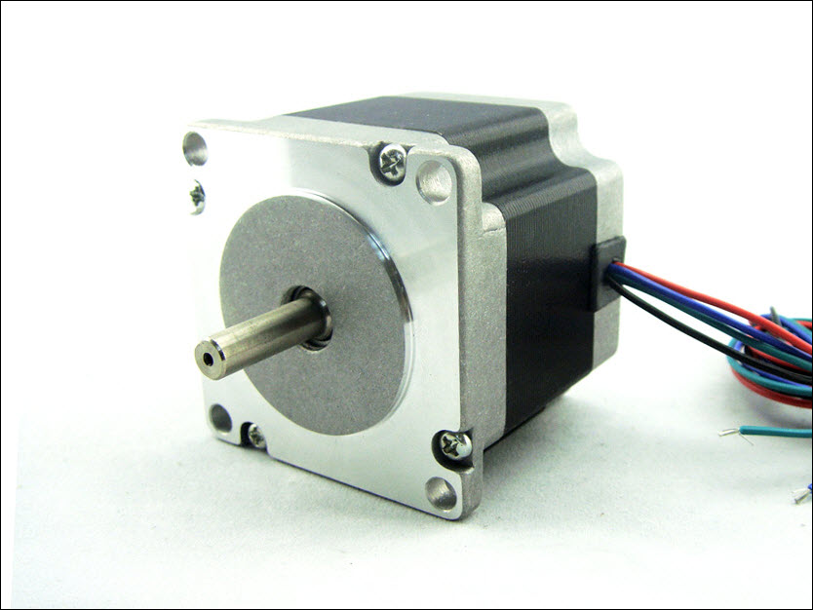
2. Bipolar Stepper Motor
We used the bipolar stepper motor to move the cross moving bar module along the x-axis.

Slide 9
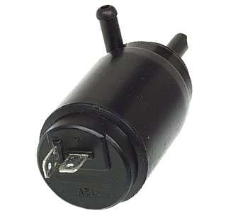
3. Pump

Slide 10
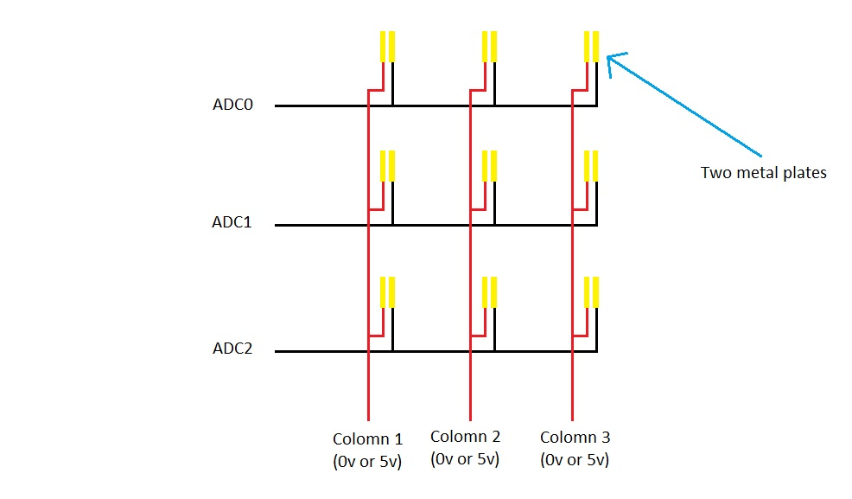
4. Sensors’ Matrix

Slide 11
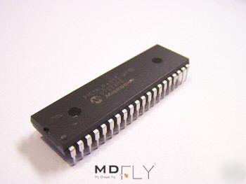
5. Microcontroller
We used Microchip PIC PIC18F4620

Slide 12
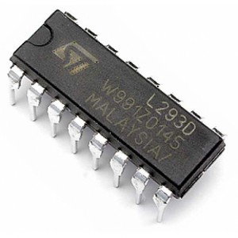
6. L293D (H-Bridge)
We connected the bipolar stepper motor with the PIC through by H-Bridge IC.

Slide 13
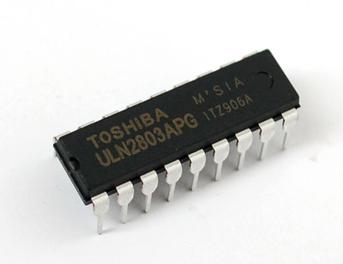
7. ULN2003A
We connected the Unipolar stepper motor with the PIC through the ULN2003A.

Slide 14
8. Model
We have constructed our model of light wood to lightness and it’s low cost.

Slide 15
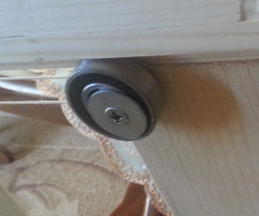
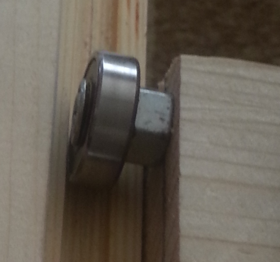
9. Bearings
We used 8 bearings, 4 of them are positioned vertically in order to achieve the x-axis movement. The other 4 bearings are positioned horizontally in order to avoid deflection and deviation.
Horizontal Bearing
Vertical Bearing

Slide 16
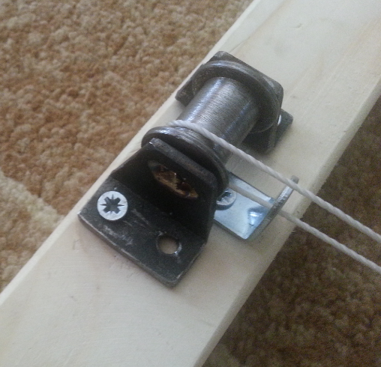
9. Poly and Rope
We used a customized poly in order to achieve low friction movement.

Slide 17




Software

Slide 18
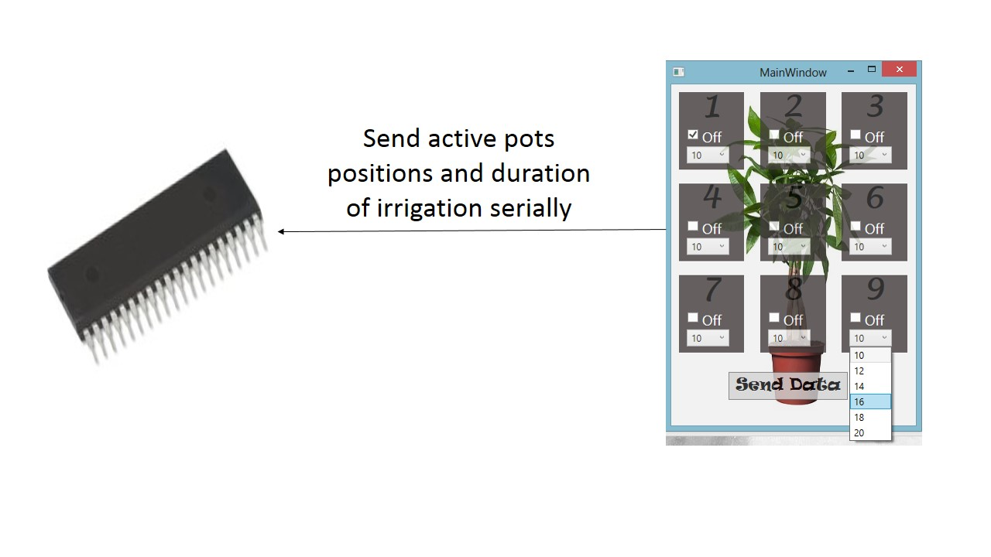
Workflow

Slide 19
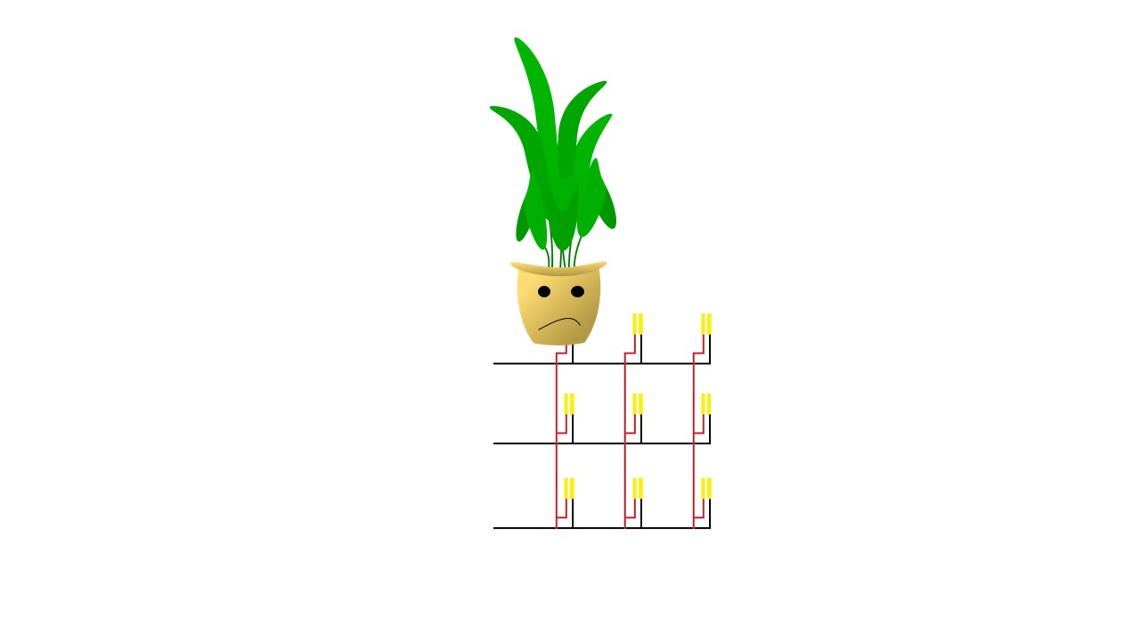
Workflow

Slide 20
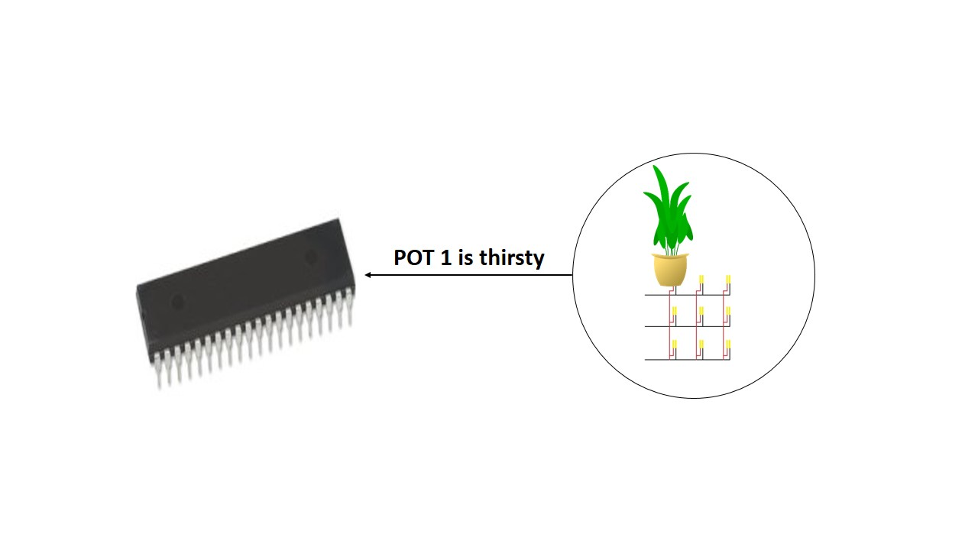
Workflow

Slide 21
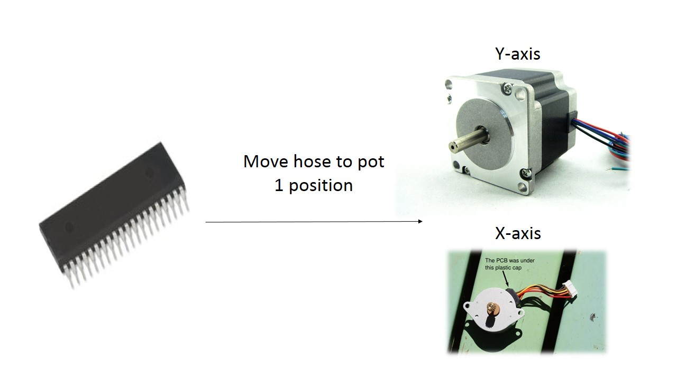
Workflow

Slide 22
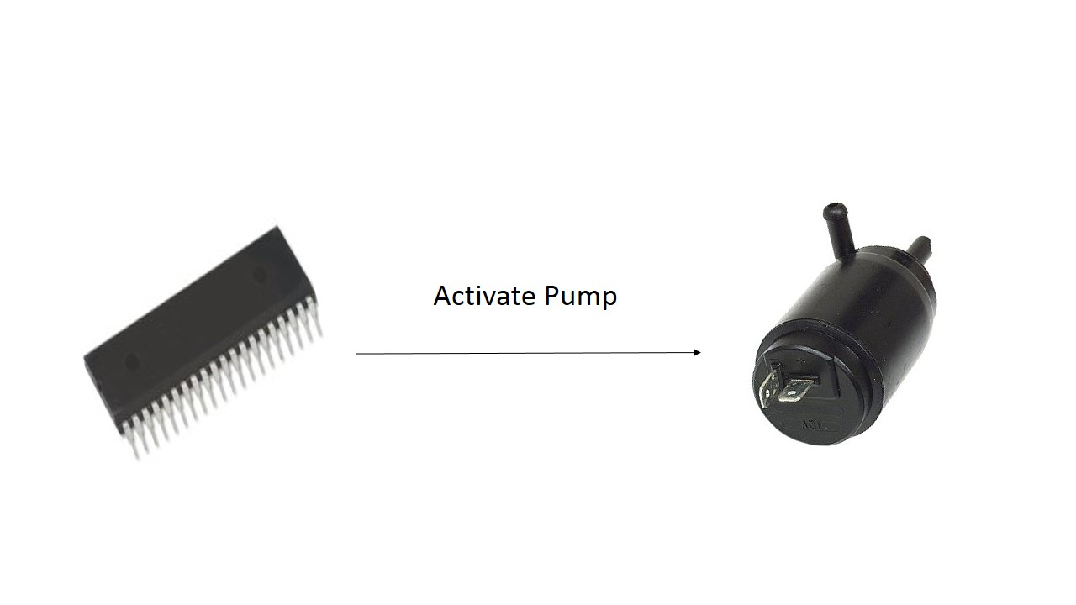
Workflow

Slide 23
Problems
Problem 1:
1. Cross beam movement
Since our first design depended only on 4 bearings (only the vertical bearings), the movement was deflective.

Slide 24
Solution
We used extra 4 bearings that helped us to make the movement of the beam totally straight without any deflection.

Slide 25
Problem 2
2. Rope friction
Because of the slippery movement of the rope on the poly and hence a lot of motor rotations that were wasted.

Slide 26
Solution
By installing a rubbery piece on the stepper, the rope has a very good friction and so perfectly efficient movement without any wasted rotations of the motor.

Slide 27
Problem 3
Sensor matrix
Soil moisture sensors available in the market cost 100$.
We need 9 sensors so 900$ was a very expensive solution .

Slide 28
Problem 3
Sensor matrix
Soil moisture sensors available in the market cost 100$.
We need 9 sensors so 900$ was a very expensive solution .
100$

Slide 29
Problem 3
X 9
Sensor matrix
Soil moisture sensors available in the market cost 100$.
We need 9 sensors so 900$ was a very expensive solution .
900$

Slide 30
Solution
We invented our own sensors using a very cheap material (row printed circuit board) so the total cost of the 9 sensors was almost 2$ instead of 900$.

Slide 31
Solution
We invented our own sensors using a very cheap material (raw printed circuit board) so the total cost of the 9 sensors was almost 2$ instead of 900$.
2$

Slide 32
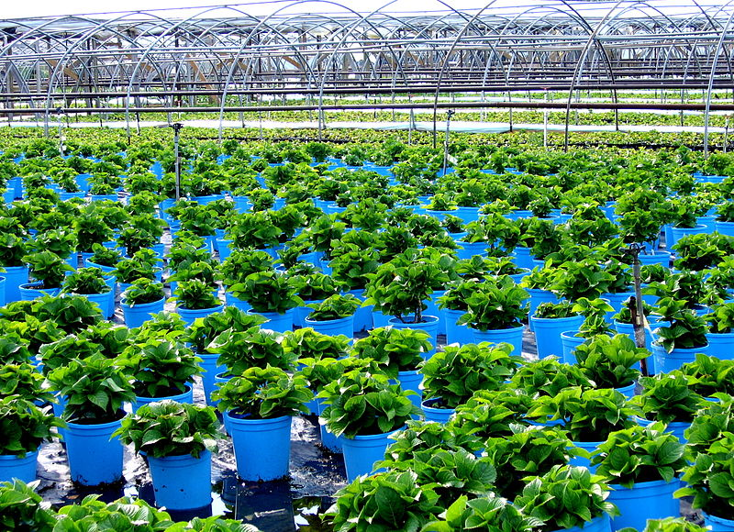

Future work
Turn it into business
Scale it to have larger customer segment

