Slide 1
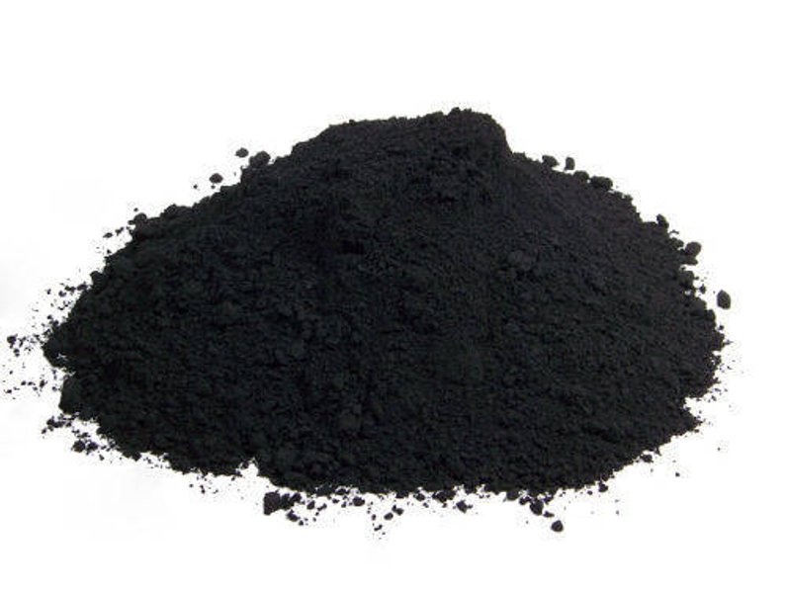
Removal of Organic Pollutants from Wastewater using Silica-Embedded Metal Oxide Nanoparticles
Group Members
Assala Hanoun
 Dua‘aGhanem
Supervisor:
Dr. Amjad El-Qanni

Slide 2

Outline
Introduction
Phenol risks
Synthesis of the nanoparticle
characterization of the nanoparticles
Calibration curve
Adsorption isotherms
pH effect
Kinetics study
Thermodynamics Studies

Slide 3

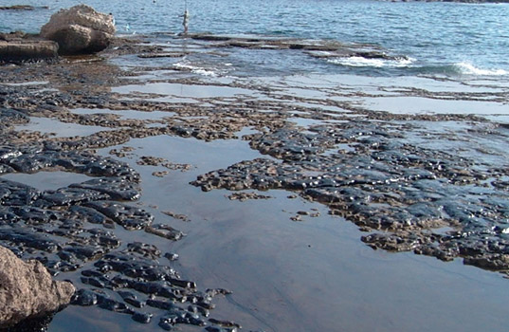
Introduction
As a result of the rapid development of the chemical and petrochemical industries, the surface and ground waters are polluted continuously by various organic and inorganic chemicals such as; phenolic compounds, organic dyes, heavy metals, and many other undesired wastes.
Phenol and its derivatives are considered
as noxious pollutants because they are
toxic and harmful to living organisms even
at low concentrations.

Slide 4

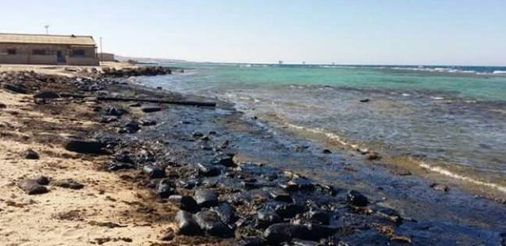
Phenol risks
The utilization of phenol-contaminated water causes protein degeneration, tissue erosion, paralysis of the central nervous system and also damages the kidney, liver and pancreas in human bodies
According to the recommendation of the World Health Organization (WHO), the permissible concentration of phenolic contents in potable waters is 1 μg/L.
the removal of phenols from water and wastewater
bodies is an important issue in order to
protect public health and the environment.

Slide 5
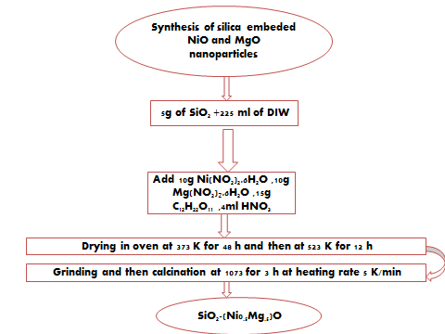
Adsorbent

Slide 6
Characterization of the nanoparticles
X-ray diffraction (XRD), Brunauer-Emmett-Teller (BET) were used for the characterization of the surface of the prepared nanoparticles. The XRD results show that the crystalline domain size equals to 13 nm, while the specific surface area is 48 m2/g.

Slide 7
Calibration curve

Slide 8
Adsorption Experiments
Adsorption experiments were carried out as batch type. The aim of these experiments was to determine the effect of important variables on the adsorption, such as the pH effect of the Adsorbate , time, initial phenol concentration, and temperature.
The studies are :
Isotherm study
Kinetic study
pH effect
Thermodynamic study

Slide 9
Adsorption isotherms
Different diluted concentrations of mother solution were prepared at constant pH (7.4).
5 ml of each concentration was put in special vial.
0.05 mg of silica-embedded NiO/MgO nanoparticles was added to each vial.
vials put in the shaker for 3 hours at temperature (25℃).
Then put them in centrifuge for 10minutes.
COD test was done for vials of phenol with nanoparticles.

Slide 10

pH effect
80ppm concentration was diluted from mother solution.
Many vials were prepared, each vial contain 5ml of 80ppm concentration of phenol and different value of pH.
0.05 mg of silica-embedded NiO/MgO nanoparticles was added to each vial.
Vials put in the shaker for different times at temperature (25℃).
Then put them in centrifuge for 10minutes.
COD test was done for vials of phenol with nanoparticles.

Slide 11

Kinetics study
80ppm concentration was diluted from mother solution, the pH of concentration was 7.6.
Many vials were prepared, each vial contain 5ml of 80ppm concentration of phenol.
0.05 mg of silica-embedded NiO/MgO nanoparticles was added to each vial.
Vials put in the shaker for different times at temperature (25℃).
Then put them in centrifuge for 10minutes.
COD test was done for vials of phenol with nanoparticles.

Slide 12
Thermodynamics Studies
80ppm concentration was diluted from mother solution, the pH of concentration was 7.6.
Many vials were prepared, each vial contains 5ml of 80ppm of phenol.
0.05 mg of silica-embedded NiO/MgO nanoparticles was added to each vial.
vials put in the shaker for different at temperature (25℃, 35℃ .45℃).
Then put them in centrifuge for 10minutes.
COD test was done for vials of phenol with nanoparticles.

Slide 13

Result and Discussion

Slide 14
Adsorption isotherm
The results of the adsorption of phenol onto the nanoparticle at different initial concentrations are given in table below
C₀ (g/L) | Ce (mg/L) | mass (g) | volume (L) | Q_{exp} (mg/g) | R% | T (K) | T (min) | C_{e}/Qe | Qmax (mg/g) | KL (L/g)
20 | 0 | 0.0519 | 0.005 | 1.92 | 100 | 298 | 180 | 0 | 3.71 | 0.95
60 | 25 | 0.0505 | 0.005 | 3.465 | 58.333 | 298 | 180 | 7.21
80 | 43 | 0.0506 | 0.005 | 3.656 | 46.25 | 298 | 180 | 11.76
100 | 64..5 | 0.0506 | 0.005 | 3.507 | 35.5 | 298 | 180 | 18.38
120 | 82 | 0.0502 | 0.005 | 3.784 | 31.666 | 298 | 180 | 21.66

Slide 15
The figure below shows A plot of the Langmuir isotherm equation for the phenol adsorption on the nanoparticle.

Slide 16
PH effect
The figure below shows the removal percentage related to the initial concentration along with different pH values

Slide 17
Kinetics study
The figure blow show s the change in the concentration of phenol at predetermined time intervals. As shown, the concentration of phenol dropped slightly during the first 10 mins, and remains approximately constant after 125 minutes

Slide 18
Thermodynamics study

Slide 19
Thermodynamic parameter for the adsorption of phenol onto SiO₂-(Mg_{0.5}Ni_{0.5}).
T | 1000/T | Q_{max} | KL | lnK_{L} | ∆G_{ads} | ∆S_{ads} | ∆H_{ads}
298 | 3.355704698 | 0.00105 | 950 | 6.856462 | -16987.4 | -84.63 | 42.201
308 | 3.246753247 | 0.00433 | 540 | 6.291569 | -16110.9
318 | 3.144654088 | 0.00592 | 325.5 | 5.785362 | -15295.6

Slide 20

Conclusions
this project, the adsorption of phenol on SiO₂-(Mg_{0.5}Ni_{0.5}) was investigated. The adsorption isotherms were also determined and were appropriately described by the Langmuir adsorption model. The phenol adsorption rate was fast and equilibrium was achieved within times of less than 30 min. In addition, the optimum pH where we have the highest removal was at 7. And the increase in temperature has a positive effect. So, it is understood that the adsorption reaction is an endothermic reaction. According to the parameters from thermodynamics study , the negative ΔG◦ values indicated that the adsorption of phenol was feasible and spontaneous, the negative value of ΔH◦ confirmed the endothermic nature of adsorption. The negative value of ΔS◦ suggested the decreased randomness at the solid/liquid interface during the adsorption of phenol.
The experimental results indicated that the SiO₂-(Mg_{0.5}Ni_{0.5}) can be successfully used for removal of phenol from aqueous solutions.

Slide 21

Questions

