Slide 1
Faculty of engineering
Civil engineering
Project name:
House building
Prepared by:
asim salameh mohammad

Slide 2
Abstract
house building" is to be constructed in ramallah. It consists of four floor , the area of floor is 250m².
The structural elements are designed by manual (theoretical) then apply verification by sap.

Slide 3
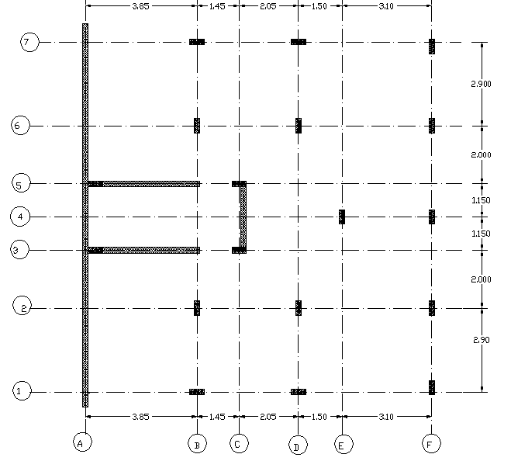
Abstract

Slide 4
Chapter One: Introduction
: Design objectives
The designed structure should sustain all loads and deformation within limits for construction use, and should be durable.
Design stages:
In this project, house building will be designed as static design.
considering gravity loads: live and dead loads and lateral loads from soil
design based on scientific knowledge.
On the other hand, in this structure we use hand calculations and compared with sap calculations.

Slide 5
Project Description:
Use a- bearing capacity of (4kg/cm²) is considered from visiting to the site and show the excavating and assessing the value of (q) .
Structural concept:
one-way ribbed slab system in the floors : this system is used because no heavy loads in the floor .Slab thickness of (25cm), blocks of (17cm) height and (40cm) width will be used, the web width is (12cm), and the flange thickness is (8cm).

Slide 6
Project Description:
Architecture description:
The building consists four floor , the ground floor including on basement wall and shear wall ,the shear wall remaining in the other floor , the area of each floor near 150 m²

Slide 7
Construction materials:
Unit weight of R.C= 25 KN/m³.
(fʹc)= 24MPa.
E_{c} = 23025 Mpa.
Yielding stress (F_{y}) = 420 Mpa.
Modulus of elasticity (Es) = 200GPa.
floor height=3.2m.
S.E.D=4Kn/ m^{2.}
weight of parameter (masonry)wall=19.7kn/m²

Slide 8
Codes and design methods :
the following methods and codes are used for design:
American Concrete institute (ACI-2008).
2.Ultimate strength method.

Slide 9
Loadings:
Vertical loads:
Dead loads:including the weight of the structural elements, (such as slabs, beams, columns, and foundations), and super imposed dead loads (SDL) .
Live loads: (LL) is considered to be (2.5KN\m²) because this building is house building .

Slide 10
Loadings:
horizontal loads:
Soil load : Soil load includes the soil pressure due to the soil on the basement walls.
Load combinations : we use in this design two combination
Wu= 1.2D.L+ 1.6L.L
Wu=1.2D.L+1.6L+1.6soil

Slide 11
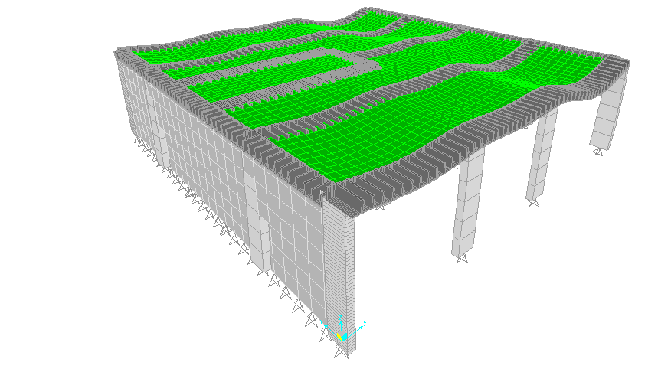
Loadings:

Slide 12
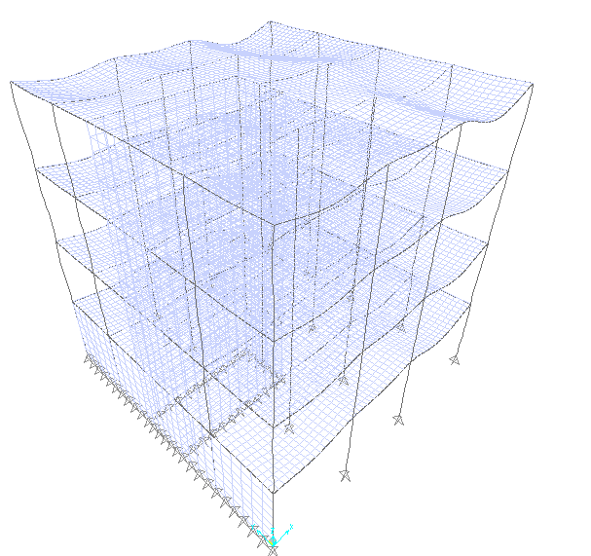
Loadings:

Slide 13
Check of equilibrium
Theoretical calculations:Dead Loads
Area of floor =11.95*12.10=145m²
Total dead load on slab =580+84.923+688.75=1354kn
DL from column=134.4kn
DL from masonry =947.6kn
Dl from staircase shear walls=290.4kn
Dl from basement walls=290.4kn
∑Dl(final)= 3016.8 KN
Live Loads:Live load=2.5KN\m²
=2.5*145=361.5kn
∑LL=361.5kn
Sap calculations:
dead load=2963 KN and live load=361.5 KN
The percentage of dead load error=(1.78%)<(5%) ok
The percentage of live load error = (0%)<(5%) ok

Slide 14
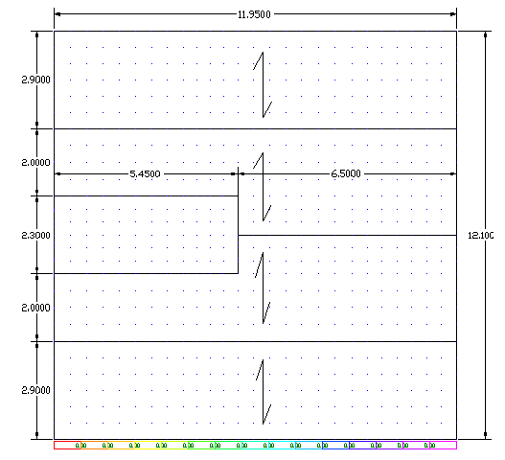
Preliminary design:
One way ribbed slab :

Slide 15
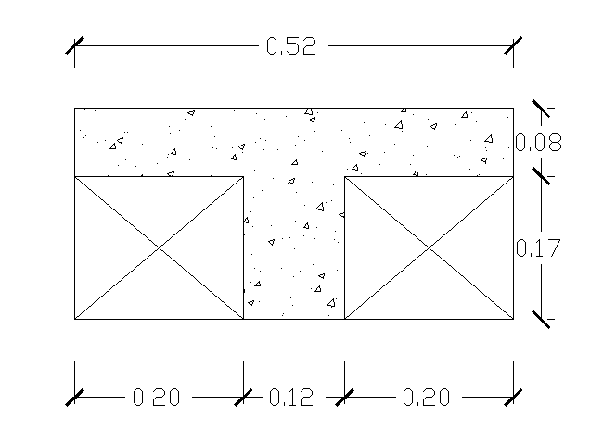
Design of slab:
One way ribbed slab :

Slide 16
Design of slab:
One way ribbed slab :
Use slab thickness h=25cm
Use concrete blocks of 40*20*17cm.
Dimension of ribbed slab = 25*52 cm.
Width of rib = 12 cm. f′c= 24 mpa.
Fy = 420 mpa
Wdslab =2.37KN\m.=2.37/0.52=4.55kn/m^{2.}
^{Total S.E.D.=}2.88+1.125=4kn/m²
Wd=4.55+4=8.55 KN\m²
WL=2.5KN\m²
Wu=1.2*8.55+1.6*2.5=14.26KN\m²
Wu=14.26*0.52=7.42KN\m
Considering the cover to be 3 cm
d=22cm

Slide 17
Use slab thickness h=25cm
Use slab thickness h=25cm
Use slab thickness h=25cm
Design of slab:
One way ribbed slab :
Max.negative moment=4.05 KN.m
p =1.87e-3<<pmin=0.0033
use p=0.00333
As=0.0033*120*220=88 mm^{2.}
As=2ø10(top)
Max.positive moment=2.8KN.m
P =1.42e-3<<pmin=0.0033
use p=0.00333
As=0.0033*120*220=88 mm²
As=2ø10(bottom)

Slide 18
Design of slab:
Check of shear:Max.Vu
Vu=1*Wu*Ln\2=1*7.42*2.45\2=9.1 KN
øVc=(1.1*0.75*(1\6)*120*220*√24)\1000=17.8 KN
Vu< øVc(no need for stirrup)
As shrinkage=0.0018*1000*80=144mm²\m
Max.spacing=min(5h or 30cm)=(40 or 30)cm
As_{(shrinkage)} =1ø8\30cm

Slide 19
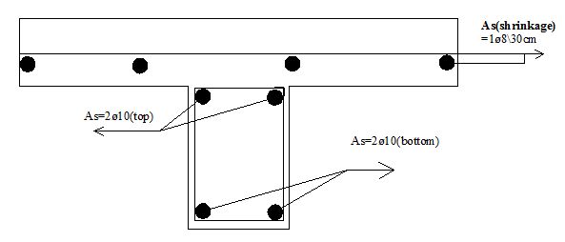
Design of slab:

Slide 20
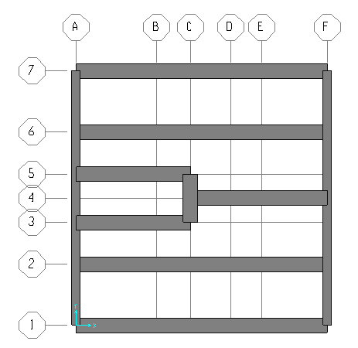
Design of beams:

Slide 21
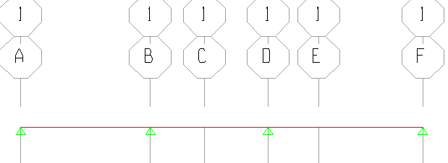
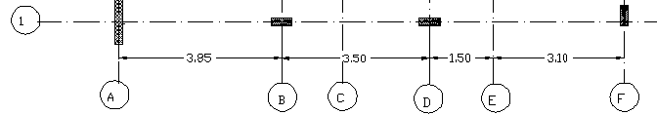
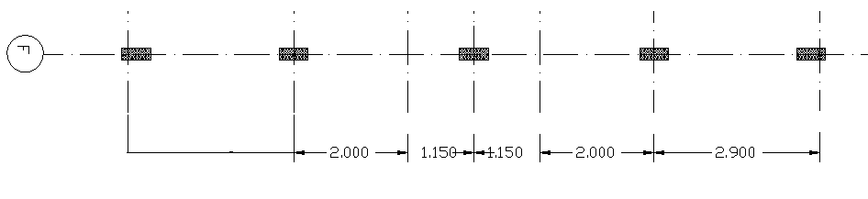
Design of beams:

Slide 22
Design of beams:
From table 9.5(a):
h_{min} = L_{n}\18.5 = 4.2/18.5 =23 cm
use h=25cm
beams (1,2,3,4,5,6 and 7)→use h=25cm ,b=70cm.
beam (a and f)→use h=25cm ,b=40cm.
Wu on slab=14.26 KN\m^{2.}
weight of parameter (masonry)wall=19.7kn/m²

Slide 23
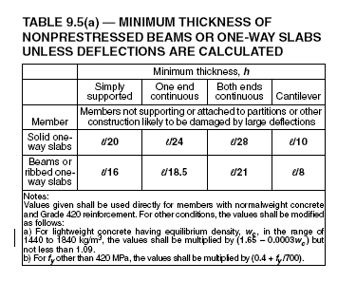
Design of beams:

Slide 24
Design of beams:
For beam # 1:
H=25cm b=70 cm
Own weight=4.375KN\m
Wu =47.6 KN\m
Max.positive moment= Wu*L_{n}²\14=60 KN.m
p=0.00493 As=758.8mm² use4ø16
Pmin=0.00333<0.00493
Max.negative moment= Wu*L_{n}²\10= 84 KN.m
p=0.00706 Pmin=0.00333<0.00706
As=1087.45mm² As=6ø16

Slide 25
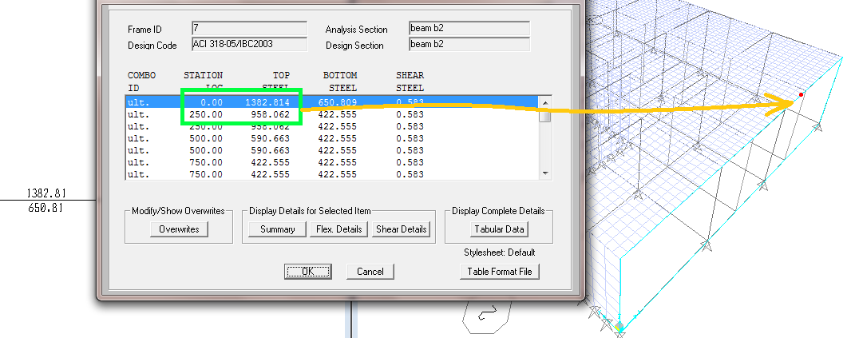
Design of beams:
:Sap results
Max top area of steel =1009mm2(sap)
%error(top steel)=((1009-1087.48)\1087.48)=7%
Max bottom area of steel =781mm2(sap)
%error(top steel)=((781-759)\759)=3%

Slide 26
Design of beams:
For beam # 2:
H=25cm b=70 cm
Own weight=4.375KN\m
Wu =37.5 KN\m
Max.positive moment= Wu*L_{n}²\14=47.3 KN.m
Max.negative moment= Wu*L_{n}²\10= 66.2 KN.m
p=0.0055 Pmin=0.00333<0.0055
As=842mm² As=5ø16 or 6ø14
For beam F:
weight of parameter (masonry)wall=19.7kn/m^{2.}
H=25cm b=40 cm
Own weight=2.5KN\m Wu=31.1 KN\m
Max.+Ve moment=12.6kn.m
Max.negative moment=18.4kn.m
As=3ø12

Slide 27

Design of beams:
Check for shear:
for beam 1:
Wu=47.6kn/m
Max. Vu = 1.15Wu*L_{n}\2= 115 KN.m
øVc=0.75*(1\6)*700*220*√24=94.3 KN
Vu at d= Vu-Wu*d = 104.5 KN
, check if Vs<(2/3)(fc^0.5)bw <502kn the cross section is large enough
Vs≤ (1/3)bw d≤251.5kn
VS=Vn-Vc=13.67 Kn
Smax.= min. ( d/2 , 60cm )
= min(110,600)
=110mm
assume d=8mm
Av=2*лd²/4=100.53
s≤679.5mm
Use s =11 cm. Av\s=1ø8\17.5cm

Slide 28
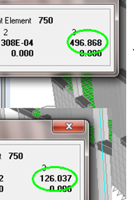
Design footing:
we choose critical footing to design it and check dimensions in this stare we design the footing to tolerate the load from four roof:
Pd=497kn.
LL=126.04KN.
ult.=797.9kn.
footing area=Pactual/q=(496.9+129.04)/400=1.565m².
square footing=B*L=1.25*1.25m
assume L=1.5m. b=1.2

Slide 29
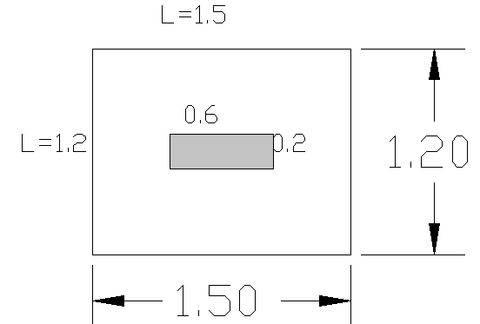

Design footing:

Slide 30
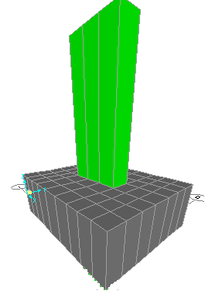
Design footing:
ΦVc=263.3kn pu=828.544kn.
qu=Pu/Af=828.544/1.8=460.3kn/m.
Vu=qu*(L-d)=246.3kn<263.3kn.
vup=Pu-quA ̥=529.32kn
ΦVcp=1939kn>529.32kn. Ok
From sap:
desplacement=0.0073m<0.01m ok.

Slide 31
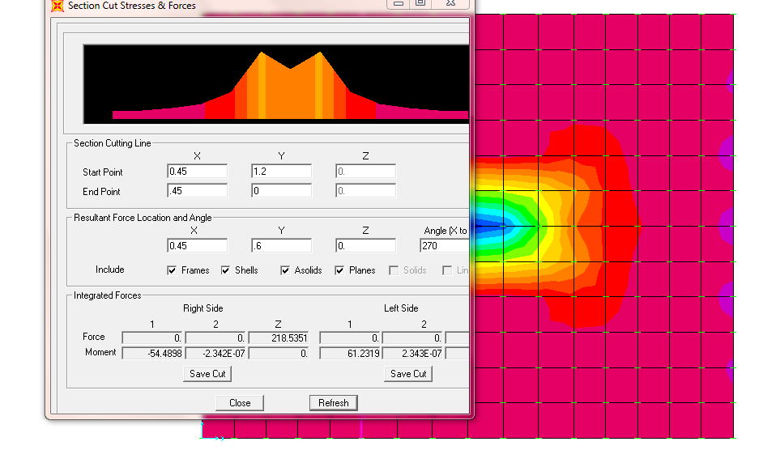
Design footing:
M11:moment in x direction =61 KN.M
p =7.32*e-4
use Pmin=0.0018
Use As= 6Φ14

Slide 32
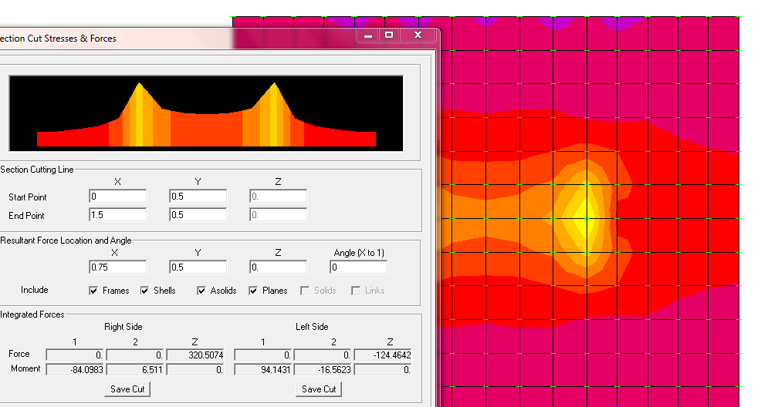
Design footing:
M22 moment in Y direction =94 KN.M
p =9*e-4
use Pmin=0.0018
use 8Φ14

Slide 33
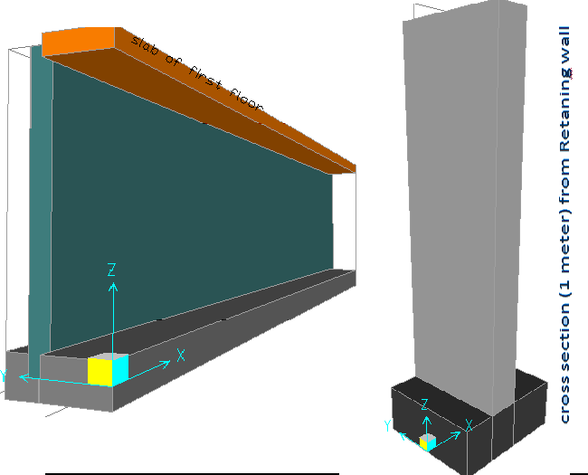
Basement wall:

Slide 34
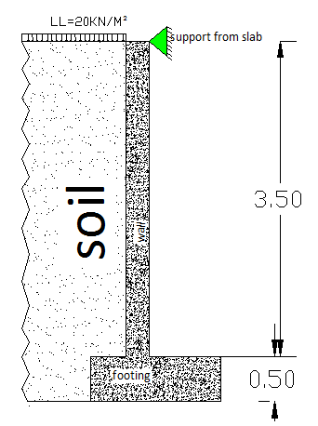
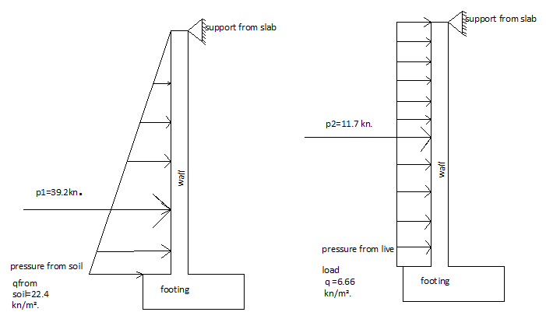
Basement wall:

Slide 35
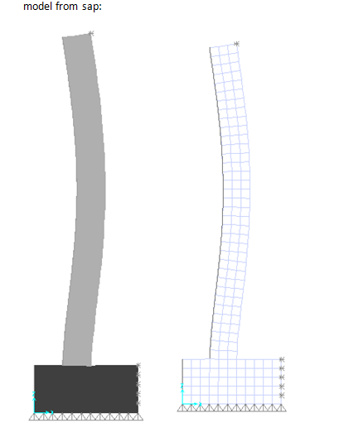

Slide 36
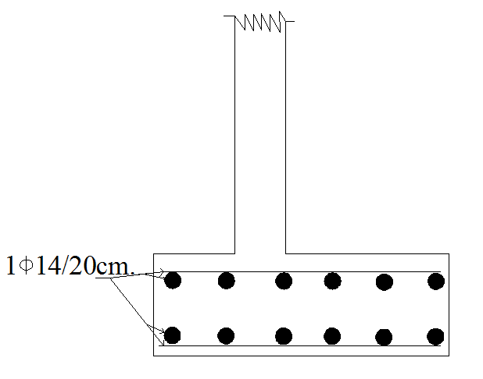
design for flexure:
Bottom steel in Y direction
m22=moment for footing in y direction =1291kn.m
p =1.6e-3=0.0016<pmin=0.0018
bottom of As/m=Pbd=0.0018*1000*430=774 mm² use 1Φ14/20cm.
Top steel in Y direction:
use Pmin=0.0018
As/m=Pbd=0.0018*1000*430=774 mm²
use 1Φ14/20cm.in top.
in X direction use As min.
use 1Φ14/20cm.
.

Slide 37
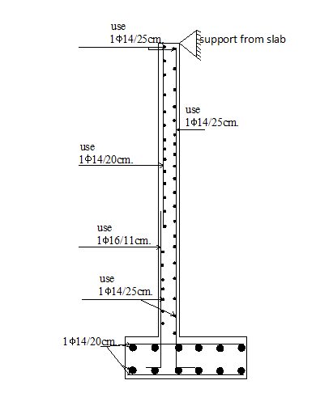
Basement wall:
Steel in the wall in Z direction:
d=210mm. M=1635.2kn.m
p =8.993e-3=0.009>pmin=0.0033
use P=0.009
use 1Φ16/11cm.
As at support at z=3.5m→use As(min)
1Φ14/25cm but I want use 1Φ14/20cm.
For positive moment :
Mu=552kn.m use 1Φ14/25cm.
Steel in the wall in X direction:
Mu=72kn.m d=210mm b=3000mm.
p =1.45e-3=0.0016<pmin=0.0033
use 1Φ14/25cm.

Slide 38
.
Thank you

