Slide 1
Design of sewage networks and WWTP for ASIRA AL-SHAMALYA village
Prepared by :
AHMAD JOMAA
SALAM SALAMA
SALEH HASSON
Submitted to : Dr. HAFEZ SHAHEN

Slide 2
Introduction
Water is the most essential element to live on earth which must be provided to all human beings. Keeping water healthy and clean needs designing and continuous monitoring besides the need for disposing the wastewater in a suitable way.
To be able to show the importance of this idea, we are going to design water network and wastewater network for asira Al-shamalya village.

Slide 3
Objectives
The main objectives of this project are:
To analyze the water consumption in the Asira al-shamaliya village.
To design a WDN under the current and future conditions.
To design a wastewater collection network.

Slide 4
The importance of the project
Most of people in the village are suffering from getting rid of wastewater, so in our project we can help people to get rid of the wastewater in more environmental friendly way by designing wastewater collection network.

Slide 5
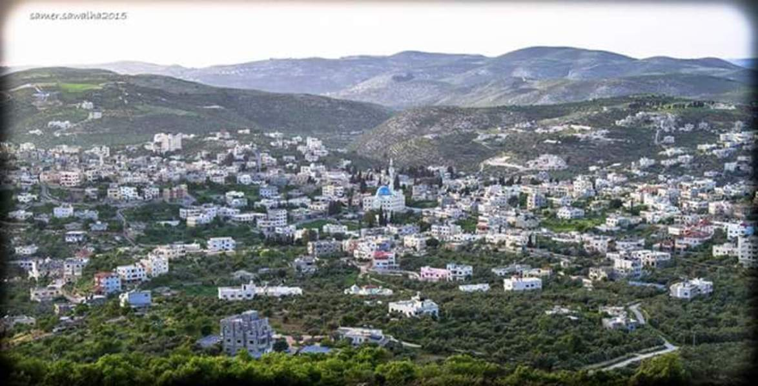
The Study Area : Asira al-shamaliya

Slide 6
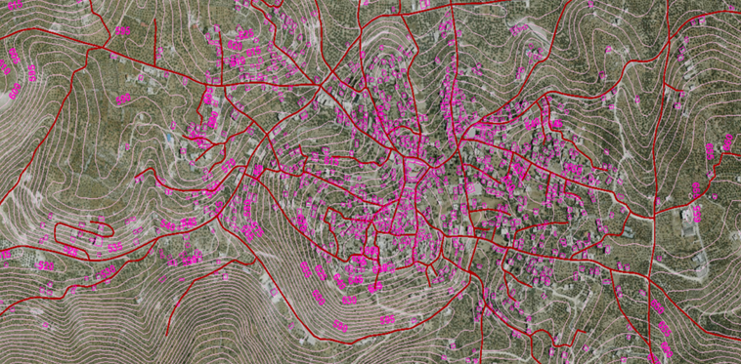
TOPOGRAPHY

Slide 7
TOPOGRAPHY
Maximum elevation = 665 m above MSL
Minimum elevation =510 m above MSL

Slide 8
AREA AND LAND USE
The total area of Asira al-Shamaliya is 34,500 dunums, divided into 44 basins of which 29,300 dunums is agricultural land, the rest are non-agricultural lands, pastures and forests.

Slide 9
DATA COLLECTION
Boundary of the study area.
Contour map
Roads network
Building map
Population number

Slide 10

Preparation of data
Calculation the Population
P2017 = 9371 ‘‘From the Palestinian Central Bureau of Statistics’’
r : Growth Rate
P(2050) = P2017 * (1+r )^n
P(2050) = 9371 * (1 + 0.024)^33 =20497 .

Slide 11
Calculation of Sanitary Load
Demand = 100L /day .capita
Peak hourly factor = 2.7
Wastewater generation 80%
Load calculation = Wastewater generation + infiltration
Wastewater generation =
0.8 * 0.10 * 20497 * 2.7 = 4428 CM /day
Infiltration = 0.2 * 0.8 * 0.10 * 20497 = 328 CM / day
Sanitary load = 4428 + 328 = 4756 CM / day

Slide 12
Sewer Collection Network
Combined Sewers
Sanitary sewer systems and Storm sewer systems .
Separate Sewers
1- Sanitary sewer systems collect and transport wastewater.
2- Storm sewer systems collect and transport stormwater runoff.

Slide 13
Equations used in SewerCAD
Design Period
Population
WWGF : Waste Water Generation Factor = (70 – 90) % .
Per capita consumption
Infiltration Flow
Unit Count

Slide 14
Draw the Network by SewerCAD program.
Length of conduit will not exceed 50 m.
Avoid making closed loops.
Putting manholes every intersection and curves

Slide 15
CONSTRAINTS
Velocity ( 0.6 – 3 )m/s.
Cover ( 1 – 5 )m.
Slope( 1 – 15 )%.

Slide 16
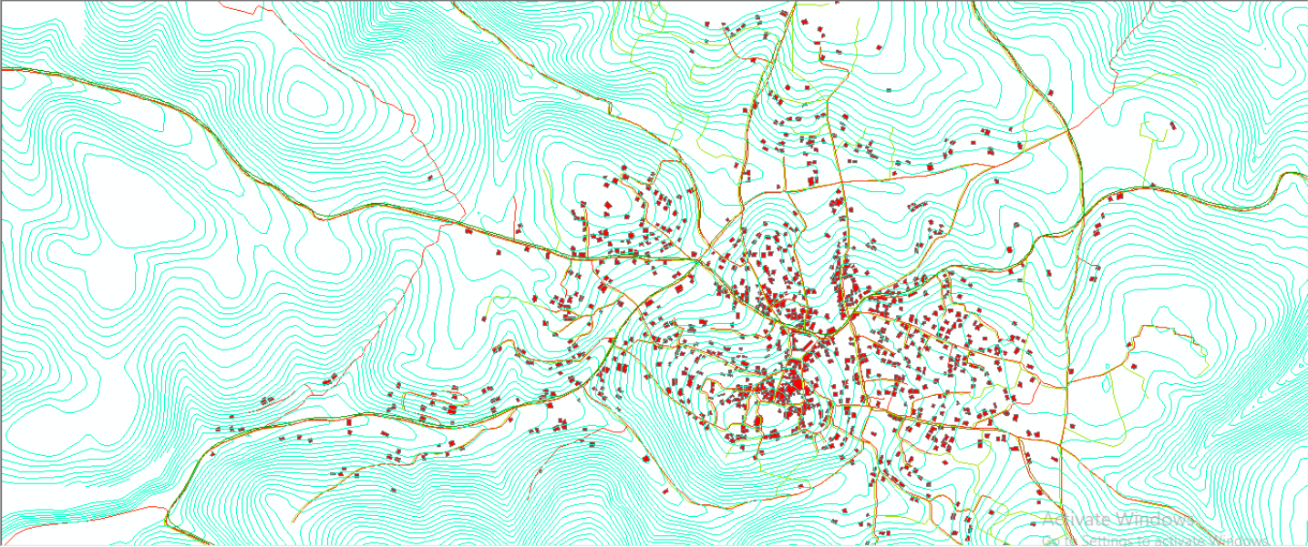
Draw the Network by SewerCAD program.

Slide 17
A questionnaire
We conducted a questionnaire for 60 people
large proportion of the population had more than five members family
32.8% consume from 9-12 cup per month
The only way to get rid of waste water is by absorbing cesspools, including what is deaf and the other outlet
And this presents groundwater and evaporation for pollution .

Slide 18
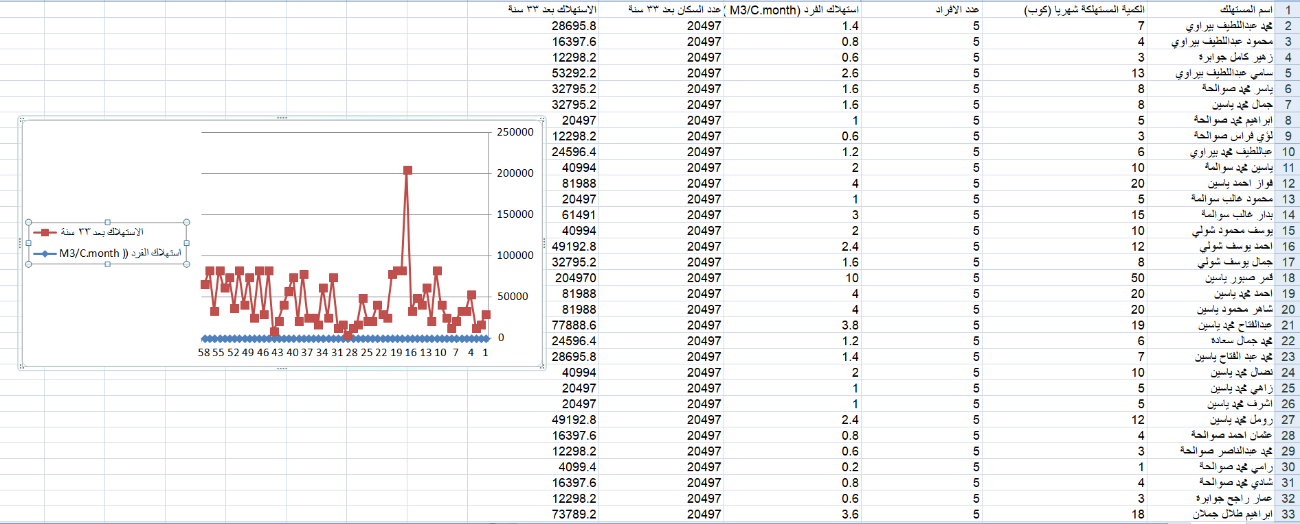
curve of the consumption

Slide 19
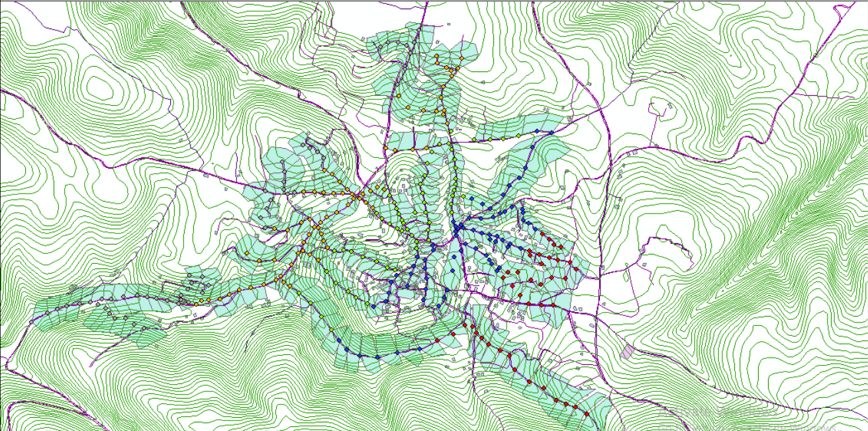
Allocating the area for each manhole
Allocating areas by ArcGIS programe.

Slide 20
Load on manholes
We base in calculation in the population base
So we need to calculate:
The population per each manhole
The Unit Load per manhole

Slide 21

Calculating the population per each manhole
population for each manhole(person) =
(Area covered by each manhole)*(population density)
the population density =

Slide 22

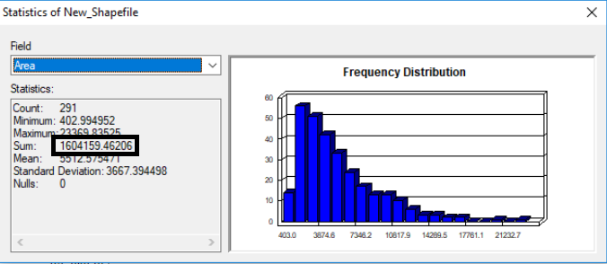
* Area covered per each manhole is evaluated using GIS (approximately), is equal to 1604159

Slide 23
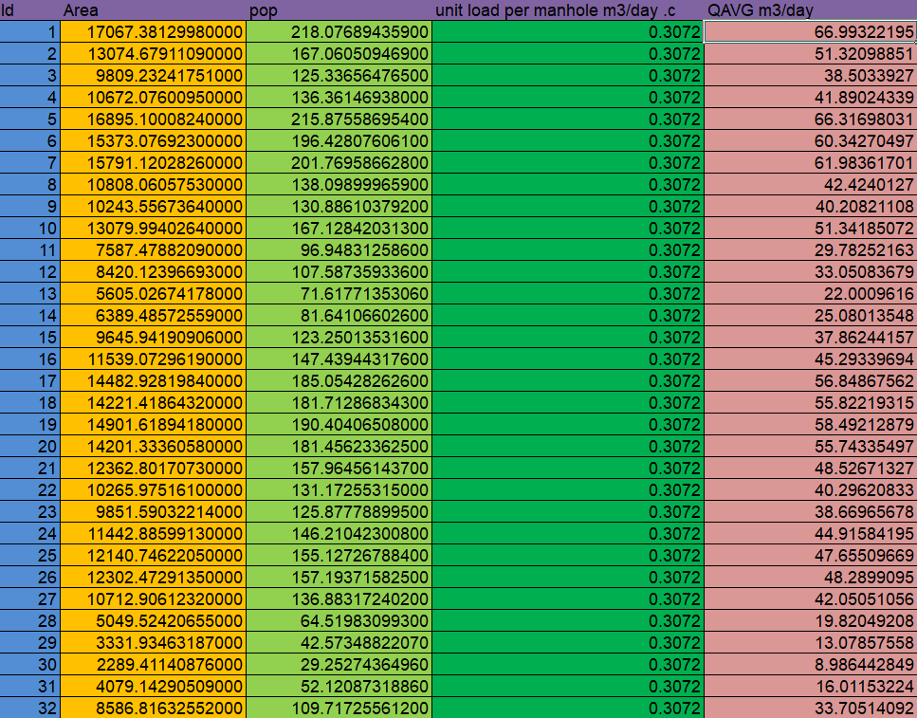
        The population per each manhole

Slide 24


Calculating the unit load per each manhole
Unit Load per manhole = (water consumption * % of wastewater generation*PHF)+ (water consumption * % of wastewater generation* infiltration)
Unit Load per manhole = 307.2 = 0.3072

Slide 25
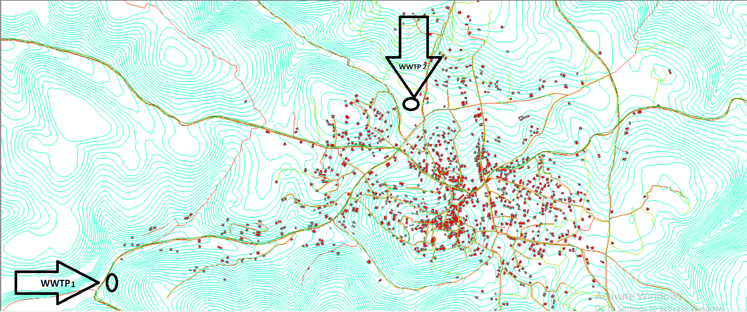
Layout the network
We have two outfalls in the area.

Slide 26
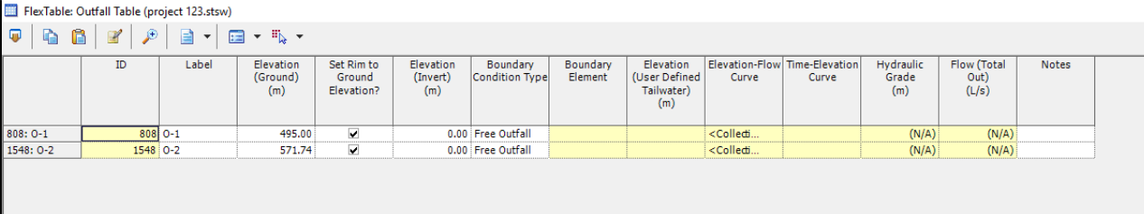
Out fall 1 Elevation = 495.0 m .
Out fall 2 Elevation = 571.74 m .

Slide 27
Conclusion:
- Our design is applicable and serviceable for the selected design period of 33 years.
if we decrease the diameter of the pipe the velocity increase , If we decrease the cover the slope increased and vice versa so we have to make sure to adjust the value of cover , slope and velocity within the allowable ranges as follow:
• Allowable cover range [1 – 5] m .
• Allowable velocity range [0.6 – 3] m/s.
• Allowable slope range [1 – 15] %..

Slide 28
Recommendation:
In the end ,we recommended going ahead with this project as soon as possible since this village suffers from waste water , so this village really need to it..

Slide 29
Thank you

