Slide 1
An-Najah National University
Faculty Of Engineering
Department Of Building Engineering
Graduation Project(2)
Redesign Of al-rahma medical clinic
Prepared By:
Ala’ honjol
Amal kharoub
Liana qabaha
Supervisor:
Eng. Fadi Fatayer

Slide 2
Contents
Site Analysis
Architectural Design
Environmental Design
Structural Design
Electrical Design
Mechanical Design
Safety Design
Total Cost

Slide 3
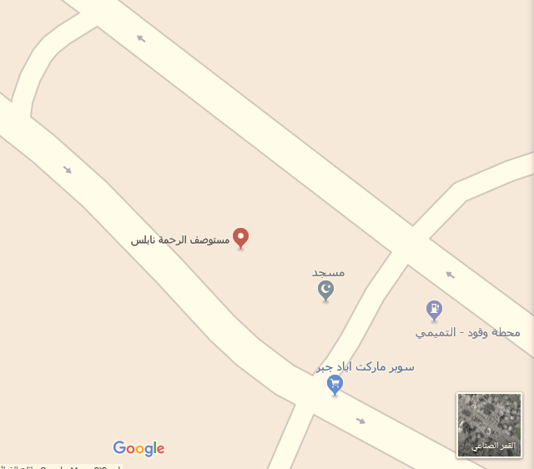
Site Analysis

Slide 4
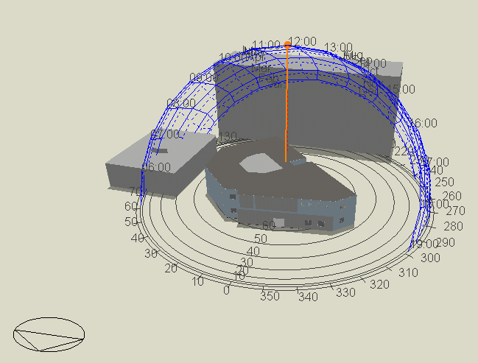
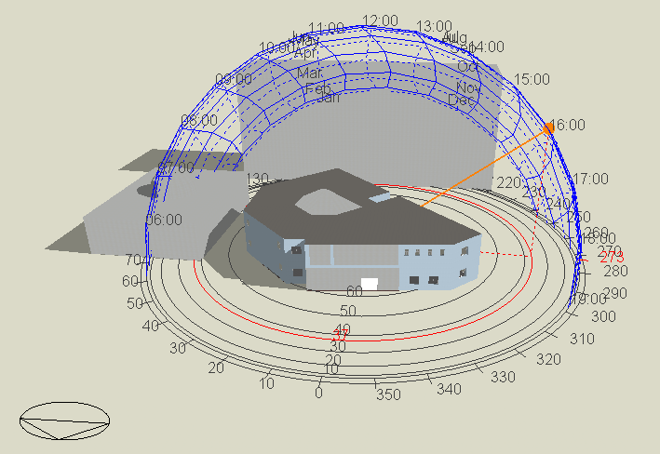
Site Analysis
Shadow in 21 July at 12pm
Shadow in 21 July at 4am

Slide 5
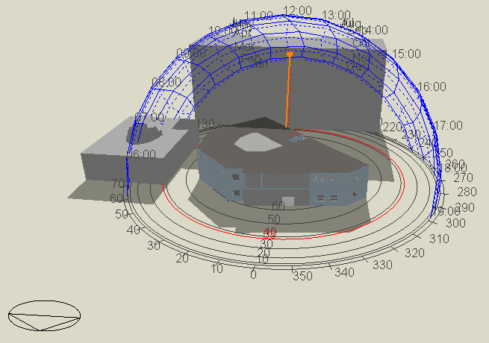
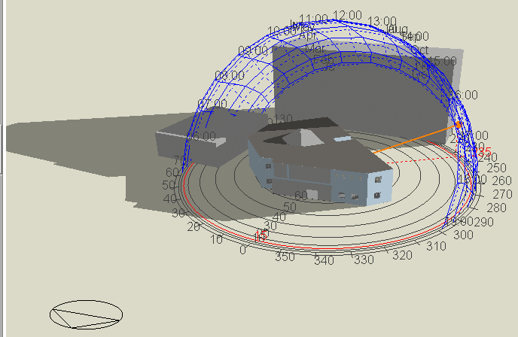
Site Analysis
Shadow in 21 January at 12pm
Shadow in 21 January at 4 am

Slide 6
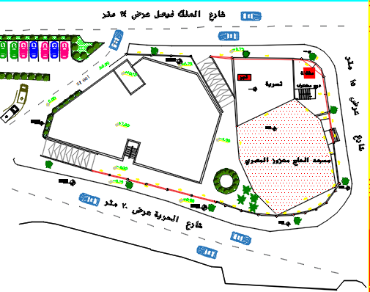
Site Analysis
N
Wind Direction

Slide 7
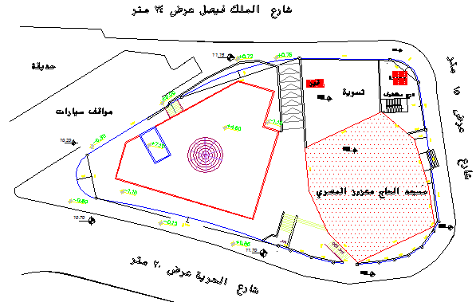
Architectural Design
N
Site plan before redesign
Site plan after redesign

Slide 8
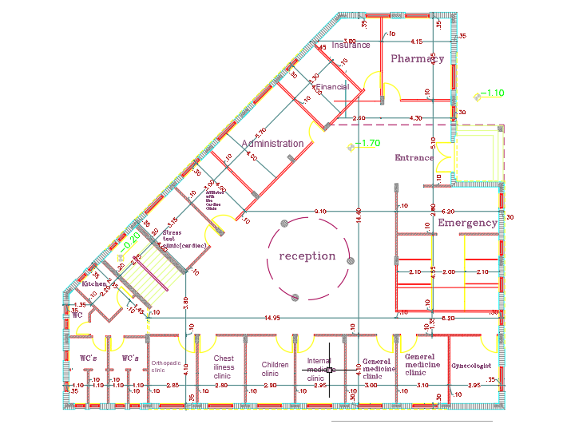
Architectural Design
basement Floor Plan Before Redesign

Slide 9
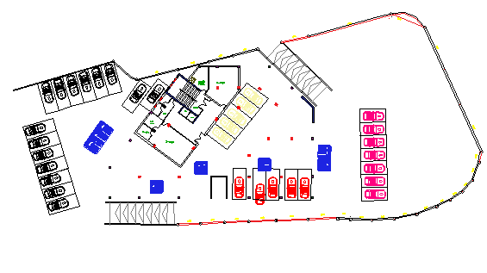
Architectural Design
basement Floor Plan after Redesign

Slide 10
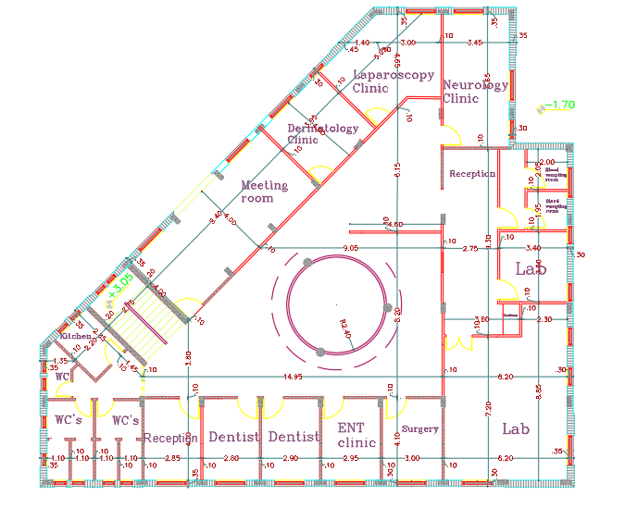
Architectural Design
ground Floor Plan before Redesign

Slide 11
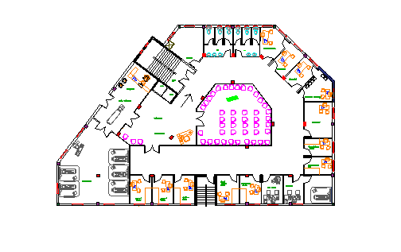
Architectural Design
ground Floor Plan after Redesign

Slide 12
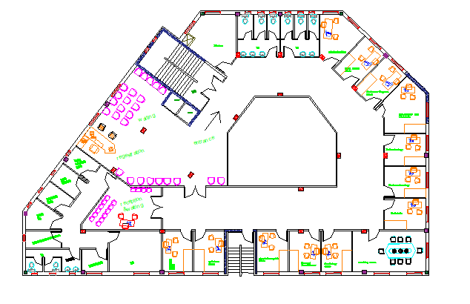
Architectural Design
first Floor Plan after Redesign(added)

Slide 13
Architectural Design
Comparison between old Al-Rahma center spaces, New design of medical clinic and standard.
Al-Rahma clinic after redesign |  |  |  | Al-Rahma clinic before redesign |  |  | standard
room | length(m) | width(m) | area(m^2) | length | width | area | length | width | area
Clinic | _ | _ | 12 | 4 | 3 | 12 | 4 | 3 | 12
Kitchen | _ | _ | 20 | 2.8 | 2.2 | 6.2 | 4.2 | 2.8 | 11.76
Waiting | _ | _ | 152 | _ | _ | 95 | _ | _ | _
Reception+ waiting | _ | _ | 222 | _ | _ | 150 | 19 | 12 | 228
Reception | 10 | 4 | 70 | _ | _ | 55 | _ | _ | _
W.C's | 2.4 | 1.4 | 3.36 | 2 | 2 | 4 | 2.4 | 1.2 | 2.9
Surgery | 6 | 4 | 24 | 4.1 | 3 | 12.3 | _ | _ | _
Pharmacy | 5 | 4 | 20 | 4 | 3 | 12 | _ | _ | 20.0

Slide 14
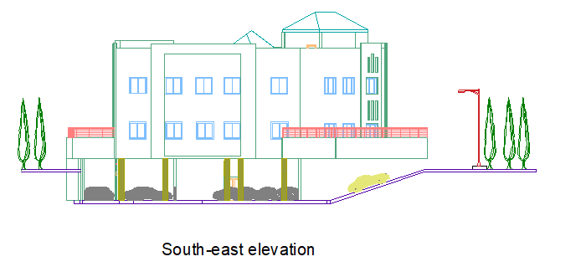
Architectural Design

Slide 15
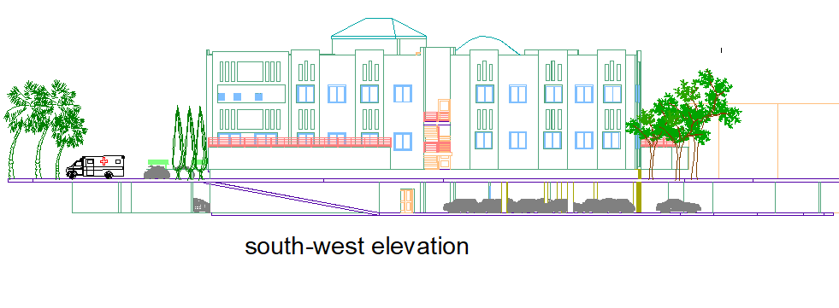
Architectural Design

Slide 16
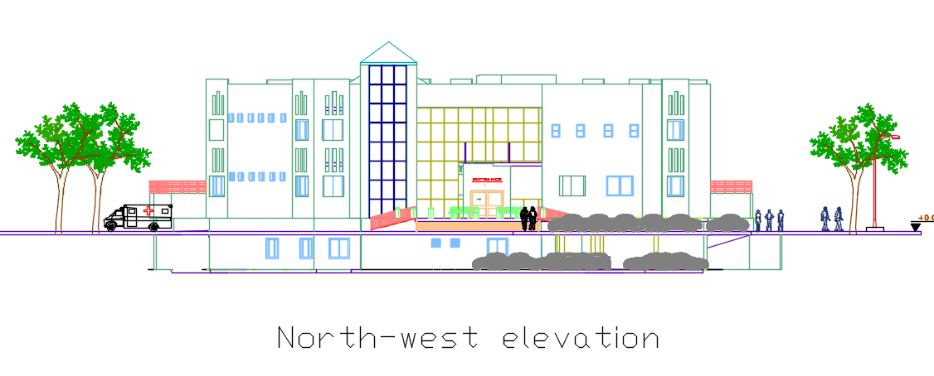
Architectural Design

Slide 17
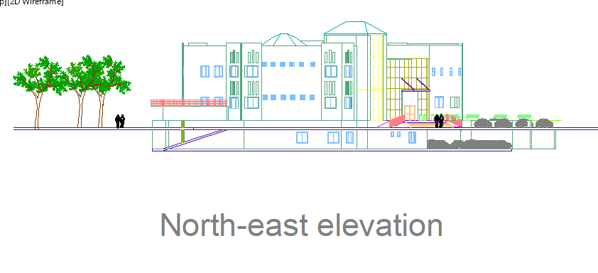
Architectural Design

Slide 18
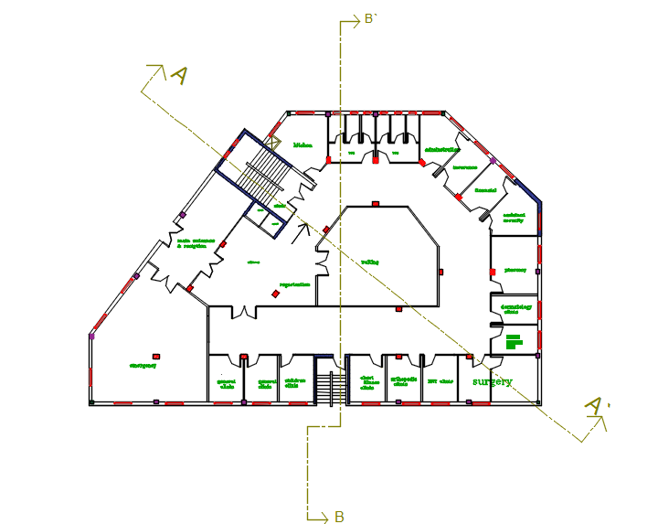
Architectural Design

Slide 19
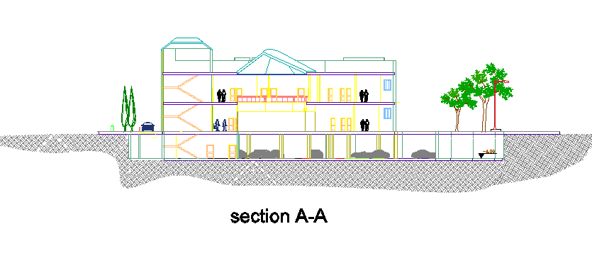
Architectural Design

Slide 20
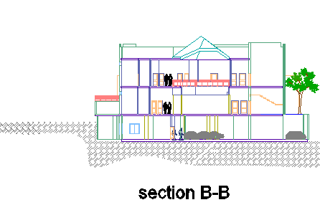
Architectural Design

Slide 21
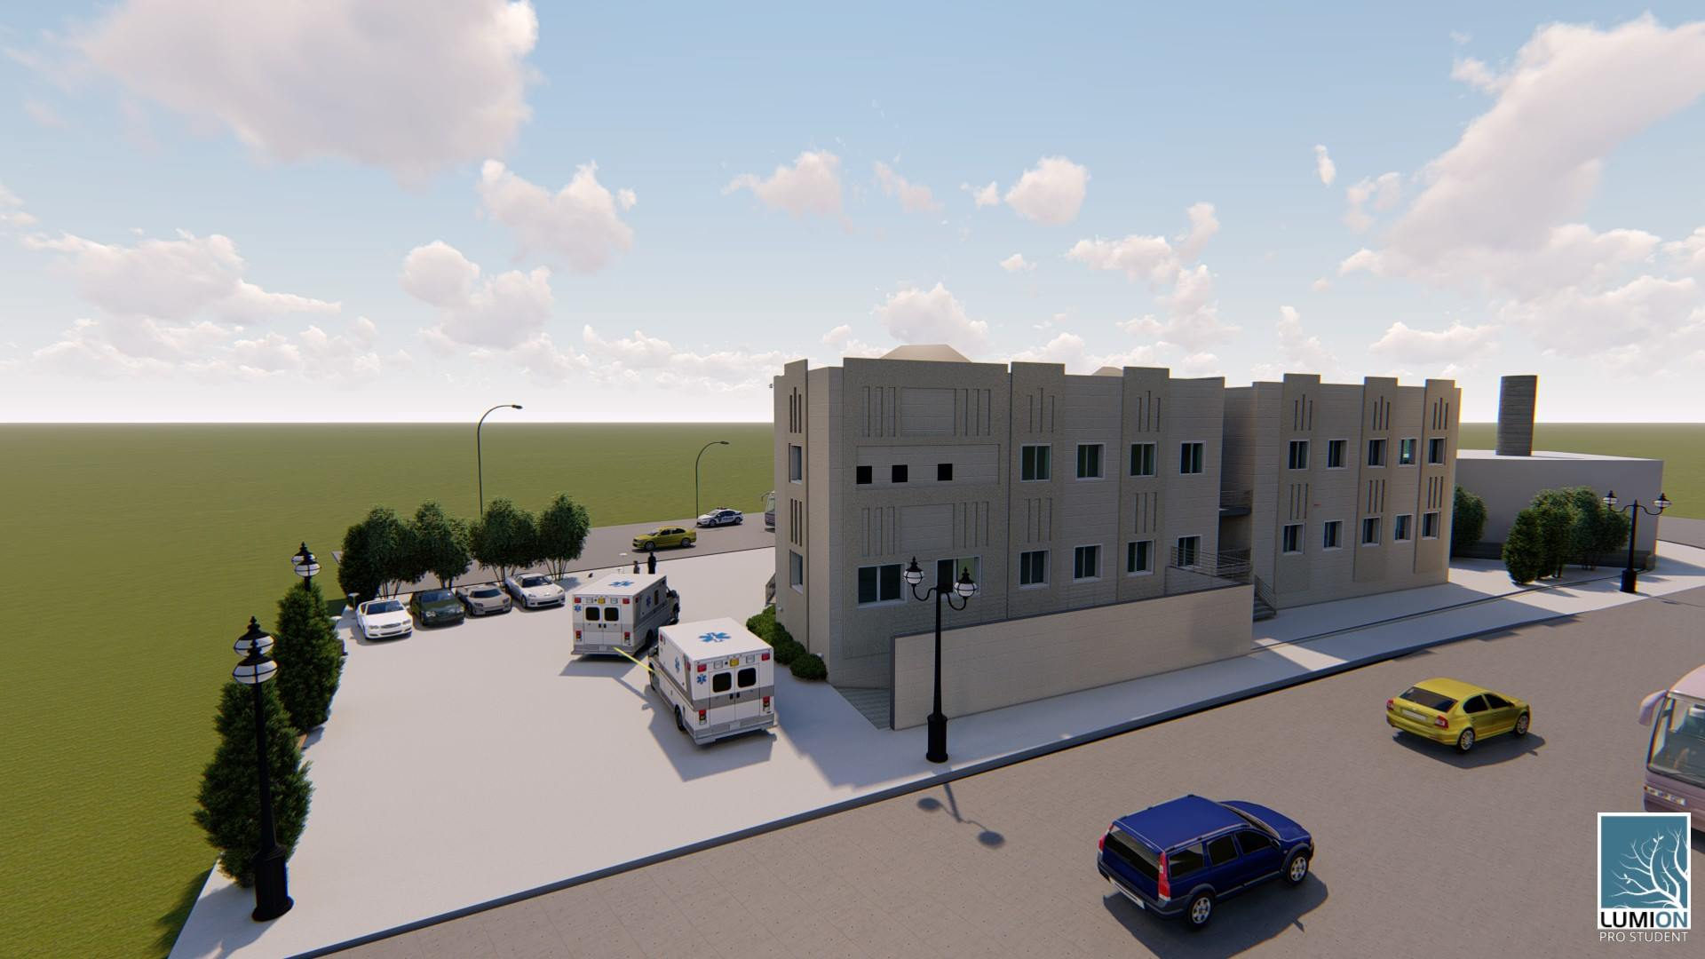
Architectural Design

Slide 22
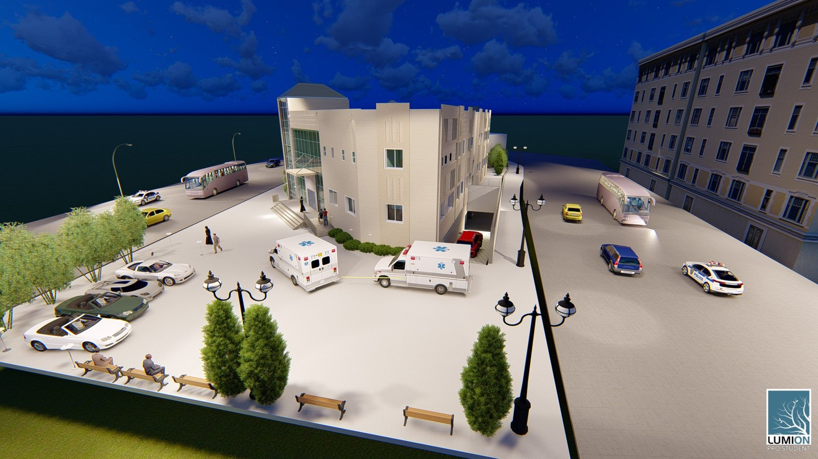
Architectural Design

Slide 23
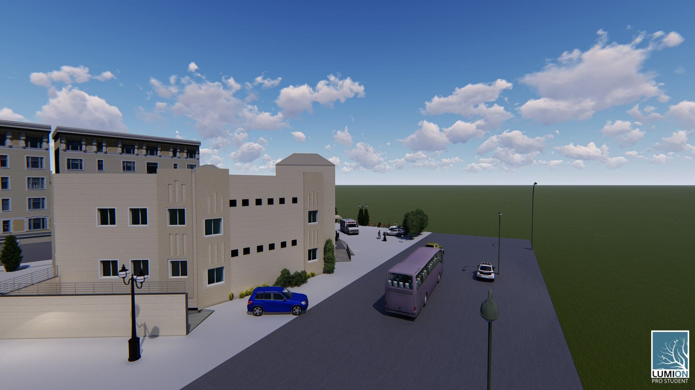
Architectural Design

Slide 24
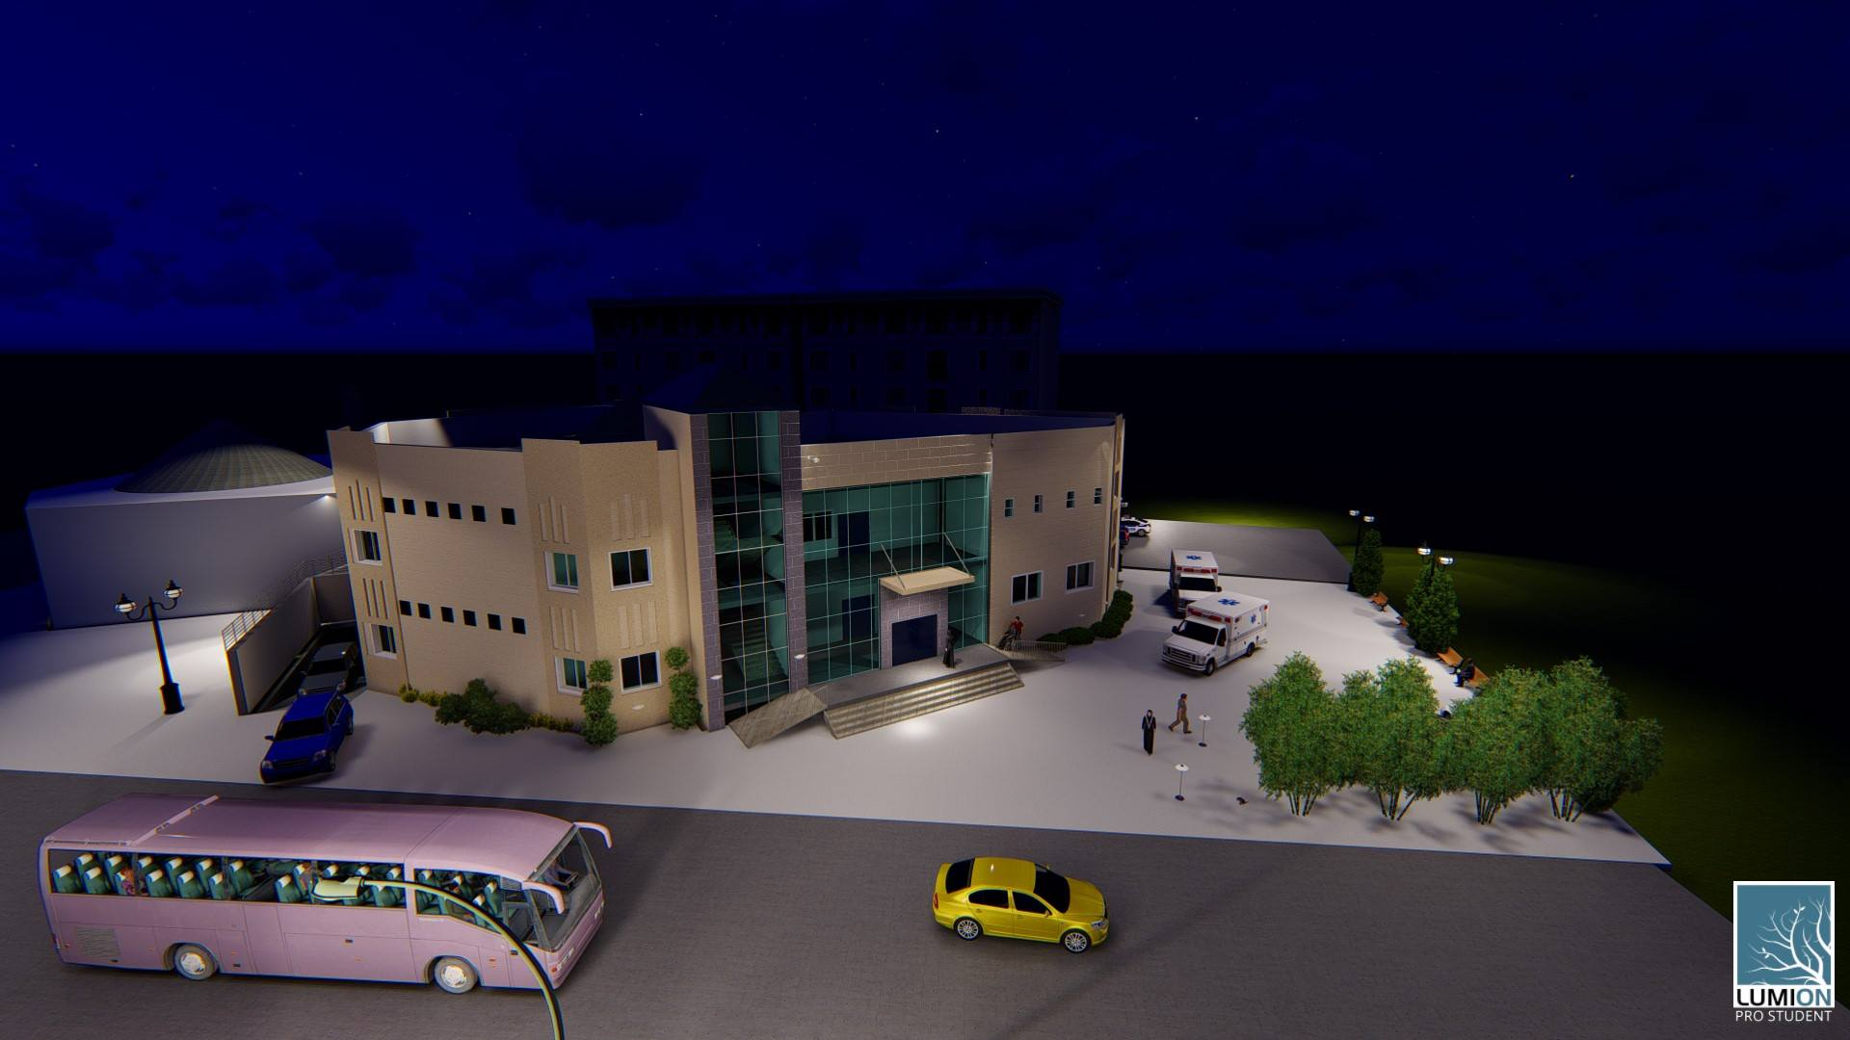
Architectural Design

Slide 25
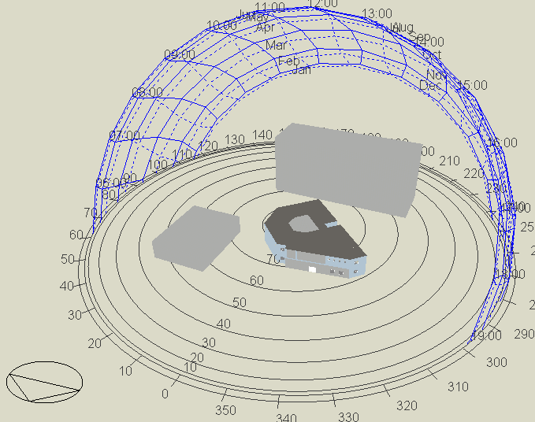
Environmental design
Sun path:

Slide 26
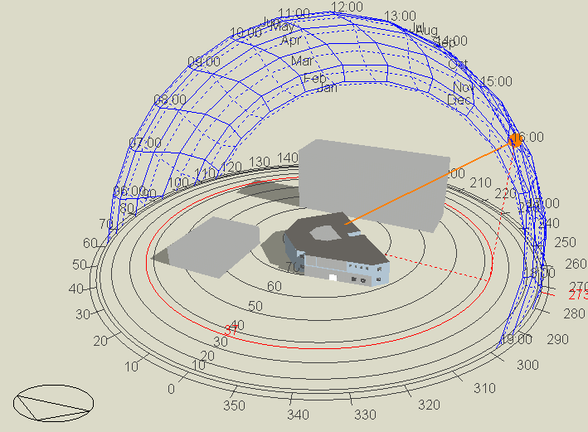
Environmental design
Shadow: In 21/July at 4:00 pm

Slide 27
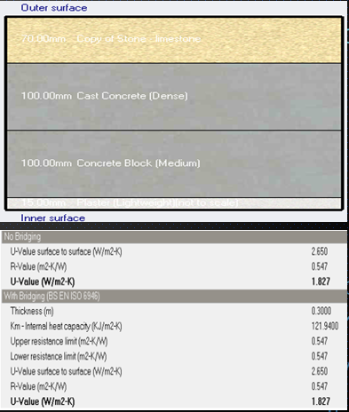
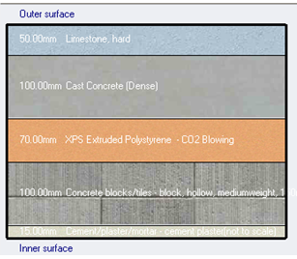
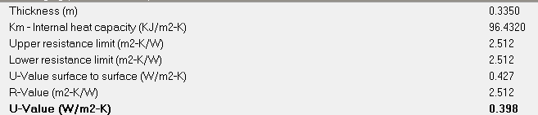
Environmental design
Before treatment
U-value for exterior wall

Slide 28
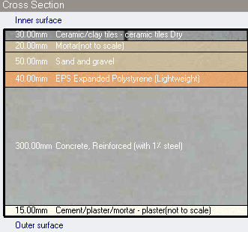
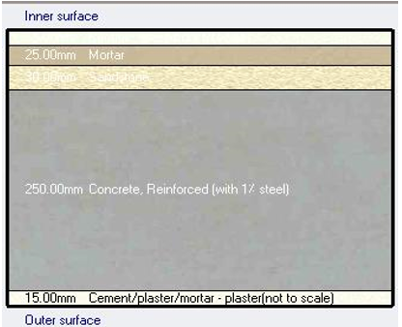
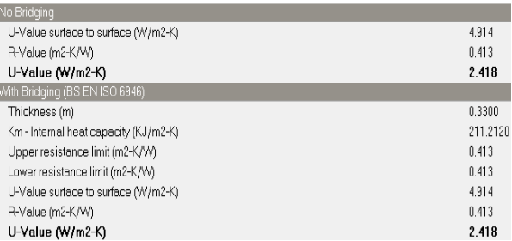
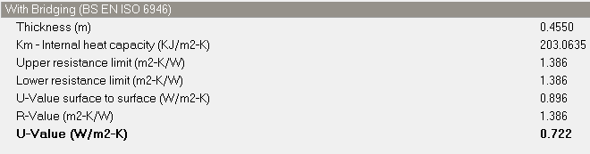
Environmental design
Before treatment
U-value for roof

Slide 29
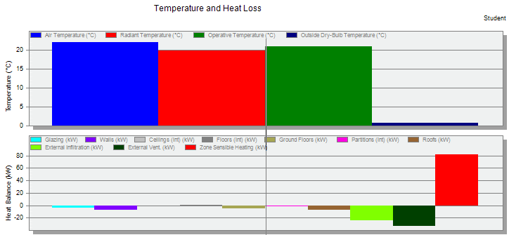
Environmental design
Total heating and cooling capacity
Total heating load = 102.6 KW Cooling load= 67 KW

Slide 30
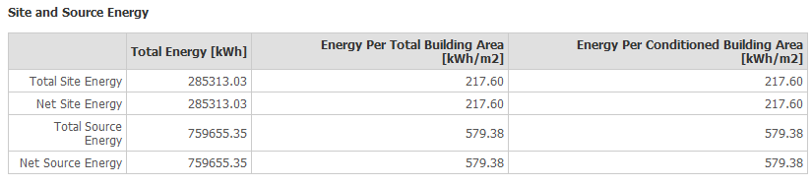
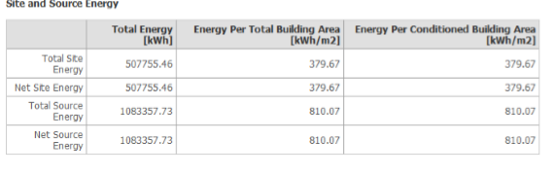

Environmental design
Total site energy= 217 KWh/$m^{2}$
Standard value = 240 KWh/$m^{2}$/
Total site energy before treatment = 379 KWh/$m^{2}$

Slide 31
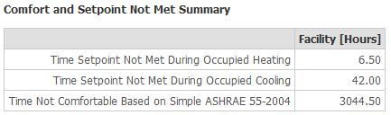
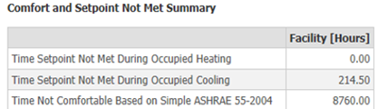
Environmental design
Not comfort hours:
Not comfort hours before treatment:

Slide 32
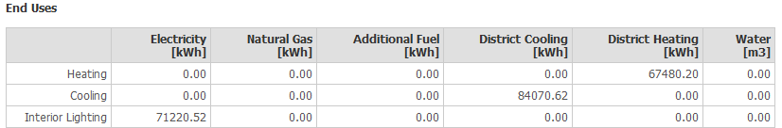
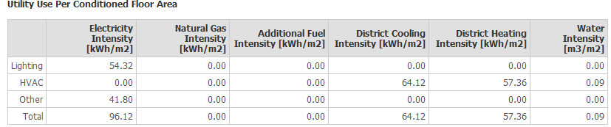
Environmental design
Total heating and cooling:

Slide 33
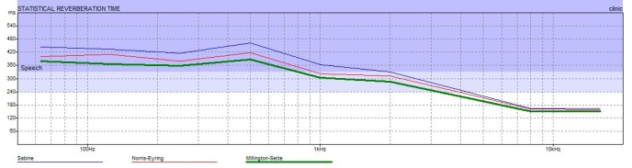
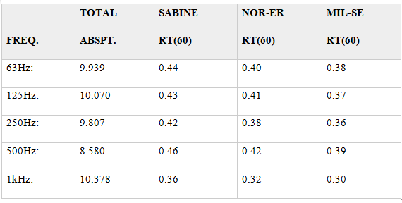

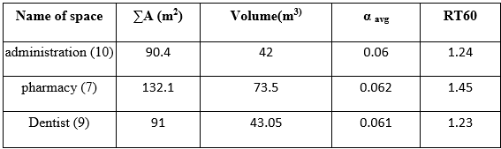
Environmental design
RT60 value: (0.4_0.7)
RT60 of clinic before treatment

Slide 34
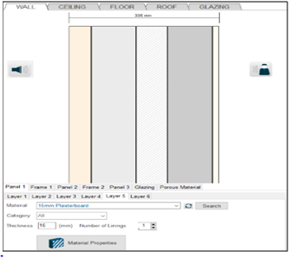
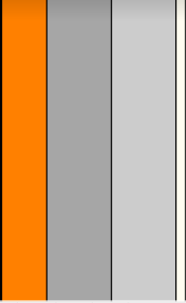
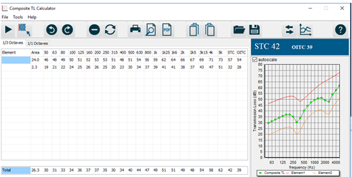
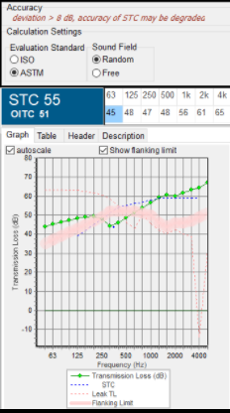
Environmental design
STC in exterior wall before treatment
STC in exterior wall:

Slide 35
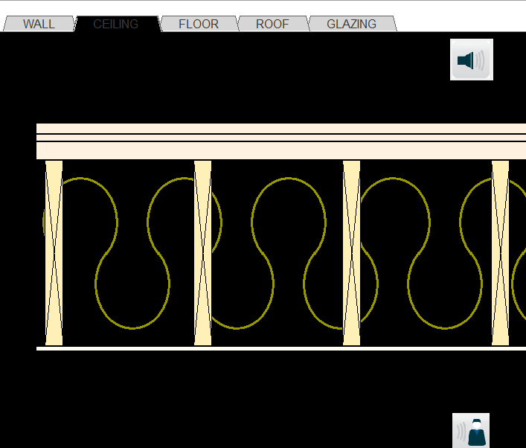
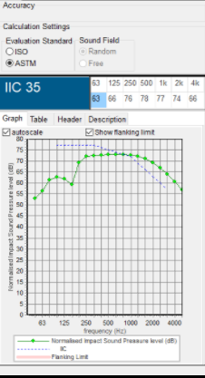
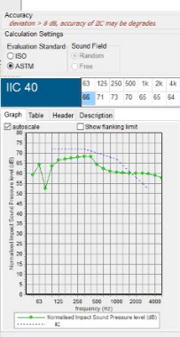
Environmental design
IIC for roof:
IIC for roof before treatment:

Slide 36
Structural Design
Design codes.
Loads.
ETABS model and checks.
Structural elements and detailing.

Slide 37
Structural Design
Design codes :
ACI -318-11 for reinforced concrete structural design.
UBC -97 for earthquake load computations.
ASCE for load computations.
(ACI 350.3-06) for computing loads applied on water tanks under earthquake action.

Slide 38
Loads Used
Structural Design
Type of load | Load (KN/m²)
Super Imposed | 4 KN/m²
Live Load | 5 KN/m²
External Wall | 21 KN/m²
Bearing Capacity of soil | 200 kN/m²
Concrete with compressive strength of f’c | 28 MPa
Yielding strength of steel Fy | 420 MPa

Slide 39

Structural Design
The analysis and design were done using by ETABS program.
ETABS 3D Model for The Block

Slide 40


Structural Design
Compatibility check:

Slide 41
Structural Design
Checks for model :
Equilibrium check
Load type | Manual value (kN) | ETABS value (kN) | % error
Live load | 10562.5 | 10560.0282 | 0.021
SID load | 8450 | 8448.0225 | 0.023
Dead load | 18191.68 | 18570.3306 | 2

Slide 42
Structural Design
Checks for model :
Internal forces check
Element | Length(m) | Width (m) | Weight (KN) | Manual force(KN) | ETABS value(KN) | Difference % | CHEK
Coulmn | 0.4 | 0.35 | 16.68 | 762.48 | 782.066 | 2.5 | ≤10% → OK
Beam | 6.8 | 0.7 | 41.65 | 602.58 | 612.79 | 1.6 | ≤10% → OK
Slab | 3.3 | _ | _ | 15 | 17 | 0.12 | ≤10% → OK

Slide 43
Structural Design
Checks for model :
Drift limitation check
STORY | Ux | Uy | ΔSx | ΔSy | Δmx(mm) | Δmy(mm) | Drift limitation (mm) | check
B.F | 0.6 | 0.7 | 0.6 | 0.7 | 2.31 | 2.695 | 10 | OK
G.F | 1.55 | 2.11 | 0.95 | 1.41 | 3.657 | 1.41 | 10 | OK
F.F | 2.5 | 3.7 | 0.95 | 1.59 | 3.657 | 6.1215 | 10 | OK

Slide 44

Structural Design
Seismic Design:
The Structural System in Nablus.
The seismic zone factor is 2B which have factor Z = 0.20.
Seismic Importance factor (I) = 1.25
Soil profile: Silt Clay
Seismic velocity Coefficient (Cv)= 0.28
Seismic acceleration Coefficient (Ca)= 0.4
Structural system force reduction Coefficient (R) = 5.5

Slide 45



Structural Design
Slab reinforcement
T-section Ribbed slab
slab reinforcement cross section.

Slide 46



Footing reinforcement.
Isolated footing:
Structural Design
Footing Reinforcement cross section for edge column.

Slide 47




Column reinforcement
Structural Design
Group A
Group C
Column 30*30 cm reinforcement cross section
Group B
Column 35*50 cm reinforcement cross section.
Column 35*40 reinforcement cross section.

Slide 48



Beam reinforcement
Structural Design

Slide 49


Beam reinforcement
Structural Design

Slide 50


Structural Design
Shear wall reinforcement

Slide 51

Structural Design
Staircase Design

Slide 52
Structural Design
the dimension of elements
Element | Name | Dimensions (cm)
Tie beams | TB1 | 30*50
Beams | Main Beam | 70*35
 | Secondary Beam | 40*35
 | Dropped Beam | 60*70
Columns | C1 (Corner column) | 30*30
 | C2 (Edge column) | 40*35
 | C3 (Center column) | 50*35

Slide 53



Electrical design
Lamps used for clinic:
The lamps used before treatment : Fluorescent

Slide 54

Electrical design
DIAlux model for clinic:

Slide 55

Electrical design
Uniformity for clinic : From the lighting handle book ( 500-700 lux)
Space | Al-Rahma clinic new design | Al-Rahma clinic | Standard (Lux)
Clinic | 535 | 117 | 500-700

Slide 56

Electrical design
From above uniformity = 0.71 so it is OK. (meep, 2011)

Slide 57

Electrical design
: UGR
From figure above Max UGR= 10 <19 ok no glare

Slide 58

Electrical design
Ground floor lighting plan:

Slide 59

Electrical design
Ground floor socket plan

Slide 60
Mechanical Design
Calculations
Floor | No.of water closet | No.of lavatories | No.of kitchen sink | Total DFUs
Basement floor | 2 | 3 | 0 | 11
Ground floor | 6 | 5 | 1 | 31
First floor | 8 | 7 | 1 | 41
total |  |  |  | 83

Slide 61

Mechanical Design
Manhole System for site plan.

Slide 62

Mechanical Design
Sewer System For wc (first floor)

Slide 63

Mechanical Design
Water Drainage Plan For basement

Slide 64

Mechanical Design
Water Drainage Plan For first floor

Slide 65

Mechanical Design
Water Supply For basement

Slide 66

Mechanical Design
Water Supply For GF

Slide 67

Mechanical Design
Water Supply For F.F

Slide 68

Mechanical Design
Water Tanks Plan

Slide 69

Mechanical Design
Water Drainage System

Slide 70


Mechanical Design
H-vac design ( VRF design )
Total heating load
Total cooling load

Slide 71

Mechanical Design
VRF design
3d h-vac system

Slide 72

Mechanical Design
Number of duct | wedth | depth
1 | 130 | 100
2 | 100 | 75
3 | 300 | 200
4 | 125 | 100
5 | 100 | 75
6 | 100 | 75
7 | 300 | 200
8 | 175 | 125
9 | 125 | 75
10 | 300 | 250
11 | 125 | 75
12 | 200 | 275
13 | 125 | 75
14 | 125 | 100
15 | 125 | 100
16 | 250 | 275
17 | 125 | 100
18 | 300 | 275
19 | 350 | 300
20 | 125 | 100
21 | 300 | 275
22 | 125 | 100
23 | 300 | 275
24 | 125 | 125
h-vac system with duct sizing for ground floor

Slide 73






Safety design
Safety fixture:

Slide 74



Safety design
Fire suppression system:

Slide 75

Safety design
Fire plan:

Slide 76

Safety design
Reflected ceiling plan:

Slide 77
Cost
1. Civil work total cost= 1701937.29 NIS
2. Architectural work total cost = 1137945 NIS
3. Electrical, mechanical and safety work= 761262.5 NIS
4. Total cost= 3,600,000 Nis =2003.33 m2.

Slide 78


