Slide 1
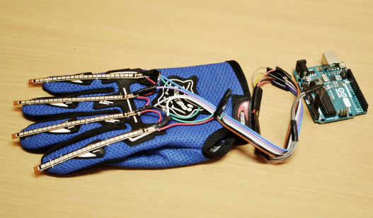
Wireless controlling using Smart Glove and Bluetooth
Prepared by Haia sabri Dweikat
Rawan Isleem
Supervisor Dr. Yousef Dama

Slide 2
Outlines
Objective
Introduction
List of suggested application we can control
Hardware Requirement
Implementation of the system and Project block diagrams
Flow chart represents how flex sensors and Bluetooth works
Future work and Suggested Changes

Slide 3
Objectives
Our project is conceived as an idea to ease the lives of those among us who are unfortunate have lost the ability to move due to a significant amount of paralysis, accident or due to old age or patient.
This project aims to present a smart gloves which we choose as a best solution for disable people to control any things around them.
This project can make their life easier by wearing this glove and control anything around using a kind of wireless technology.

Slide 4
Introduction
Nowadays, technology and human life cannot be separated as it has become the phenomenon of the world.
But, how the technology can help people that have some physical disability?
We have firm hopes to design a prototype to help the disable people to do any things in their life and live in comfortability as ordinary people and do any things without need for assistance.

Slide 5
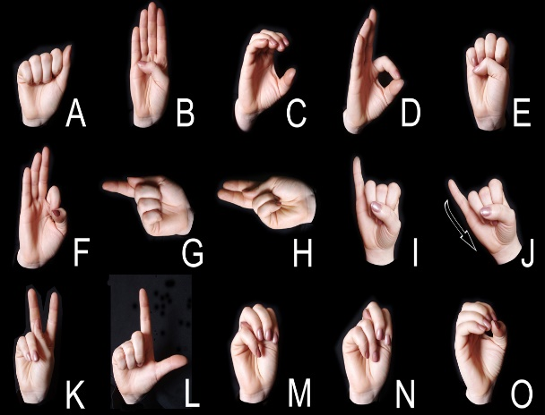
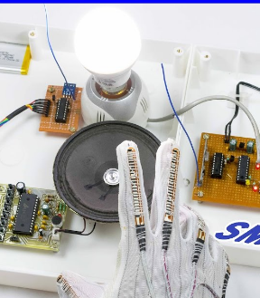
Some of suggested application we can control
Light on/off
Moving a table
Controlling wheel chair
Smart Glove-Turns sign language into text or voice
Fan control

Slide 6
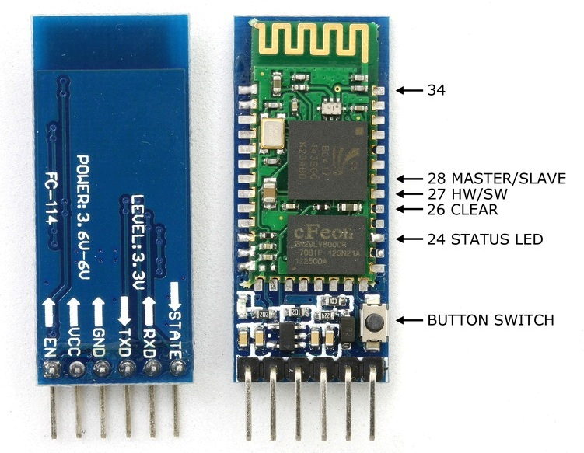
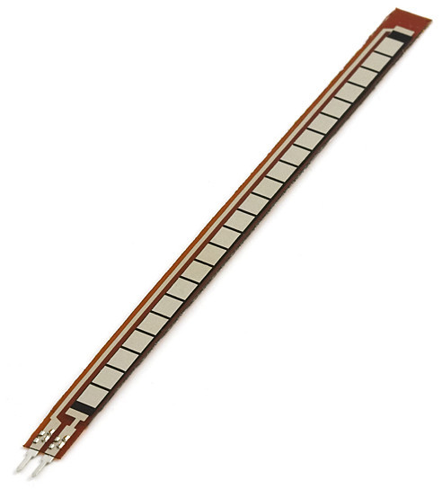
Hardware component
Bluetooth module
Flex sensors

Slide 7
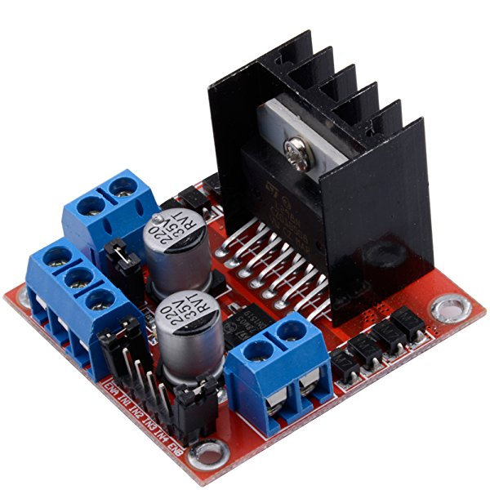
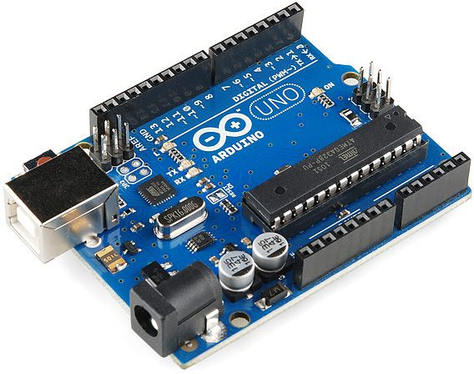
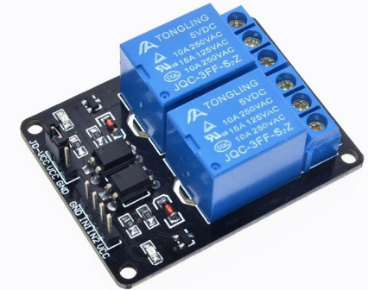
L298 Dual H Bridge
Arduino UNO &mega
2-Channel Relay Module

Slide 8
Implementation of the system
Smart glove with flex sensor
Our project was carried out by using 4 flex sensors on 4 fingers, and The purpose is to show the way at which we use these sensors which fitted on a glove for different control.
By tracing the movement of the fingers, the output analog voltage will be measured and evaluated.
Application
In our project we work on two of the previous application which is;
1. light on/off
2. Moving table

Slide 9
The interface between Smart glove and application
To establish a connection between these two part we use Bluetooth module for this job.
Arduino Uno
Used to read the analog voltage value of flex sensors in transmitter part.
Then based on these values we send some commands via Bluetooth for different control.
At receiver ,based on the received command we can control any devices

Slide 10
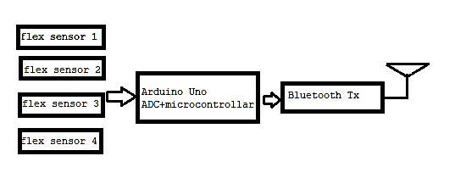
Project block diagrams
The proposed system contain two side
Transmitter side
4 flex sensors
Arduino Uno
Bluetooth transmitter

Slide 11
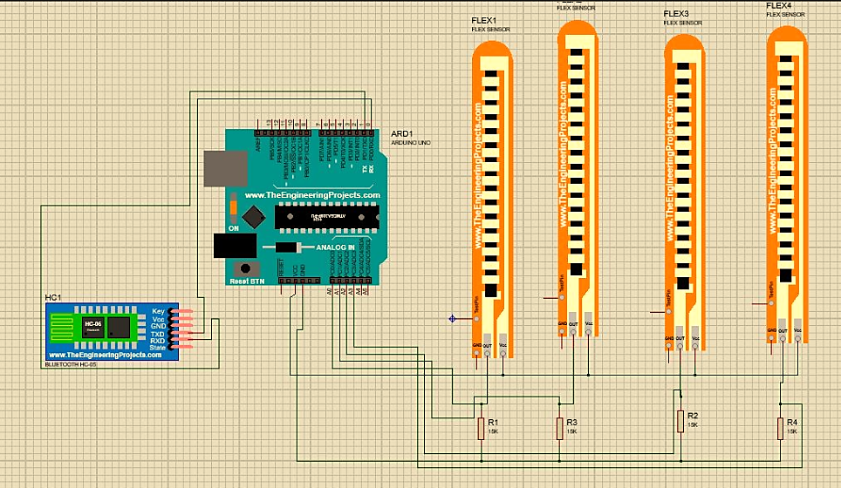
Transmitter smart glove design

Slide 12
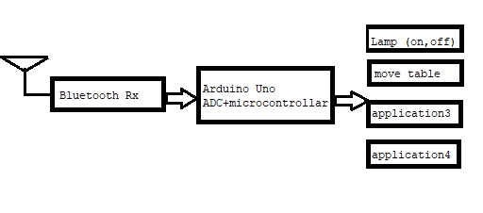
Receiver side.
At the receiver part we work on two application ,the first one is moving table and we need
1. Bluetooth receiver
2. Arduino mega 2650.

Slide 13
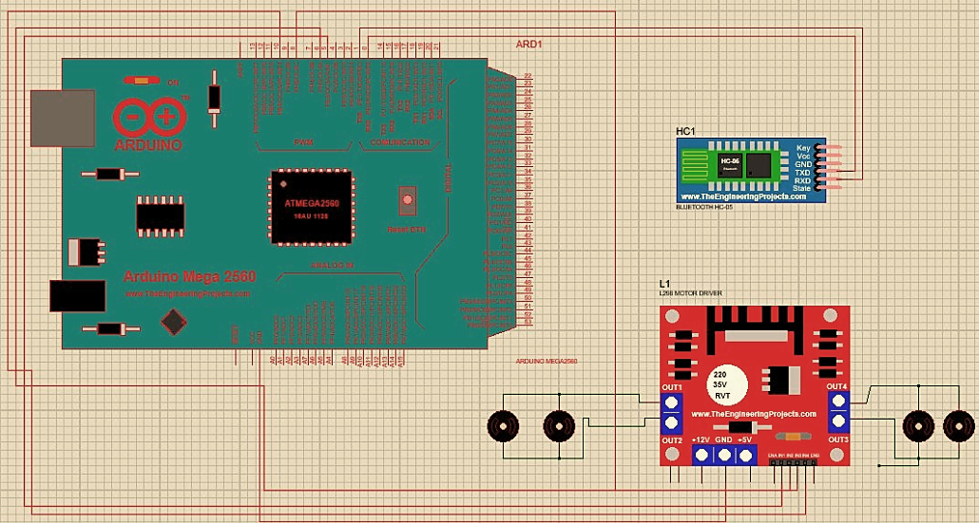
Receiver design (This circuit for moving table (Motor’s)

Slide 14
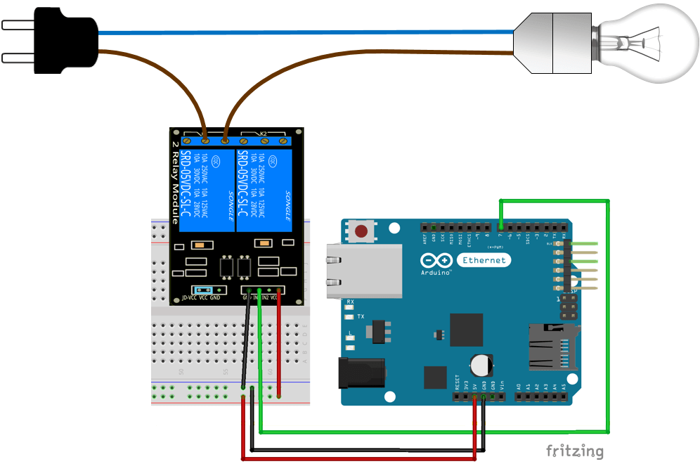
Receiver design (The second application circuit for light on/off)

Slide 15
Diagram which represent the all system

Slide 16
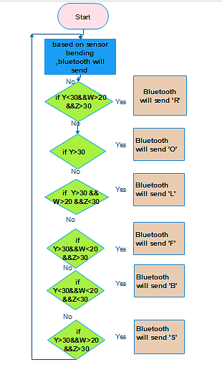
Flow chart of how flex sensors and Bluetooth works
Transmitter work flowchart

Slide 17
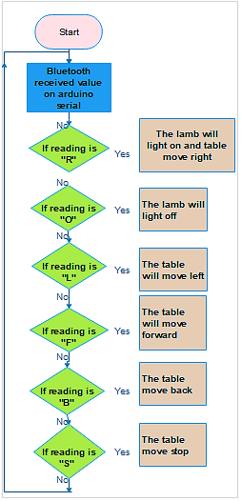
Flow chart of how flex sensors and Bluetooth works
Receiver work flowchart

Slide 18
Future work and Suggested Changes.
  In our graduation project 1, we use the smart glove to control only two application.
  The importance of our project that we can improve this glove to control many device.
  In term of the interface between TX and RX ,Instead of using Bluetooth module to communicate between the gloves and the application , we can use RF module.
  RF module can provide us a greater range compared to Bluetooth.

Slide 19


