Slide 1

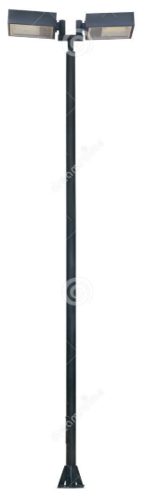
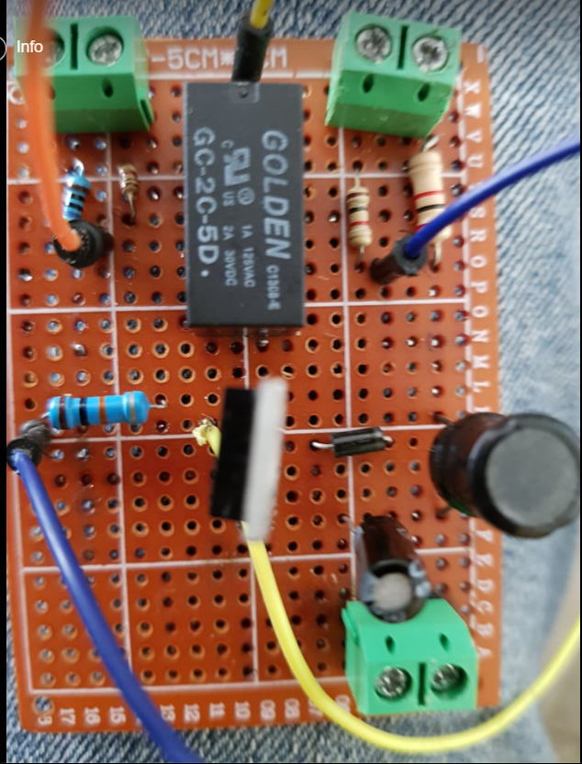
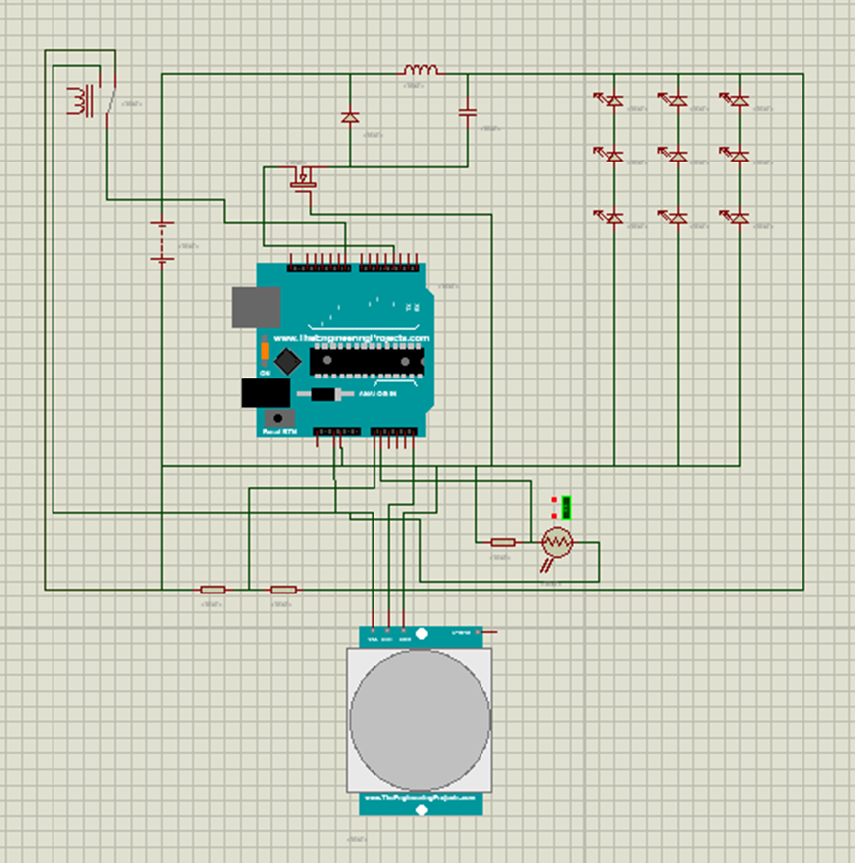
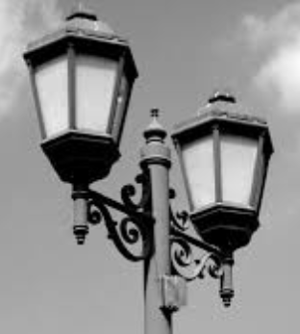
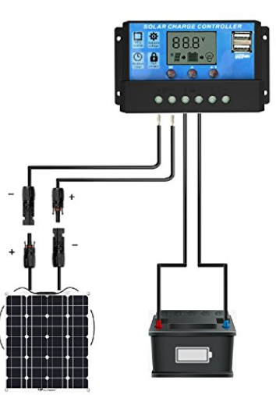
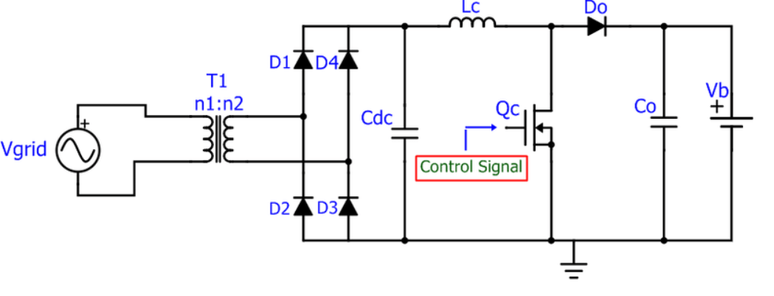
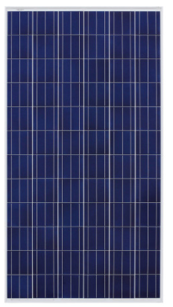
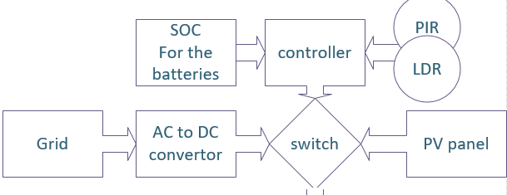
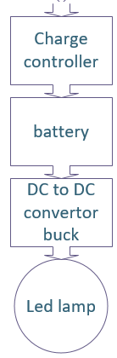
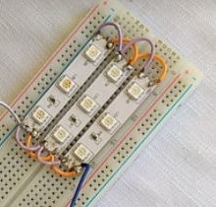
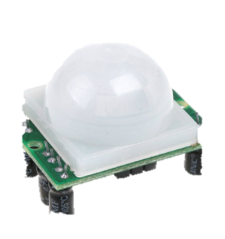
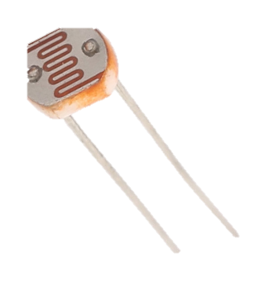
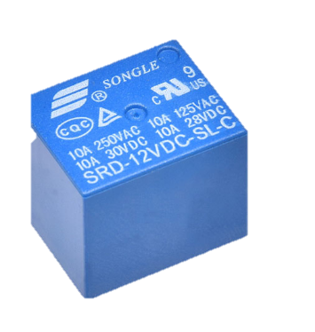
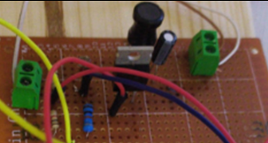
Smart Street lighting
The hardware design
Done BY :
Adham Sayyed , Thana Kewan
Supervisor: Dr. Moieen Omar
The buck converter:- The core—controlling the intensity of the lamp by changing duty cycle of it , we used led instead of the lamp
PIR: detect the motion , LDR: detect the light , SOC: detect the voltage.
Relay to charge between the solar panel and the grid to charge the battery
objectives
The parts
The circuit
® design a sustainable complete street lighting system
® reducing a large amount of energy
® street lighting will be environmentally friendly
® increasing the lifespan to the lamp, more efficiency and reliability.
1
PV part
2
GRID part
This Part consist of the solar panel which get the DC voltage from the sun, charge controller and battery to store the electricity
This Part works when the SOC of the battery in the solar panel is small
So the relay take an order to open and the system work from the grid, it consist of a rectifier convert AC to DC
Problem Statement
In daily life we tend to waste a lot of energy for street lighting, because it used timers and the day and night around the year is uncertain , there is pollution , moreover there is losses in the cables.
And street lighting is one of the major responsibilities on the country
results :Changing in the intensity of the lamp
Solution
Events | DC for the Buck | PWM from the Arduino | LDR | PIR
100% lighting | 1 | 254 | Full night | There is a motion
70% lighting | .7 | 195 | Full night | There is no motion
50% lighting | .5 | 127 | Half night | There is a motion
30% lighting | .3 | 77 | Half night | There is no motion
0% lighting | 0 | 0 | No night | -
System combines the solar and the grid , reduce the unnecessary working hours, controlling the intensity of the LED lamp
3
Control Part
Working Procedure
This part is the most important part, the microcontroller took the events around it and decide the duty cycle of the buck converter – the intensity if the lamps due to the motion . The brightness, SOC and the state of the grid to change the duty cycle
SOC , AC , PIR , LDR
DC/DC converter Duty Cycle
Intensity of the lamp
lamp
consolation
This solar street lighting system is a project to solve all the possible problem in the current street lighting system
Around 77%-85% of power consumption can be reduced by using this system

