Slide 1
A Secure Authentication System borrowing the concept of Blockchain with the utilization of centralized and decentralized nodes
Group members: Ahmad Maqboul & Wasim Anabtawi
Supervised by: DR.Othman Othman M.M

Slide 2
Disclaimer

Slide 3
Definitions

Slide 4
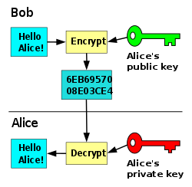
Definitions
Asymmetric encryption

Slide 5
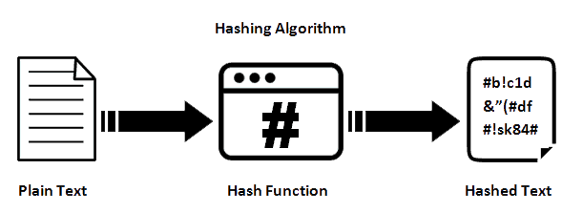
Definitions
Hashing Algorithm

Slide 6
Table of contents
Main problem
Introduction
Related work
Goals & Motivation
Architecture & Design
Evaluation
System Security Analysis
Future Work

Slide 7
Main problem

Slide 8
Main Problem
Current System takes time
Not automated
Physically be there

Slide 9
Introduction

Slide 10
Introduction
Huge amounts of info & assets exchanged all the time
More exposure & Anonymity for people online leads to less trust
Need for an authentication system

Slide 11
Introduction
Centralized authentication systems
  Single Point of Failure
Decentralized authentication systems
  DHT (Distributed Hash Table)
  Blockchain [2008]
Why not just use Blockchain?
  High computation
  51% Attack

Slide 12
Related Work

Slide 13
Related Work
Research about centralized authentication systems
  Authentication with Fog [Jun-Ya Lee et al.] [2014]
Research about de-centralized authentication systems
  Blockchain with IOT [Umair Khalid et al.] [2020]

Slide 14
Goals & Motivation

Slide 15
Goals & Motivation
Identity proof why?
Manipulation from certain sides
  Biased Organizations
Identity theft & fraud

Slide 16
Architecture

Slide 17
Architecture
Proposed system is a combination
Three interdependent Actors
Digital certificates from 2 sides -> QR Code
Mobile Application

Slide 18
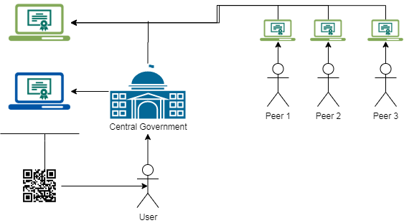
Three main actors:
1- User that wants to be identified
2- Central side
3- Generated peers

Slide 19



What did we use in the system?
SHA 512 (Hashing)
Flask 1.1.2 (Web API)
RSA 2048 (Encryption)

Slide 20
Design

Slide 21
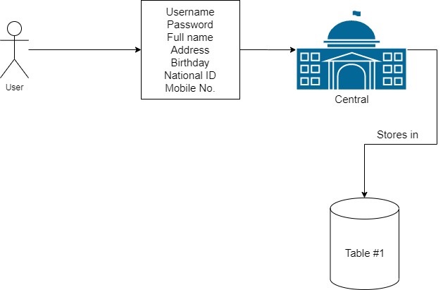
User Sign-Up

Slide 22
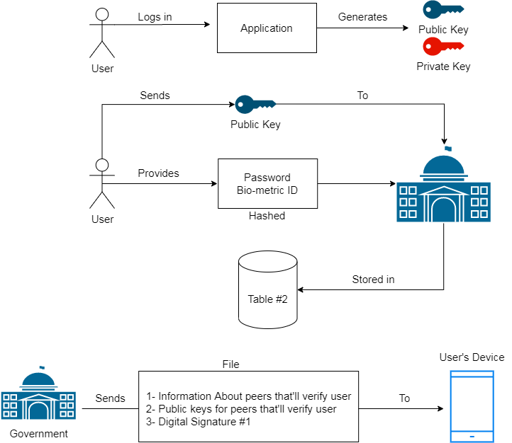
Initial User Validation

Slide 23
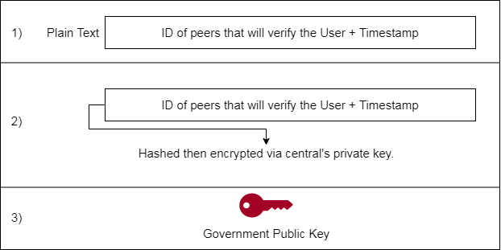
Contents of Digital Signature #1

Slide 24
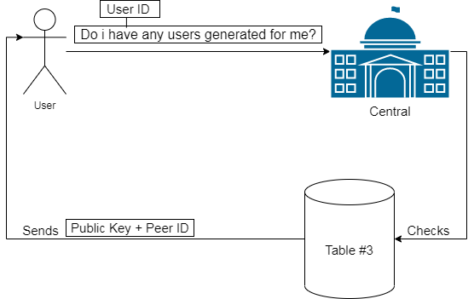
Live Message #1:
Periodically during the day

Slide 25
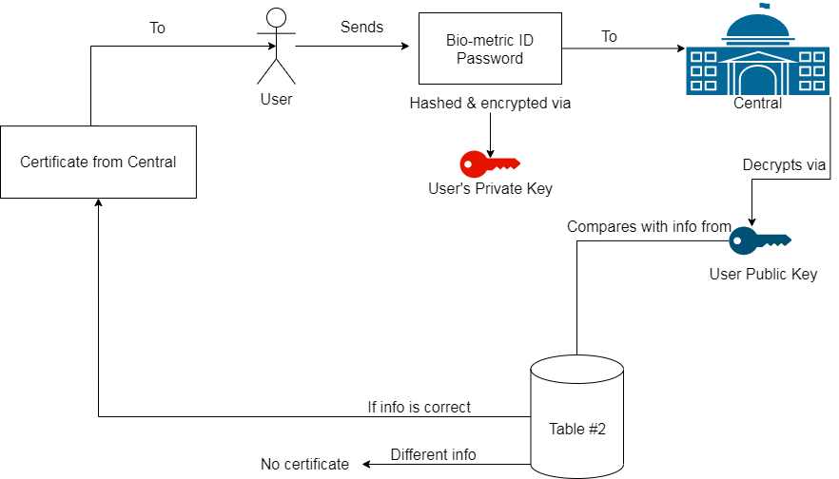
Certificate from central side

Slide 26
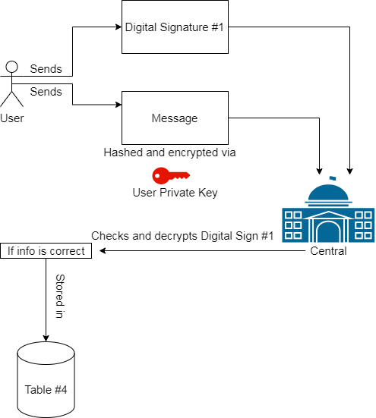
Certificate from peers
Part 1

Slide 27
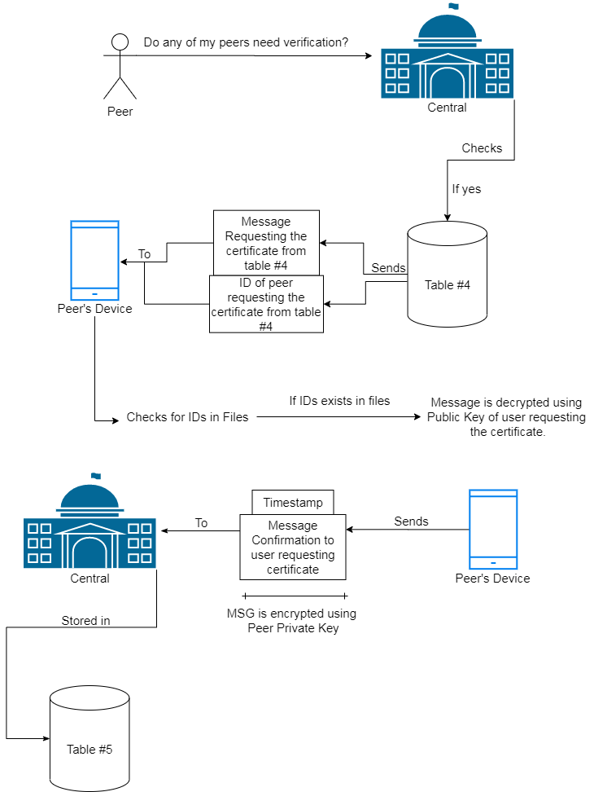
Certificate from peers
Part 2
[Live message #2]
From peers to central
Periodically during the day

Slide 28
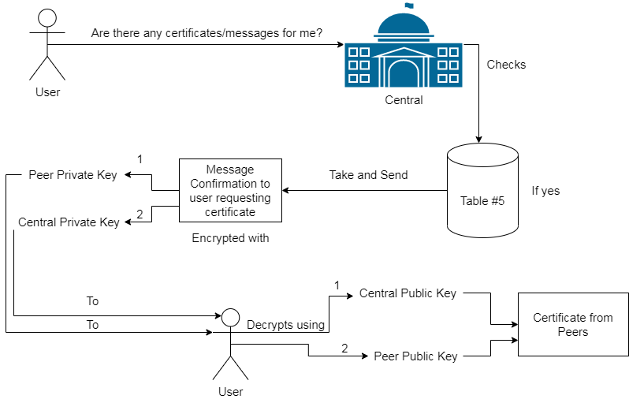
Certificate from peers
Part 3
[Live message #3]
From user to central
Periodically during the day

Slide 29
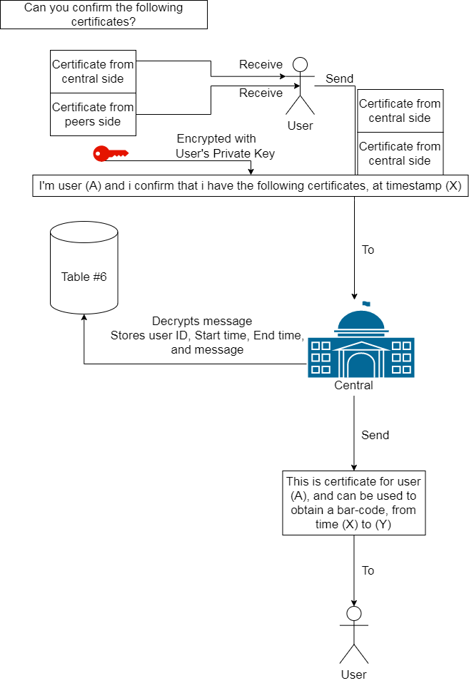
Confirmation with central side
[Final Certificate]

Slide 30
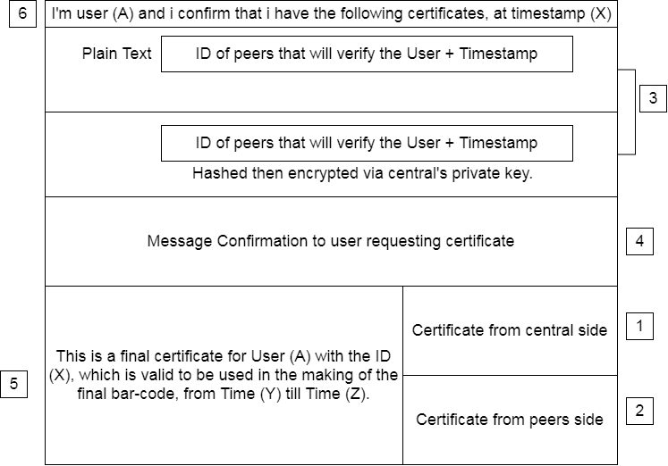
Contents of
Final full certificate -> QR code

Slide 31
Evaluation

Slide 32
Evaluation
Time for getting certificate & Number of peers
  Finding number of peers
Message size before & after execution
  Effect of using Flask API
Number of Hashing functions & Encryption functions
  Effect of functions on CPU load

Slide 33
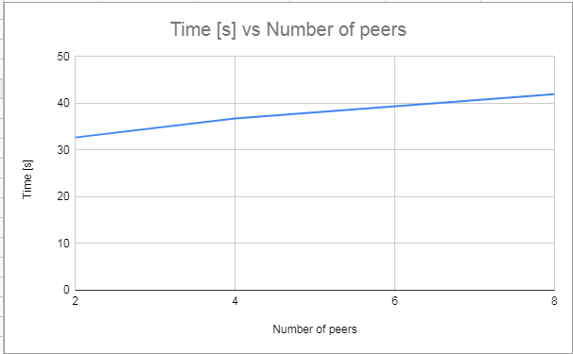
Un-validated user

Slide 34
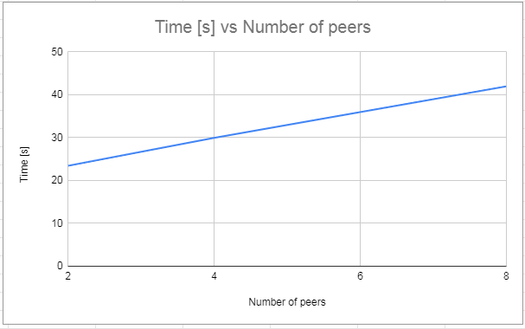
Validated user

Slide 35
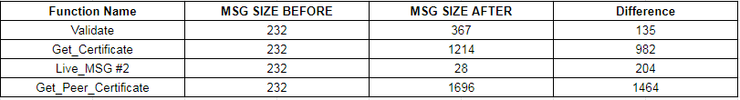
Message size comparison
Effect of flask API

Slide 36
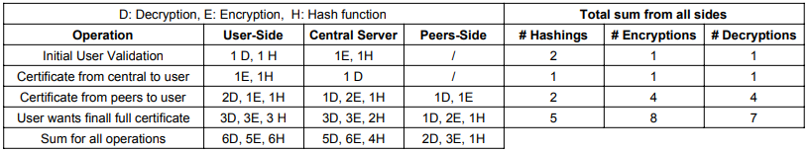
# Encryptions - Decryptions & # Hash functions

Slide 37
System Security Analysis

Slide 38
System security analysis
Identity Fraud
  [Biometric ID & Password]
Network Spoofing
  [Encrypted & Hashed data]
Replays in certificates
  [Timestamps & Certificate History Table]

Slide 39
Future Work

Slide 40
Questions?

