Slide 1
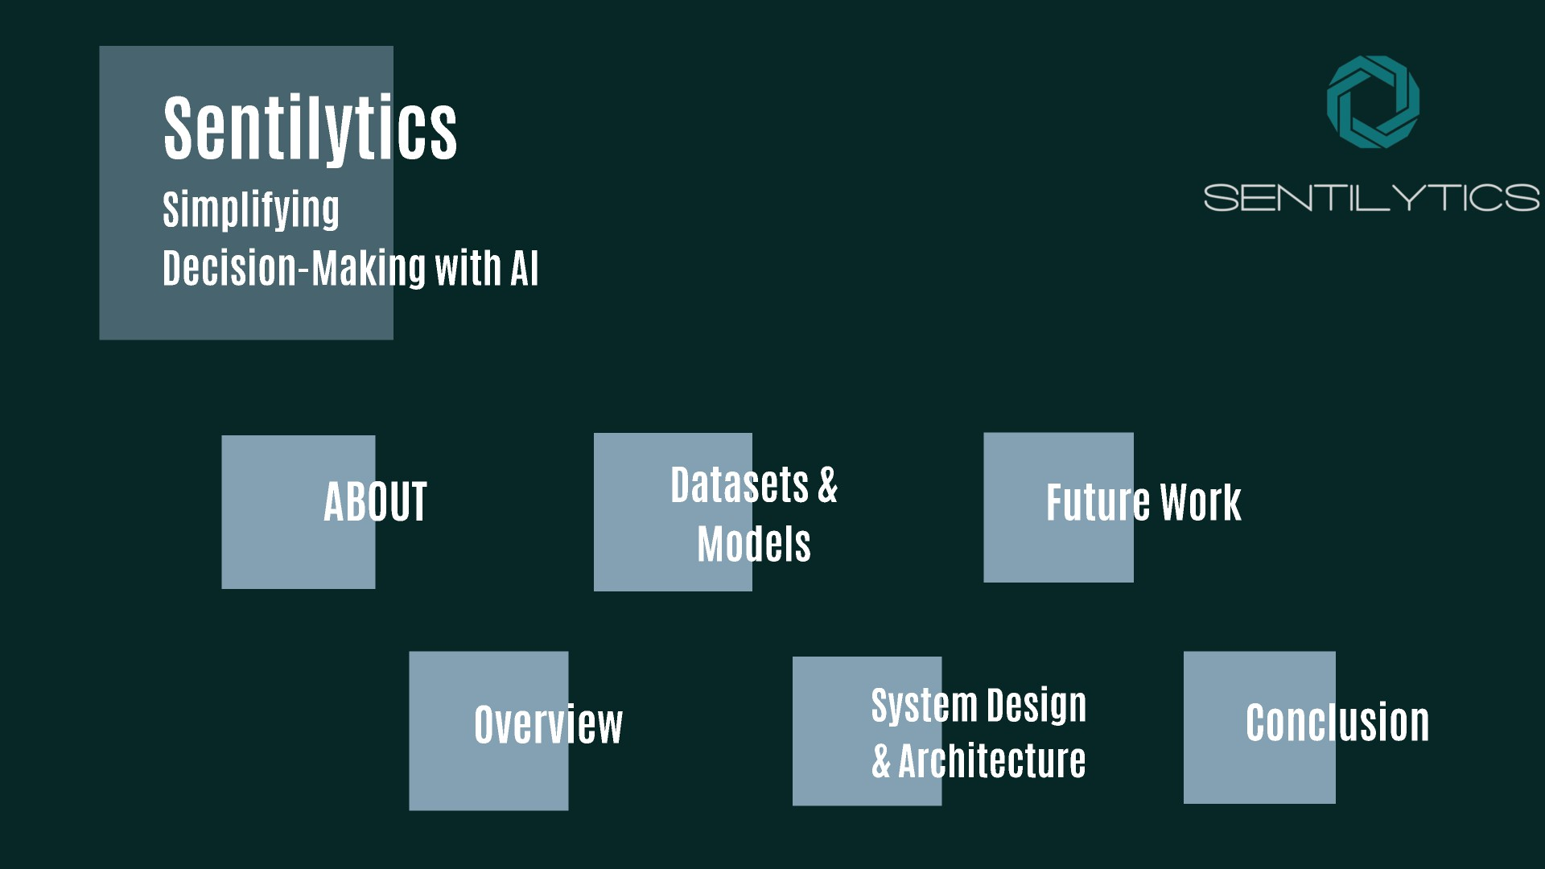

Slide 2
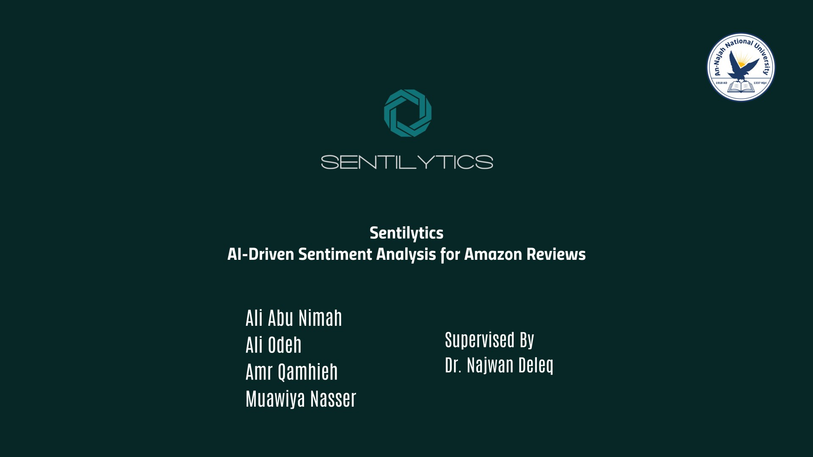

Slide 4
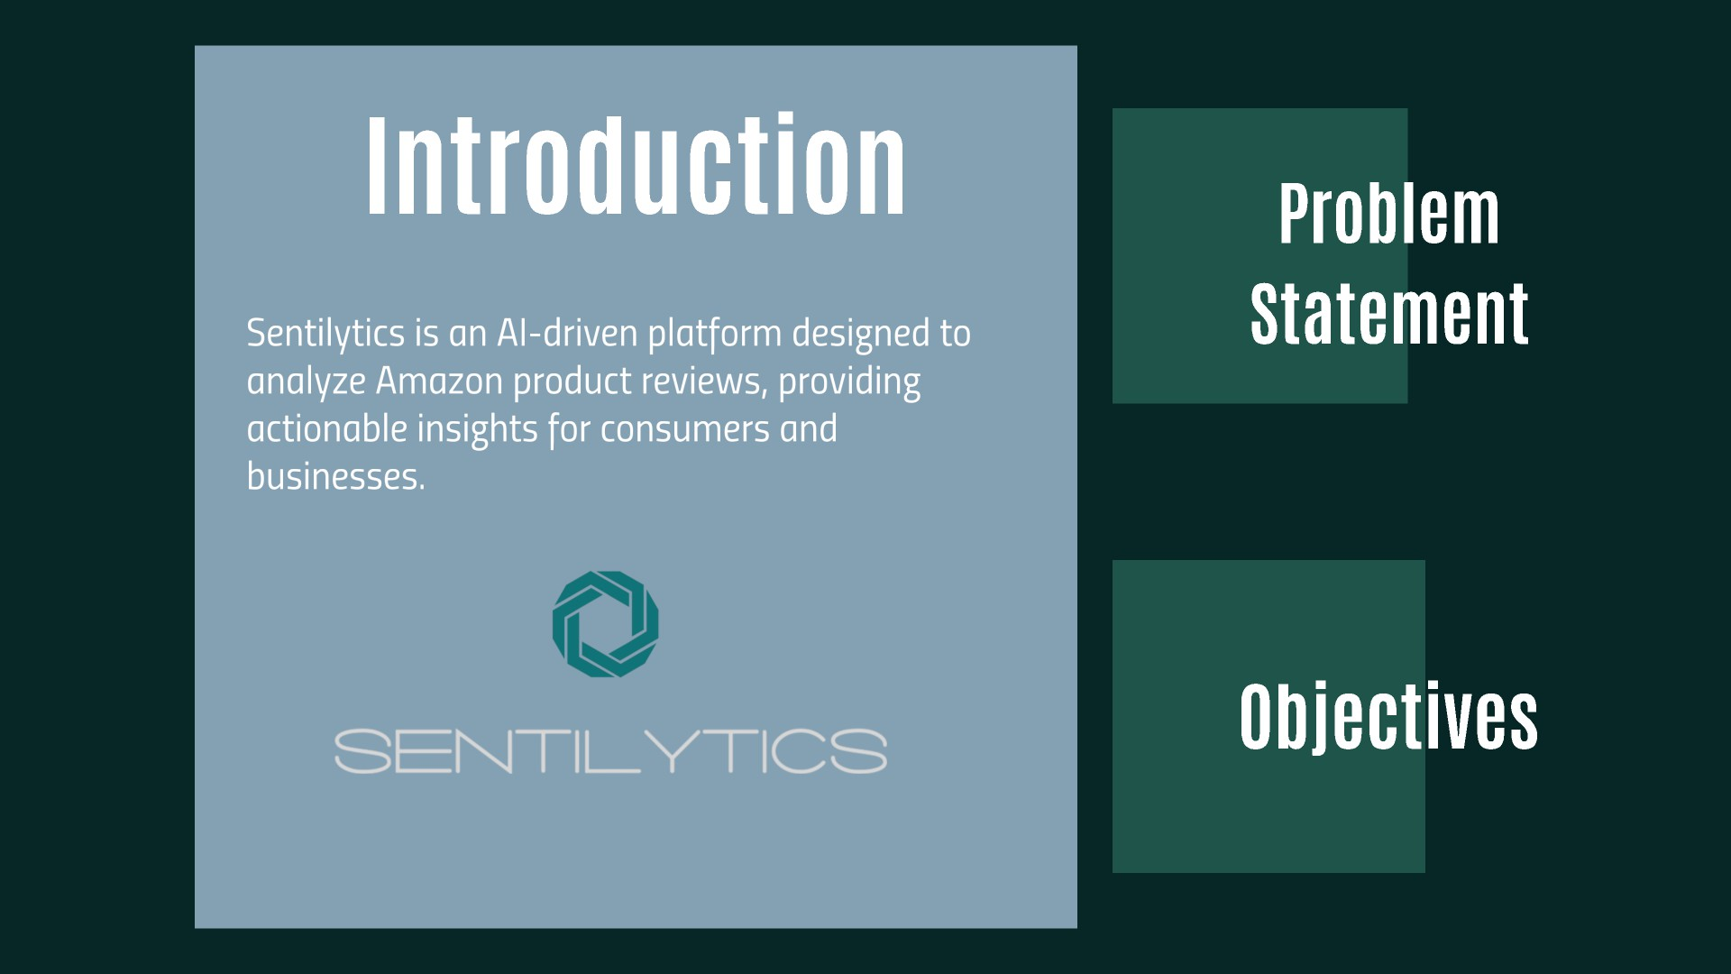

Slide 5
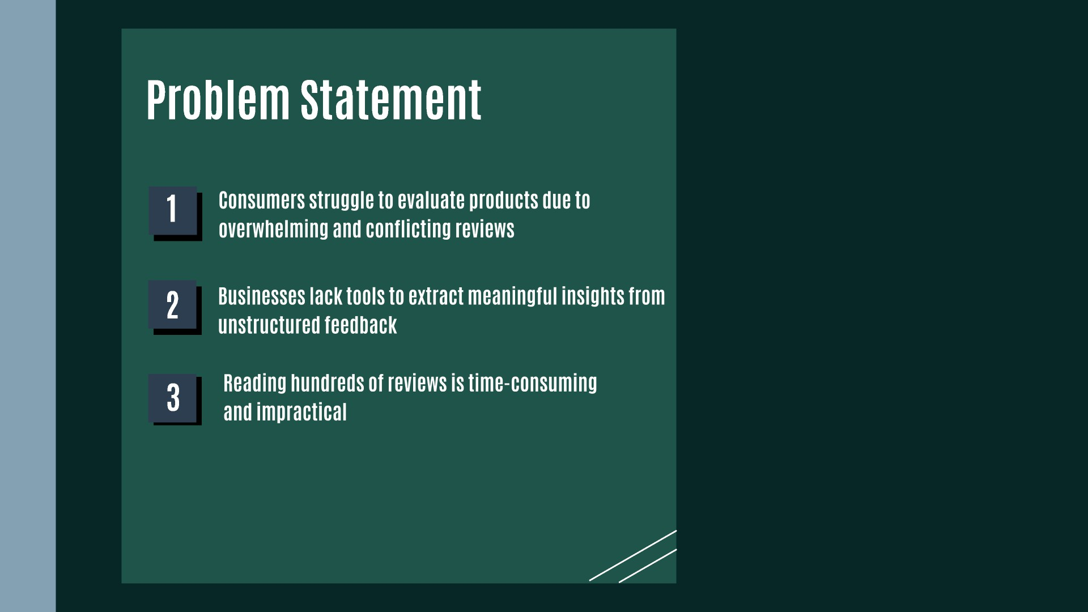

Slide 7
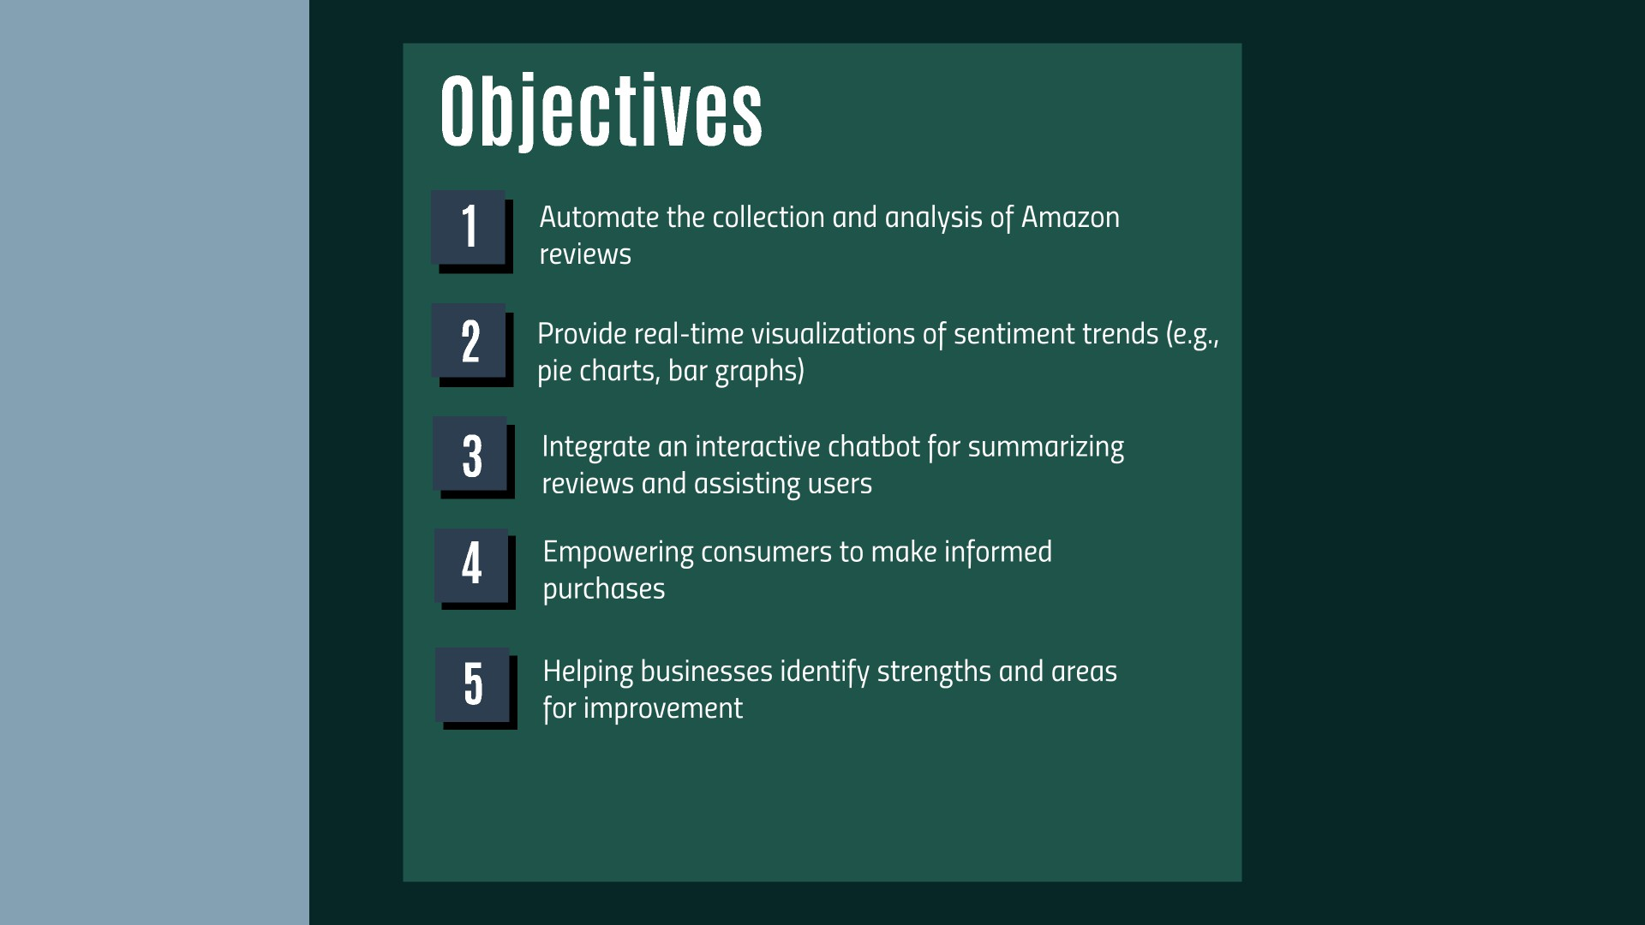

Slide 10
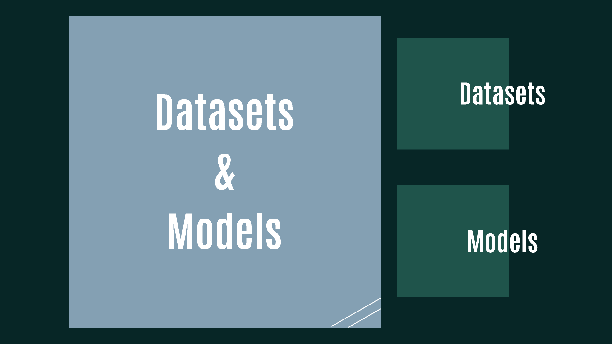

Slide 11
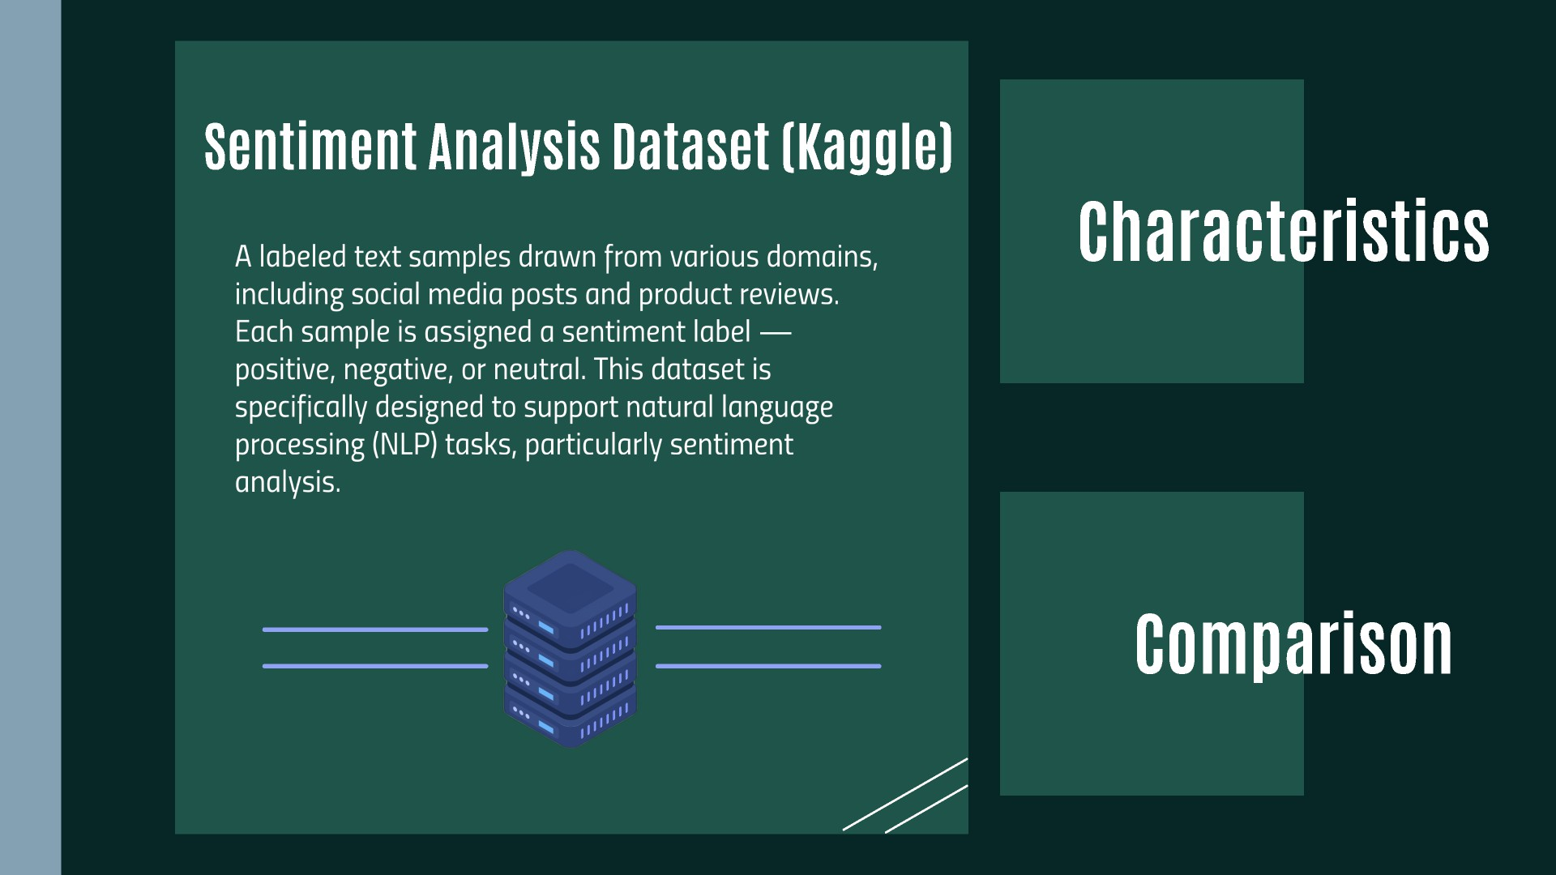

Slide 12
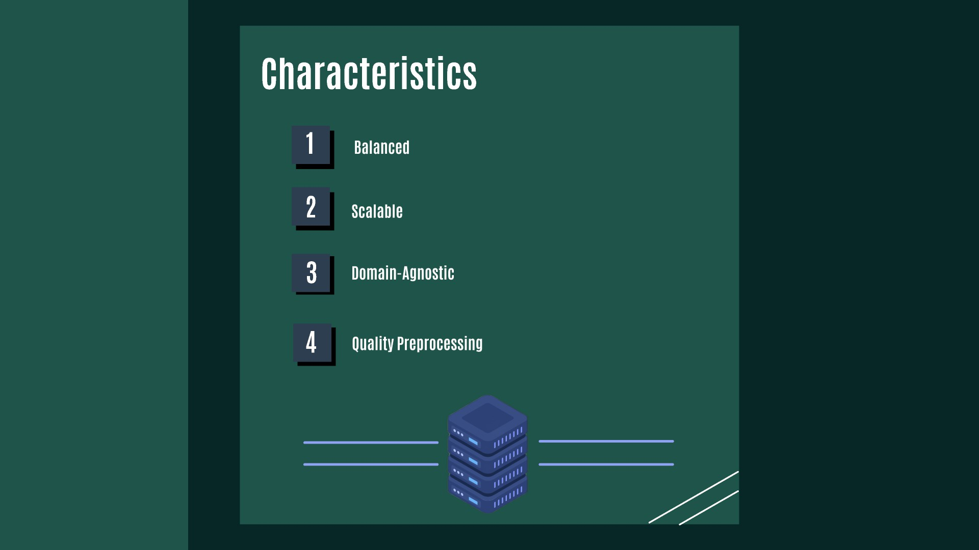

Slide 14
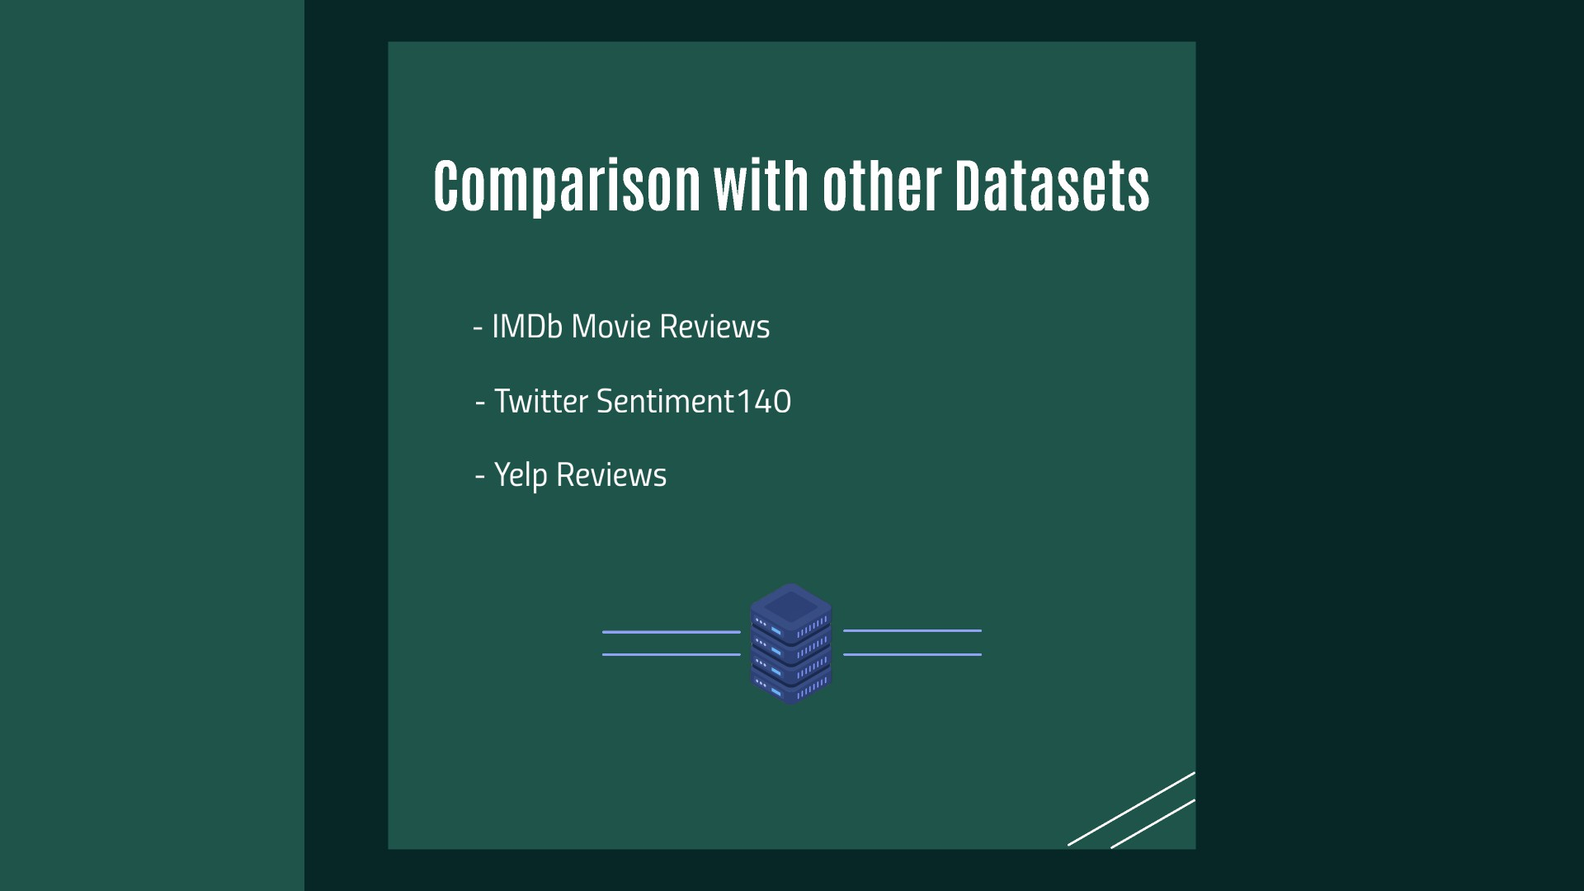

Slide 17
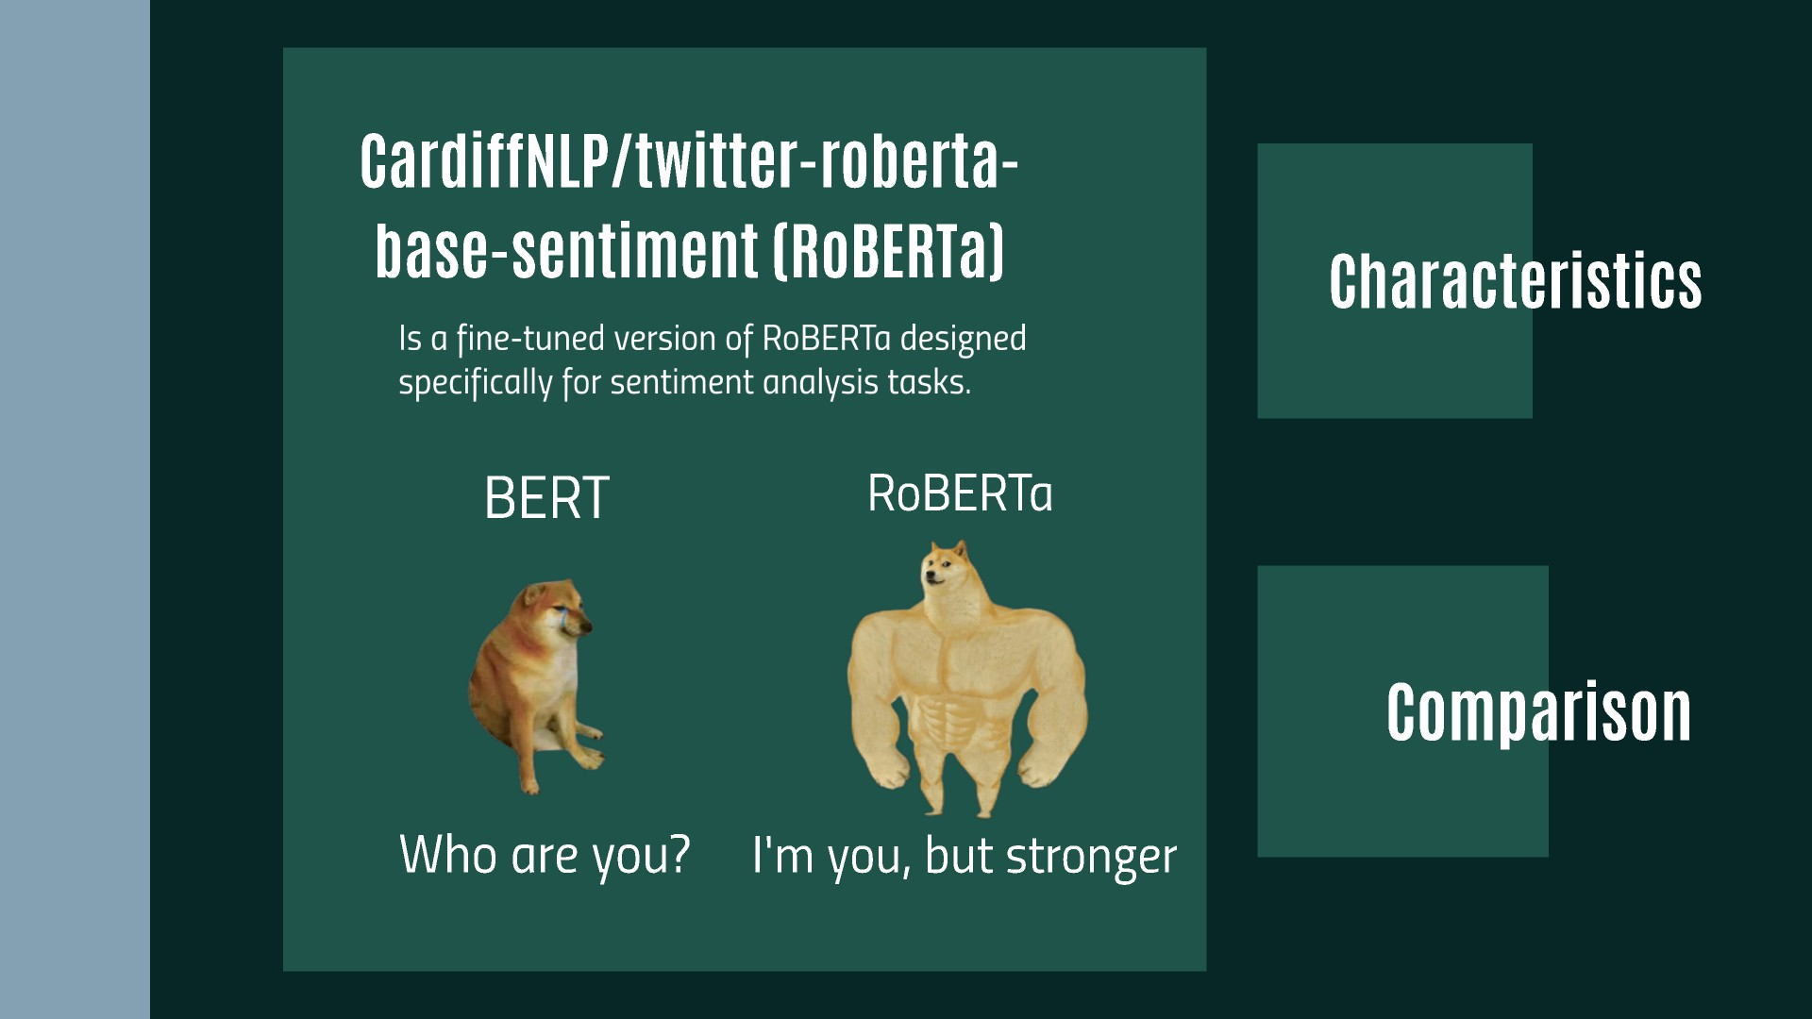

Slide 18
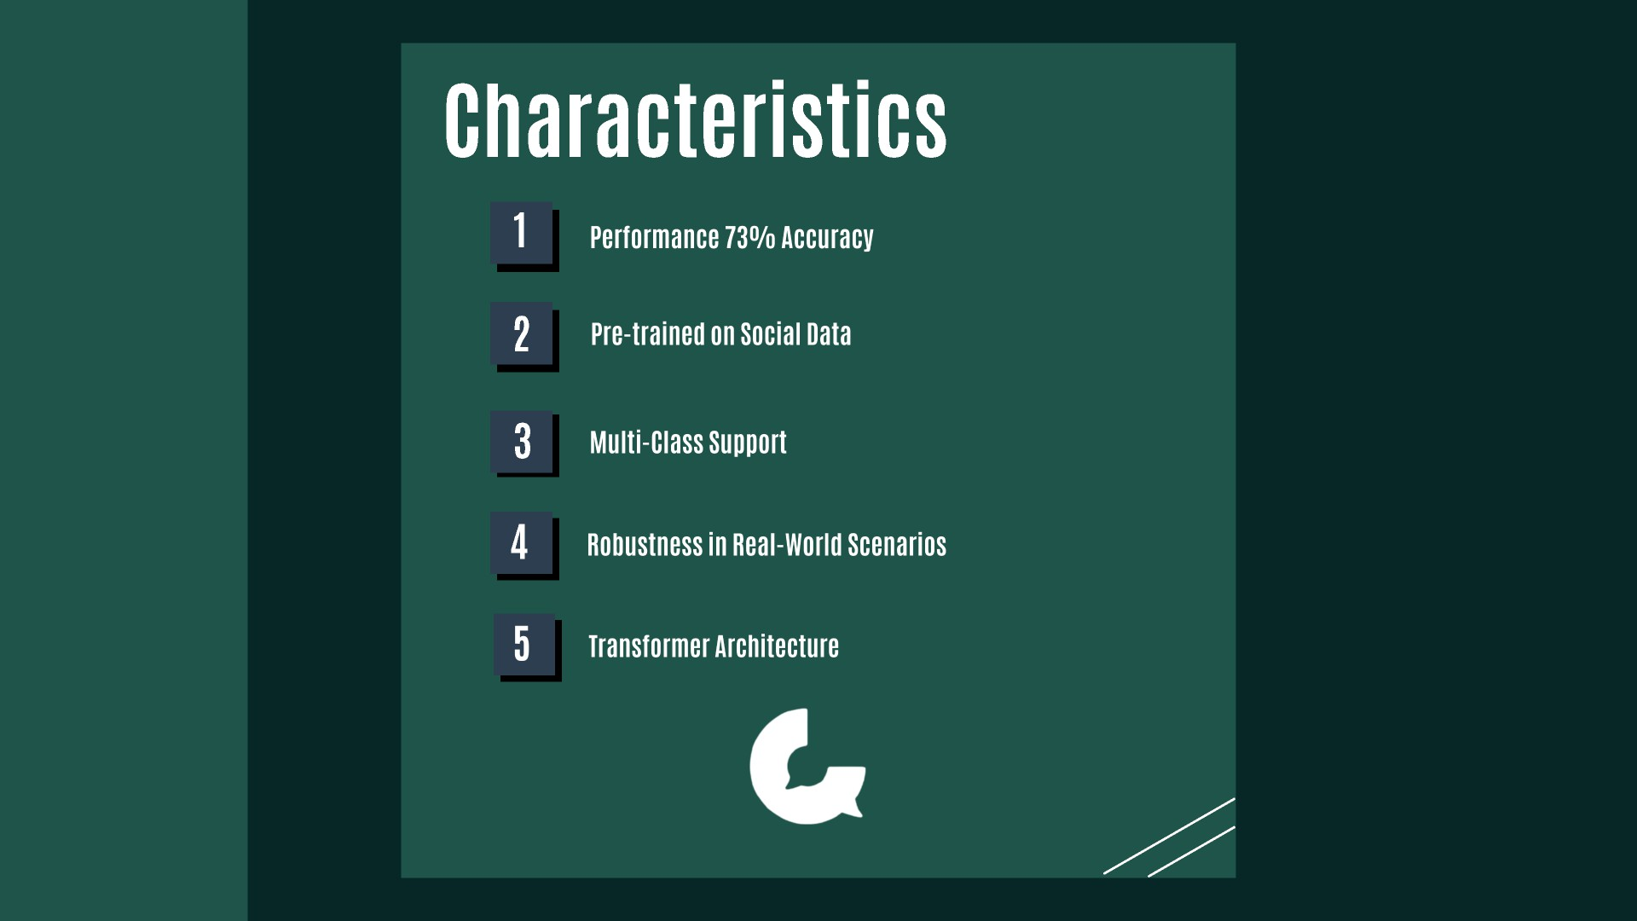

Slide 20
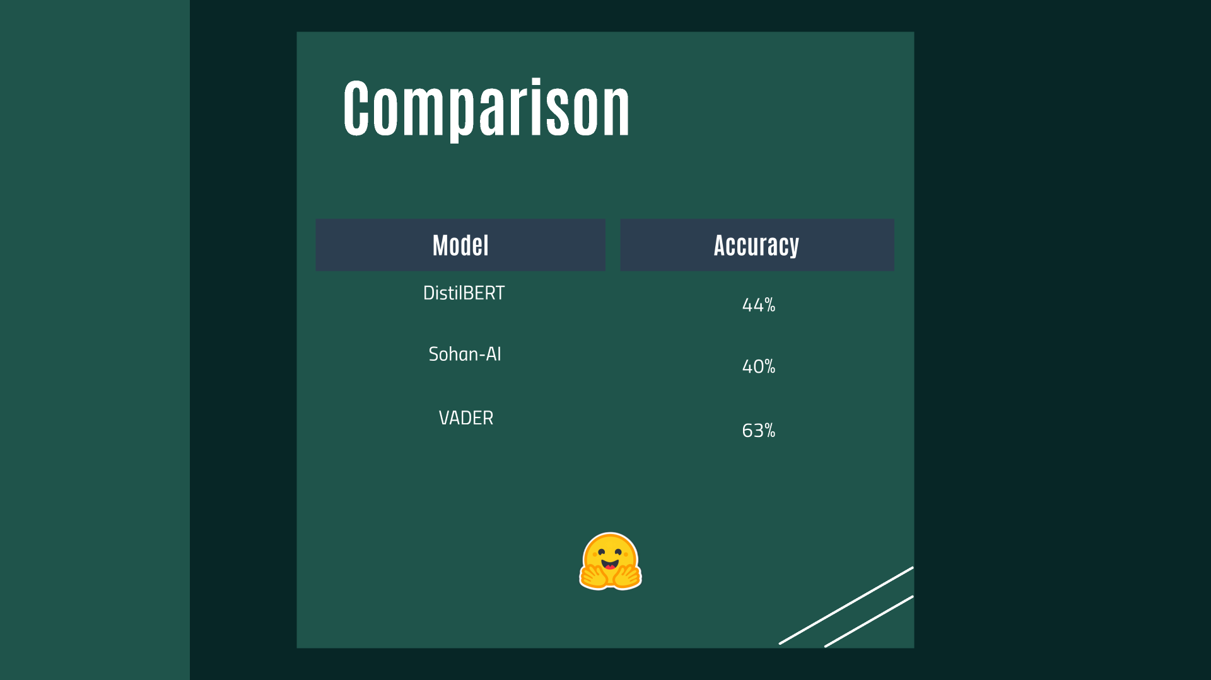

Slide 24
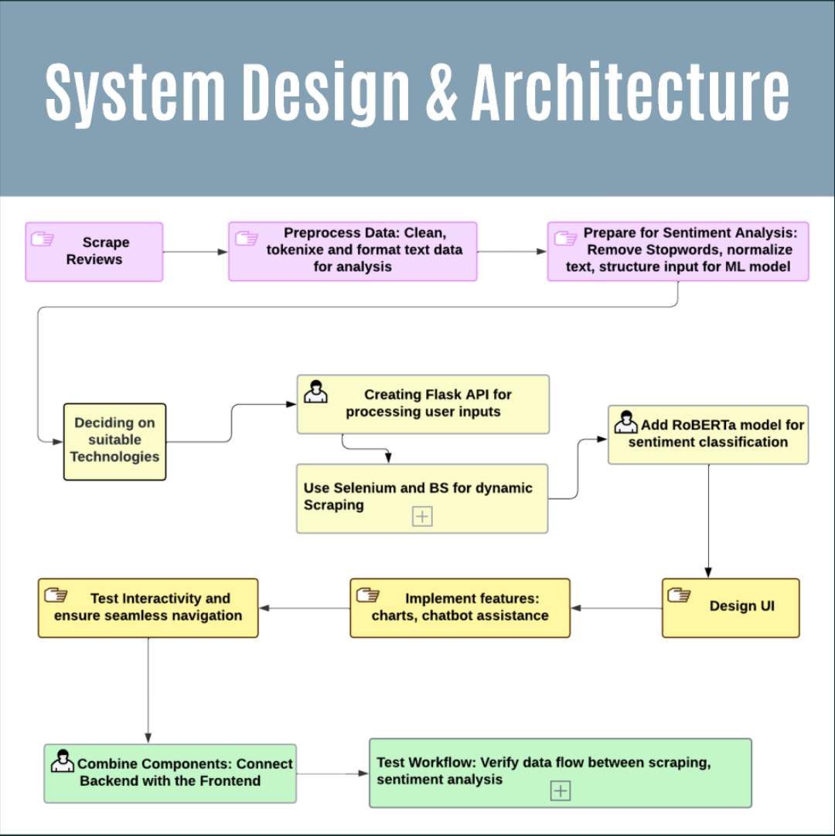
^{l}.-----,^{I}L^{c}
Scrape Reviews
Preprocess Data: Clean, tokenixe and format text data
for analysis
Prepare for Sentiment Analysis:
Remove Stopwords, normalize
₋ text, structure input for ML model
J
Creating Flask API for processing user inputs
Deciding on suitable Technologies
f
l-.
Add RoBERTa model for sentiment classification
'--+
r---+
IUse Selenium and BS for dynamic
IScraping
[±]
'-------'
Test Interactivity and ensure seamless navigation
Implement features: charts, chatbot assistance
Design UI
Combine Components: Connect Backend with the Frontend
Test Workflow: Verify data flow between scraping,
sentiment analysis
[±]

Slide 25
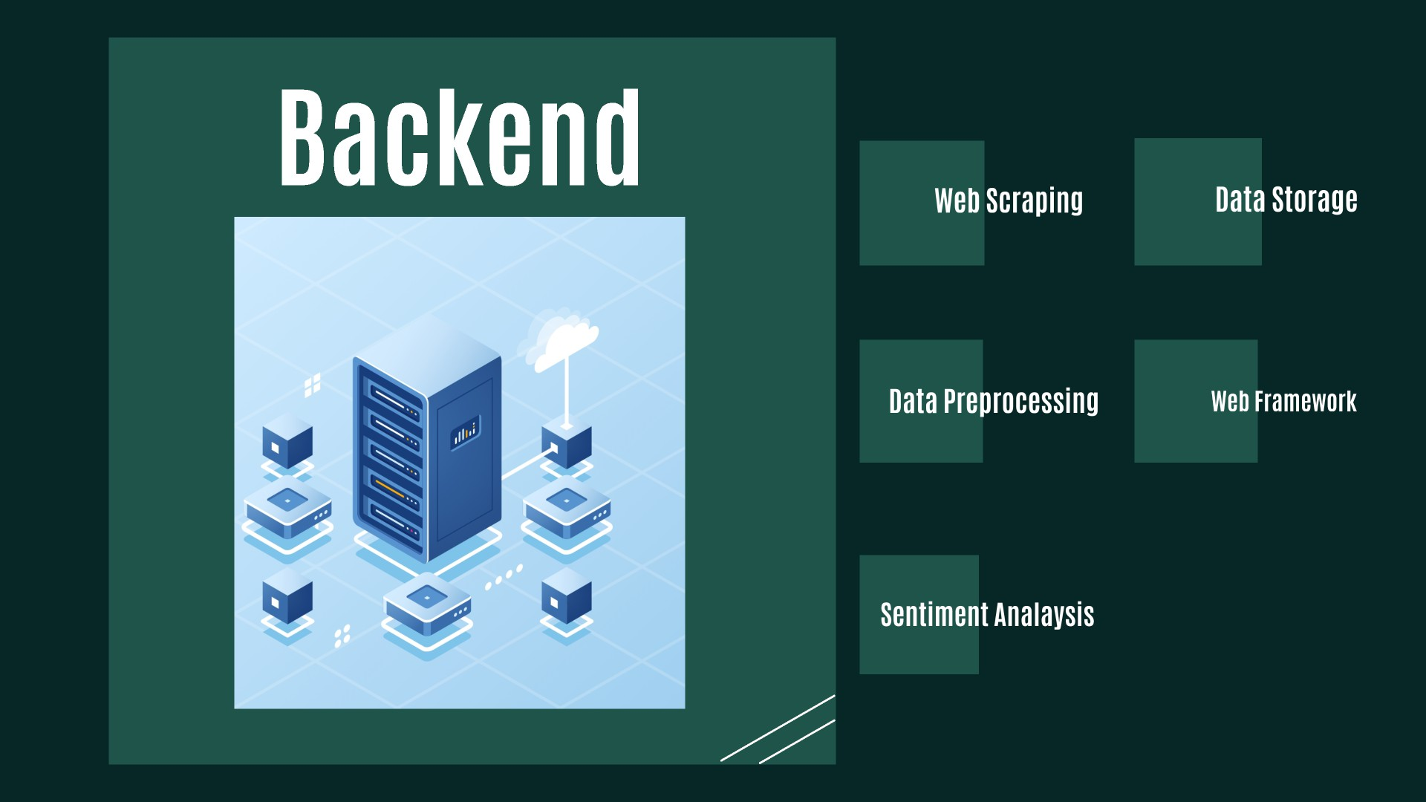

Slide 26

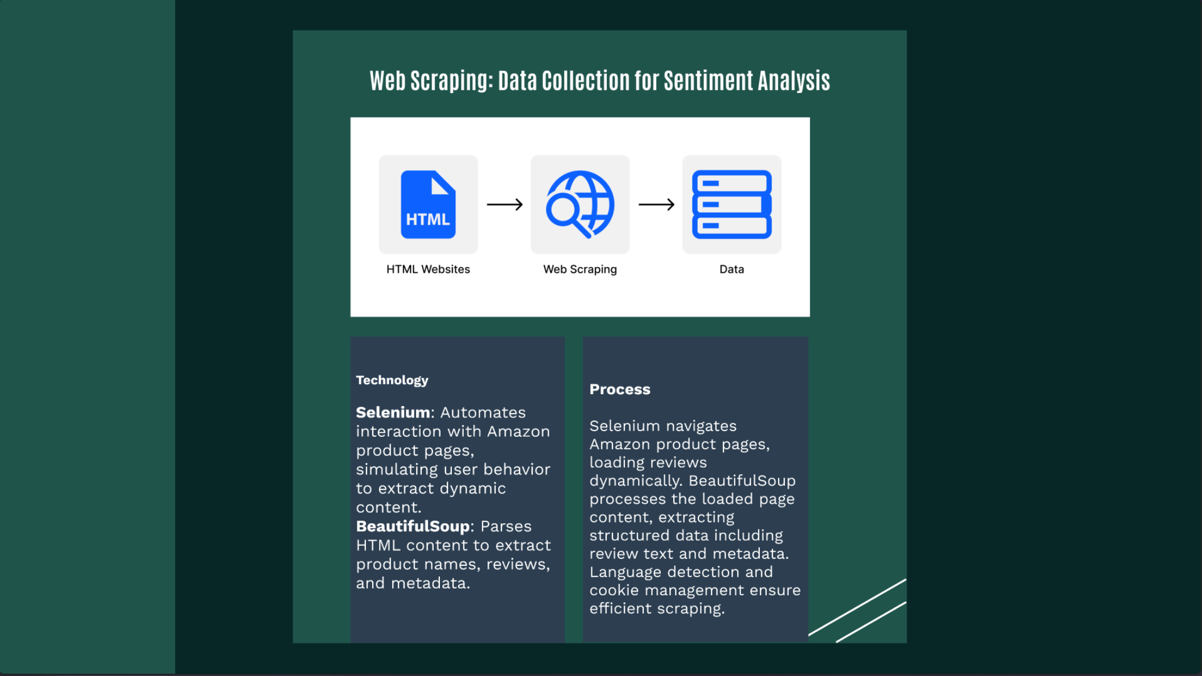
HTML Websites
Web Scraping
Data
Technology
Process
Selenium: Automates
interaction with Amazon
product pages, |  | .
simulating user behavior
to extract dynamic
content.
BeautifulSoup: |  |  | Parses
HTML content to extract product names, reviews,
and metadata.
Selenium navigates
Amazon product pages,
loading reviews
dynamically. BeautifulSoup processes the loaded page
content, extracting
structured data including
review text and metadata. Language detection and
cookie management ensure
efficient scraping.

Slide 28
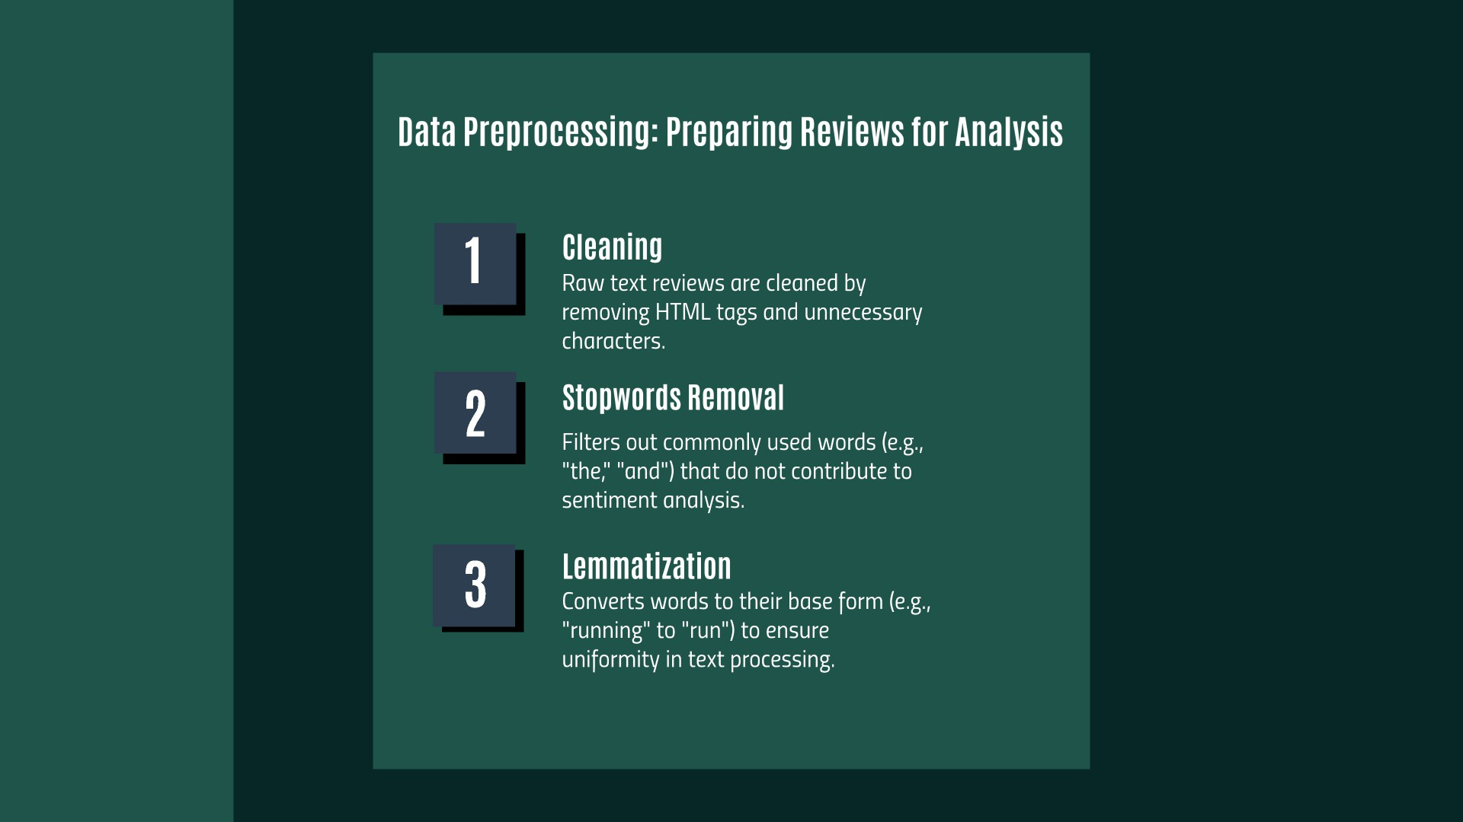

Slide 30
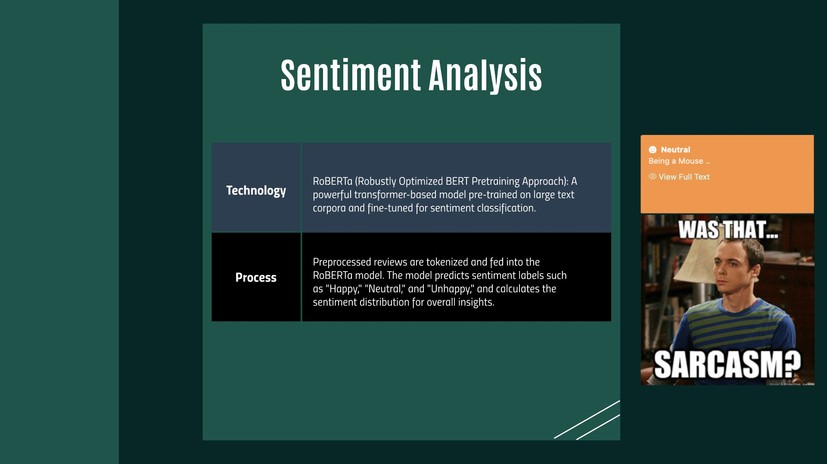

Slide 32
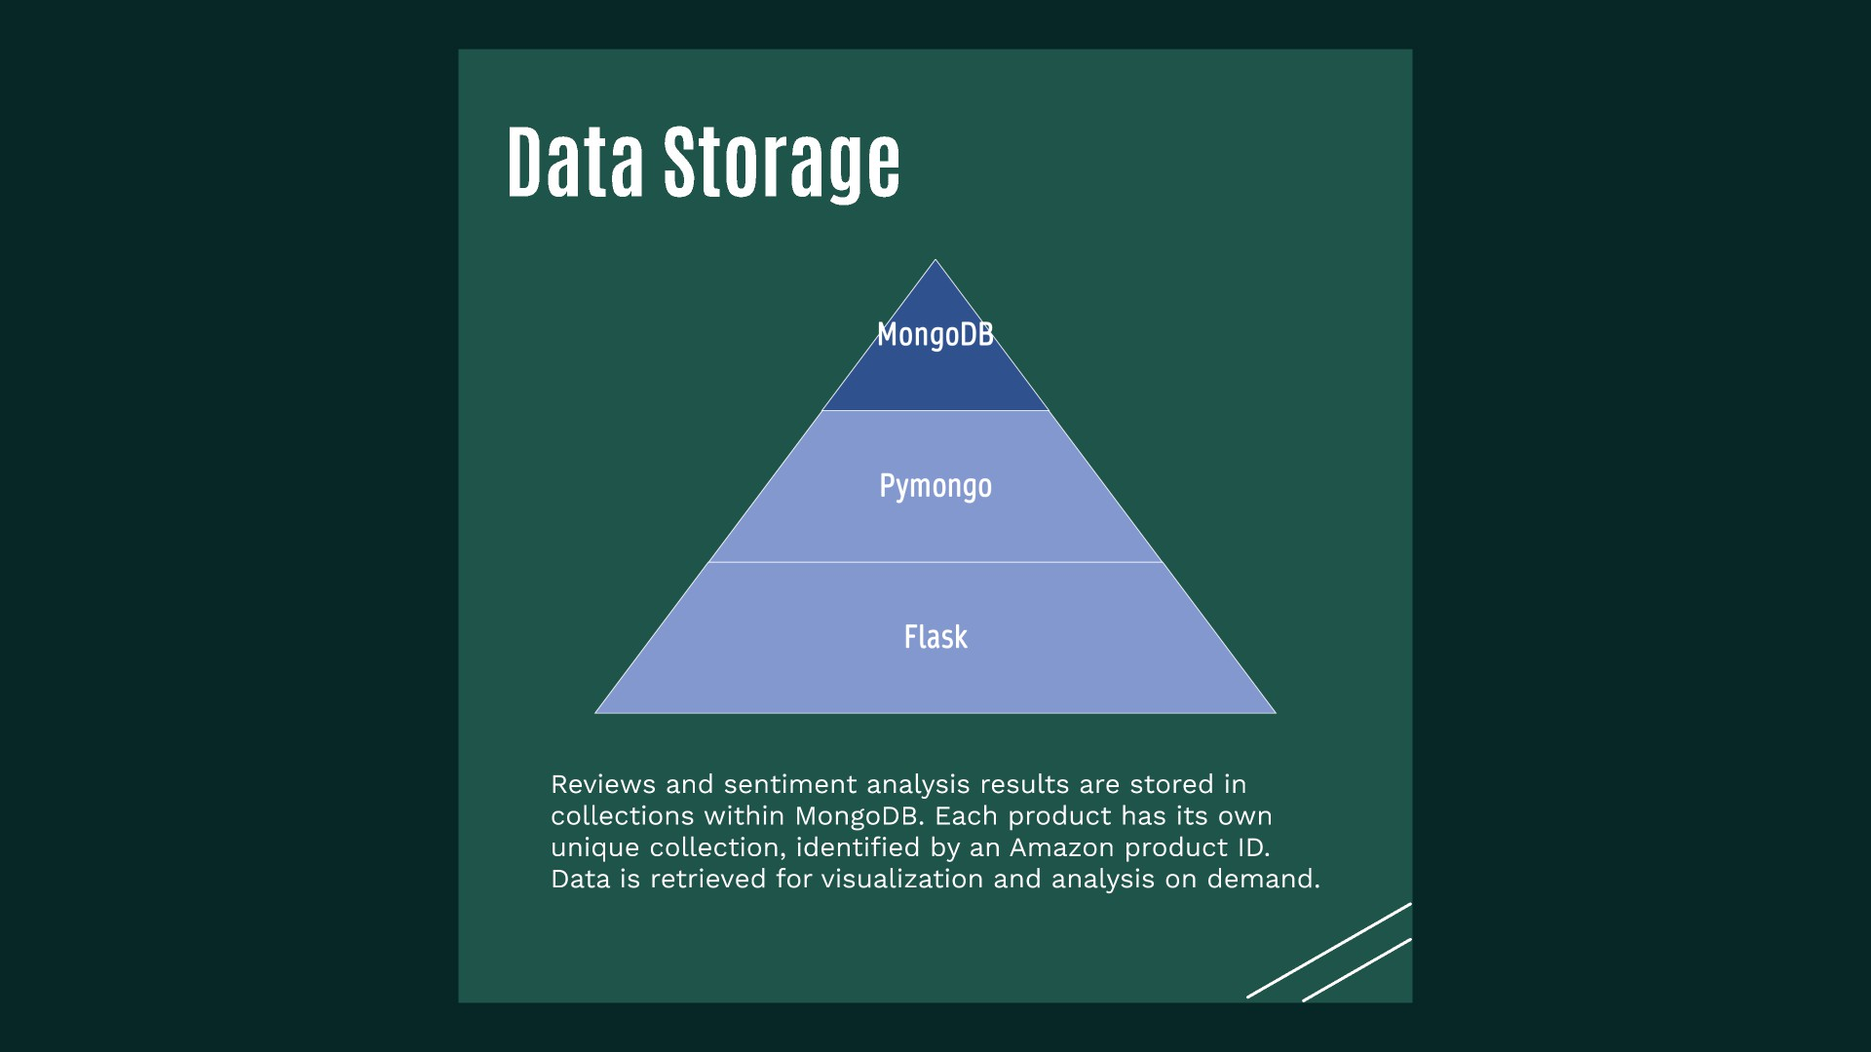

Slide 34
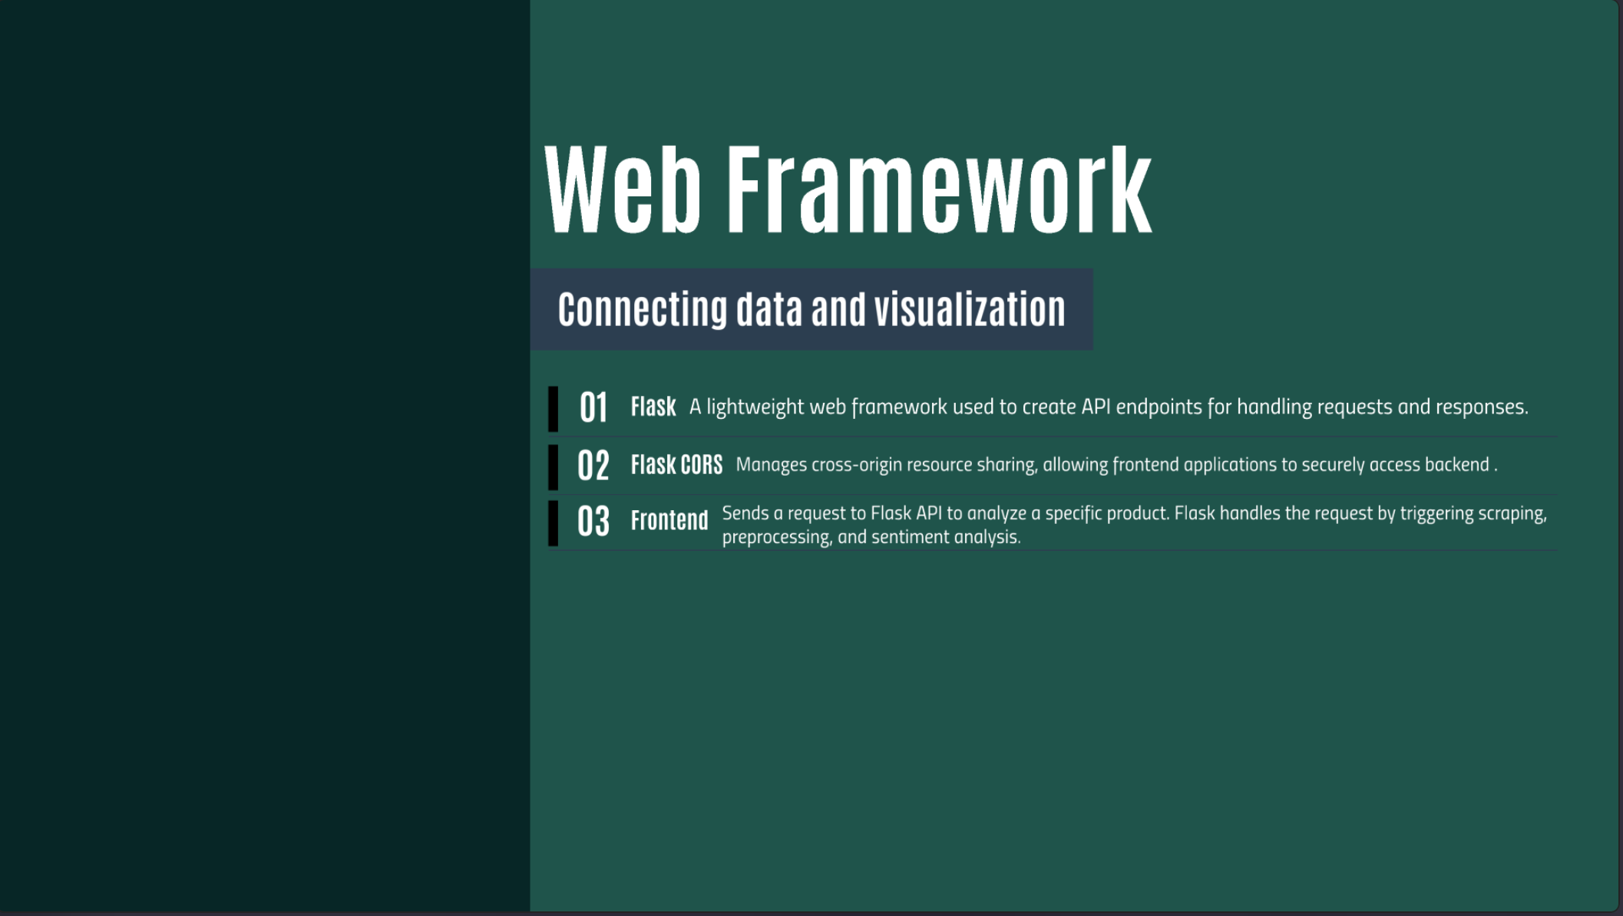
Web Framework
connecting data and visualization
01
Flask A lightweight web framework used to create API endpoints for handling requests ond responses.
02
Fl8Sk CORS
Manages cross-origin resource sharing, allowing frontend applications to securely access backend
.
03
frontend
Sends a request to Flask API to analyze a specific product. Flask handles the request by triggering scraping,
preprocessing, and sentiment analysis
.

Slide 37
^{l}.-----,^{I}L^{c}
Scrape Reviews
Preprocess Data: Clean, tokenixe and format text data
for analysis
Prepare for Sentiment Analysis:
Remove Stopwords, normalize
₋ text, structure input for ML model
J
Creating Flask API for processing user inputs
Deciding on suitable Technologies
f
l-.
Add RoBERTa model for sentiment classification
'--+
r---+
IUse Selenium and BS for dynamic
IScraping
[±]
'-------'
Test Interactivity and ensure seamless navigation
Implement features: charts, chatbot assistance
Design UI
Combine Components: Connect Backend with the Frontend
Test Workflow: Verify data flow between scraping,
sentiment analysis
[±]

Slide 38
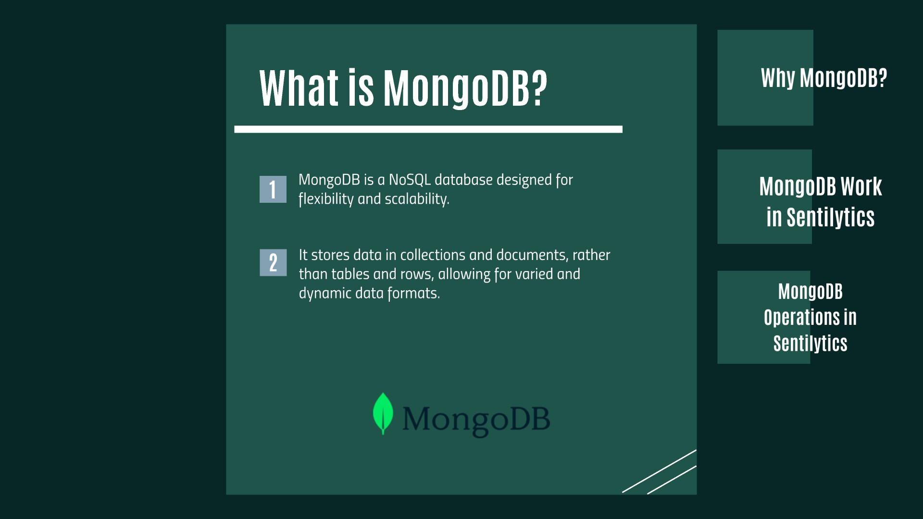

Slide 39
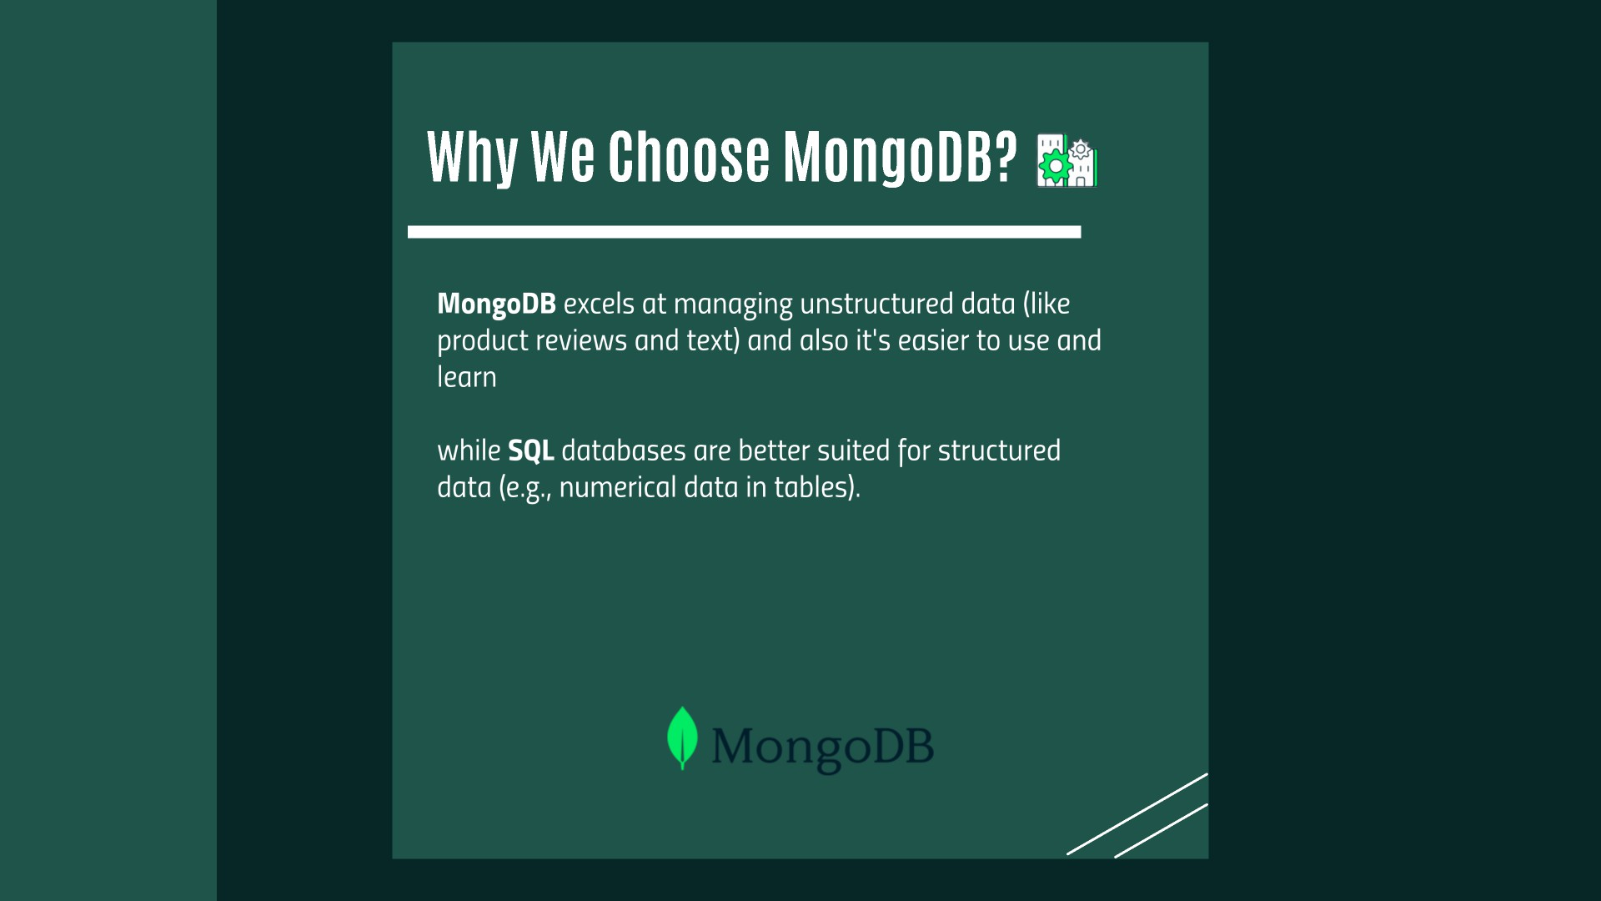

Slide 41
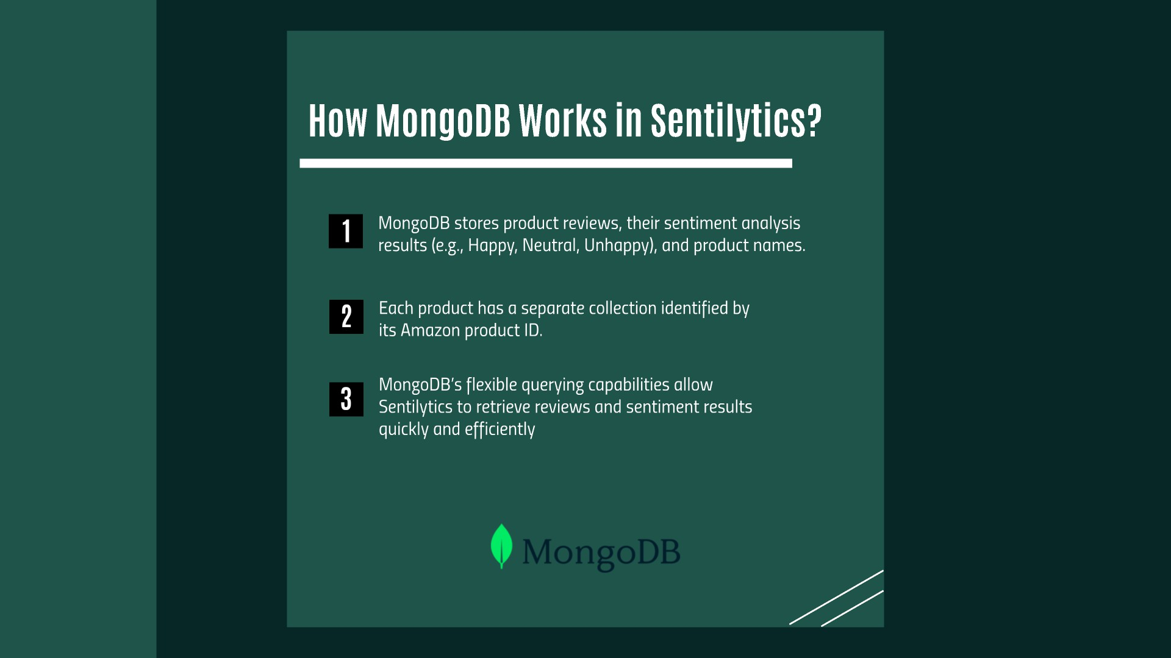

Slide 43
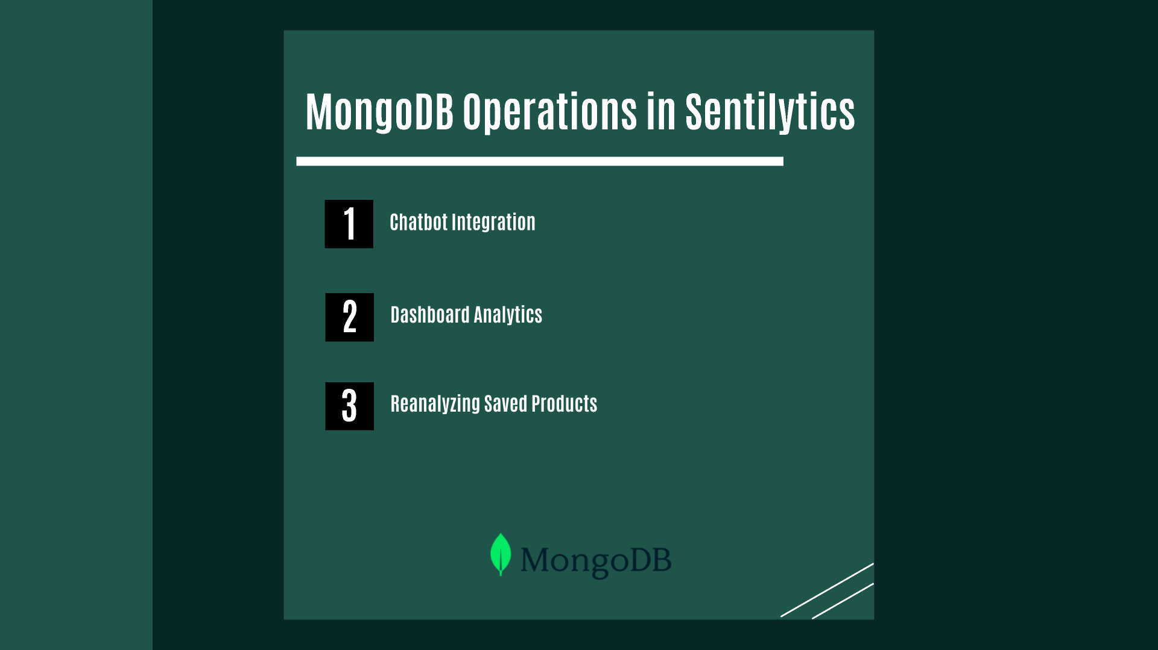

Slide 45
^{l}.-----,^{I}L^{c}
Scrape Reviews
Preprocess Data: Clean, tokenixe and format text data
for analysis
Prepare for Sentiment Analysis:
Remove Stopwords, normalize
₋ text, structure input for ML model
J
Creating Flask API for processing user inputs
Deciding on suitable Technologies
f
l-.
Add RoBERTa model for sentiment classification
'--+
r---+
IUse Selenium and BS for dynamic
IScraping
[±]
'-------'
Test Interactivity and ensure seamless navigation
Implement features: charts, chatbot assistance
Design UI
Combine Components: Connect Backend with the Frontend
Test Workflow: Verify data flow between scraping,
sentiment analysis
[±]

Slide 46
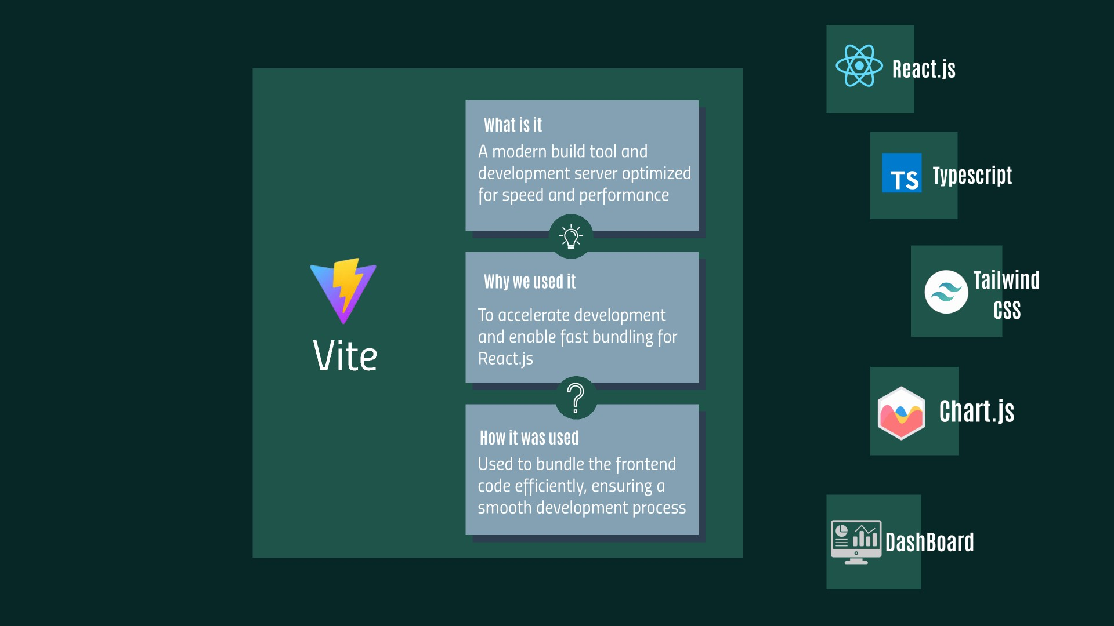

Slide 47
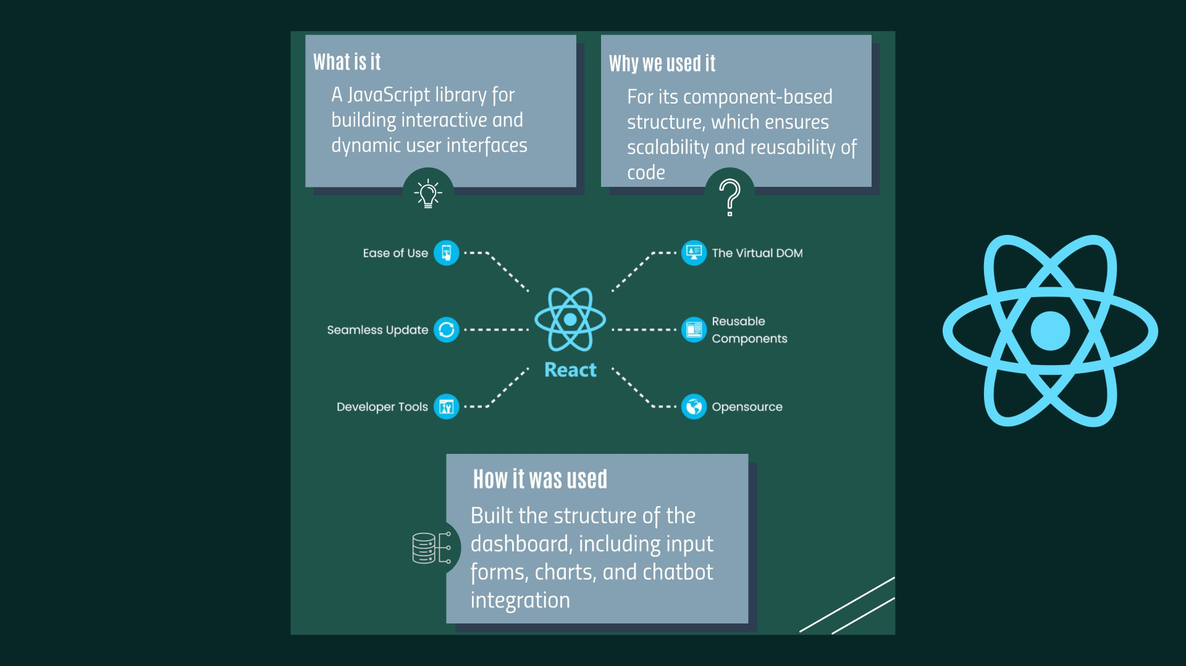

Slide 49
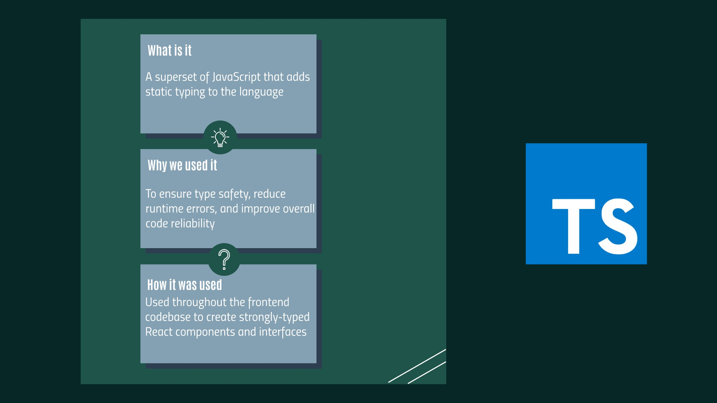

Slide 51
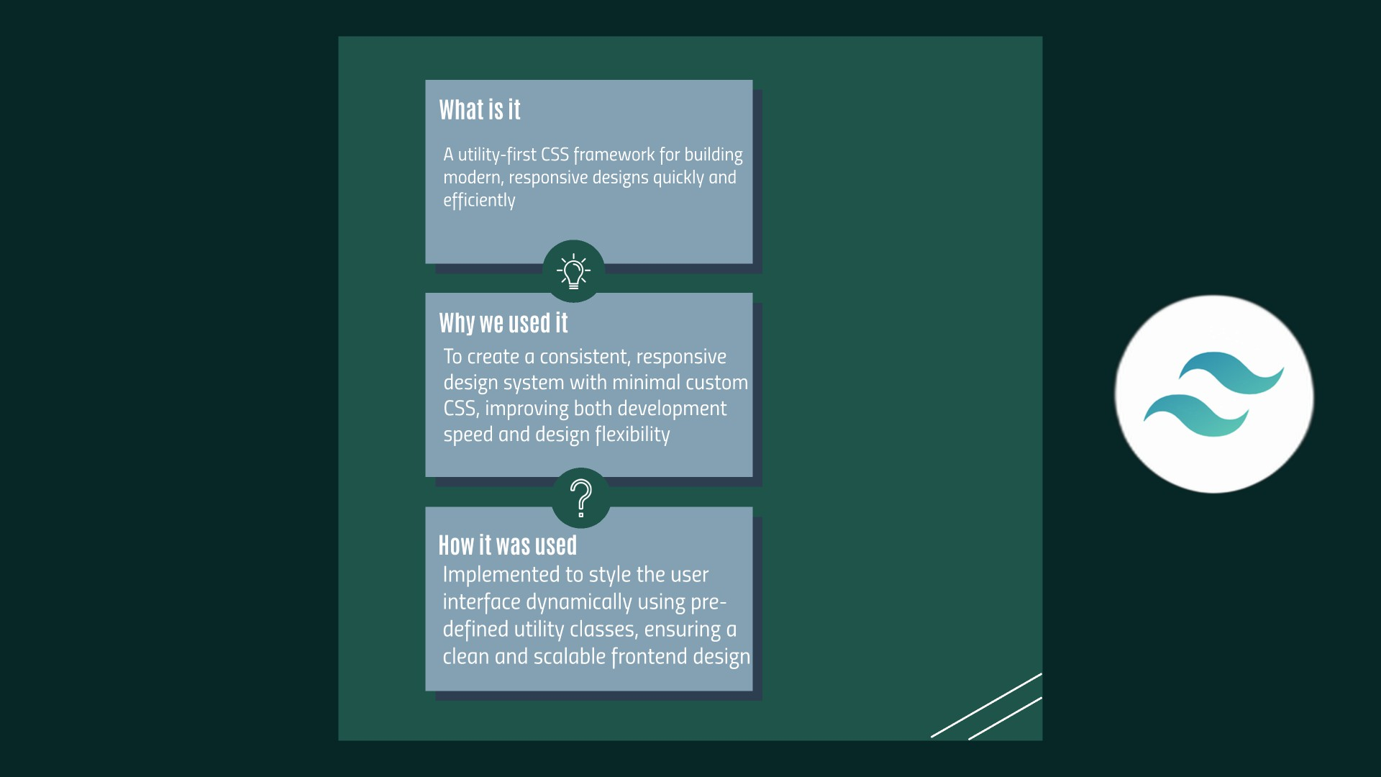

Slide 53
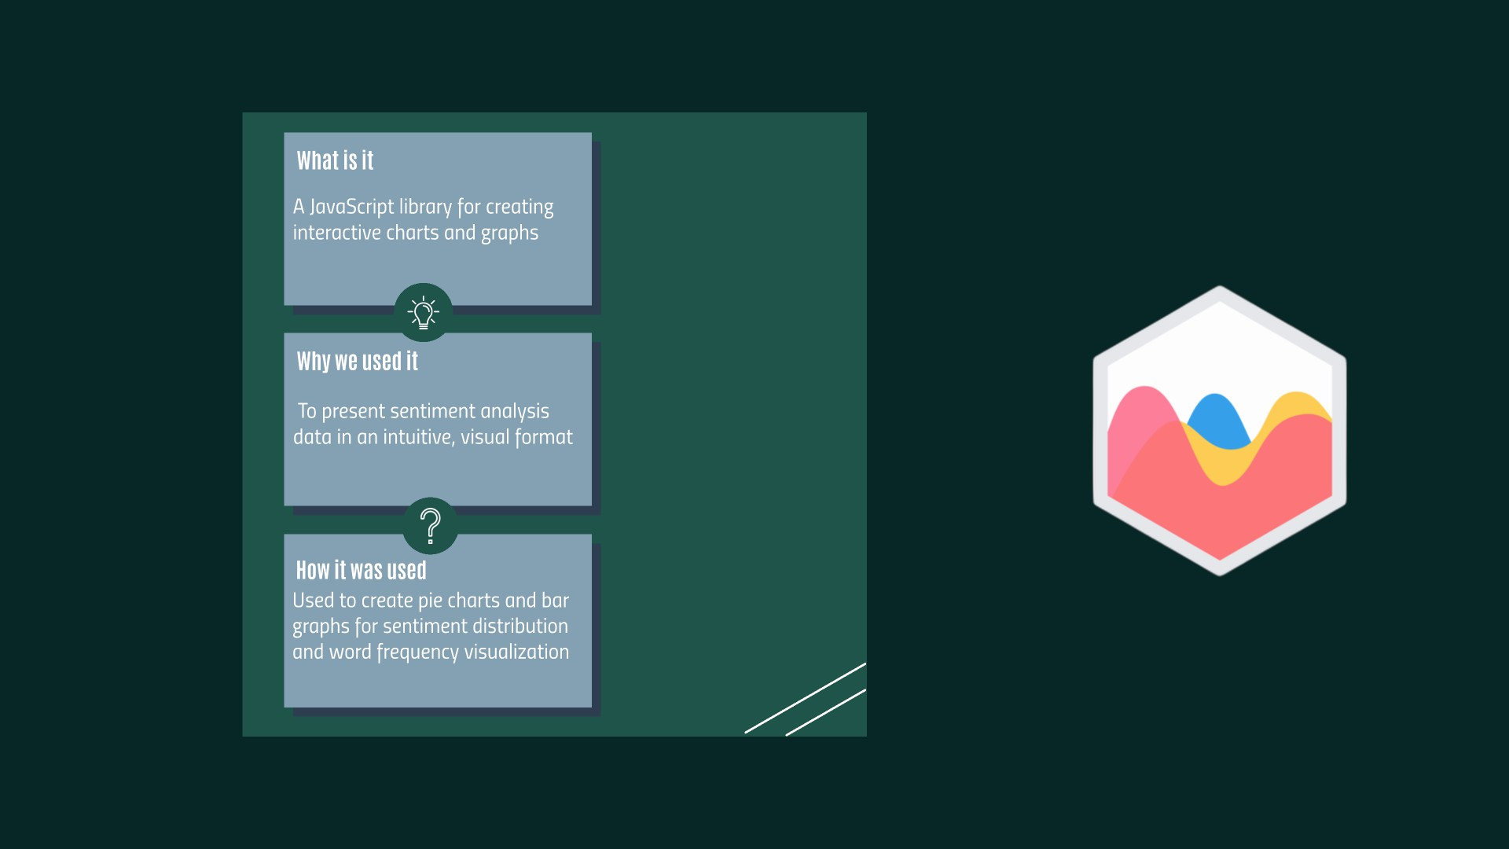

Slide 55
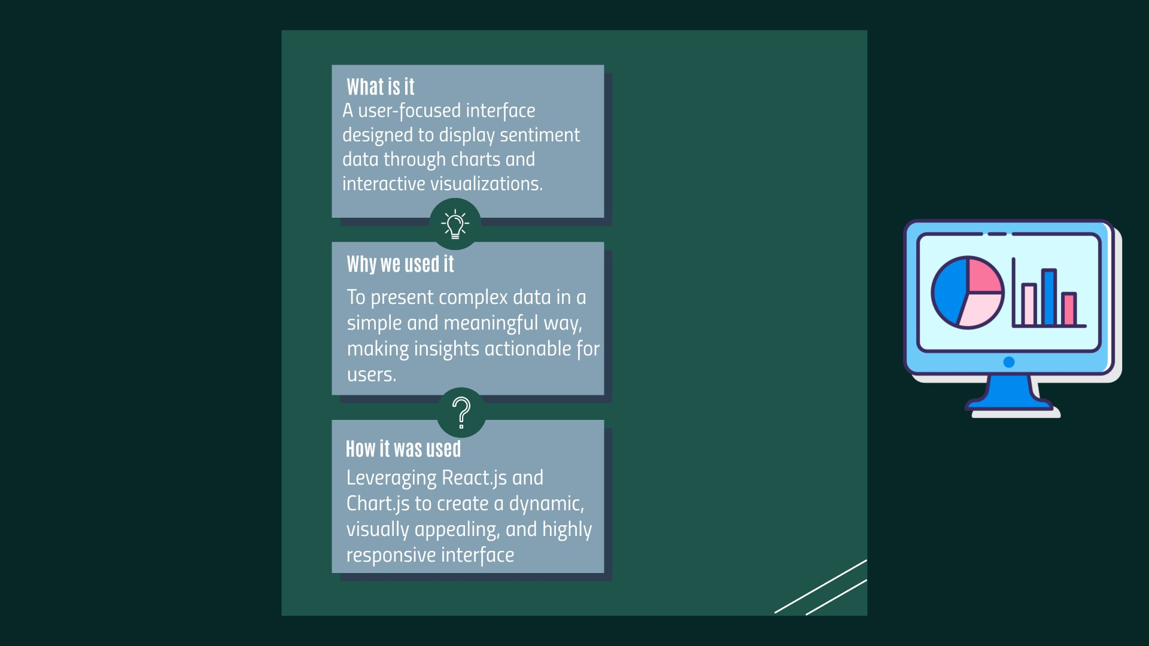

Slide 57
^{l}.-----,^{I}L^{c}
Scrape Reviews
Preprocess Data: Clean, tokenixe and format text data
for analysis
Prepare for Sentiment Analysis:
Remove Stopwords, normalize
₋ text, structure input for ML model
J
Creating Flask API for processing user inputs
Deciding on suitable Technologies
f
l-.
Add RoBERTa model for sentiment classification
'--+
r---+
IUse Selenium and BS for dynamic
IScraping
[±]
'-------'
Test Interactivity and ensure seamless navigation
Implement features: charts, chatbot assistance
Design UI
Combine Components: Connect Backend with the Frontend
Test Workflow: Verify data flow between scraping,
sentiment analysis
[±]

Slide 58

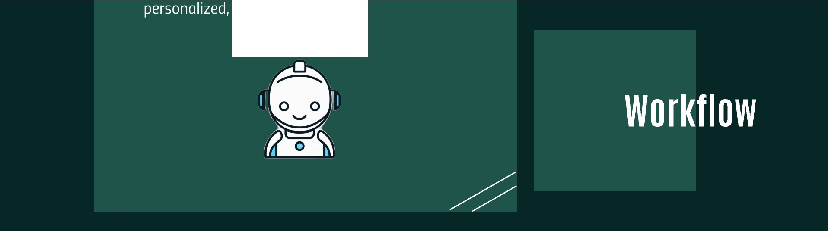
insightful resonses.

Slide 59
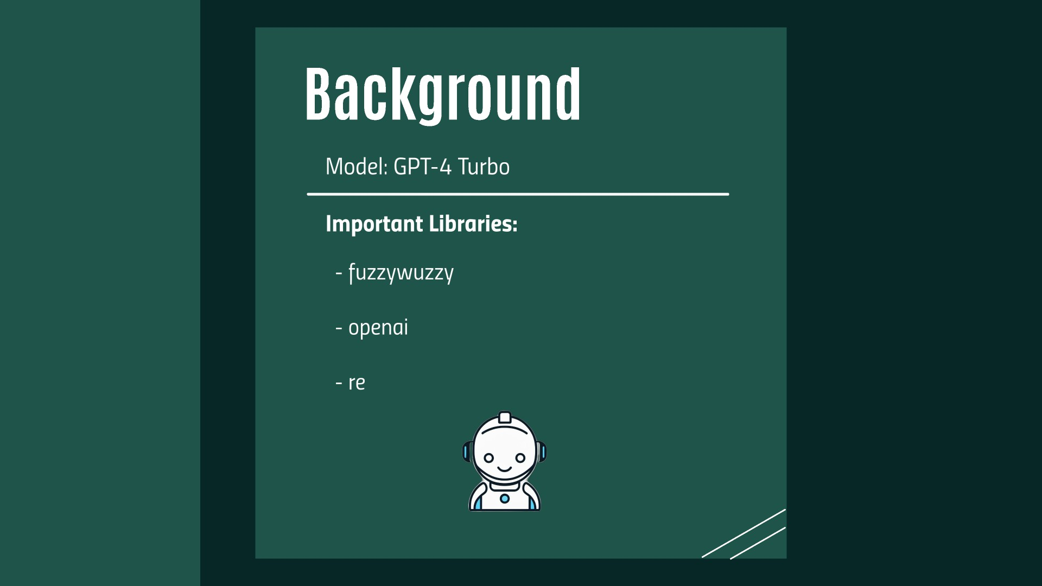

Slide 60
insightful resP.onses.

Slide 61
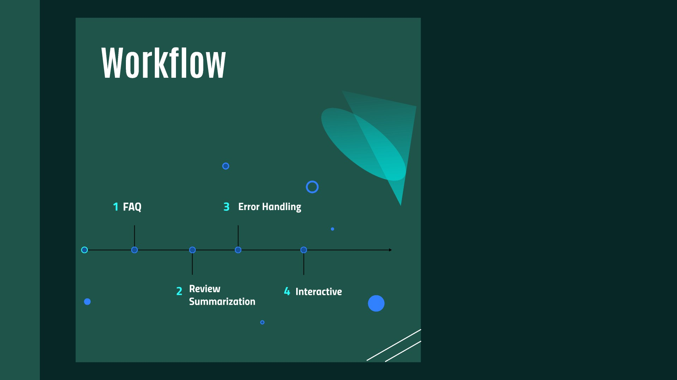

Slide 62
insightful resP.onses.

Slide 63
^{l}.-----,^{I}L^{c}
Scrape Reviews
Preprocess Data: Clean, tokenixe and format text data
for analysis
Prepare for Sentiment Analysis:
Remove Stopwords, normalize
₋ text, structure input for ML model
J
Creating Flask API for processing user inputs
Deciding on suitable Technologies
f
l-.
Add RoBERTa model for sentiment classification
'--+
r---+
IUse Selenium and BS for dynamic
IScraping
[±]
'-------'
Test Interactivity and ensure seamless navigation
Implement features: charts, chatbot assistance
Design UI
Combine Components: Connect Backend with the Frontend
Test Workflow: Verify data flow between scraping,
sentiment analysis
[±]

Slide 65
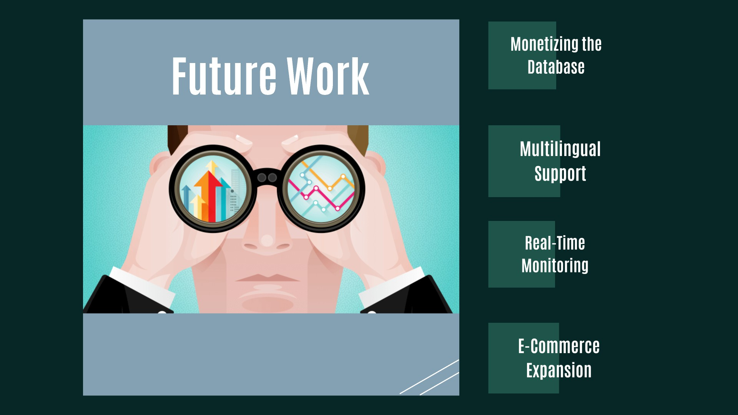

Slide 66
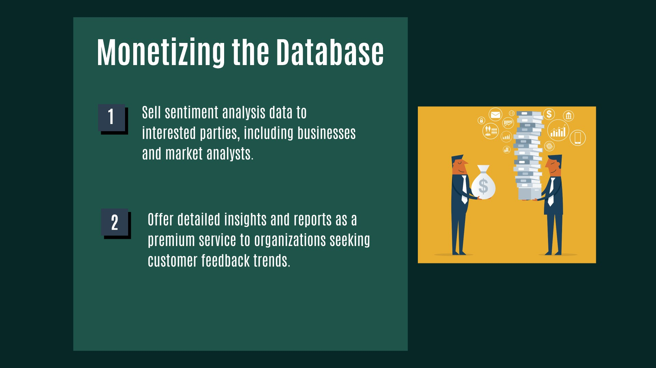

Slide 68
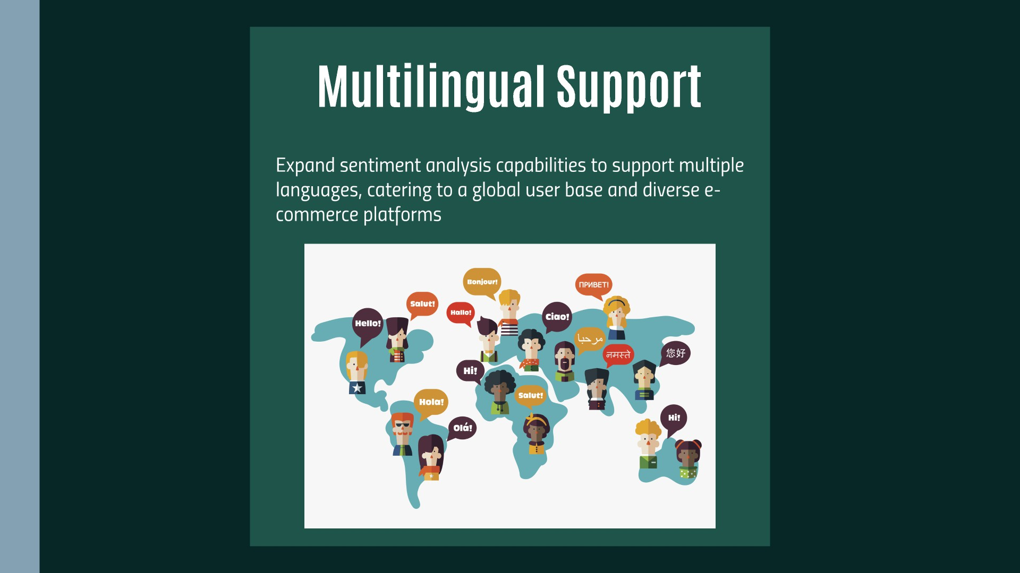

Slide 70
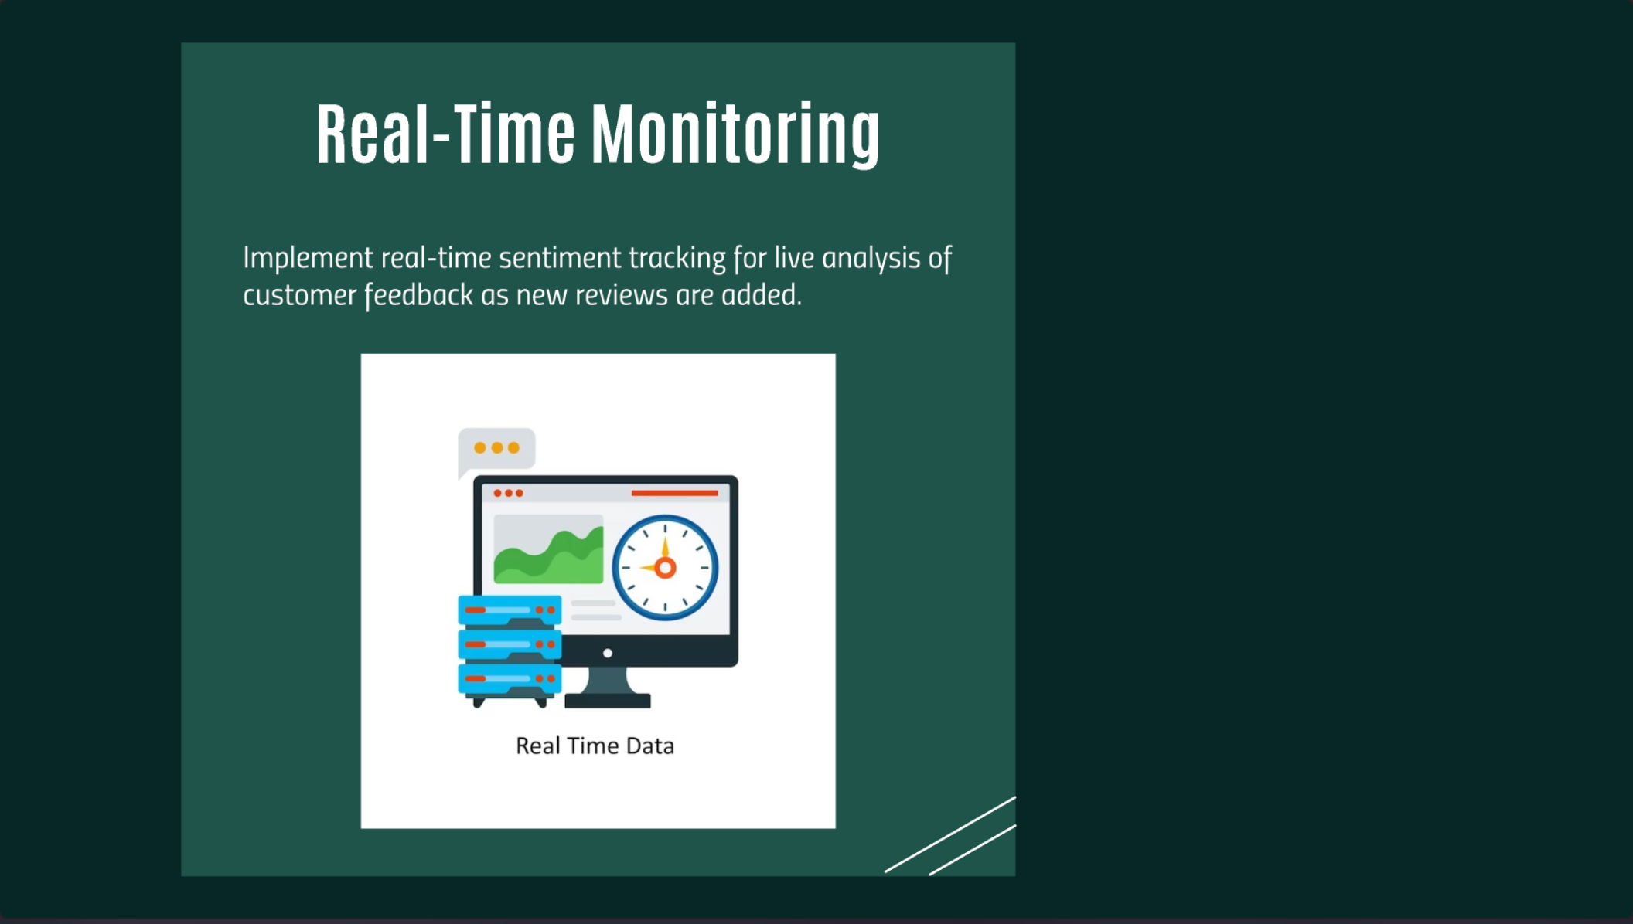

Real-Time Monitoring
Implement real-time sentiment tracking for live analysis of
customer feedback as new reviews are added.
•••
•••
Real Time Data

Slide 72
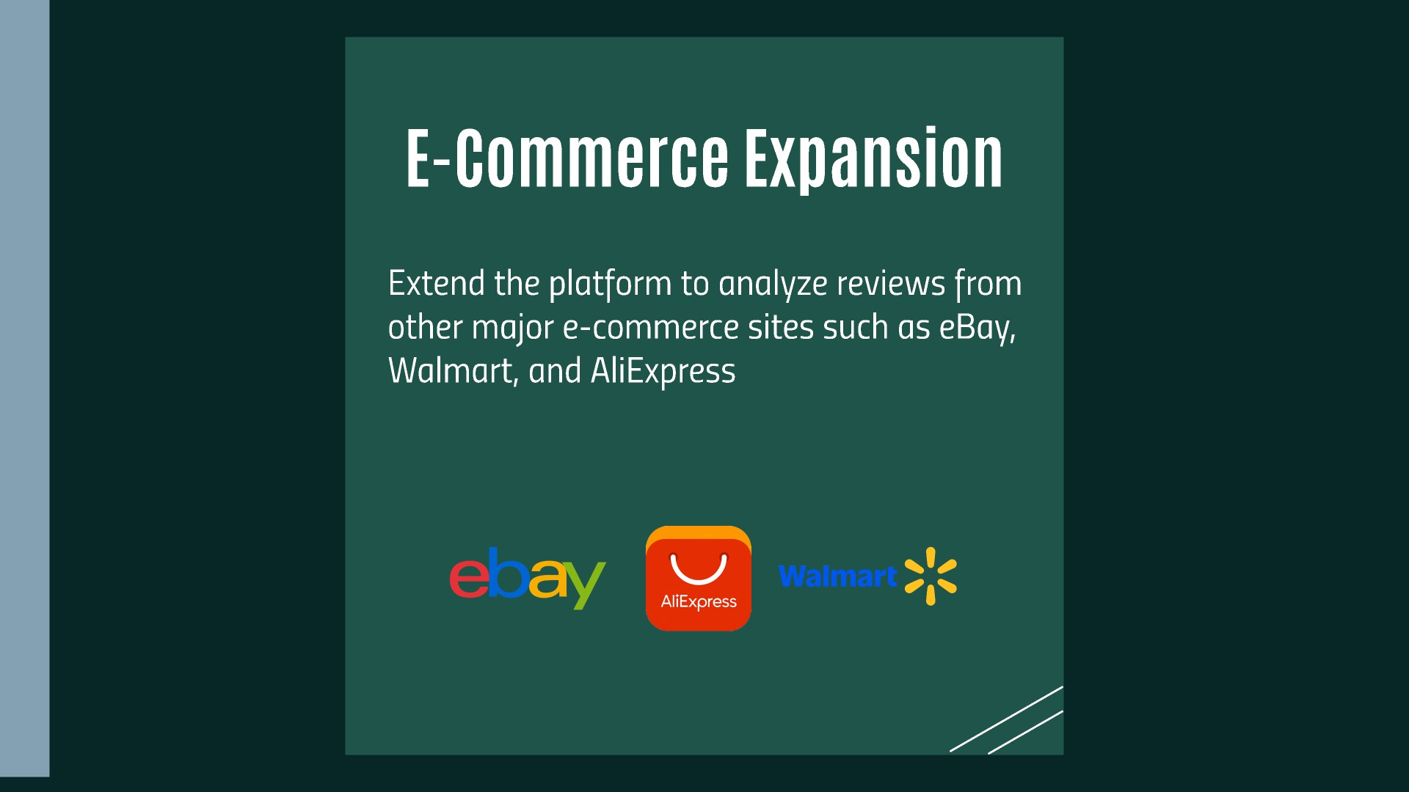

Slide 75
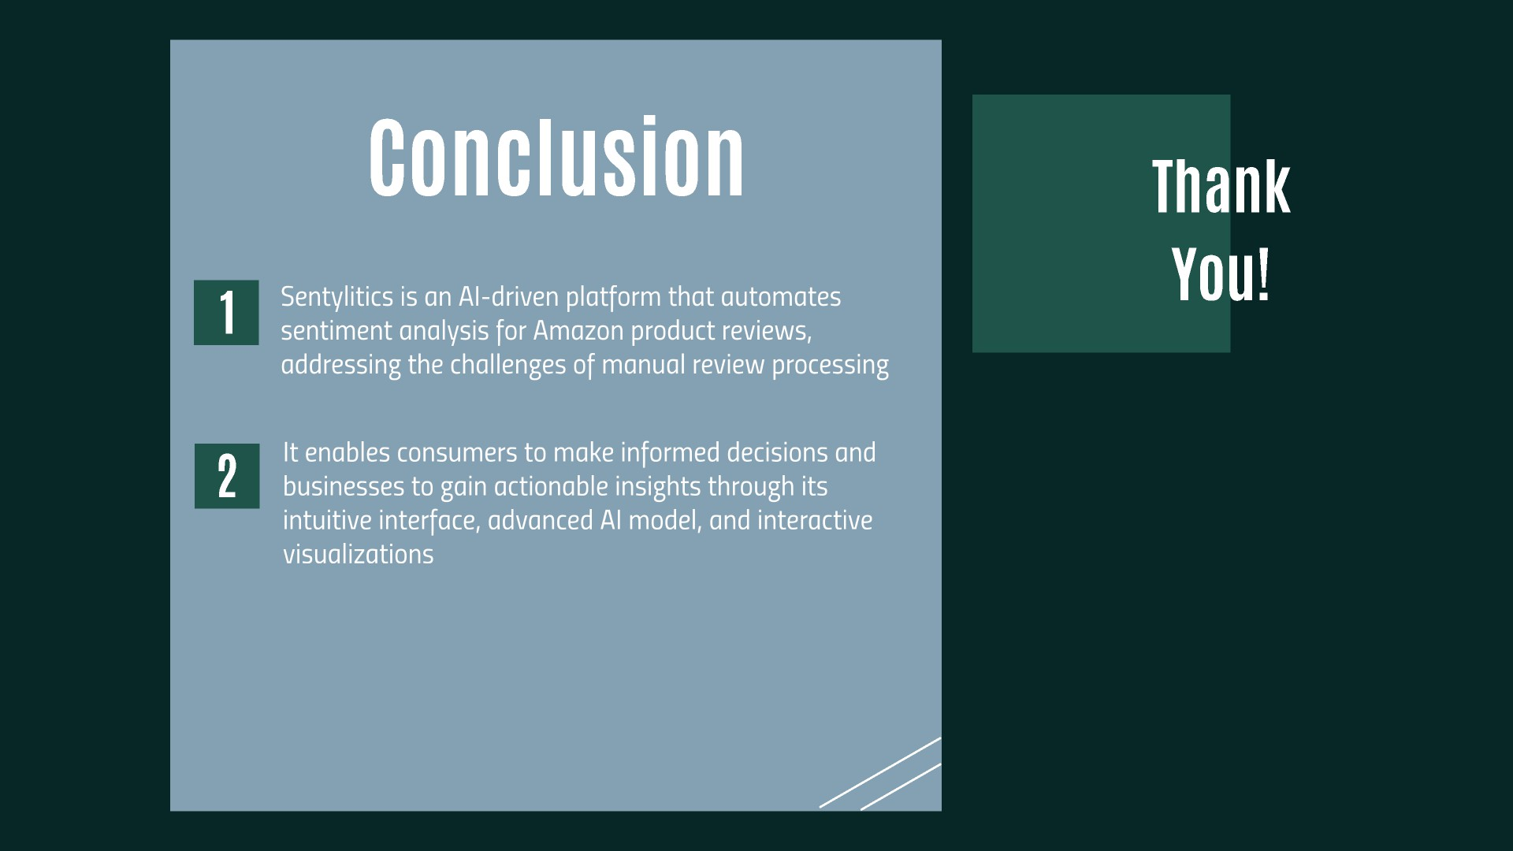

Slide 76
