Slide 1

An-Najah National University
Faculty of Engineering
Building Engineering Department
(Graduation Project 2)
prepared by
Osaid jaber , amer omar , fadel ayash and bilal salahat
Restaurant Design
Supervisor : Eng. Narmeen Al-Barq

Slide 2
Contents
Site analysis
Architectural Design
Environmental Design
Structural system Design
Electro-Mechanical system Design
Safety design
Quantity Survey and Cost

Slide 3
Environmental Design

Slide 4
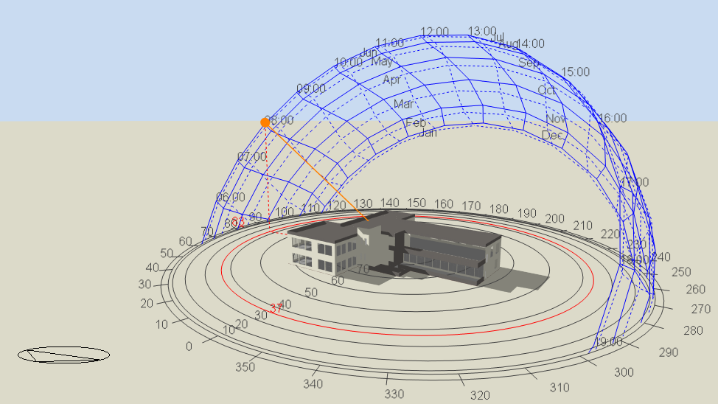
Environmental Design solar analysis
In a summer day
21/jun at 8.00 am

Slide 5
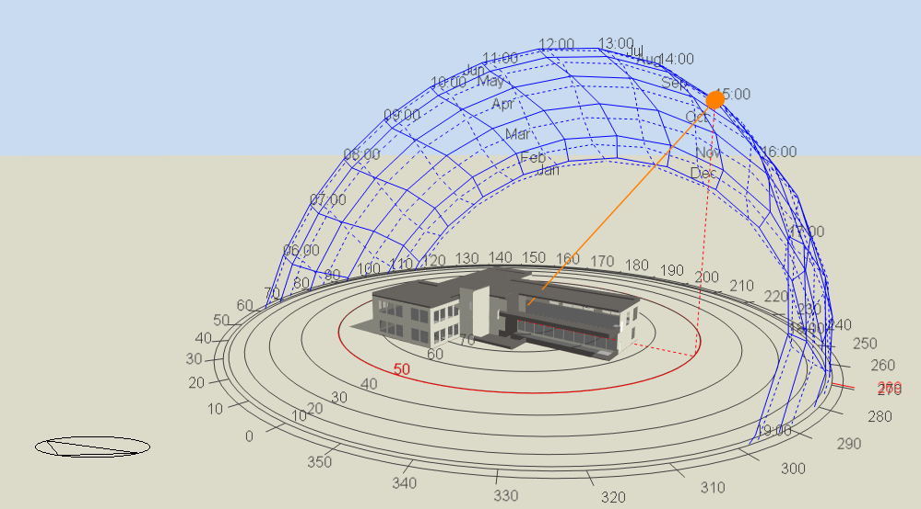
Environmental Design solar analysis
In a summer day
21/jun at 3.00 pm

Slide 6
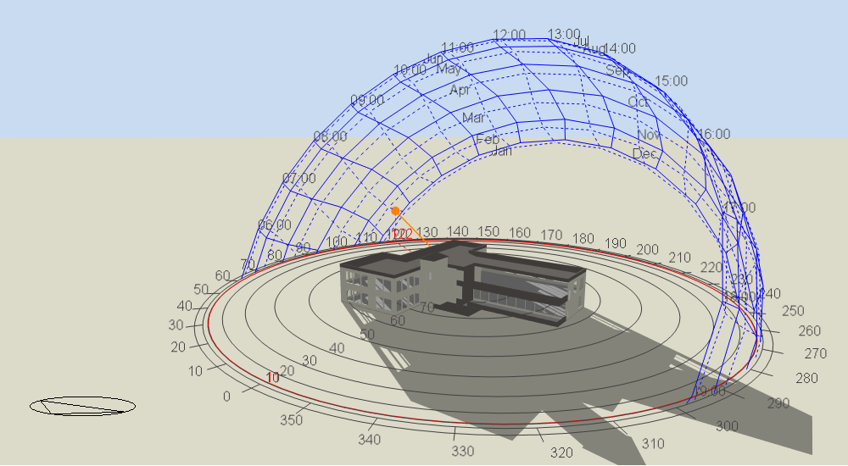
Environmental Design solar analysis
In a winter day
21/jan at 8.00 am

Slide 7
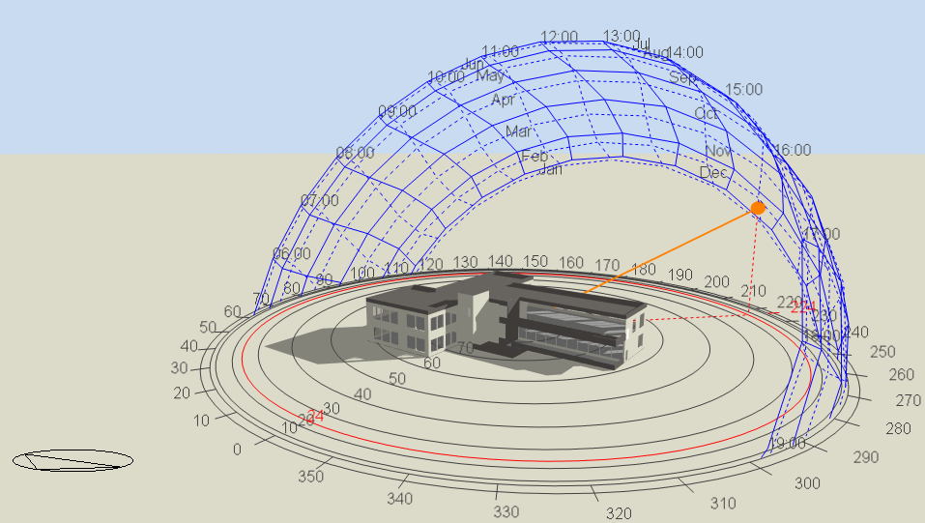
Environmental Design solar analysis
In a winter day
21/jan at 3.00 pm

Slide 8
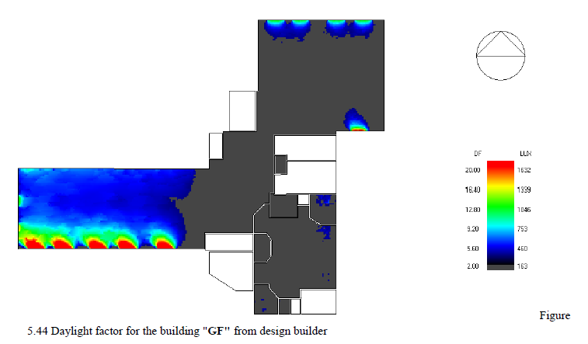
Solar Analysis
Daylight factor

Slide 9
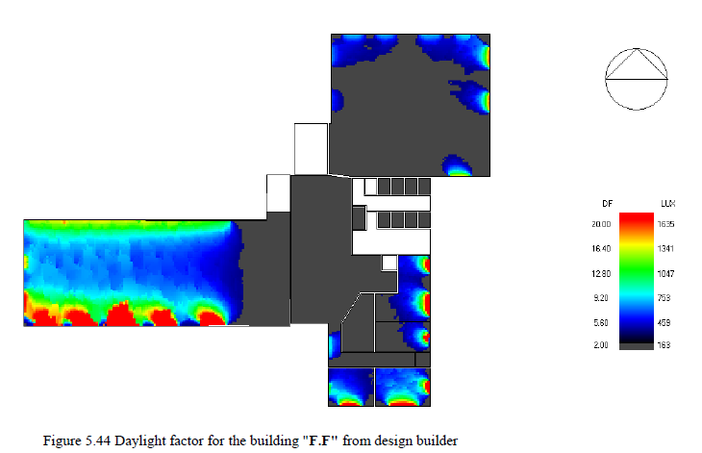
Solar Analysis
Daylight factor :

Slide 10
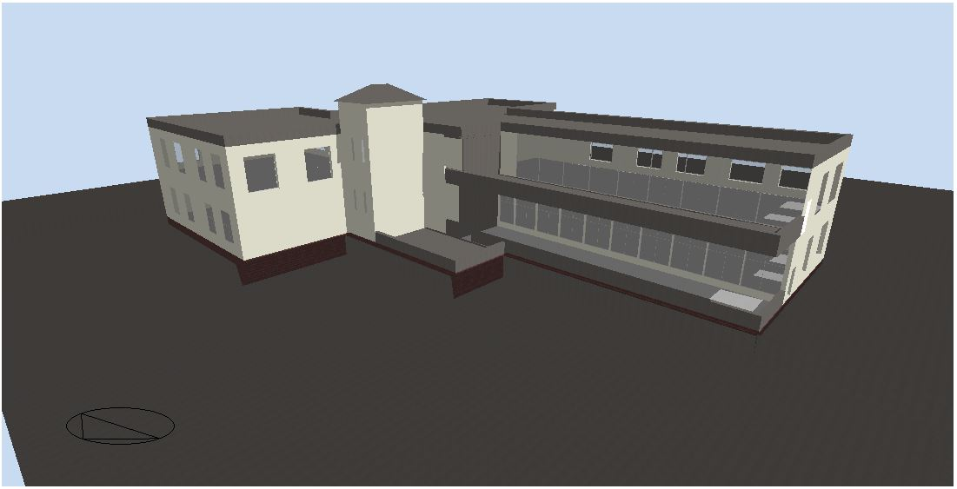
Heating and Cooling Load
Total Heating Capacity = 75.610 kW
Total Cooling Capacity = 111.55 kW

Slide 11
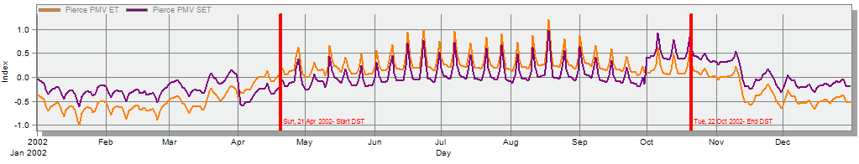
Thermal Comfort
PMV graph

Slide 12
Environmental Design
Thermal Design
Old U-value for building envelope
u-value w/m²-k | component
2.243 | External wall
1.512 | Partition
3.084 | Floor
1.912 | Roof
2.70 | Windows

Slide 13
Environmental Design
New U-value for building envelope
u-value w/m²-k | component
0.481 | External wall
1.955 | Partition
0.487 | Floor
0.498 | Roof
1.761 | Windows

Slide 14
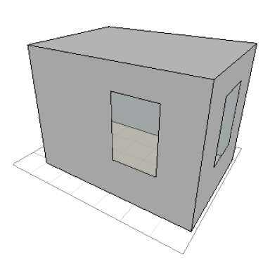
Acoustical analysis (RT60):
- Manager office:
Acceptable range = (0.6-1.3) sec .
empty space
RT60 at 500 Hz=0.62 s
RT60 at 250 Hz=0.67 s
RT60 at 125 Hz=0.7 s

Slide 15
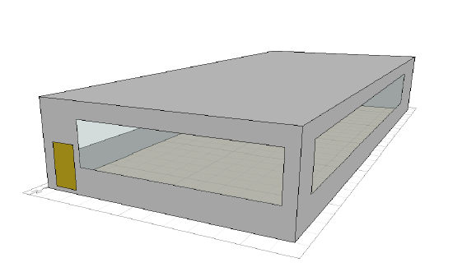
Acoustical analysis (RT60):
DINING HALL :
Acceptable range = (0.6-1.3) sec .
empty space
RT60 at 500 Hz=0.67 s
RT60 at 250 Hz=0.72 s
RT60 at 125 Hz=0.76 s
RT60 at 63 Hz=0.79 s

Slide 16
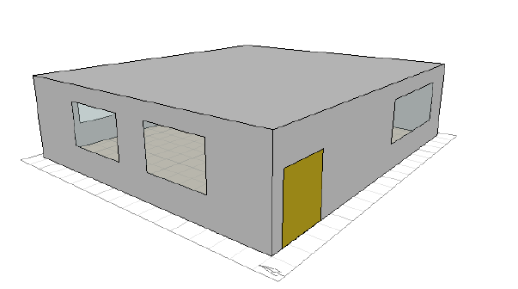
Acoustical analysis (RT60):
DINING HALL 2 :
Acceptable range for Manager office= (0.6-1.3) sec .
empty space
RT60 at 500 Hz=0.64 s
RT60 at 250 Hz=0.94s
RT60 at 125 Hz=1.03 s

Slide 17
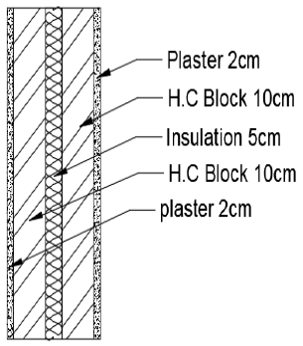
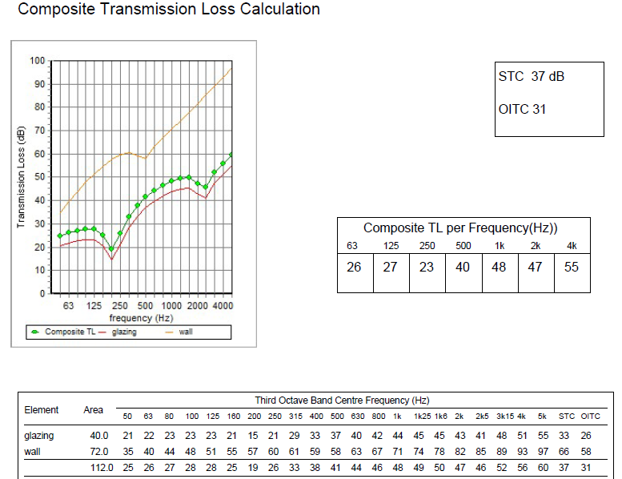
Acoustical analysis (STC):
External wall of DINING HALL 1 :

Slide 18
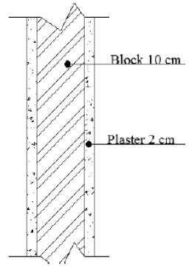
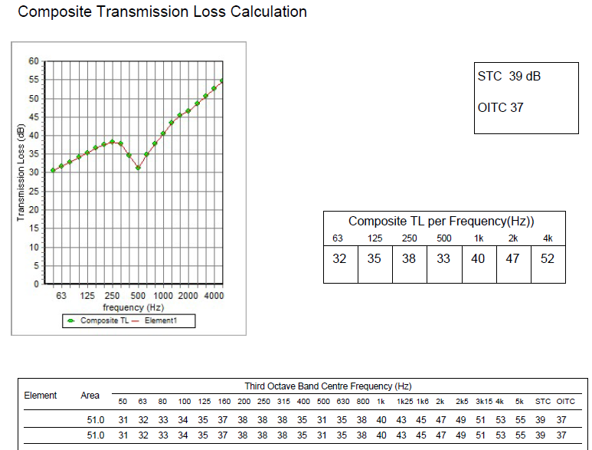
Acoustical analysis (STC):
DINING HALL 1 internal partition exposed to waiting

Slide 19
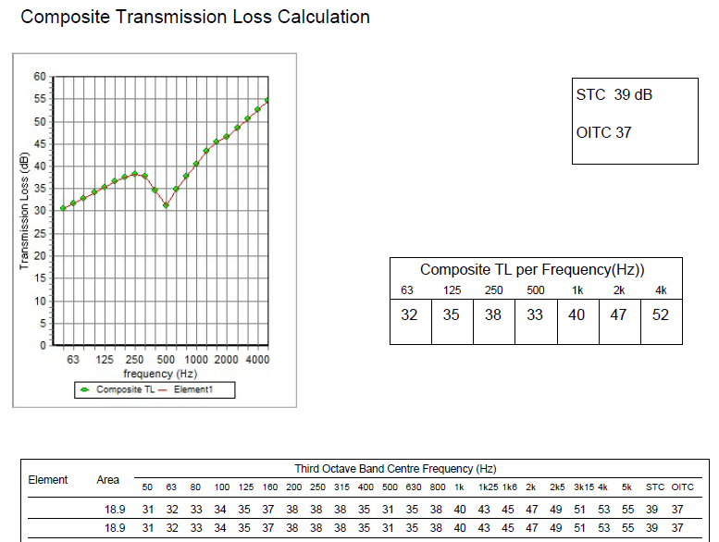
Acoustical analysis (STC):
MANAGER OFFICE internal partition :

Slide 20
Electrical design

Slide 21
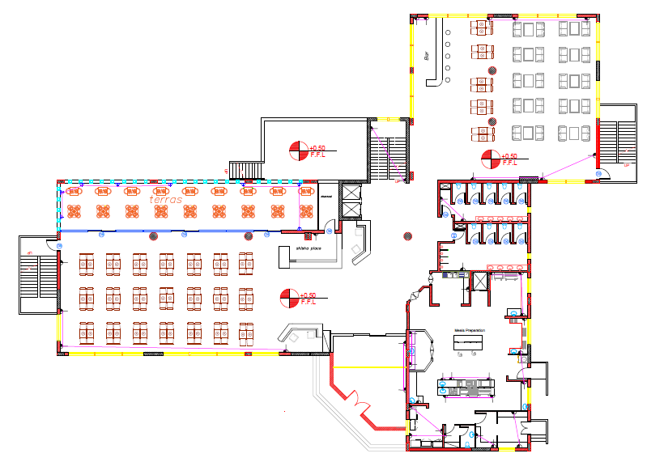
Electrical design
Ground Floor socket plan

Slide 22
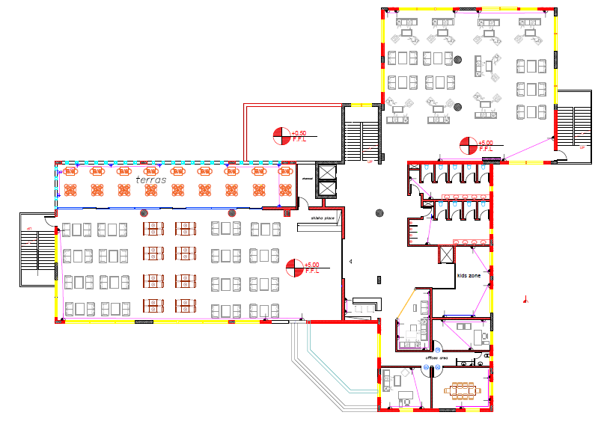
Electrical design
First Floor socket plan

Slide 23
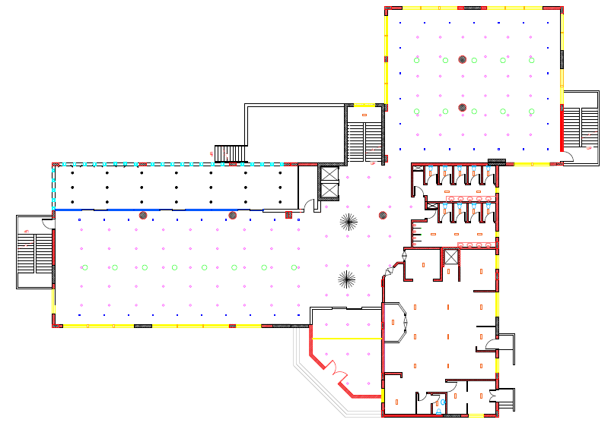
Ground Floor Lighting Plan

Slide 24
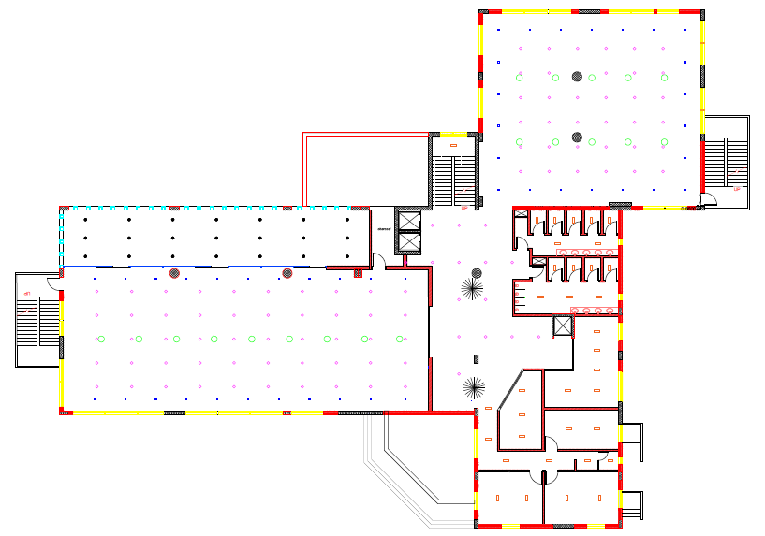
First Floor Lighting Plan

Slide 25
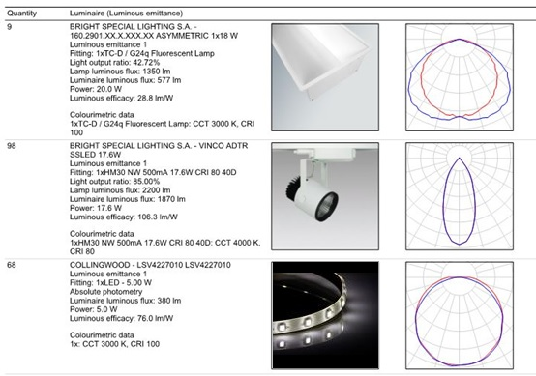
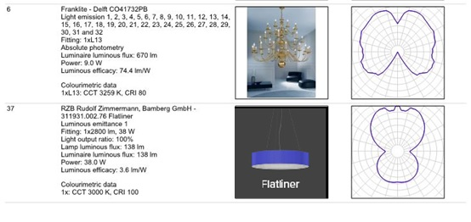
Luminaires selection :

Slide 26
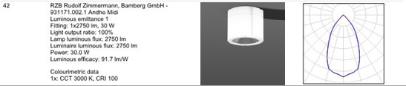
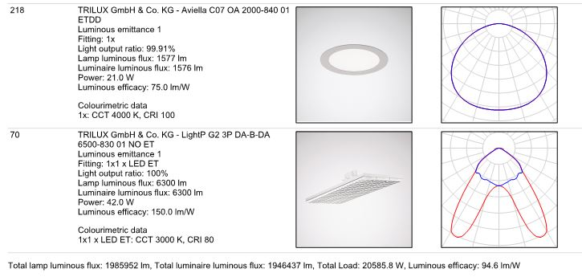
Luminaires selection :

Slide 27
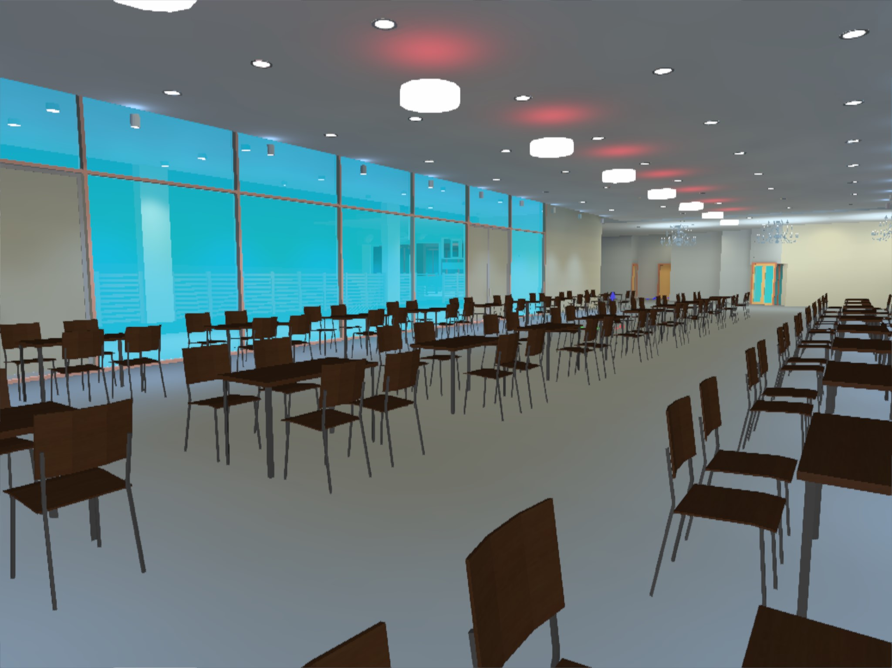
Dialux picture : dining hall

Slide 28
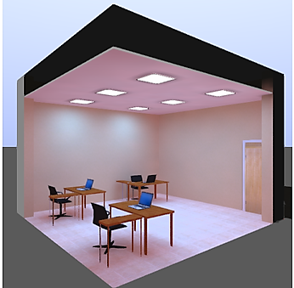
Dialux picture : manager office

Slide 29
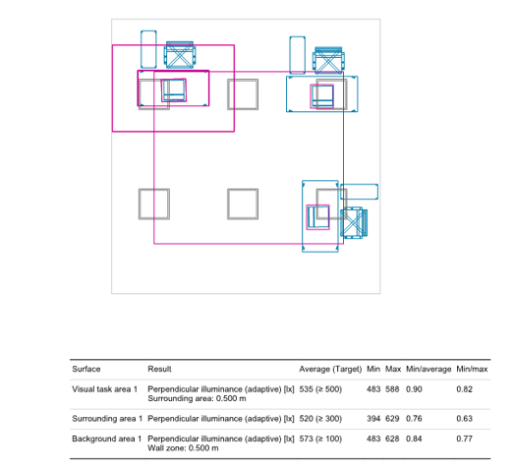
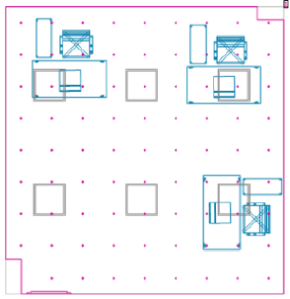
manager office
Required illuminance 500 lux
Required uniformity (>0.60)
Average Illuminance
535 Lux

Slide 30
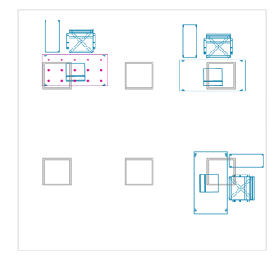
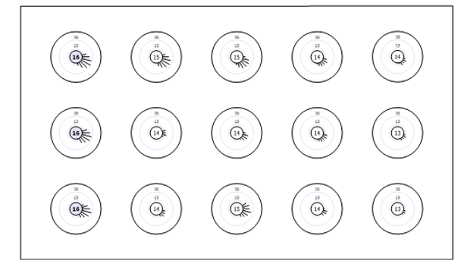
manager office (UGR)
UGR = 17.7

Slide 31
Structural design

Slide 32
The structural design was made by using "ETABS" software

Slide 33
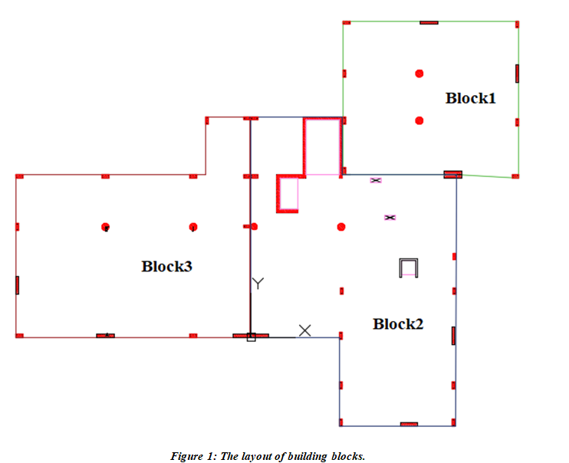
We divided the project to three blocks

Slide 34
Design codes
1. ACI – 318 for reinforced concrete design.
2. UBC – 97 for seismic design.

Slide 35
Material properties
- Allowable bearing capacity (q_{all}) = 250 kN/m²
Concrete:
fʹ_{c} of slab and beams equal to 24 MPa and for columns and footing equals to 28 MPa.
Steel bars: yielding strength (F_{y}) = 420 MPa.

Slide 36
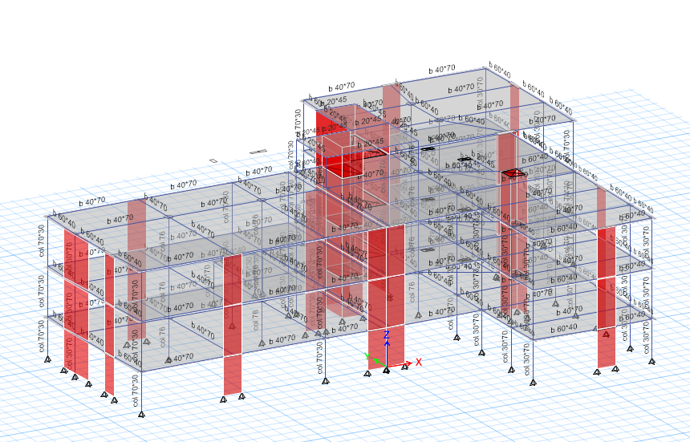
Building Modeling:

Slide 37
Loads
Super imposed load (SID): 4KN/m²
.
Dead Load: is represented by the own weight of the structure.
Live load: load of the occupancy and furniture of restaurant building. Live load = 5 KN/m².
Seismic load due earthquake

Slide 38
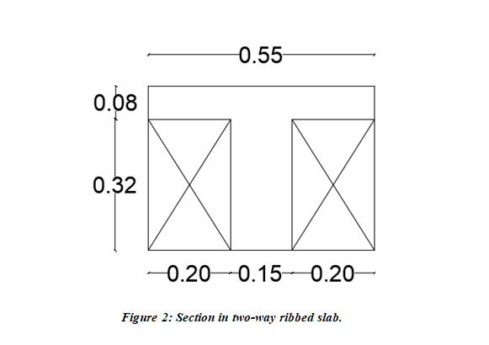
Slab System:
Two-way ribbed slab was used , the expected thickness of slab according to h = 𝐿max /27 = 11 /27 = 0.4m.

Slide 39
Beams
The beams used in this building have dimensions of (40*70) cm, (20*45) cm, (60*40) cm,

Slide 40
Columns
There are two types of square columns with diameter of (75) cm and (65) cm and one type of rectangular columns with dimension of (70 * 30 cm).

Slide 41
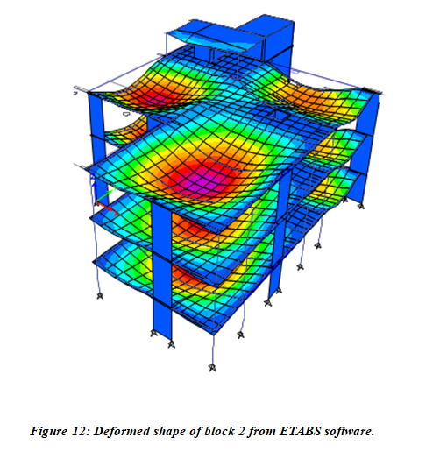
Compatibility check

Slide 42
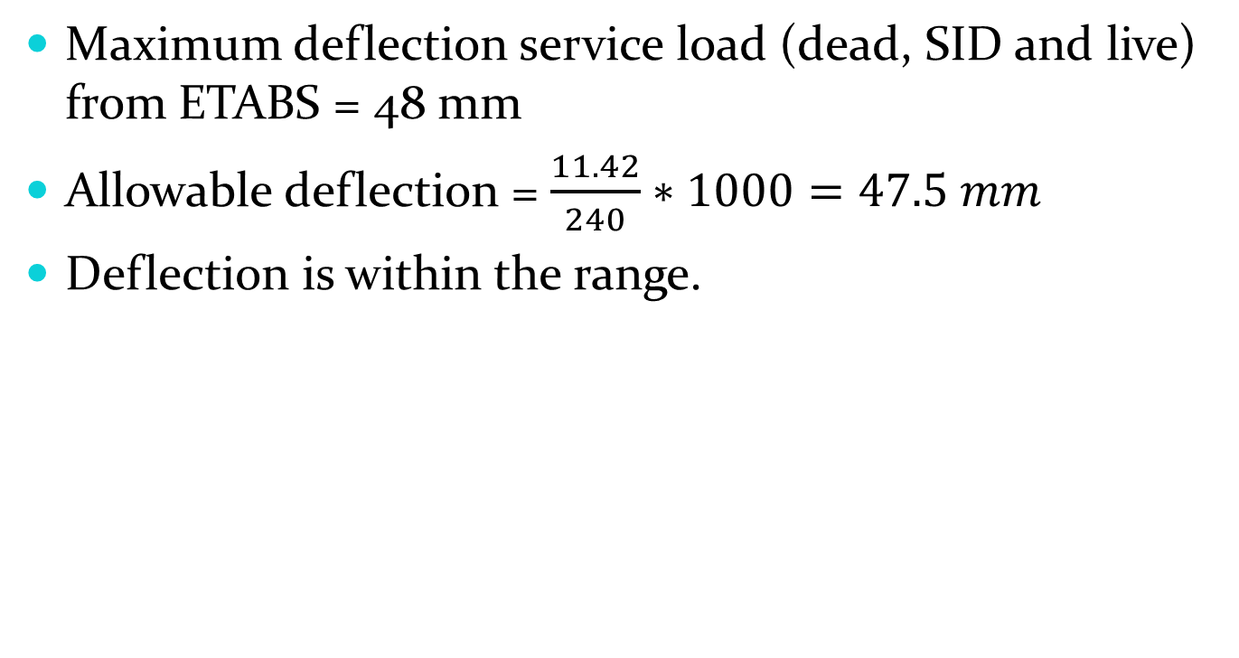
Deflection Check
Maximum deflection service load (dead, SID and live) from ETABS = 48 mm
Allowable deflection = $\frac{11.42}{240}∗1000=47.5 mm$
Deflection is within the range.

Slide 43
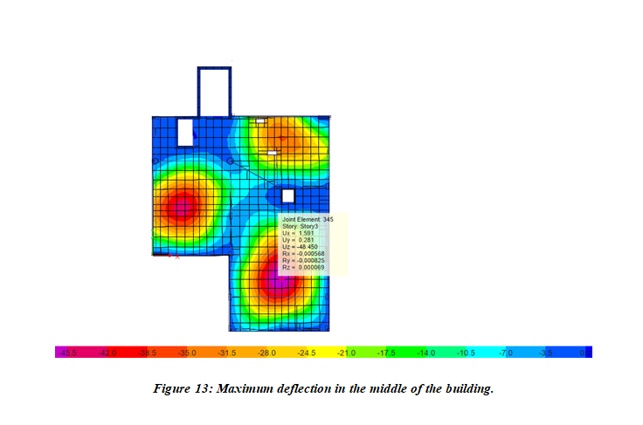

Slide 44
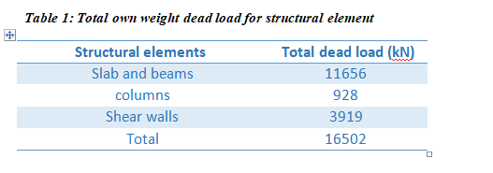
Equilibrium Check

Slide 45
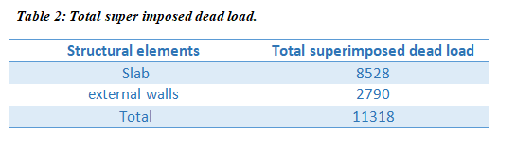

Slide 46
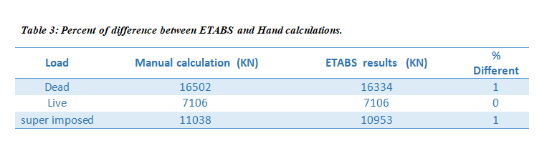

Slide 47
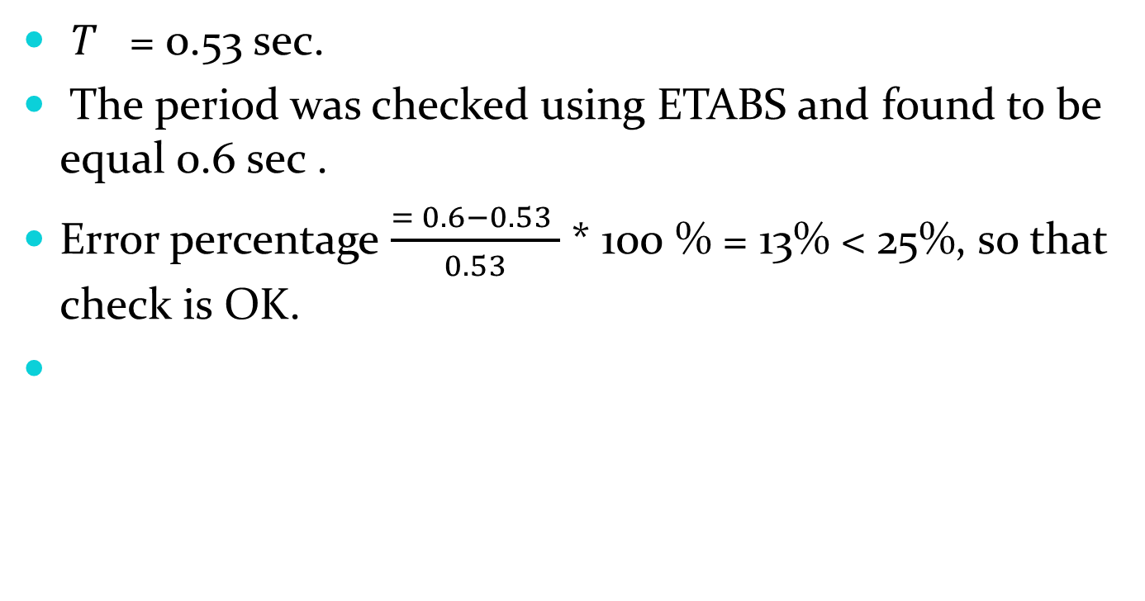
•Period
$T_{}$= 0.53 sec.
The period was checked using ETABS and found to be equal 0.6 sec .
Error percentage $\frac{= 0.6−0.53 }{0.53}$ * 100 % = 13% < 25%, so that check is OK.

Slide 48
Modal Participation Mass Ratio
Modal participation mass ratio was greater than 90% of the full mass of the structure in both X and Y directions by 7 models.

Slide 49
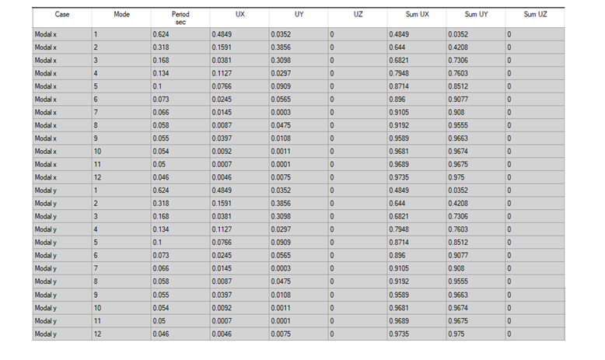

Slide 50
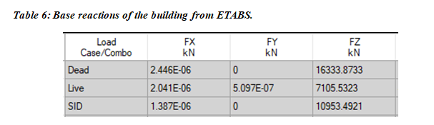
Base shear check

Slide 51
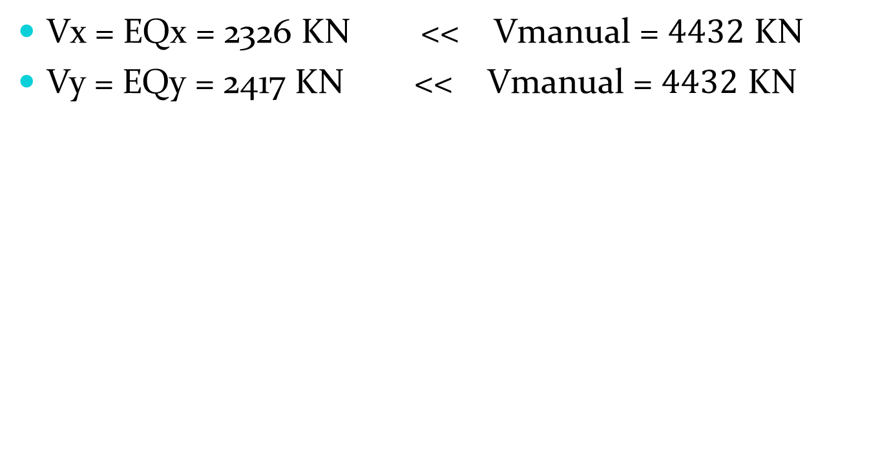
Vx = EQx = 2326 KN << Vmanual = $4432$ KN
Vy = EQy = 2417 KN << Vmanual = $4432$ KN

Slide 52
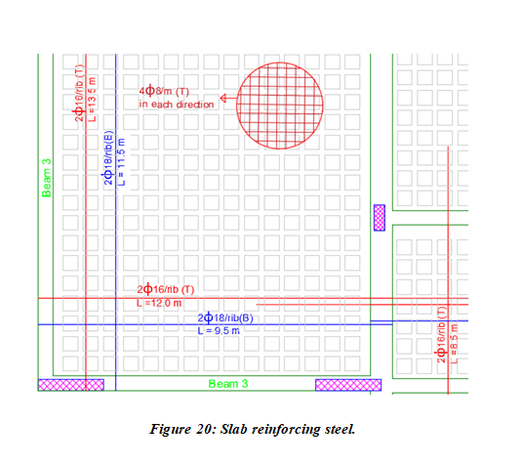
Slab design

Slide 53
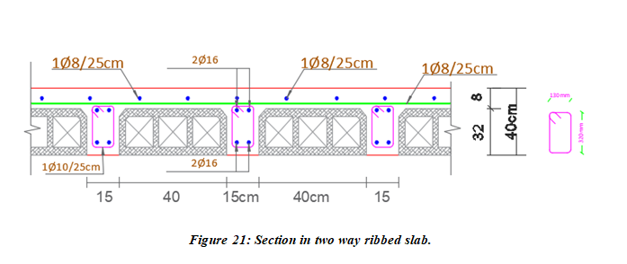
Slab design

Slide 54
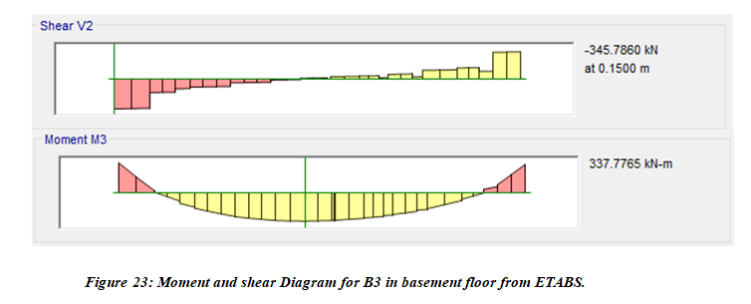
Beams Design

Slide 55
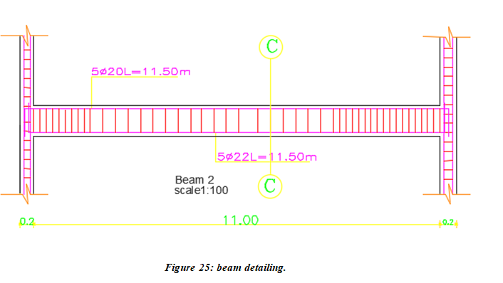
Beams Design

Slide 56
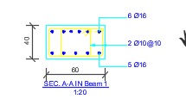
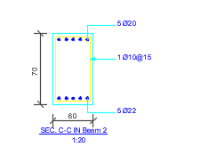
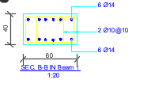
Beams Design

Slide 57

Columns Design

Slide 58

Columns Design

Slide 59

Columns Design

Slide 60

Shear walls design

Slide 61

Footing design

Slide 62

Footing design

Slide 63

Staircase design
Thickness = 0.15m.

Slide 64

Stair details.

Slide 65
Thank You

