Slide 1
Design an off-grid photovoltaic power system for a remote rural area called Khirbet Tana
Israa Othman
Moath Saleh

Slide 2
Objectives
The aim of this working project is to propose a design of an off-grid photovoltaic power system for a remote rural area called Khirbet Tana, east of Beit Furik, Nablus, Palestine.

Slide 3
introduction
Palestine is 100% dependent on fuel imported through Israel for power generation, gasoline etc.
In general, Palestine relies on Israel for the majority of its energy imports.
According to Renewable Energy and Energy Efficiency Partnership Organization,
“Only 9% of electricity was generated in the Gaza Strip by the Palestine Electric Company; and the rest was imported from Jordan to power Jericho in the West Bank (1%); from Egypt to power Rafah in the Gaza Strip (3%) and from Israel to power most of the West Bank and the Gaza Strip (87%).”

Slide 4
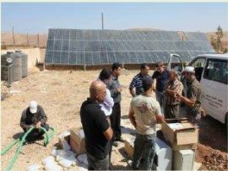
Photovoltaic Electrification Projects in Palestine
Many PV-projects have been recently established in Palestine, which is a great step to face the obstacles we have in the energy sector.
Attof village project
The village is located in the east of the town Tammoun in Tubas, with a population of about 120 people living in 22 houses, it contains mosque and school. Before the project is accomplished, the electrical loads and street lighting were fed through a diesel engine capacity of 20 KW works for 4 hours per day.

Slide 5
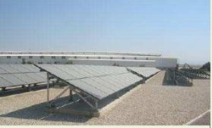
Jericho PV-Plant Project
The Palestinian Energy Authority has implemented a project refers entirely to it, which is a lighting project in the industrial area in Jericho by generating electricity from solar cells, since the Jericho is an area with a suitable environment that encourages industrial investment , and has a viable valuable in terms of geographic location, strategic , and climate .

Slide 6
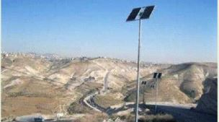
Lighting “Wadi An-Nar” Road Project
It is the only road that connects the southern West-bank with its northern, and the Jordan Valley and the borders with Jordan, which is severe aliasing and fractures road, with a length of about 3.6 km, and there are no lines to the electricity grid.

Slide 7
In particular, Khirbet Tana, which is a community of around 250 people. It is located in Area C of the West Bank.
The village lacks basic infrastructure mainly because Israel does not allow Palestinian development of any kind in Area C. Roads are unpaved and in ruins. There are no water or sewage lines and no electricity grid.

Slide 8
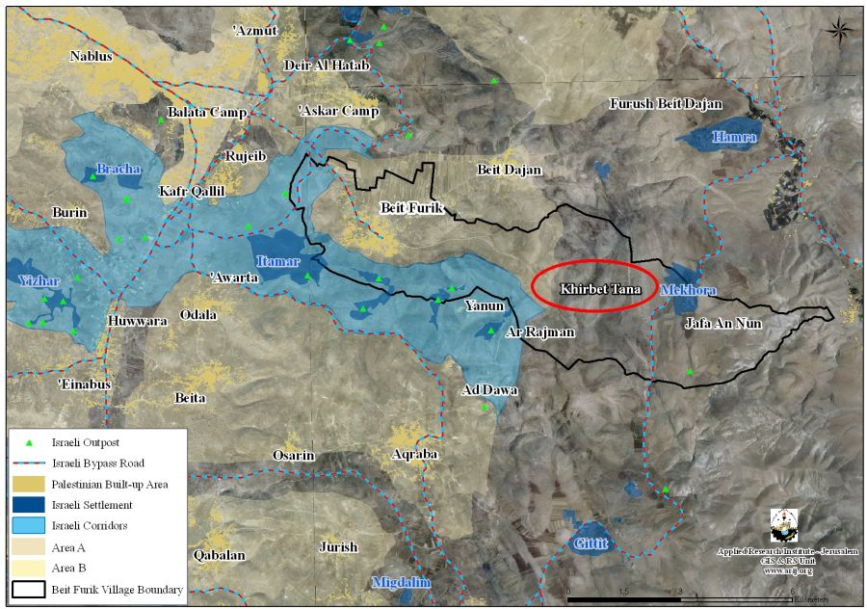
Map of Khirbet Tana

Slide 9
Designing PV System
Daily energy consumption for 14 families in Khirbet Tana.
Appliances | power (W) | Operating hours (hour/day) | Consumption (kwh/day) | The quantity | Total consumption(kWh/day)
Refrigerator | 170 | 4 | 0.68 | 14 | 9.52
Lighting modules (lamps) | 18 | 6 | 0.108 | 28 | 3.024
fan | 90 | 4 | 0.36 | 14 | 5.04
Washing machine | 600 | 0.4 | 0.24 | 14 | 3.36
TV | 80 | 2 | 0.16 | 14 | 2.24
Total |  |  |  |  | Σ= 23.182

Slide 10
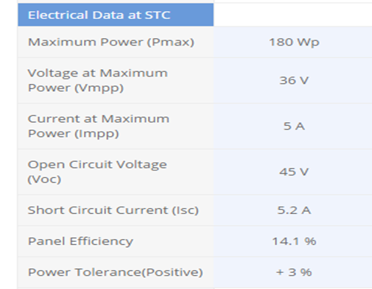
PV Module
The total consumption equals to 23.2 kWh, the total Kwp = 7.75 Kwp
Using (SL-180-24) modules, 43 modules are needed to cover the need of the targeted population.
Module Specifications

Slide 11
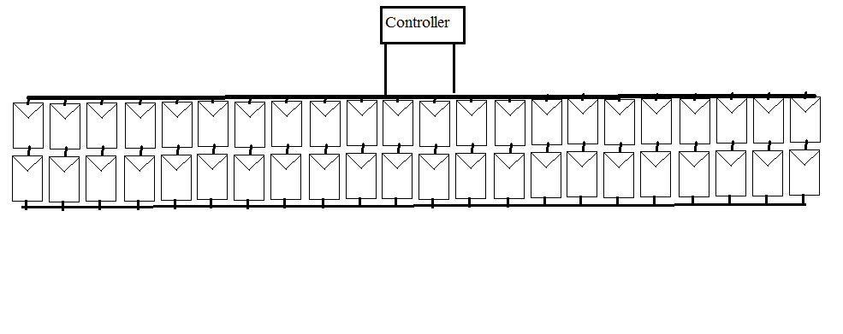
Schematic Figure For The Proposed PV System

Slide 12
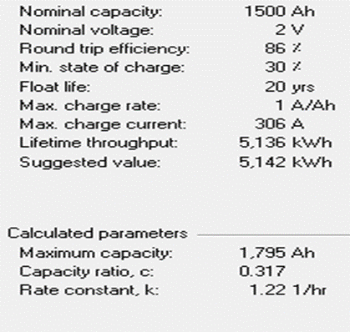
Batteries
The system is rated at 48 volt and the battery has nominal voltage of 2 volts. So number of batteries will be: 48/2=24 batteries in series.
Batteries Specifications

Slide 13
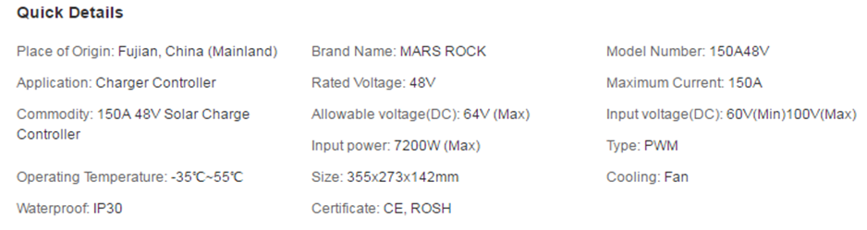
Charge Controller
Charge Controller Specifications
The charge controller rated current equals to 143 A

Slide 14
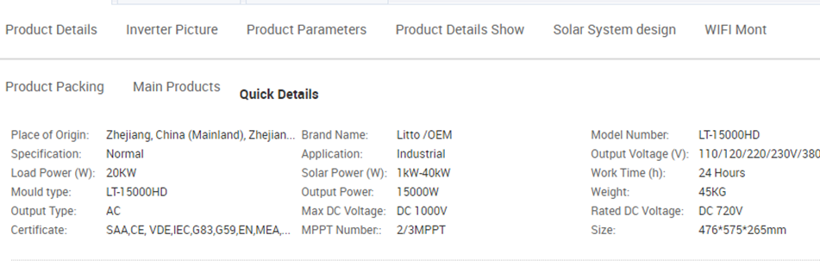
Inverter
Inverter specification
In order to convert DC power to AC, we have to use inverter with specific characteristics.
We need an inverter of size 15 kW. So we choose inverters of LT-15000HD from Litto manufacture with size of 15 kW

Slide 15
Cable Wires
Dc wires between PV modules to the batteries through controller must with stand the maximum current produced by PV modules.
The cross sectional area = 2.56 mm²
Cable size between battery and inverter.
The cross sectional area = 50 mm²
Cable size between inverter and the load.
The cross sectional area = 4.2 mm²

Slide 16
Conclusion
Solar Photovoltaic (solar PV) systems can convert the energy (radiation) from the sun directly into electrical power.
Solar PV systems generate renewable electricity producing no pollution, therefore contributing to a reduction of greenhouse gas emissions and to the improvement of local air quality. PV panels can produce electricity at the same place where it is finally consumed. In this way the energy losses from the transmission and distribution of power may be reduced.
PV is particularly suitable for rural areas where there is often more surface available for the installation of the panels. Furthermore, PV provides a competitive and clean solution for the electrification of remote rural areas where the power grid is not available.
In our case, the Civil Administration does not recognize Khirbet Tana as a village worth planning and prohibits construction there. Therefore, implementing a PV system in such an area will be worth it.
This proposed 8 KW PV system will cover the need of 14 families in Khirbet Tana. On an area of 72 m². The system will cost about 16000 $.

