Slide 1
Game Applications
Prepared by
Esra’a Nassar
Mona Amer
Supervisor
Dr. Samer Arandi.

Slide 2

Snake and Ladder
السلم والثعبان

Slide 4
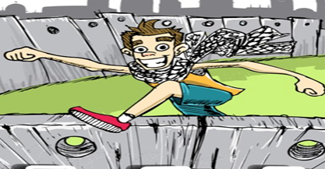
Wall Jump

Slide 5


Slide 6
Outline
Why games?
Why iOS devices ?
Why cocos2d-x ?
Main overview about the games
Snake and ladder game
Wall Jumper game
Demo time

Slide 7
Why Gamming ?
Gamming vs. application in marketing
Gamming Faming and globalization
Gamming is Harder than app in developing.
entertainment.
Better in working result.

Slide 8

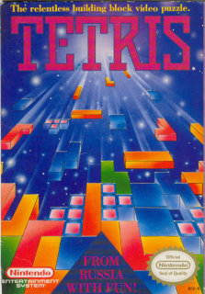
History of gamming
Industry of the games was in 1952.
The first game on a mobile phone was a Tetris game on the Hagenuk MT-2000 device from 1994 .

Slide 9

History of gamming
Nokia launched the very successful Snake on selected models in 1997.Snake and its variants has since become one of the most-played video games and is found on more than 350 million devices worldwide.

Slide 10
Why we use these game?
Snake and ladder
    To put our mediterranean touch on this classic game.
    Make our Arabic_version computirized.
Wall Jumper
  Idea took from our environment life (Apartheid Wall)
  Make game that deal with our real life.

Slide 11
Outline
Why gaming?
Why iOS devices ?
Why cocos2d-x ?
Main overview about the games
Snake and ladder game
Wall Jumper
Demo

Slide 12
Why iOS ?
  Try Some thing new.
  iOS marketing (Apple store ).
  Related research.

Slide 13
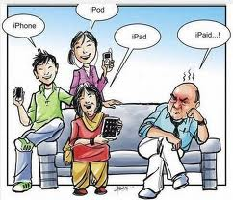
iOS Device
  An iOS device is an iPhone, an iPad, or an iPod Touch (a device that runs the iOS Operating System)

Slide 14
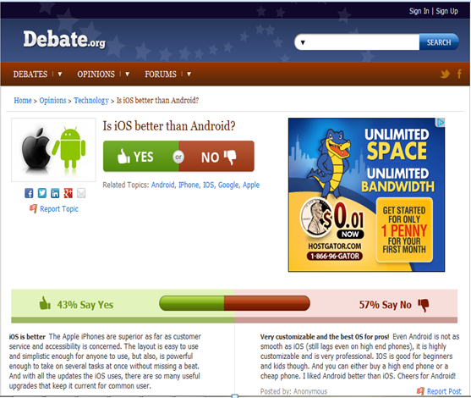
iOS Device

Slide 15
Outline
Why games?
Why iOS devices ?
Why cocos2d-x ?
Main overview about the games
Snake and ladder game
Wall Jumper game
Demo time

Slide 16


Cocos2d vs. cocos2d-x
Cocos2d is an open source 2D game framework. The original Cocos2D framework is written in Python but has since been ported to other languages and platforms such that the cocos2d-x .
Notes:
CICS = Customer Information Control System

Slide 17
Why cocos2d-x ?
  Portable
  Using C++ language
  Open source
  Support multiplatform

Slide 18
Language and programs used :
Languages used :
      C++ Language
      Xml Language
Tools used :
      Visual Studio 2010
      cocos2d-2.0-x-2.0.4
      xcode (Mac device )
      Texture Packer GUI

Slide 19
Outline
Why games?
Why iOS devices ?
Why cocos2d-x ?
Main overview about the games
Snake and ladder game
Wall Jumper game
Demo time

Slide 20

Game Overview

Slide 21
Outline
Why games?
Why iOS devices ?
Why cocos2d-x ?
Main overview about the games
Snake and ladder game
Wall Jumper game
Demo time

Slide 22
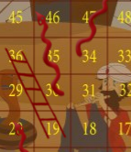
Snake and Ladder
Classic bored game with 10 x 10 grid, each cell has a number from 1-100 but we make our own grid 8x8.
Some cell contains snake and other ladders.(special cases)

Slide 23
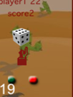
Snake and Ladder
Dice that rolled randomly.
Two choices weather to play automatic or drag and drop.

Slide 24
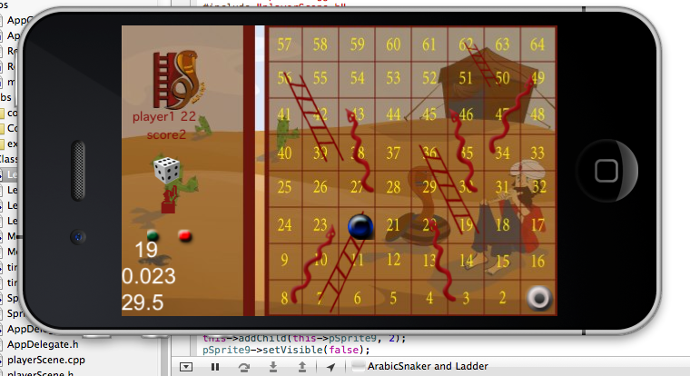
Snake and Ladder
Layers in arranging pictures
algorithm in classify the grid

Slide 25
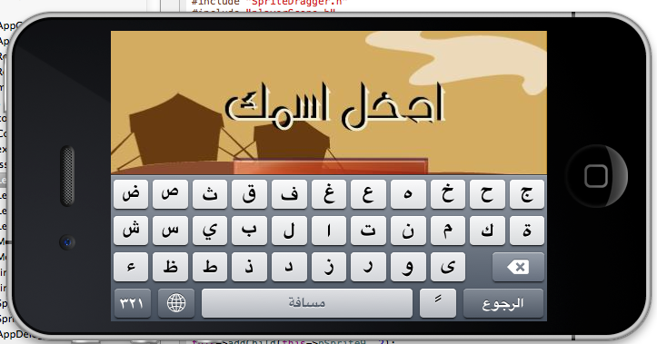
Snake and Ladder
CCtextField for keypad bored

Slide 26
Snake and ladder
Adding sounds using
CocosDenshion::SimpleAudioEngine::sharedEngine()- >playBackgroundMusic(
"soundeffect.wma", true);

Slide 27
Adding more features
To increase the performance
      Adding xml files that generate the second level by using the same functionality but different places of the snake and ladder on the grids.
<?xml version="1.0"?>
-<level> -<config> <name>level1</name> <atlas>level_1</atlas> <sprites>9</sprites> <background>gameScene.png</background> <music>music.mp3</music> < <win>welcome.mp3</win> </config> -
<sprite> <image>l1.png</image> <sound>bounce.mp3</sound>
<x>227</x> <y>135</y> </sprite>

Slide 28
Outline
Why games?
Why iOS devices ?
Why cocos2d-x ?
Main overview about the games
Snake and ladder game
Wall Jumper game
Demo time

Slide 29
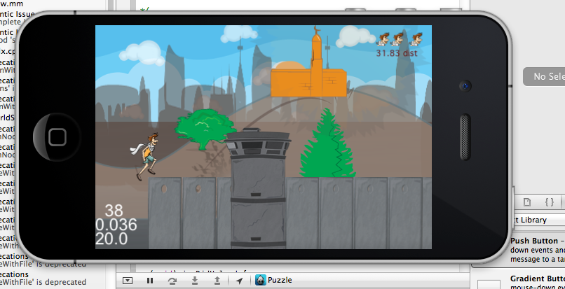
Wall Jumper Game
Runner Game depending on parallax

Slide 30
Idea
Back ground layer runs in different speed
_backgroundNode->addChild(_pieceofwall1,1 , Speed , ccp(_fort1->getContentSize().width-40,-20) );
CCPoint Speed = ccp(0.08, 0.08);
CCPoint bgSpeed = ccp(0.05, 0.05);
CCPoint bgSpeed1 = ccp(0.1, 0.1);
Continuous of the background movement, just like camera sensing
by adding objects in the update method.
_backgroundNode->setPosition(ccpAdd(_backgroundNode->getPosition(),ccpMult(backgroundScrollVert,dt))) ;

Slide 31
Idea Cont
Walls and rocks appear in a specific time to let the jumper jump over it.
method name
schedule(schedule_selector(HelloWorld::step));
class name
Label test speed
m_time += dt;
sprintf(string, "%2.2f dist", m_time);
label1->setString(string)

Slide 32
Idea Cont
Sprites that decrease when the player collide the walls (soul will disappear will be invisible.
CCSprite *soul0 = CCSprite::create("sprit.png");
soul0->setVisible(false);

Slide 33
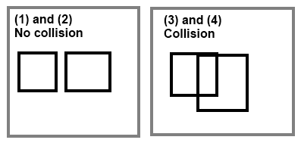
Collision Detection Method
int xd=destenationsprite1->getPositionX();
int xp=pSprite2->getPositionX();
int yd=destenationsprite1->getPositionY();
int yp=pSprite2->getPositionY();
int width=destenationsprite1->getContentSize().width;
int height=destenationsprite1->getContentSize().height;
//pointes initialize
int upperleftx=xd-width/2;
int upperrightx=xd+width/2;
int lowerrightx=yd-height/2;
int upperrighty=yd+height/2;

Slide 34
Collision Detection Method(cont)
if((xp>=upperleftx && xp<=upperrightx)&&(yp>=lowerrightx && yp<=upperrighty)){
startflag=1; // collision detected
destenationsprite1->setVisible(false);}
else
startflag=0;// no Collision detection
}

Slide 35
Jump method
void HelloWorld::jump(CCObject* sender){
if ( start_jump == 0)
start_jump = 200;
}
if ( start_jump > 100)
{
int y = m_pSprite1->getPositionY();
m_pSprite1->setPositionY(y+1);
start_jump--;
}
else if ( start_jump > 0 )
{
int y = m_pSprite1->getPositionY();
m_pSprite1->setPositionY(y-1);
start_jump--;
}
else
{
start_jump = 0 ;
}
Called by updated method
that call them each time

Slide 36
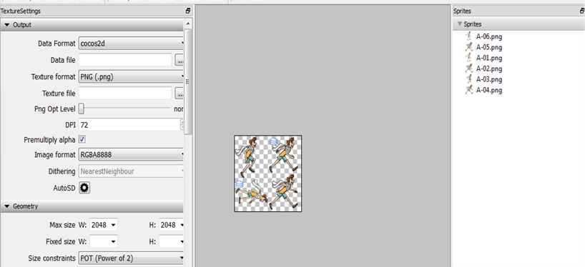
New technical Way in presenting the images
The most important thing in the game is the size.
    Decrease the size of the images by using texture packer.

Slide 37

Problems
Downloading the Mac on windows machines .
Transferring from win32 to Mac took our time because some variables,
methods and functions defined in the windows, deprecated in Mac.
The MAC LAB was too late for us to transfer our project.
The xcode programmers has two many pauses during the compile.

Slide 38

Demo time ☺ ☺

Slide 39

Questions ? ! ? !

