Slide 1

Graduation Project II
Integrated school design
Graduation Project 2
Prepared by:
Enas Badwan
Luay Dwaikat
Mohamd Dbos
Taghreed Abed
Supervisor:
Eng. Ameer Aker

Slide 2
Outlines
Site analysis and architectural design.
Passive Design.
Structural Design.
Electro-mechanical Design.
Quantity survey and costs.

Slide 3
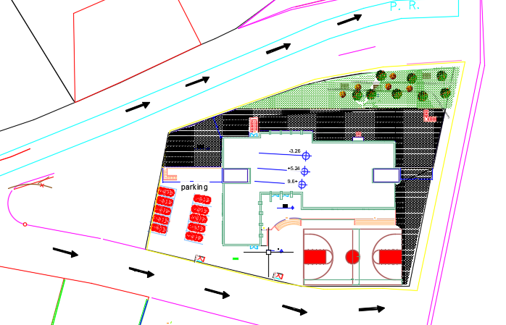
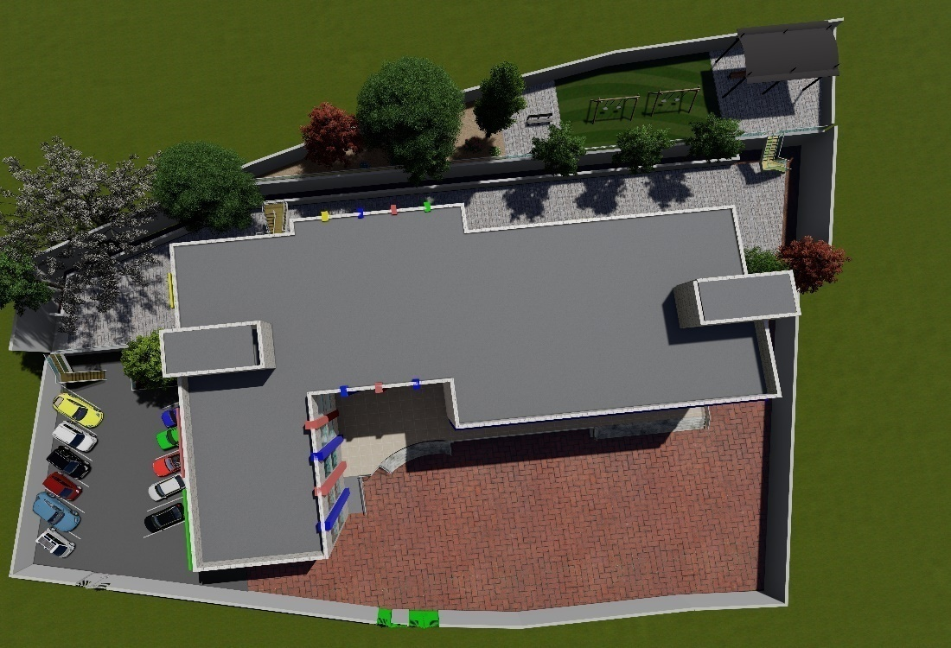
Architectural Design
Site plan (plan)
Site plan (3D)

Slide 4
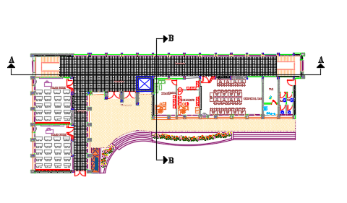
Architectural Design
Contains: head master, secretary, computer lab, classes room ,Wc for staff.
Basement floor

Slide 5
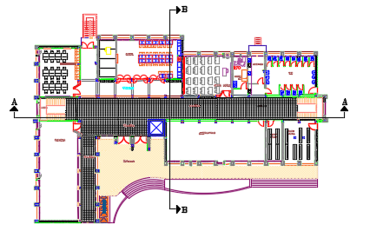
Architectural Design
Contains: classes room, gymnasium, cafeteria, multipurpose ,first aid ,Wc ,teachers room.
Ground floor

Slide 6
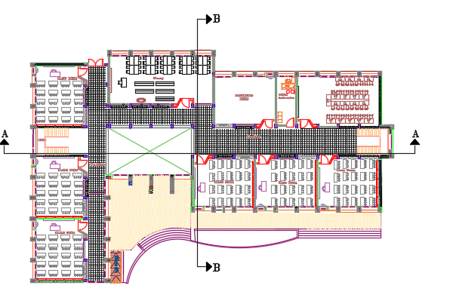
Architectural Design
Contains: classes room , library, social worker , lab .
First floor

Slide 7
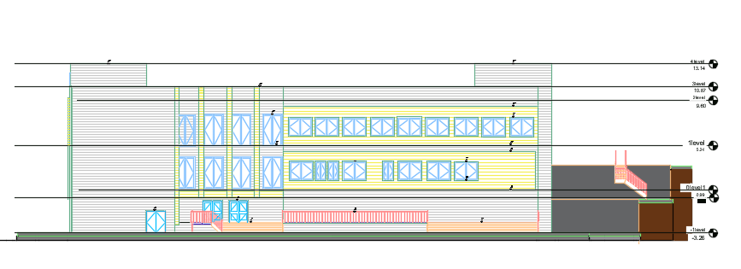
Architectural Design
South Elevation

Slide 8
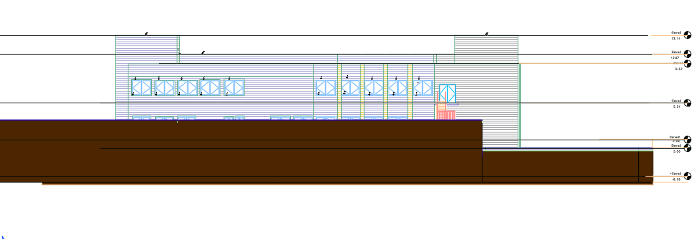
Architectural Design
North Elevation

Slide 9
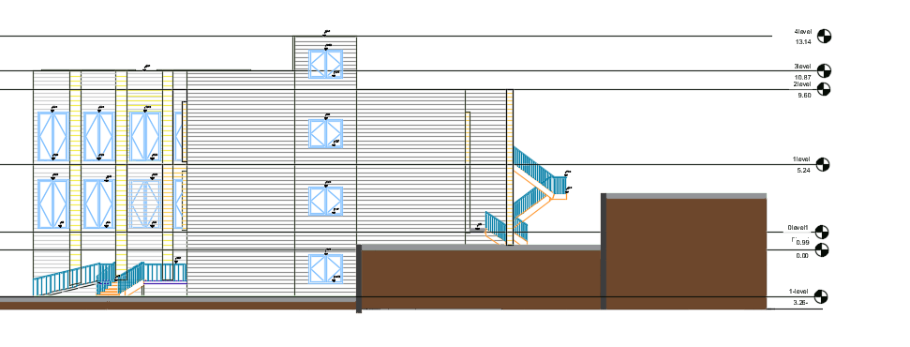
Architectural Design
East Elevation

Slide 10
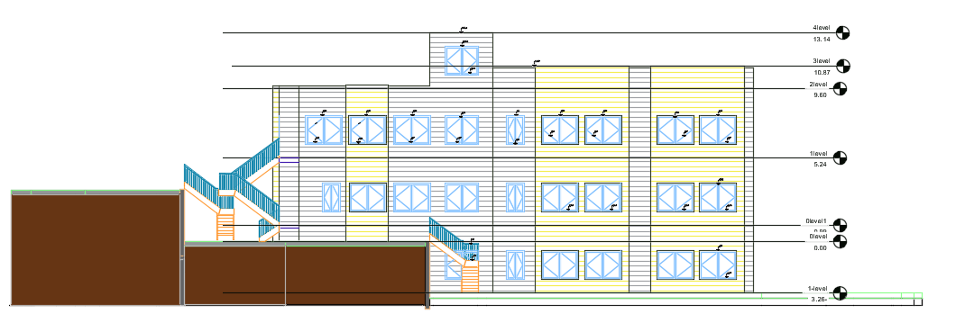
Architectural Design
West Elevation

Slide 11
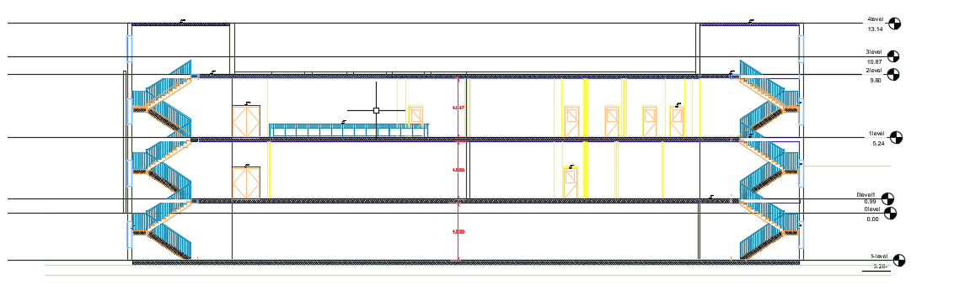
Section A-A
Architectural Design

Slide 12
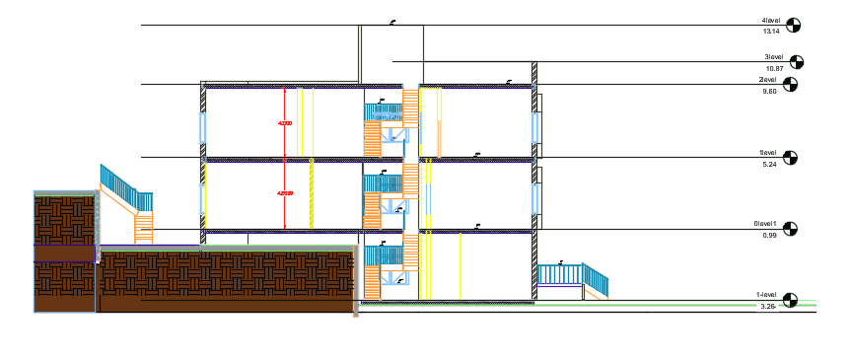
Architectural Design
Section B-B

Slide 13
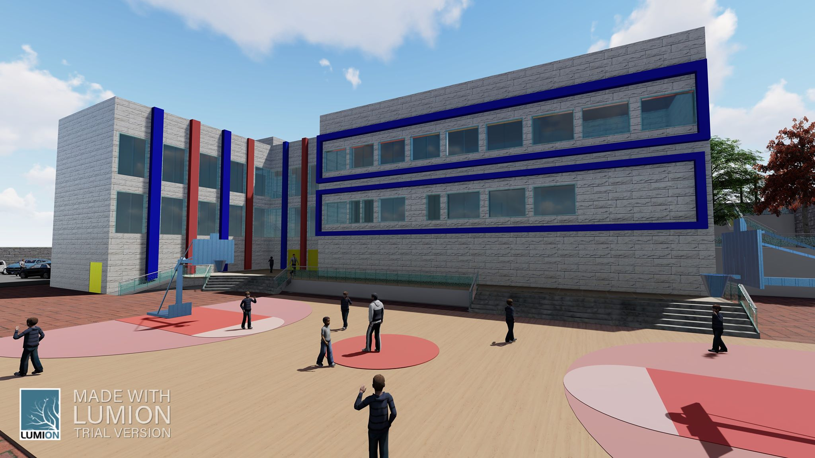
Architectural Design
3D View

Slide 14
Architectural Design
3D View

Slide 15
Passive Design
Thermal simulation.
Acoustical Design.

Slide 16
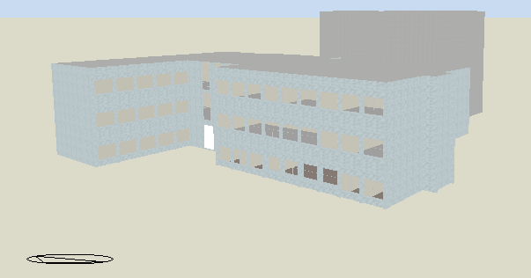
Thermal simulation
Design Builder ( 3D Model)

Slide 17
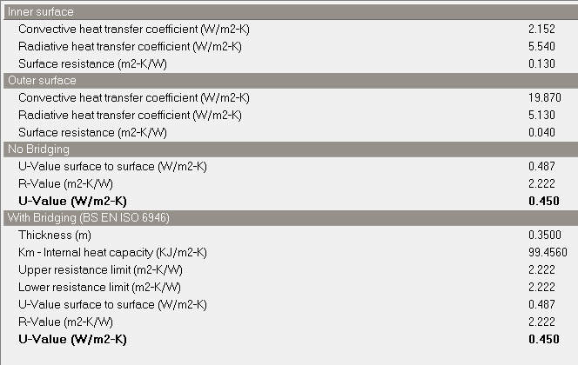
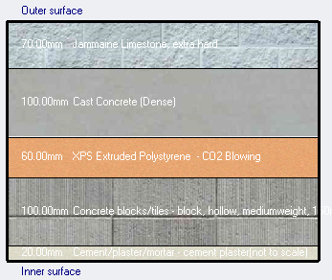
Thermal simulation
External wall layers
U-value =0.45 w/m².K

Slide 18
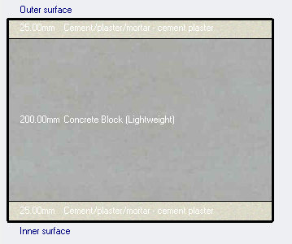
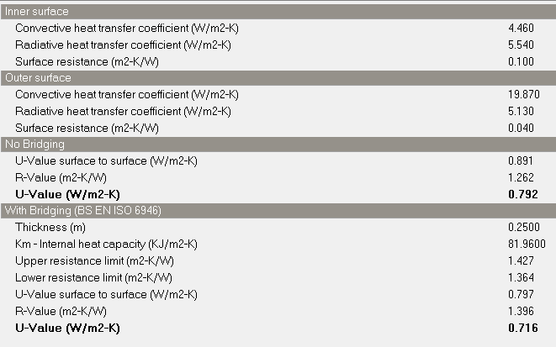
Thermal simulation
Internal wall layers
U-value = 0.716 w/m².k

Slide 19
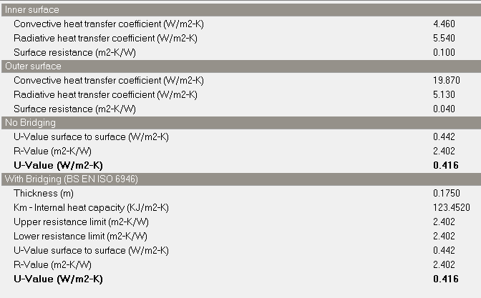
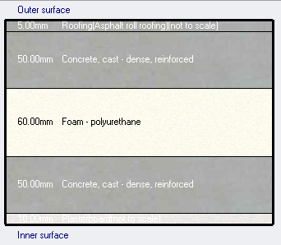
Thermal simulation
Roof layers
U-value = 0.416 w/m².k

Slide 20
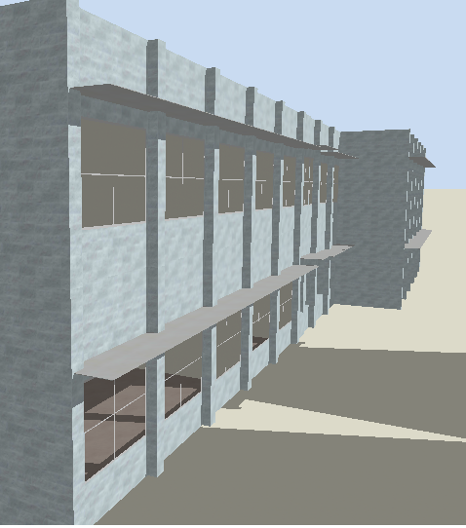
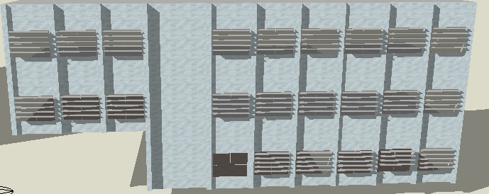
Thermal simulation
western windows (horizontal Louvers)
southern windows (over hang (cantilever)

Slide 21
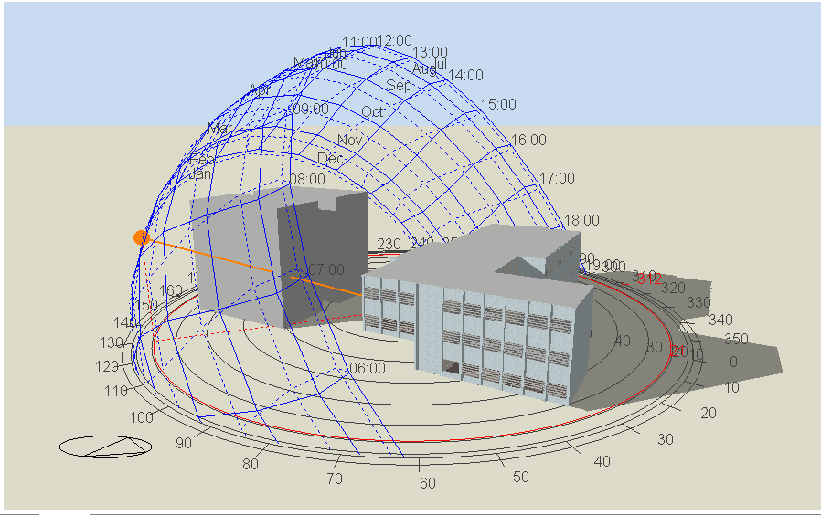
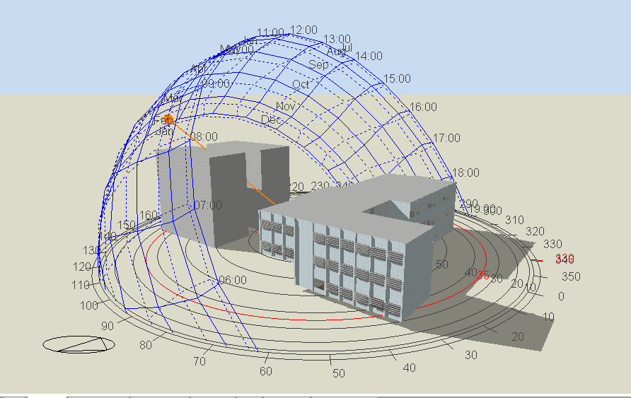
Thermal simulation
shadow in winter (sun path 21/1 at 9:00 am )
Shadow in winter (sun path 21/1 at 11:00 am )

Slide 22
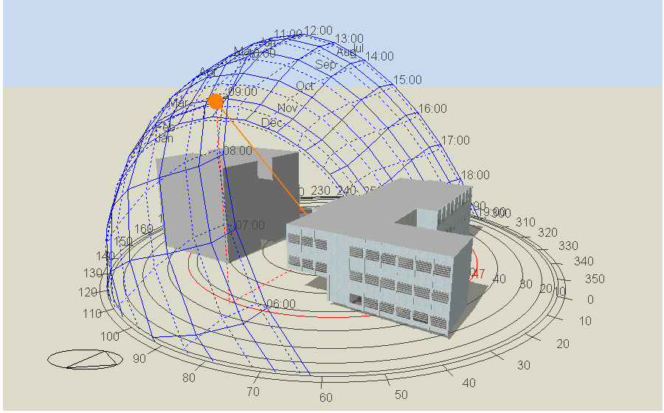
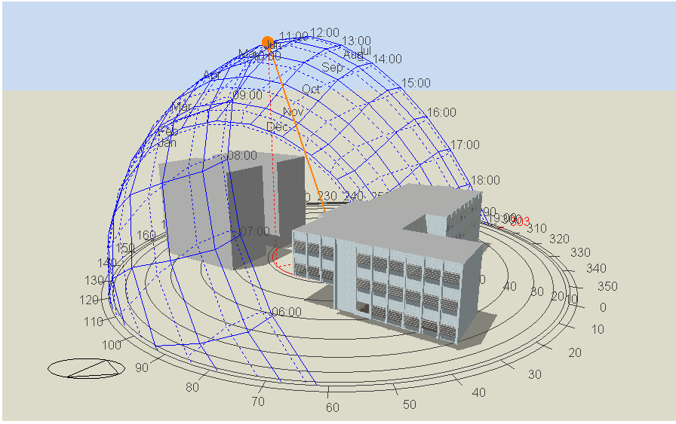
Thermal simulation
Shadow in summer (sun path 21/7 at 9:00 am )
Shadow in summer (sun path 21/7 at 11:00 am )

Slide 23
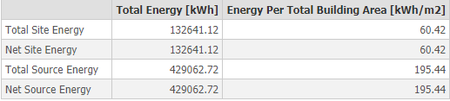
Thermal Simulation
Firstly mixed VRF with Natural vent
Heating and cooling load
Cooling load 120.1 kw
Heating load 141 kw
Site and Source Energy
Total site energy

Slide 24
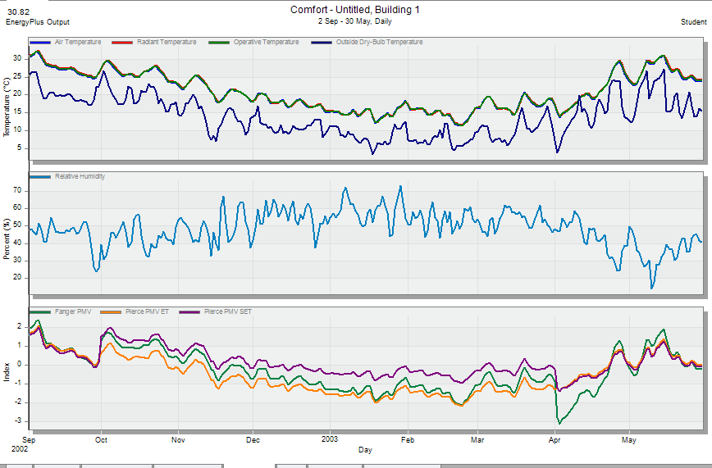
Thermal Simulation
Comfort diagram-Set

Slide 25
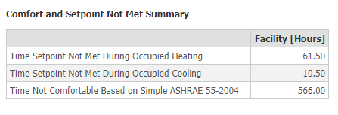
Comfortable and non-comfortable hours.
Comfort diagram-Set

Slide 26
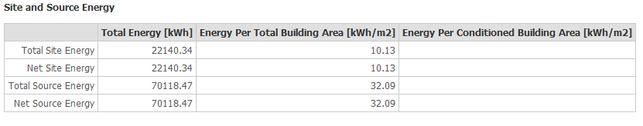
Secondly Natural ventilation without HVAC
Total site energy

Slide 27
Comfort diagram-Set

Slide 28
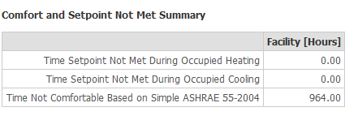
Comfortable and non-comfortable hours.
Comfort diagram-Set

Slide 29
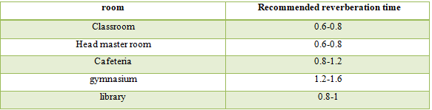
Acoustical Design
Reverberation time (RT60)
Recommended RT60

Slide 30
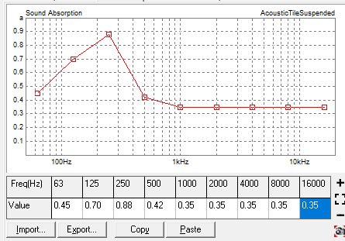
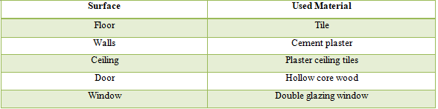
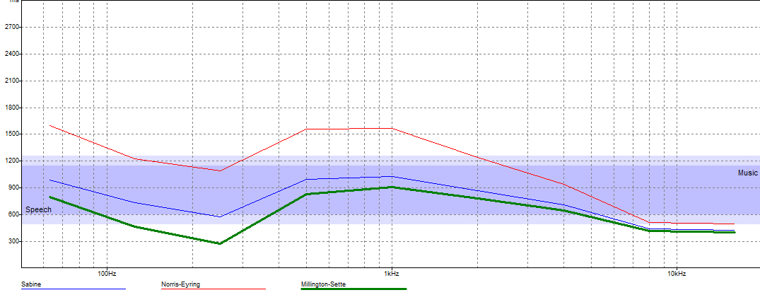
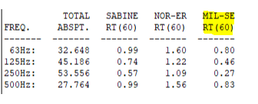

Acoustical Design
Classroom 1 in basement

Slide 31
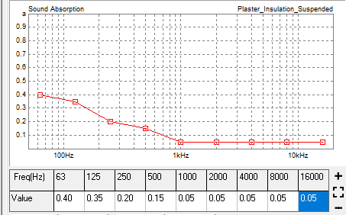
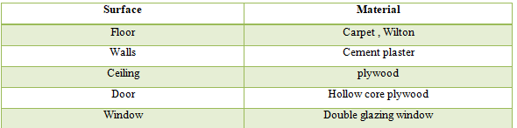
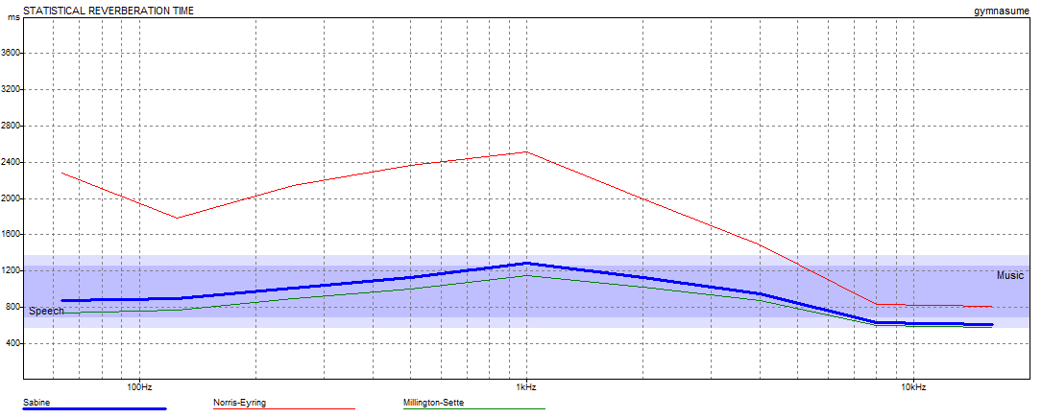
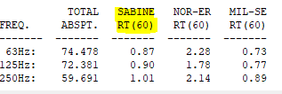

Acoustical Design
Gymnasium

Slide 32
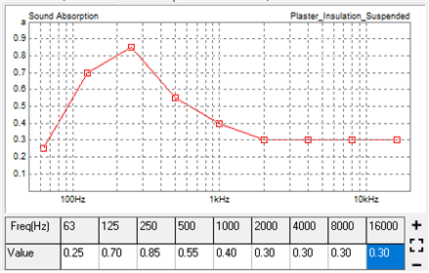
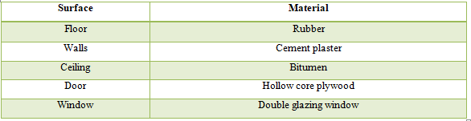
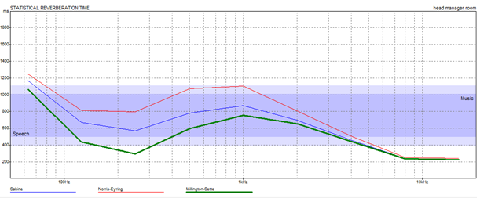
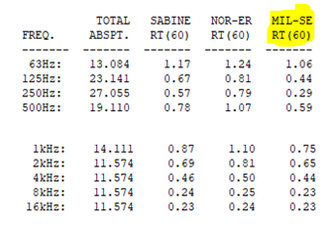
Acoustical Design
Head master room

Slide 33
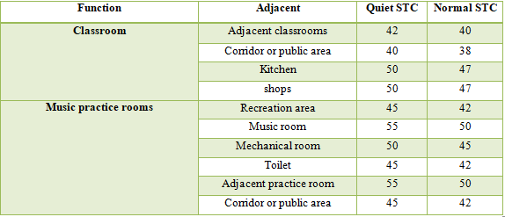
Acoustical Design
Sound transmission class (STC)
Standard STC value

Slide 34
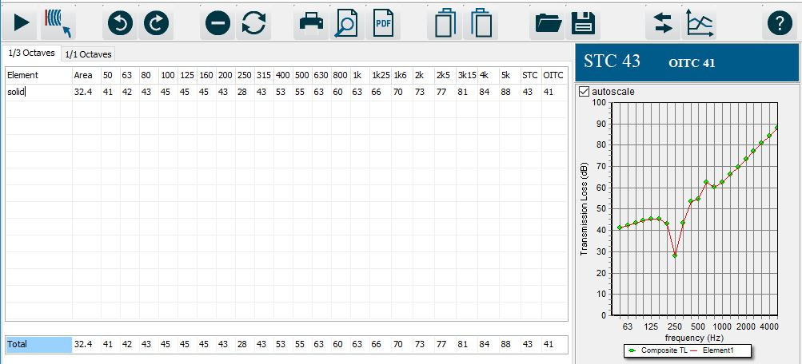
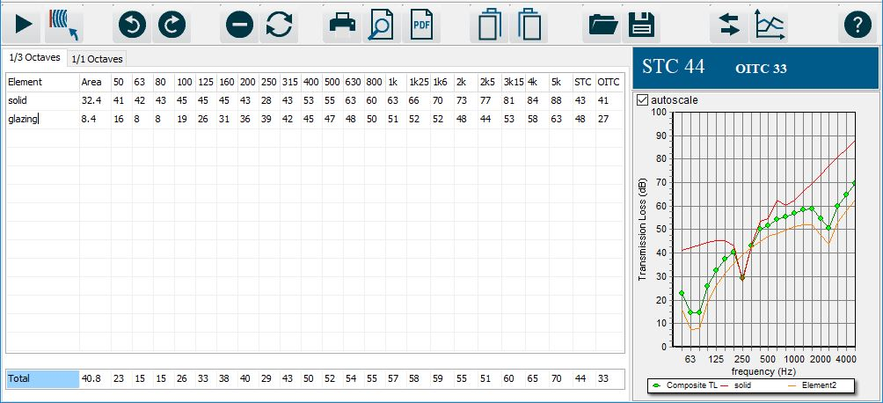
Acoustical Design
Sound transmission class(STC)
this results was achieved from Insul program.
External wall 1 without window STC value
External wall 2 with window STC value

Slide 35
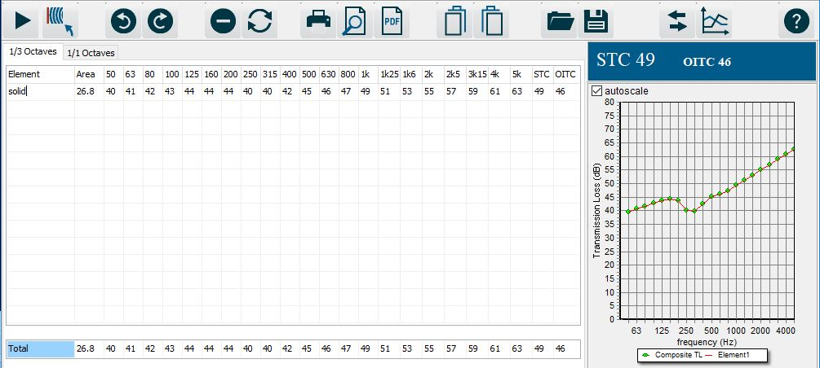
Acoustical Design
Sound transmission class(STC)
this results was achieved from Insul program.
Internal wall STC value

Slide 36
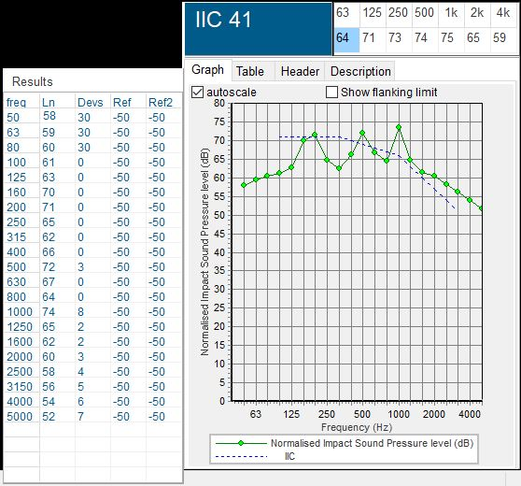
Acoustical Design
Impact Insulation class (IIC):
ceiling
IIC Value

Slide 37
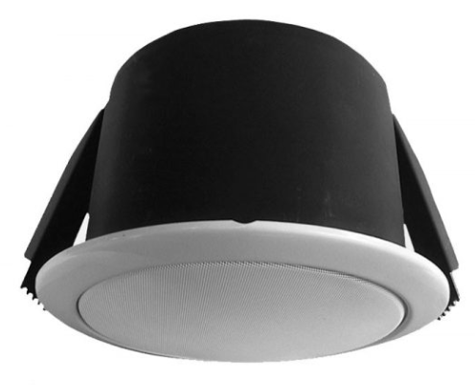
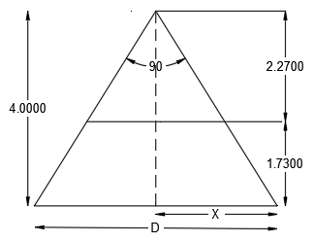
Acoustical Design
Loud speaker distribution
TOA PC-1867FC ceiling mount Loud speaker
Loud speaker distance for calculation

Slide 38

Acoustical Design
Loud speaker distribution
Loud speaker distribution in basement

Slide 39

Acoustical Design
Loud speaker distribution
Loud speaker distribution in ground floor

Slide 40

Acoustical Design
Loud speaker distribution
Loud speaker distribution in first floor

Slide 41
Structural Design

Slide 42

Codes and Loads
Loads
Live Load = 4.8 kN/$m^{2}$
SID = 3.5 kN/$m^{2}$
Eq Load coefficients (UBC-97)
R = 5.5 , I = 1.1
Z = 0.2 (Nablus) , Cv= 0.4 , Ca = 0.28
Soil Profile (SD)
Codes
UBC-97 for Earthquake design
ACI 318-14 for RC structure design

Slide 43


3D modeling from ETABS Program for design

Slide 44
Structural system
Final Design Sections
Materials
Concrete B300 , B350
Steel fy = 420 Mpa
Slab thickness 25 cm
Columns dimensions ( 30*50) cm
Beams dimensions ( 60*50 , 40*50) cm
Structural System
One Way Ribbed Slab
With Drop Beams
Walls Thickness 30 cm

Slide 45


Model Checks
Compatibility Check for block 2
Compatibility Check for block 1

Slide 46

Model Checks
Deflection Check
Limit = L/240
= 6.5/ 240 = 27 mm

Slide 47
Equilibrium Check
Load | Manual calculation | Calculation from ETABS (kN) | Difference (%)
Dead load | 16128.9 | 16331.0 | 1.23
Live load | 11529.9 | 11648.6 | 1.02
Superimposed Dead load | 17014.0 | 16944.9 | 0.40
Equilibrium Check for block 1

Slide 48
Equilibrium Check
Load | Manual calculation | Calculation from ETABS (kN) | Difference (%)
Dead load | 7713.7 | 7866.2 | 1.93
Live load | 5002.5 | 5001.3 | 0.02
Superimposed Dead load | 9039.7 | 9039 | 0.007
Equilibrium Check for block 2

Slide 49


Stress strain check
Block 1
Block 2

Slide 50

Seismic Design Using Response Spectrum – UBC 97
W(block 1) = 39400 KN
Soil type SD
Z = 0.2
I = 1.1
R = 5.5
C_{v} = 0.40
C_{a} = 0.28
W(block 2)= 20032.17 KN
Seismic hazard map of Palestine

Slide 51
Period check (T) for the building
Seismic Design Using Response Spectrum – UBC 97
 | T(Sec) for Block 1 | T(Sec) for Block 2
ETABS Value | 0.427 | 0.525
Manual Value | 0.546 | 0.546

Slide 52
Base shear check for the building
Load case/comp | T (sec) | V_{manual} | V_{ETABS}
EQx | 0.427 | 4963.6 | 3864.6
EQy | 0.427 | 4963.6 | 3864.6
Block 1
Load case/comp | T (sec) | V_{manual} | V_{ETABS}
EQx | 0.520 | 2549.5 | 2470.6
EQy | 0.520 | 2549.5 | 2470.6
Block 2

Slide 53

The distribution of columns and shear walls and basement wall in the building:
Basement

Slide 54

The distribution of columns and shear walls in the building:
G and F floors

Slide 55


The distribution of footings in the building:
Mat footing

Slide 56

Slab Reinforcement

Slide 57

Cross section in slab

Slide 58

Beams Reinforcement

Slide 59



Beams Reinforcement
B1
Sec 8-8
B2
Sec 9-9
B3
Sec 10-10

Slide 60


B4
Sec 7-7

Slide 61


S.B
Sec 6-6

Slide 62
Beams Reinforcement Steel
no beam | stirrups | steel rein | width (cm) | depth(cm) | Beam no
12 | 1∅10/10cm end | 4∅16 top | 50 | 60 | Beam1
 | 1∅10/20cm mid | 2∅12 mid
 |  | 4∅12 bot
12 | 1∅10/10cm end | 6∅16 top | 50 | 60 | Beam 2
 | 1∅10/20cm mid | 2∅12 mid
 |  | 4∅12 bot
8 | 1∅10/10cm end | 4∅16 top | 50 | 60 | Beam 3
 | 1∅10/20cm mid | 2∅12 mid
 |  | 6∅16 bot
4 | 1∅10/10cm end | 4∅16 top | 50 | 40 | Beam 4
 | 1∅10/20cm mid | 2∅12 mid
 |  | 4∅12 bot
40 | 1∅10/10cm end | 4∅16 top | 50 | 40 | S.Beam
 | 1∅10/20cm mid | 2∅12 mid
 |  | 4∅12 bot

Slide 63


Columns Reinforcement
no column | stirrups | steel rein | width (cm) | depth(cm) | Column no
73 | 1∅10/10cm end | 10∅14 | 30 | 50 | column
 | 1∅10/20cm mid

Slide 64
Footing Reinforcement
Reinforcement in shorter | Reinforcement in longitudial | Dimension | Footing
3∅16 Top | 3∅16 Top | 2.1*1.5*0.40 | F
5∅16 bot | 6∅16 bot

Slide 65


Footing Reinforcement
Sec 1-1
Footing

Slide 66



Footing Reinforcement

Slide 67



Shear Wall Reinforcement

Slide 68

Water tank Reinforcement
Section in water tank

Slide 69

Water tank Reinforcement
Sec A-A

Slide 70

Retaining walls Reinforcement
wall | A | B | C | D | E | F | L | H(m) | 1 | 2 | 3 | 4 | 5 | 6 | 7 | 8
1 | 0.4 | 1.3 | 2.2 | 0.5 | 0.4 | 3.9 | 15 | 6 | 5Ø12 | 5Ø12 | 5Ø12 | 5Ø32 | 4Ø20 | 5Ø16 | 4Ø16 | 4Ø16
2 | 0.4 | 1.3 | 2.2 | 0.5 | 0.4 | 3.9 | 20 | 6 | 5Ø12 | 5Ø12 | 5Ø12 | 5Ø32 | 4Ø20 | 5Ø16 | 4Ø16 | 4Ø16
3 | 0.3 | 0.9 | 1.7 | 0.5 | 0.3 | 2.9 | 13 | 4 | 5Ø12 | 5Ø12 | 5Ø12 | 4Ø25 | 4Ø16 | 4Ø16 | 4Ø16 | 4Ø16
4 | 0.3 | 0.9 | 1.7 | 0.5 | 0.3 | 2.9 | 10 | 4 | 5Ø12 | 5Ø12 | 5Ø12 | 4Ø25 | 4Ø16 | 4Ø16 | 4Ø16 | 4Ø16
5 | 0.3 | 0.7 | 1.6 | 0.5 | 0.3 | 2.6 | 15 | 4 | 5Ø12 | 5Ø12 | 5Ø12 | 5Ø20 | 4Ø16 | 4Ø16 | 4Ø16 | 4Ø16
6 | 0.3 | 0.7 | 1.6 | 0.5 | 0.3 | 2.6 | 15 | 4 | 5Ø12 | 5Ø12 | 5Ø12 | 5Ø20 | 4Ø16 | 4Ø16 | 4Ø16 | 4Ø16
7 | 0.3 | 0.7 | 1.6 | 0.5 | 0.3 | 2.6 | 9 | 4 | 5Ø12 | 5Ø12 | 5Ø12 | 5Ø20 | 4Ø16 | 4Ø16 | 4Ø16 | 4Ø16
8 | 0.3 | 0.7 | 1.6 | 0.5 | 0.3 | 2.6 | 9 | 4 | 5Ø12 | 5Ø12 | 5Ø12 | 5Ø20 | 4Ø16 | 4Ø16 | 4Ø16 | 4Ø16

Slide 71

Retaining walls Reinforcement
Retaining wall at h = 4m outer

Slide 72
Electro-mechanical
Design

Slide 73
Electrical Design
Lighting Design
Sockets Design
Circuit Breaker Design

Slide 74

Electrical Design
Lighting Design
DIAlux evo program
Classes Room
Surfaces | reflection factor | colors
wall | 68 % | gray white
ceiling | 70 % | light gray
floor | 59 % | gray
 | Standard | Design
illuminance | 500 | 506
Glare (UGR) | 22 | 14.6

Slide 75

3D View
3D view for classroom

Slide 76

Electrical Design
Lighting Arrangement in basement floor

Slide 77

Electrical Design
Sockets distribution in basement

Slide 78


Electrical Design
Circuit Breakers boards

Slide 79


Mechanical Design
Safety and security design
Detectors
Fixed temperature heat detector
Photoelectric smoke detector

Slide 80

Safety Design
Detectors system In basement floor
Smoke detector

Slide 81

Safety Design
Detectors system In ground floor
Heat detector
Smoke detector

Slide 82

Safety Design
Detectors system In first floor
Smoke detector

Slide 83

Safety Design
Alarm system in basement
Indoor fire alarm
Control panel
Outdoor fire alarm

Slide 84



Safety Design
2. Fire fighting system
NO .extinguishers in each floor

Slide 85


Safety Design
Sprinklers distribution in basement
HCFC Fire extinguisher

Slide 86


Mechanic Design
3. Water consumption

Slide 87


Mechanic Design
3. Water consumption

Slide 88

Mechanic Design
Pipes diameters

Slide 89
Electro Mechanic Design
Drainage pipe diameter
For lavatory 2″ diameter horizontal pipe
For kitchen sink 2″ diameter horizontal pipe
For water close WC 4″ diameter horizontal pipe
For vent 2″ diameter
For main stack 4″ diameter

Slide 90


Electro Mechanic Design
4- Drainage system

Slide 91


Electro Mechanic Design
4- Drainage system

Slide 92

Electro Mechanic Design
Slope 1%
Rain water manhole
Rain water drainage

Slide 93
Quantity surveying

Slide 94
Quantity surveying
Project total cost = 4167616.40 NIS
Unit cost = 1988.37 NIS/m²

Slide 95


