Slide 1
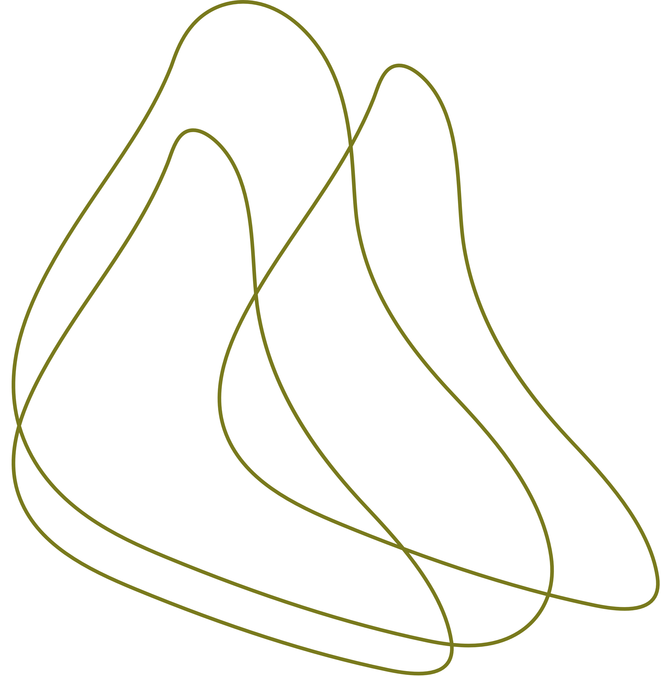




Taste of palestine
Presented by Diana Qwariq
Raya Shafai

Slide 2








Contents:
Introduction
motivation
How to start the system
First level :the water and salt
5
Second level :squeezing the olive
Third level :closing
7
6
Forth level :labeling
8
Final level :measuring

Slide 3


Introduction
“Taste of Palestine” is designed to automate the traditional process of preparing Palestinian olives. The system gently squeezes the olives, fills jars with them, adds water and salt, seals the jars, and measures their weight to ensure quality.

Slide 4



Motivation
The “Taste of Palestine” project was inspired by the desire to preserve and enhance a key aspect of Palestinian culture—olive preparation. This time-honored tradition is labor-intensive, and many families still rely on manual methods passed down through generations.
Our motivation is to support the Palestinian community by creating a solution that modernizes this process, reducing the physical burden while maintaining the authenticity and quality of our olives.

Slide 5
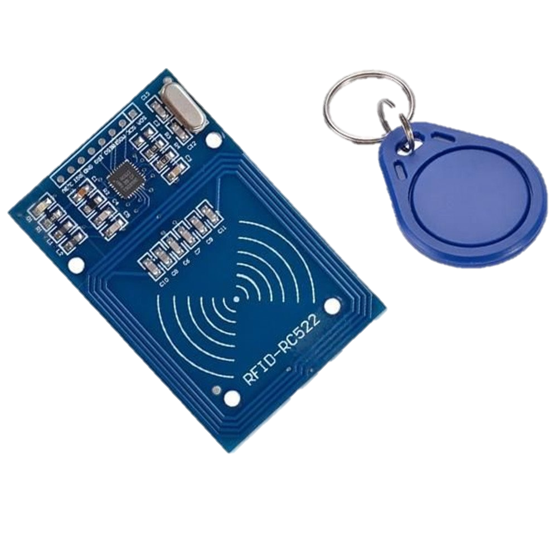
How to start the process?
“To start the system, the user must first scan an authorized RFID card. Once the card is validated, the system will prompt the user to select the desired quantity of olives. The user can choose between 500 mg or 250 mg, depending on their preference. After making the selection, the system will proceed with the next steps of the olive processing.

Slide 6


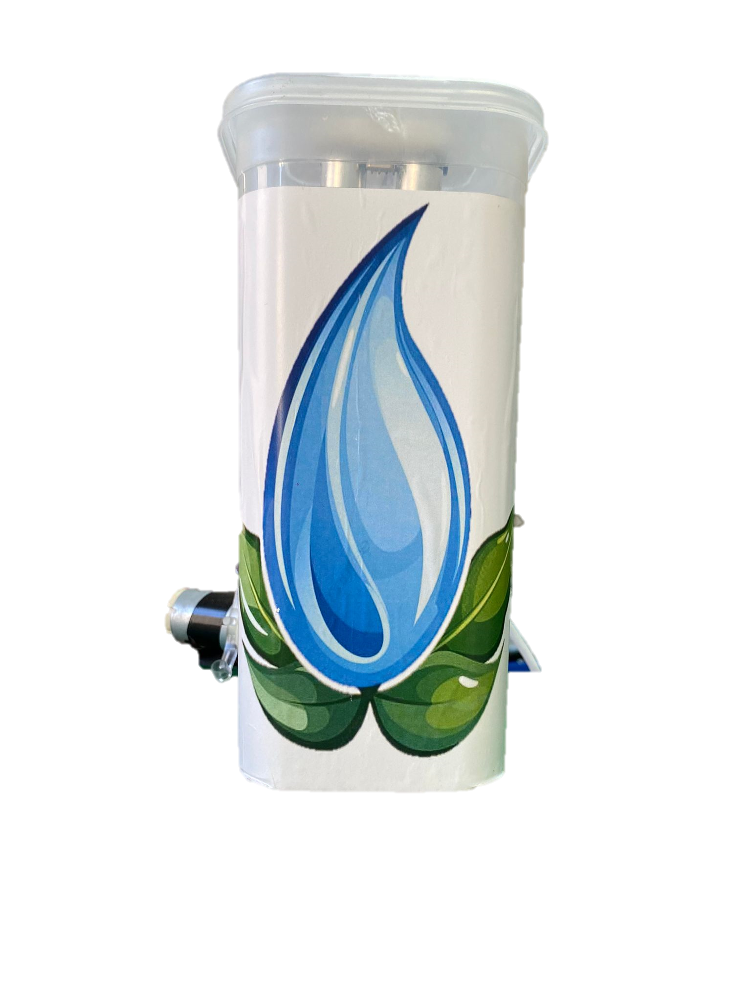


Pickling The olives
In our system, a pump and a valve work together to fill the jar with a precise amount of saltwater solution, essential for pickling olives. Once the desired quantity of olives is placed in the jar, the valve opens, allowing the saltwater to flow through. The pump then activates, ensuring the solution is evenly distributed and the jar is filled to the required level.

Slide 7

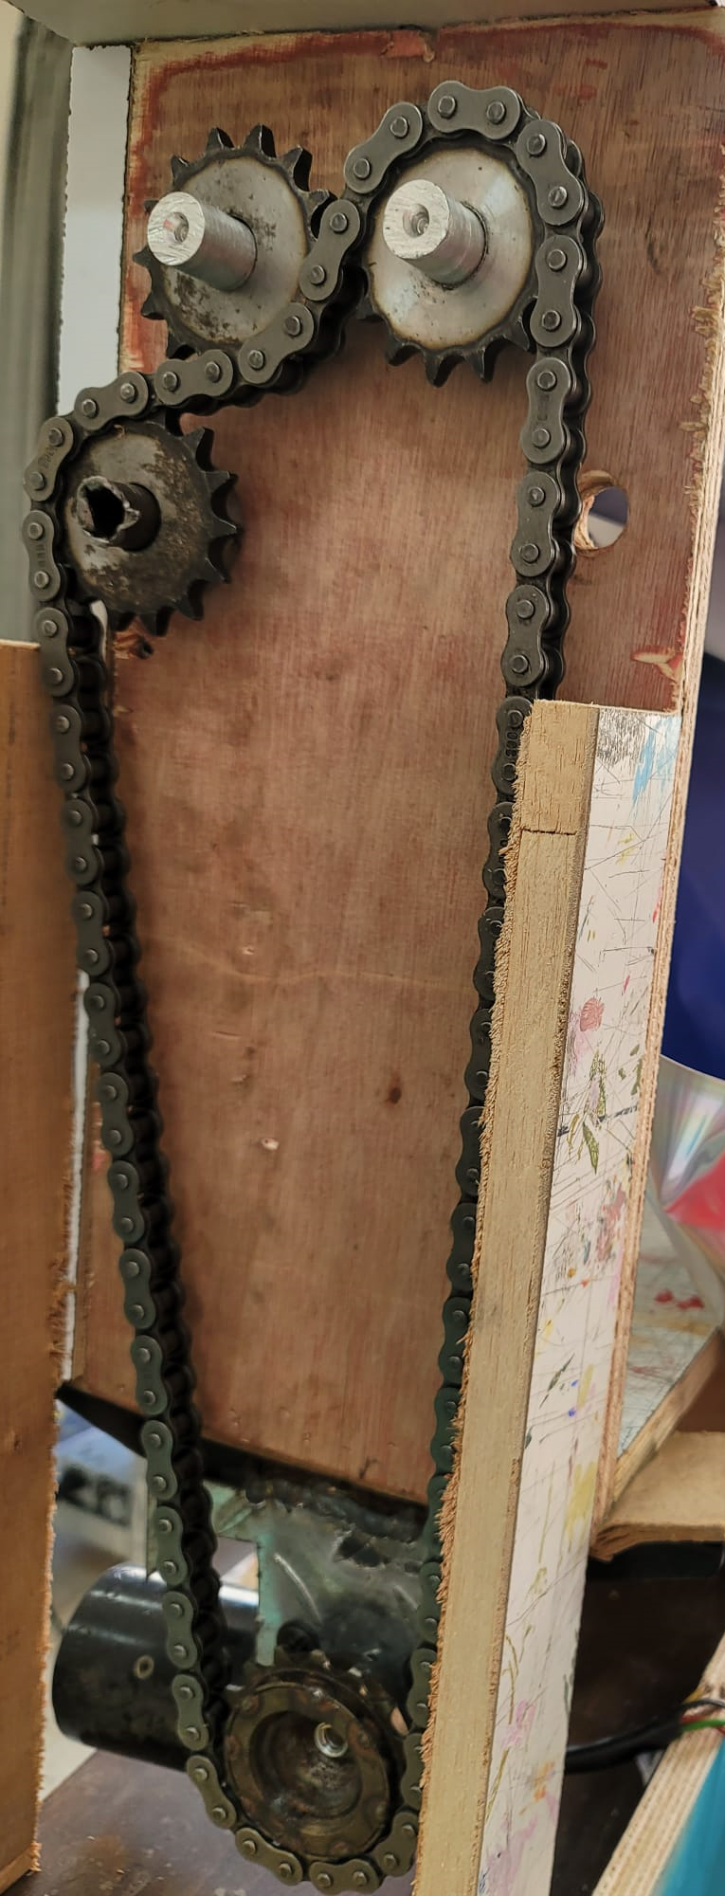
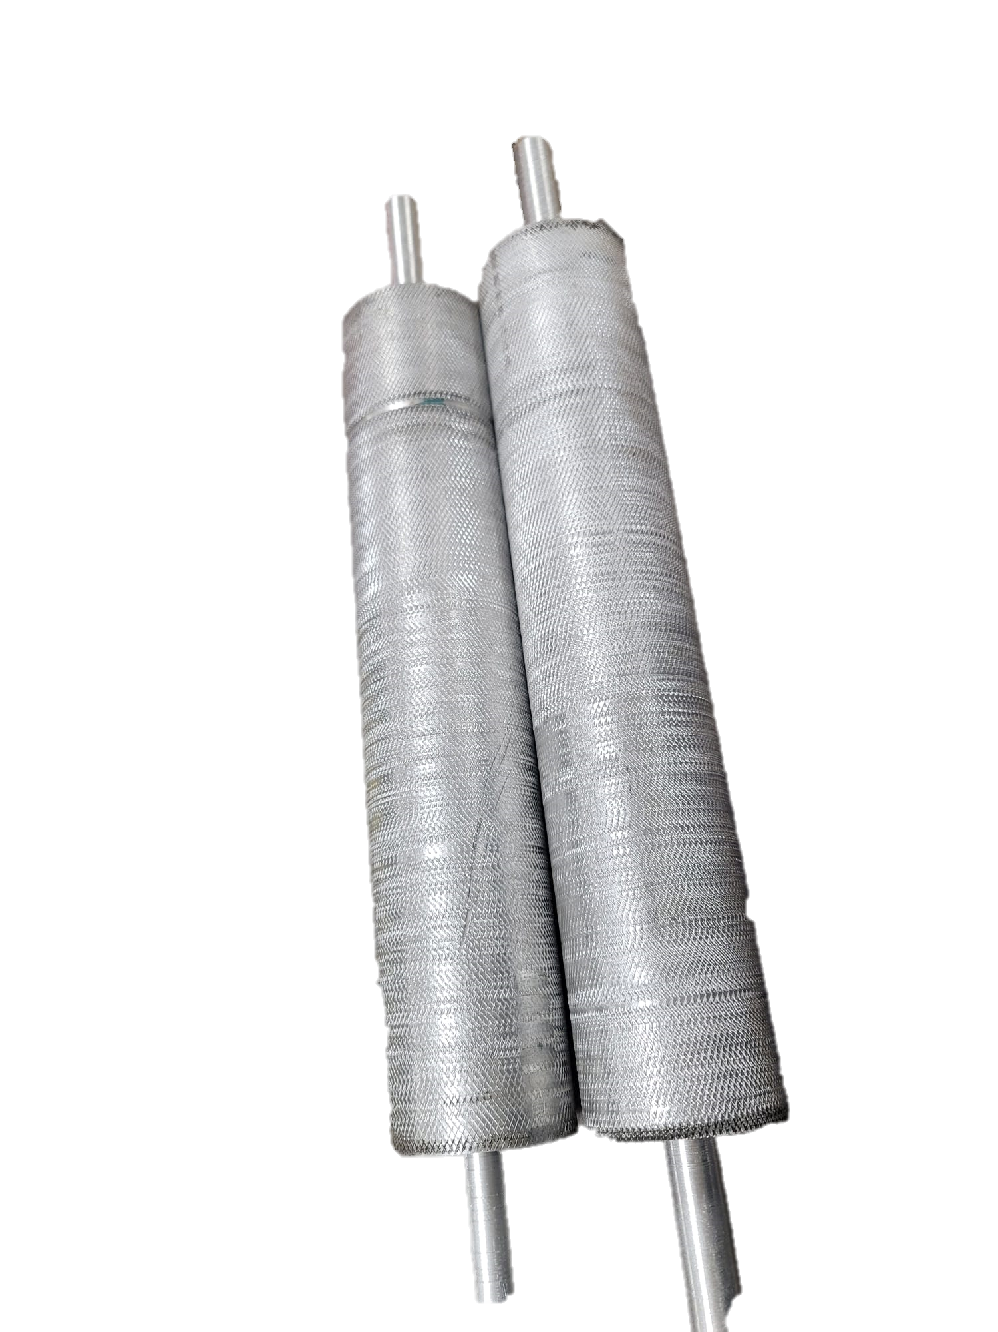


second level: Squeezing the olives
Now we will moving to the squeezing part.This is accomplished using two aluminum rollers, which are connected by three gears and a track system. The track is powered by a windshield wiper motor, which drives the rollers to rotate in opposite directions. The surface of these rollers is roughened to ensure that the olives are effectively squeezed as they pass through.
Proponents

Slide 8

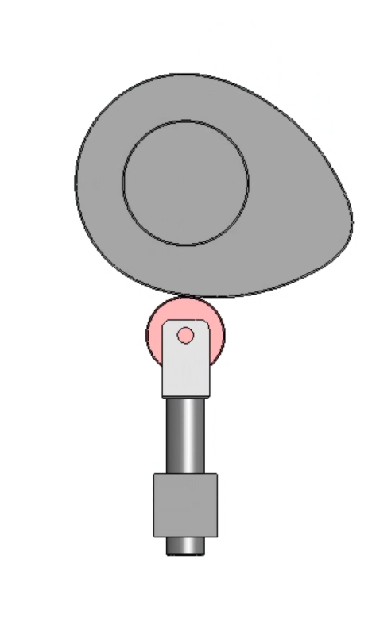

Third level: Closing the jar
What We Know

Slide 9

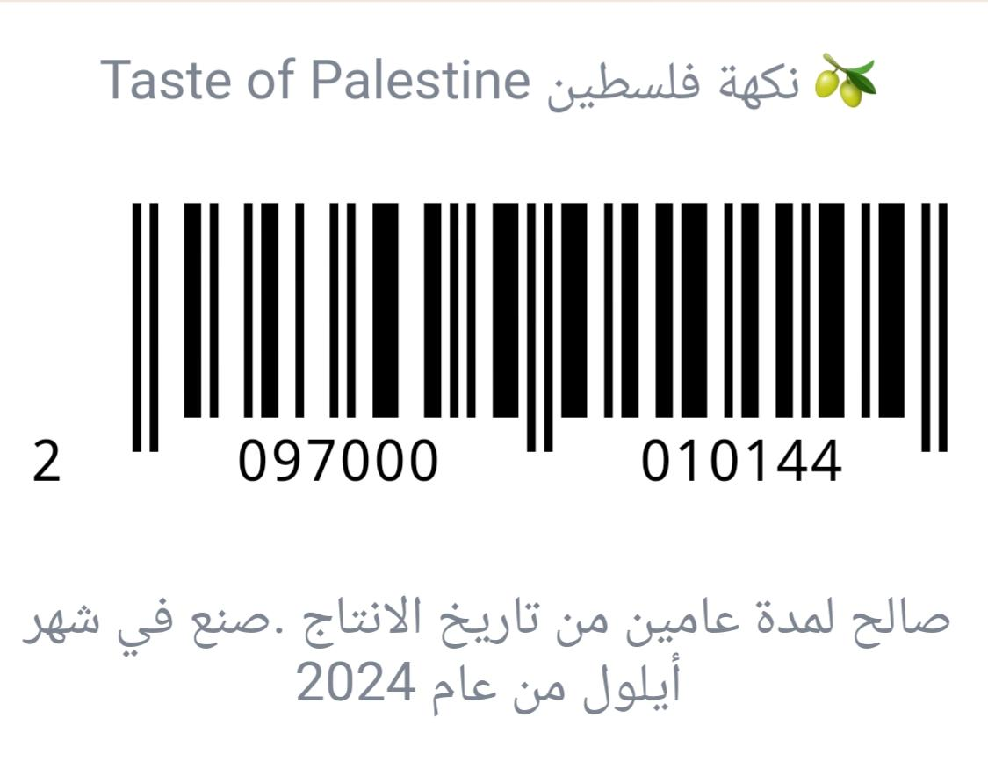
Forth level :the labeling
At the fourth level, the process moves to labeling the jars. Each jar receives a label that includes the project name, a barcode for tracking, and the expiration date of the product.

Slide 10

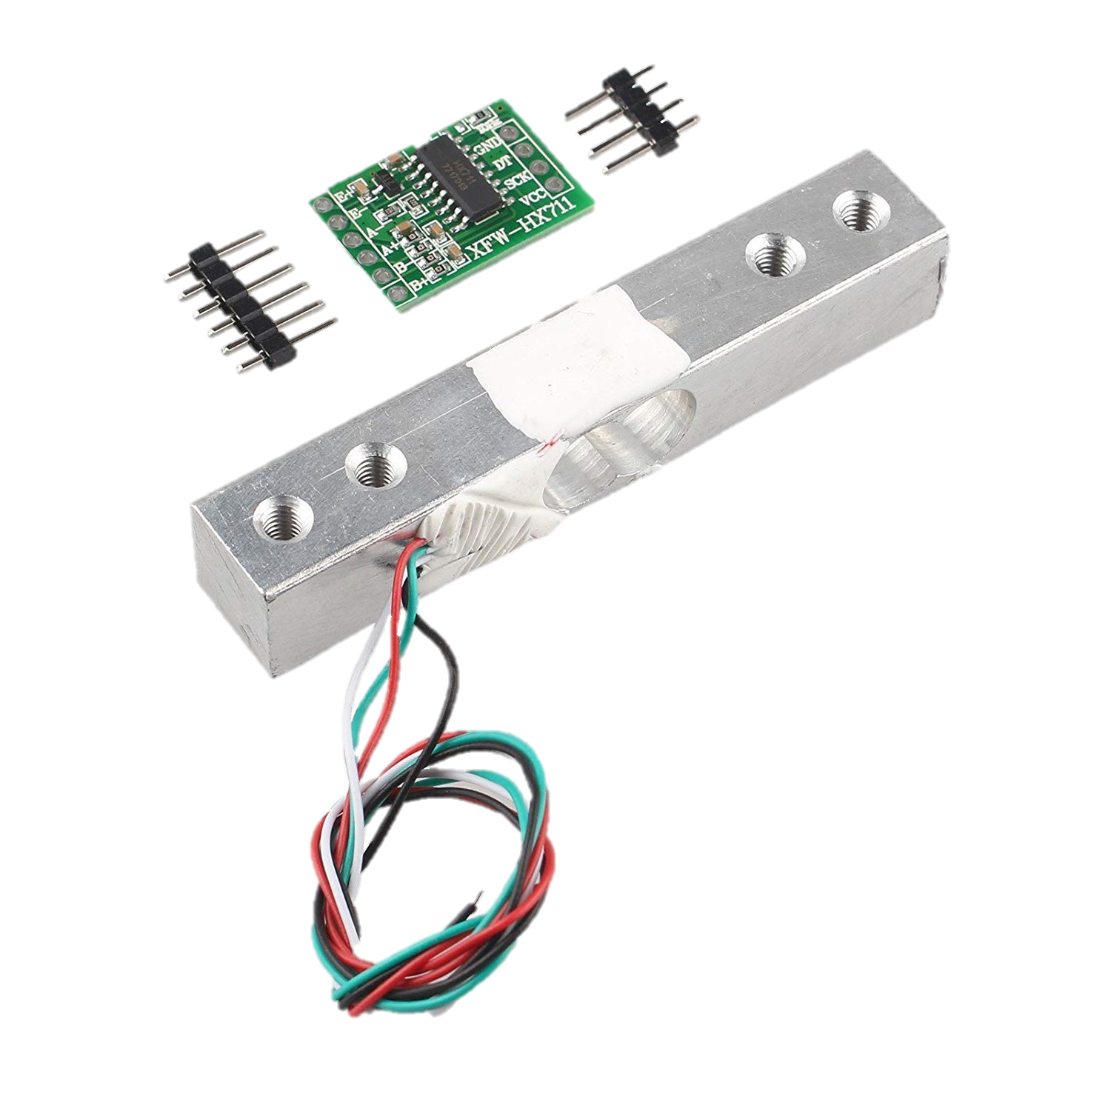
Measuring the weight
The final level involves accurately measuring the weight of the filled jar, including the olives and the water. This is achieved using a load sensor connected to a driver, which ensures precise weight measurement.
Contribution
Implication

Slide 11

Future work:
we will add an option to remove the nucleus from the olives, improving the processing efficiency.
we will integrate an olive pressing mechanism to extract olive oil, expanding the functionality of the project and providing a complete olive processing solution. These advancements will enhance the system’s versatility and cater to a wider range of olive-based products.

Slide 12

Thank
You

