Slide 1



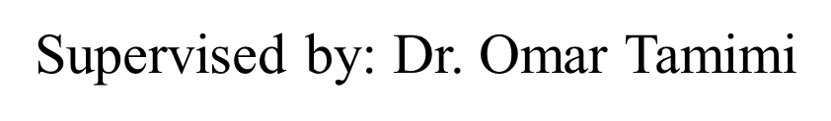
Real Time Adaptive Active Noise Cancellation
Prepared by:
Hind AL Haj (11925021)
Elham Alhasan (11610504)
Ru’a Khamous (11611104)

Slide 2
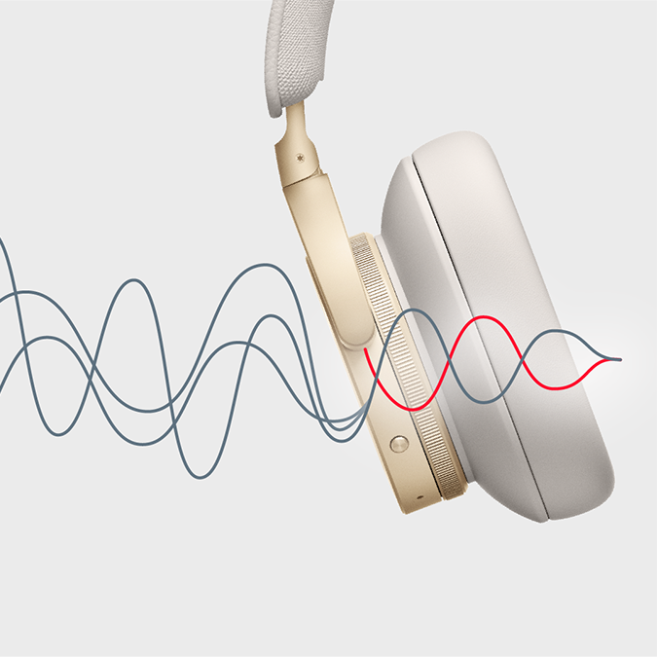
Abstract
Real-Time Adaptive Active Noise Cancellation (ANC) is an important project related to its potential to significantly improve the quality of life and enhance different industries by addressing the issue of unwanted background noise.
Real-Time Adaptive Active Noise Cancellation holds immense significance. Its potential impact on quality of life and the way we experience sound underscores its importance in modern society.
The main objectives of a Real-Time Adaptive Active Noise Cancellation (ANC) project are to develop a sophisticated technology that can effectively reduce or eliminate unwanted background noise in real-time, enhancing the quality of audio experiences and improving various aspects of daily life.

Slide 3
Goal
• The goal of the project is to design and implement an noise cancellation system using an adaptive filter.

Slide 4
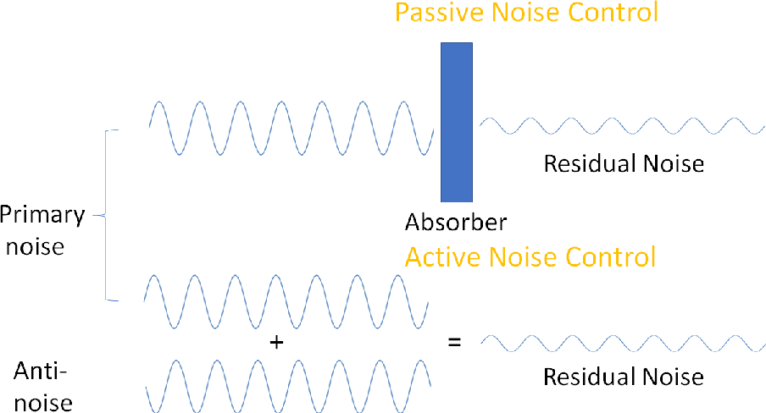
The problem
Interest in noise pollution has increased, as the number of tools needed to combat the problem. In noise control, we can determine between two methods: passive and active. Until now, the method used has mainly been passive, where sound blocked and variable absorption materials are used to prevent sound transmission or resurface spaces to change their response.Nowadays, ANC have increased the importance of this type of solution , especially for lower audio frequencies (20Hz-160Hz) Where Passeve method have more difficulties.

Slide 5
Active Noise Cancellation
ANC is the process of using a microphone to monitor environmental noise and creating anti-noise.
Anti-noise is then superimposed with audio playback to cancel noise entering the user's ear
Active noise cancellation can be achieved with digital filters .

Slide 6



Adaptive Filtering Techniques
The simplest type of active noise cancellation.
the noise-capturing microphones are placed on the outside of the headphones.
This is pretty handy for ANC ear buds,
where there is limited real estate for a mic inside the wearer's ear.
Feedforward
1
uses microphones placed inside the ear cup to
pick up the sound that reaches the listener's ear.
With the mic place inside the ear cup and in front of the speaker
it gets to hear the resulting signal in exactly the same way the listener does.
Feedback
2
Hybrid
by using both external and internal microphones, hybrid ANC is capable of canceling out a wider range of frequencies, providing a more immersive noise-canceling experience. With hybrid ANC, the external microphones capture ambient noise, while the internal microphones pick up the sound that reaches the listener's ears.
3

Slide 7



Types of Active Noise Cancellation
Analogue Active Noise Cancellation
Digital Active Noise Cancellation
Analogue active noise cancellation uses analogue electronic circuits to create the anti-noise signal
Digital active noise cancellation uses digital signal processing (DSP) algorithms to create the anti-noise signal.

Slide 8




Analogue circuit is composed of three separate stages
Stage 1 : non-inverting amplifier
This stage simply takes the input from the audio jack and amplifies the signal.
Amplifying this signal is crucial since the microphone produces a smaller signal that is difficult to work with..
Stage 2 : phase inverting configuration
This stage is supposed to invert the phase.
so that the output added with the ambient sound from outside the headphones deconstructive interferes.
Stage 3: summing, non-inverting, amplifying stage
Modified noise from the second stage and the sound will be added together and sent to the output . This allows the user to hear their sound while the ambient noise is still being cancelled by deconstructive interference.

Slide 9
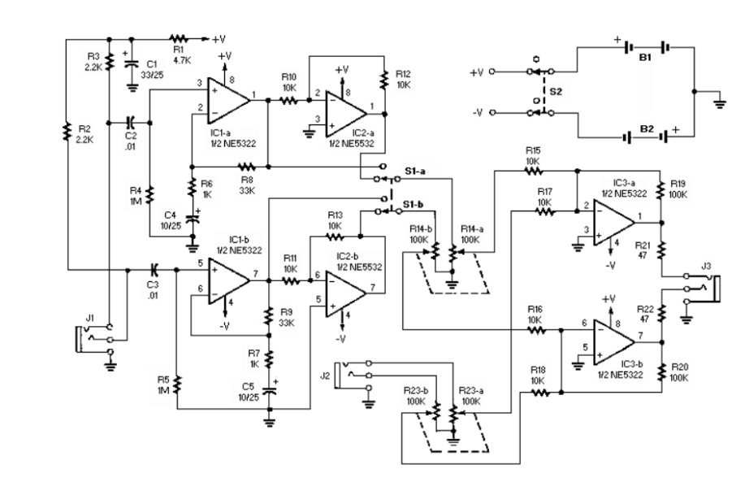
Analogue ANC circuit

Slide 10
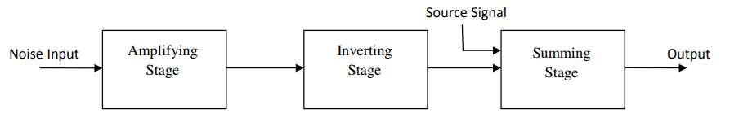
Block Diagram of Analogue ANC circuit

Slide 11
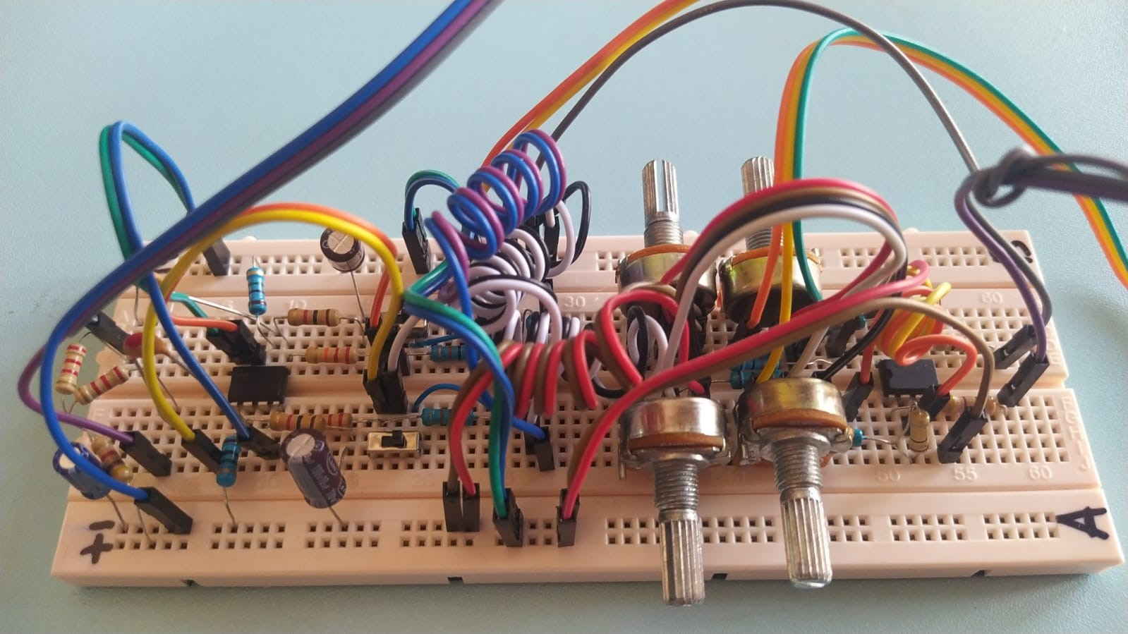
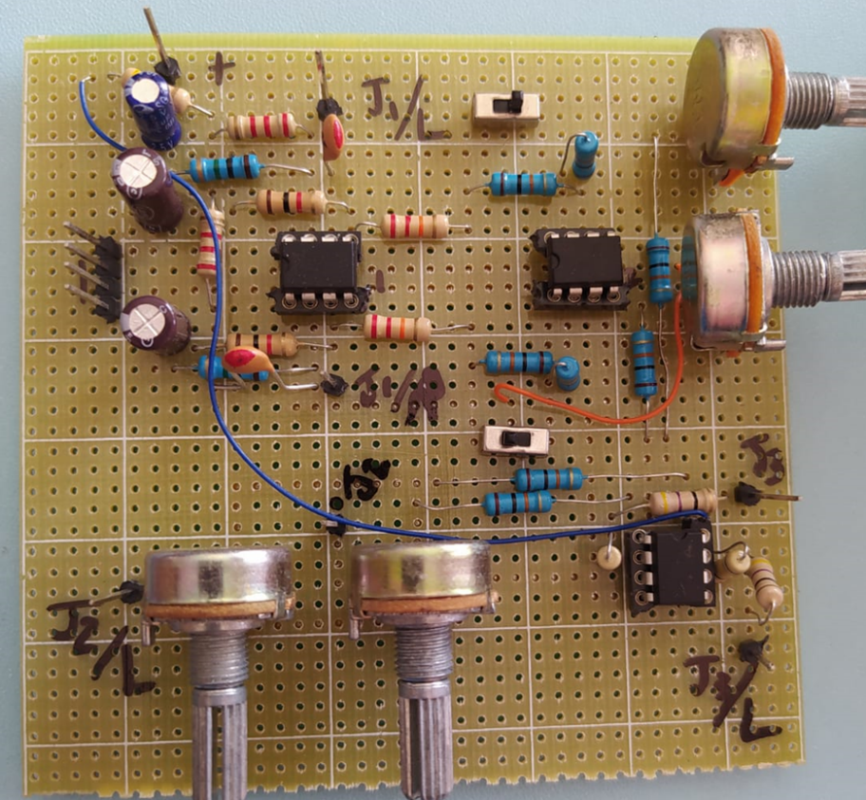
Breadboard Circuit for test
PCB board Circuit for results

Slide 12
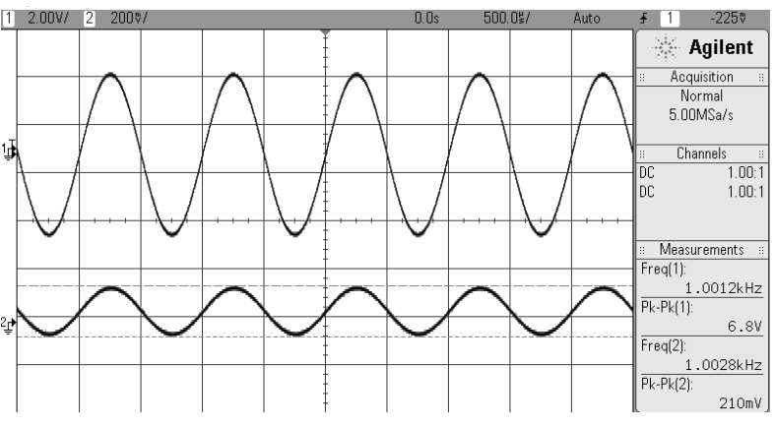
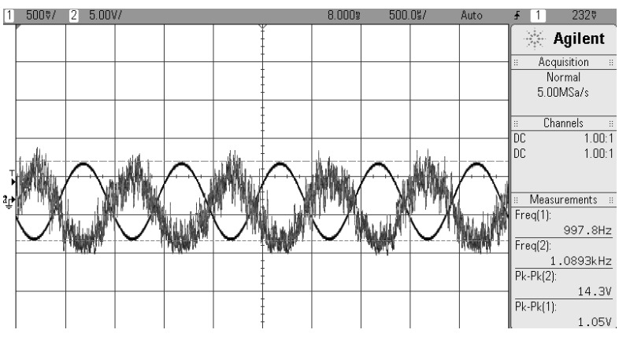
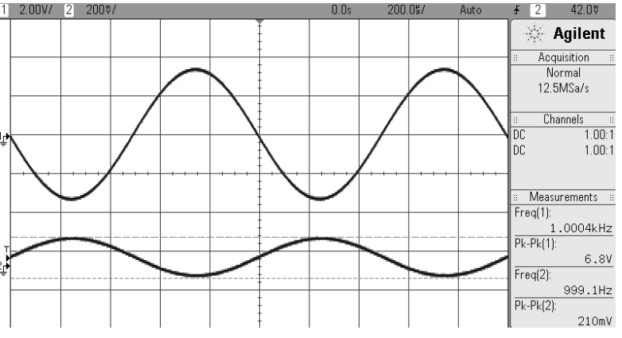
Left-Side Output Stage 2
(channel 1: output after inversion; channel 2: input signal)
Left-Side Output Stage 1 (channel 1: output after amplification; channel 2: input signal)
Left-side Output Stage 3 (channel 1: output after noise signal (white noise) summed

Slide 13
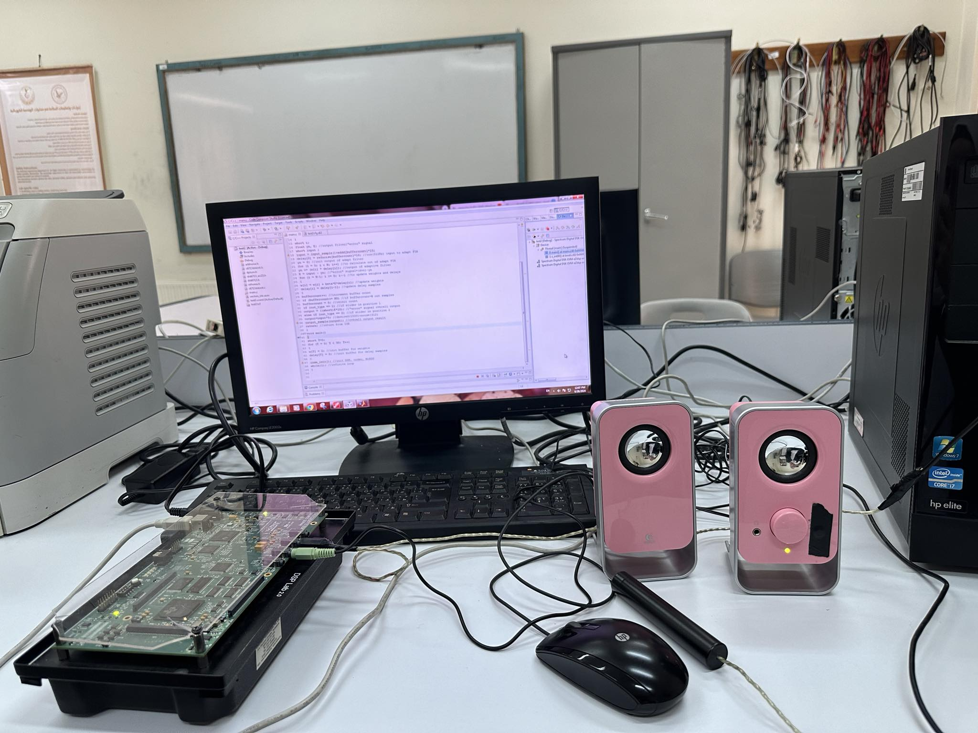
Digital ANC Hardware setup

Slide 14
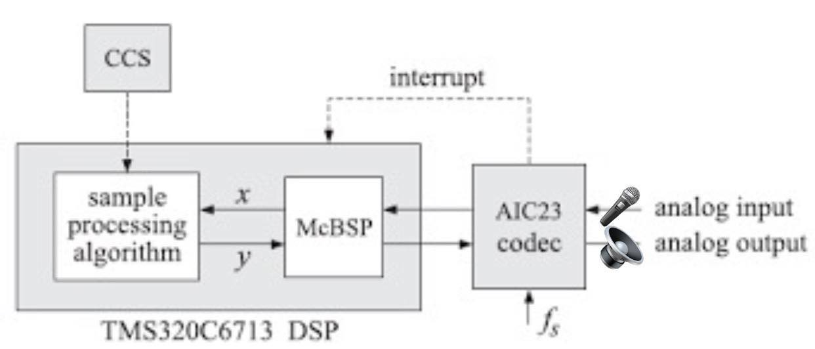
Digital ANC Circuit Block Diagram

Slide 15
Digital ANC Hardware setup Components
TMS320C6713-based DSK board: serves as a powerful tool for developing and implementing real-time active digital noise cancellation systems, leveraging its high-performance DSP capabilities, flexible I/O interfaces, and robust development tools.
Microphone: responsible for capturing real-time noise signals.
Speaker: playing the anti-noise signals generated by the DSP in an ANC system.
Code Composer Studio: to program the DSK kit to perform a certain signal-processing task.
PC: To insert a test input .

Slide 16
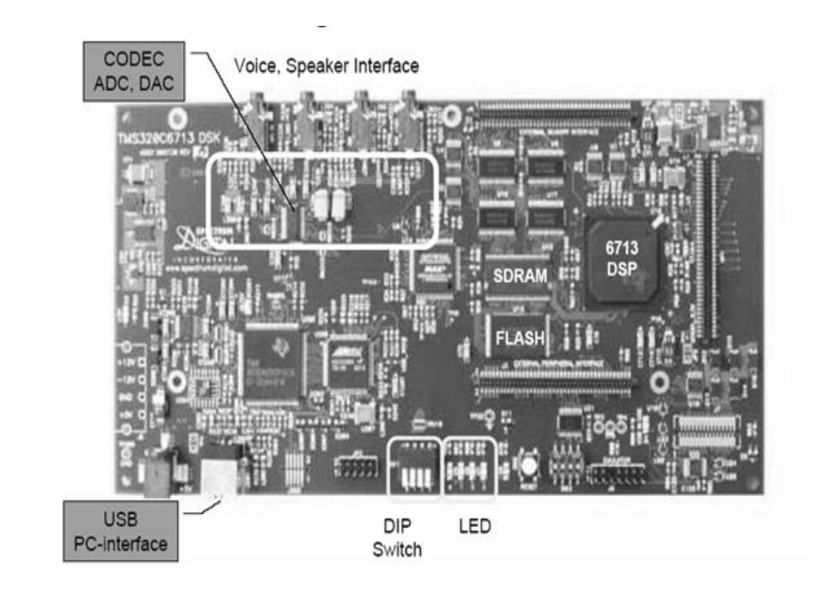
TMS320C6713-based DSK board
DSK is a complete DSP system with the necessary hardware and software support tools.
• It consists of: C6713 DSP, 32-bit stereo codec (AIC23) for input and output, 16MB SDRAM, 256KB flash memory, 4 input/output (Line in, mic in , line out, Headphone) , 4 dip switches and 4 leds.
• DSK operates at 225MHz.

Slide 17
TMS320C6713-based DSK board
Uses sigma-delta technology that provides ADC and DAC.
Can be set to variable sample rates (8,16, 32, 44.1, 48, 96 KHz)
Is connected to 12MHz system clock.
The ADC circuitry on the codec converts the input analog signal to a digital representation to be processed by the DSP. The maximum level of the input signal to be converted is determined by the specific ADC circuitry on the codec, which is 6Vp-p with the onboard codec.

Slide 18
TMS320C6713-based DSK board
Along the output path is a DAC, which performs the reverse operation of the ADC.
An anti-aliasing filter at the input with cut off frequency of fs/2.
A reconstruction low pass filter to smooth the signal at the output with cut off frequency of fs/2.

Slide 19
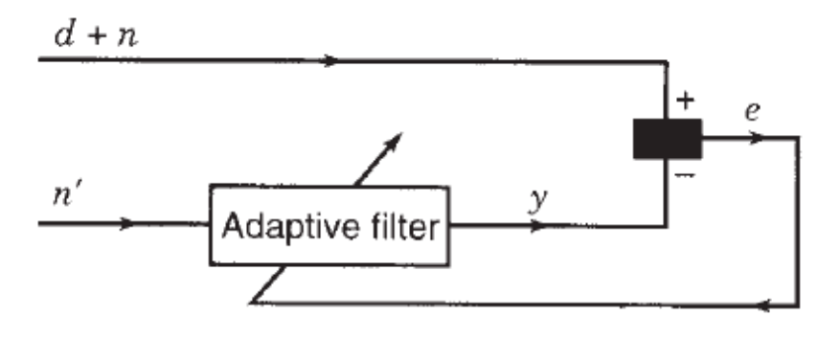
Adaptive Filter & LMS Algorithm
LMS Algorithm
Adaptive Filter Block Diagram
Least mean squares (LMS) algorithms are a class of adaptive filter used to mimic a desired filter by finding the filter coefficients that relate to producing the least mean square of the error signal (difference between the desired and the actual signal).
The basic idea behind LMS filter is to approach the optimum filter weights by updating the filter weights in a manner to converge error.
The algorithm starts by assuming small weights (zero in most cases) and, at each step, by finding the gradient of the mean square error, the weights are updated.

Slide 20
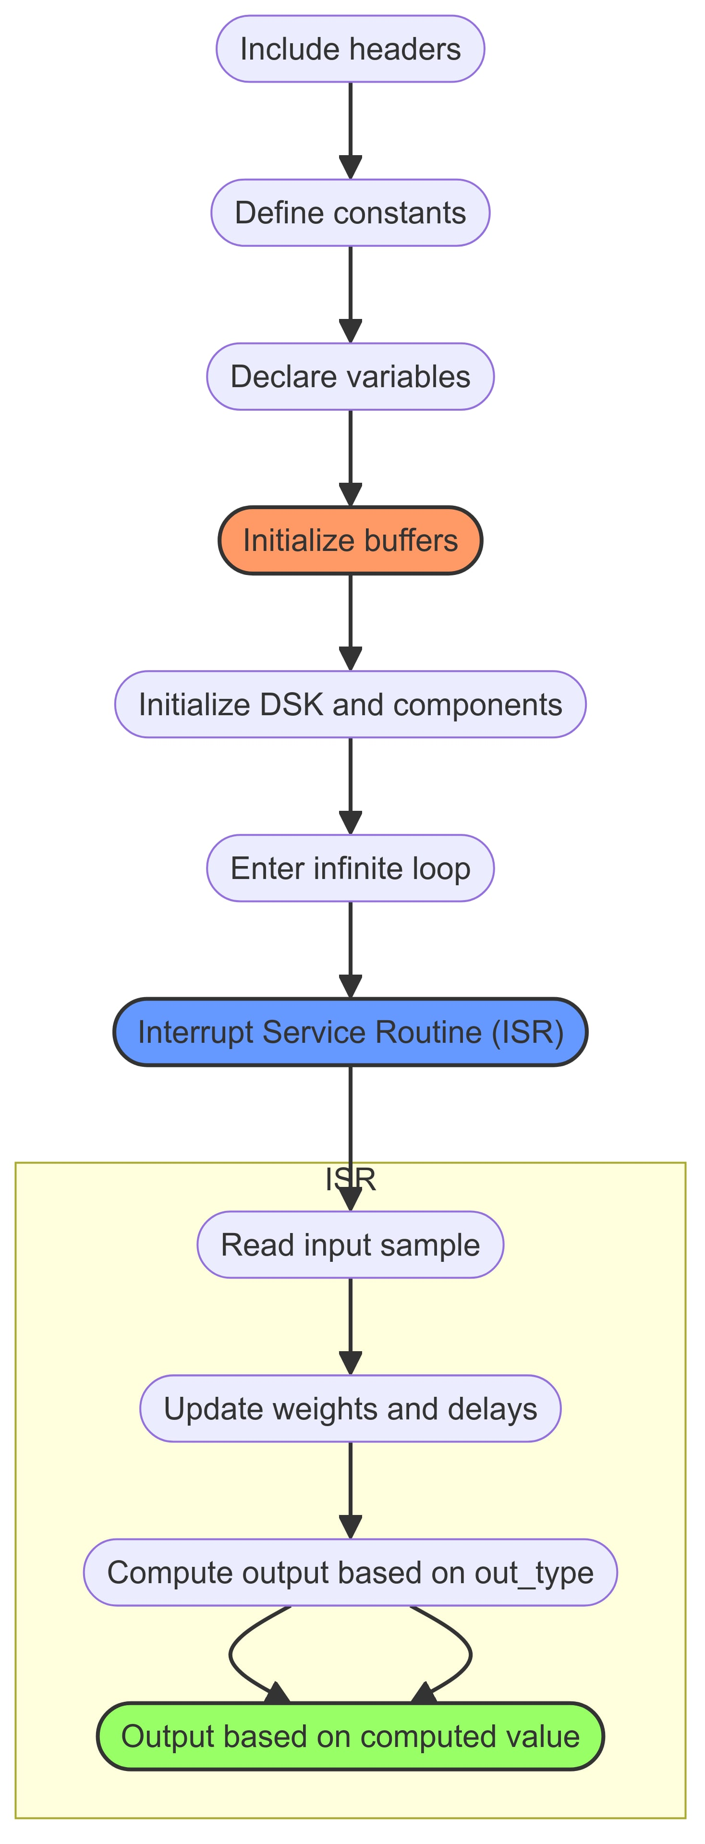
The Code Flowchart
Include Headers: "DSK6713_AIC23.h", "refnoise.h", "addnoise.h".
Define Constants: Uint32 fs= DSK6713_AIC23_FREQ_8KHZ, beta 1E-12, N 30, NS 128.
Declare Variables: Variables like float w[N];, float delay[N];, short output;, etc.
Initialize Buffers: Initialize w and delay arrays.
Initialize DSK and Components: comm_intr();.
Enter Infinite Loop: while(1);.
Interrupt Service Routine (ISR): Handles the core processing logic.
Read Input Sample: Read the input sample and add noise (input = input_sample() + addd[buffercount] * 10;).
Update Weights and Delays: Update the weights and delay samples.
Compute Output Based on out_type: Determines the output type.
Output Based on Computed Value: Output the final computed value.

Slide 21
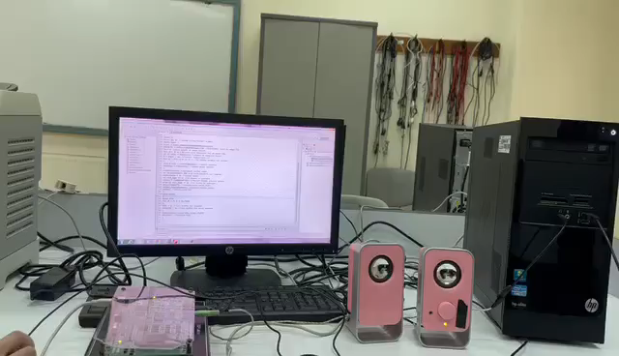
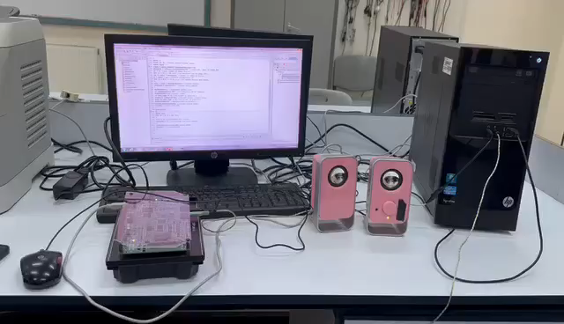
First Demo (PC input)
Second Demo (Microphone input)

Slide 22

Applications and Use Cases
Home Electronics
Transportation
Noise cancellation in smart speakers, TVs, and headphones.
Quieter rides in vehicles, trains, and airplanes.
1
2
3
Industrial Settings
Reducing machinery noise in factories and workshops.

Slide 23
Conclusion
Real Time Adaptive Active Noise Cancellation (ANC) represents a significant leap forward in audio technology, providing superior noise reduction by continuously adapting to environmental changes. This advanced technology enhances user experience across various settings, from consumer electronics to automotive and industrial applications. By leveraging real-time data and sophisticated algorithms, adaptive ANC offers unparalleled noise management, ensuring comfort and clarity in dynamic noise conditions. As the technology evolves, its integration into everyday devices will continue to improve, promising even more refined and efficient noise cancellation solutions for a wide range of users.

