Slide 1
SMART SAFETY
Yousef Hawwari and yaser nabulsi

Slide 2
Outline
Introduction
Problem
Solution
What Can Engineer Do ( Mobile Application )
What Can Manger Do ( Website )
Challenge
Future Work
Demo

Slide 3
Introduction
What is Smart Safety ?!
Who Can Use it !

Slide 4
Problem & Solution
Why did we choose this Project ?

Slide 5
What Can Engineer do ( Mobile App )
Answer the safety questions of the project stages, add a comments and pictures to the questions
Add a new stage of safety for the project
Send the safety reports to the manager

Slide 6
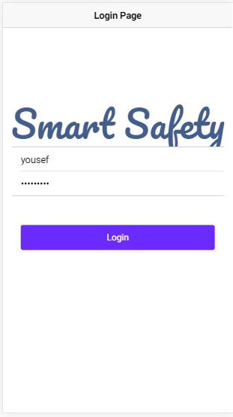
What Can Engineer do ( Mobile App )

Slide 7
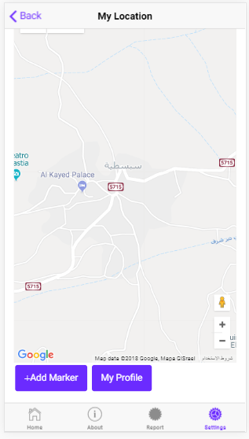
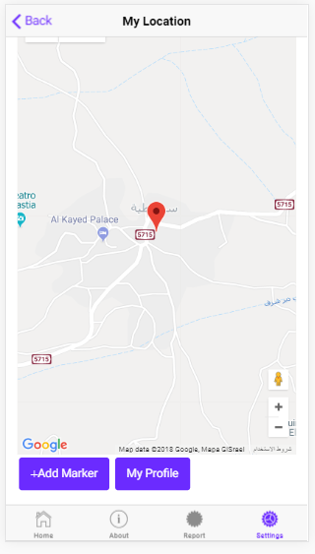
What Can Engineer do ( Mobile App )

Slide 8
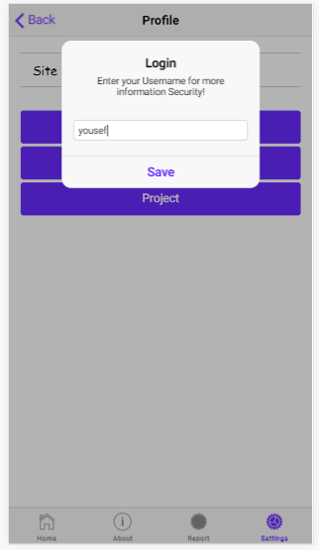
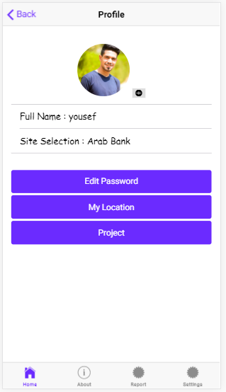
What Can Engineer do ( Mobile App )

Slide 9
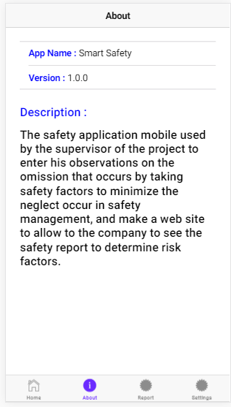
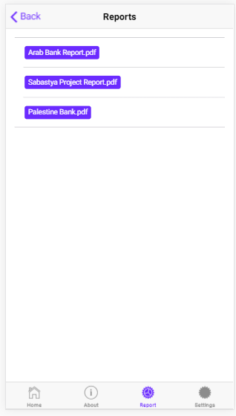
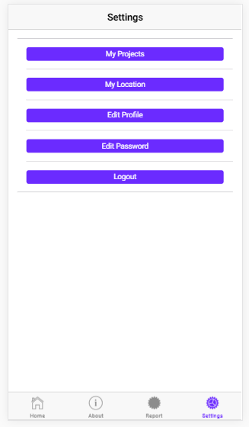
What Can Engineer do ( Mobile App )

Slide 10
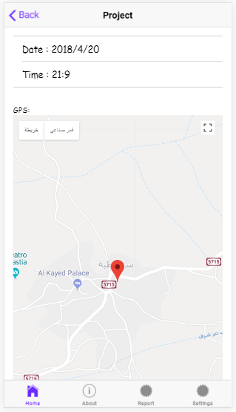
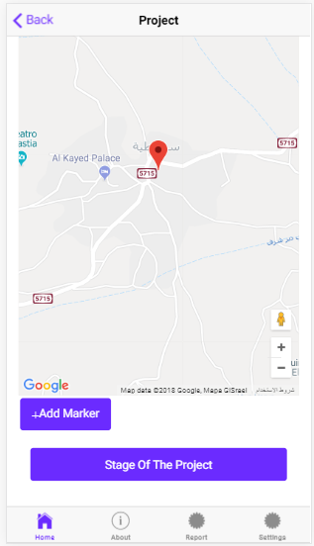
What Can Engineer do ( Mobile App )

Slide 11
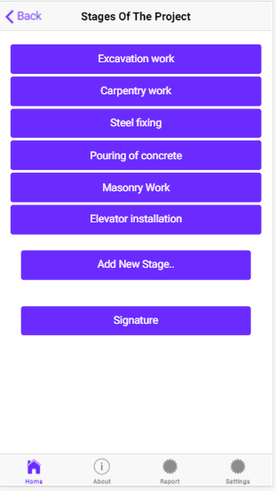
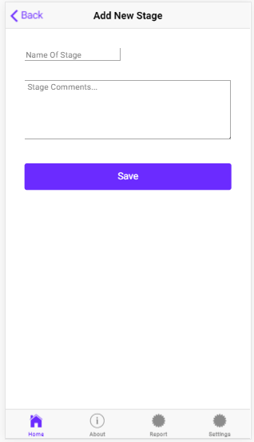
What Can Engineer do ( Mobile App )

Slide 12
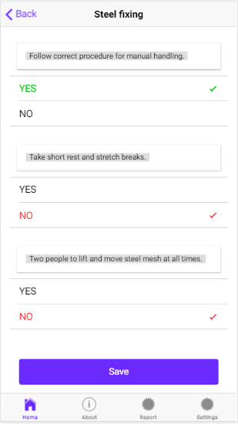
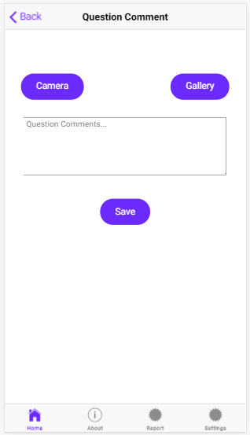
What Can Engineer do ( Mobile App )

Slide 13
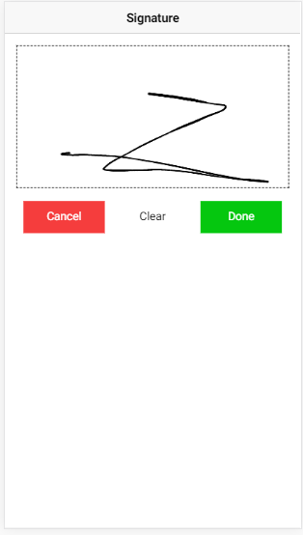
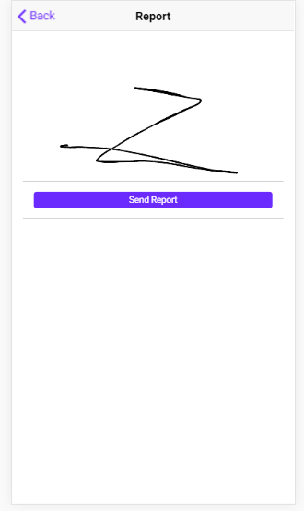
What Can Engineer do ( Mobile App )

Slide 14
What Can Manger do ( Website )
Make new project and manger the projects
Add new engineer or employee user
Download the safety reports

Slide 15
What Can Manger do ( Website )
Login
Profile
Project
Engineer
Report
About Us
Edit Profile
Add
Add
Download
Edit
Remove
Delete

Slide 16
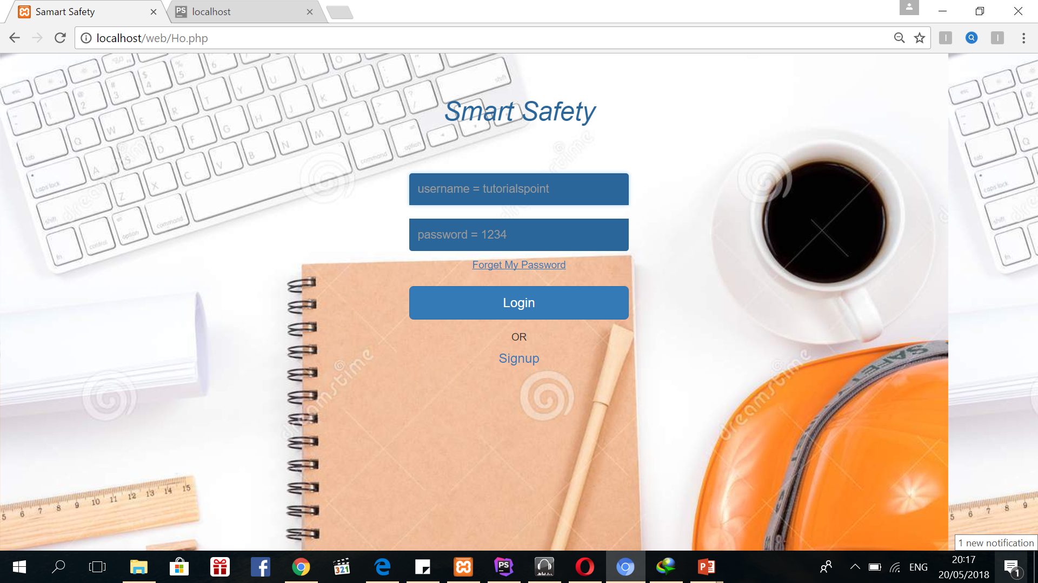
What Can Manger do ( Website )

Slide 17
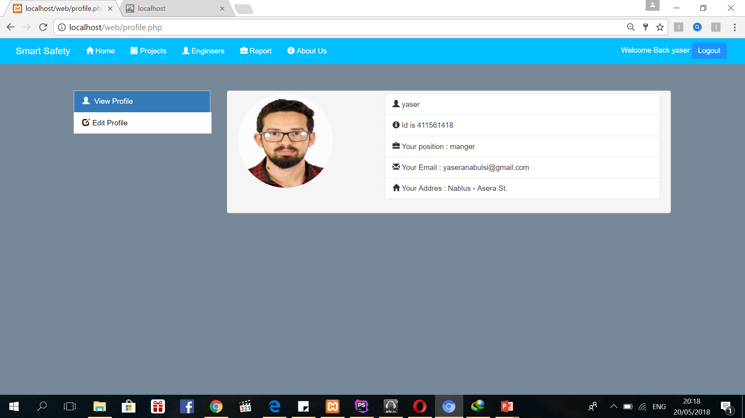
What Can Manger do ( Website )

Slide 18
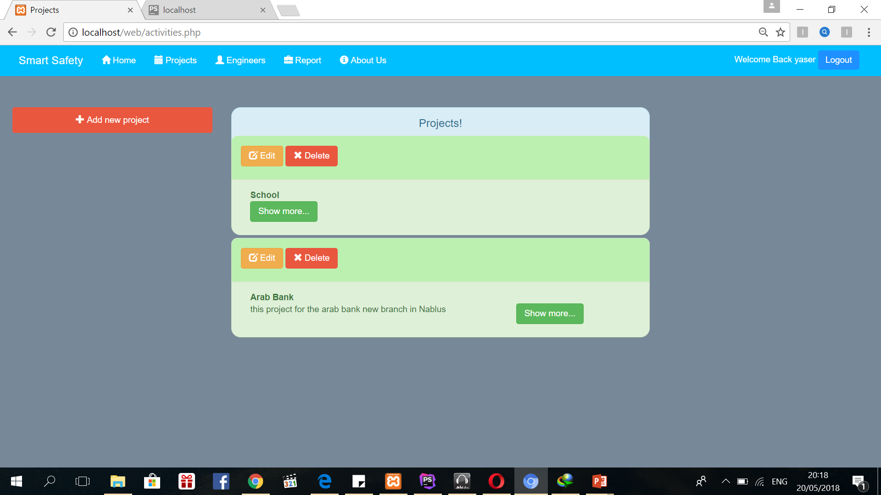
What Can Manger do ( Website )

Slide 19
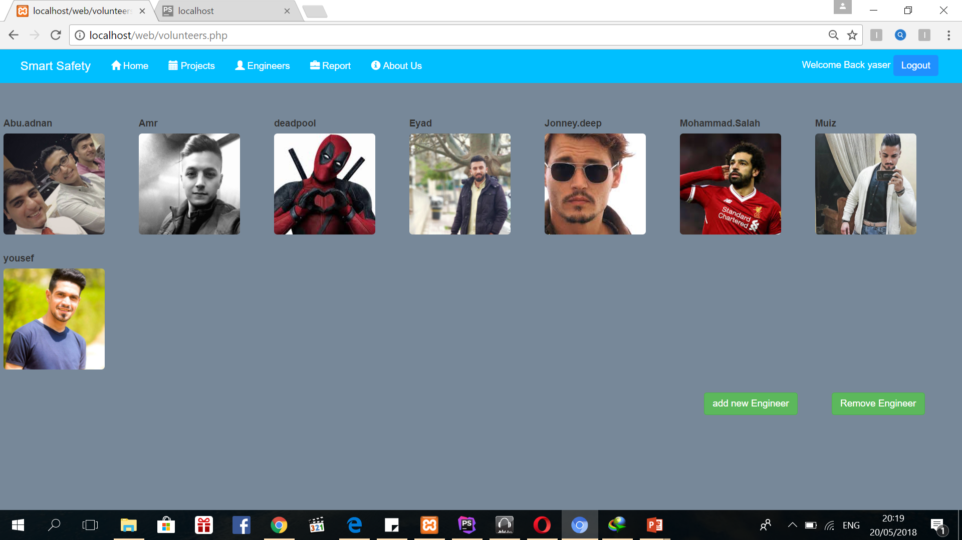
What Can Manger do ( Website )

Slide 20
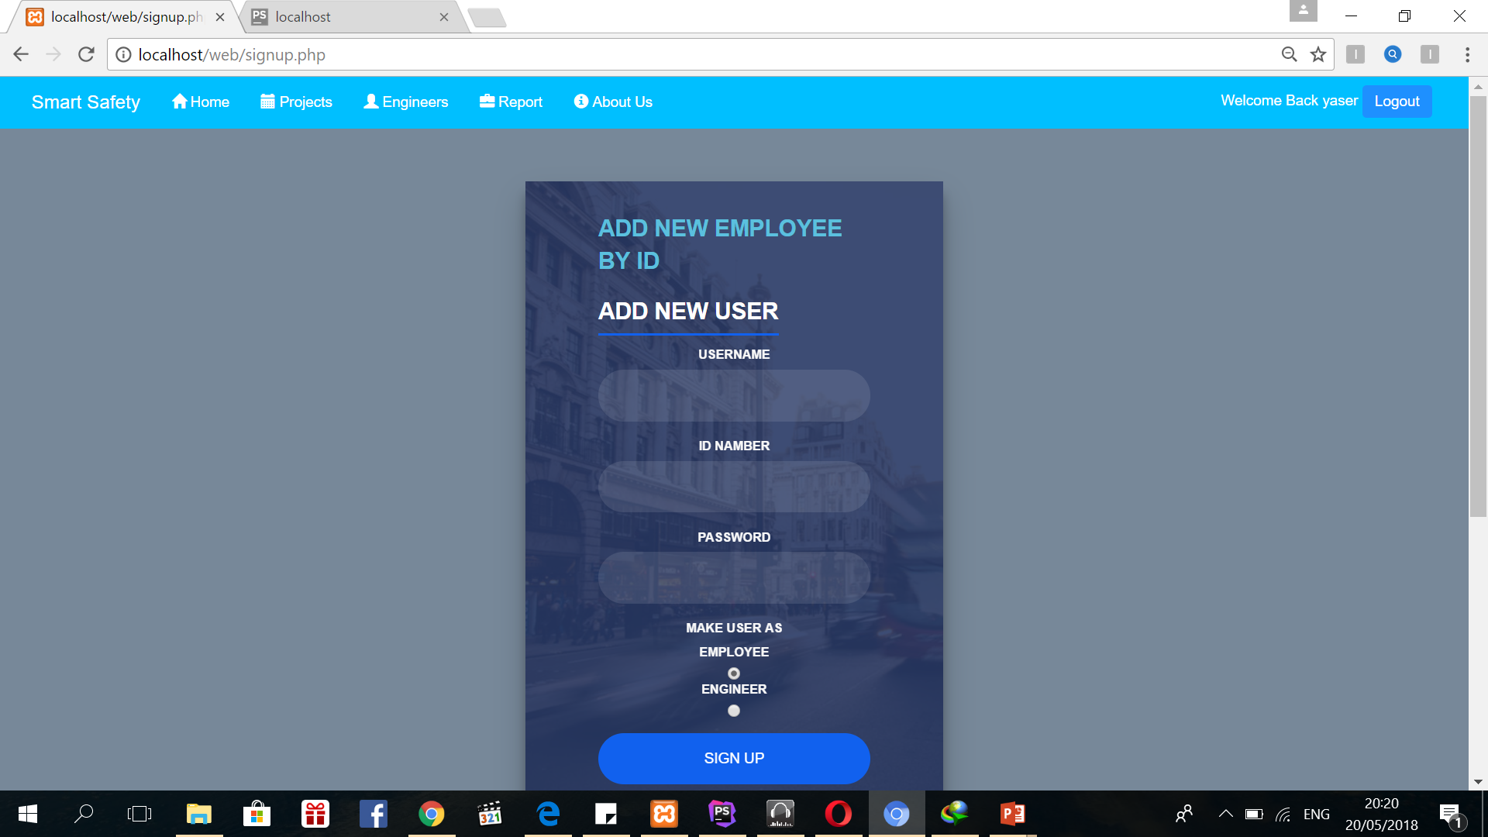
What Can Manger do ( Website )

Slide 21
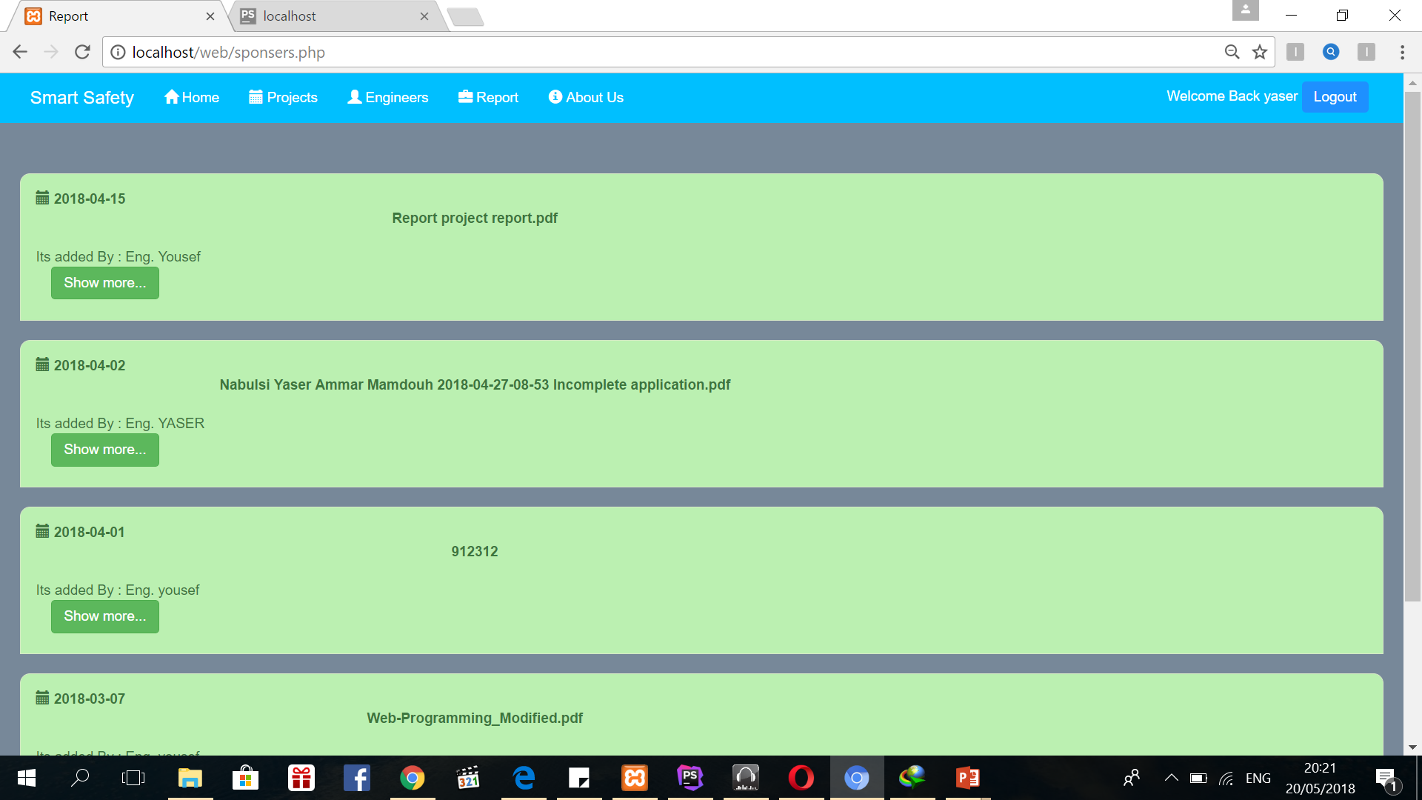
What Can Manger do ( Website )

Slide 22
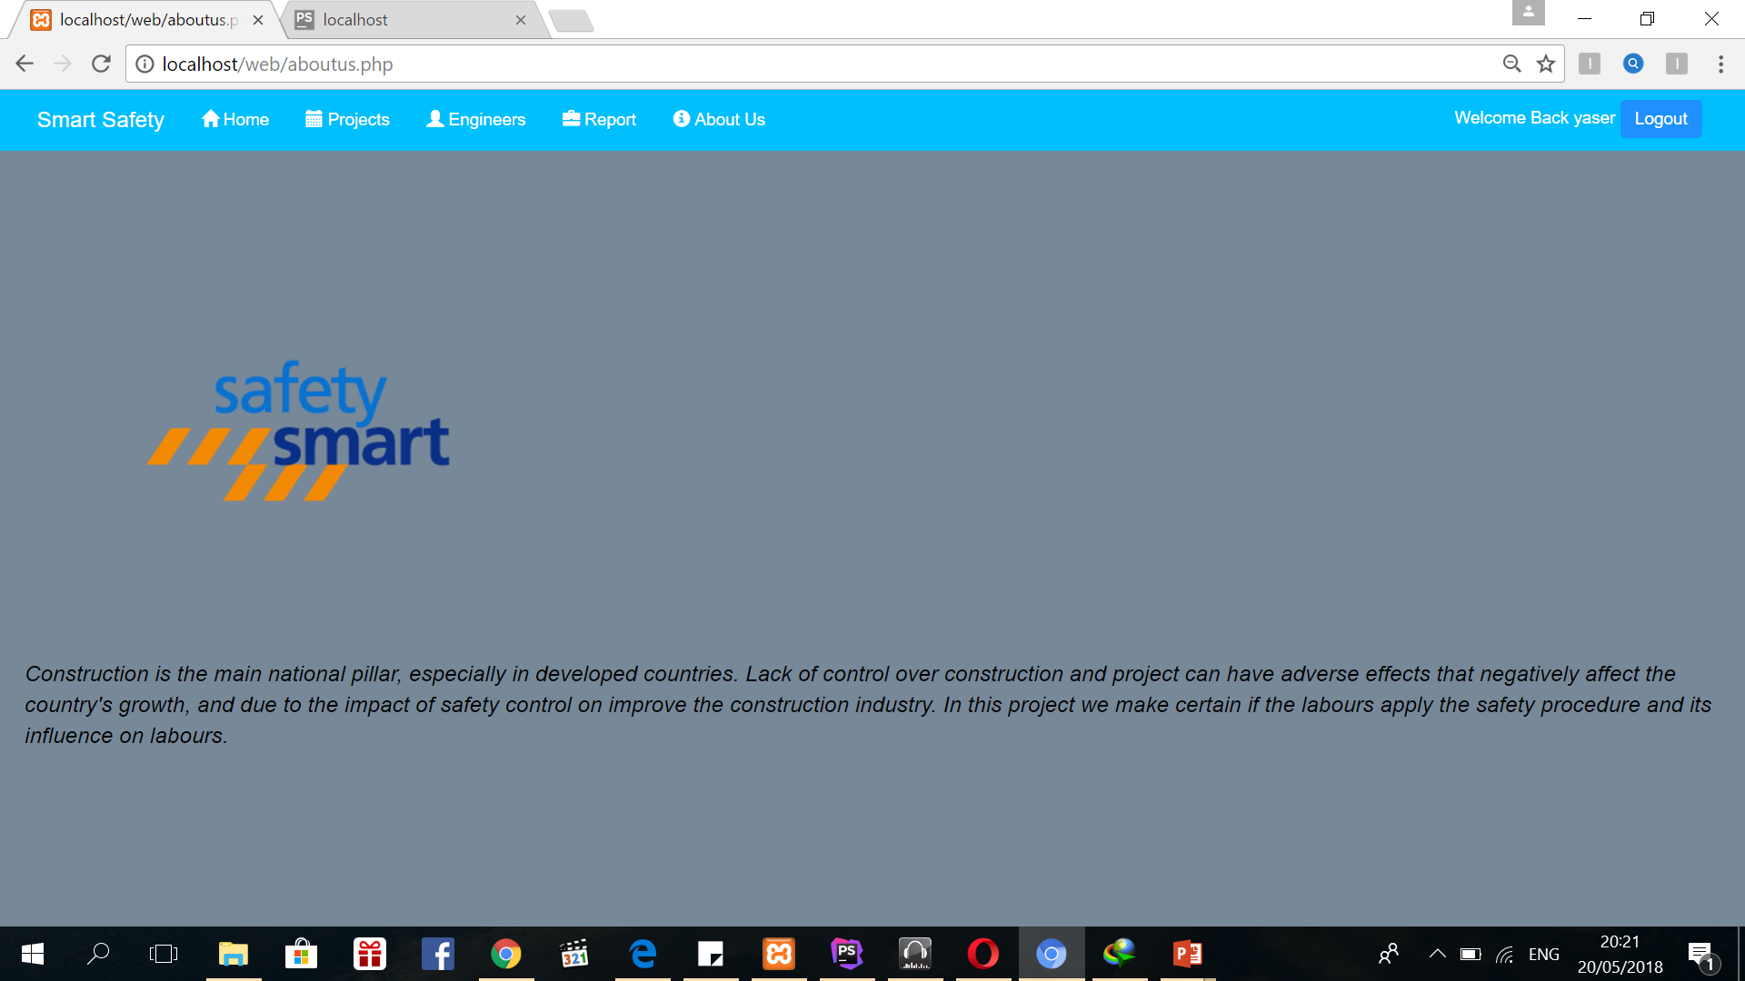
What Can Manger do ( Website )

Slide 23
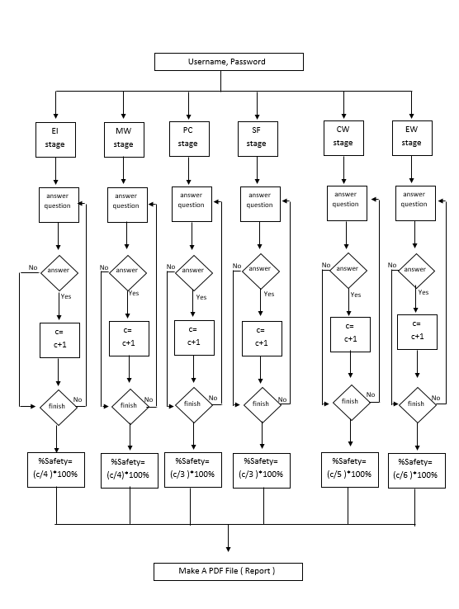
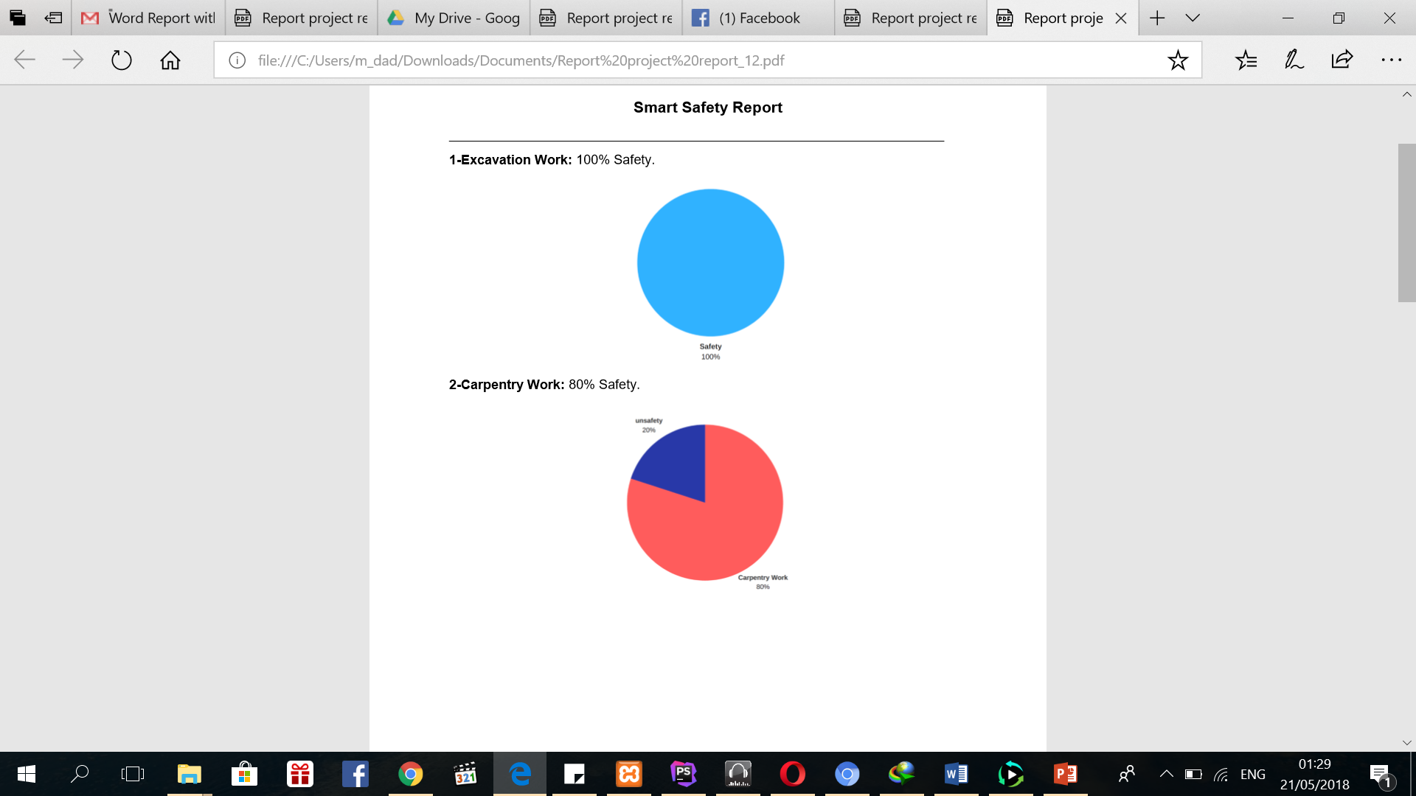
Report

Slide 24
Challenges
Data Challenge
Framework

Slide 25
Future work
We seek to develop the project to be used by accredited companies and to increase safety in construction factories.

Slide 26
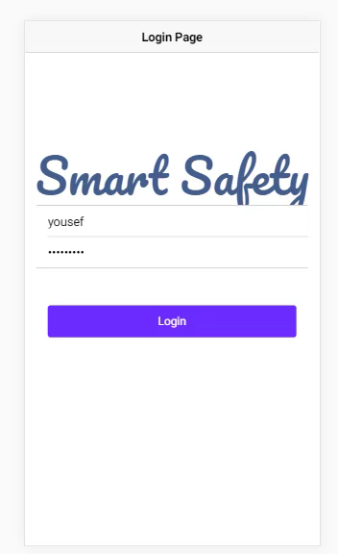
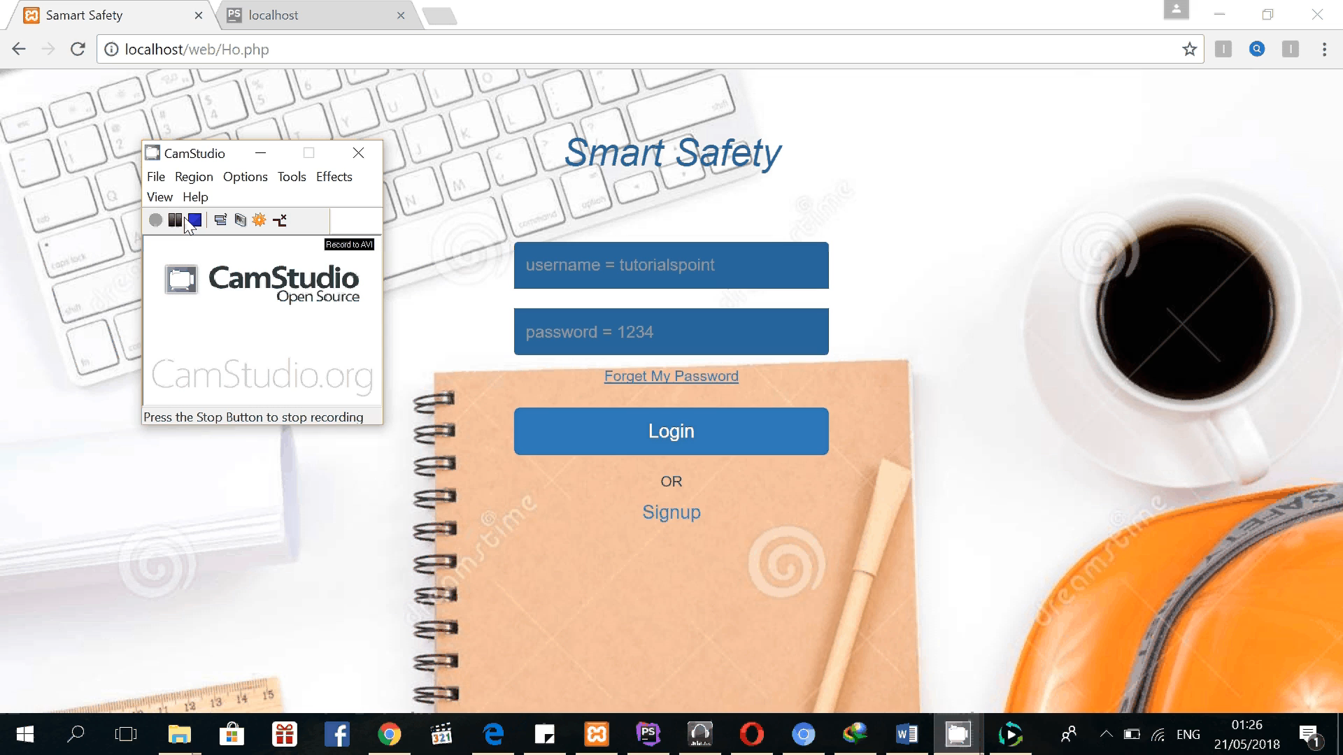
DEMO
Mobile Application
Website

Slide 27
Thanks for good listening.

