Slide 1
Graduation Project
Quality Management System in Hotel
supervised by: Eng. Tamer Haddad
Prepared by: Azza Atera
Dana Eid
Maysa Nidal
Thekrayat Hawash

Slide 2
Presentations out line:
QMS in Hotel.
Case study Haddad Hotel.
Current system for Haddad hotel.
Developed QMS.
Measurement indicator.

Slide 3
Objectives:
Study tourism and hospitality industry in Palestine .
Study the level of customer satisfaction.
Building quality system to improve services.
Building a system in order to follow the level of customer satisfaction and proposed improvement.

Slide 4
Methodology
Haddad Park & its relevant facilities have been studied, especially Haddad hotel and the presented service has followed.
Data about tourism has collected, comprehensive questioners designed, all customer needs& requirements have covered and what is customer service level expectation, then data have been analyzed to have clear results.
The service level presented in hotel was compared with customer expectation and the gap between them has been studied to try to fill it using special tools.
The study has been applied on Haddad hotel to improve quality & develop services.

Slide 5
    Definition of Quality Management system (QMS):
“Quality Management Systems means the combination of processes used to ensure that the degree of excellence specified is achieved”.

Slide 6
TQM Definition:
“TQM is a total organizational approach for meeting customer needs and expectations that involves all managers and employees in using quantitative methods to improve continuously the organization’s processes, products and services

Slide 7
Hospitality:

Slide 8
Case study : Haddad Hotel
Haddad Park Description
Haddad park and tourist village was inaugurated in April 5, 2005.
indoor swimming pools
vast gardens
playing fields, tennis and volley ball courts
utilities
A restaurant
indoor hall of a large capacity to host
A roman styled theatre

Slide 9
The village provides the following services:
Hosting wedding parties with all their requirements upon demand.
summer camps.
Hosting conferences and intellectual and social seminars.
A 4 star hotel welcomes different customers all the time.
big and small graduation parties for the universities' graduates.
Birthday parties.

Slide 10
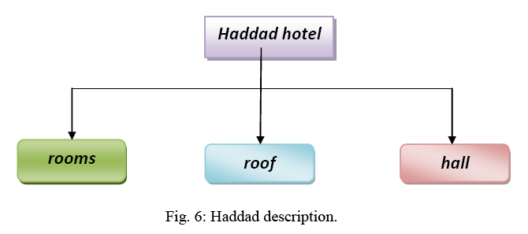
Haddad Hotel Description
Haddad hotel contains several sections with 20 employees may increase in the high seasons,
their target is customers comfort and provide all the services that meet customers need.

Slide 11
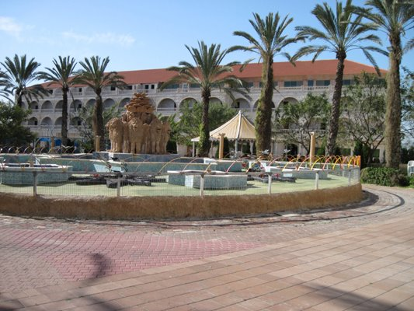
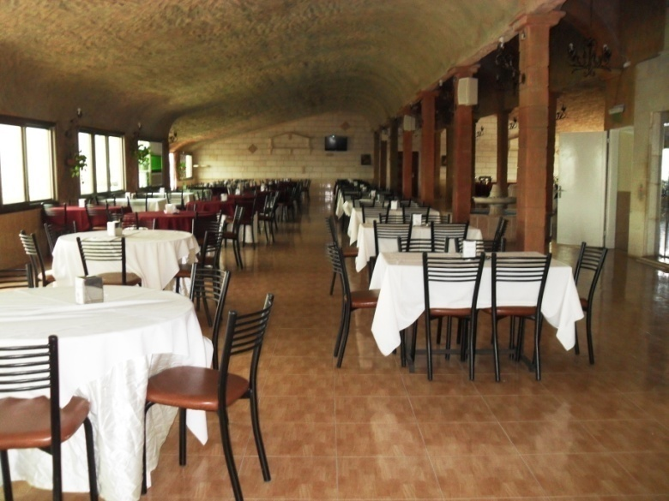
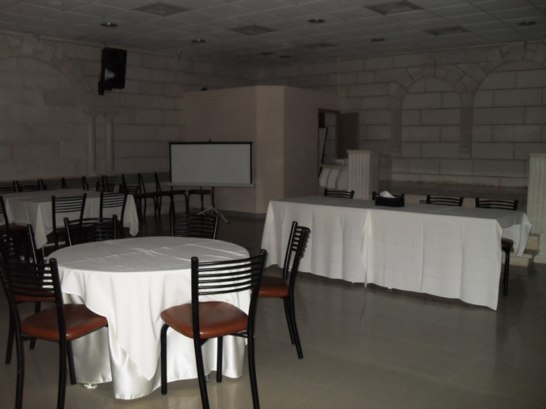
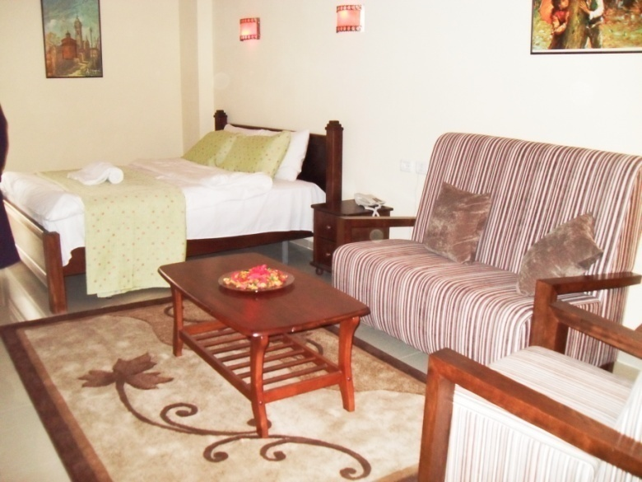

Slide 12
Administrative sections:
General Manager: full Permissions.
Managing Director.
Administrative affairs.
Human Recourse .
Accounting.
Marketing and public relations.
Logistics.

Slide 13
three work shifts
family project
Haddad village
Sections are being developed as needed without a prior plan
no special system to follow-up the staff and training the employees.
New employees testing in a period of 3 months

Slide 14
Haddad Vision and Mission
everyone feels at home.
make Haddad Hotel seem the best as dynamic and leading standard hotel.
where everyone works as a team; with a sense of pride, security and belongingness
Haddad Vision
they are committed to maintain their leadership in the hotel industry by providing excellent Customer Service as perceived by Guests and always ready to exceed their expectations without compromise.

Slide 15
Where Haddad mission is working all together, there Honor to serve customer in every Opportunity because every Moment of Truth with you count for us to live up to your Expectation. they are committed to provide total customer satisfaction through:
Assuring wholesome and safe accommodation.
Providing alert, competent and personalized service.
Enhancing cooperation and teamwork in the organization.
Ensuring employee's welfare and development.
Working towards globally competitive service.

Slide 16
HADDAD Hotel values:
Develop right attitude
Honor and competency to serve
Learn and Improve.
Empowerment and Teamwork.

Slide 17
Current Level of Customer Satisfaction
data have been collected from Haddad tourism village through distributing questioners.
The questioners have been distributed in the period between March and April

Slide 18
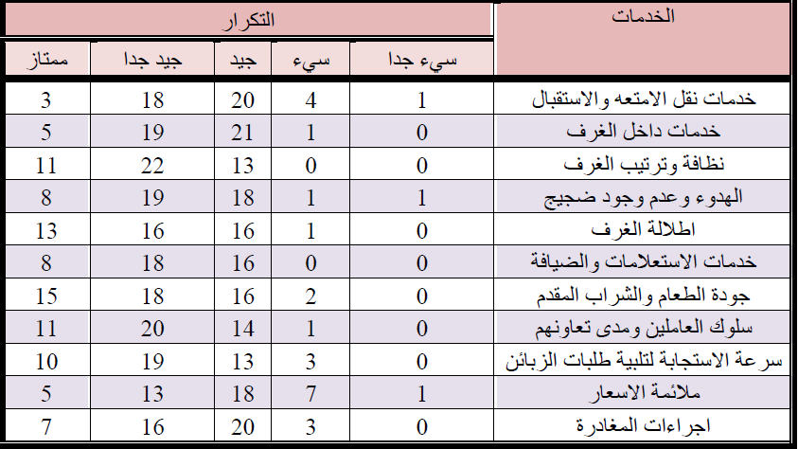
questioner results.

Slide 19
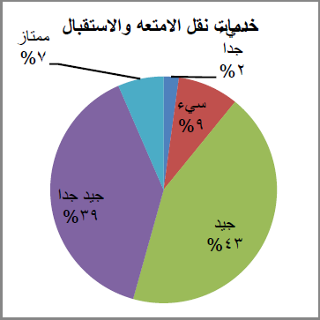
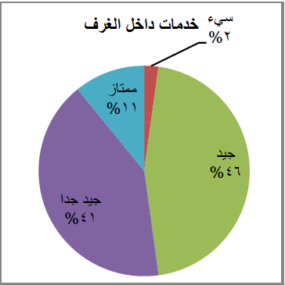
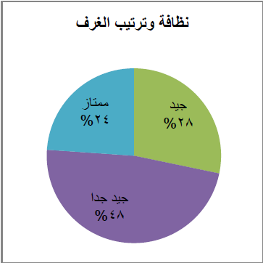
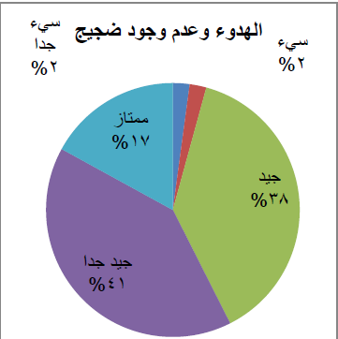
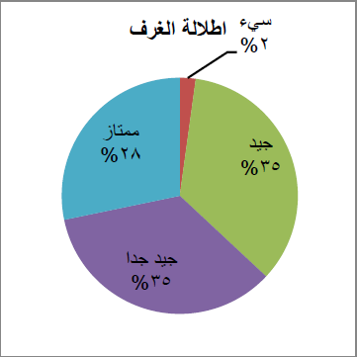
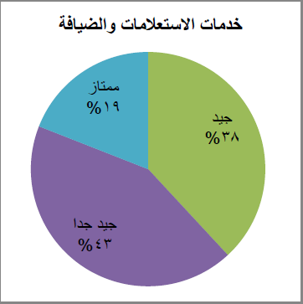

Slide 20
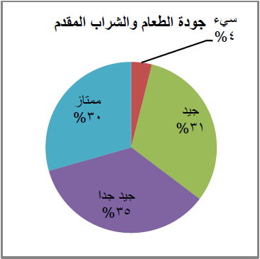
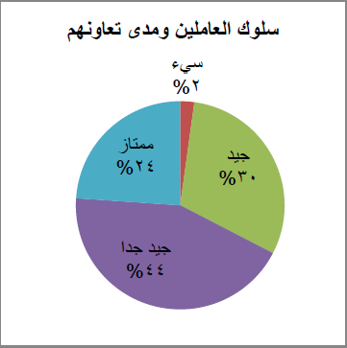
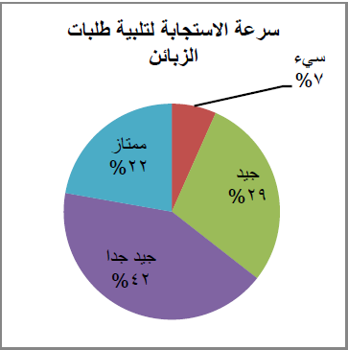
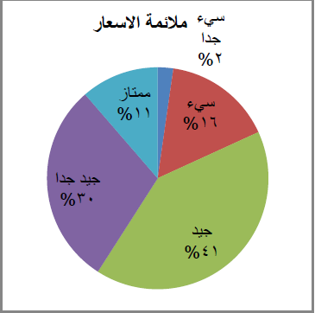
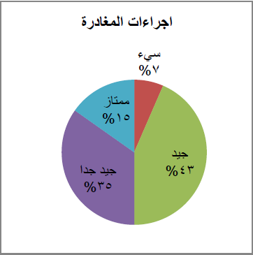

Slide 21
Dissatisfaction Cause Analysis
A Cause-and-Effect Diagram is a tool that helps identify, sort, and display possible causes of a specific problem or quality characteristic.
Weakness points:
25% Noise
27% prices
33% Reception
15% Services inside the rooms

Slide 22
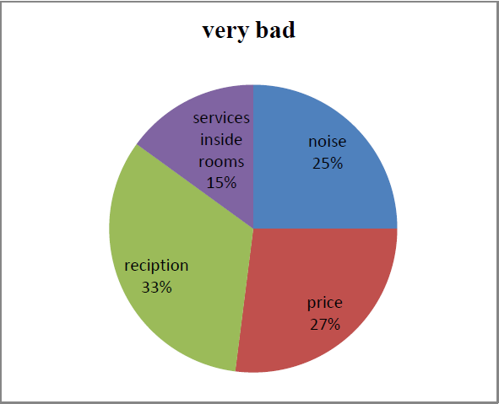

Slide 23
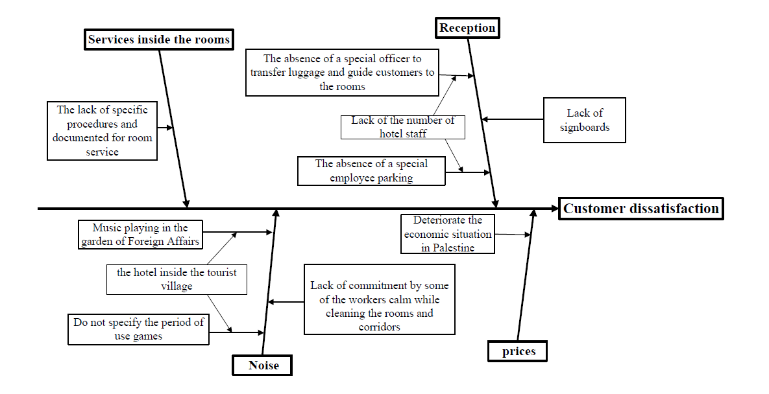

Slide 24
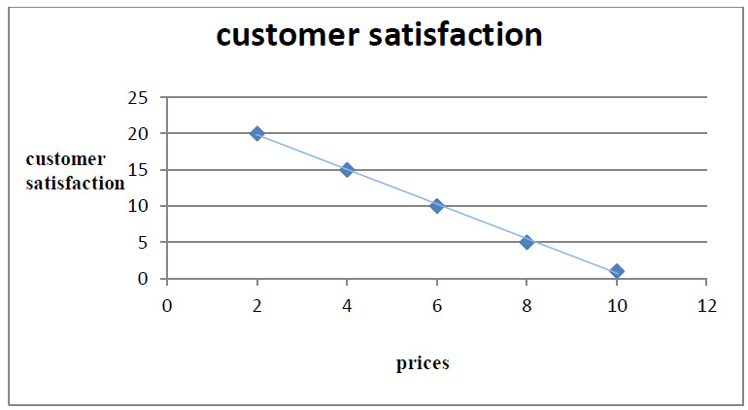
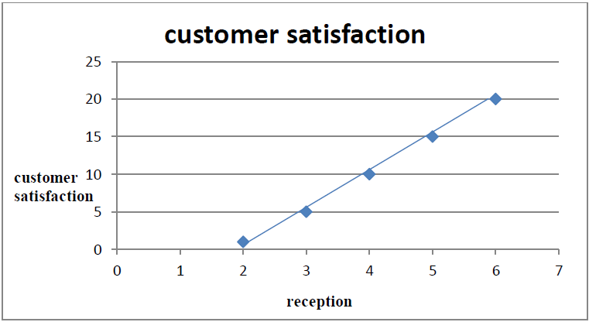
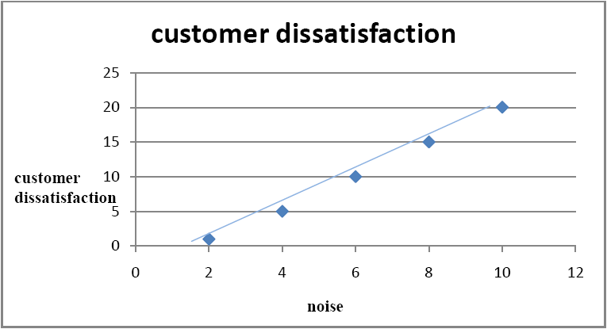
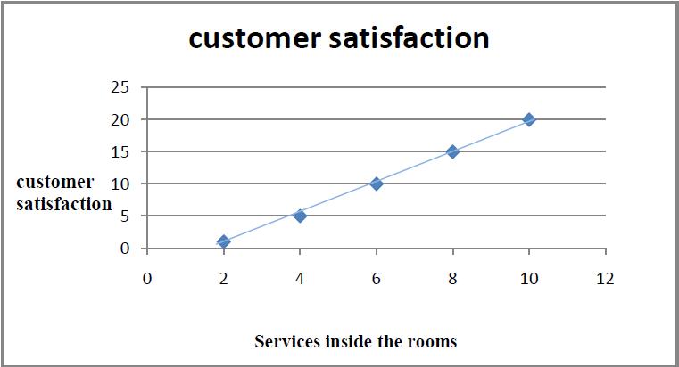
Interlinking: It’s a Quantitative modeling of cause and effect relationship between external and internal performance criteria.

Slide 25
Organizational Structure
A hotel organizational structure is a comprehensive plan by a hotel owner to define departmental activities and responsibilities.

Slide 26
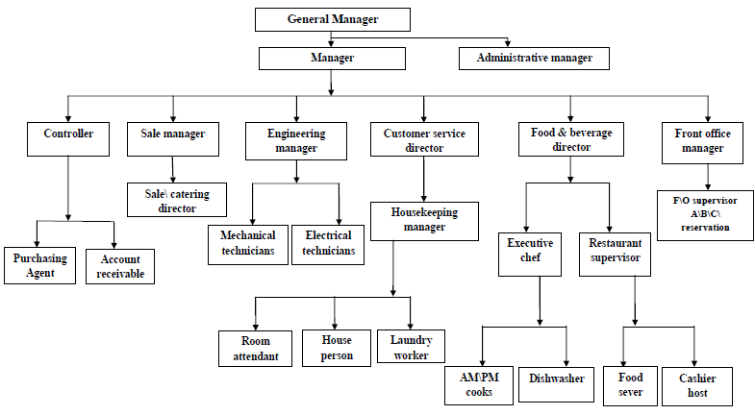
Organizational Structure

Slide 27
Job Titles
Controller.
purchasing department:
Purchasing manager
Warehouse man
2. account receivable :
Minor accountant
Major accountant

Slide 28
Job Titles
Sale department.
Sale manager
Maintenance department.
mechanics technician
electrical technician

Slide 29
Job Titles
Customer Service department.
customer service manager
housekeeping supervisor
Workers
Food beverage department.
Official cooks
Official restaurant

Slide 30
Job Titles
F\O department.
Recipient

Slide 31
Procedure
Customer service director.
Housekeeping manager:
Room attended:
Receiving the customer from entrance to the reception.
After finishing the check in procedure, he shows the customer their rooms, and introduces them to hotel facilities.

Slide 32
Procedure
2- Laundry worker
Receiving beds & cushions covers, workers uniform from cleaning -workers to be washed.
Washing and ironing all received clothes & covers .

Slide 33
Procedure
3- House person
Distributing the work to workers (rooms ,hall ,loopy area) .
Collecting papers & questioner from rooms after customers leave their rooms.
Receiving maintenances require from cleaning workers .
Filling Form 4/1 about the required maintenance and sending it to F\O.

Slide 34
Procedure
Food & beverage director
Executive chef.
- receiving booking list from coordinator.
cooking all meals (breakfast, lunch, dinner ).
Dishwasher.
- Washing tableware cup goblet & kitchenware.
- Drying & polishing tableware cup goblet.

Slide 36
Procedure
Restaurant supervisor.
- Supervising all restaurant issues (clean & workers).
- Sending request list to cover the needs.
Auditing all restaurant accounts and sending report to minor accountant .
Food servers.
- Receive arrival customers.
- Collect customer order and serve them .

Slide 37
Procedure
Cashier host
- Accounting customers.
- If the bill not paid by customer, it will send to the reception.
- Preparing account report to minor accountant.

Slide 38
Procedure.
Controller.
Purchasing agent:
Purchasing manager
- Receiving purchasing order from warehouse manager &choose the best vendor .
- Sending purchasing order Form 1/1 to the supplier.
- Sending tenders if it’s needed according to Form 1/2 .
- Open and distinguish tenders in cooperation with administrative manager according to Form 1/3.
- Sending final report to administrative manager.

Slide 39
Form 1/1
Form 1/2 & Form 1\3

Slide 40
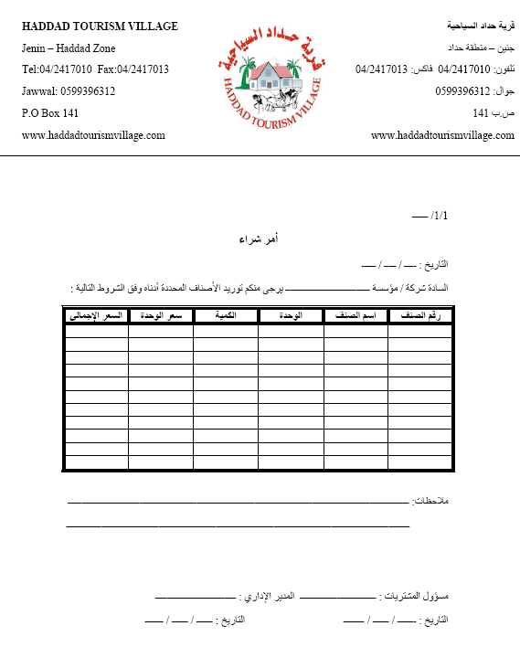

Slide 41
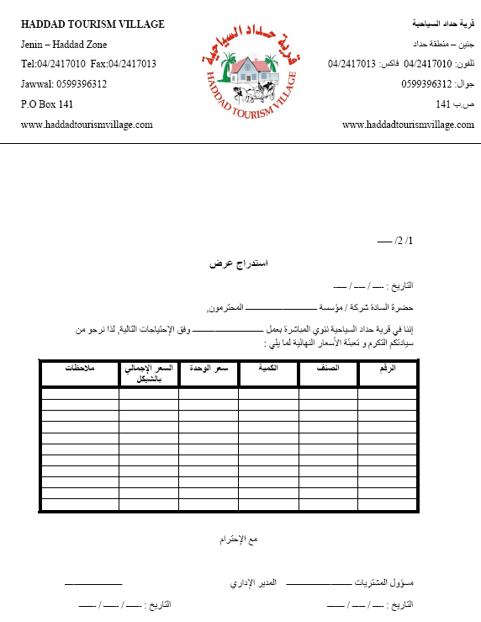

Slide 42
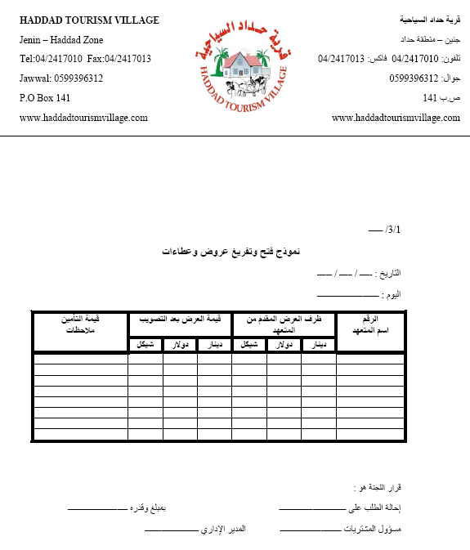

Slide 43
Procedure.
Warehouse man
Receiving orders from all departments according to their needs.
Checking available quantities in warehouse to insure that there is no damaged product.
- Sending the purchase order to purchasing manager when the available quantity reach the predetermined reorder point.

Slide 44
Procedure
Account department.
Minor accountant receive (bills , entrance ticket , sales ticket ).
Filling Form 2/1 in received information and auditing them.
Sending the form to administrative manager in order to audit it.
Sending the form to major accountant for final auditing.

Slide 45
Form 2\1
Form 2\1

Slide 46
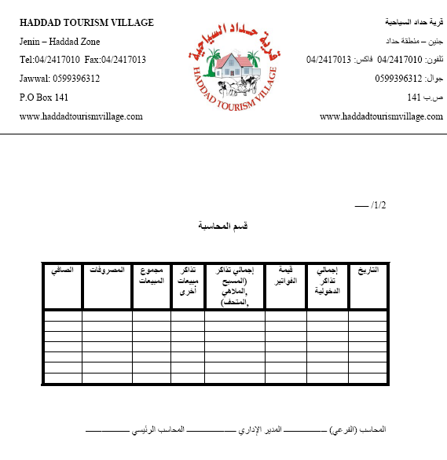

Slide 47
Procedure.
Sales manager.
Receiving groups Reservation.
Coordinating with food and beverages department and housekeeping in order to make the required preparation.
Check in/check out for groups.

Slide 49
Procedure.
Maintenance director.
- Receiving maintenance order according to Form 4/1 from F\O .
- Repairing defects in the rooms .
Sending reports 4/1 to the administrative manager.
Administrative manager.
- Receiving and Auditing final reports from all departments.

Slide 50
Form 4\1
Form 4\1

Slide 51
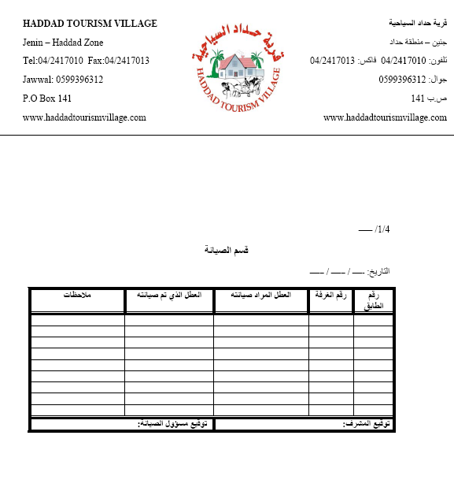

Slide 53
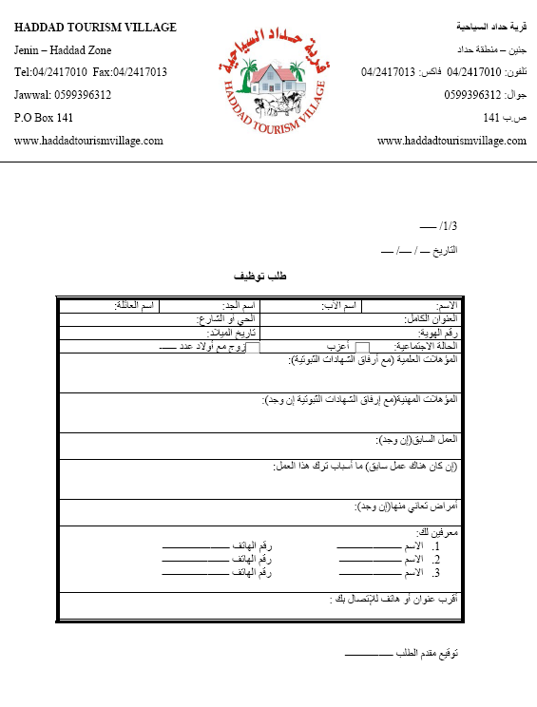

Slide 54
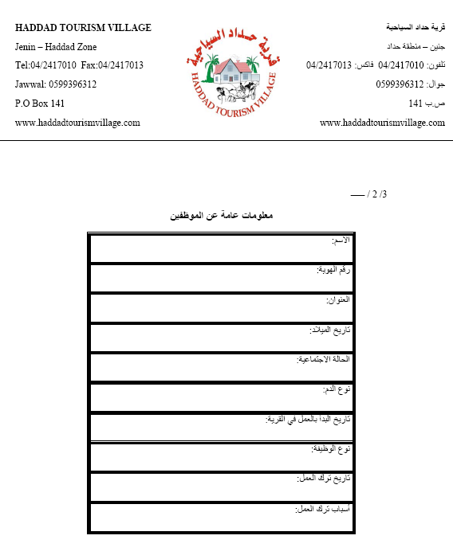

Slide 55
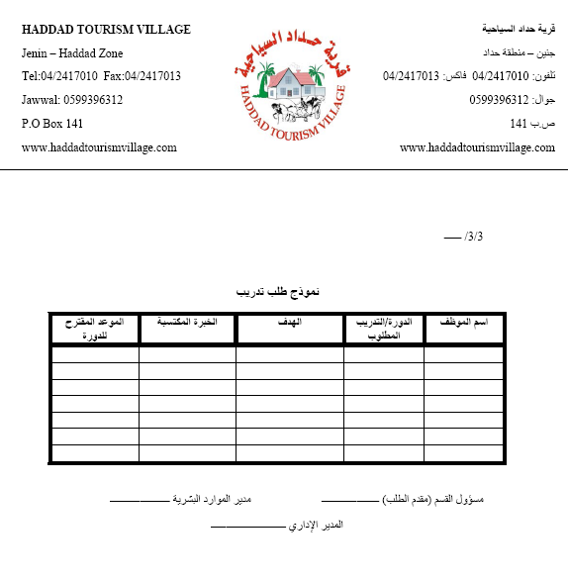

Slide 56
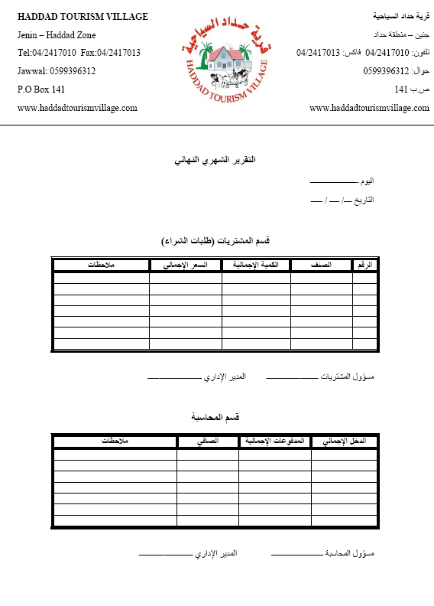

Slide 57
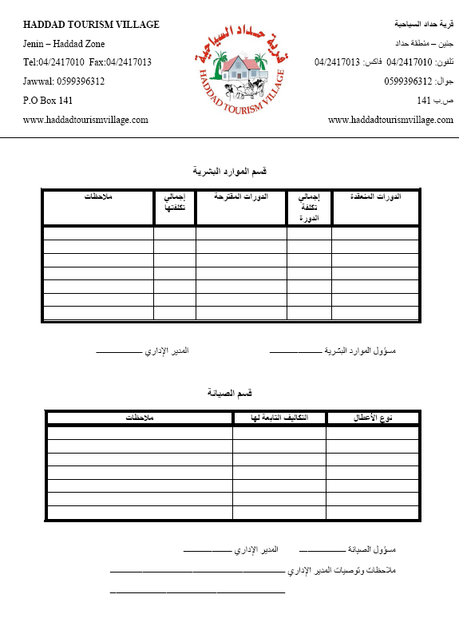

Slide 58
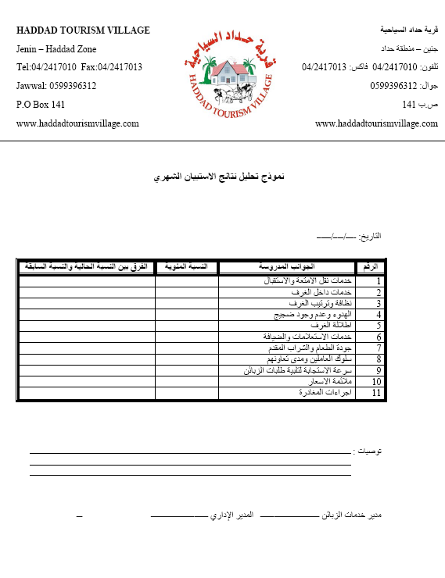

Slide 59
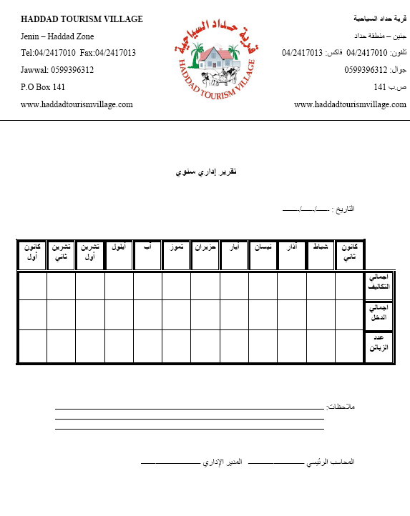

Slide 60
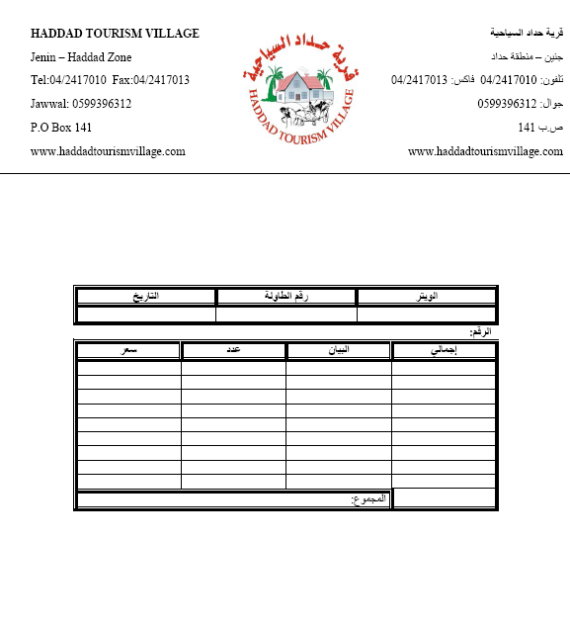

Slide 61
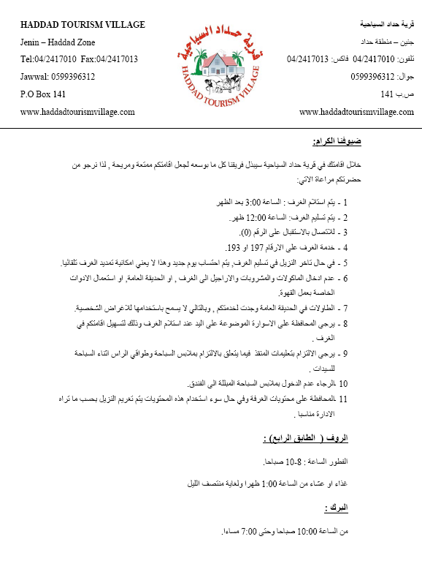

Slide 62
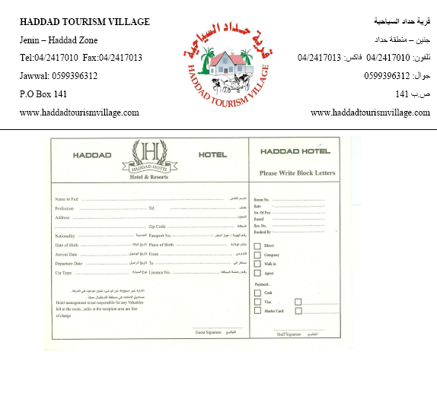

Slide 63
Management Reports For Controlling Quality Of Service
This reports measure quality level to be as indicator for system improvement, it's preferred to computerize these data in order to ease the analysis of questioner data.
Hint: all data in reports for this chapter are estimated for clarifying.

Slide 64
Alert Report:
It's a report that reflect customer dissatisfaction and determine the reasons of this dissatisfaction to take corrective actions that return customer confidence.

Slide 65
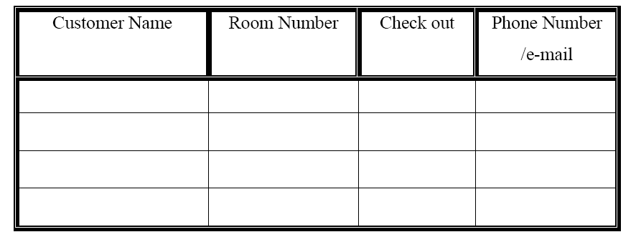
Alert report

Slide 66
Daily Control Report

Slide 68
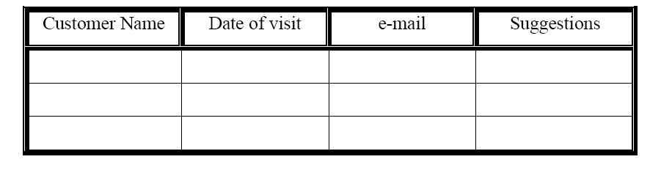
Guests Suggestion Reports

Slide 69
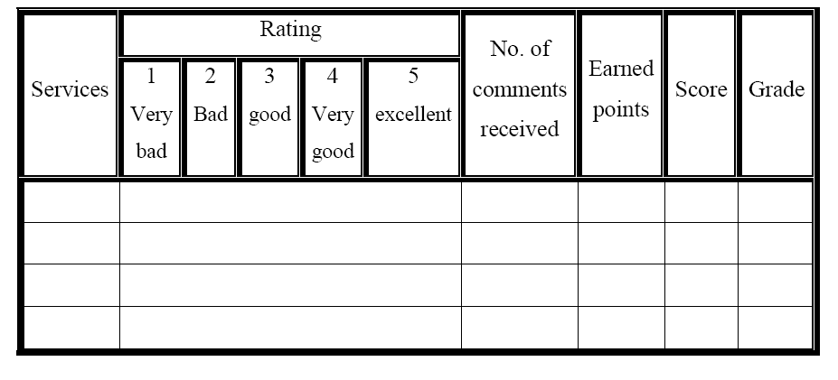
Monthly Action Plan

Slide 70
QMS yearly action plan trend

Slide 73
Conclusion
By descriptive analysis for questioner results some weakness points have been determined in Haddad Hotel which affected on level of services and customer satisfaction, so a system was built to improve current situation, and some corrective actions have been taken into consideration during the implementation of this study such as employing officer to hold bags and attending customers to their rooms.

Slide 74
Limitations
The nature of Haddad Hotel is a family business which lead to overlapping job titles and responsibilities.
The hotel sector is considered as seasonal industry so there was many difficulties in collecting data because the questioner was distributed in winter.

Slide 75
Recommendations
According to other data that collected from questioner, the following recommendation should be take in consideration :
Concentrate on service quality and high response from employees.
Hiring employee to receive customer and show them there rooms .
Hiring employee to hold customer bags .
Hiring employee to parking customer cars .
Interest in hotel marketing through advertisements .
Organize tourist program for the hotel .
The questioner should be distributed monthly to help continuous improvement.
building a data base to analyze the questioner results.

Slide 76
References
https://sites.google.com/a/njit.edu/chaitanya/ie673.
http://basicsofmanagement.com/commitment_and_leadership.php.
http://www.scribd.com/doc/77228736/Defining-the-Tourist-Industry-is-Difficult.
a handbook for Mohamed Adel Mohamed Samy Mohsen, B.Sc., PGD, M.Sc., supervision of Dr Phillip Coleman, Director Professor Eleri Jones (2009) , THE INTRODUCTION OF A TOTAL QUALITY MANAGEMENT CULTURE IN HOTELS.
Michael Conklin, Chief Methodologist, MarketTools, Measuring and Tracking Customer Satisfaction
University of Michigan Business School, American Customer Satisfaction Index at http://www.bus.umich.edu/research/nqrc/acsi.html.
Prof. Sachin K. Jadhav , SSVPS’s Arts, Commerce and Science College, Shindkheda, Strategies of Financing in the Tourism Industry .
Ricard Santomà, TSI – Turismo Sant Ignasi (ESADE) – Ramon Llull University ,Barcelona, Spain,(2007).
Mar Vila, ESADE – Ramon Llull University, Barcelona, Spain, (2007).
DEMING, W.E. (1986) Out of the Crisis (Cambridge, MA, MIT Centre for Advanced Engineering Study).

Slide 77
Other sites:
http://www.blackwellreference.com/public/tocnode?id=g9780631233176_chunk_g978140511096921_ss1-1.
http://repository.uwic.ac.uk/dspace/bitstream/10369/893/3/Mohamed%20Mohsen.pdf.txt.
http://www-03.ibm.com/able/open_computing/iso.html.
http://www.iso.org/iso/iso_catalogue/management_standards/quality_management/iso_9000_selection_and_use.htm.
http://en.wikipedia.org/wiki/Hospitality.
http://en.wikipedia.org/wiki/Hospitality_industry.
Hotel Organization Structure eHow.com http://www.ehow.com/about_5598090_hotel-organization-structure.html#ixzz1u0bHmvXK.
http://en.wikipedia.org/wiki/Flowchart.

Slide 78
Thanks For Your Listing

