Slide 1



ENHANCING ARABIC TEXT COMPREHENSION THROUGH
Automated Grammar-Aware Question Generation
By: Deema Jabi , Raneen Sawalmeh
UNDER THE SUPERVISION OF DR. AMJAD HAWASH

Slide 2

INTRODUCTION
Improving the understanding and automated analysis of Arabic texts has become essential in rapid digital progress, particularly given the rising need for intelligent systems communicating with natural language.
This project focuses on enhancing Arabic text comprehension through the development of an automated, grammar-aware question generation system.

Slide 3

Problem Statement
1- Complex morphology and syntax
3-Lack of precise educational tools
2- Limited availability of AI systems for Arabic question generation and challenges in grammar-aware formulation.

Slide 4
Proposed Solution
Develop an automated Arabic text comprehension system using advanced NLP models
Integrate AI-based assessments
01.
03.
Developing Tutorial Modules
Generate contextually relevant and grammatically accurate questions
02.
04.

Slide 5

Project Objectives
Enhance Arabic Text Comprehension
01.
02.
Automated Grammar-Aware Question Generation
Enhance the Educational Process Using AI
03.

Slide 6
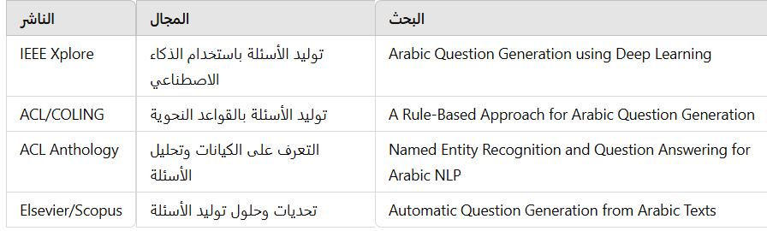

RELATED WORKS
Summary of Previous Works: Focused on Arabic text processing using NLP, particularly syntactic and semantic analysis.
Differences Between the Current Project and Previous Works
This project differentiates itself by integrating grammar-aware strategies to automatically generate contextually accurate questions, addressing the complexities of Arabic grammar in a novel way.

Slide 7
System Architecture
01.
Presentation Layer
Processing Layer
02.
NLP Layer
03.

Slide 8
System Activity
Tools and Libraries Used:
A natural language processing library that supports tasks like syntactic analysis and named entity recognition.
01.
Stanza
A Python library for natural language processing, offering simple tools like tokenization, stemming, and text analysis.
02.
google ai
03.
gTTS
A library that converts text to speech using Google's Text-to-Speech API .

Slide 9
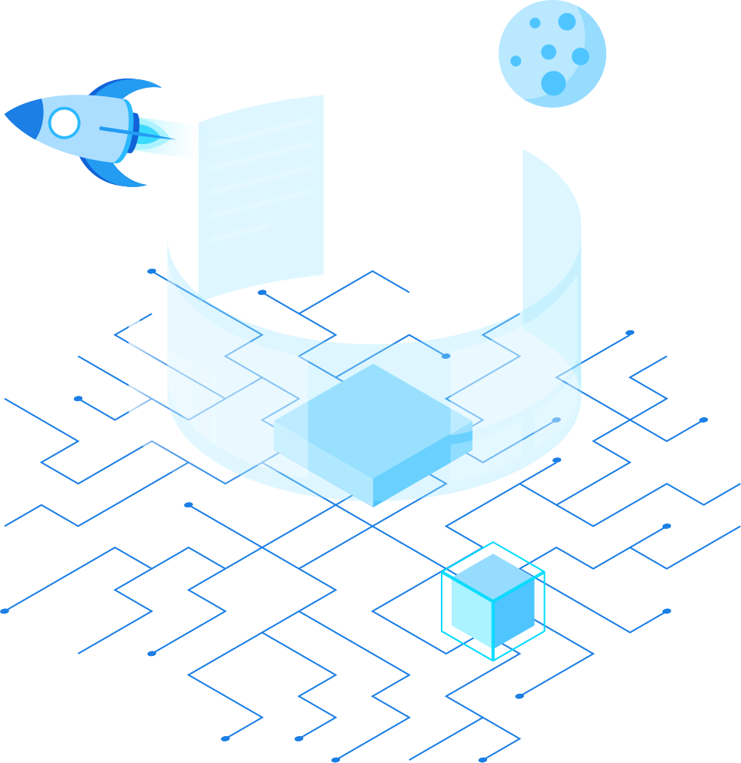


Integrated Development Environment
Jupyter Notebook
Google Colab

Slide 10
Algorithms
1-Word Classification Based on Syntactic Context
01
WORD SEGMENTATION:
BASIC CLASSIFICATION:
02
Break the sentence into individual words.
Classify each word based on its syntactic type (noun, verb, adjective, pronoun, etc.).
CONTEXTUAL ANALYSIS:
NAMED ENTITY RECOGNITION:
03
04
Examine the neighboring words (before and after) to understand the context.
Identify named entities such as people, places, or organizations (e.g., "Ahmed" or "Cairo").

Slide 11
Algorithms
2- Create questions using input text
SET UP THE ENVIRONMENT
CONNECT TO THE SERVICE
01
02
Setting up the work environment By installing a library google.generativeai as genai
Configure the connection to the Google Gemini API
RECEIVE THE QUESTIONS
05
Get the generated questions.
DEFINE THE INPUT TEXT
SEND THE TEXT TO THE SERVICE
03
04
Choose the text that will be used to generate the questions.
Request question generation from the input text via the API.

Slide 12
TEST & TRAIN
1️⃣Dataset Preparation: Collected diverse text samples from multiple domains to test system robustness From different sources.
2️⃣ Preprocessing Evaluation: Assessed the performance of keyword extraction, lemmatization, and stop-word removal.
3️⃣ Recommendation Accuracy: Compared AI-generated questions with human-generated ones using Precision, Recall, and F1-score.
4️⃣ User Engagement: Collected feedback through user surveys on usefulness, relevance, and clarity of generated questions.

Slide 13
TEST & TRAIN
5️⃣ Real-Time Performance: Measured system response time for different input lengths and complexity levels.
6️⃣ Personalization Evaluation: Assessed the system’s ability to generate context-aware questions based on input variations.
7️⃣ Scalability Tests: Evaluated system performance with large-scale text inputs.
8️⃣ Error Handling: Tested system resilience against incomplete or erroneous inputs.

Slide 14
CONCLUSION
  AI-powered system enhances comprehension of Arabic texts through grammar-aware question generation.
  NLP techniques ensure contextually accurate questions.
  The Tkinter-based GUI makes the system user-friendly and interactive.
  The integration of text-to-speech enhances learning and engagement.

Slide 15


FUTURE WORK
Improving Language Analysis Algorithms
Supporting Additional Dialects and Languages
Integration with Interactive Learning Platforms

Slide 16
[1] H. alharbi, “Natural language processing in arabic texts: Techniques
and applications,” Journal of AI and Linguistics, 2021.
[2] J. devlin, M. W. Chang, K. Lee, and K. Toutanova, “Bert: Pre-training
of deep bidirectional transformers for language understanding,” in
Proceedings of NAACL, 2019.
[3] A. pradeep, An Introduction to NLTK and its Applications. Natural
Language Processing, 2020.
[4] Z. zhao, Y. Xie, and W. Tang, “Sentence segmentation and tokenization
for arabic texts,” Computational Linguistics Journal, 2021.
[5] A. alotaibi, “Arabic linguistics and text analysis: Challenges and
solutions,” Linguistics Studies, 2022.
[6] S. yoon, “gtts: Google text-to-speech for various applications,” Speech
Processing, 2020.
[7] R. sharma and A. Agarwal, “Automated question generation using ai:
A survey,” International Journal of AI Research, 2020.
[8] A. rosenfeld and P. Kaskie, “Chatbots in education: Using ai to foster
interaction,” AI in Education Journal, 2020.
[9] H. li and Y. Zhang, “Intelligent question generation for e-learning:
Techniques and applications,” E-learning Technologies, 2020.
[10] V. solanki and S. Patel, “Ai-driven educational tools for interactive
learning,” AI and Learning Journal, 2021.
[11] M. abdul, “Ensuring text logic and syntax in arabic sentences,” Arabic
Linguistics Review, 2020.
[12] M. rahman, “Word classification in arabic language using nlp,” Arabic
Computational Linguistics, 2020.
[13] A. Name, “Title of the paper,” Journal Name, vol. Volume Number, p.
Page Range, 2023.
[14] Smith, J., & Brown, A., “Title of the paper,” Journal of Arabic Studies, vol. 15, pp. 123-135, 2024.
References

Slide 17



Thank You

