Slide 1
Playing Cards Arm
Presented By : Nael Kilani & Mohammad Abu Salah.
Supervisor: Dr. Luai Malhis.
Graduation Project Presentation.

Slide 2
Agenda:
Introduction.
Components.
Overview.
Demo.
Obstacles.
Future Work.

Slide 3
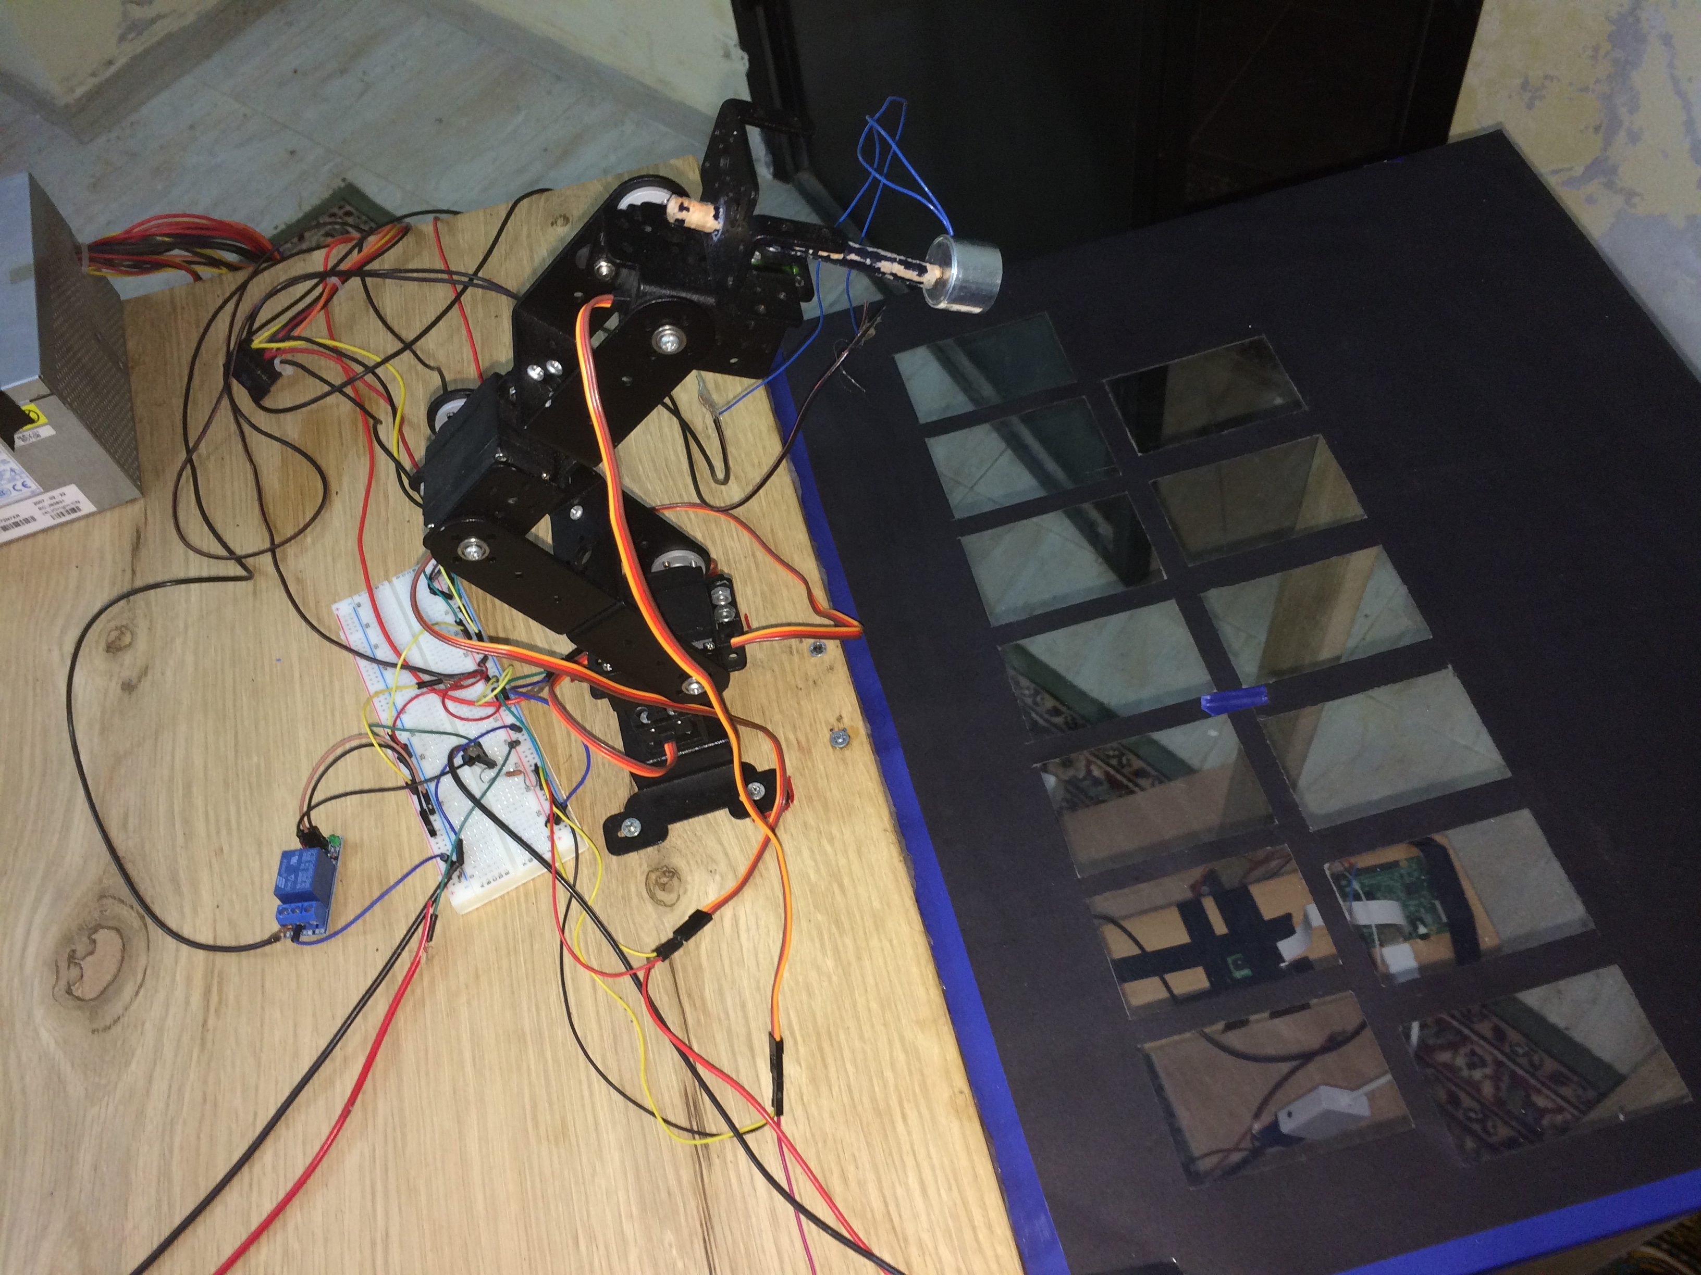
Introduction:
  Where did the idea come from ?

Slide 4
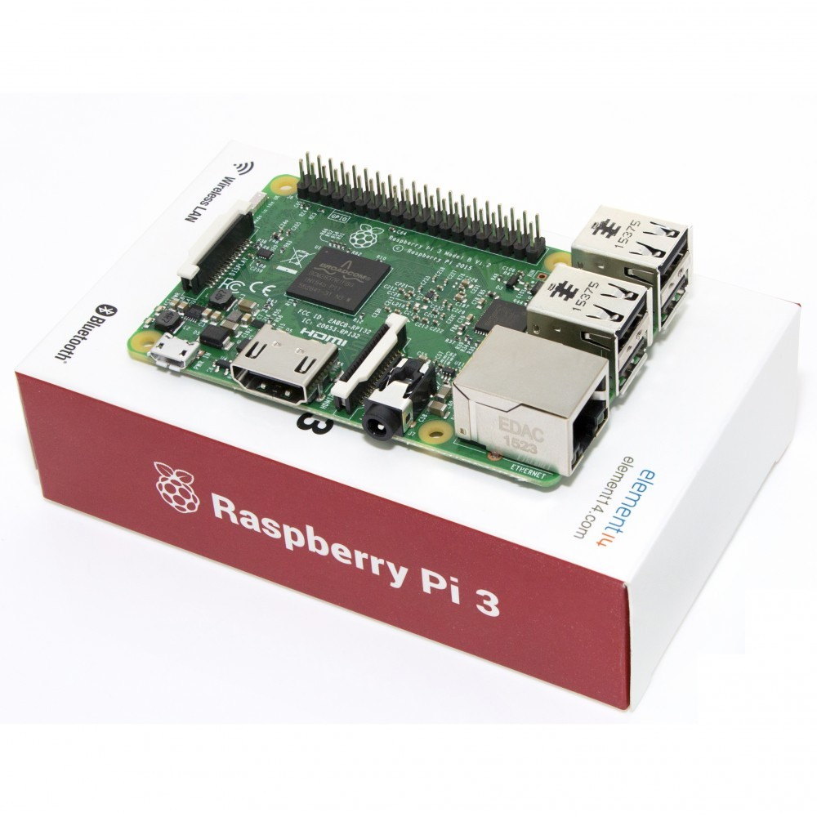
Components:
Raspberry Pi 3

Slide 5
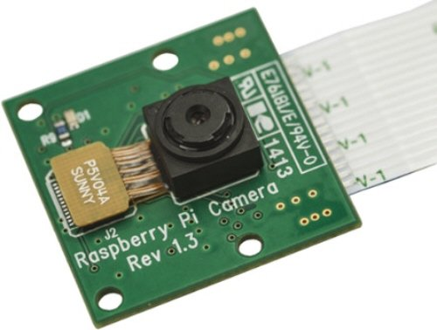
Components (cont..):
Raspberry Pi Camera

Slide 6
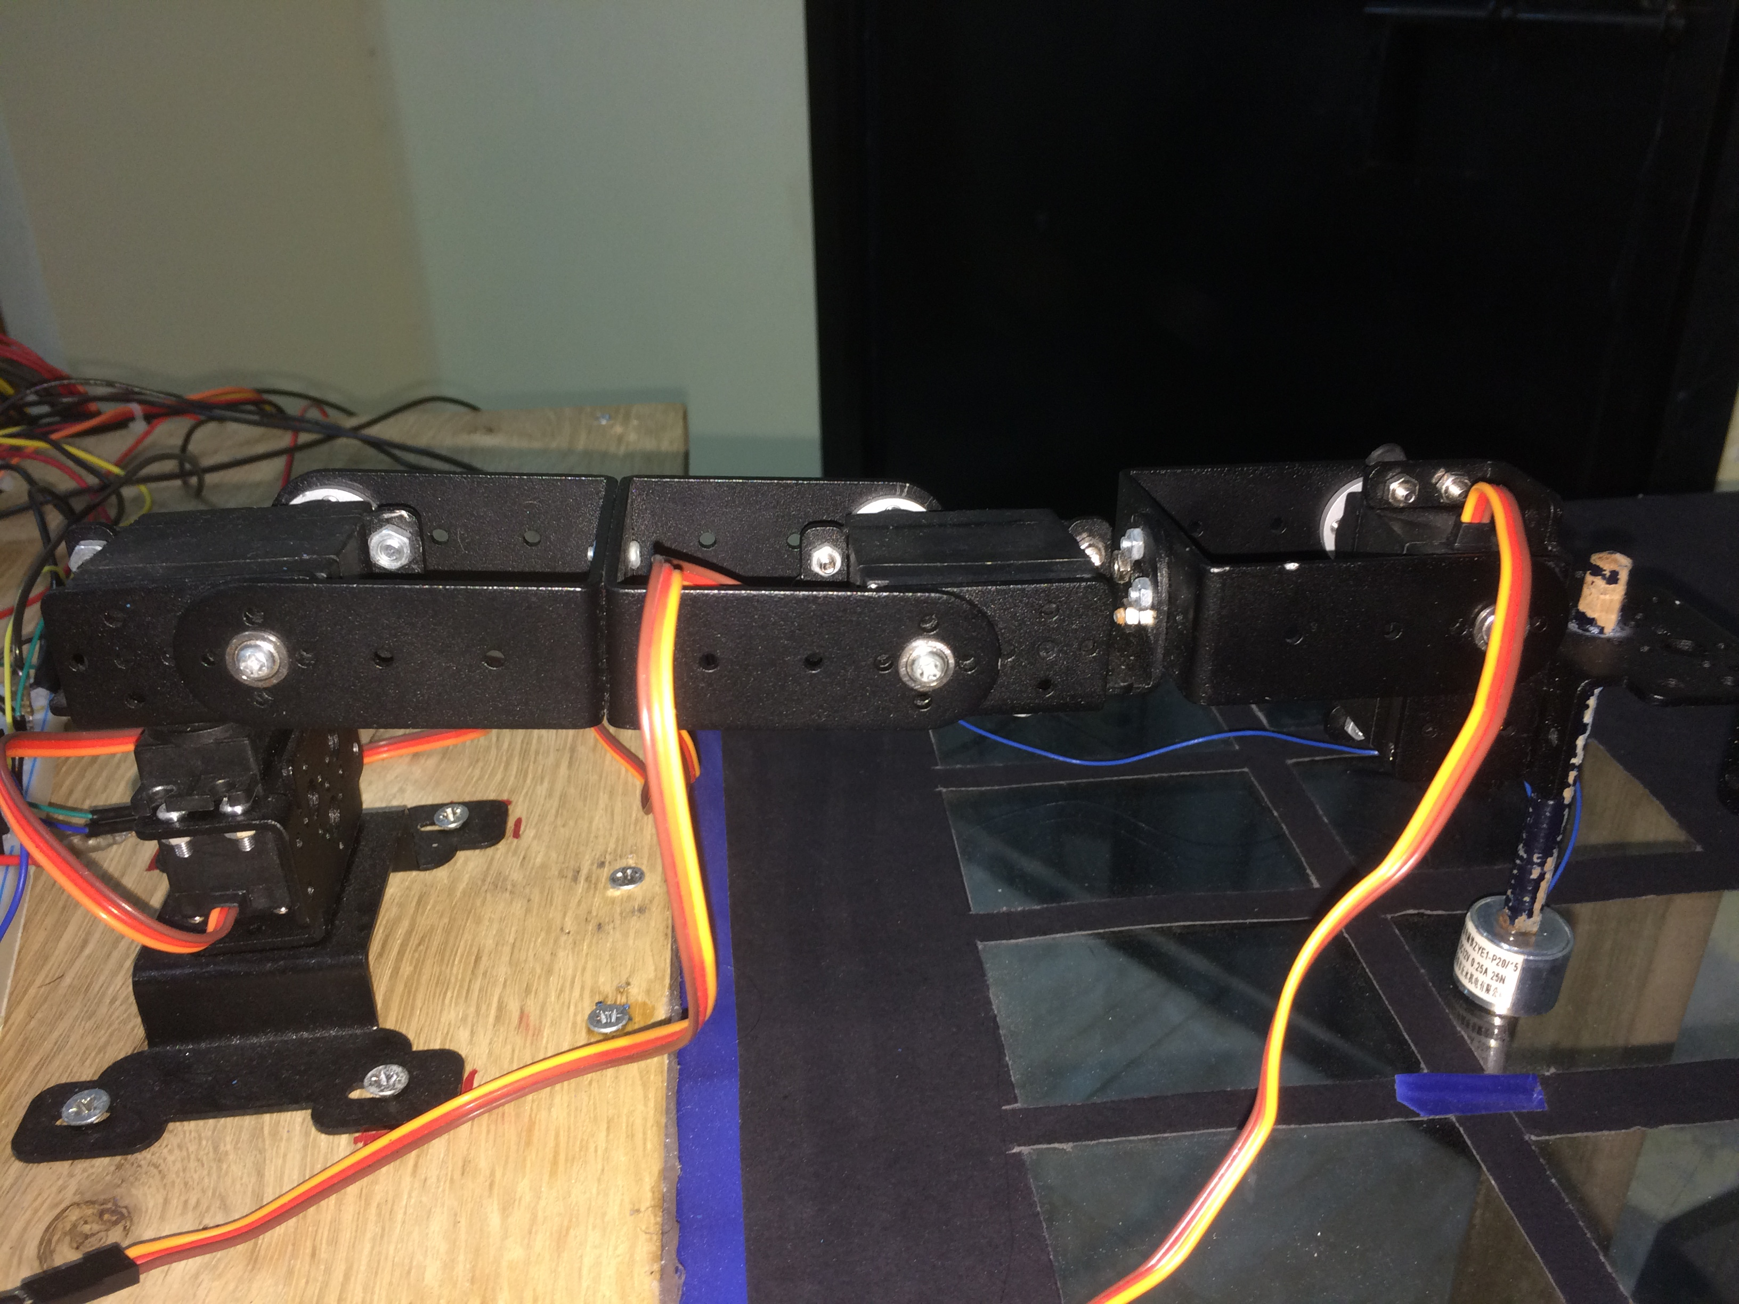
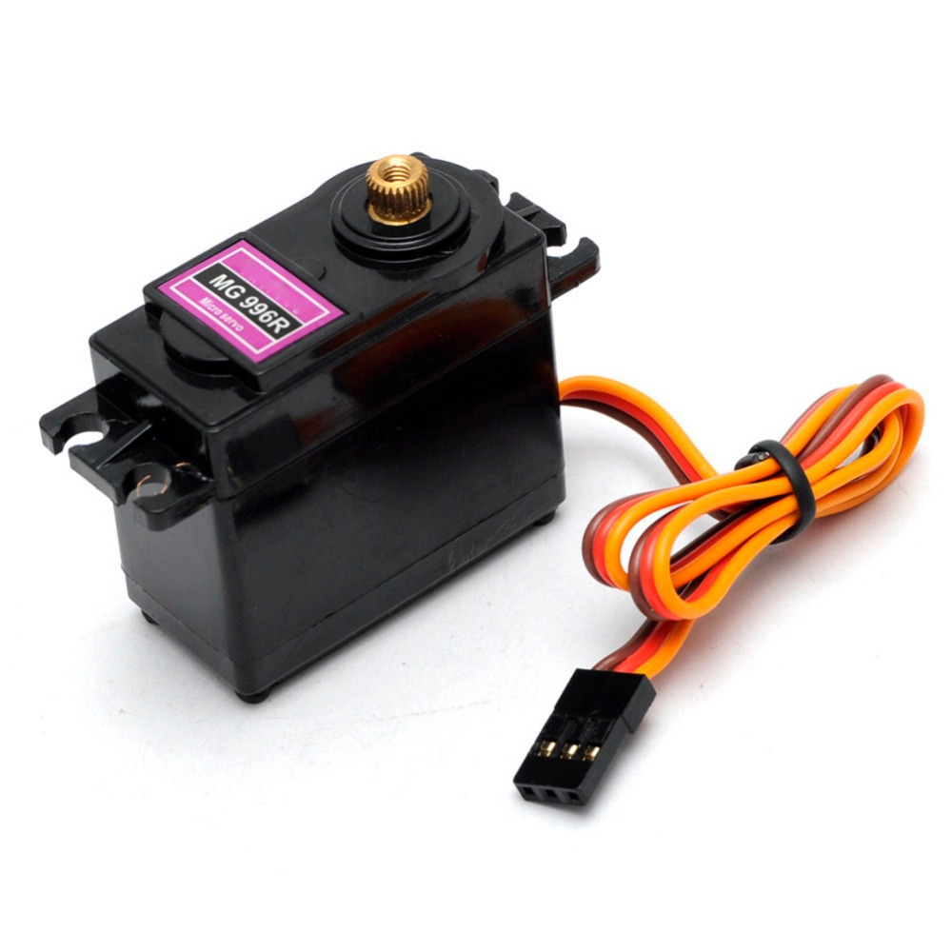
Components (cont..):
MG996R Servo Motor

Slide 7
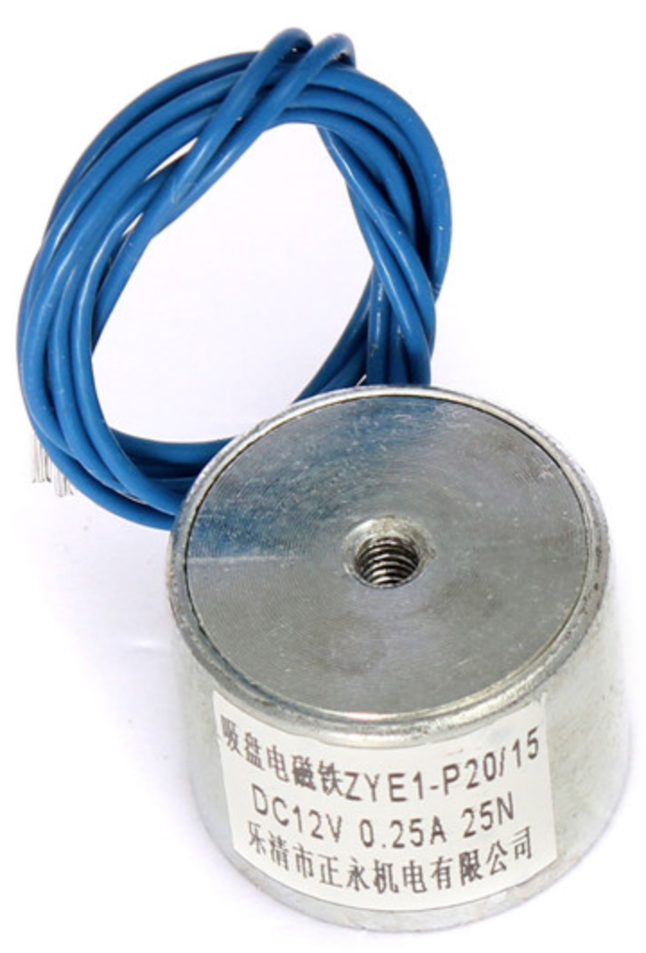
Components (cont..):
DC Magnet

Slide 8
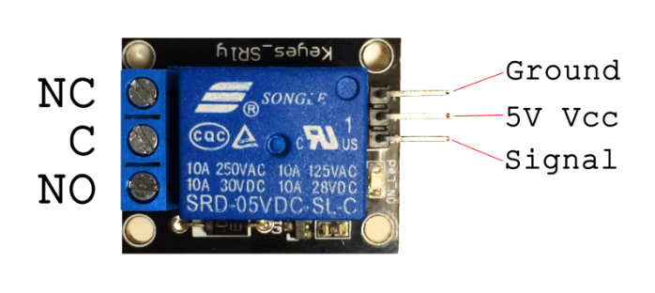
Components (cont..):
5V relay

Slide 9
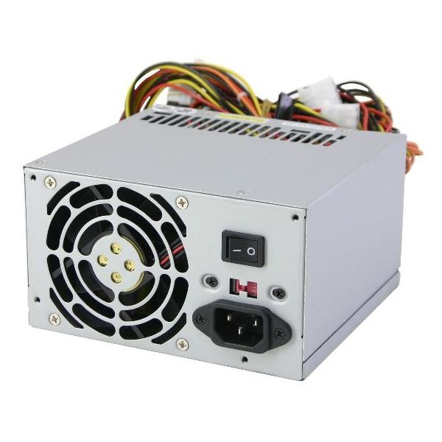
Components (cont..):
Power Supply

Slide 10
Overview:
  • Card Detection and Recognition.
  • Mobile Application.
  • Robot’s Arm.

Slide 11
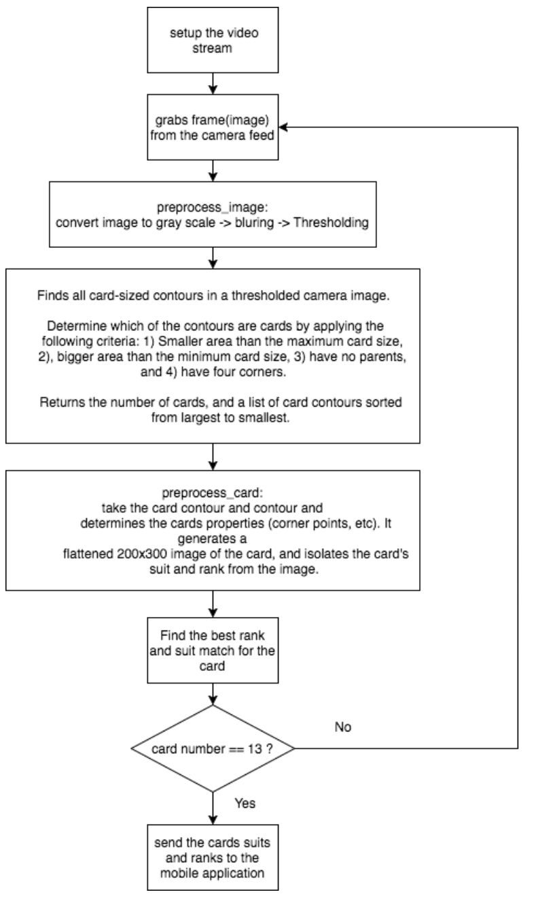
Card Detection and Recognition Algorithm:

Slide 12
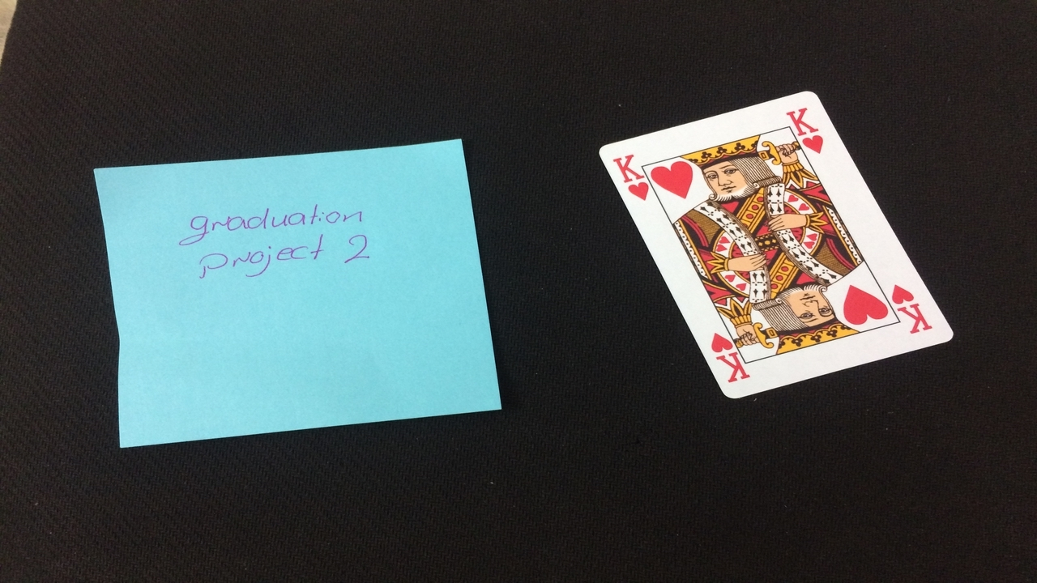
Algorithm(cont..):
Original image.

Slide 13
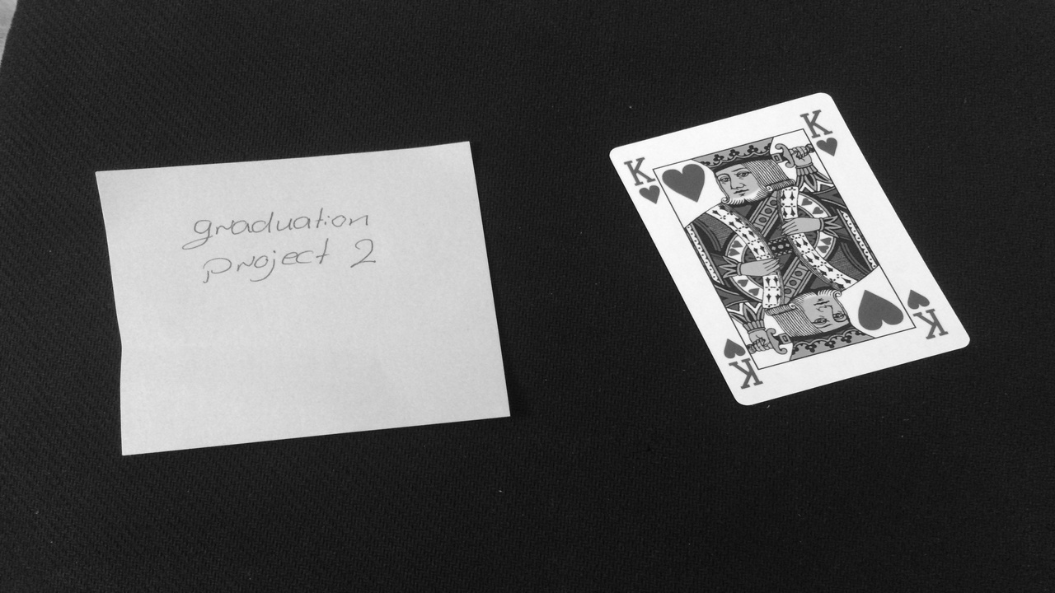

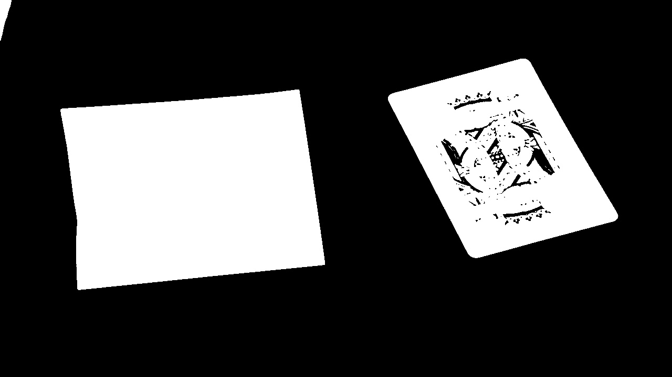
Algorithm(cont..):
Preprocess Image:
Gray Scale image.
Blurring image.
Thresholding image.

Slide 14
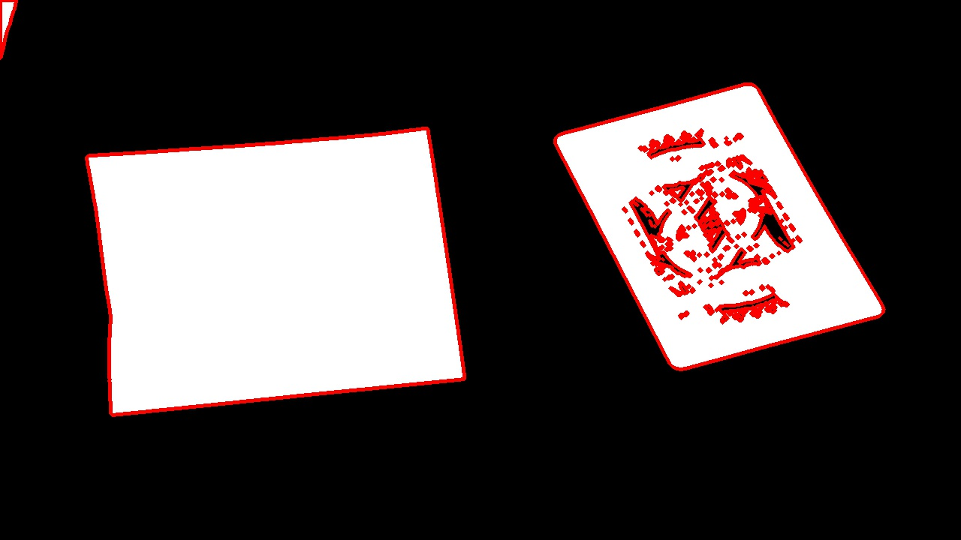
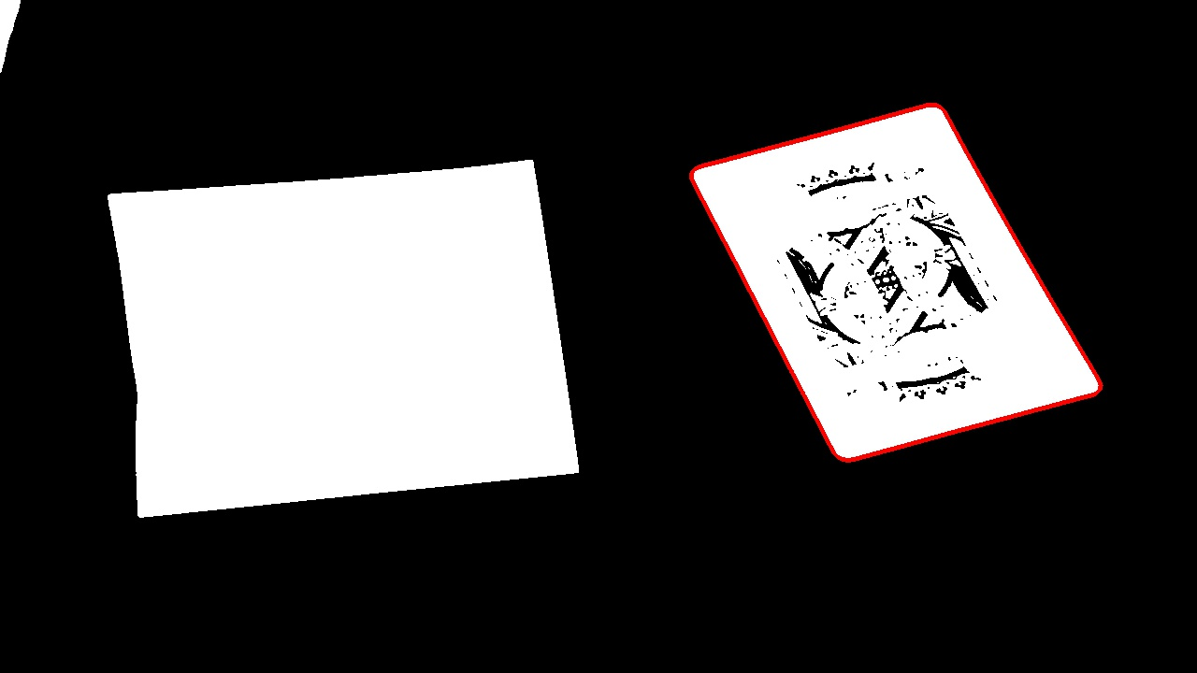
Algorithm(cont..):
Card-Sized Contours :
Criteria:
Smaller area than the maximum card size.
Bigger area than the minimum card size.
Have no parents.
Have four corners.
Contours.
Card’s contour.

Slide 15
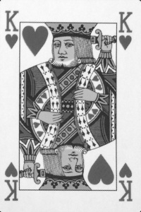



Algorithm(cont..):
Preprocess Card:
Card’s corner.
Flattened Image.
4x Zoom corner.
Thresholding Corner.

Slide 16




Algorithm(cont..):
Preprocess Card:
Suit image after
finding bounding
rectangle which covers it.
Rank image after
finding bounding
rectangle which covers it.
Bottom half.
Top half.

Slide 17
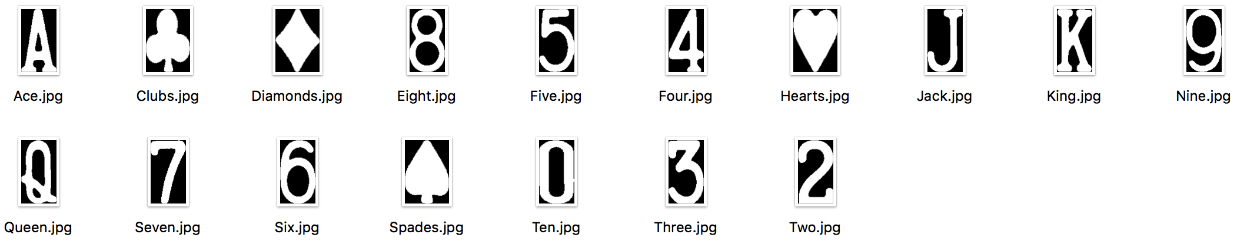


Algorithm(cont..):
Matching:
Training images.
Best rank
difference image.
Best suit
difference image.

Slide 18
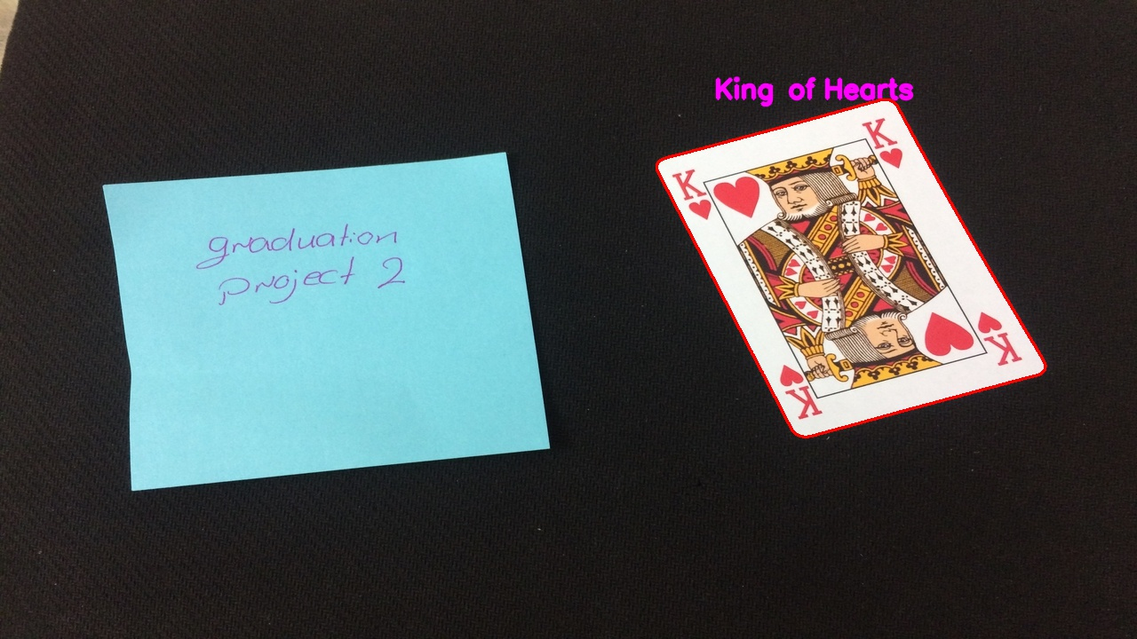
Algorithm(cont..):
Result:
Output image.

Slide 19
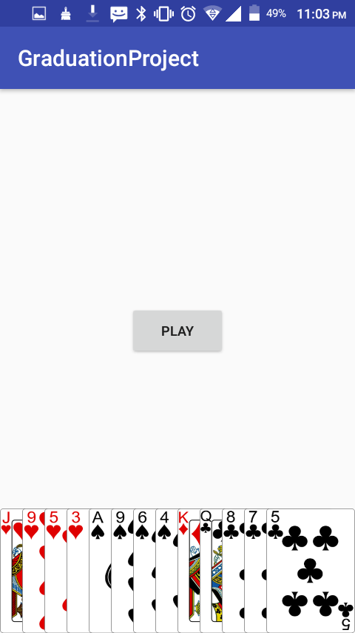
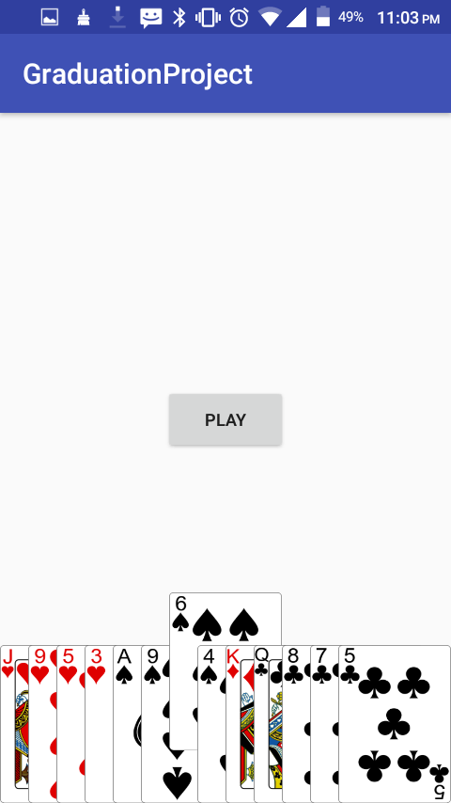
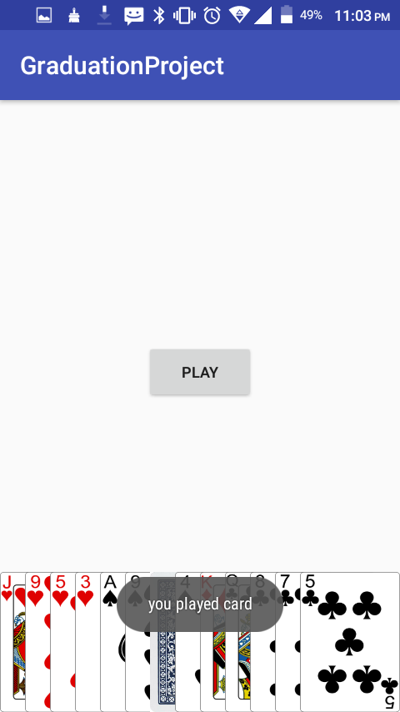
Mobile Application:
Result:
Mobile application.

Slide 20
Robot’s Arm:

Slide 21
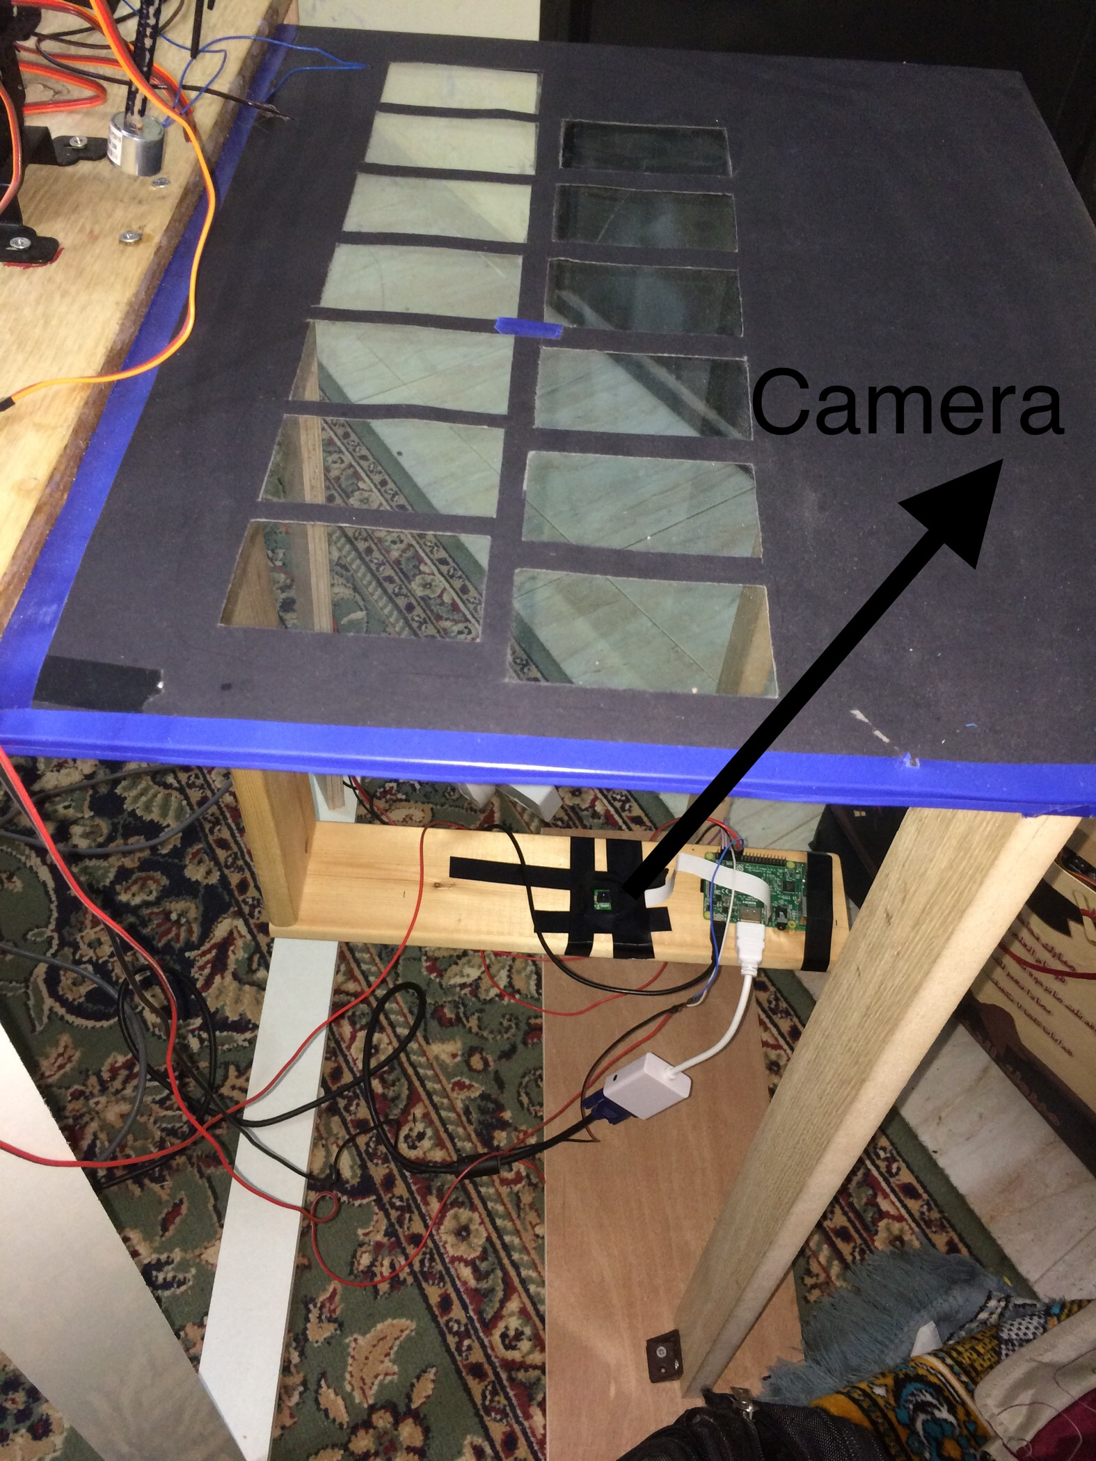
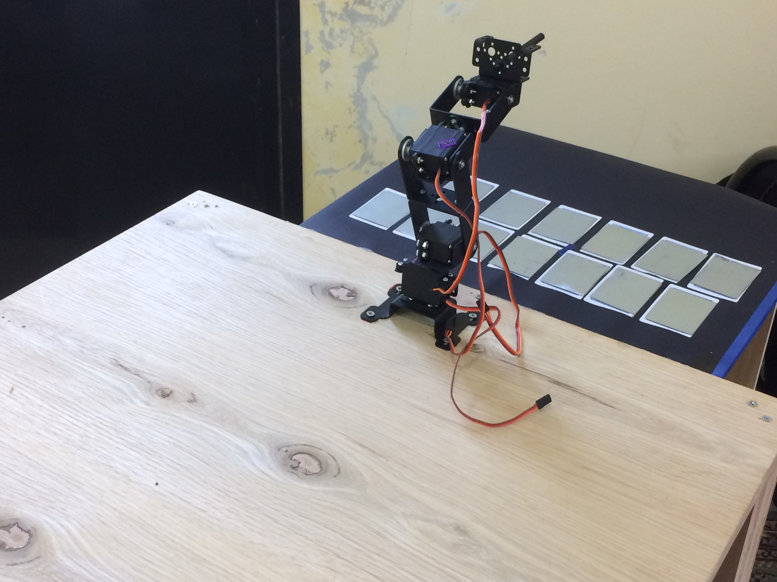
Robot’s Arm (cont..):

Slide 22
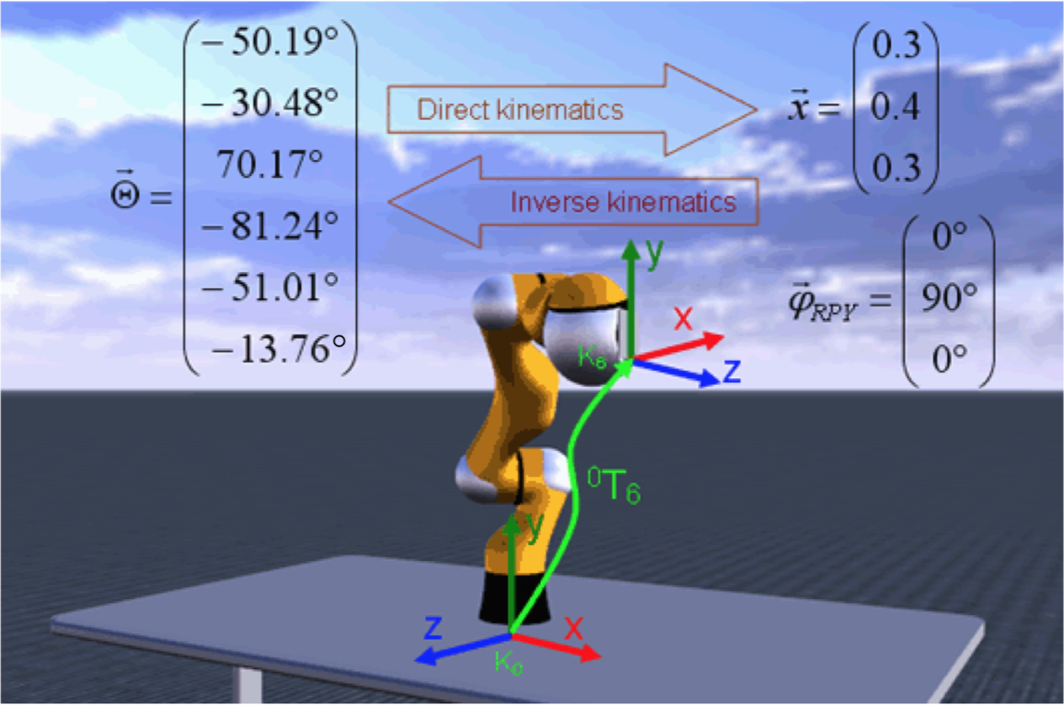
Robot’s Arm (cont..):
Robot kinematics.

Slide 23
Robot’s Arm (cont..):
Why we used the glass?
Why the glass background is black?
How we solved the inverse kinematics problem?

Slide 24
Obstacles:
• Weak knowledge about Raspberry Pi was a bit of a struggle.
• Damage of SD cards and Raspberry Pi.
• The Inverse Kinematic Problem.

Slide 25
Future Work:
• Adding an AI algorithm to give the robot the ability of controlling the decision of playing by itself.
• Adding count result of each game.

Slide 26
Thank You ☺

