Slide 1

Customer service system
شركة كهرباء طوباس
Shaima’ Albzoor
Aya Arafat
Supervised by Dr. Ashraf Armosh
Anhar S. Naghnaghia
Sajida H. Dweikat
Supervised by Haya Samaneh

Slide 2
Agenda
Problem Statement
Overview
Modules
Technologies
Methodology
Quality Factors
Constraints
Future Work
Demo

Slide 3
Problem Statement
Many companies deal with customers using Manual processes which are often slow, ineffective and inaccurate way, especially when those companies have many councils.
In process the application needs to have the approval from many employees in different roles, which may lead to great delay or lose the application in one of the nodes.

Slide 4
Overview
Customer Service System is a web Application, which help companies to keep tracking their customers’ applications in fast, effective, accurate and secure way.
Save time and help employees finish applications faster with the help of the workflow part of the application.

Slide 5
Modules
Applications
Workflow
Notification System
Reports
User rights
Templates

Slide 6
Technologies
ASP.Net
DevExpress
Javascripts
CSS
SQL Database
Crystal Reports
Structure: three tires

Slide 7
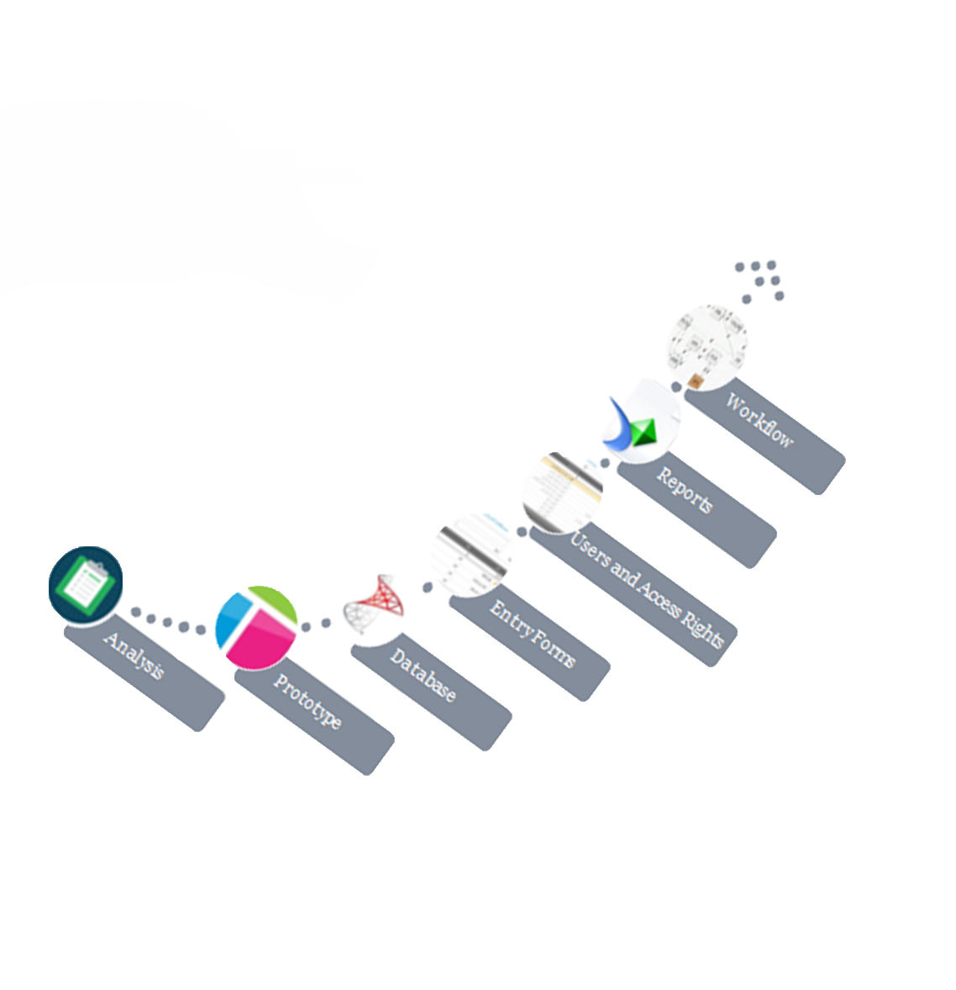
Methodology
Crystal Reports
AQL server 2012
Axure

Slide 8
Requirements Analysis
Studying Tubas Electricity Company requirements.
Project specifications.

Slide 9
Prototype
Pages interfaces.
Azure RP Pro Software.
Several versions of the prototype.

Slide 10
Database
Microsoft SQL Server Management Studio 2012.
SQL Server Express
Normalized database.
Layer generator.

Slide 11
Entry Forms:
Lookups
Transactions
Files

Slide 12
Lookups
Fees with values and units.
Conditions and procedures.
Regions and councils.
Services and categories.
Consumption types.
Building types.

Slide 13
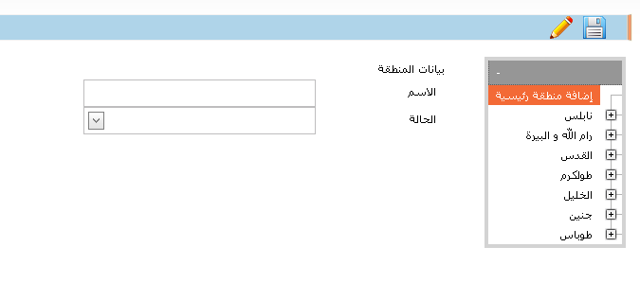
Lookups

Slide 14
Transactions
Applications Form

Slide 15
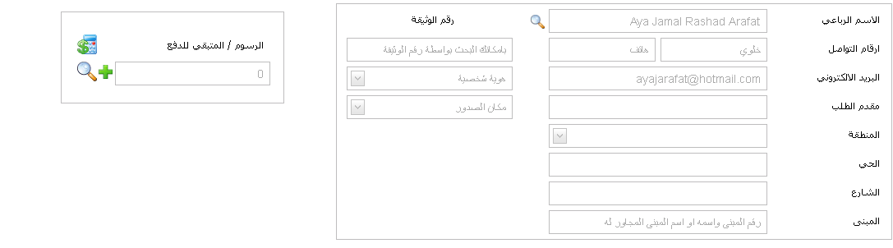
Applications

Slide 16
Files:
Users
Templates

Slide 17
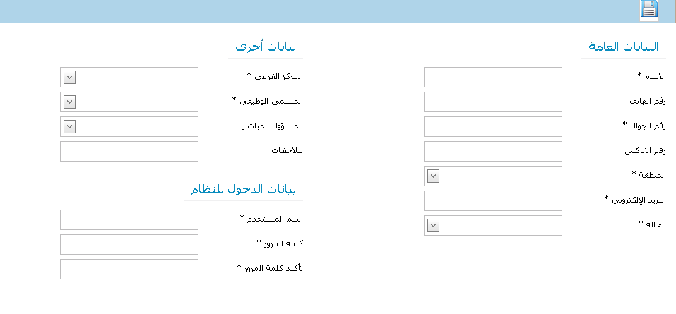
Users:

Slide 18
Define Templates
General form for all applications.
DevExpress HTML Editor to add any additional fields.

Slide 19
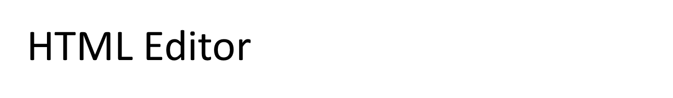
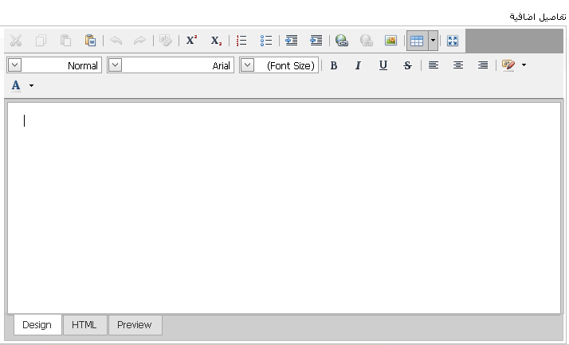
HTML Editor

Slide 20
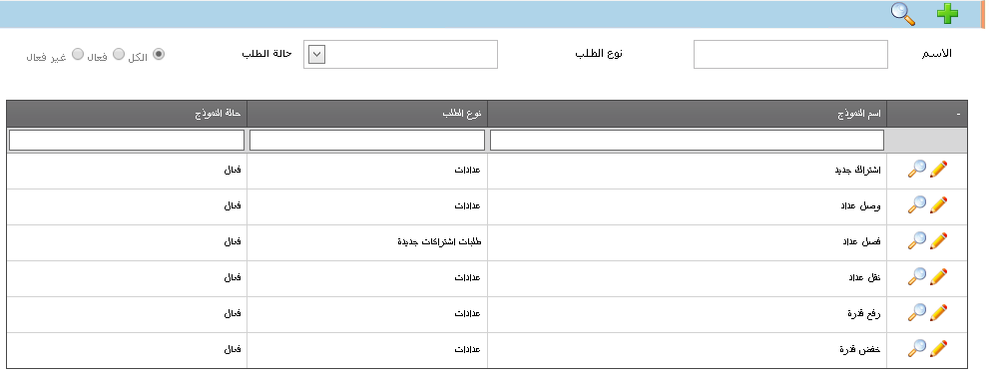
Templates’ management page allows us to search, view and edit existing templates.

Slide 21
User and Access Rights
Roles and Rights
Multi-Session and Multiusers.

Slide 22
Reports
Monitoring and managing.
Printing the reports.
Crystal reports.
Export report to Excel.

Slide 23
Reports
Different types:
  -Participations Report.
  -Notifications Report.
  -Applications Report.

Slide 24
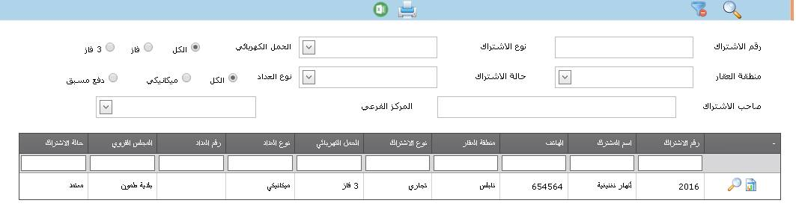
Participations Report

Slide 25
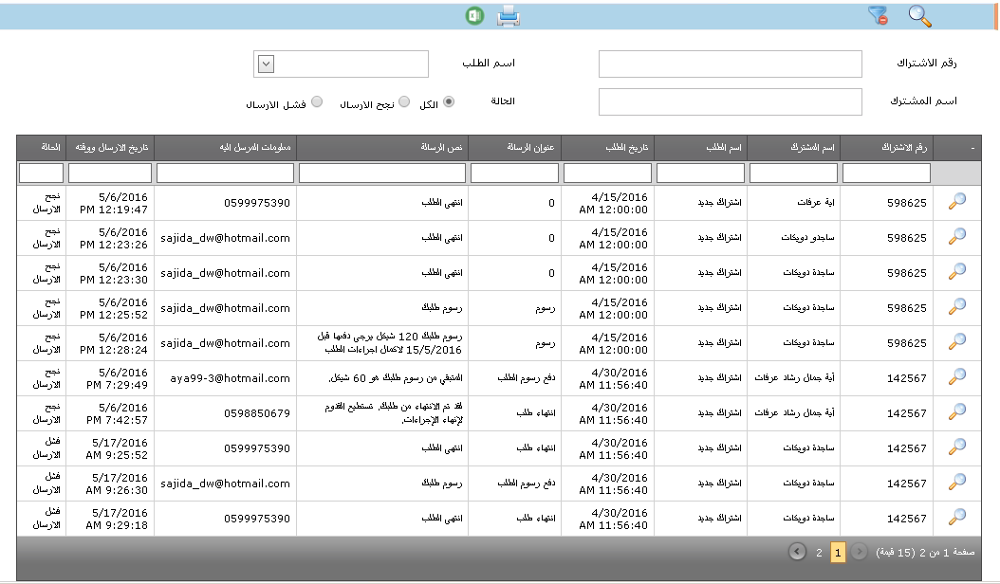
Notifications Report

Slide 26
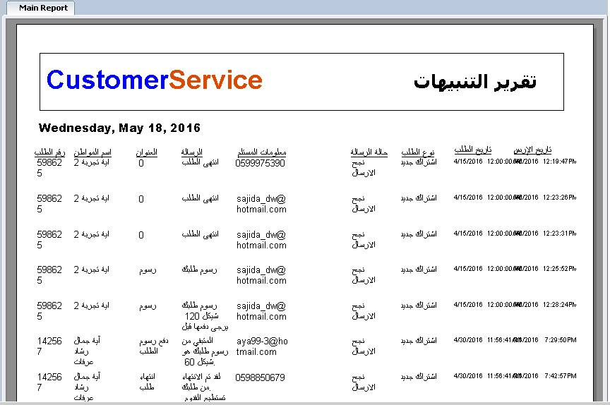
Printing

Slide 27
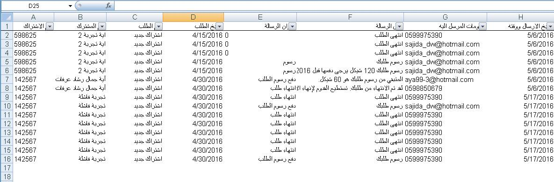
Export to Excel

Slide 28
Workflow
Determines the road in which each application type need to follow in order to be finished completely and successfully.
Actions in each state:
Approve, Reject,Bend and Return

Slide 29
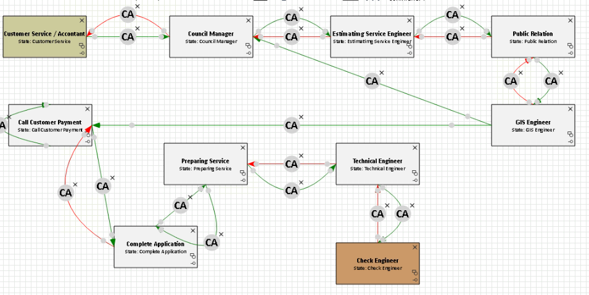

Slide 30
Notification System:
Costumers.
Users.

Slide 31
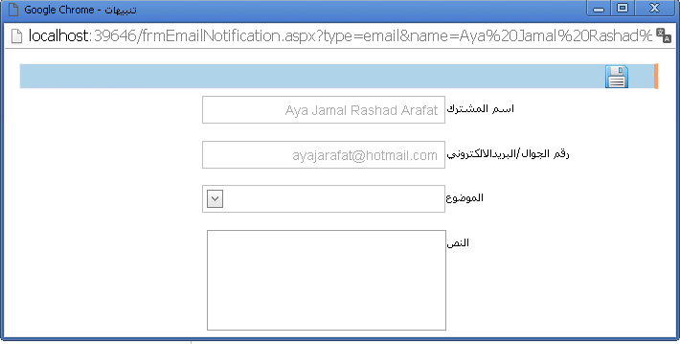

Slide 32
Quality Factors
Usability
Performance
Flexibility
Security

Slide 33
Constraints
Requirements.
Team management.
More time of working because of VPN.
Multi developers per page.

Slide 34
Future Work:
Mobile version for employees.
Portal for customers.
Integration with third party applications.

Slide 35
Demo

