Slide 1
Reality of Highway Construction Equipment in Palestine
Prepared by Abdullah Qawariq
Alaa Al-Hasan
Noor Johar
Shahd Jaber
Supervisor Eng. Mohammed Abu Neama

Slide 2
Outline
Introduction
Methodology
Data Analysis
AHP Method
Conclusion and recommendations
Future studies

Slide 3

Statement of problem

Slide 4
Project Objectives
Know more about the types of equipment used in highway construction projects
Identify problems related to equipment.
Find the factors that impact on equipment productivity
Identify criteria for construction equipment selection

Slide 5
Significance of the project
A model for equipment selection based on Analytical Hierarchy Process (AHP) was developed.
Suggestions and solutions to minimize problems related to equipment were presented.

Slide 6
Highway construction equipment

Slide 7
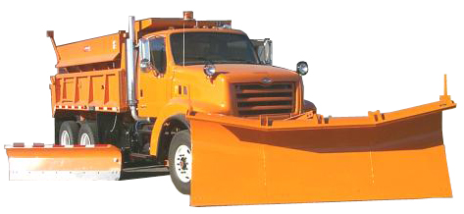
Sweeper

Slide 8
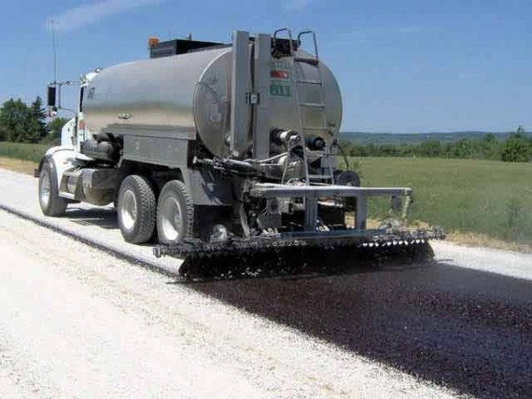
Paver

Slide 9
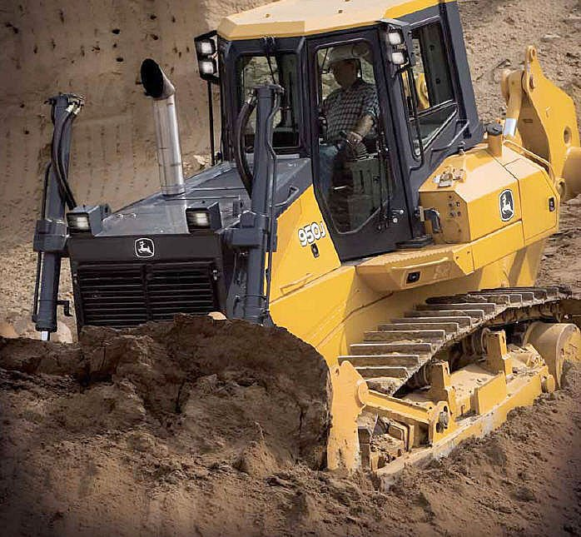
Bulldozer

Slide 10
Causes of low productivity
Price of the equipment
Long time required for importing equipment
Closing of borders and Israeli rules
Low cash support from the owner
Organizational problems, like: not getting permission from the owner to begin work

Slide 11
Criteria and standards for equipment selection
Price of equipment
Availability of maintenance parts and ease to repair equipment
Availability of equipment and ability to import it abroad
Skilled labor availability
Default age of equipment
Productivity of equipment

Slide 12
Method for selection equipment
Analytic Hierarchy Process

Slide 13
Methodology
Data collection
  Previous studies
  Interviews with contractors
  Questionnaire distribution

Slide 14

Methodology
Sample size
Data analysis using excel program.

Slide 15
Data analysis
Data which analyzed using excel program
Questionnaire distribution.
Respondents characteristics.
Chosen equipment.
Causes of low productivity.
Criteria for equipment selection.
Notes:
We used Microsoft excel in order to analyze data that are related to:
Questionnaire and it’s respondent’s characteristics also to analyze responds for chosen equipment and it’s low productivity causes and finally we use it in criteria for equipment selection analysis.

Slide 16
Questionnaire distribution
Notes:
We distribute 46 questionnaire but we got 35 response
We started in distributing the questionnaire in 19 January of this year, and we finish distribution in 30th of march,
Before we started the distribution process , a pilot test was made for insuring that the other contractors will understand the information listed in the questionnaire, and if there are any comments to be taken into consideration.
Questionnaires were distributed for different highway contracting companies in Nablus & Ramallah.
It was done using interviews, also we made an online questionnaire using Google forms.
We faced many difficulties in distribution process:
1- some of contractors does not give us any help and they refused to fill the questionnaire
2- also, it was hard to reach some contracting companies since they don’t have a website or any contact information to contact them or to know where they are.

Slide 17
Respondent’s experience
Notes:
For the contractors that we distributed the questionnaire for, results shows that majority of them were have companies with an experience in work of 10 to 20 years in highway projects work.
And that helped us in taking a rational and logical results.
Few of them were with more than 20 years of experience and that helped us more.

Slide 18
Contractors grade
Notes:
According to the Palestinian Contractor Union as shown in the figure
about 46% of the respondents 16 contractors out of 35 classified first class, 20% of the respondents which is equal 7 contractors out of 35 classified second class, 20% of the respondents 7 contractors out of 35 contractors classified third class, 11% of the respondents 4 contractors out of 35 classified fourth class, and only 3% of the respondents (1 contractor out of 35 classified fifth class.
It's obvious that the largest percentage of respondents’ classification was first class, and a very small percentage of 3% of respondents are classified fifth class, and this make the data more reliable.

Slide 19
Chosen equipment
Notes:
This section of questionnaire includes an important question that indicates the contracting companies' decision for selection equipment in projects; whether it is buying, short-term renting or long-term renting.
Also, includes evaluation of reasons for renting equipment in the contractors’ point of view.
43% of the contractors preferred to purchase their equipment, the rest prefer renting them for short period, no one goes with renting for long period.

Slide 20
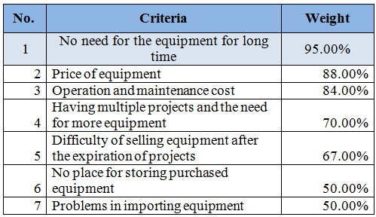
Evaluation of reasons for renting equipment
Notes:
For the contractors who preferred to rent equipment, their main reasons of renting were as follow with a weight for each reason.
No need for the equipment for long time with weight of 95%
Price of equipment with weight of 88%
.
.
.
.

Slide 21
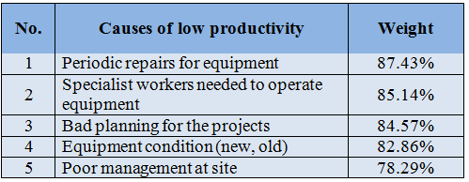
Causes of low productivity
Notes:
Contracting companies were requested to rate the degree of importance of reasons that decrease the equipment productivity.
The rank of causes shows in figure with a weigh for each cause.

Slide 22
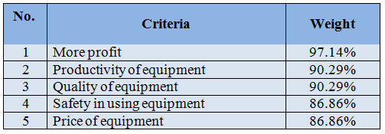
Criteria for equipment selection
Notes:
This table shows the criteria that is taken into consideration in selecting equipment, and the top five criteria are: “more profit”, “productivity of equipment”, quality of equipment”, “safety in using equipment”, and “price of equipment”.

Slide 23
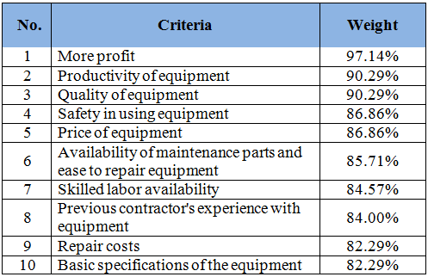
Top ten criteria

Slide 24
AHP method
AHP or Analytical Hierarchy Process is one of the multi criteria decision making techniques for organizing and analyzing complex decisions.
Can be used to provide relative priorities on ratio scales from paired comparisons.
It allows some inconsistency in judgment
Notes:
Analytical hierarchy process is developed by Thomas Saaty , it is one of the multi criteria decision making techniques for organizing and analyzing complex decisions.
this technique can be used to provide relative priorities on a ratio scales from paired comparisons. It allows also some small inconsistency in judgment

Slide 25
AHP method
It assumes complete aggregations among criteria
It develops a linear additive model
The weights and scores are achieved basically by pair wise comparisons between all options with each other
Notes:
The AHP is a compensatory method that assumes complete aggregations among criteria, and develops a linear additive model. However, the weights and scores are achieved basically by pair wise comparisons between all options with each other

Slide 26
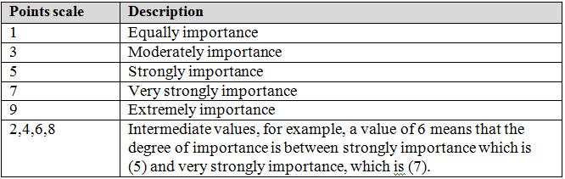
AHP method
Pair-wise comparison scale

Slide 27
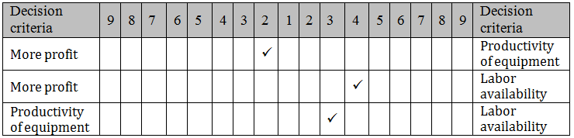
AHP method
Example
Notes:
The questionnaire was distributed to 35 contractors, after analyzing the results, the best 10 criteria were selected.
These ten criteria were included in another questionnaire and one contractor with good experience was asked to compare between them.
. Because it is not easy to perform manual calculations for 10x10 matrix, the comparison made by one respondent among only three criteria are taken as an example
.

Slide 28
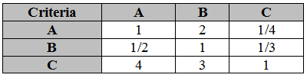
AHP method - Example
Notes:
These criteria were assigned the alphabet order where “A” represents more profit, “B” represents the productivity of equipment and “C” refers to the labor availability
In order to determine the priority of each criterion and check the consistency of the judgment, the following steps should be conducted:
1. Creating a pair-wise comparison matrix
2. the pair-wise comparison matrix created this matrix which is synthesized through dividing each item of the matrix by the summation of its column as shown in this table

Slide 29

AHP method - Example
Notes:
After synthesizing the matrix, the priority vector is determined through calculating the row averages of the synthesized matrix as shown here

Slide 30
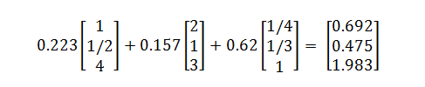

AHP method - Example
Judgment consistency
Notes:
In order to check judgment consistency, the following steps will be done:
1. Determining the weighted sum matrix as we can see in this equation:
2. Dividing each item in the weighted sum matrix by their particular priority vector.

Slide 31


AHP method - Example
Notes:
3. Determining λ_{max} through calculating the average of values obtained in part 2
4. Determining the consistency index CI

Slide 32

AHP method - Example
Notes:
5. Choosing a suitable value for the random consistency from table . The R.C value corresponding to matrix size 3x3 is equal to 0.58.
6. Determining the consistency ratio using the following formula
Because the value of consistency ratio is less than 0.1, the judgment is satisfactory and the results are acceptable.

Slide 33
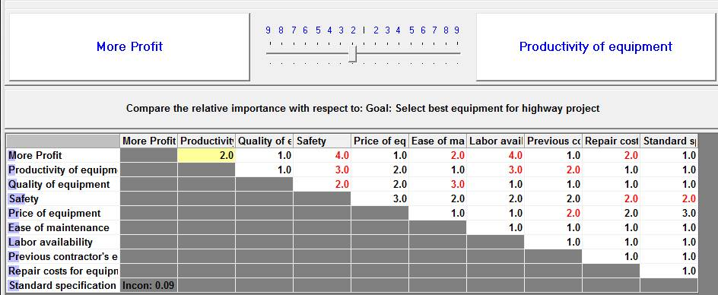
AHP method
Pair-wise comparison between two criteria “More profit & Productivity of equipment”
Notes:
this figure describes the pair-wise comparison between two criteria “More profit and the Productivity of equipment”, that the respondents assigned
a rating 2 which indicated that more profit is twice important than productivity of the equipment with respect to the major goal .
The objective here is to find the errors and measuring the logical inconsistency of judgment. also missing judgments are considered to be inconsistency.
Consistency ratio has to be less than 0.1 to claim that the judgment is reasonable, otherwise consistency have to be reviewed
As we show here that the inconsistency for this respondent is 0.09 which is less than 0.1; therefore this respondent has a consistent judgment, and the results are acceptable

Slide 34
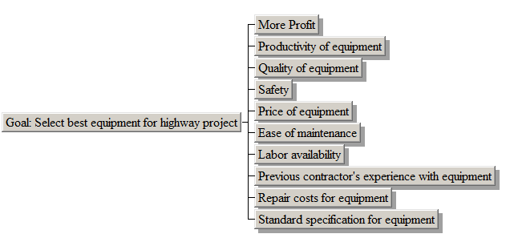
AHP method
Hierarchy model established at Expert Choice
Notes:
This hererchy consist three level First level is the main objective which is selecting the best construction equipment for highway project the hierarchy
The second level is criteria

Slide 35
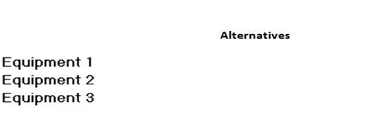
AHP method
Notes:
and the last level are alternatives

Slide 36
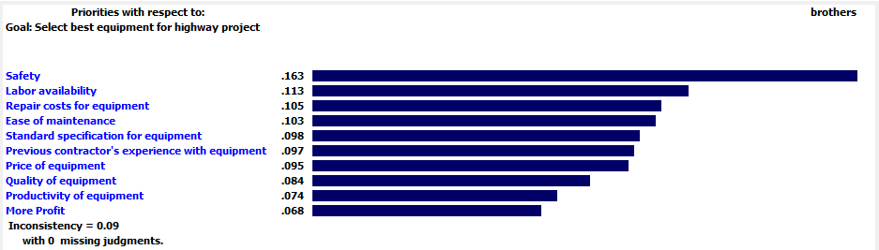
AHP method
Importance of each criterion
Notes:
After completing the pair-wise comparisons, the relative weights for the criteria is determined, then the relative priorities for each criterion is identified and the results were synthesized in order to come up with the overall priority. This table shows the rank and the priorities of each criterion from one expert to the questionnaire using the expert choice software. It is obvious that the most important five criteria considered for the selection of the construction contractors in descending order are: “Safety”, “Labor availability”, “Repair costs for equipment”, “Ease of maintenance” and “Standard specification for equipment”.

Slide 37
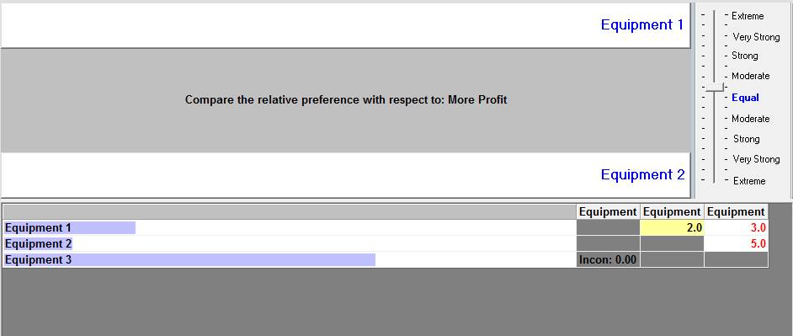
AHP method
Verbal judgment between alternative with respect to more profit

Slide 38
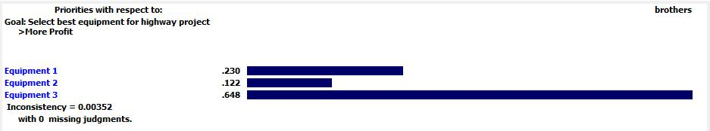
AHP method
Alternatives overall priorities with respect to more profit

Slide 39
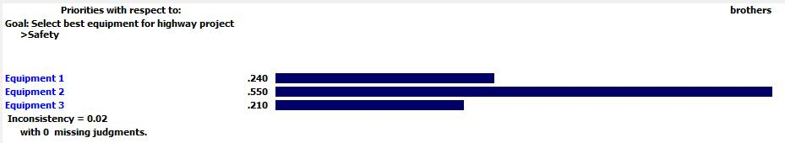
AHP method
Alternatives overall priorities with respect to safety

Slide 40
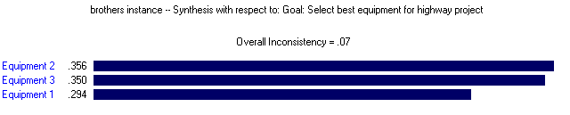
AHP method
Overall priorities of different alternative with respect to major goal

Slide 41
Analysis figures
Performance sensitivity analysis
Dynamic sensitivity analysis
Gradient sensitivity
Head to head sensitivity
Two-dimensional sensitivity

Slide 42
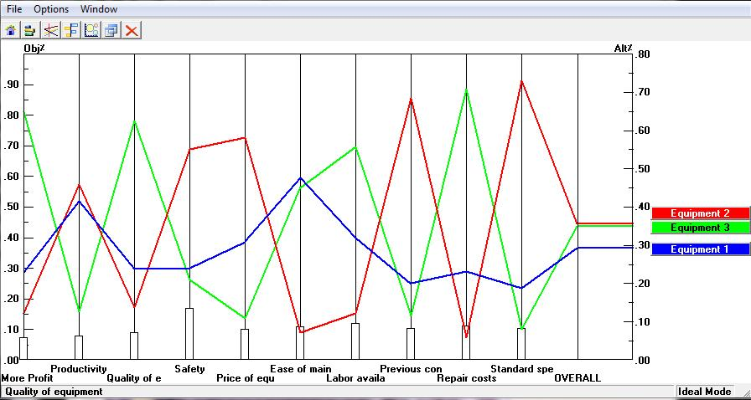
AHP method
Performance sensitivity analysis
Notes:
`

Slide 43
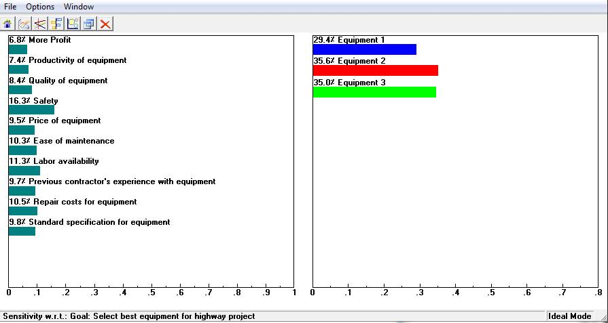
AHP method
Dynamic sensitivity analysis

Slide 44
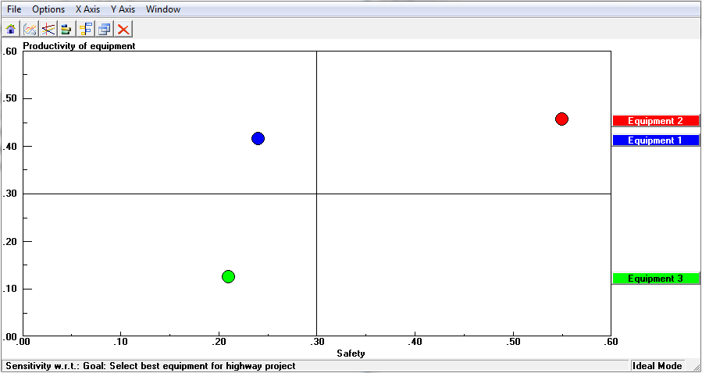
AHP method
Two-dimensional analysis

Slide 45
Conclusion and Recommendations
It’s recommended for the contracting companies to use the proposed model.
Create a database in every construction company containing the names of companies selling and renting that has been dealt with previously.
Carefully consider the criteria on which basis the equipment are compared.

Slide 46
Conclusion and Recommendations
The decision of equipment selection should be in the hands of responsible people
It is recommended that exist of CFO of the company during the selection of equipment process

Slide 47

Future studies

Slide 48
Thank you

