Slide 1

Automated Assembly Line
-AAL-

Slide 2
Outline
Introduction .
What problem does AAL solve.
Parts.
Project Timeline.
How does AAL Work.
Final Product.
Future Work.
2

Slide 3
1.
Introduction
3

Slide 4

-Automated Assembly line system provides a comprehensive solution to the challenges encountered in traditional factory work. It enables factories to achieve higher productivity, consistent product quality, improved efficiency, and enhanced worker safety. By harnessing automation technology, we empower businesses to optimize their operations, stay competitive, and create a more efficient and harmonious work environment.
4

Slide 5
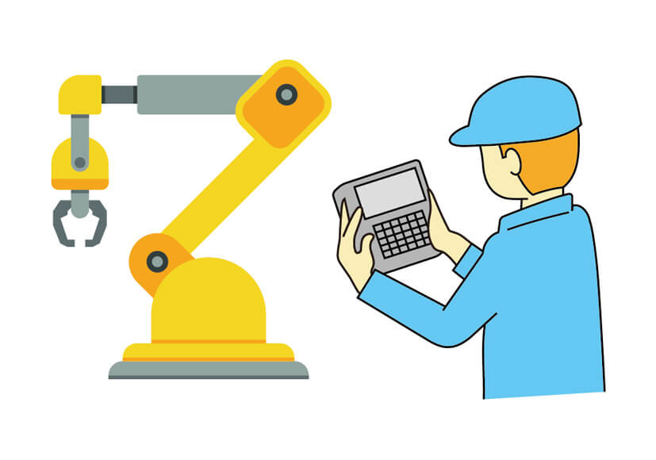
What problem does AAL solve
5

Slide 6

What problem does AAL solve
productivity.
Costs.
Accuracy.
Ensure worker safety.
6

Slide 7
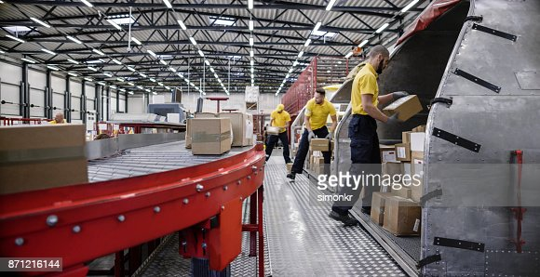
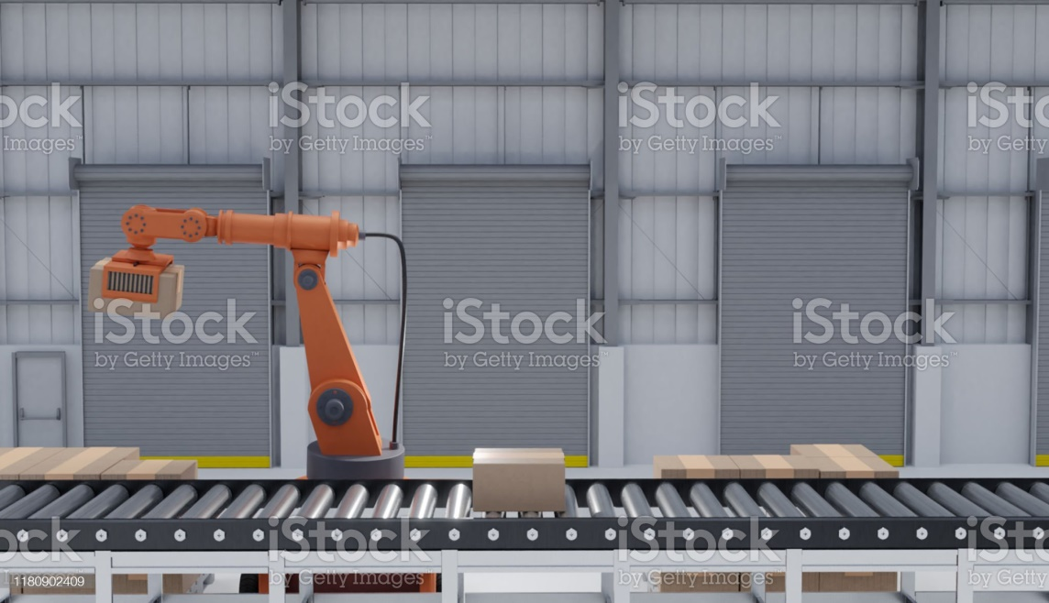
What problem does AAL solve
Before solution
After solution
7

Slide 8


Parts
-Mechanical
-Electric
8

Slide 9

Mechanical Part
steel rod 8mm
Vertical Self Alignment Block Bearing Flange
3D prints arm parts
5mm x 8mm Flexible Shaft Coupling Rigid
9

Slide 10
Electric Part
Arduino mega 2560
Raspberry pi 4 model b 8G
shield stepper driver 42ch
module cl4015 (12v-5v) Buck Converter
10

Slide 11
Electric Part
Bread board
IR sensor
power supply 10A
ESP8266 WIFI module
11

Slide 12
Electric Part
Stepper Motor
MG996R HIGH TORQUE SERVO MOTOR 180 DEGREE 9KG
TowerPro SG 90 Micro Servo Motor
MG995 High Speed Servo Motor
12

Slide 13
Electric Part
Raspberry pi camera
Wires (male-male)
50CM Raspberry Pi Camera Cable
Wires (female-male)
13

Slide 14
Project Timeline
buy parts
Connecting electrical parts to the project
Confirm the idea
1
3
5
2
4
6
Planning how to implement the idea
Building the project structure
Testing
14

Slide 15
How does AAL Work.
15

Slide 16

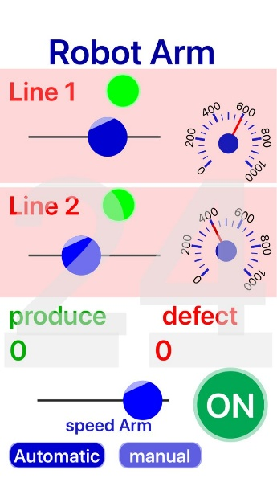
How does AAL Work.
-Initially run the system.
-We used RemoteXY website to design our mobile application.
-In our mobile application we have two pages.
Automatic
16

Slide 17

How does AAL Work.
-Where this object takes the speed of the motor and keep running until the object on the production line reach the IR sensor area then the IR detect the object and then we set the speed of the motor to 0 to stop it.
17

Slide 18
How does AAL Work.
-Raspberry pi 4 we used machine learning model and trained it with images, and we wrote a python script to capture frames from camera and send it to the model.
-We want to check the object in the first line, we check two things the color of the object and the shape.
-We want the object to be red and the shape to be cylinder.
18

Slide 19
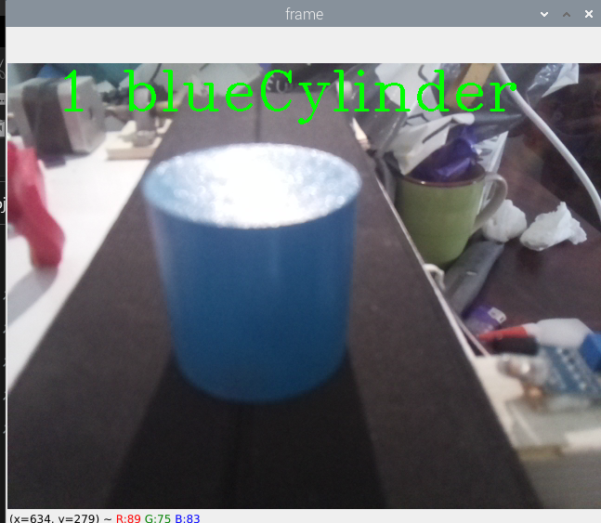
How does AAL Work.
-Any other colors and shapes the system consider it as defect and the arm throw it out.
19

Slide 20
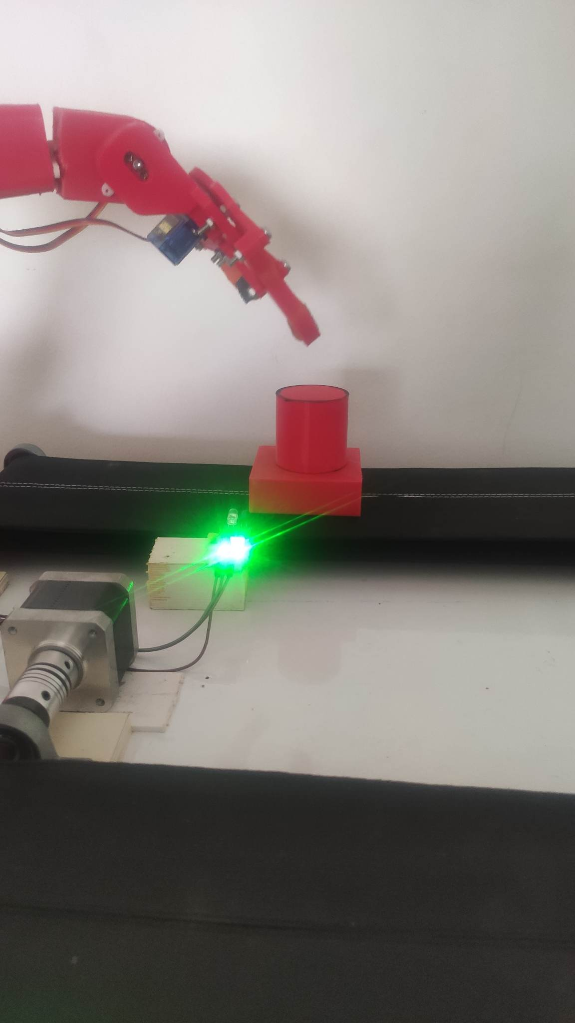
How does AAL Work.
-If the object red and the shape cylinder.
-The robotic arm transfers the object from the first production line and assembles it onto the other object on the second production line, which is waiting it, if the arm didn’t take the object it will try again.
-Then the second production line moves the object until it bypasses the IR sensor.
20

Slide 21

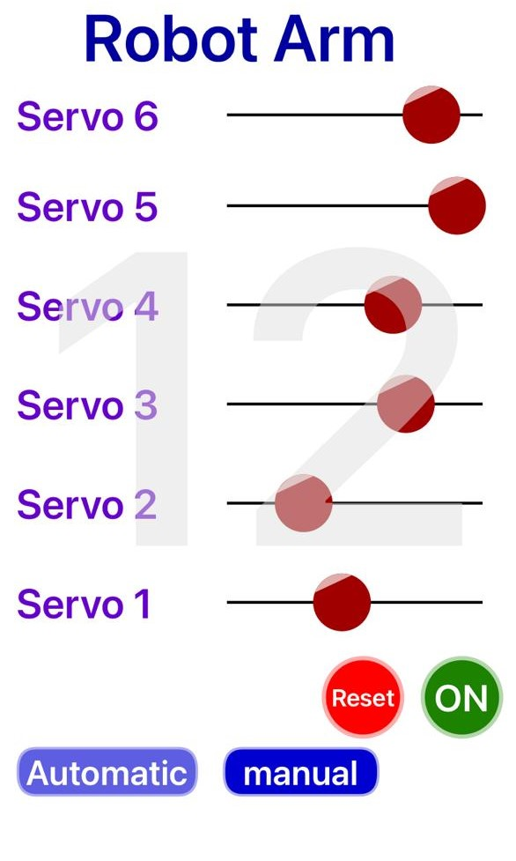
How does AAL Work.
-The second page of the mobile application.
-We have the six slider for controlling the servos Manual.
- Reset button.
21

Slide 22
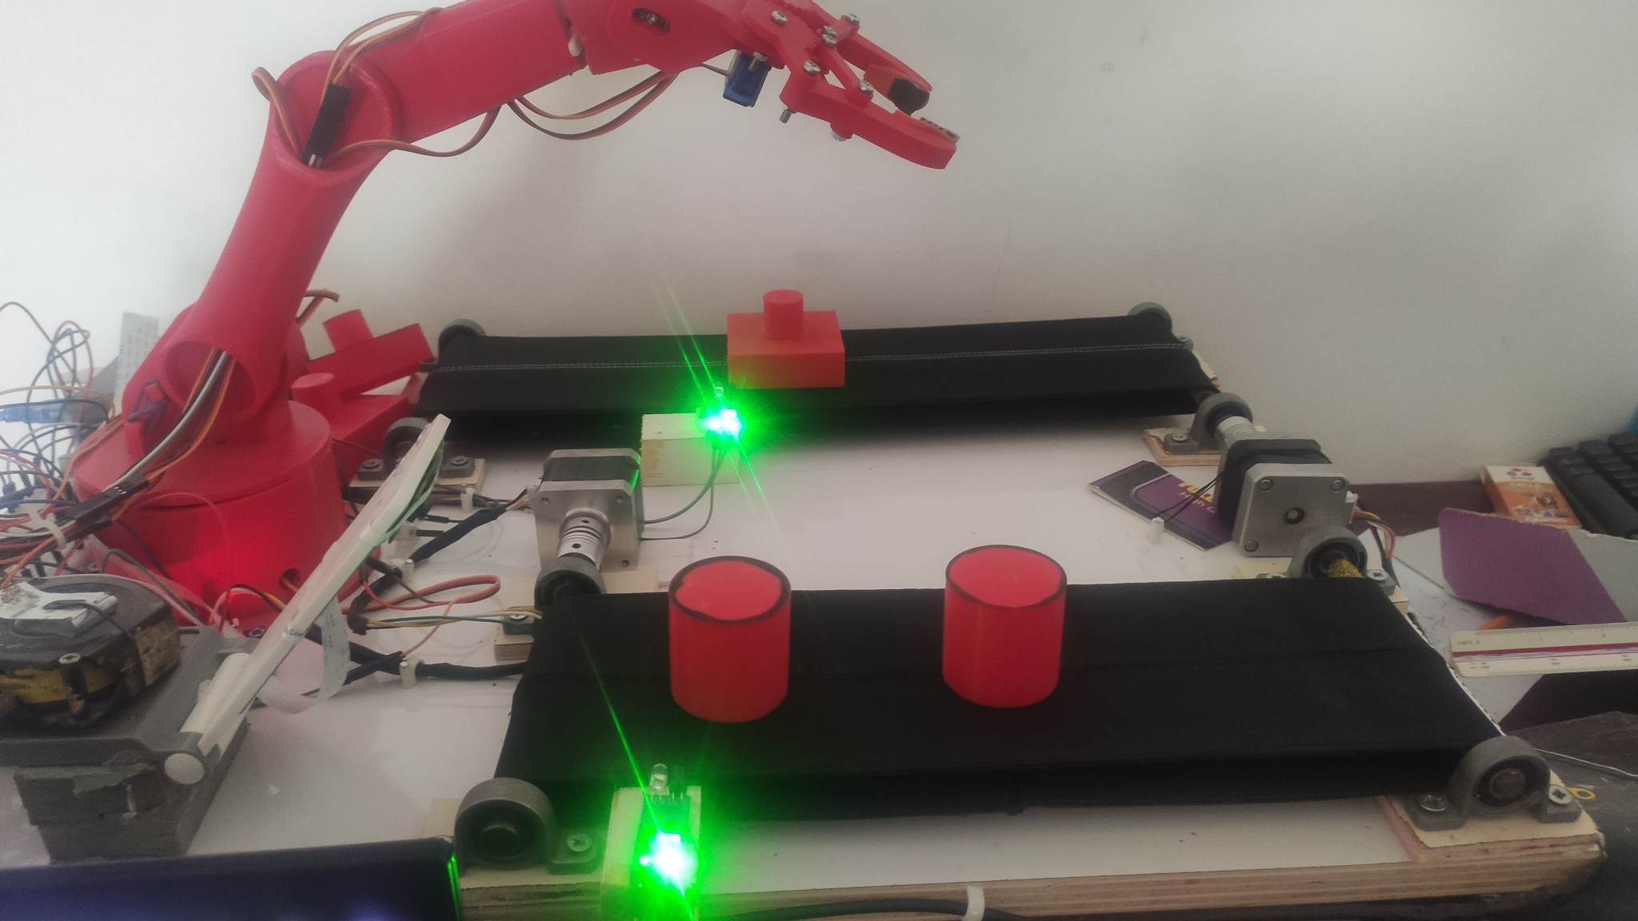

Final Product
22

Slide 23
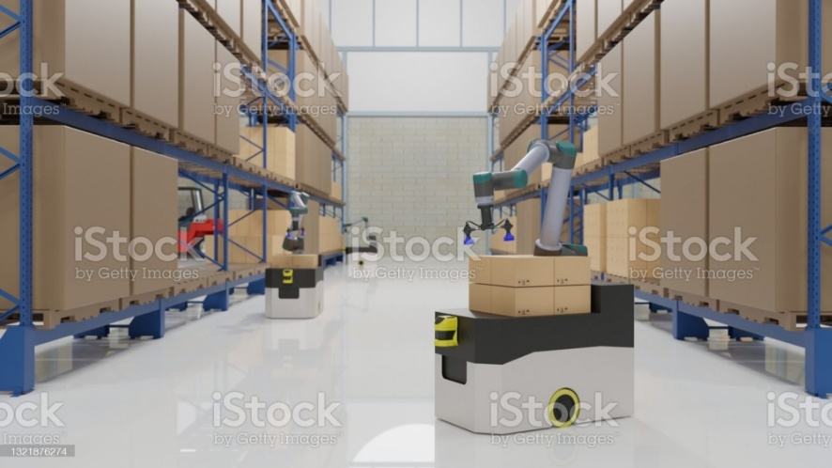
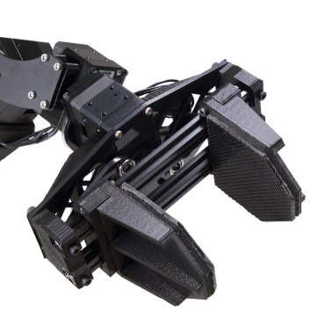
Future work
-Developing predictive maintenance algorithms to identify and address potential issues before they impact production.
-Advanced robotic manipulators and grippers could expand the range of objects that can be handled and assembled by the system.
-Add mechanism to check the final product.
23

Slide 24

Team Presentation
-Yasser Saife
-Baraa Khalaf
24

Slide 25

THANKS!
Any questions?
25

