Slide 1
Shobbek Lobbek Fashion
Lamees Maali
Bayan Rddad

Slide 2
Outline:
1- why shobbek lobbel fashion
2- methodology
3- ios app
4- challenges
5-feature

Slide 3
why ?
save money for both customer and investor
Easy of use
Digital marketing

Slide 4
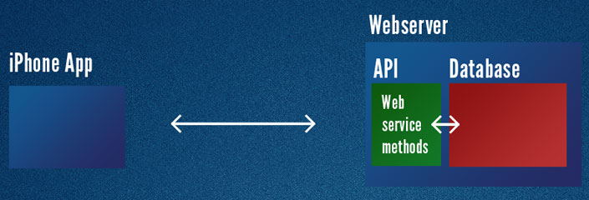
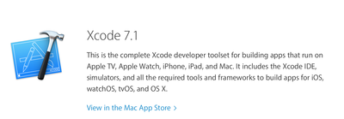
methodology

Slide 5
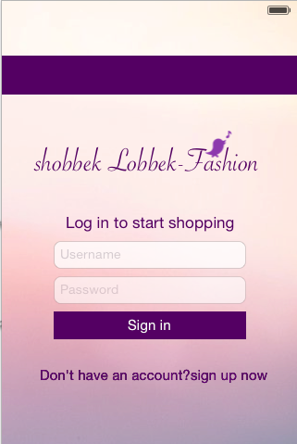
ios app

Slide 6
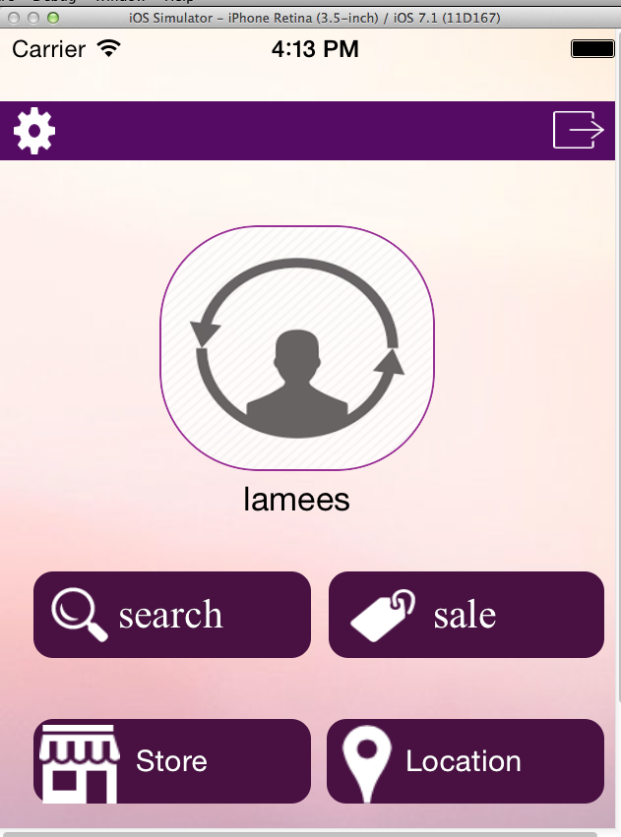

Slide 7
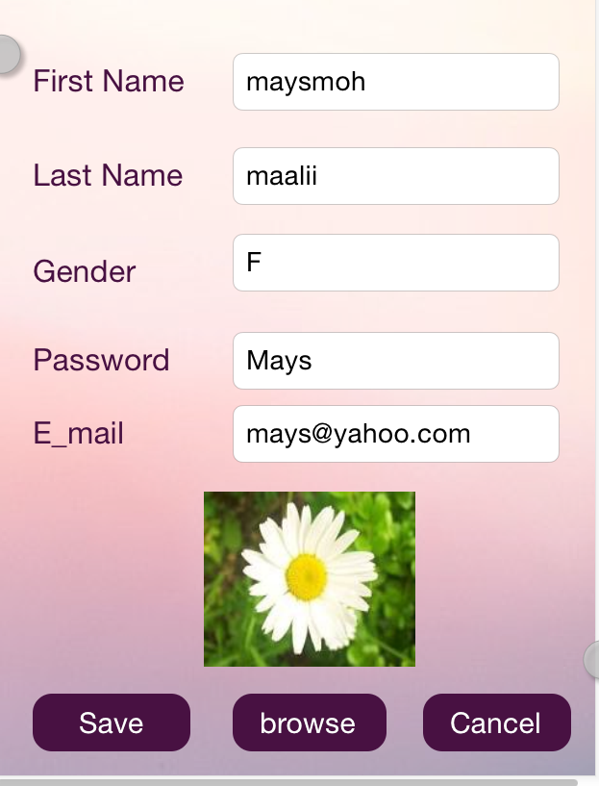

Slide 8
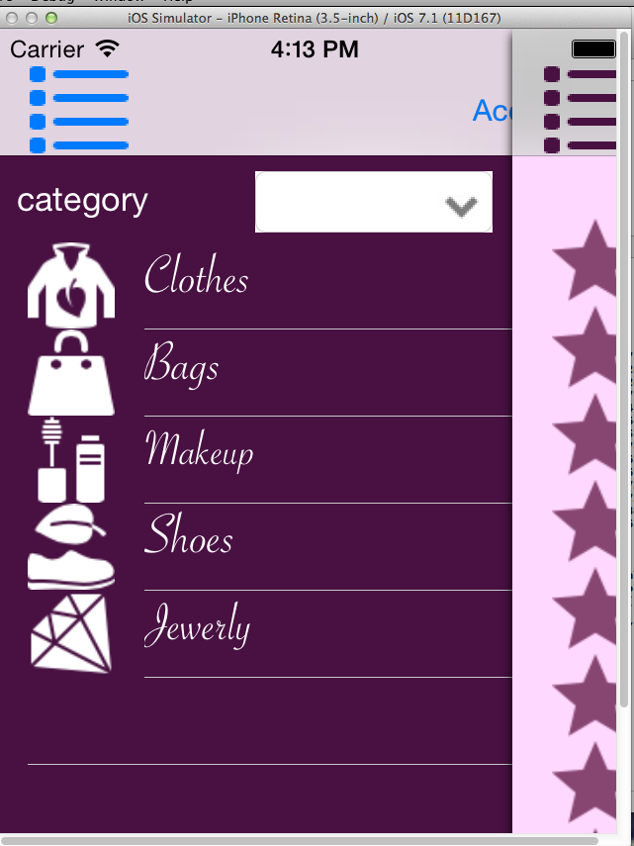

Slide 9
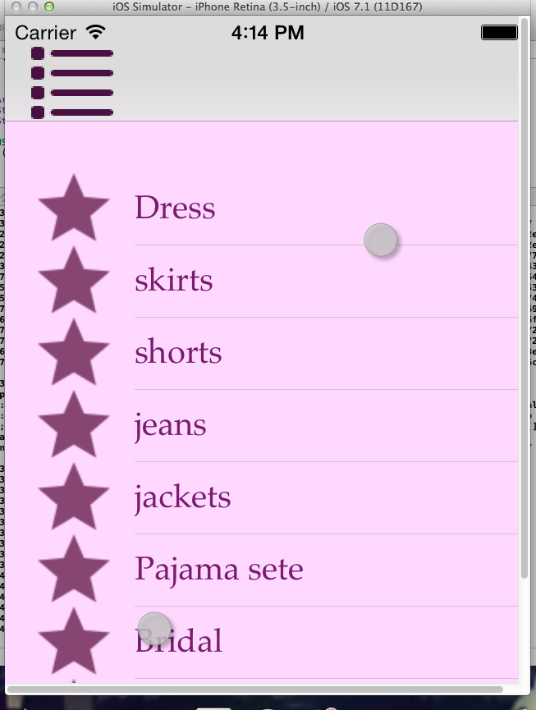

Slide 10
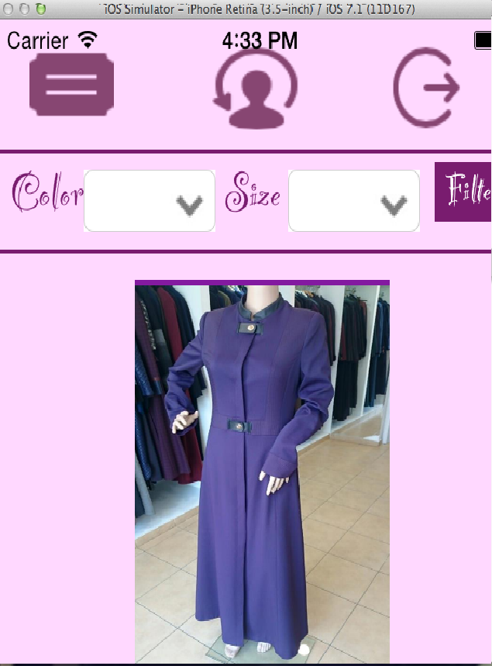

Slide 11
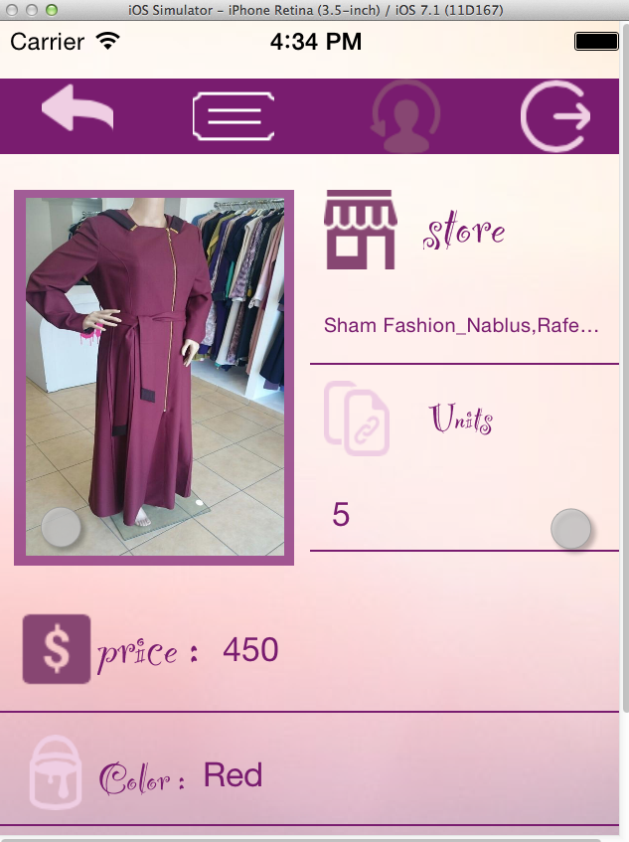

Slide 12
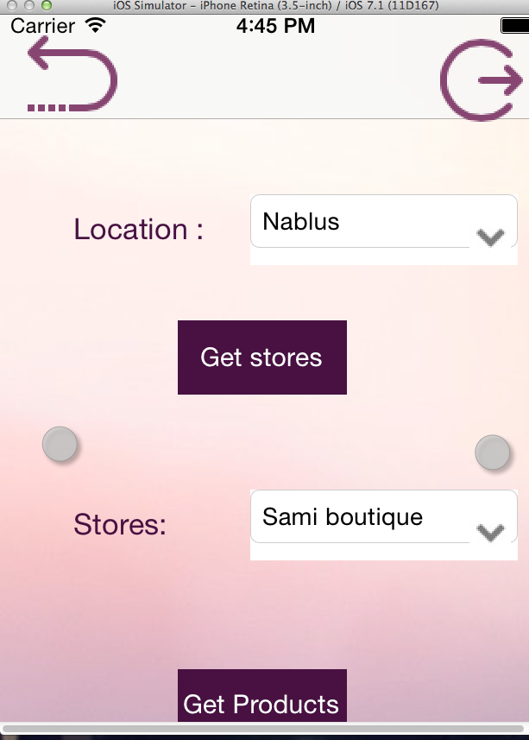

Slide 13
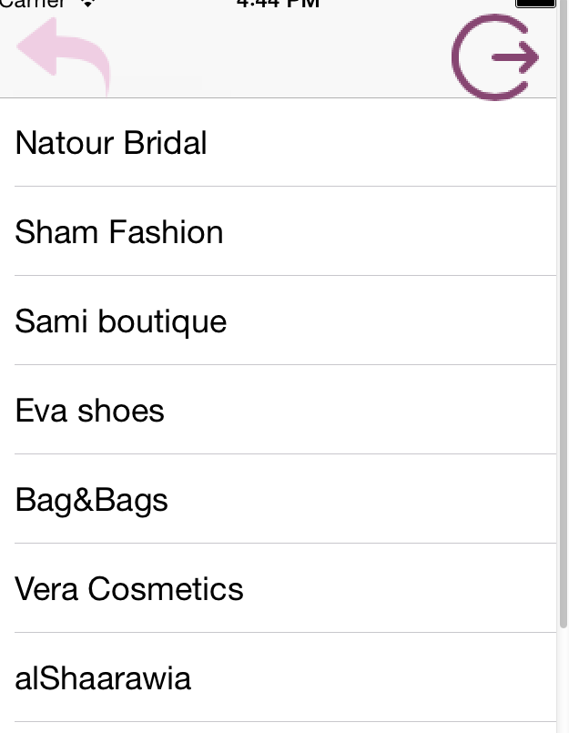

Slide 14
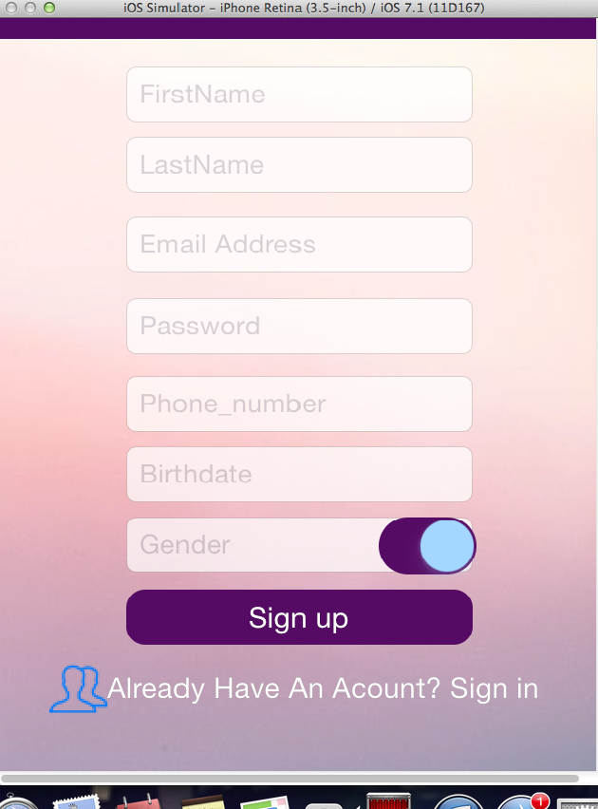

Slide 15
challenges
virtual machine
XML request
database
images

Slide 16
Future work
multi platform
General shopping app

