Slide 1

Lego Code
Q/A
Why it is called Lego Code?
What is the purpose of this Project/Tool?
What is the methodology used in Code Generation?
What features this tool provides?

Slide 2
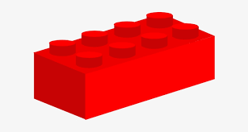
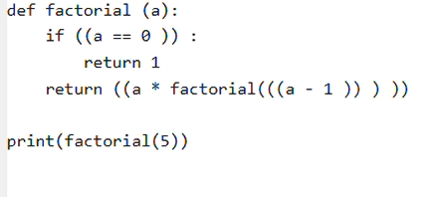


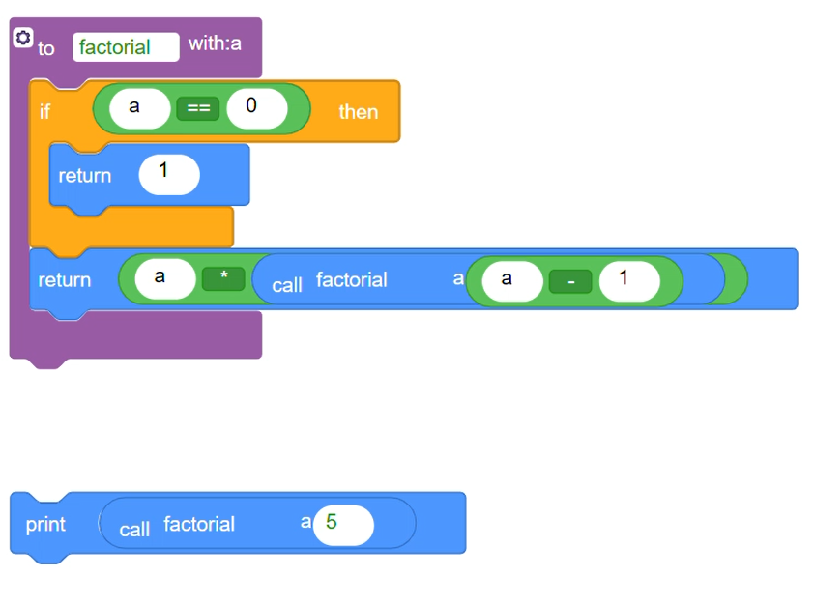
Why it is called Lego Code?

Slide 3
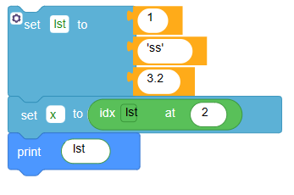
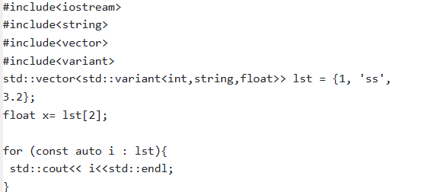
What is the purpose of this Project/Tool?

Slide 4
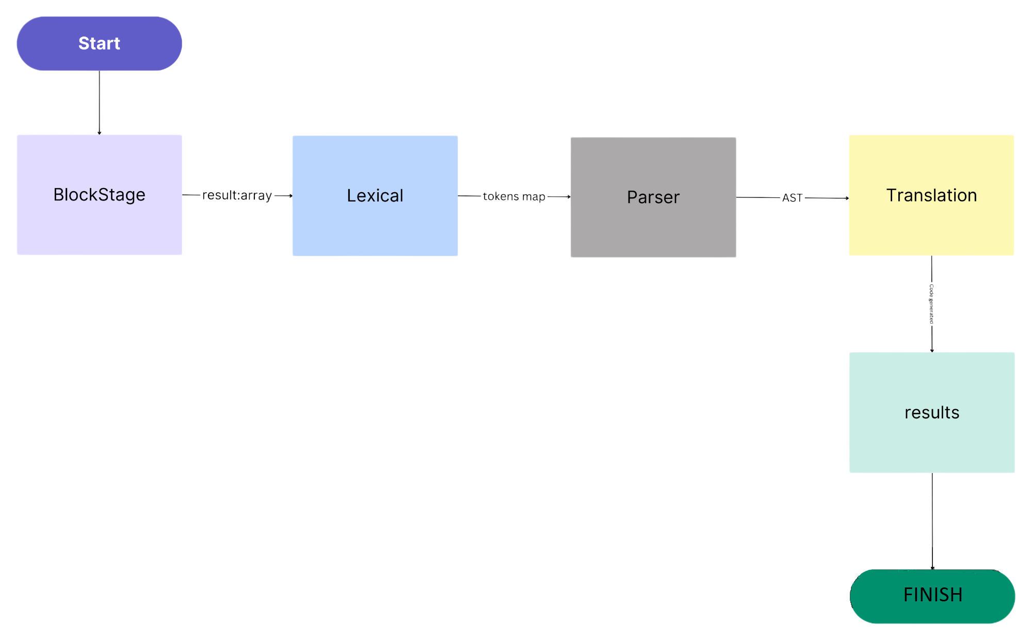
Methodologies used:

Slide 5



Slide 6
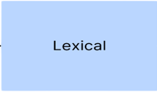
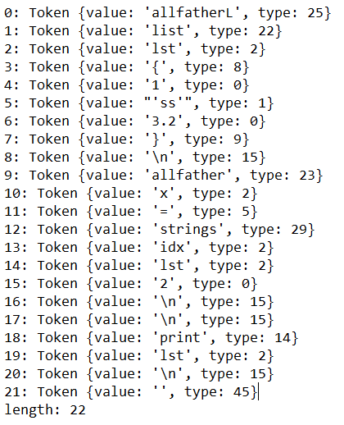

Slide 7

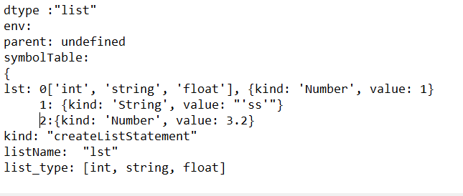

Slide 8
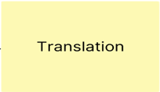

Slide 9

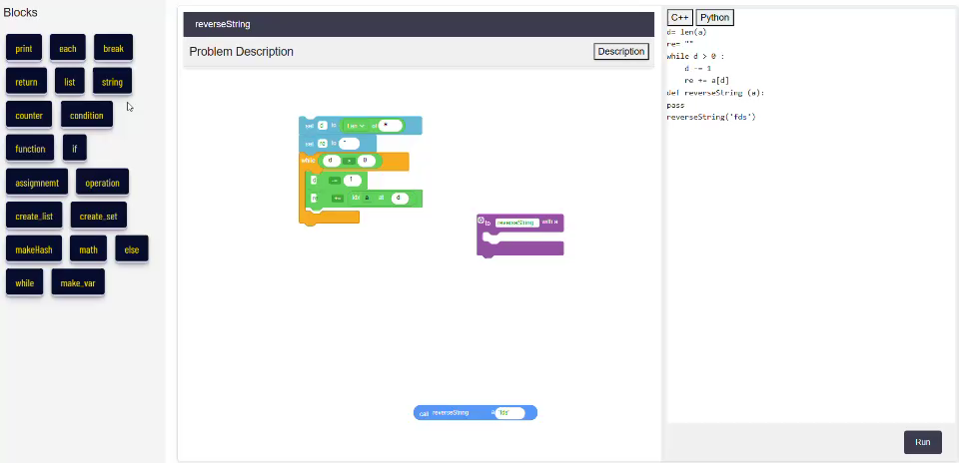

Slide 10
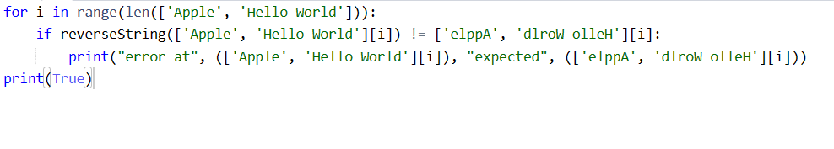

Slide 11



Technology Used:

Slide 12
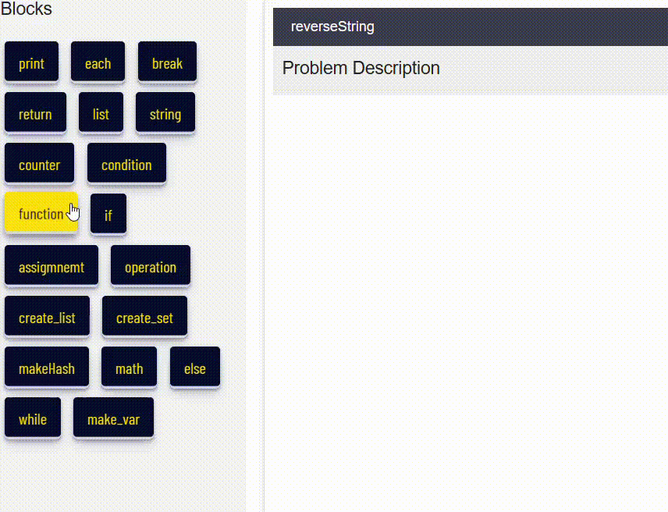

Slide 13
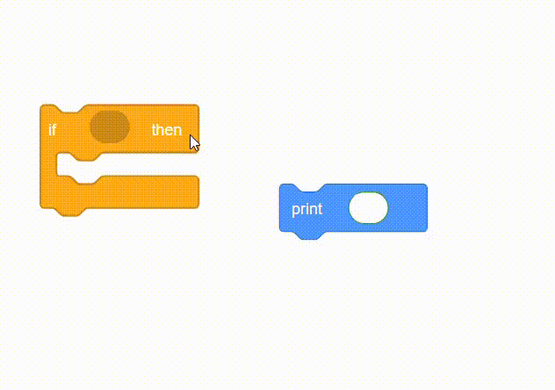
Blocks:

Slide 14
Features:
Tutorial
Step-Block
Simple Drawing game

Slide 15
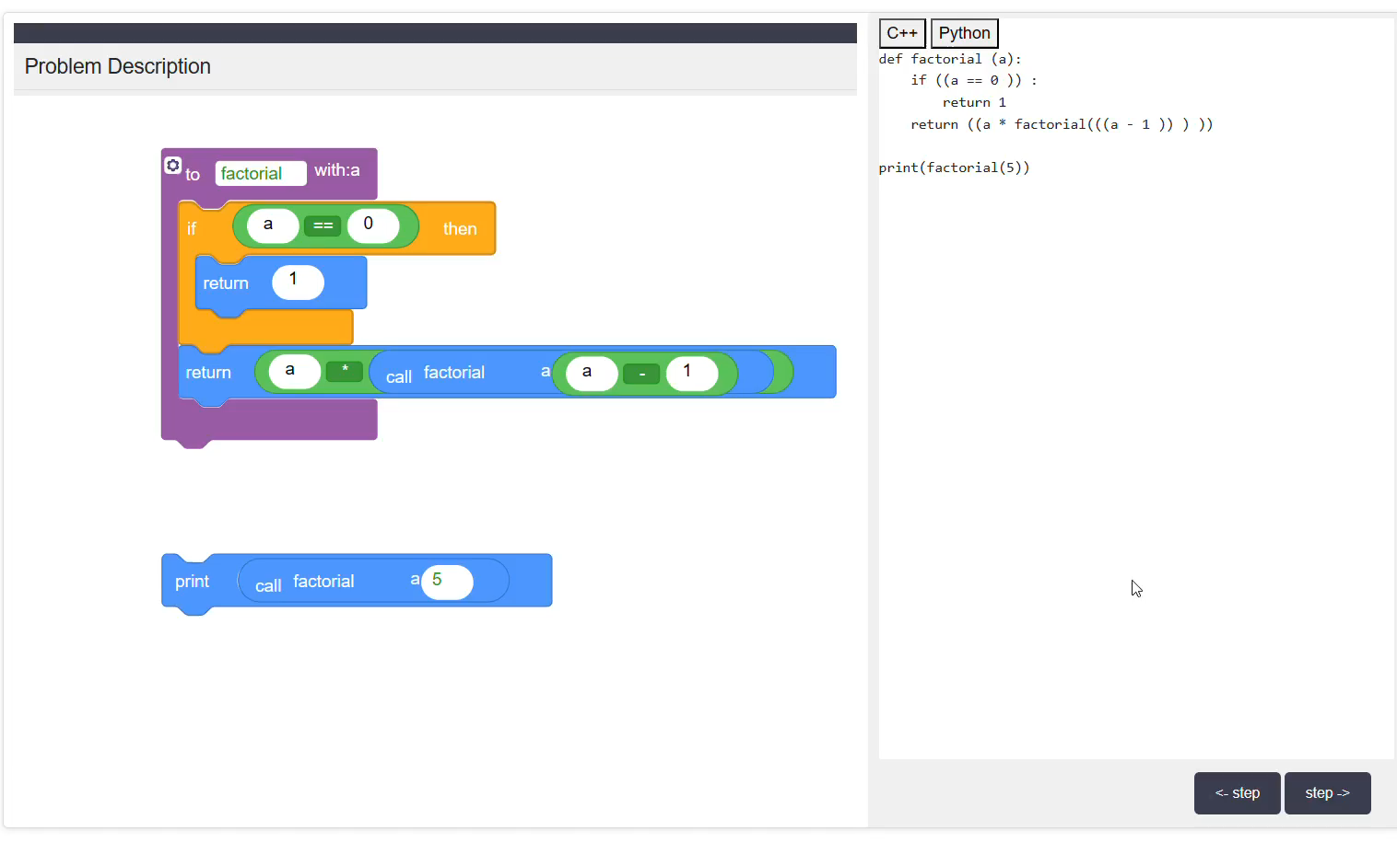
Step-Block

Slide 16
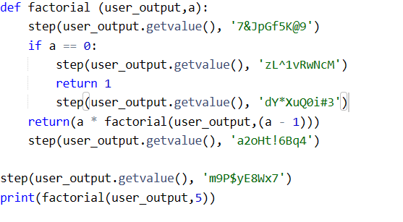

Slide 17
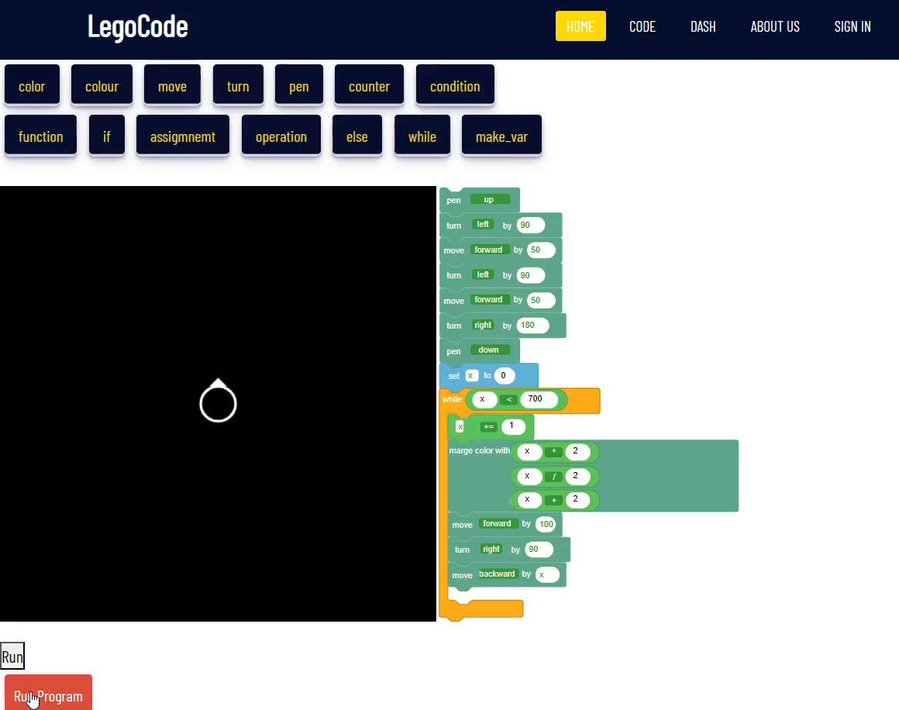

Drawing game:

Slide 18
Future work:
Add questions with different levels.
Decrease error percentage and fix more appearing bugs and translation.
Add the OOP concepts to the program so it fits advanced not only beginners.
Upgrade the functionality in general.

Slide 19
Thank You!

