Slide 1

“Multiple door security system”
Prepared by:
Saif abu hanieh
Samir haydar
Dr. naser abu Zaid

Slide 2
Titles:
Introduction.
Tools and devices.
Work steps.
Results.
Future work.

Slide 3

Introduction:

Slide 4
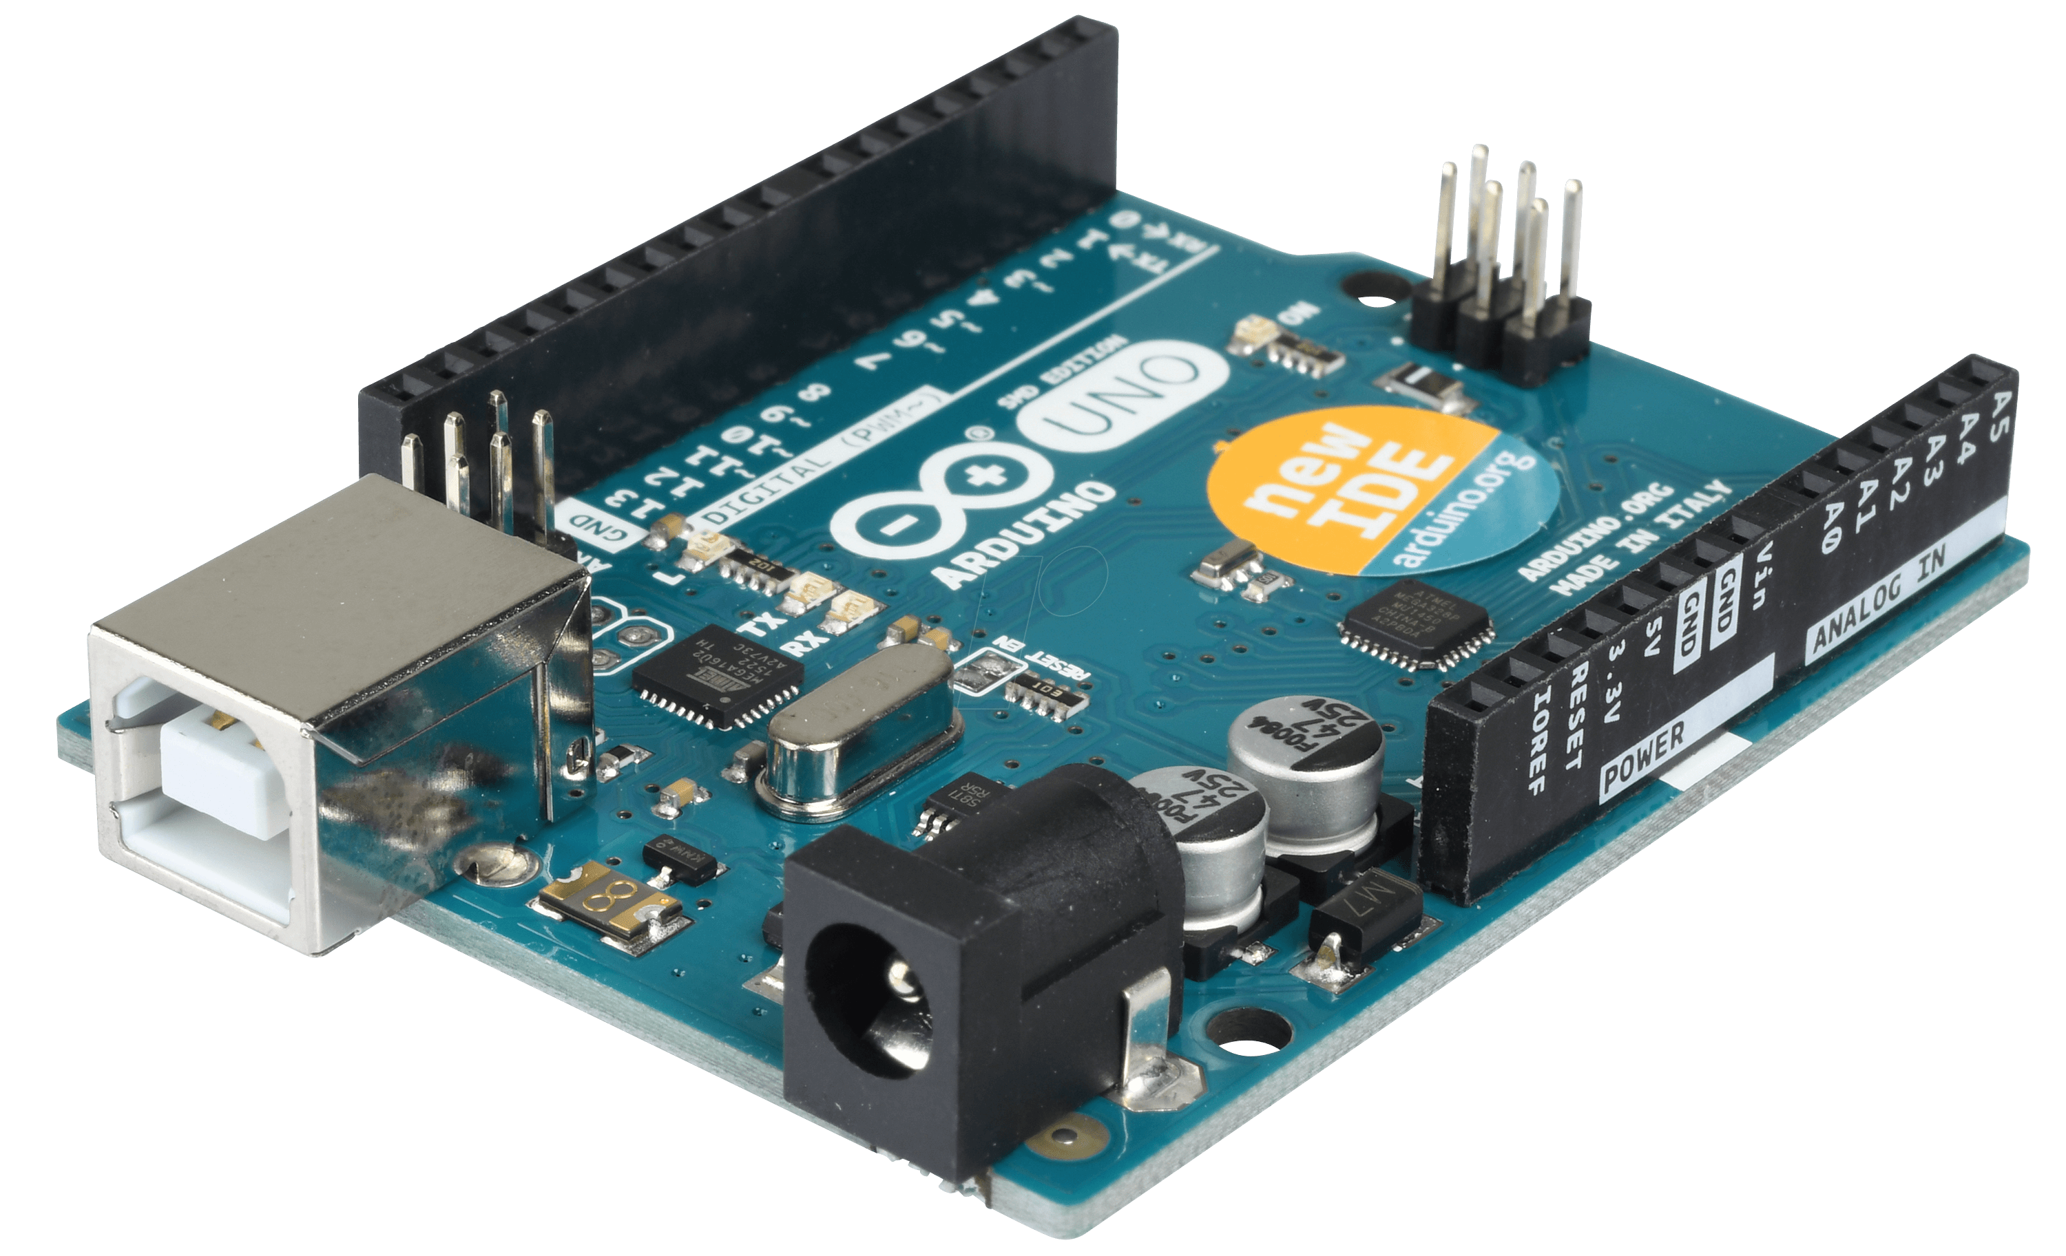
Tools and Devices:
Arduino uno:

Slide 5
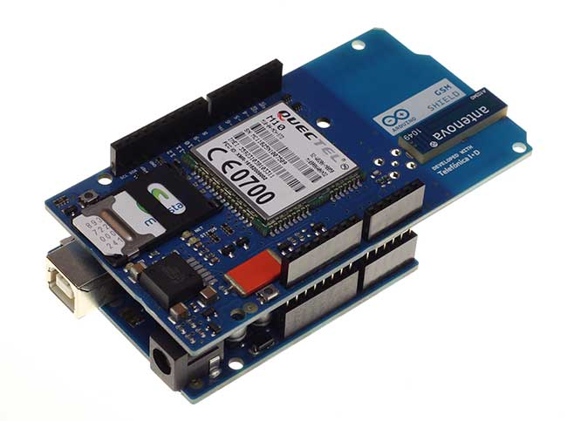
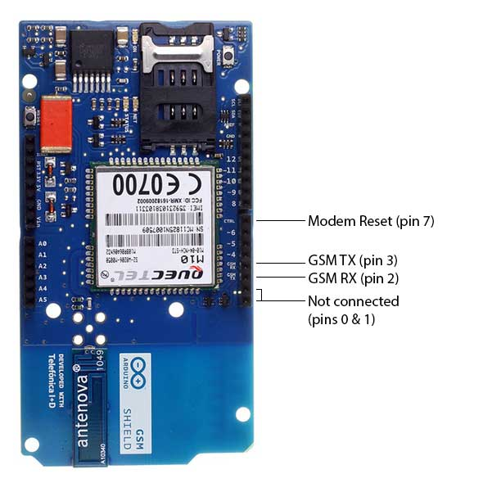
GSM shield:

Slide 6
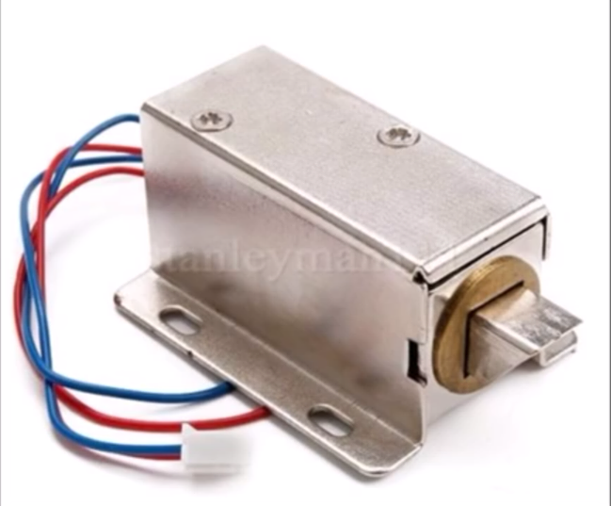
Electrical switch:

Slide 7
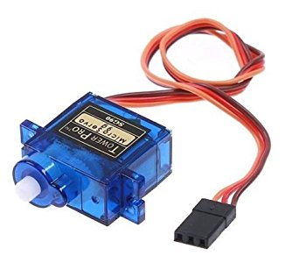
Servo motor:

Slide 8
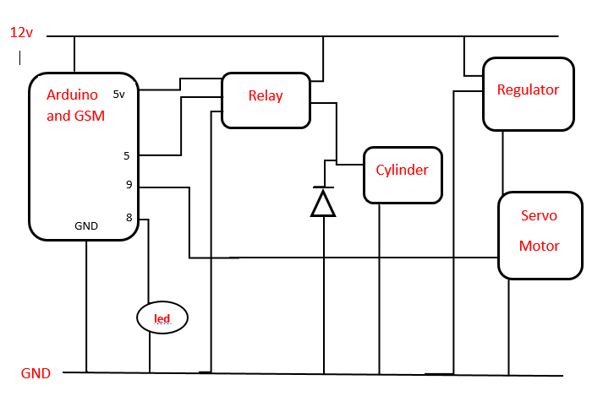
Work steps:
Step1:

Slide 9
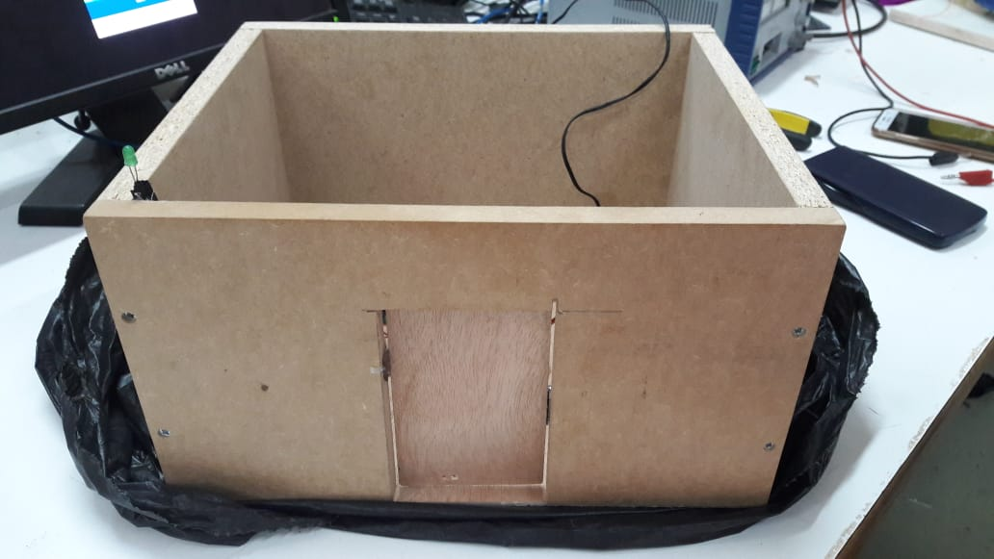
Step 2:

Slide 10
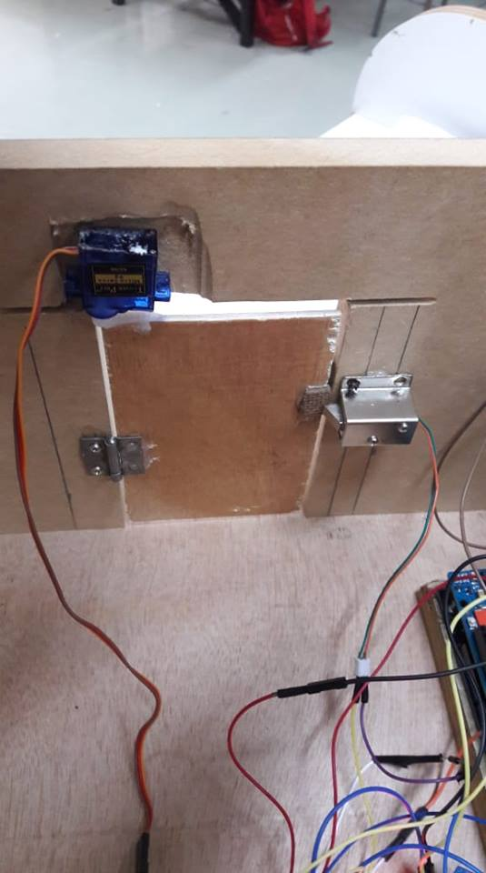

Slide 11
Results:
Make call microcontroller check if authorized
yes electrical switch open servo will rotate 90 degree delay 4sec servo back 90 degree
electrical switch close

Slide 12
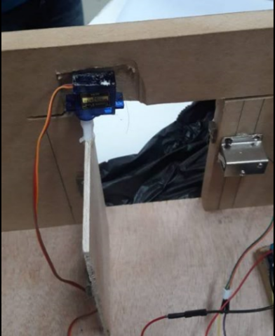

Slide 13
Make call microcontroller check if authorized NO electrical switch remain close microcontroller report this call
Sending SMS to manager.

Slide 14
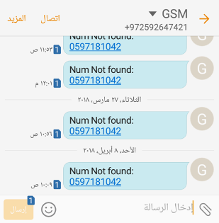

Slide 15
Future work:
We will improve this system by increasing number of the doors, adding special sensor at each door to make feedback if anybody entered or not.

Slide 16

THANK YOU
ANY QUESTIONS

