Slide 1
Smart Grass Cutter
Bassam Hillo and Fadi Jarawan

Slide 2
Outlines :
Idea.
Hardware.
Algorithm.
Work done .
Demo .
Constraints.
Future work.

Slide 3
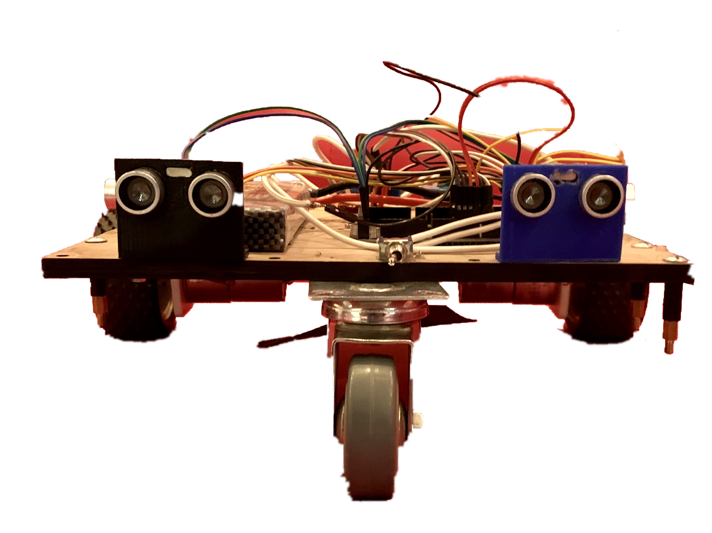
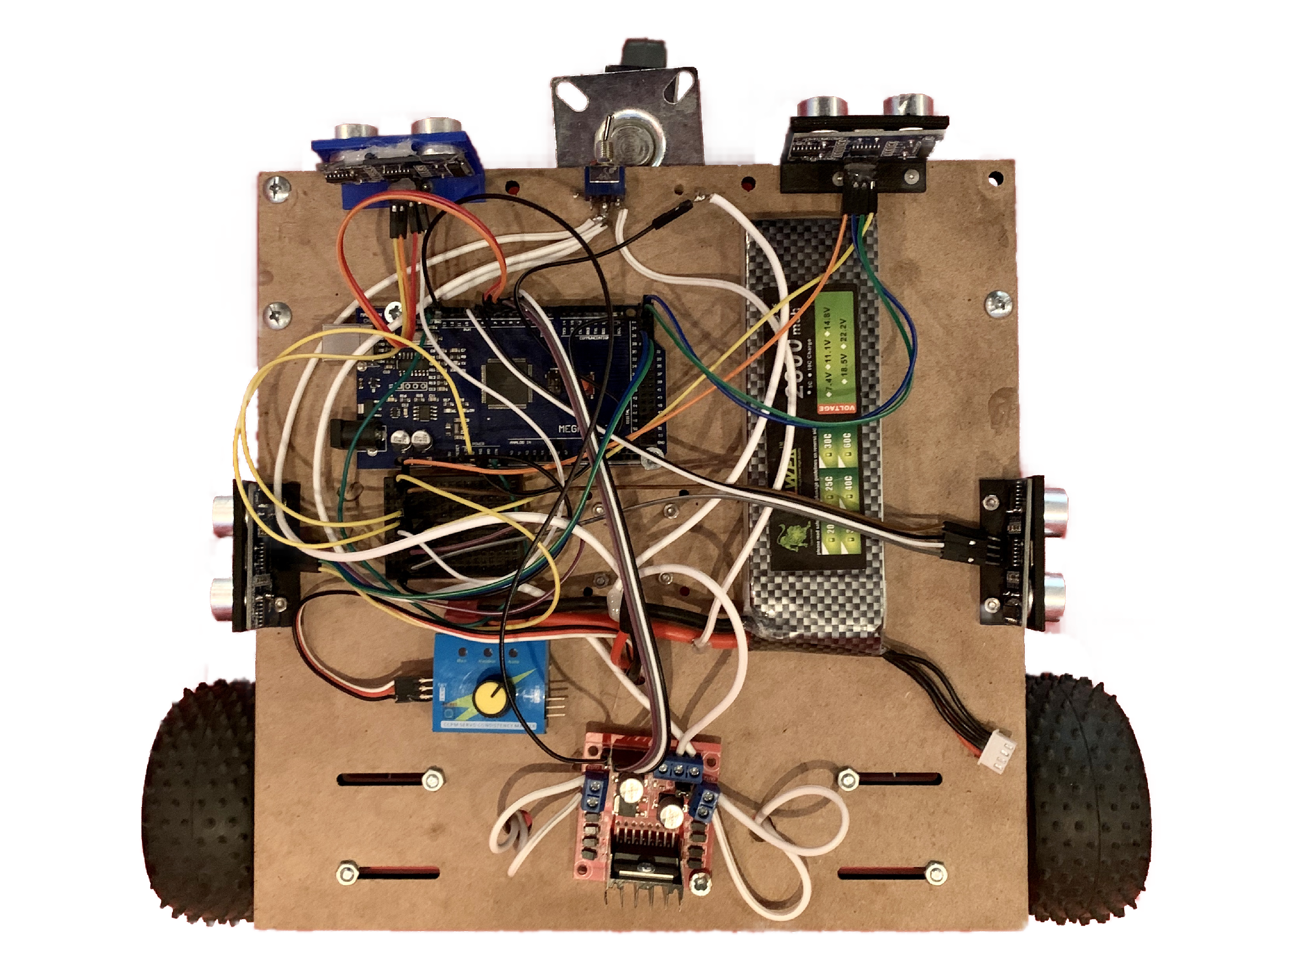
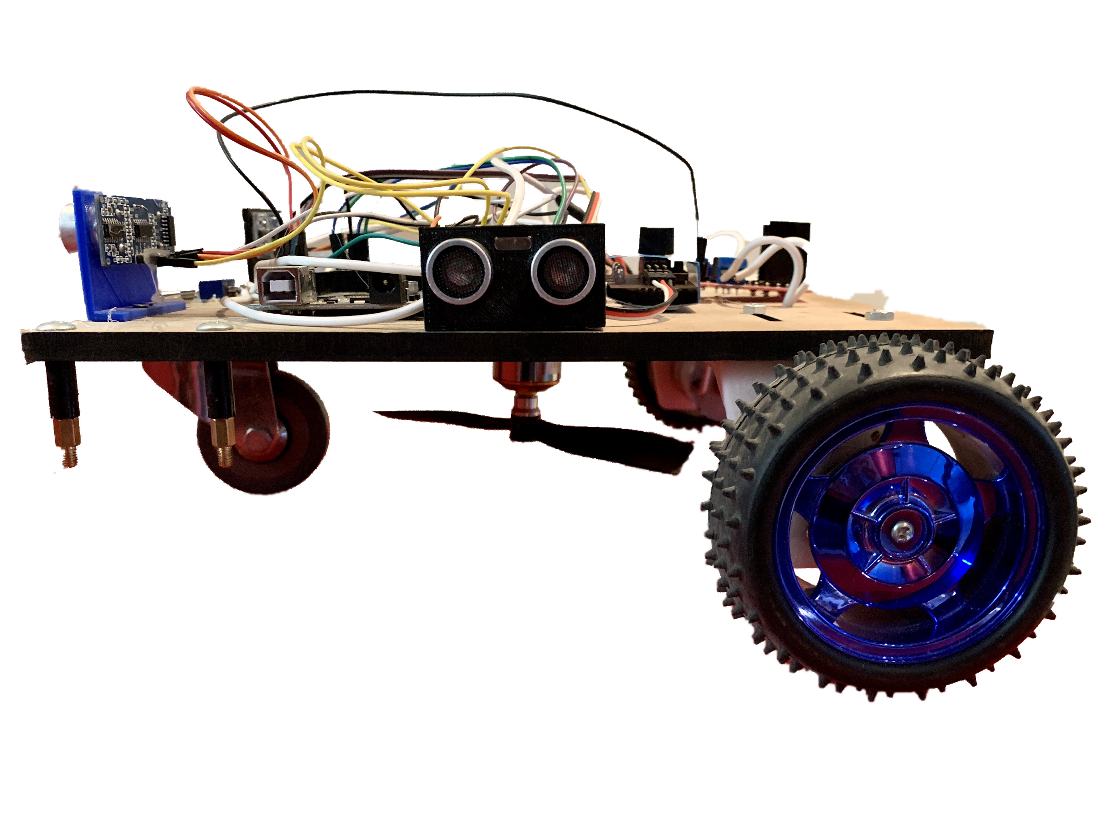
Idea : Smart Grass Cutter

Slide 4
Hardware component:
Arduino microcontroller.
Ultrasonic sensor.
DC Motor .
Brushless DC Motor.
DC Motor driver.
Battery.

Slide 5
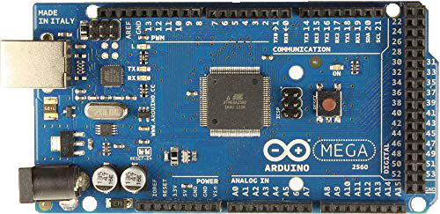
Arduino MEGA

Slide 6
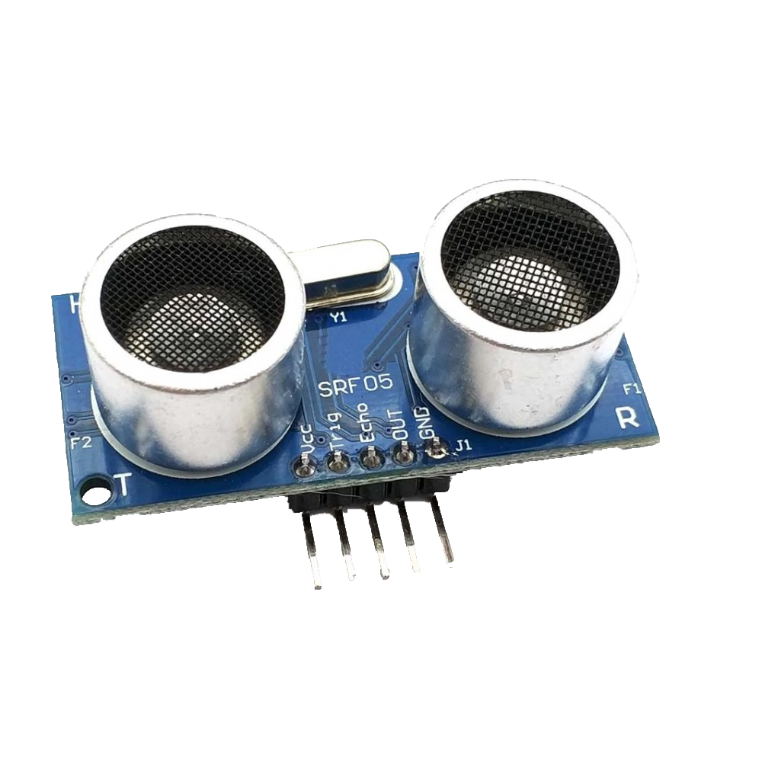
Ultrasonic sensor

Slide 7
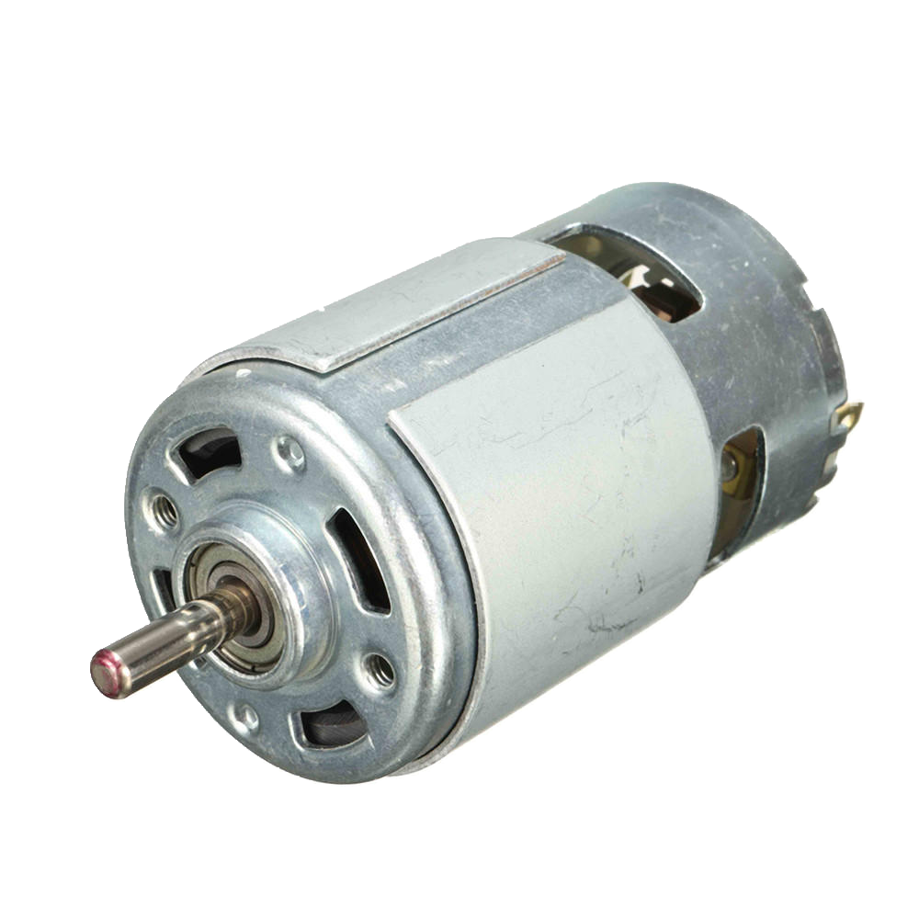
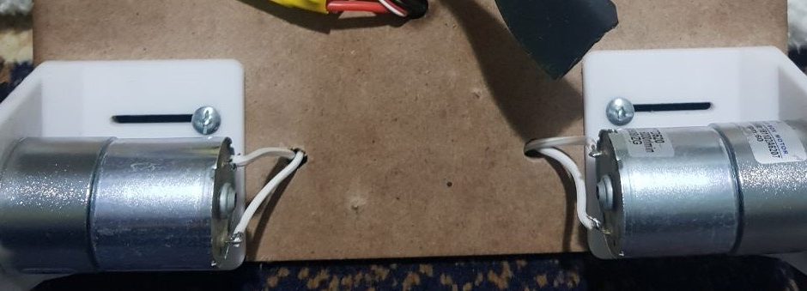
DC Motor

Slide 8
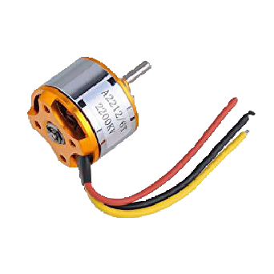
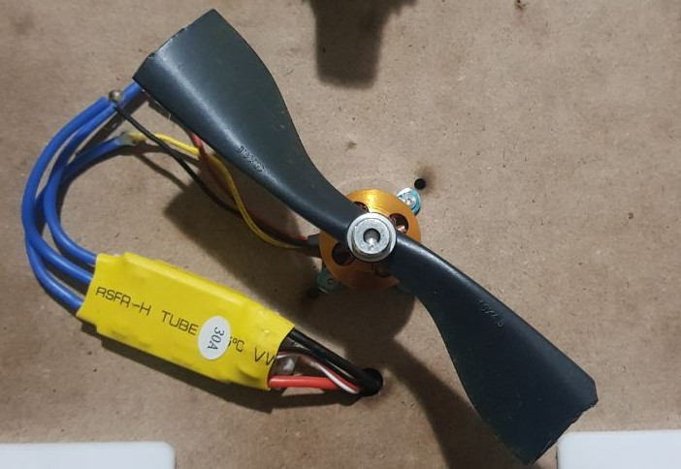
Brushless DC Motor

Slide 9
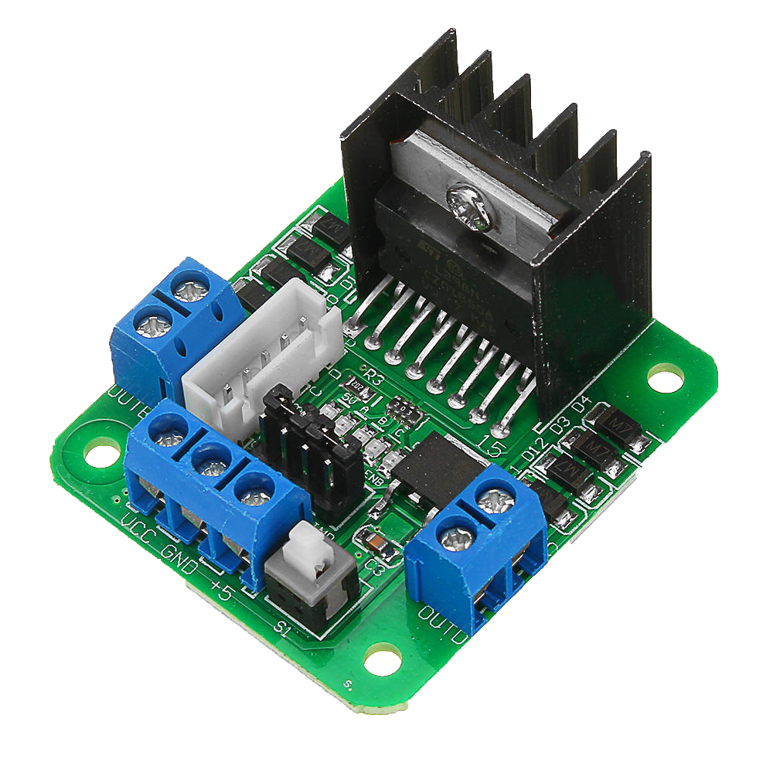
DC Motor Driver

Slide 10
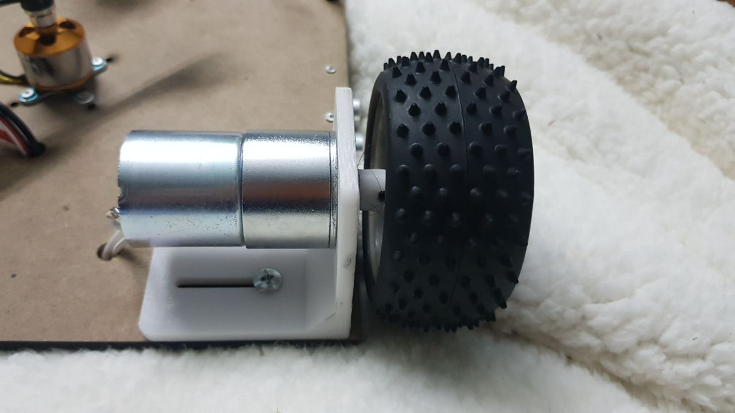
Printed Component

Slide 11
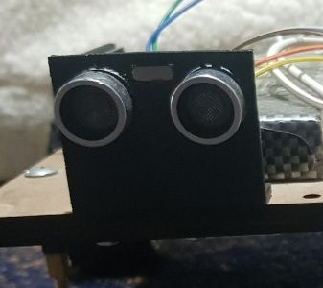
Printed Component

Slide 12
Work Phases:
Detect the distance from objects ( Front, Right, Left ) .
Calculate the next step.
Give the motor the action to move.

Slide 13
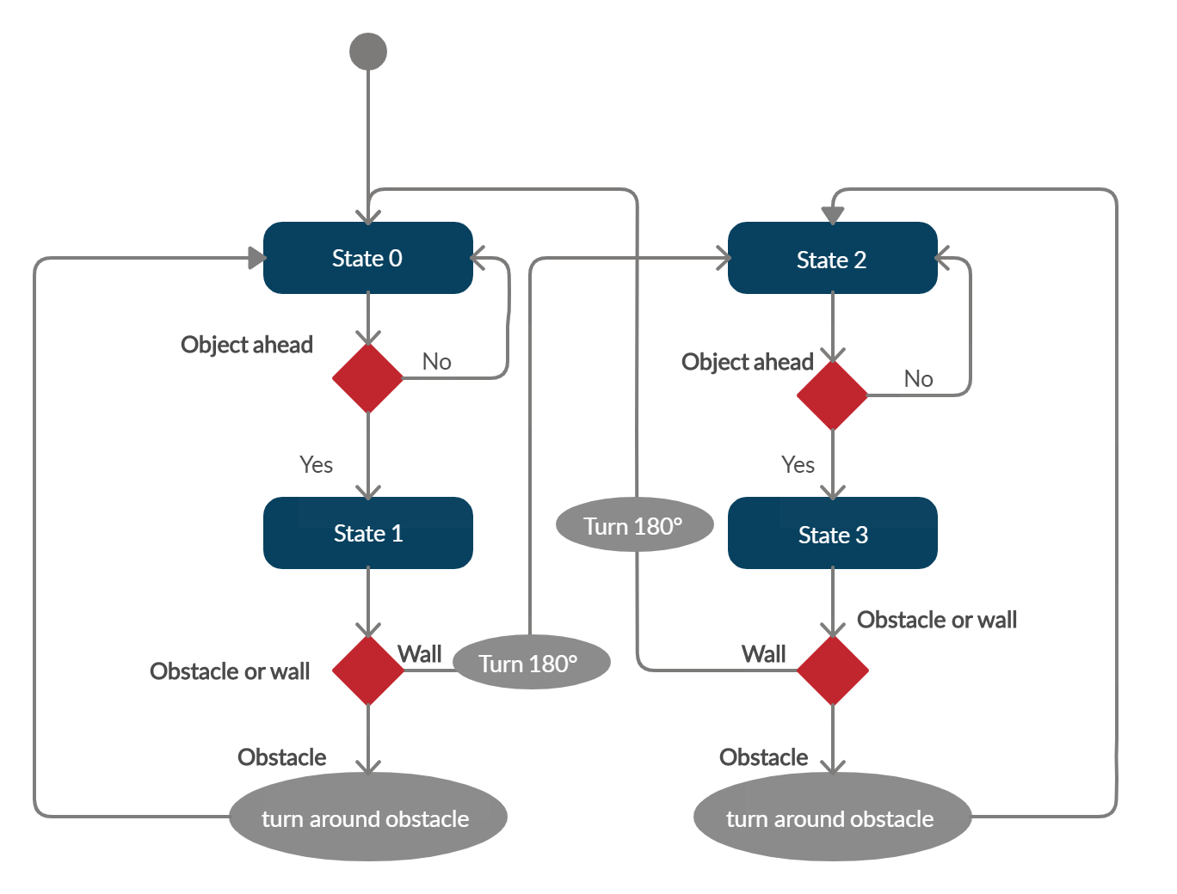
Algorithm

Slide 14
Demo

Slide 15
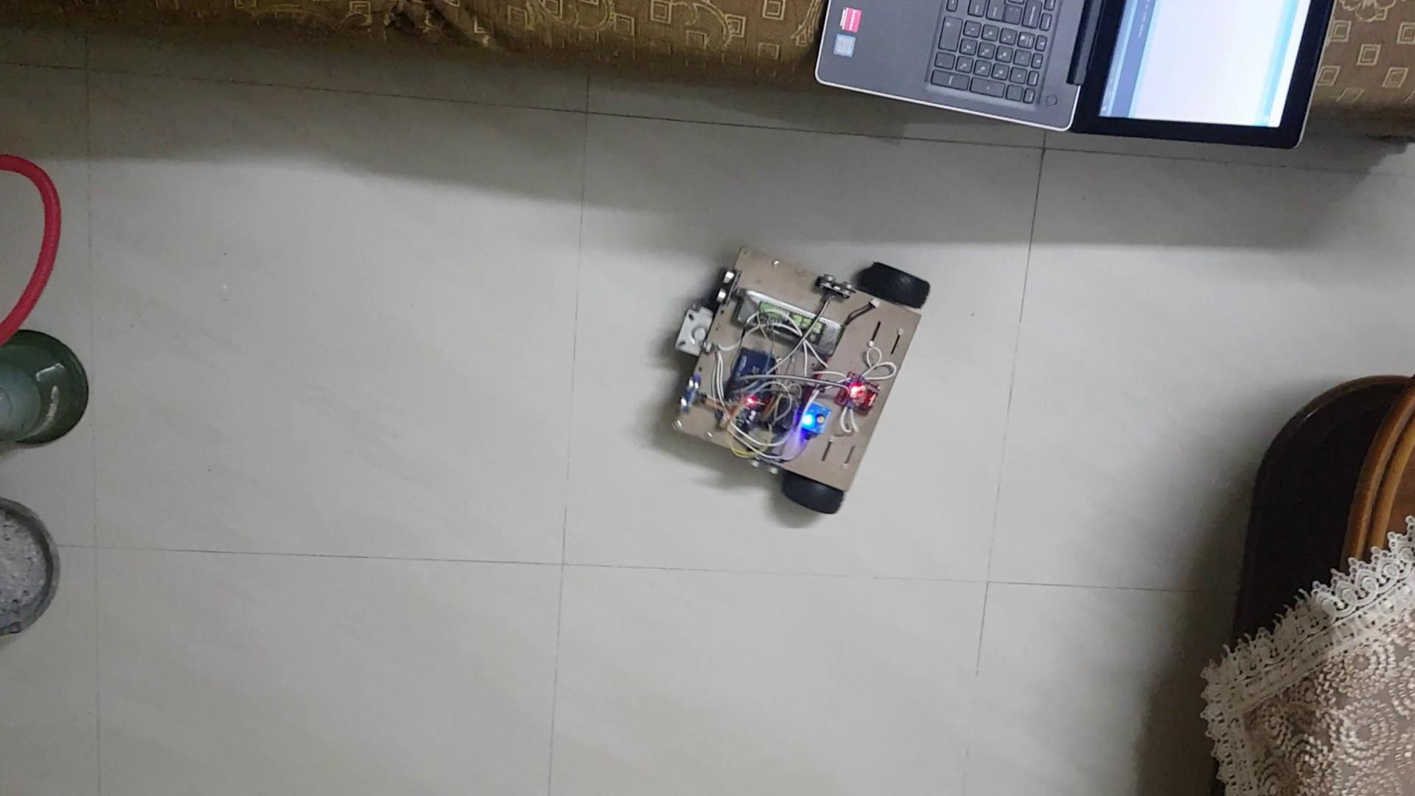
Demo

Slide 16
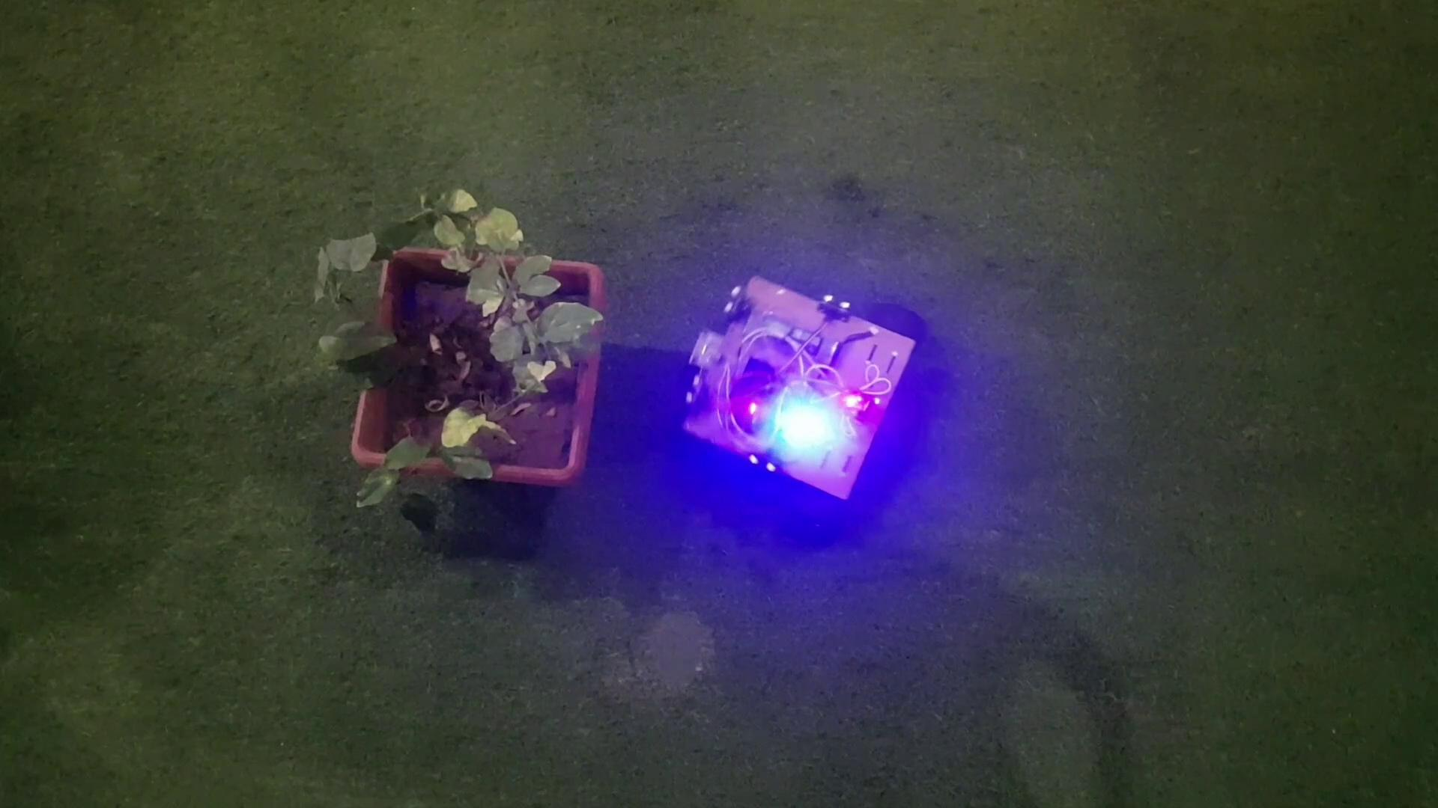
Demo

Slide 17
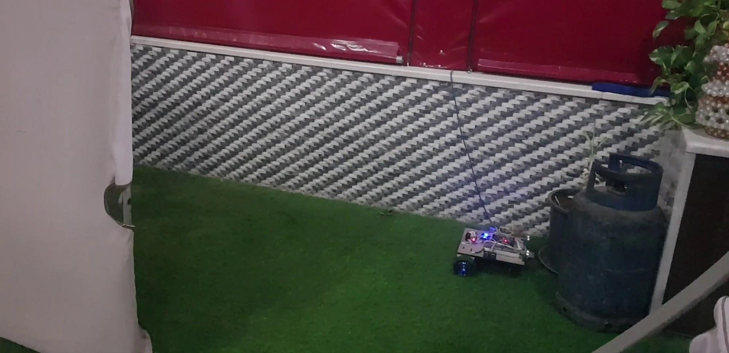
Demo

Slide 18
Constraints :
Prevent Daviation.
Turn left and right at grass.
Detect the front distance.

Slide 19
Future Work
Solar cells.
Camera.
AI.
SIM card.
Bluetooth.

