Slide 1
Holy Quran Application
Students : Ala’a Abu Odeh.
Isra’a Hinnawi.
Supervisor : Aladdin Masri.

Slide 2
outline
Idea
Software Algorithms
Features
Application Scope
Problems
Future development

Slide 3
Idea
As we see ,in our daily life the iOS mobile became heavily used , because it has many applications that help us in our work and communication , so from this we take our idea to make application in iOS mobile.

Slide 4

dea cont…
Most of us usually doesn’t use the Quran application on iphone ,ipad,…etc. If we ask our self why?!

Slide 5
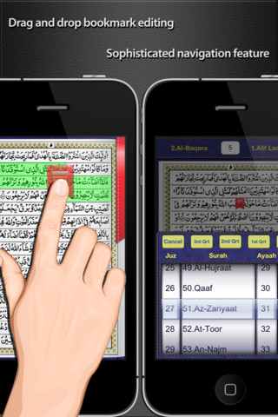
Idea cont…
Simply, most of Quran applications don’t contain all the features that meet the needs of the user.

Slide 6
Idea cont…
Therefore…
We make Quran Application that has the most functionality all the users need.

Slide 7

Software Algorithms
As software requirements , we need apple device.
we install virtual machine then ios operating system .
Using Xcode as software development tools, that supported distributing a product build process over multiple systems , Xcode includes the GUI tool instruments.

Slide 8
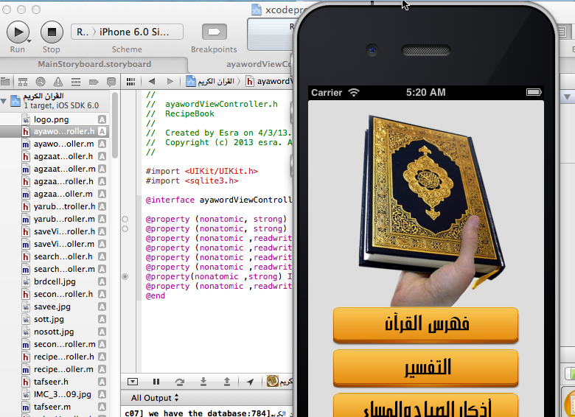
Software Algorithm..
Xcode has an iphone6.0 Simulation

Slide 9
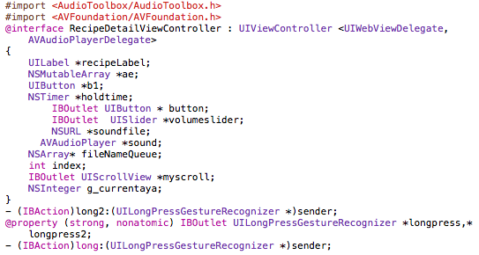
Software Algorithms cont…
We use many languages :
1) Objective C as basic programming language.
* Itʼs primary use in modern computing is on Mac OS X as a desktop language and also on iPhone OS (or as it is now called: iOS).
* Because Objective-C is a strict superset of C, we are free to use C in an Objective-C file and it will compile fine.
* Because any compiler of Objective-C will also compile any straight C code passed into it, we have all the power of C along with the power of objects provided by Objective-C.

Slide 10
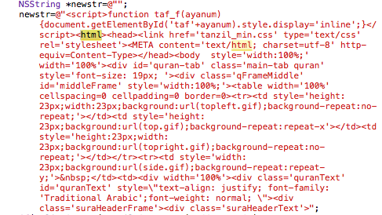
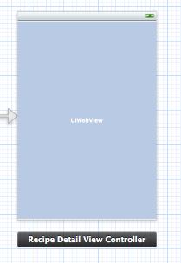
Software Algorithms cont…
2) HTML to display the text of surahs.
We load the HTML page on the Web View object in Xcode .

Slide 11
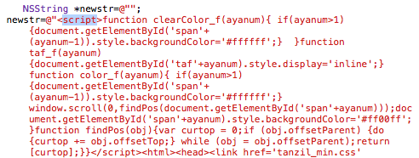
Software Algorithms cont…
3) Java Script to make function of scrolling to specific position we need and highlight the verse .

Slide 12
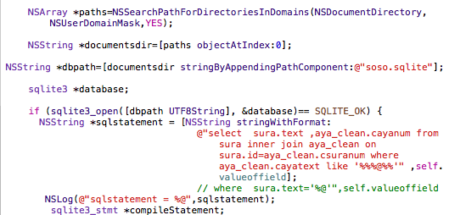
Software Algorithms cont…
We also used database to store the text of verses and assign interpretation for each verses.
Sentences of database connection

Slide 13
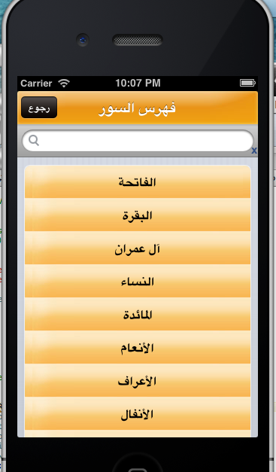
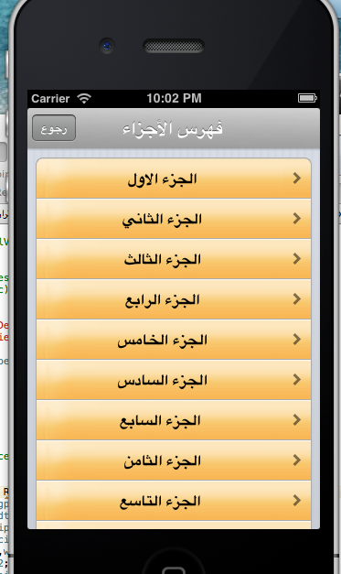
Features
User can easily find the sorahs that want to read or listen and also can choose the number of parts of Quran.

Slide 14
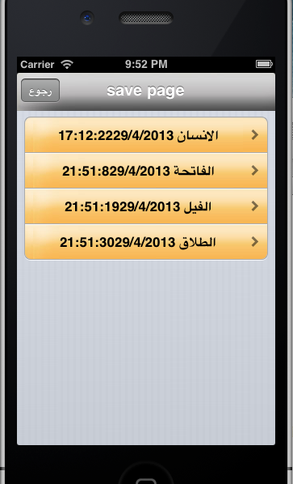
Features cont…
store the number of verse and the exact date of storage that we can return to it through list of bookmarks .

Slide 15
Features cont…
User can search for a word that give us the exact place where this word is mentioned

Slide 16
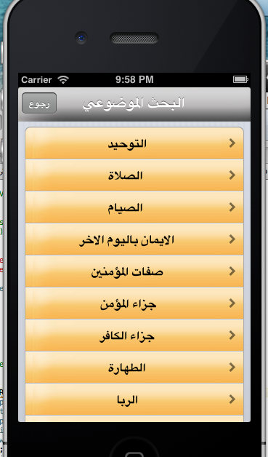
Features cont…
objective research which handles searches by specific topic and also give us exact position of this verse.

Slide 17
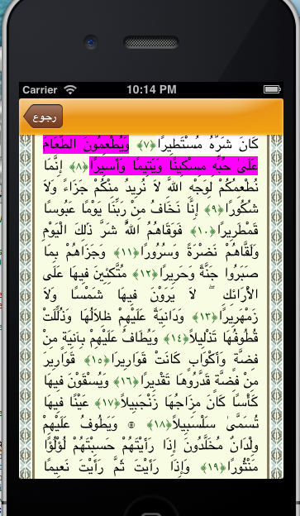
Features cont…
This application for listen to the famous reader and read(listen option will make scroll automatically
And light the verse text).

Slide 18
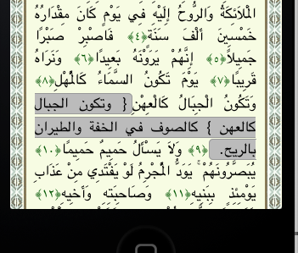
Features cont…
Finally ,our project will contain the Interpretation of the verses of the Quran.

Slide 19
Features cont…
The user can easily move to next or previous surah or/and next or previous part of Quran.

Slide 20
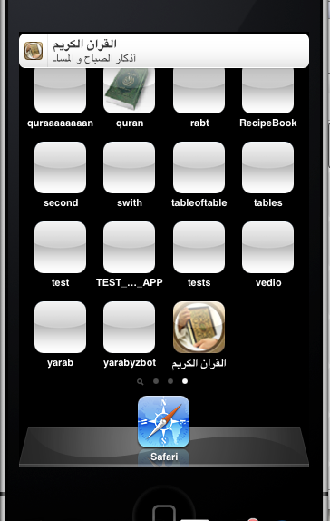
Features cont…
An additional thing that we add is Reciting the morning and evening ,that the user can read or listen
to it ,also our application make
notification to remind the user .

Slide 21
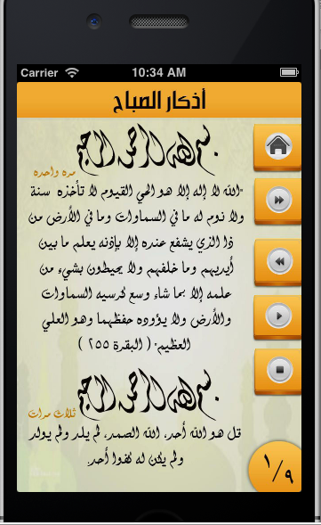
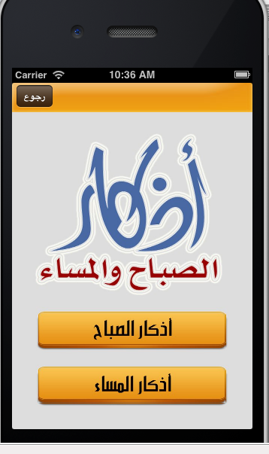
Features cont…

Slide 22
Application Scope
Quran application is developed to make cleaning process easier especially for working people.
Our project is designed to make people accept the idea of reading and hearing the Quran daily and easily.

Slide 23
Problems
The first problem of unavailable mac devices that solved by download virtual machine.
The second problem of sound on virtual machine.
Another problem that happened because can’t easily update the database on xcode.

Slide 24
future development
Now we are working to add more than one famous reader for all the Quran by contacting server.
Also we will add the sound for each page in Reciting the morning and evening by divided the full sound of it .
We hope to modify the design to make it run on ipad and tablet .

Slide 25
THANK YOU!

