Slide 1

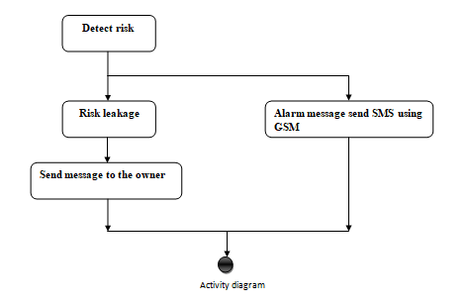
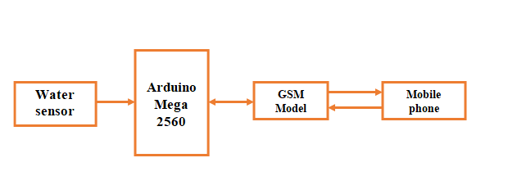
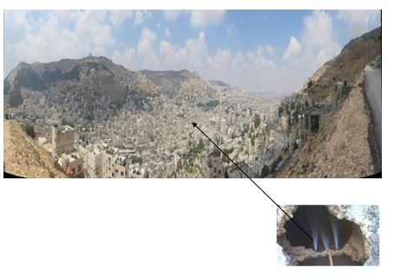
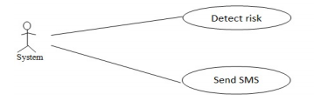
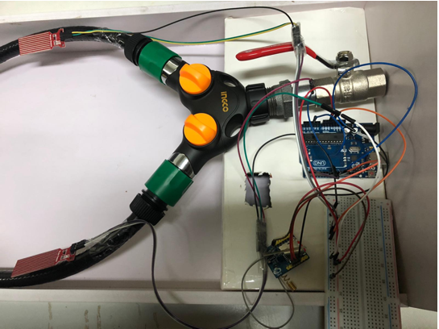
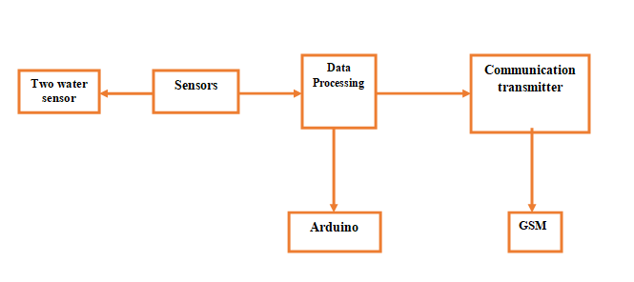
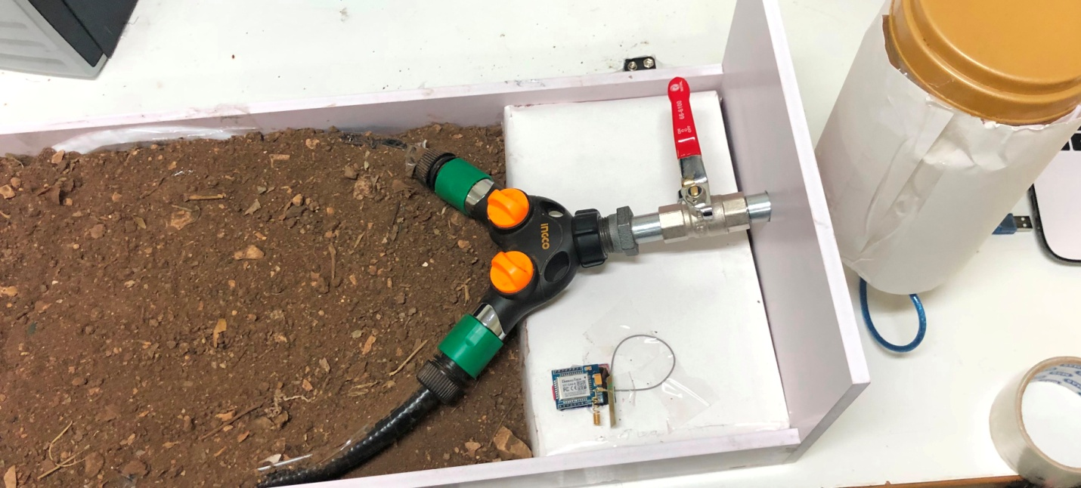
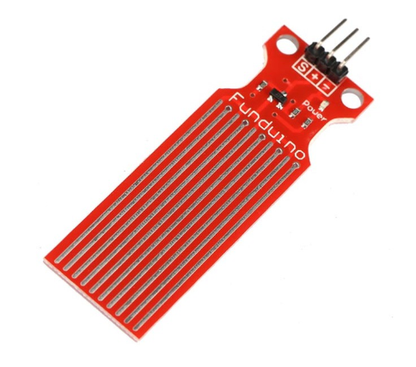
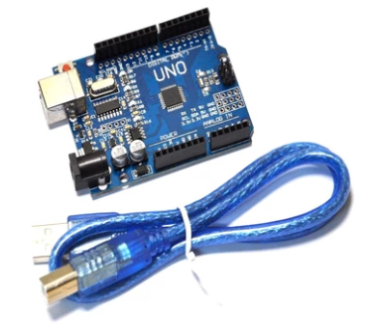
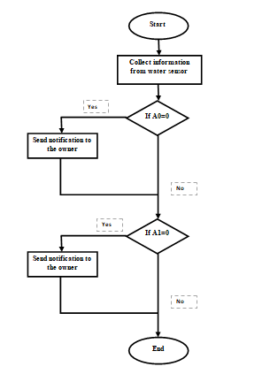
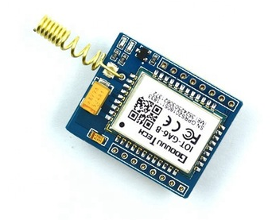
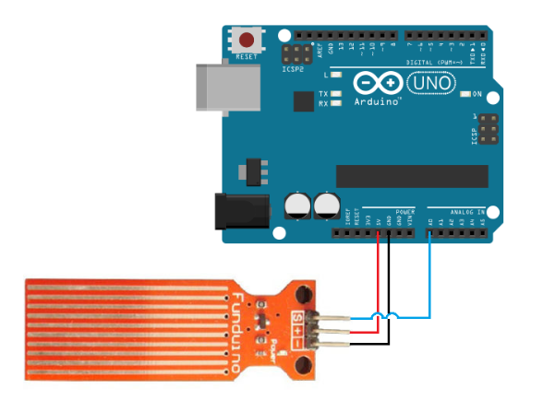
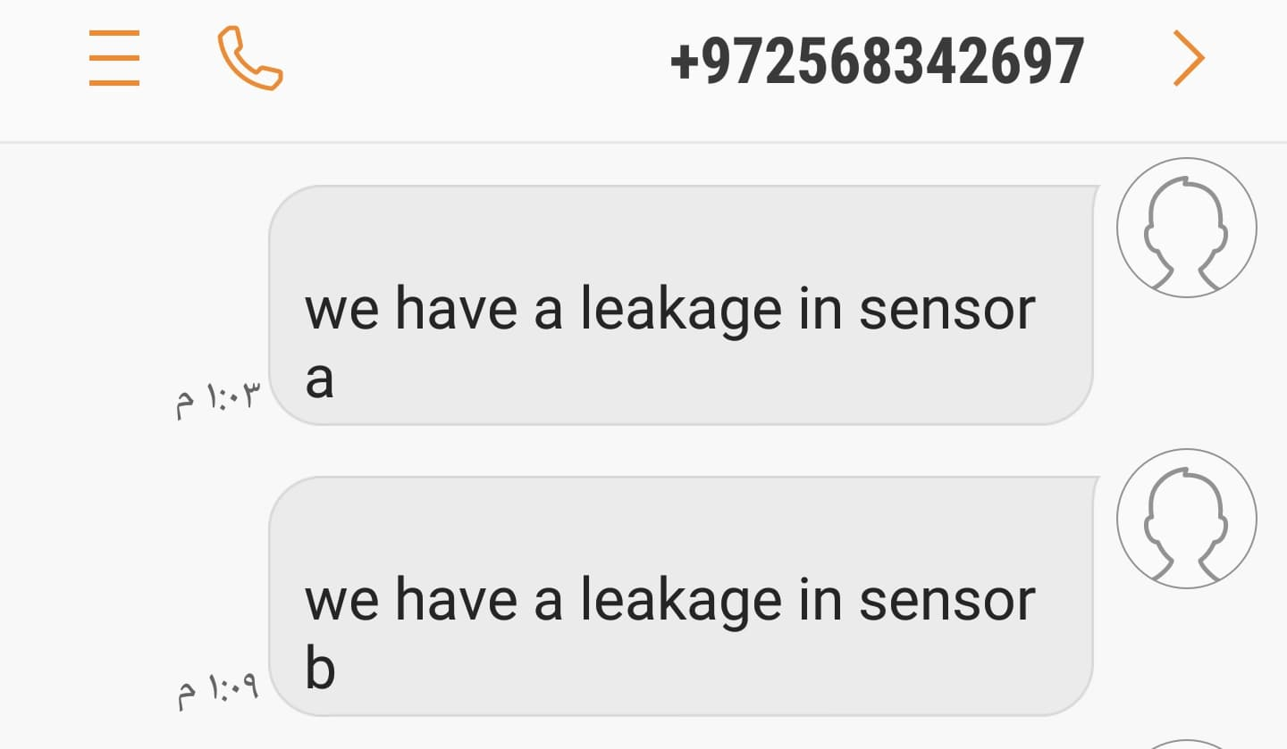
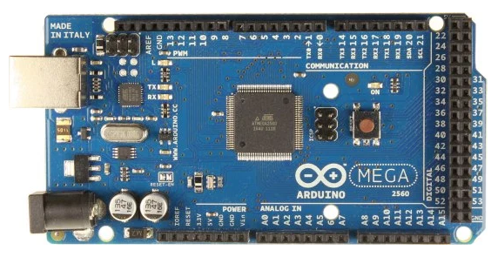
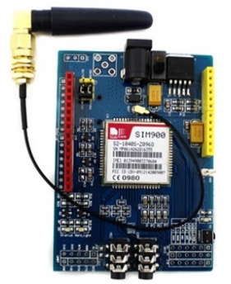
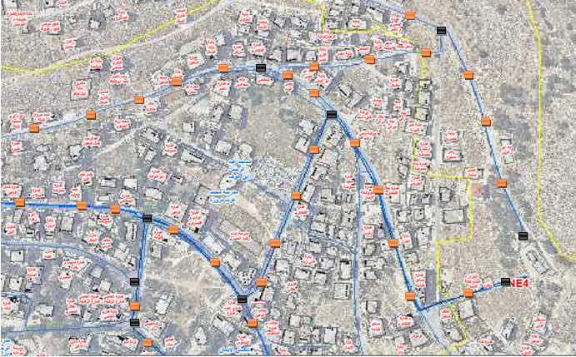


Figure (9): Connecting diagram of water sensor
Figure (9): Connecting diagram of water sensor
Figure(16): distributed control circuit with GSM and sensors in some location of Tell
Figure(16): distributed control circuit with GSM and sensors in some location of Tell
Figure(16): distributed control circuit with GSM and sensors in some location of Tell
Figure(16): distributed control circuit with GSM and sensors in some location of Tell
Figure(16): distributed control circuit with GSM and sensors in some location of Tell
Control circuit with arduino
Leakage Detection in Pipelines Using Water Leakage Sensor
Prepared by: Fareeda Mutawe Nuha Sweedan Ayat Abu Shehab
Supervisor: Dr.Falah Hasan
An-Najah National University
Introduction
Methodology
Results
Our project is a monitoring system based on wireless sensor networks for leakage detection in underground water pipes to overcome the problem of water dispersion in water distribution networks.
The software program is responsible for accepting data and commands, executing different commands, controlling operational terminals, and supporting data Input/output ports. The software mainly consists of two parts, one is control part, and the other is alarm part
. This block diagram defines all the function to be performed by the system.
Activity diagram of the system
Materials
Arduino Uno
Our experimental work
water sensor
IOT-GA6-B GSM Module
To clarify the idea of ​​the project, we used these simple tools,
Future Work
Connecting diagram of water sensor
result of leakage on our phone number
+CMTI | SMS has been received
+CREG | Network registration indication
+CMGS | To send the message
+CMSS | To Send Message from Storage
+CMGW | command writes an SMS to the first location available
+CPMS | command allows the message storage area to be selected (for reading, writing, etc
+CMGR | Read Message
+CCLK | Clock Management
+CUSD | Unstructured Supplementary Service Data
Arduino mega2560
Conclusion
SIMCOM SIM900 modem
The main problem that is addressed in this system is the use of an effective wireless sensor based on the water monitoring system. Using the monitoring system, we can easily prevent the water and the water will be provided. In our system, we mainly rely on the technical method that deals with the control, features and effective methods of leakage control. Based on the microcontroller..
Flowchart for water sensor
distributed control circuit with GSM and sensors in some location of Tell
Control circuit with arduino
Water leakage sensor
(: AT commands for GSM-GPRS

