Slide 1
Implementation of Industrial Engineering Concepts to Improve Al-Reef Factory for Metal Furniture
Prepared by:
Mahmoud Nasrallah
Rami Jaber
Samer Abu Alrob
Submitted to:
Dr. Ahmad Ramhi

Slide 2
Outline
Introduction
Problem Statement
Objectives
Methodology
Assessment
Results and Analysis
Conclusion and Recommendations

Slide 3
Introduction
Small scale industries were defined around the world by multiple definitions, for example UNIDO defines industries which have 10-50 worker as small scale industries
PCBS consider industries that have 5-19 worker as small-scale industries and dominated by the family character

Slide 4
Introduction
Al-Reef for metal furniture factory is considered a good example for small-scale industries in Palestine
The factory was established in 2007 on 500 square meters of leasehold land
Ten workers work manually to assemble more than thirty types of metal furniture models

Slide 5
Problem Statement
Al-Reef factory suffers from many problems:
  Improper administrative system
  No specified area for store raw material and finished product
  Insufficient material handling system
  Improper location and infrastructure
  Improper layout and no clear production lines
  Lack of attention to safety regulations

Slide 6
Objectives
Developing necessary manufacturing support system
Designing proper assembly lines
Reengineering the material handle methods
Designing a proper layout in line with the new assembly lines
Propose safety solutions

Slide 7
Methodology
Designing data collection sheet
Collecting on ground data
Visual inspection
Studying and analyzing data and information
Propose proper solutions for development
Check the validity of these solutions
Propose recommendation for Al-Reef owners
Notes:
Replace come out – propose proper solution for development

Slide 8
Assessment
Administrative system assessment
Inventory assessment
Process assessment
Material handling assessment
Safety assessment
Layout assessment

Slide 9
Results and Analysis

Slide 10
Process Design
Two methods were adapted in designing new production lines:
Line Balancing: For Sofa product
Group Technology: For the rest of the products

Slide 11
Process Design
Line Balancing:
Ranked Positional Weights method (RPW) was adapted to solve the line balancing problem following these steps:
  Identification of Precedence order
  RPW calculation
  Descending Order
  Arranging work elements into stations

Slide 12
  Identification of Precedence order:
No. | Work element description | Work element time(min) | Precedence order
1 | Sawing for profile 20/20, 20/40 and round bar | 3.67 | ---
2 | punch press for profile 20/40, (74,68) cm, profile 20/20 (15cm) and grinding | 1.73 | 1
3 | Chamfering one corner for profile 20/40, 74cm | 0.36 | 2
4 | Marker and drilling for profile 20/40 , 68 cm | 0.65 | 2
5 | Chamfering one corner for profile 20/40 , 68 cm | 0.48 | 4
6 | Punch and stamping sheet metal 3 mm (6.5, 9.7cm) and 5mm | 0.89 | ---
7 | Bending press for sheet metal 3mm (6.5, 9.7 cm) and 5 mm | 1.23 | 6
8 | Punch press and grinding for L- steel sheet 20/3 | 0.70 | ---
9 | Assembly welding | 13.89 | 3,5,7,8
10 | Cleaning | 1.00 | 9
11 | Painting | 30.00 | 10
12 | Final assembly for springs, wheels, plastic stopper and packaging | 2.95 | 11
 | Total time | 57.55

Slide 13
  RPW calculation:
No. | Work element description | RPW | Work element time(min) | Precedence order
1 | Sawing for profile 20/20, 20/40 and round bar | 54.73 | 3.67 | ---
2 | punch press for profile 20/40, (74,68) cm, profile 20/20 (15cm) and grinding | 51.06 | 1.73 | 1
3 | Chamfering one corner for profile 20/40, 74cm | 48.2 | 0.36 | 2
4 | Marker and drilling for profile 20/40 , 68 cm | 48.97 | 0.65 | 2
5 | Chamfering one corner for profile 20/40 , 68 cm | 48.32 | 0.48 | 4
6 | Punch and stamping sheet metal 3 mm (6.5, 9.7cm) and 5mm | 49.96 | 0.89 | ---
7 | Bending press for sheet metal 3mm (6.5, 9.7 cm) and 5 mm | 49.07 | 1.23 | 6
8 | Punch press and grinding for L- steel sheet 20/3 | 48.54 | 0.70 | ---
9 | Assembly welding | 47.84 | 13.89 | 3,5,7,8
10 | Cleaning | 33.95 | 1.00 | 9
11 | Painting | 32.95 | 30.00 | 10
12 | Final assembly for springs, wheels, plastic stopper and packaging | 2.59 | 2.95 | 11
 | Total time |  | 57.55

Slide 14
  Descending Order:
Work element | RPW | Work element time | Precedence
1 | 54.73 | 3.67 | ---
2 | 51.06 | 1.73 | 1
6 | 49.96 | 0.89 | ---
7 | 49.07 | 1.23 | 6
4 | 48.97 | 0.65 | 2
8 | 48.54 | 0.7 | ---
5 | 48.32 | 0.48 | 4
3 | 48.2 | 0.36 | 2
9 | 47.84 | 13.89 | 3,5,7,8
10 | 33.95 | 1 | 9
11 | 32.95 | 30 | 10
12 | 2.95 | 2.95 | 11

Slide 15
  Arranging work elements into stations:
Station | Work element | Work element time | Station time
A | 1 | 3.67 | 9.71
 | 2 | 1.73
 | 6 | 0.89
 | 7 | 1.23
 | 4 | 0.65
 | 8 | 0.7
 | 5 | 0.48
 | 3 | 0.36
B | 9 | 13.89 | 13.89
C | 10 | 1 | 1
D | 11 | 30 | 30
E | 12 | 2.95 | 2.59

Slide 16
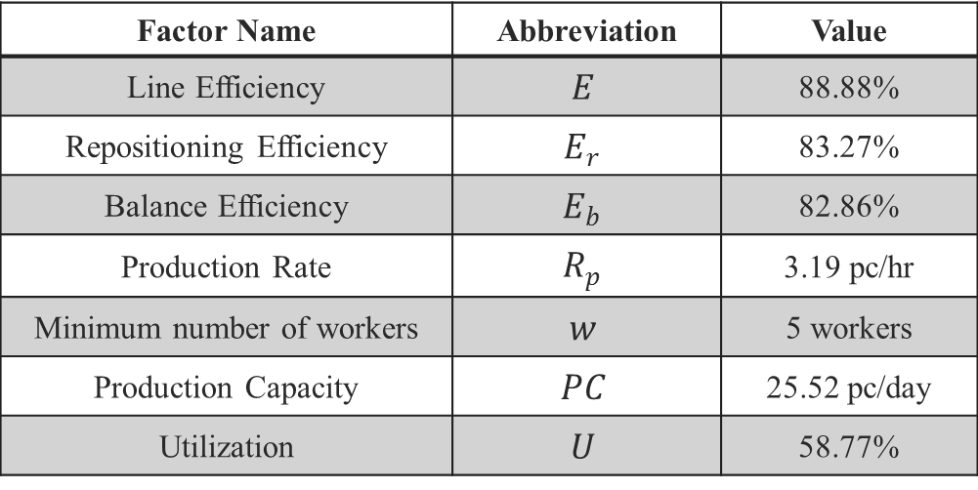
Process Design
Calculation of performance measures for Sofa line:
Factor Name | Abbreviation | Value
Line Efficiency | $$E$$ | 88.88%
Repositioning Efficiency | $$E_{r}$$ | 83.27%
Balance Efficiency | $$E_{b}$$ | 82.86%
Production Rate | $$R_{p}$$ | 3.19 pc/hr
Minimum number of workers | $$w$$ | 5 workers
Production Capacity | $$PC$$ | 25.52 pc/day
Utilization | $$U$$ | 58.77%

Slide 17
Process Design
Group Technology:
New production lines have been designed - to suit product diversity and manufacturing processes - by the principle of group technology.
Convert the factory from traditional batch production to advanced batch production.

Slide 18
Process Design
Group Technology:
Family design and selection. The following steps were adapted to design two families of products:
All products were studied with its manufacturing sequence to identify similarities between products.
Composite part is designed.

Slide 19
Process Design
Group Technology:
Calculate the weighted average demand for each product.
From-to chart was developed to show the relation between machines and the amount of parts will transfer from each machine to another

Slide 20
Process Design
Group Technology:
Flow diagram was drawn for each family and the percentage of in-sequence, by-pass and by-track were calculated.

Slide 21
All products were studied with its manufacturing sequence to identify similarities between products.
Product | Operation number | Operation sequence
سلم | 1 | Sawing
 | 2 | Marking
 | 3 | Drilling
 | 4 | Welding
H.2 Motors | 1 | Sawing
 | 2 | Marking
 | 3 | Drilling
 | 4 | Punch press small sheet
 | 5 | Welding

Slide 22
Composite Part
Composite part | Operation number | Operation sequence
Part A | 1 | Sawing
 | 2 | Marking
 | 3 | Rollup
 | 4 | Punch press
 | 5 | Punch press for small sheet
 | 6 | Drilling
 | 7 | Manual rollup
 | 8 | Welding
Part B | 1 | Sawing
 | 2 | Marking
 | 3 | Drilling
 | 4 | Chamfering
 | 5 | Grinding
 | 6 | Manual bending, rollup
 | 7 | Welding

Slide 23
Weighted Average Demand
Family A Product | Demand per month |  |  |  |  | Average | Weighted average | approx
 | September | October | November | December | January
H.2 Motor | 94 | 195 | 139 | 156 | 219 | 160.6 | 34.18% | 34
وساطة | 39 | 36 | 31 | 36 | 38 | 36 | 7.82% | 8
مجين | 6 | 1 | 8 | 7 | 11 | 8.6 | 1.86% | 2
نيلي | 90 | 129 | 90 | 91 | 86 | 97.2 | 21.12% | 21
سلم قصير | 20 | 19 | 39 | 18 | 21 | 23.4 | 5.08% | 5
طوكيو | 90 | 78 | 65 | 76 | 62 | 74.2 | 16.12% | 16
طابقين | 11 | 5 | 9 | 18 | 14 | 11.2 | 2.43% | 3
Alkal | 36 | 41 | 81 | 42 | 45 | 49 | 10.64% | 11
TOTAL |  |  |  |  |  | 460.2 | 100% | 100

Slide 24
From-To Chart
Family A
From-To | Product | Number of parts | Sum
1-2 | H-2motor | 34 | 55
 | سلم قصير | 5
 | طوكيو | 16
1-3 | مجين | 2 | 37
 | نيلي | 21
 | طابقين | 3
 | Alkal | 11
1-4 | وساطة | 8 | 8
2-4 | سلم قصير | 5 | 5
2-6 | طوكيو | 34 | 50
 | H-2motor | 16
3-4 | طابقين | 11 | 35
 | نيلي | 21
 | Alkal | 3
3-6 | مجين | 2 | 2

Slide 25
From-To Chart
To From | 1 | 2 | 3 | 4 | 5 | 6 | 7 | 8 | Total | From–to ratio
1 | 0 | 55 | 37 | 8 | 0 | 0 | 0 | 0 | 100 | ∞
2 | 0 | 0 | 0 | 5 | 0 | 50 | 0 | 0 | 55 | 1
3 | 0 | 0 | 0 | 35 | 0 | 2 | 0 | 16 | 53 | 1
4 | 0 | 0 | 0 | 0 | 19 | 8 | 0 | 21 | 48 | 1
5 | 0 | 0 | 0 | 0 | 0 | 0 | 11 | 42 | 53 | 1
6 | 0 | 0 | 16 | 0 | 34 | 0 | 0 | 10 | 60 | 1
7 | 0 | 0 | 0 | 0 | 0 | 0 | 0 | 11 | 11 | 1
8 | 0 | 0 | 0 | 0 | 0 | 0 | 0 | 0 | 0 | 0
Total | 0 | 55 | 53 | 48 | 53 | 60 | 11 | 100 | 380

Slide 26
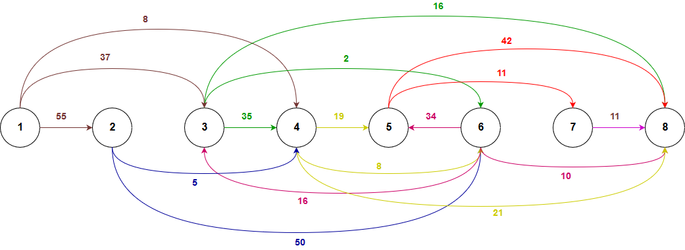
Flow diagram for family A – First Iteration:

Slide 27
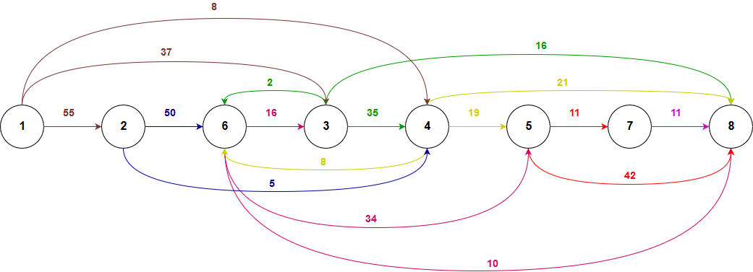
Flow diagram for family A – Second Iteration:

Slide 28
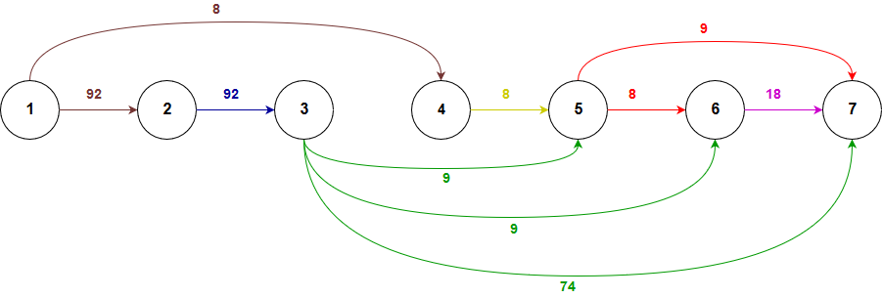
Flow diagram for family B:

Slide 29
Process Design
In-sequence, By-pass and By-track percentages:
Family | Iteration | In-sequence | By-pass | By-track
A | Iteration 1 | 31.58% | 55.26% | 13.16%
 | Iteration 2 | 51.84% | 45.53% | 2.63%
B | - | 66.67% | 33.33% | 0%

Slide 30
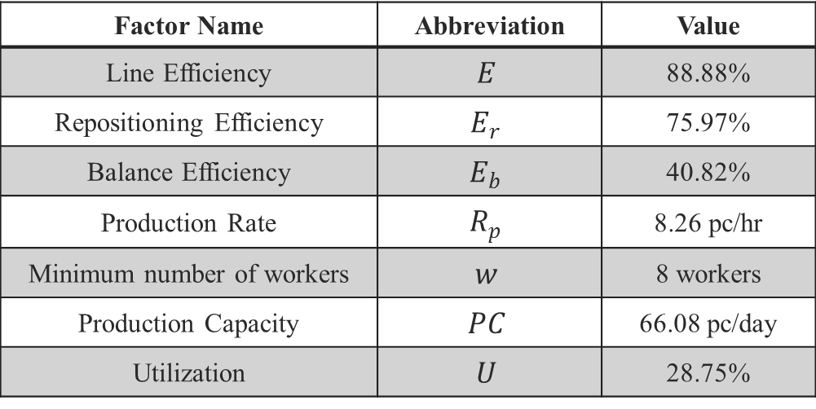
Process Design
Calculation of performance measures for Family A:
Factor Name | Abbreviation | Value
Line Efficiency | $$E$$ | 88.88%
Repositioning Efficiency | $$E_{r}$$ | 75.97%
Balance Efficiency | $$E_{b}$$ | 40.82%
Production Rate | $$R_{p}$$ | 8.26 pc/hr
Minimum number of workers | $$w$$ | 8 workers
Production Capacity | $$PC$$ | 66.08 pc/day
Utilization | $$U$$ | 28.75%

Slide 31
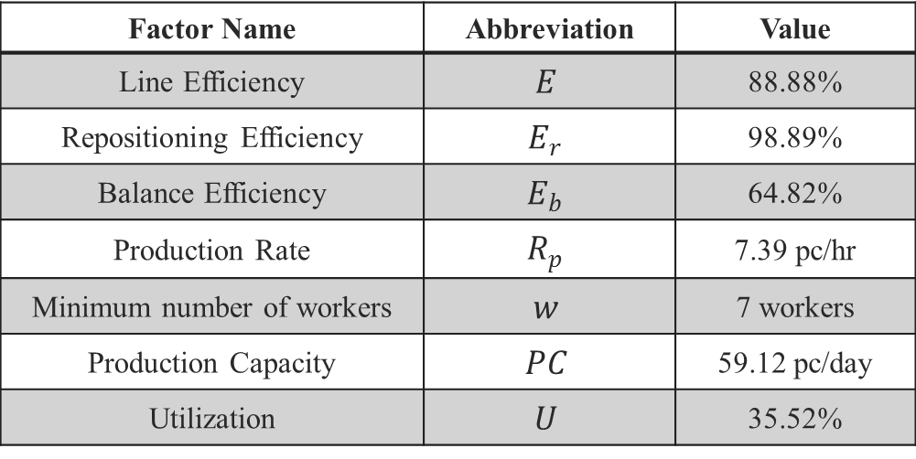
Process Design
Calculation of performance measures for Family B:
Factor Name | Abbreviation | Value
Line Efficiency | $$E$$ | 88.88%
Repositioning Efficiency | $$E_{r}$$ | 98.89%
Balance Efficiency | $$E_{b}$$ | 64.82%
Production Rate | $$R_{p}$$ | 7.39 pc/hr
Minimum number of workers | $$w$$ | 7 workers
Production Capacity | $$PC$$ | 59.12 pc/day
Utilization | $$U$$ | 35.52%

Slide 32
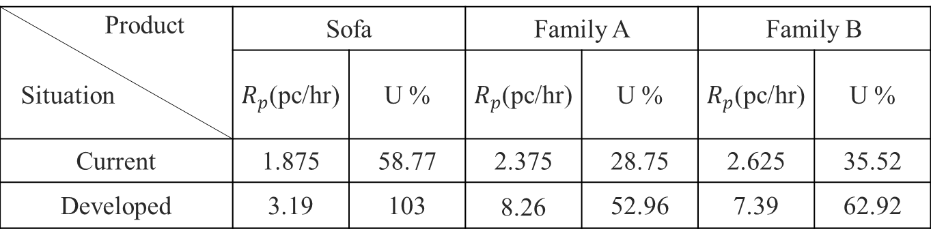
Process Design
Comparison between current process and the developed process design:
Product Situation | Sofa |  | Family A |  | Family B
 | $R_{p}$(pc/hr) | U % | $R_{p}$(pc/hr) | U % | $R_{p}$(pc/hr) | U %
Current | 1.875 | 58.77 | 2.375 | 28.75 | 2.625 | 35.52
Developed | 3.19 | 103 | 8.26 | 52.96 | 7.39 | 62.92

Slide 33
Inventory Design
Due to the shape of most raw material and its heavy weight cantilever rack system was chosen.
Other small raw materials such as welding wires, gloves, welding heads, welding mask, safety glasses and others will be stored in cupboard.
Raw materials with irregular shape that cannot be stored in either rack nor cupboard will be stored on pallets

Slide 34
Inventory Design
To designs the inventory and to determine the racks, cupboard and pallets needed, the following steps were taken:
Document the current demand and create an algorithm to calculate and anticipate future demand.
Each product was broke down into its components in order to determine the total length of each component for each product.

Slide 35
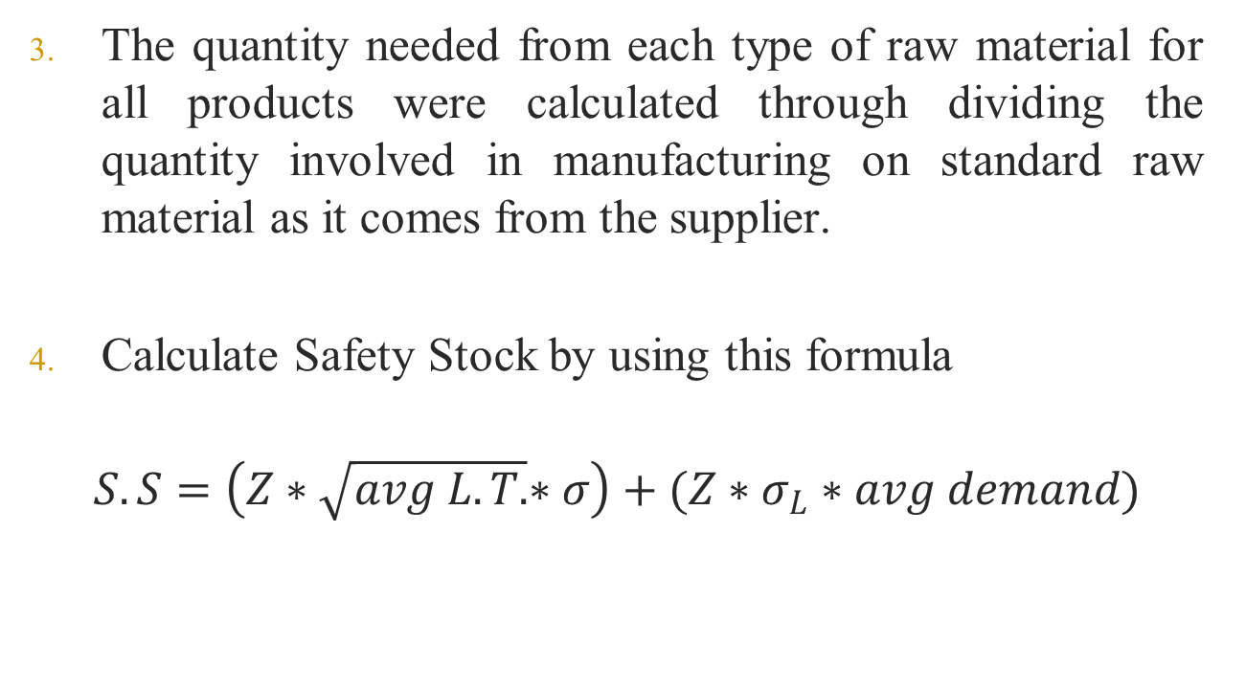
Inventory Design
The quantity needed from each type of raw material for all products were calculated through dividing the quantity involved in manufacturing on standard raw material as it comes from the supplier.
Calculate Safety Stock by using this formula
$$S.S=\left(Z∗\sqrt{avg L.T.}∗σ\right)+(Z∗σ_{L}∗avg demand)$$

Slide 36
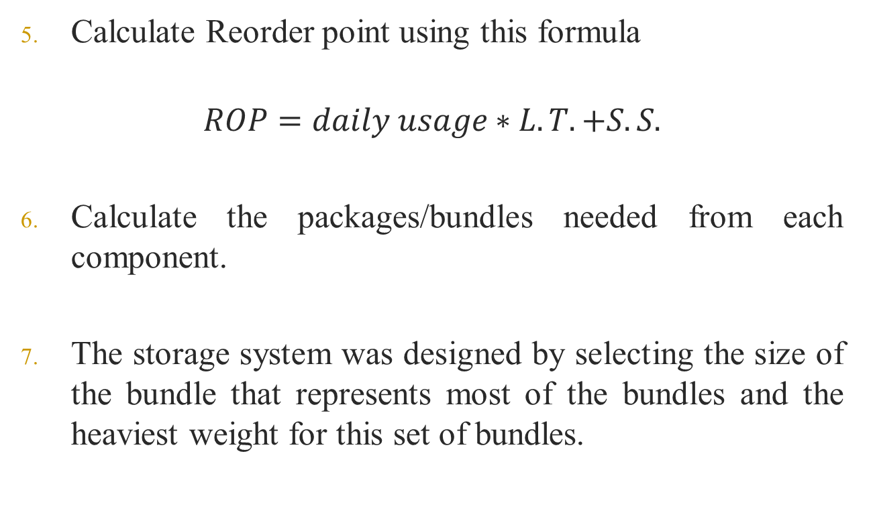
Inventory Design
Calculate Reorder point using this formula
$$ROP=daily usage∗L.T. +S.S.$$
Calculate the packages/bundles needed from each component.
The storage system was designed by selecting the size of the bundle that represents most of the bundles and the heaviest weight for this set of bundles.

Slide 37
Inventory Design
Rack Design:
  Bundle Specifications:
    Long Steel raw material’s types
    45 * 45 * 600 cm , weight 1050 kg
  Part list:
Pcs. | Designation | Item No.
16 | Cantilever arm 50 cm, RAL 5010 gentian Blue | 74895
4 | IPE 140, height 300 cm, single and double sided | 74875, 74887
6 | Horizontals 150 cm | 180385
1 | For spacing 150 cm, and upright height 300 cm (2 crosses) | 180381

Slide 38
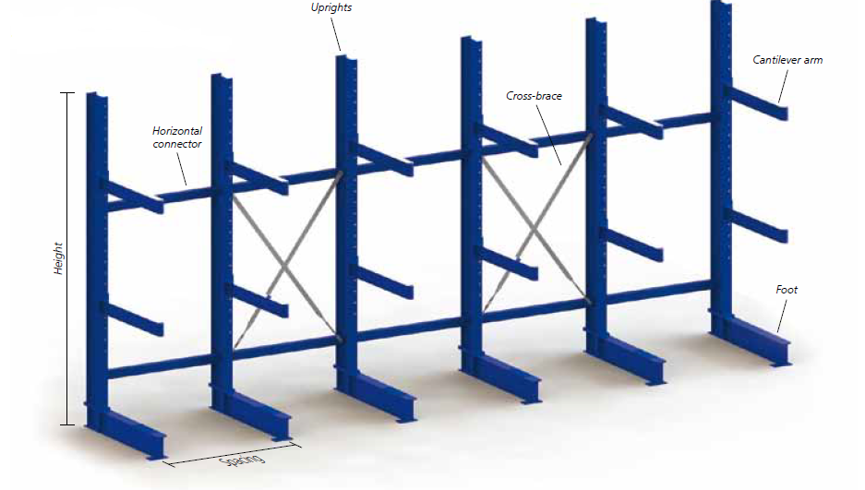
Inventory Design

Slide 39
Inventory Design
Number of structure needed from each method:
Method | Description of raw material to be stored | Number of Packages/Bundles | Number of structure needed
Cantilever Rack | Long, heavy steel | 36 | 6
Cantilever Shelve | wheels, plastic stoppers, rondellas, etc. | 105 | 1
Cupboard | Small raw materials | - | 1
Pallets | Raw material with irregular shape | 55 | 7

Slide 40
Material Handling System Design
Every material handling system should insure that
  The raw material, parts or finished products were transferred with the right quantity
  At the right time
  To the right place
  Taking into account the preservation of quality

Slide 41
Material Handling System Design
Factors that control the selection of material handling system:
  The shape and dimension of the transferred items
  The safety dimensions for workers, machines and materials
  The weight of the transferred items

Slide 42
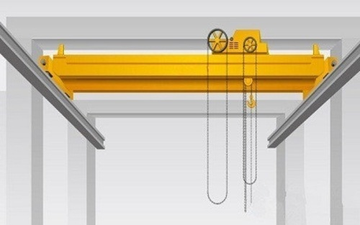
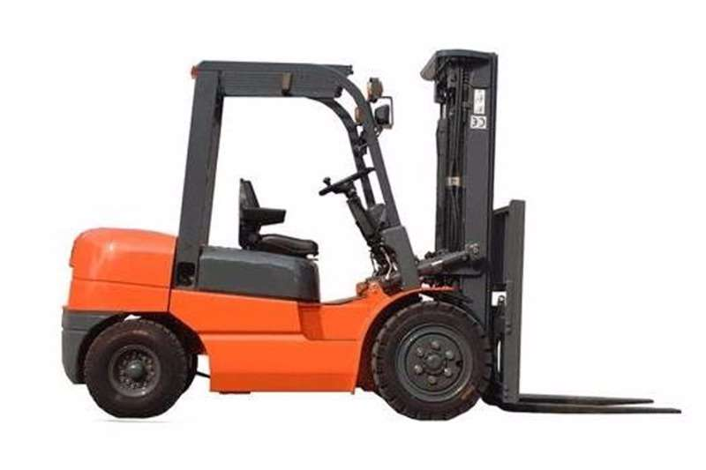
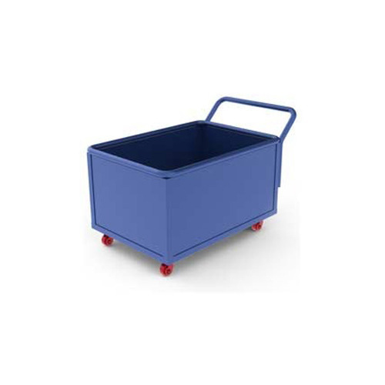
Material Handling System Design
Material handling methods used in inventory:
Three material handling methods were adapted:
Manual Overhead Crane
Forklift
Manual Trolley

Slide 43
Material Handling System Design
Material handling methods used between manufacturing stations:
As a result of the wide variety of products and differences in its dimensions and shapes, trolley / trollies are designed between manufacturing stations.

Slide 44
Material Handling System Design
Material handling methods used between manufacturing stations
Transfer Path | Trolley Dimensions (m)
 | Length | Width | Height
Sofa line | 2 | 1 | 1
Family A line | 3.2 | 1 | 1
Family B line | 2 | 1 | 1
From Cleaning Station to painting room | 2.3 | 1 | 2.3

Slide 45
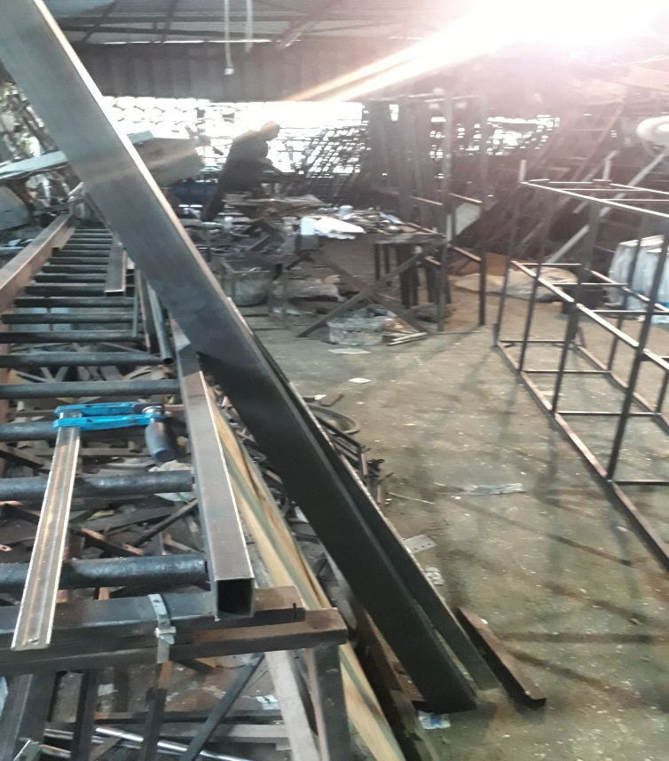
Safety Solutions
Problem | Solution
Closeness of machines from each other | Take in consideration the safe working area for each machine.

Slide 46
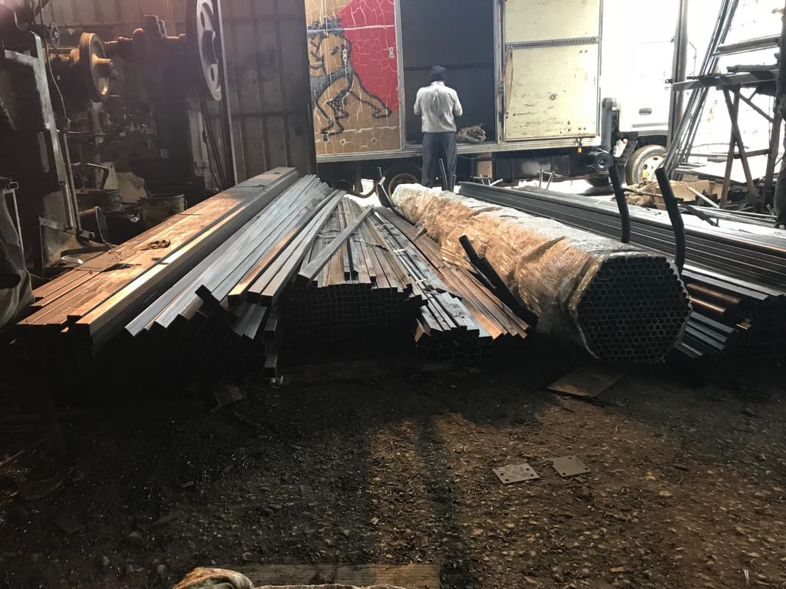
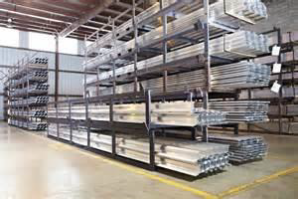
Safety Solutions
Problem | Solution
Accumulation of raw materials in the entrance of the factory | Design an inventory in a manner that guarantees no obstruction of movement due to accumulation of raw materials on the ground by using the cantilever rack system.

Slide 47
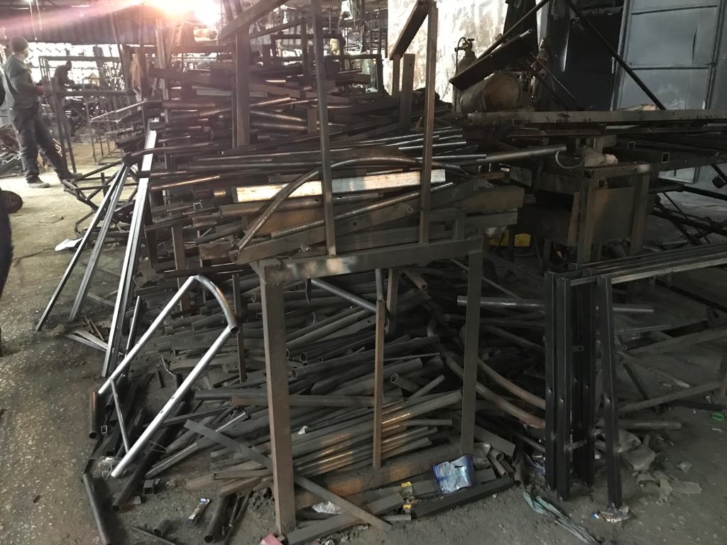
Safety Solutions
Problem | Solution
Accumulation of work in process (WIP) parts between stations | Design an efficient production lines with trollies to put these parts on it and transfer it between stations

Slide 48
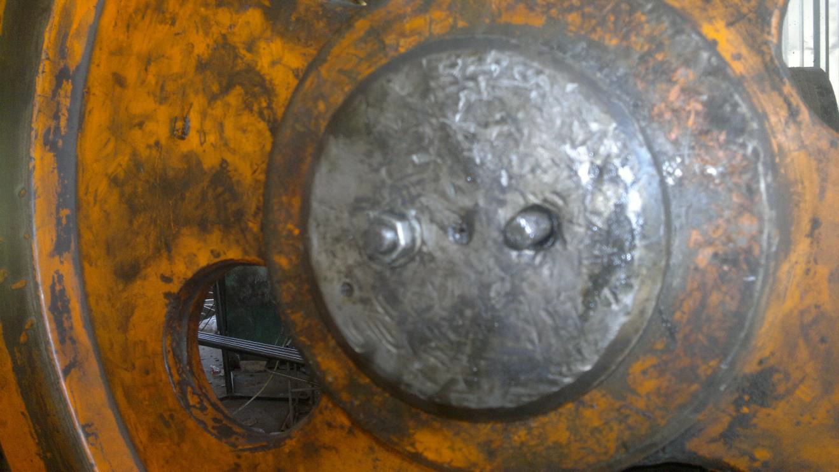
Safety Solutions
Problem | Solution
Problem of neglecting the position of the nuts on the rotor | Place the locking nuts

Slide 49
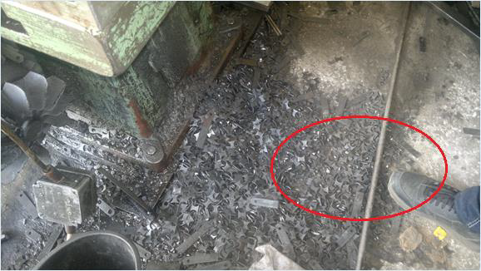
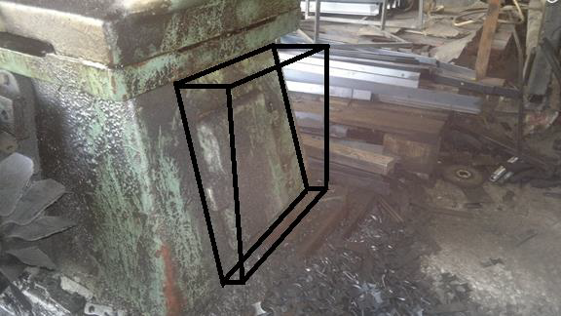
Safety Solutions
Problem | Solution
Problem of dispersal residues production of sparrow | Prepare a special box under the piston with a bag inside it that is changed weekly.

Slide 50
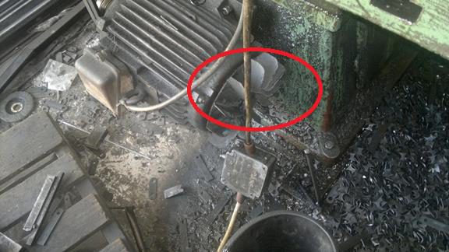
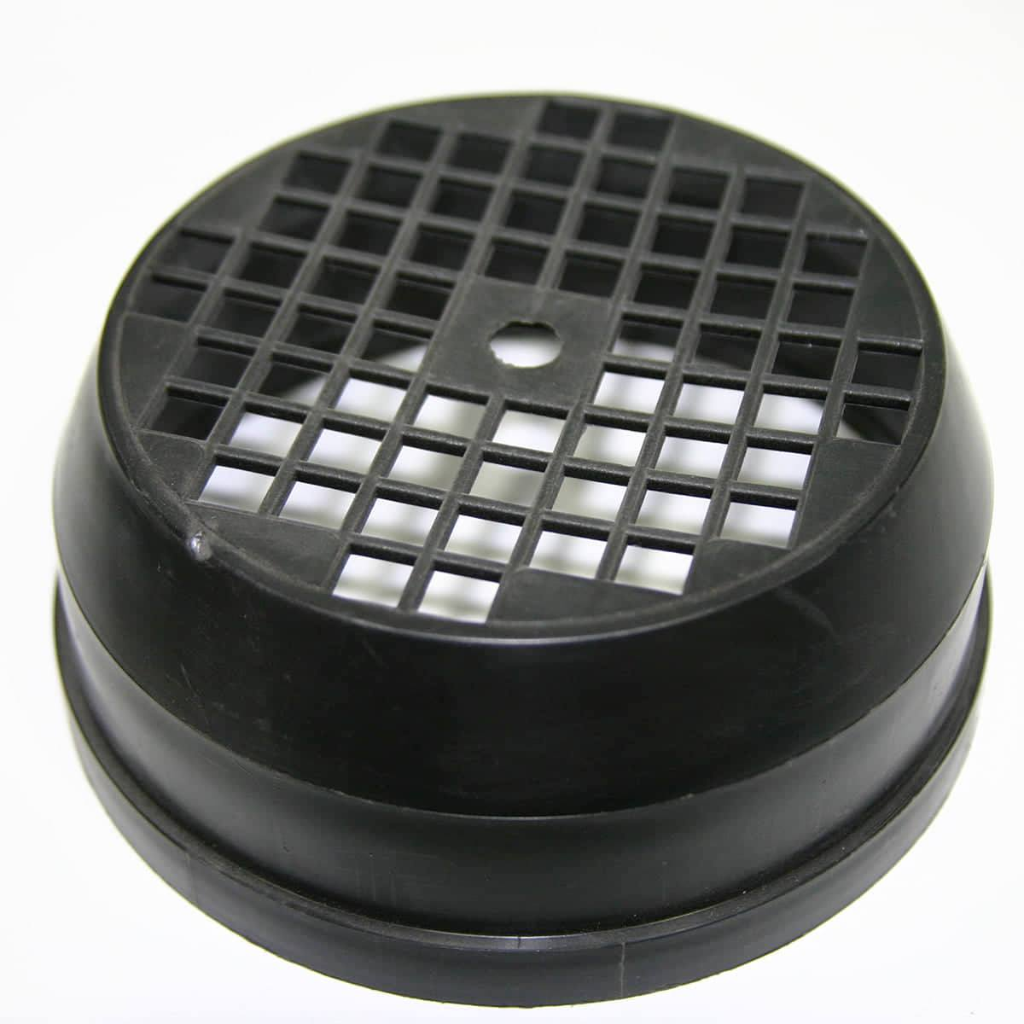
Safety Solutions
Problem | Solution
Problem not to put the protector for piston engine fans | Place a protector for the electric piston fan, place the electric control panel in a convenient place and keep the electric motor wires away from the movement of the workers

Slide 51
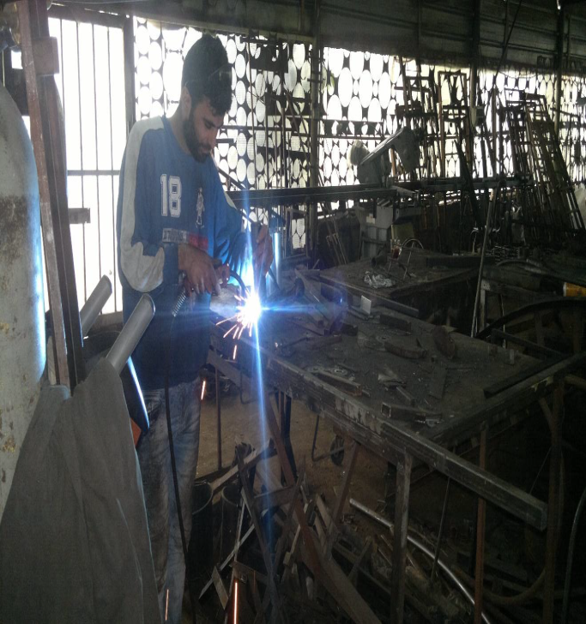
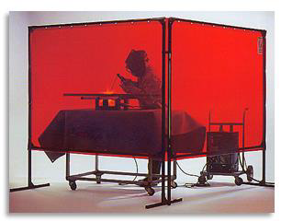
Safety Solutions
Problem | Solution
Problem of not following occupational safety in welding operations | Add air ventilation, separating welding areas from the rest of the plant barricades (dark plastic curtains) and the commitment of workers to wear appropriate protective.

Slide 52
Layout Design
Site Location:
New land were purchased in Dirstia, fairly flat and rectangular land on an area of ​​4 acres.
Inventory Layout:
The inventory has a square shape with 20 meters rib.

Slide 53
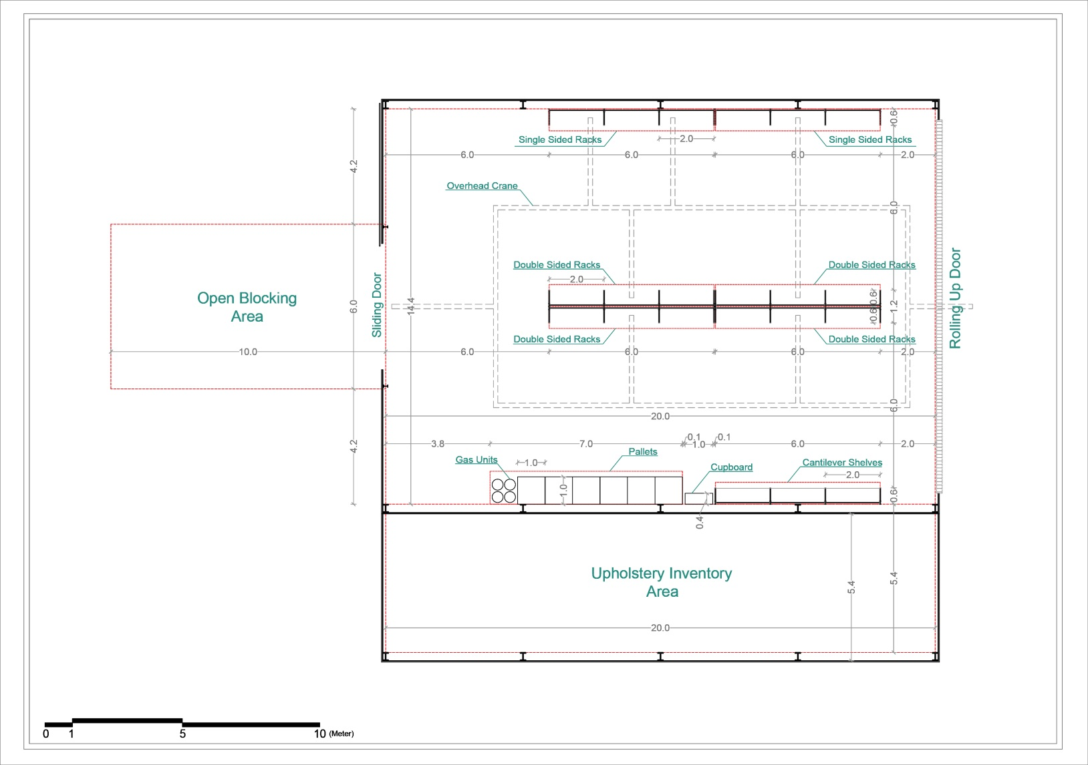

Slide 54
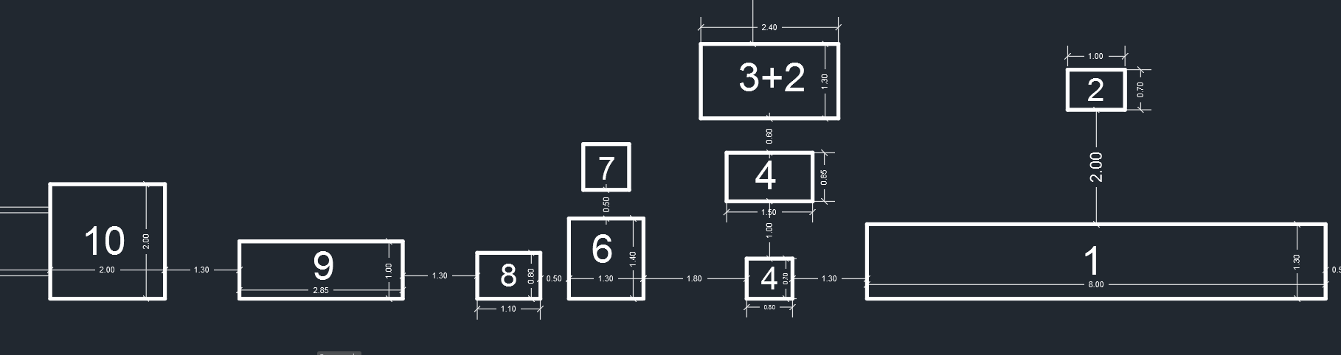
Layout Design
Production Lines Layout:
Sofa Line:

Slide 55
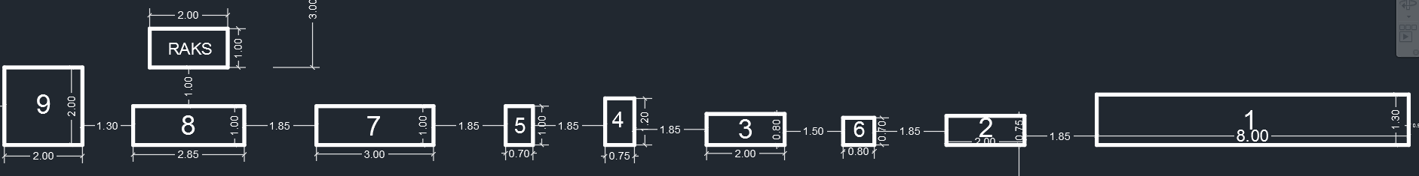
Layout Design
Production Lines Layout:
Family A Line Layout:

Slide 56
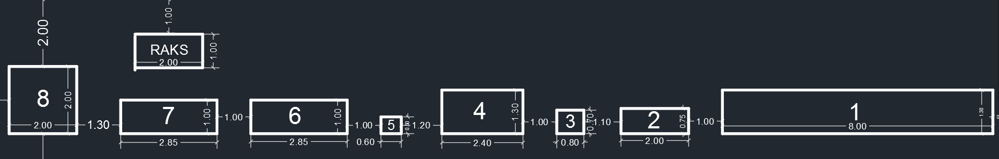
Layout Design
Production Lines Layout:
Family B Line Layout:

Slide 57
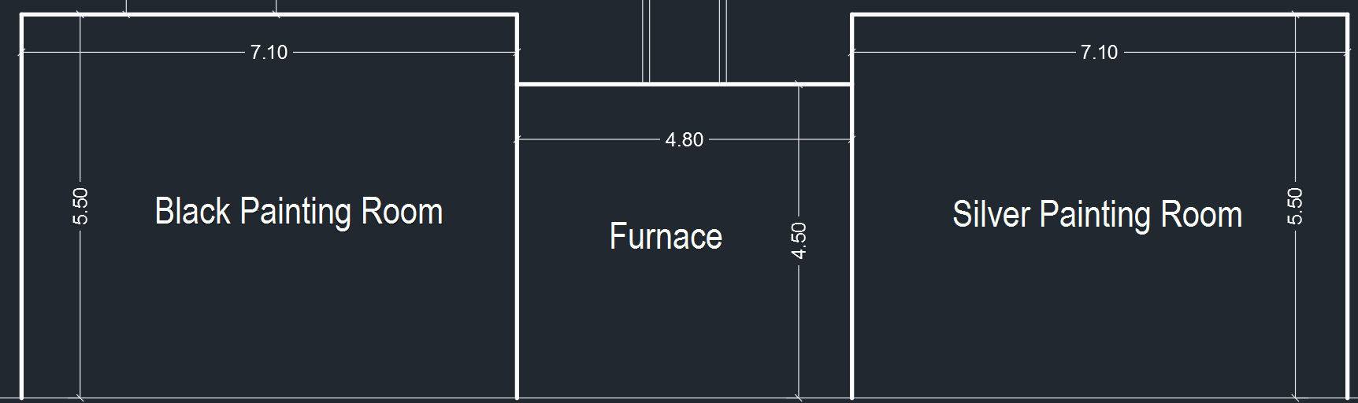
Layout Design
Production Lines Layout:
Painting Room Layout:

Slide 58
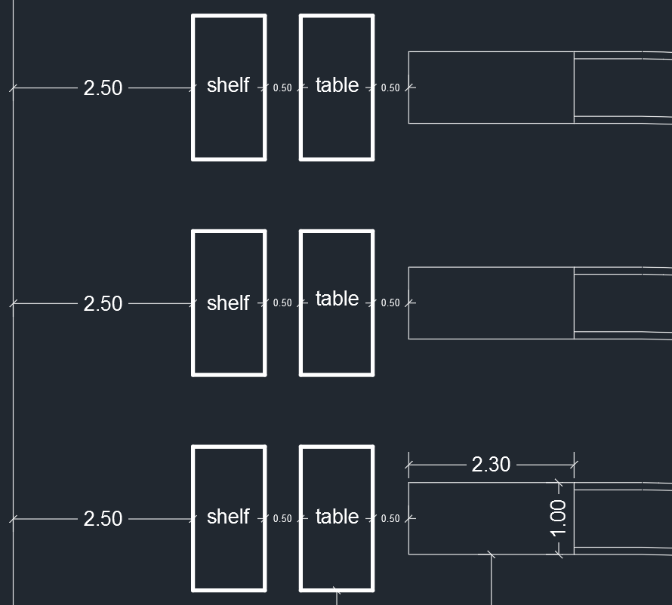
Layout Design
Production Lines Layout:
Final assembly and Packaging Layout:

Slide 59
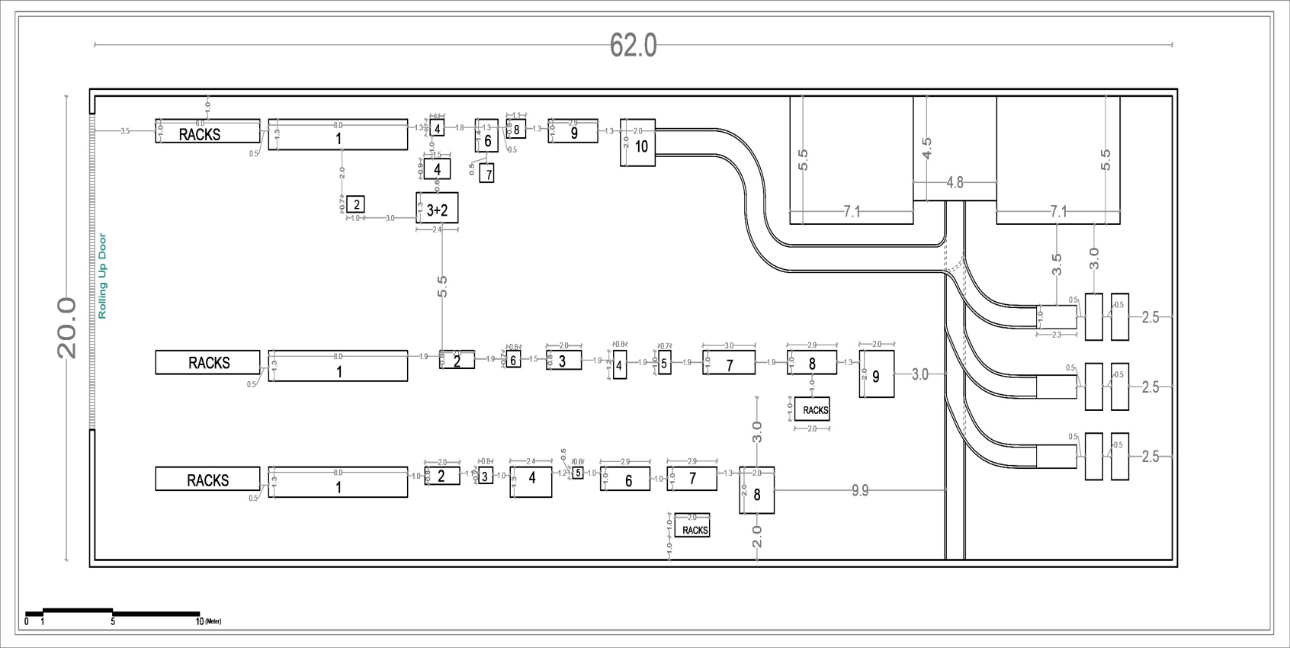

Slide 60
Administrative system
Vision statement:
Be a leading household metal furniture company in Palestine, providing diverse products with the best quality taking in consideration social responsibilities.
Mission statement:
Developing metal furniture in Palestine, improving its quality in a manner commensurate with tastes, and contributing to building the Palestinian economy and providing jobs in a safe environment.

Slide 61
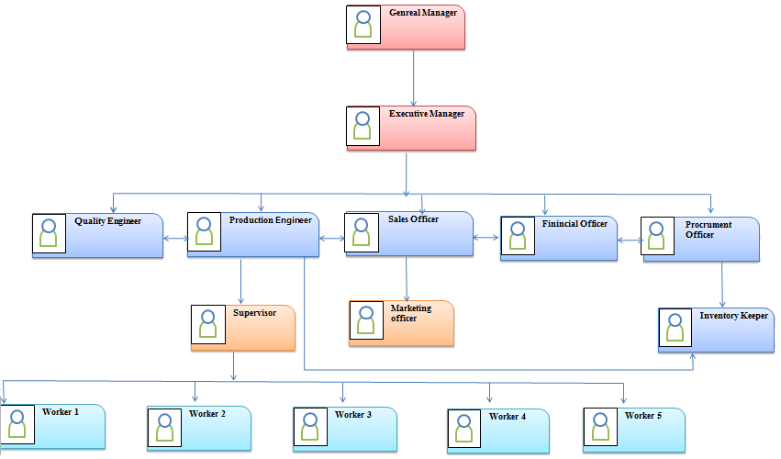
Administrative system
Organizational Structure:

Slide 62
Administrative system
Job Description:
Was build in order to :
  Facilitate smoothness and clearness transmission of information between the administrative classes
  Clarify the duties, responsibilities and authorities of each employee

Slide 63

Al-Reef Factory for Metal Furniture
JOB OVERVIEW
JOB TITLE | Production Engineer
DEPARTMENT | Production Department
REPORTS TO | Executive Manager
GENERAL JOB DESCRIPTION
Planning, coordination and control of manufacturing processes. Make sure goods are produced efficiently and that the correct amount is produced at the right cost and level of quality.
DUTIES & RESPONSIBILITIES
Oversee the production process, drawing up a production schedule. Ensure that the production is cost effective. Decide what resources are required. Estimate costs. Be responsible for the selection and maintenance of equipment. Liaise among different departments, e.g. financial, procurement. Ensure that health and safety guidelines are followed. Identify training needs. Receive new orders and specify the order’s specification
EDUCATION & TRAINING
Industrial Engineering. Mechanical Engineering
KNOWLEDGE , EXPERIENCE & SKILLS
Planning and organization skills to be able run and monitor the production process. The ability to act decisively and solve staff or equipment-related problems. The capacity to grasp concepts easily. ICT literacy to deal with various technologies and programs. Attention to detail to ensure high levels of quality. The ability to communicate clearly and persuasively with his team and clients. The ability to work under pressure and motivate others to meet deadlines. The ability to work in a logical, systematic manner.

Slide 64
Administrative system
Standard Operating Procedures (SOP’s):
The names of the SOP’s which were conducted for the procedures in the faculty with the related form/forms for each procedure and the codes.

Slide 65
No. | Procedures Name | Code | Form Name | Code
1 | Production | PR-P-01 | Production order form | PR-F-01
 |  |  | Order specification form | PR-F-02
 |  |  | Material Requisition form | PR-F-03
 |  |  | Entry of final product to warehouse form | PR-F-04
2 | Emergency Maintenance | M-P-01 | Spare Part Requisition form | M-F-01
 |  |  | Emergency Maintenance form | M-F-01-02
3 | Regular Maintenance | M-P-02 | Spare Part Requisition form | M-F-01
 |  |  | Regular Maintenance form | M-F-02-02
4 | Requesting and Receiving | R&R-P-01 | Notification of Arrival of Raw Materials form | R&R-F-01
 |  |  | Inspection and Entry of raw materials form | R&R-F-02

Slide 66
Al-Reef for Metal Furniture Regular Maintenance Procedure Procedure Code: M-P-02
Department : | Production Department |  | Document no:
Prepared by : | Quality Engineer | Date: |  | Supersedes:
Checked by : | Executive Manager | Date: |  | Date Issued:
Approved by | General Manager | Date: |  | Review Date:
Purpose: is to provide detailed instructions on how to carry out the regular maintenance procedure. And to maintain the machines and tools in good status. And to ensure that the production process will not interrupted due to irregularity of the maintenance process.
Scope: it will define the whole regular maintenance procedure, including the documentation needed to accomplish the process.
Responsibilities: The Quality Engineer is responsible for writing and maintaining the SOPs and the related forms and documents. The production engineer is responsible for schedule maintenance and calibration with the supervisor help, and to communicate with the outsource company and facilitate the work of the outsource company, and report to the financial officer.
Procedure: Schedule maintenance and calibration by the supervisor and the production engineer The production engineer communicate with the maintenance company a week before the maintenance process as scheduled in the timetable for regular maintenance The maintenance company arrives and do the regular maintenance under the supervision of both the supervisor and the production engineer If there’s any failure discovered, then the supervisor asks for spare parts from the inventory keeper using a form (M-F-01), and the company deals with the failure and repair it After the maintenance process ends, the production engineer fills out a form (M-F-02-02) and sends it to the financial manager Recording and documenting the maintenance details in the maintenance file
Related Documentation: M-F-01 M-F-02-02

Slide 67
Al-Reef for Metal Furniture Regular Maintenance Form Form Code: M-F-02-02
Maintenance order No.: | Production Area:
Scheduled Date: | Machine Name:
Date: | Machine Number:
Maintenance Methodology: In-House: □ Outsource: □
Part to be change:
Spare part needed: Yes: □ No: □
Spare Part Description:
Expected time to repair: | Actual time:
Outsource maintenance
Company name: | Agreed Date for maintenance:
Signature of the company’s representative: | Cost of maintenance:
Send from: | Send to:
Supervisor Signature: | Production Engineer Signature:

Slide 68
Conclusion and Recommendation

Slide 69
Conclusion
Build an integrated administrative system.
Design an effective and efficient three production lines which increase productivity and utilization.
Conduct an efficient material handling systems that ensure that the transferred item reaches the specified location with the correct quantity at specified time while maintaining its quality

Slide 70
Conclusion
Construct a storage system that facilitate, controlling and monitoring the raw materials and has the ability to absorb the expected demand.
Layout is designed to facilitate the process of production, in addition to the optimum utilization of available space to ensure safety standards.

Slide 71
Recommendation
Accomplishment the remaining SOPs related to purchasing and other procedures
Perform maintenance training and make the maintenance in-house as possible
In order to increase the productivity of the Sofa line after five years, it is recommended to increase the line efficiency to reach 92%

Slide 72
Recommendation
As a result of the decrease in the value of line utilization for both line A and B, it is recommended to reduce the number of workers by making schedule for the number of workers according to orders on each line
Commitment to recommended SOPs for production, regular and emergency maintenance and requesting and receiving raw materials

Slide 73
Recommendation
Continue research and development on procedures and forms
Commitment to safety regulations
Interest in advertising, especially for the deployment of new products on the market
Buying new machines with better specifications can speed up the process and reduce defects

Slide 74


