Slide 1
Graduation project 2
SECOND semester

Slide 2
1 Introduction
This chapter starts with a general background about Foundation , followed by the significance of the project.
The objectives of this project are then explained, followed by the research questions, expected outcomes, study area, approach, and finally, the project structure.

Slide 3
Objectives
In Graduation 2 project, we will explain a soil analysis for the national-hospital-street, located in Nablus, and we make a desition to select a system which achieve the low cost and high safe ( braced cut or sheet pile ).

Slide 4
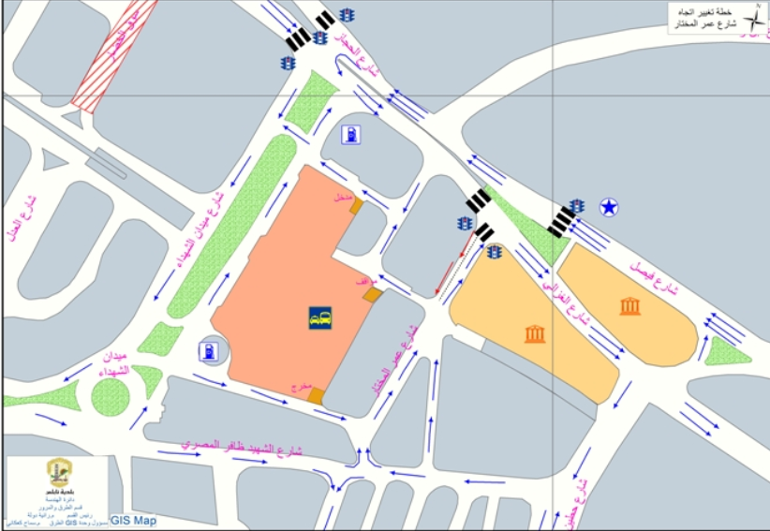
Study Area

Slide 5
Literatu reeview
.In this chapter a literature review of function of foundations, general requirements of foundation, foundation classification, Types of Foundation espitialy sheet piles and brced cut and finally this project will be done based on several researchers, papers, and books..

Slide 6
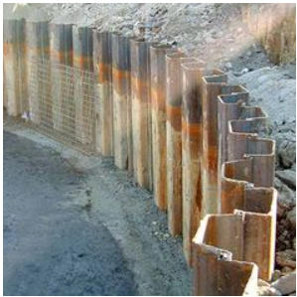
Sheet piles

Slide 7
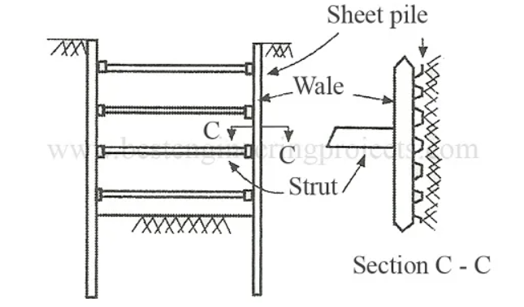
Braced Cofferdams With sheet piles

Slide 8
Soil report
General note:
The examination of soil samples was taken from Dr. Issam Jardaneh, who assured us that the examination of soil samples was conducted near the area of ​​the National Hospital (Al-Dawwar area).

Slide 9
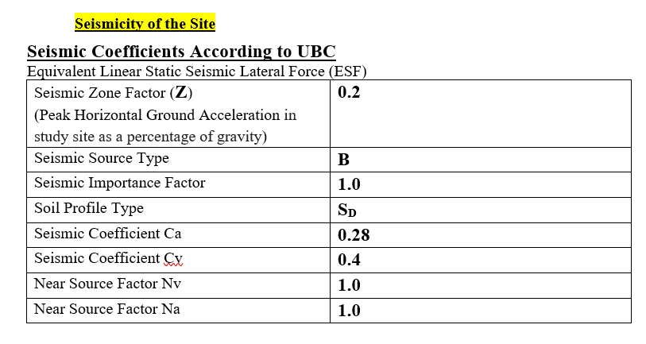
Soil report

Slide 10
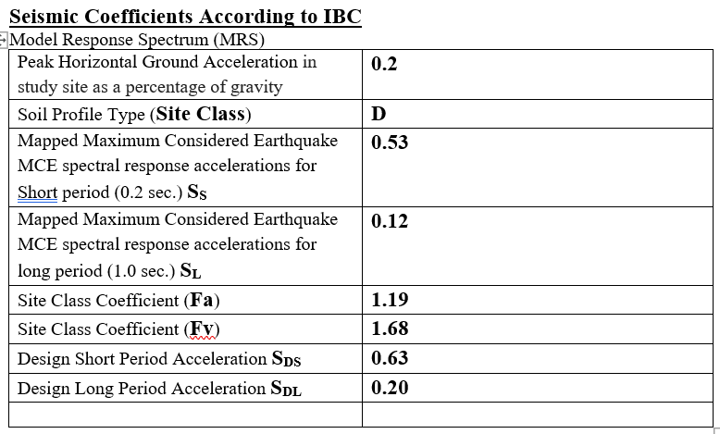
Soil report

Slide 11
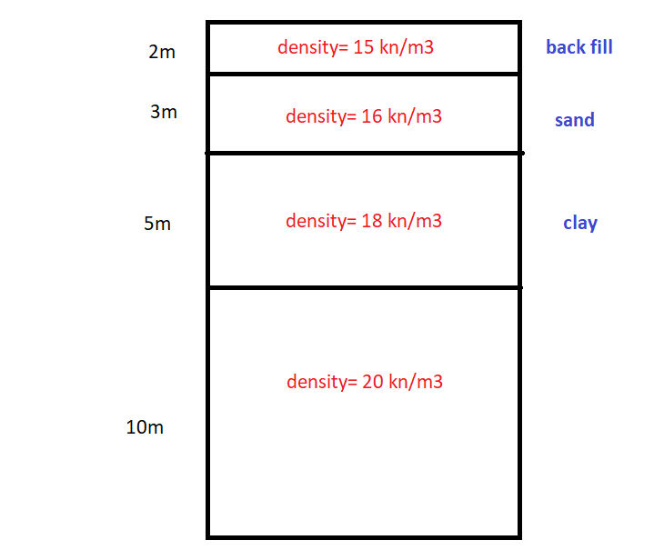
Soil report

Slide 12
Analysis for sheet piles

Slide 13
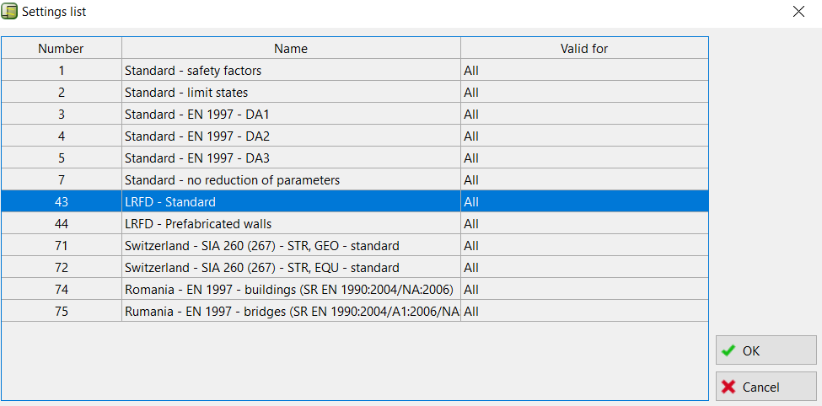
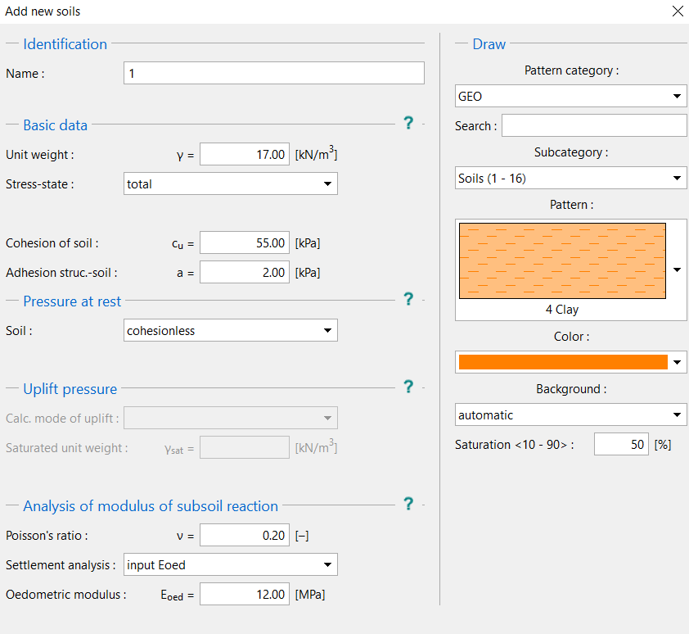
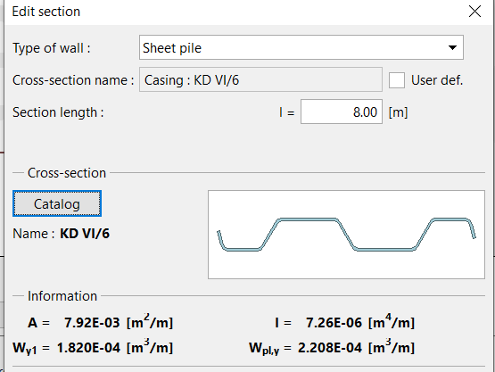

Slide 14
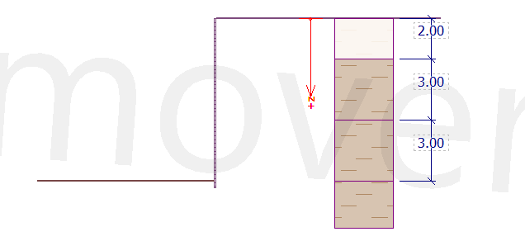
Soil profile

Slide 15
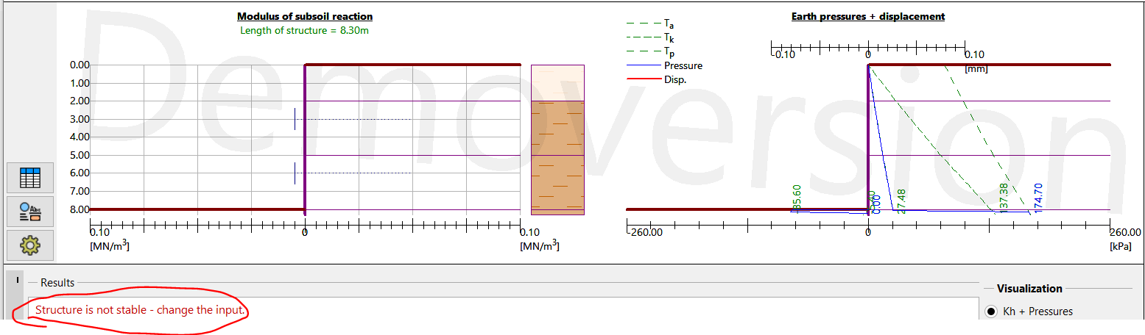
The structure doesn’t ok

Slide 16
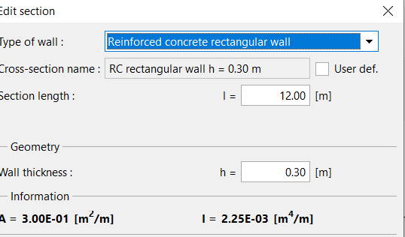
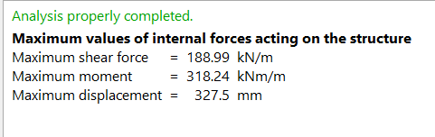
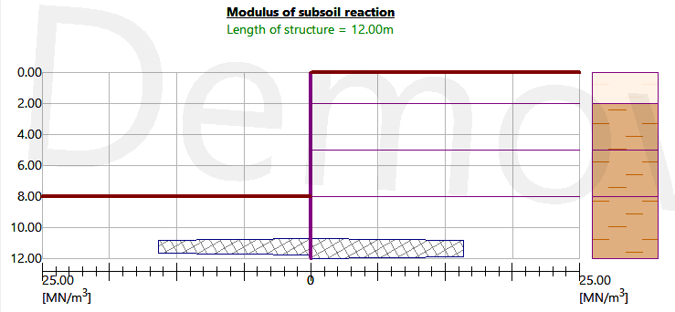
The structure ok

Slide 17
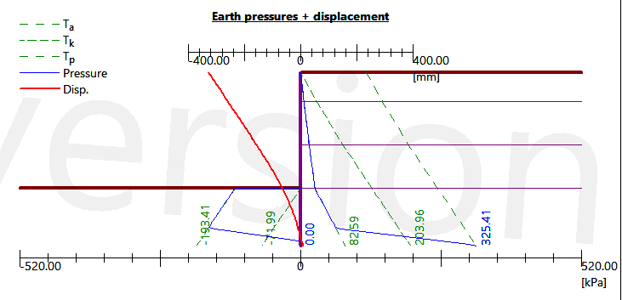
Results for Earth pressure + displacement

Slide 18
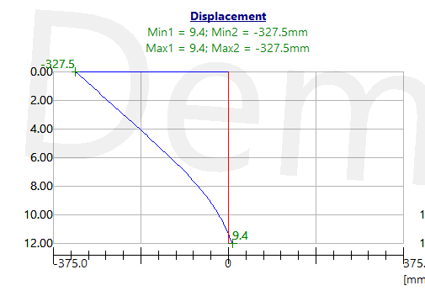
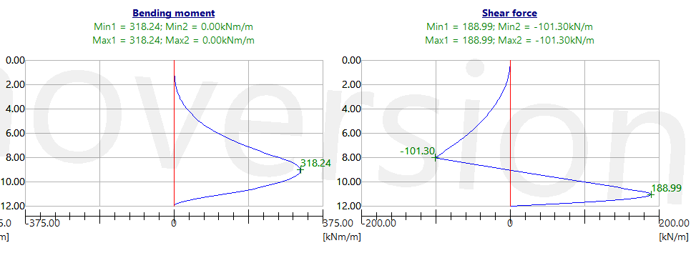
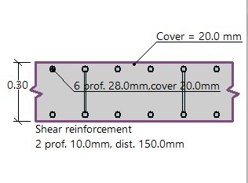

Slide 19
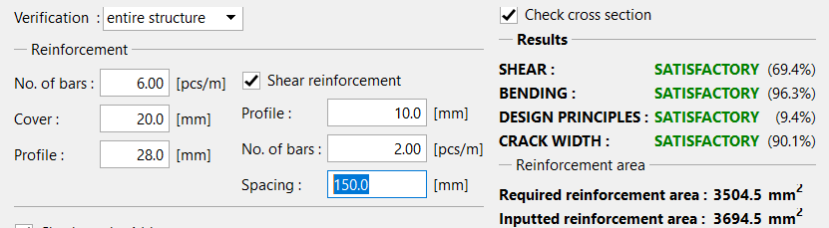
Results for reinforcment

Slide 20
Design of braced cut

Slide 21
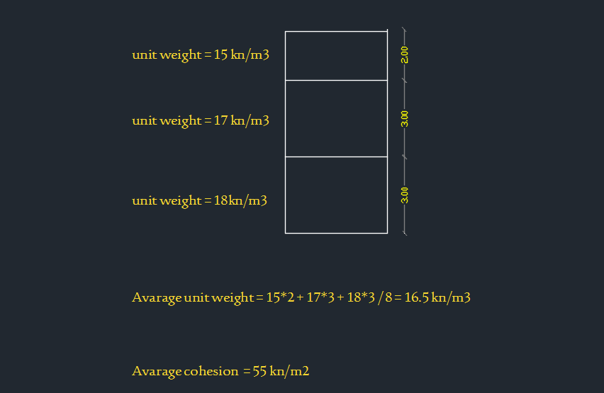

Slide 22
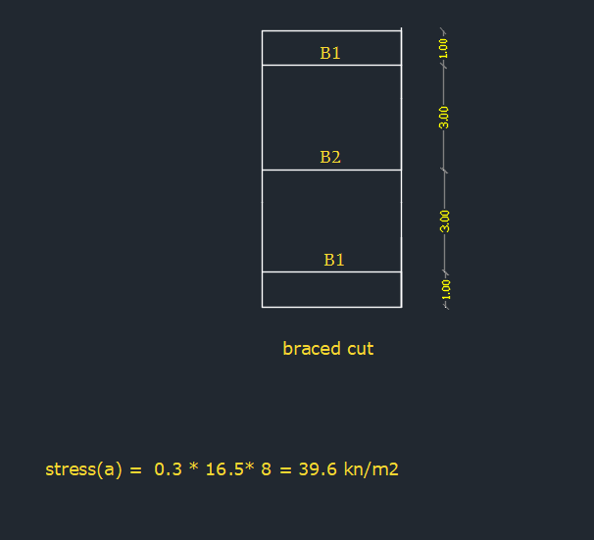
Stress = 0.3 * unit weight * height

Slide 23
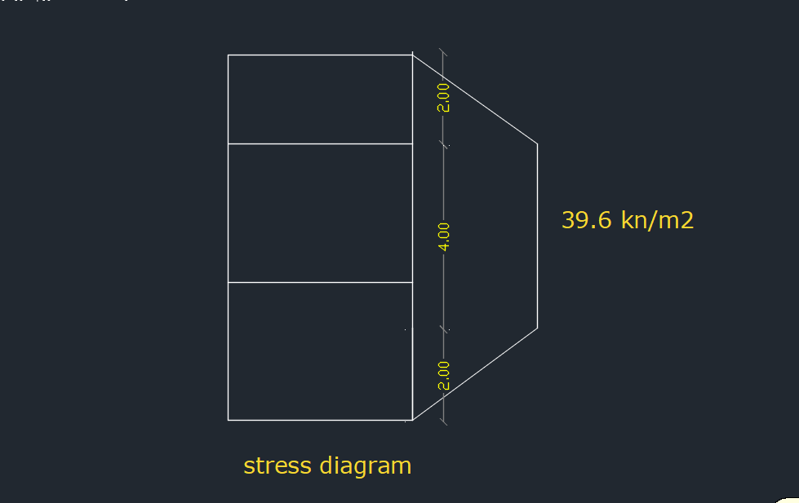

Slide 24
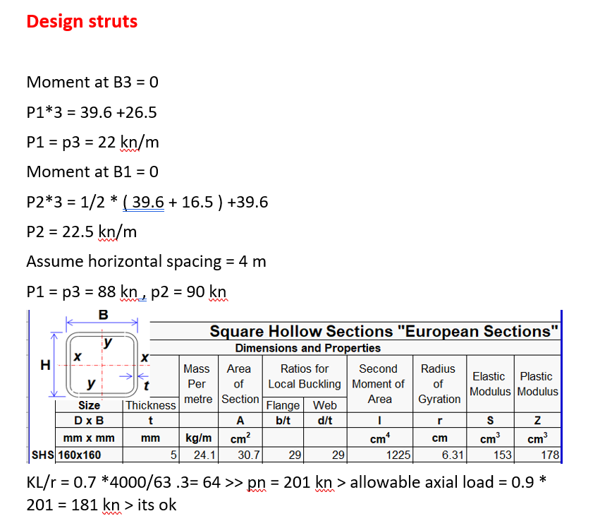

Slide 25
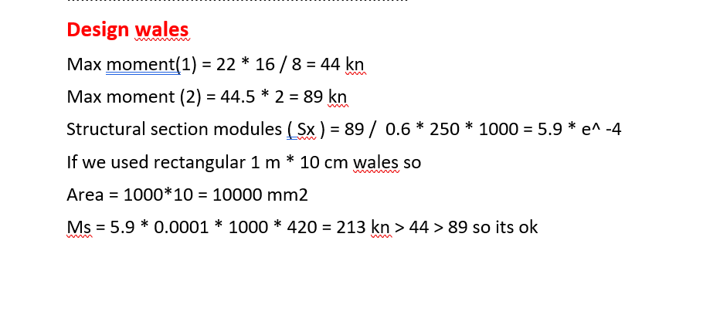
Mn = fy * A * Sx

Slide 26
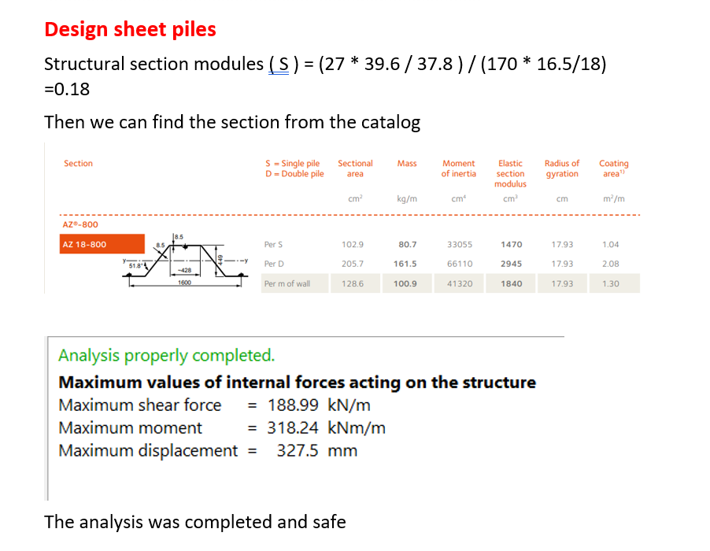

Slide 27
Conclusion and recomendations :
After we see the soil report we discuss the parameters of soil and we make a desidtion that is :
Use braced cut because its more safe (Di = 16 ) rather than sheet pile which it has Di = 0, so we finished the analyse and design the system in graduation project2.
.

Slide 28
References
Bowles, J. E., 1996, “Foundation Analysis and Design”, Fifth Edition, the McGraw Hill Companies, Inc. New York, USA.
Chen, F., H., 1988, “Foundation on Expansive Soils”, Development in Geotechnical Engineering, Elsevier, USA.
Coduto, D., P., 2011,”Foundation Design: Principles and Practice”, Second Edition, Prentice Hall, New Jersey, USA.
Das, Braja and Sobhan, Khaled, 2014, “Principles of Geotechnical Engineering”, Eighth Edition, Cengage Learning, USA.
Das, Braja, 2ss016, “Principles of Foundation Engineering”, Eighth Edition, Cengage Learning, USA.
Design Manual 7.02, “Foundations and Earth Structures”, Naval Facilities Engineering Command, Alexandria, Virginia, USA, (1986).

