Slide 1
The Observer

Slide 2
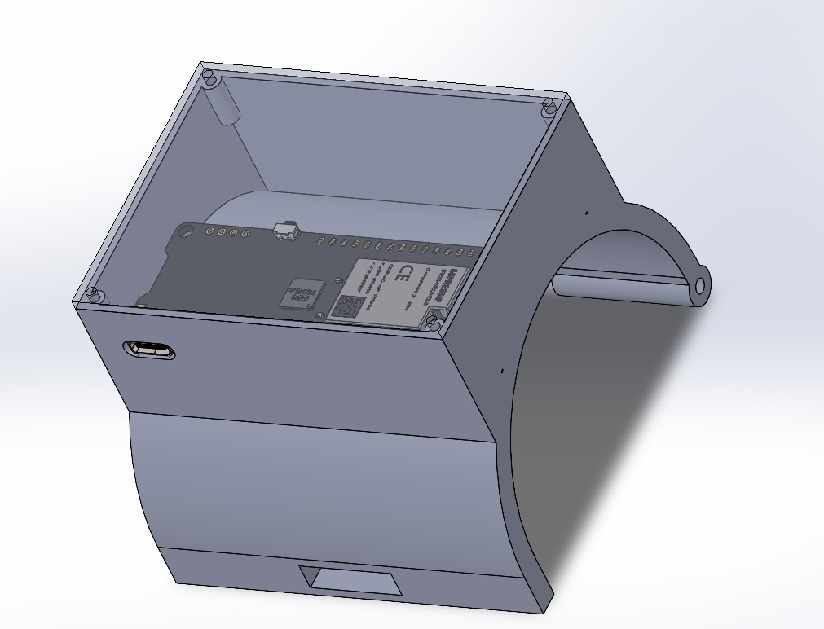
Introduction
The Observer project is a wristband connected to a cap.
The project functions as a health safety system that can be used by car drivers, children, and the elderly.
The project includes sensors to measure temperature and a gyroscopic sensor mounted on the head to issue an alert when the head is tilted.

Slide 3
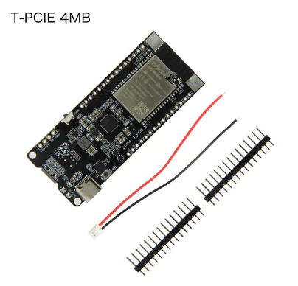
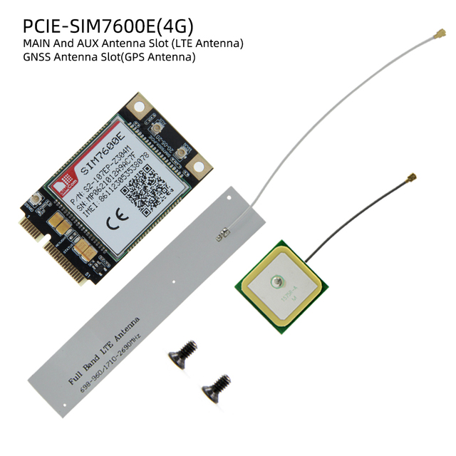
The main components
We use T-PCIE ESP32 to control all the system.
We use T-PCIE SIM7600E to get the location on the map and send it using 4G mode, we connect it with ESP32 using UART.

Slide 4
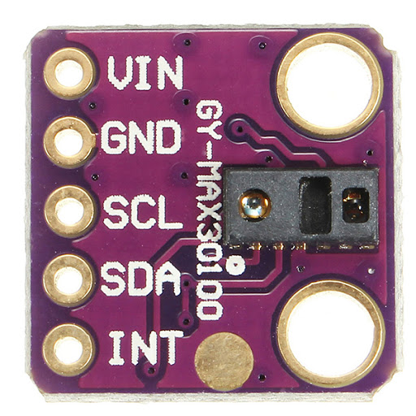
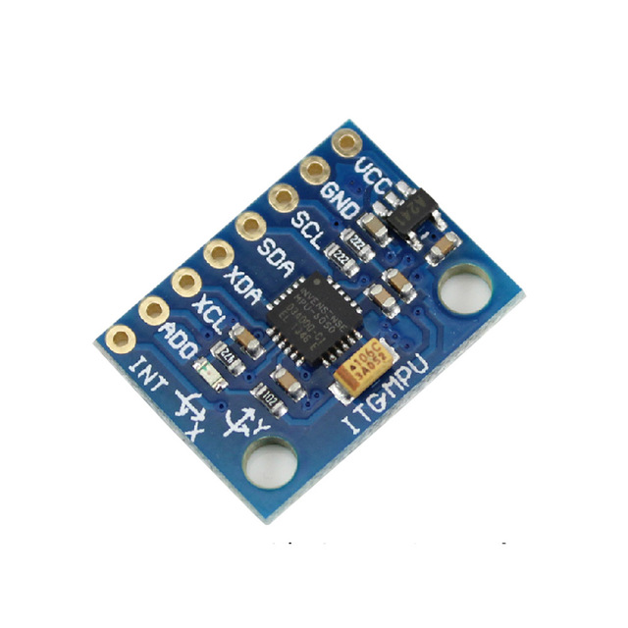
The main components
We use GY-MAX30100 to get Bpm and SPO2,we connect it with ESP32 using I2C.
We use MPU6050 to detect head tilting ,we connect it with ESP32 using I2C.

Slide 5
How it is work
We use a secure server to upload all the data from the sensors , and the mobile application get this data and display it.
These data are:
Temperature
SpO2 (the percentage of oxygen in the blood)
BPM (heart rate)
Head temperature
Long and Lat (to get the location)

Slide 6
How it is work
If the heart rate is less than 40 or more than 120, the observer sends a message to the concerned person containing the address on the map.
In the case of head tilting, the monitor issues an alert, and this alert continues to operate until the head returns to its normal position. The significance of this alert lies during driving.

Slide 7
Difficulties
We encountered an issue with location detection because the GPS device only works outdoors. So, we used a longer GPS antenna to place it in an outdoor location.

Slide 8
Improvement
One of the drawbacks in this project is the relatively large size of the wristband. The project can be improved by using specialized components to reduce the size of the wristband.
The project can also be further developed by wirelessly connecting the wristband to the cap.

Slide 9
Conclusion

