Slide 1

Automated smart farm with PV
Done y : Ahmad N. Dwikat
Supervised by:Dr.haneen al ott

Slide 2
الفهرس
Chapter 1:Introduction
Chapter 2 :Constrains , Standards /Code And Earlier course work
Chapter 3 Literature Review
Chapter 4 : Methodology
Chapter 5 : Results and analysis
Chapter 6: Discussion
Chapter 7 : Conclusion and recommendations

Slide 3
A smart farm with automated systems makes crops more productive and efficient. This project covers some agricultural aspects such as irrigation, humidity and temperature control as well as power and water supply.
This project reduces the need of human labor
This project is also covering an efficient way of using power and it is using a clean solar power instead of regular power sources making it a green farm and environmental friendly.

Slide 4
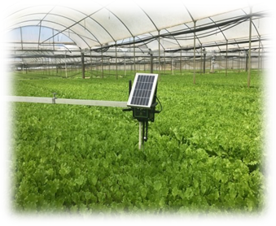
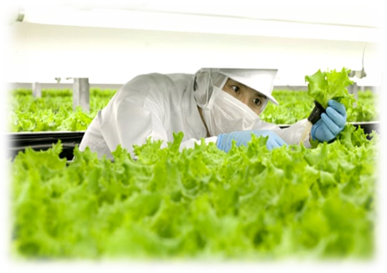
Smart farming

Slide 5
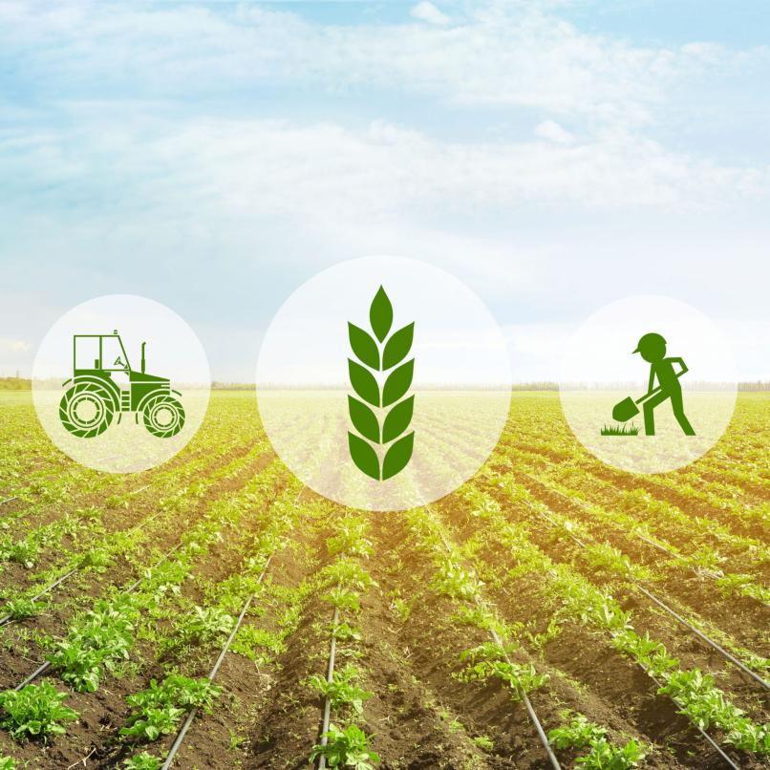
Statement of problem
Palestine is facing major problems in agriculture because of using primitive techniques in farming, and due to the lack of farming skills and human errors.

Slide 6
project objective
develop the agriculture in Palestine
provide a module of a smart farm
covers the basic definition of smart farming

Slide 7
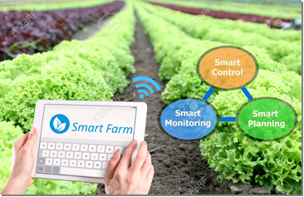

Slide 8
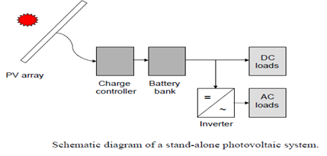
Stand alone photovoltaic system

Slide 9
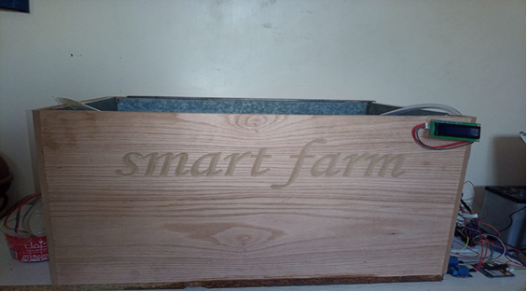
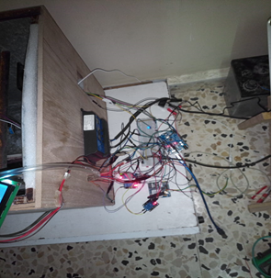
Hardware, that the project is based and designed on

Slide 10
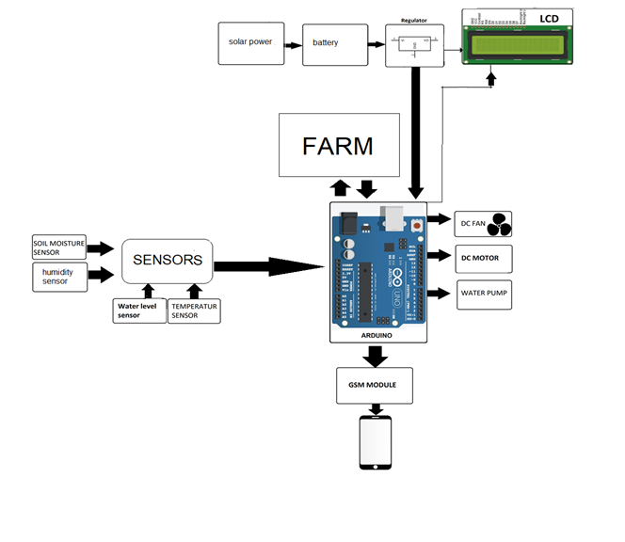

Slide 11
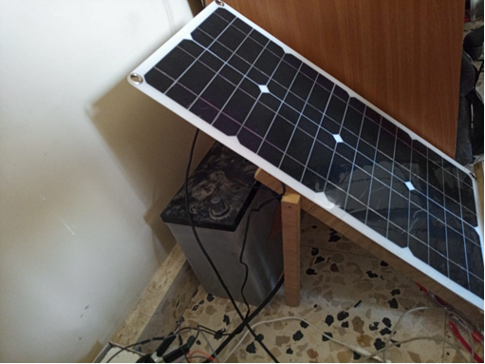
Solar cell

Slide 12
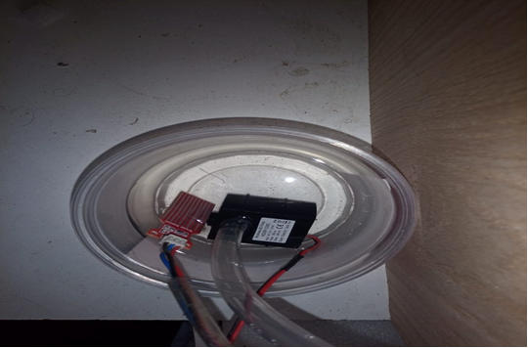
water level and pump in tank

Slide 13
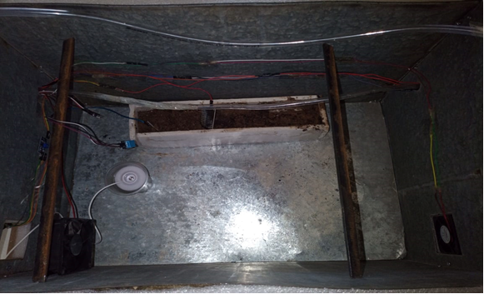
Inside project

Slide 14
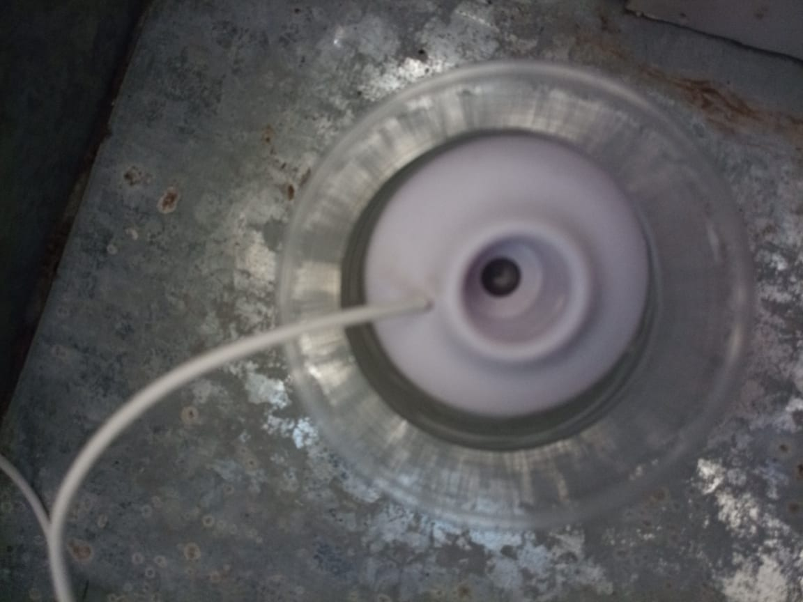
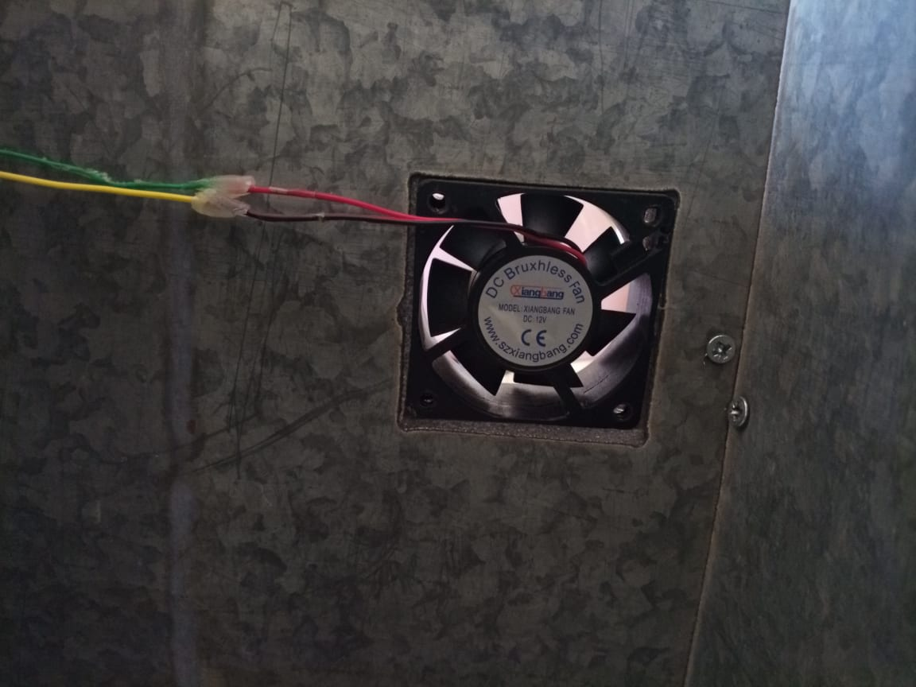
humidifier
fan

Slide 15
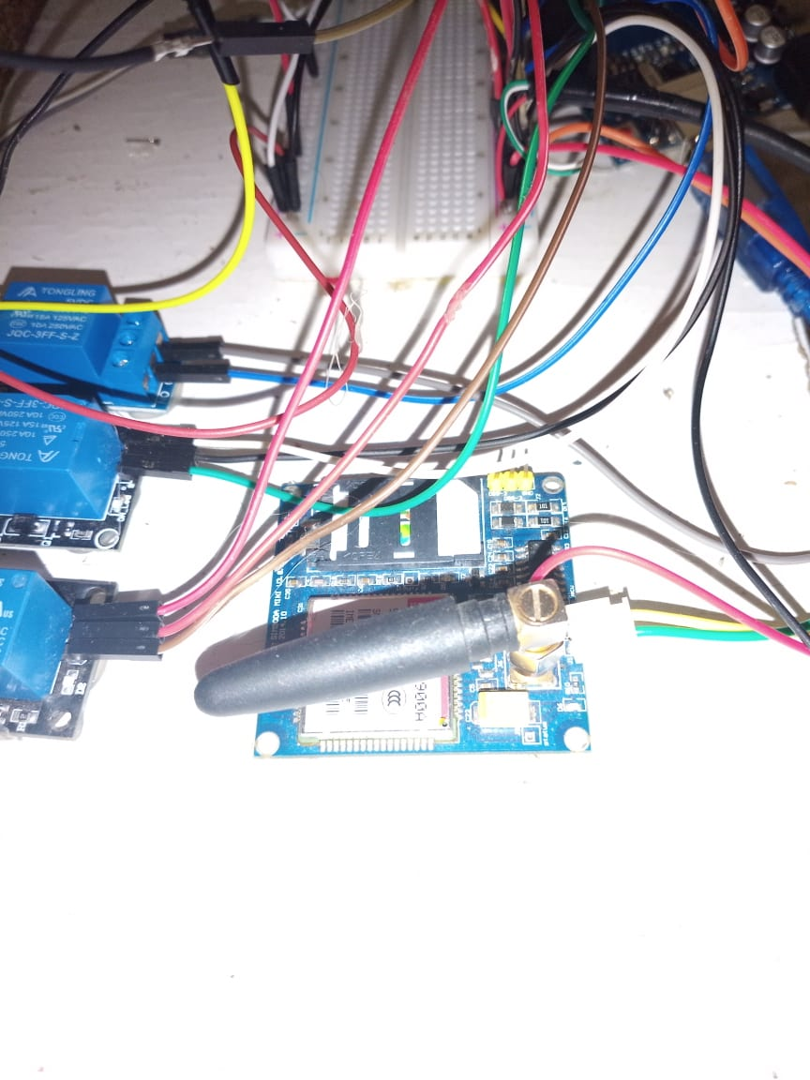
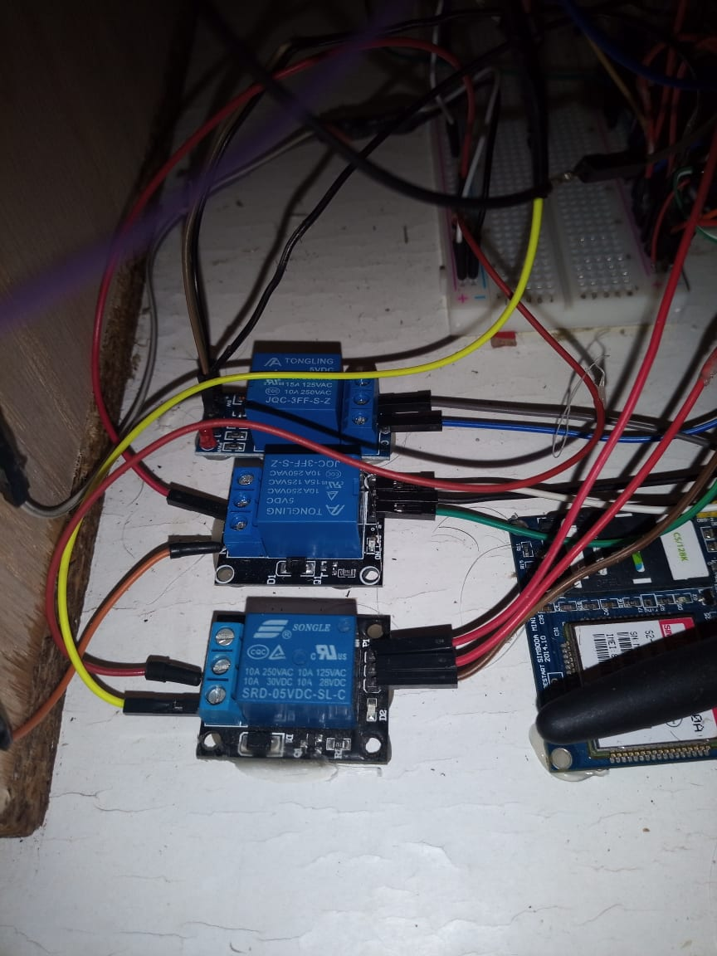
Relay and gsm

Slide 16
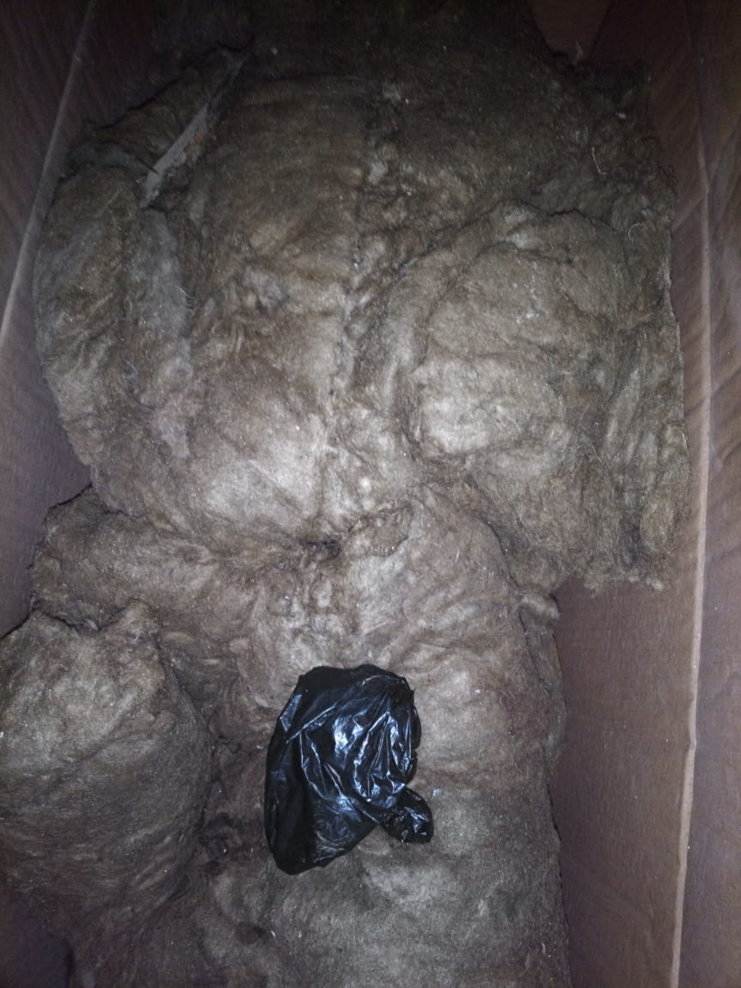
Rock wool
inorganic material made into matted fiber used especially for insulation or soundproofing.

