Slide 1


2022
2021
An-Najah National University
Faculty of Engineering and Information Technology
Design of a wastewater collection network for Berqin village using SewerCAD
By:
Mohammad Atatri
Osama Odeh
Fahd Falah
Emran Amodi
Under Supervision of: Dr. Mohammad Nihad Almasri

Slide 2
Background

Slide 3

The project that we have today aims to:
Study wastewater management system in Birqen Village located in Jenin Government.
Cesspits is the used way to dispose wastewater in the village, without treatment. Also, discharging the Cesspits is expensive except it’s bad smell and diseases.

Slide 4
Objectives

Slide 5
Main objectives for the work:
To design a wastewater network of Birqen village using (SewerCAD).
To estimate the total cost of the wastewater collection network.

Slide 6
So we are going to design a (WWCN) for Birqen Village, meeting :
the current and the expected needs in the future for the daily use in the village.

Slide 7
Study Area
“Birqen”

Slide 8
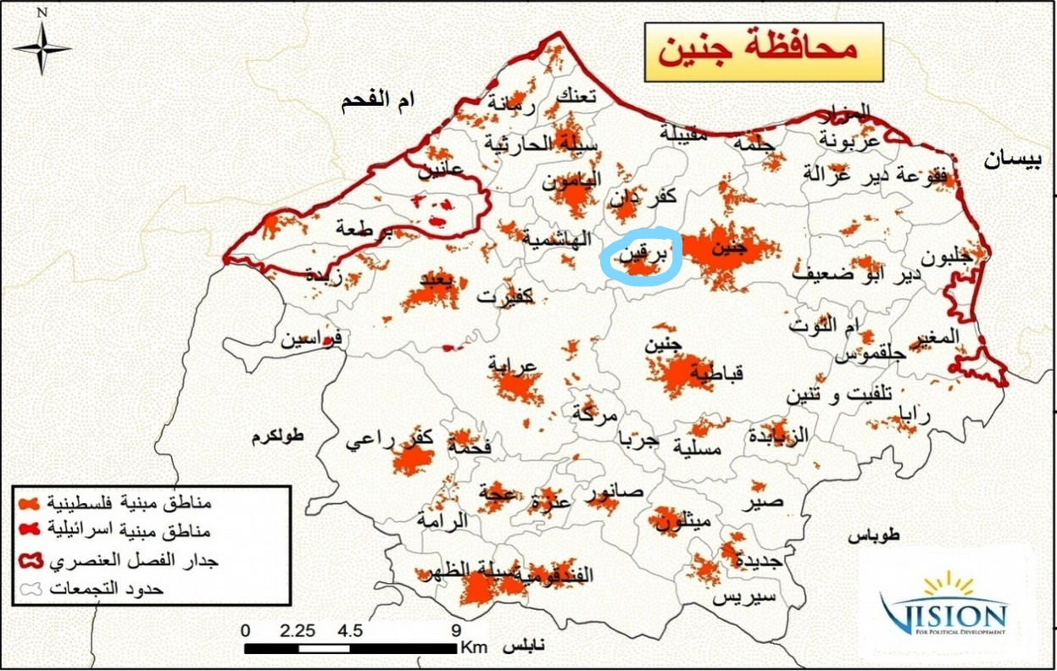
Birqen located (4 km) to the southwest of Jenin.
(270 m) above mean sea level

Slide 9
Water sources:
Birqen depends on 8 well, 6 wells for the pedestrians and two for the municipality, these wells pumps about 2500 cubic meter per month.

Slide 10
السنة | عدد السكان
1997 | 4394
2007 | 5685
2017 | 7064
2051 | 16959

Slide 11
Methodology

Slide 12
The work will be with the help of(SewerCAD) software.
And it’s generally:
Design a (WWCN) for Birqen Village.

Slide 13







Determination of the project
Cost Estimation
Data Collection
Methodology
Design the network
Data Processing
Load Estimation

Slide 14
Collection of information:
----------------------------------------------
Contour lines, road network, and boundary of Birqen.
The amount of water supplied each month.

Slide 15
Design of the network
----------------------------------------------
First of all, convert the AutoCAD to GIS shapefiles.
Divide the area to four parts.
Place the manholes and connect them with conduits.
Placing outfall for each part at the lowest elevation on that part.

Slide 16
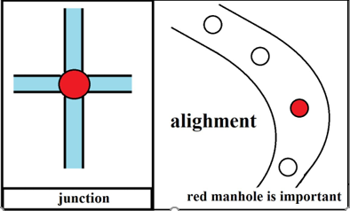
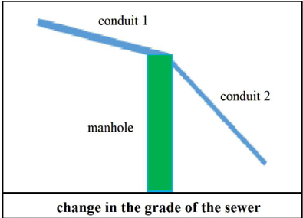
MANHOLES PLACING
-------------------------------------------------
Importance: cleaning and maintenance
connecting sewers together
Where we find manhole?

Slide 17
Analysis And Design of the network

Slide 18
LOAD DETERMINATION
---------------------------------------------
Assumption:
The load on all the manholes are equal
The average daily water consumption = 103 L/c.d
The return flow = 80%
The peak factor = 4
The infiltration rate = 20%
Design period 30 years.

Slide 19
Calculations:
Unit load = {QWW + QI)
=(Population*average daily water consumption (per capita per day) *return flow (%) *peak factor)
+
(Population* water demand* return flow (%) *% Infiltration)
= 5869170.72 L/d
= 5869.18 m³/d

Slide 20
Load distribution on the manhole :
Load on one manhole = the total load / number of manholes
= 5.1 m³/d

Slide 21
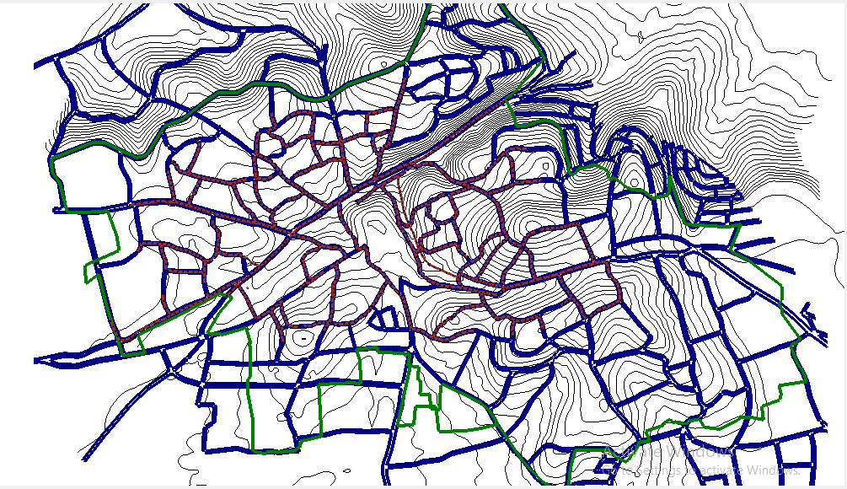
Plan View for a networks

Slide 22
Identifying the following:
The elevations by the T-Rex.
For conduits, cross-section type (circular) type, the material (PVC) and diameters starting from (8”) for all conduits.
Modify the constrains:
Velocity (0.5-3.5) m/s.
Cover depth (1-4) m.
Slope (1-20) %.
Using drop structures.

Slide 23
Input the load on manholes: by population base way.
The unit load = 5.1 m³ /c.d
Calculation option list:
Calculation type: (Design).
Time analysis type: ( steady state)
Run the model.

Slide 24
Results
----------------------------------------------
Diameters: from 8” to 12”.
Velocity: within (0.5 – 3.08) m/s.
Cover depth: (1- 5.94) m.
Slope: (0.5 – 30)%.

Slide 28
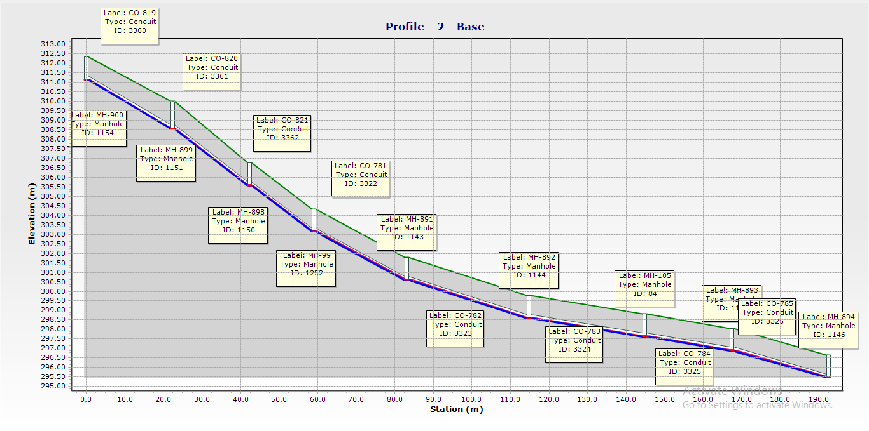
PROFILES
---------------------------------------------
The following profile shows the maximum slope:

Slide 29
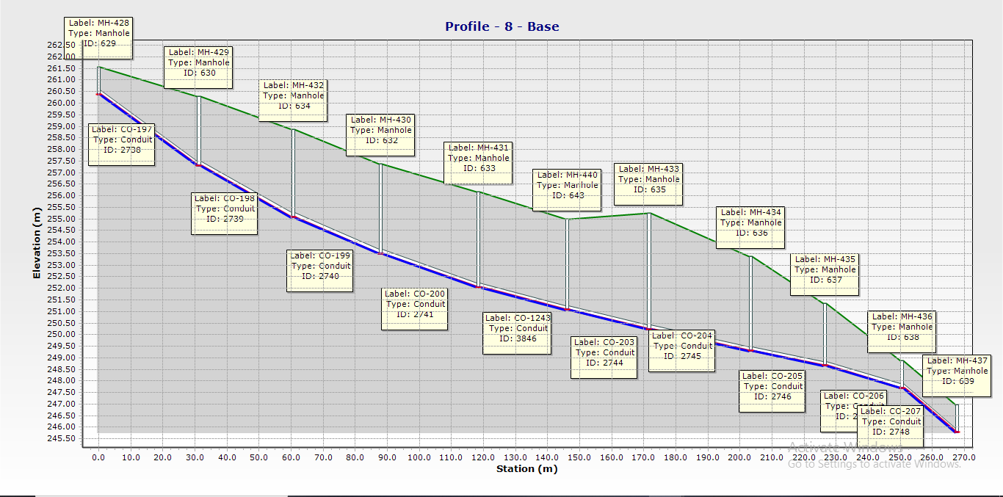
Profile shows the maximum depth

Slide 30
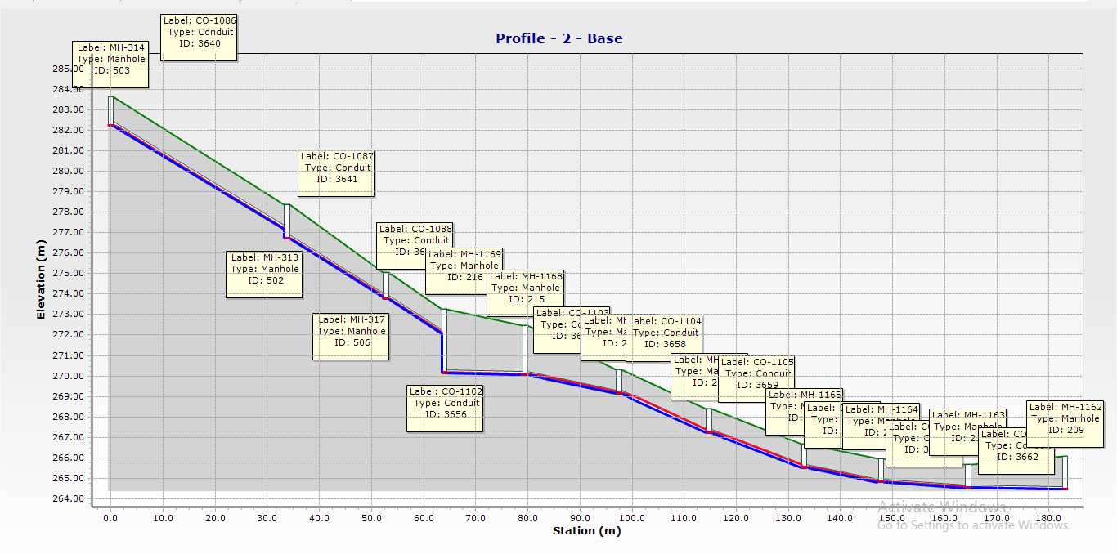
Profile shows using drop manhole.

Slide 31
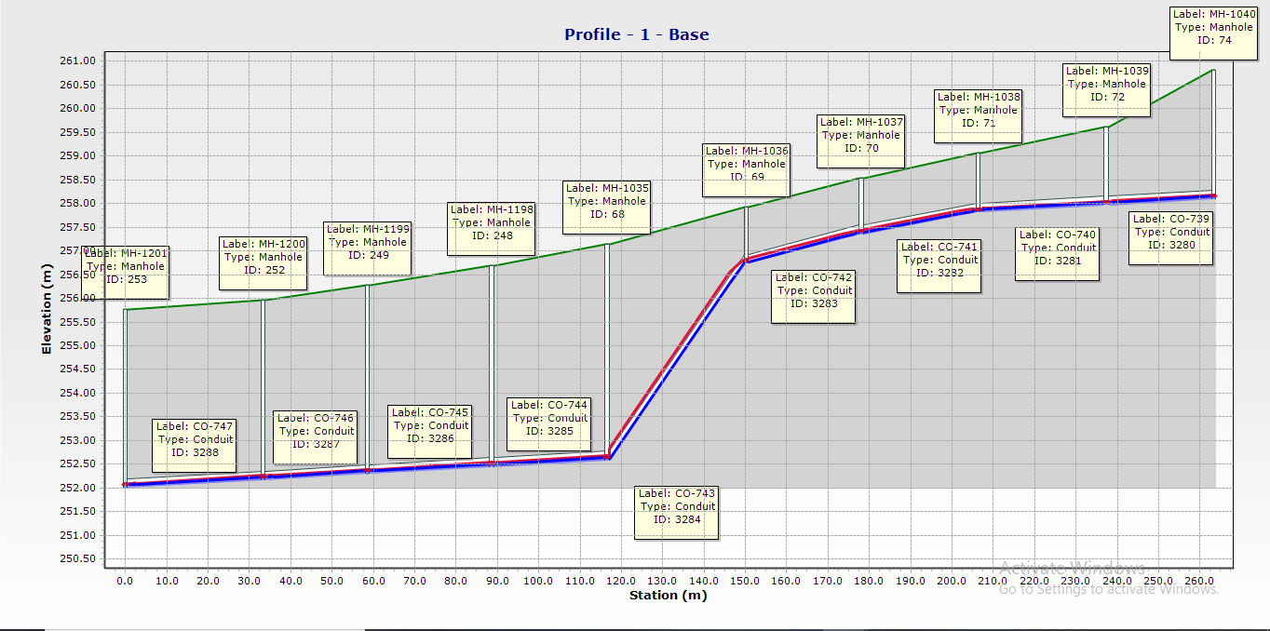
Profile show the maximum velocity.

Slide 32
Cost Estimation

Slide 33
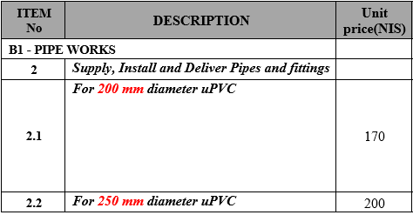
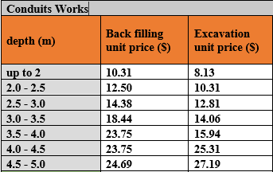
Conduit Costs:
Excavation:
{Avg depth * Unit price for (Excavation + Backfilling) * Length}
Material:
{ Diameter * Unit price for the diameter * Length }

Slide 34
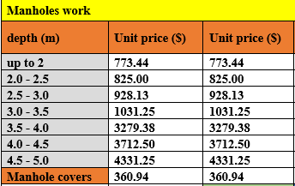
Manholes cost:
{ Excavation + materials}
{ (the depth * Unit price) + Cover of the manhole “ Fixed price”}

Slide 35
Cost Results:
When the estimation was done, we reached these results:
1- the total cost for the whole project is (3995554) $.
2- The price for each Km2 is (205956.4) $
3- The price of the network is (565.6) $, for a single capita

Slide 36
Obstacles

Slide 37
Problems we faced in the design:
The main problem we face is the topography of the Village.
Loops of the network.
Cover depth were high in some conduits.

Slide 38
Conclusion and
Recommendation

Slide 39
Conclusions:
the total Number of manholes used in the network is 1151 manhole and same as for conduits.
The material used in Conduits is “PVC” and the diameters ranged between (8-12 ) inches.
The velocities were within the range (0.5 – 3.5 ) m/s.
Most of the conduits were within the range of cover depth (1-4) m.
Most of the conduits were within the range of slope (1-15) %.
The topography has a clear effect on the slope, cover depth and velocity.

Slide 40
Recommendations:
Using the data collected to apply this design of the wastewater collection network in the study area of Birqen.
Studying the obstacles that could be faced during the construction of the network.
Studying and selecting a location for wastewater treatment plant.

Slide 41
Thank you

