Slide 1
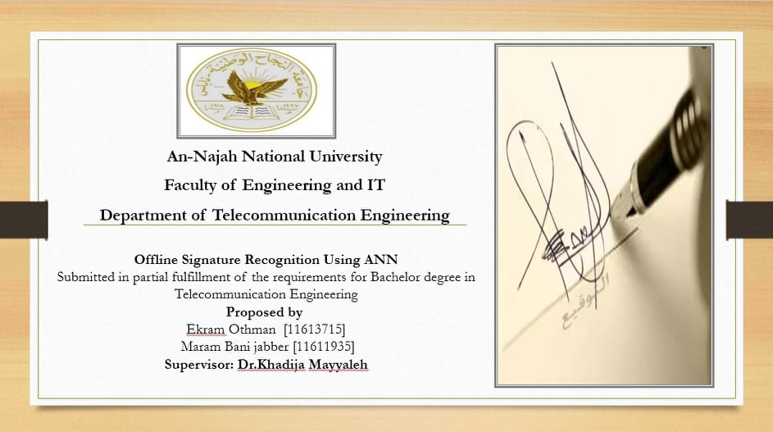

Slide 2

introduction
A person’s signature is an important vital feature for a person that can be used to verify human identity, so we used the artificial neural network method to recognize the signature , and it consists of simple elements that work in parallel, these elements are inspired by the biological nervous system.

Slide 3
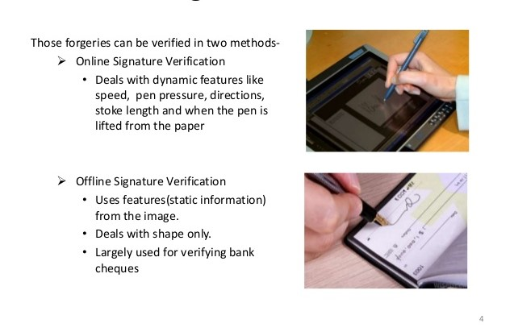
The principle of its work is that the signature is captured and presented to the user in a form picture. Signature verification can be classified into online signature verification and offline signature verification.

Slide 4
Off line vs. online signature verification
Online verification is based on dynamic capturing of signatures when they are made whereas Offline verification generally uses a scanned image of signatures.
The objective of this project is to focus on the offline model of verification where several signatures are put through various processes before finally verifying it to be true or forged through Artificial Neural Networks (ANN).

Slide 5
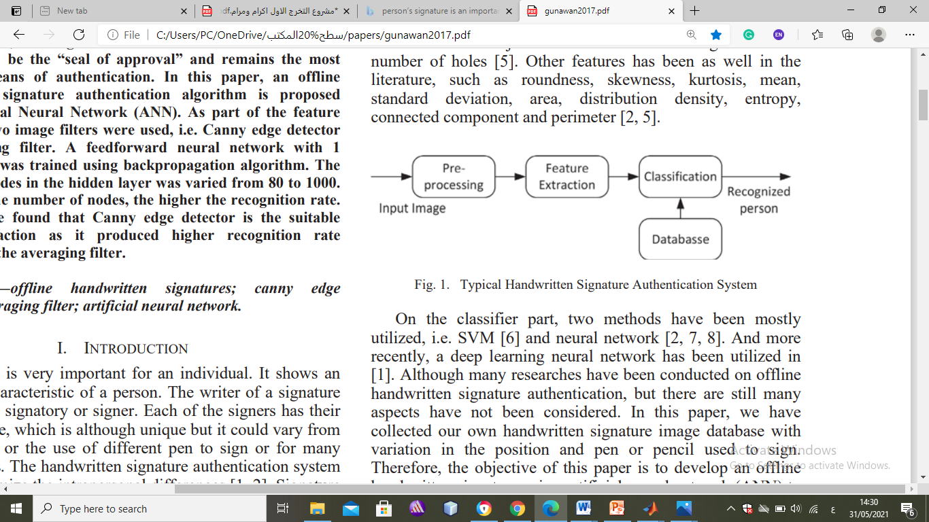
The objective of this project is to focus on the offline model of verification where several signatures are put through various processes before finally verifying it to be true or forged through Artificial Neural Networks (ANN). . To perform verification or identification of a signature,
several steps must be performed. These steps
*Image pre-processing
* Feature extraction
* Neural Network are: Training

Slide 6
Algorithms and methods
From many algorithms and methods with different accuracy percentages In this project we propose a human signature recognition system based canny edge detection and pattern averaging and back propagation neural network system.

Slide 7
Main Concepts
The developed framework consists of two main phases which are the:
processing phase
the classification phase
in which the image is classified as many signatures To perform verification or identification of a signature several steps must be performed, These steps are
*Image pre-processing *
Feature extraction *
Neural network training

Slide 8
IMAGE processing phase
It is the first step in signature verification and recognition.
the image processing phase the signatures are processed using many techniques such as
*conversion to grayscale
*filtering using median filter
*segmentation using canny edge detection
These techniques are done in order to enhance the quality of images and to extract the important features in such a way to take only the signature and ignoring the other features and parts of the image

Slide 9
Signature Images Processing
1- RGB to grayscale conversion
2- Image smoothing using median filtering
3- Adjustment of image intensities
4- Thresholding (Hard activation function)
5- Canny edged based segmentation
6- Features extraction and rescaling using pattern averaging

Slide 10
RGB to grayscale conversion
The images were first converted from RGB to grayscale in which this conversion is done using the luminosity method . This method is a
*more sophisticated version of the average method.
*It also averages the values of the image matrix.
green is weighted most heavily,because humans are more sensitive to green than other colors .
The formula for luminosity is 0.21R + 0.72 G + 0.07 B

Slide 11
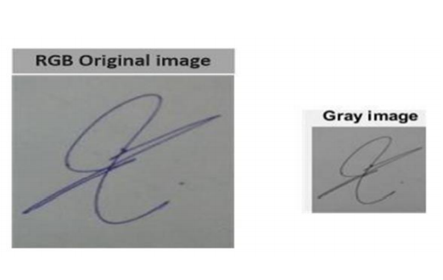
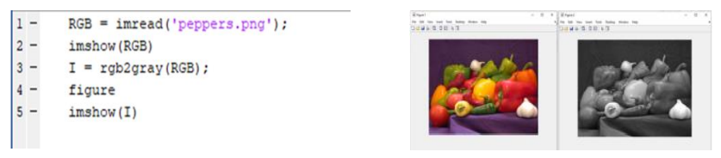
RGB_Conversion for a signeature image
Matlab code for RGB_Conversion for a normal image

Slide 12
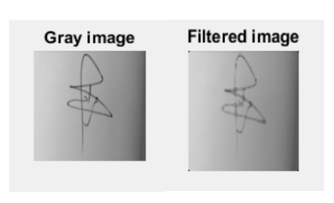
Image smoothing
Smoothing, so called blurring, is an image processing technique used in order to reduce the noise in an image to produce less pixelated and clearer image.
Most smoothing techniques are based on
1-Median Filtering(Smoothing Non-Linear Filter)
2. Average Filtering(Smoothing Linear Filters)
The input signature image after applying median filter

Slide 13
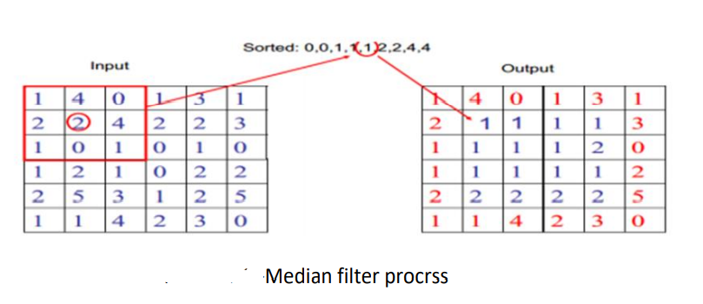
Image smoothing using median filtering
This filter is used to reduce impulsive noise or the salt-and pepper in an image with preserving the useful features and image edges.
Median filtering is a non-linear process in which the output of the being processed pixel is found by calculating the median of a window of pixels that surrounds that studied pixel.

Slide 14
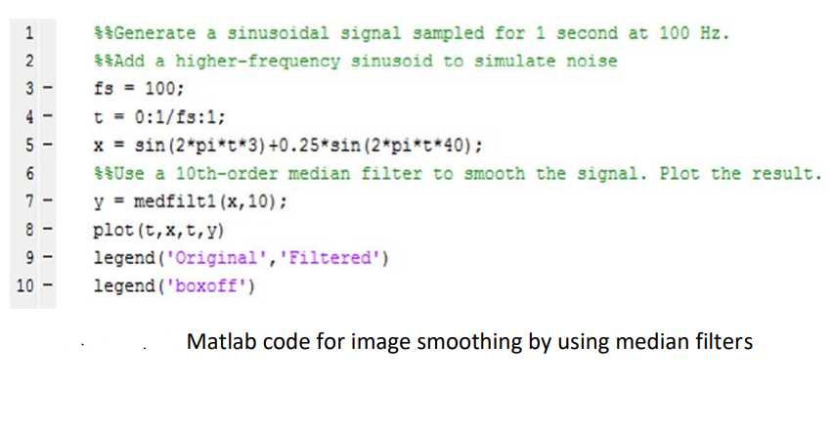
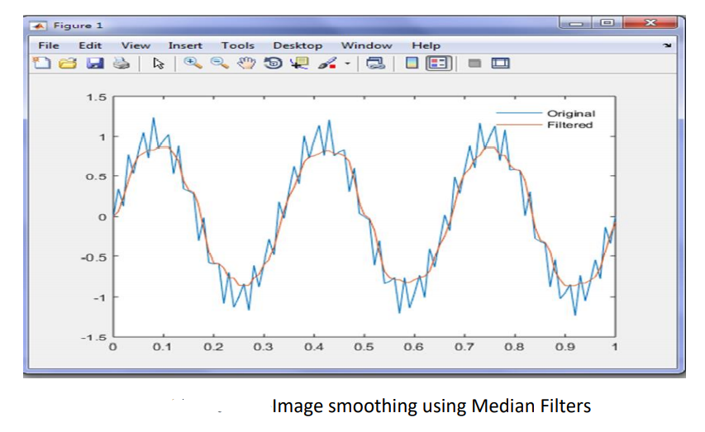

Slide 15
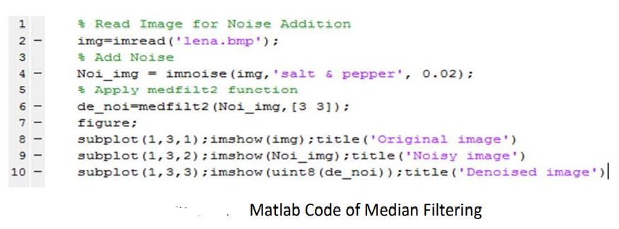
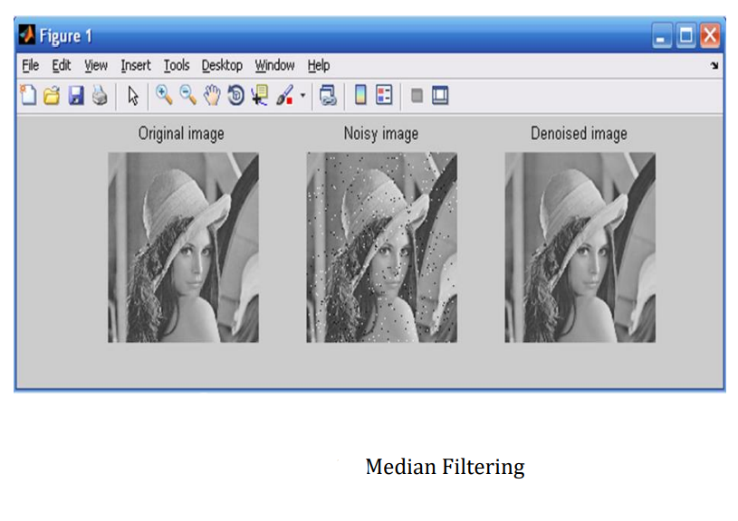

Slide 16
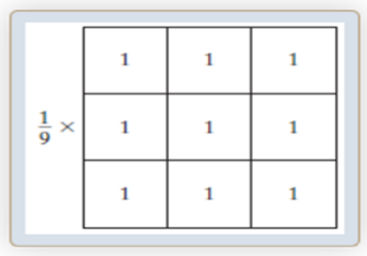
Image Smoothing using Average Filtering
The output of a smoothing, linear spatial filter is simply the average of the pixels contained in the neighborhood of the filter mask.
The idea behind smoothing filters is straightforward. By replacing the value of every pixel in an image by the average of the gray levels in the neighborhood defined by the filter mask, this process results in an image with reduced “sharp” transitions in gray levels. Because random noise typically consists of sharp transitions in gray levels, the most obvious
application of smoothing is noise reduction.
Average Filter mask is as follows:

Slide 17
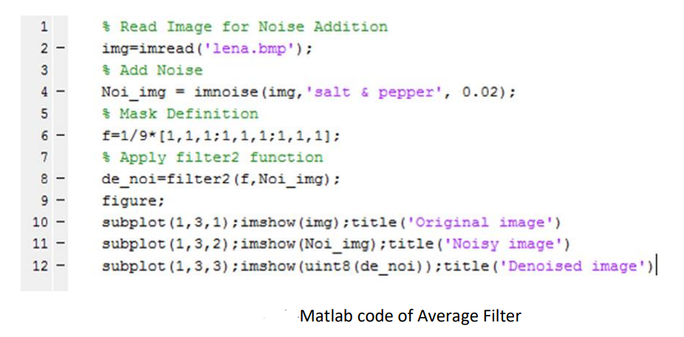
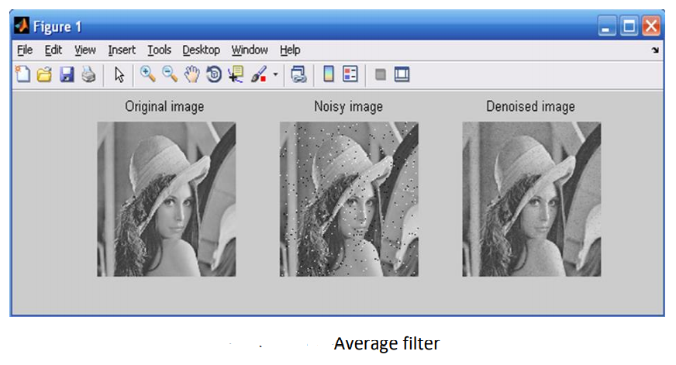

Slide 18
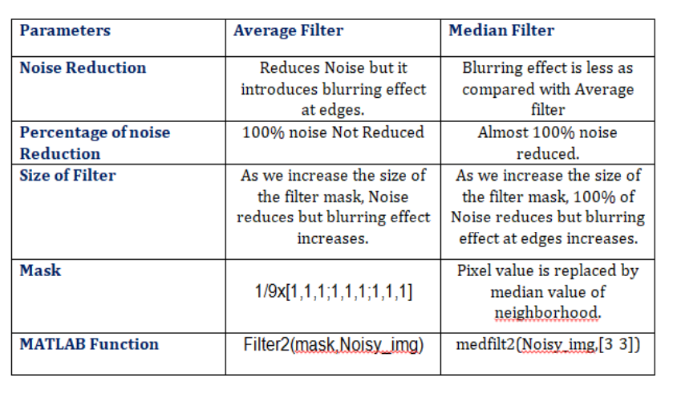
Comparison Between Filters

Slide 19
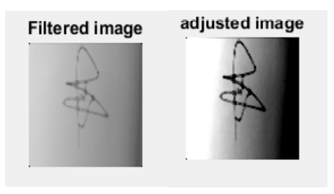
Adjustment of image intensities
For the purpose of increasing the image intensity and enhance its quality, the images undergo intensity adjustment.
This image processing technique that aims to enhance the contrast of the image by increasing the intensity of its pixels.

Slide 20
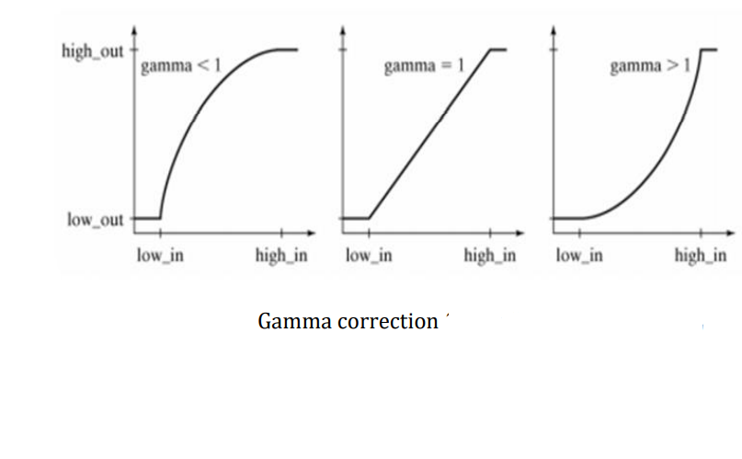
During this operation, the intensity value of each pixel in the input image is transformed using a transfer function to form a contrast-adjusted image.
Gamma contrast adjustment is the most common used transfer function

Slide 21
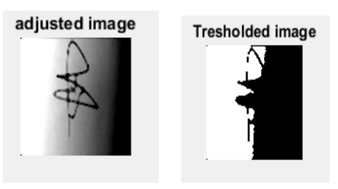
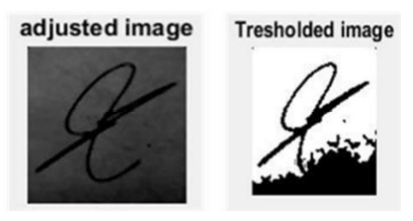
Thresholding (Hard activation function)
Thresholding is the separation of region of images into two regions.One region corresponds to the foreground region, in which it contains the objects that we are interested in.The other region is the background, corresponds to the unneeded objects.
The input of this method is usually a grayscale or color image, while the output is a binary image representing the segmentation.
The black pixels refer to background and white pixels refer to foreground.

Slide 22
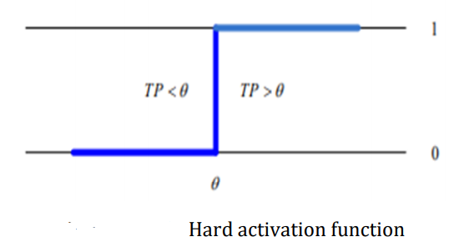
In the threshold function the output is zero if the summed input is less than certain value of threshold, and 1 if the summed input is greater tha threshold.
The function of the hard function is defined by:

Slide 23
Canny edged based segmentation
Algorithm for the image processing
The goal of such image processing operation is to represent some meaningful and needed areas of the image, such as tumors, faces etc…
In other words, the segmentation is the grouping of interesting regions of the image into foreground regions of interest and background regions to be ignored using some techniques such as tresholding.

Slide 24
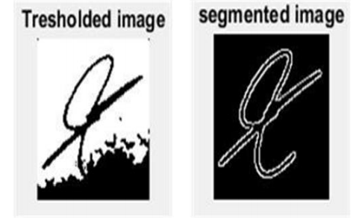
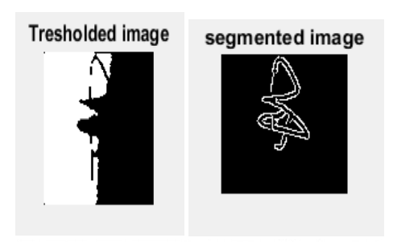
The Canny edge detector is considered as one of the best currently used edge detectors since it provides good noise immunity and detects the true edges or intensity discontinuities while preserving a minimum error. Canny operator has been used for such algorithm with regard to the following criteria
*To maximize the signal-to-noise ratio of the gradient
*To ensure that the detected edge is localized as accurately as possible
*To minimize multiple responses to a single edge

Slide 25
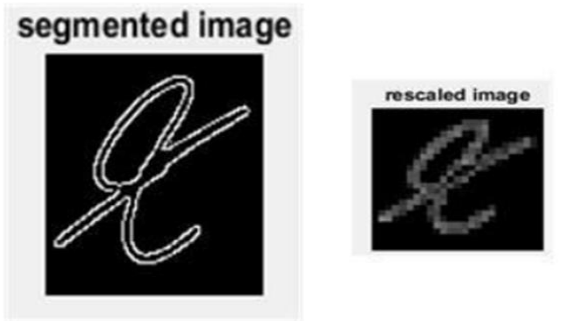
Features extraction and rescaling using pattern averaging
algorithm for Feature Extraction (the Pattern Averaging)
After the segmentation process using the canny edge detection, the images size should be reduced in order to be fed to the neural network. To reduce the size of images while keeping the useful and needed features extracted ,by the previously used methods, we used patter averaging.

Slide 26
Segmented Signatures
At the end of this image processing phase the images are saved all in a file.
This was meant to evaluate the effectiveness of the system and to assure that all images were correctly segmented and rescaled.

Slide 27
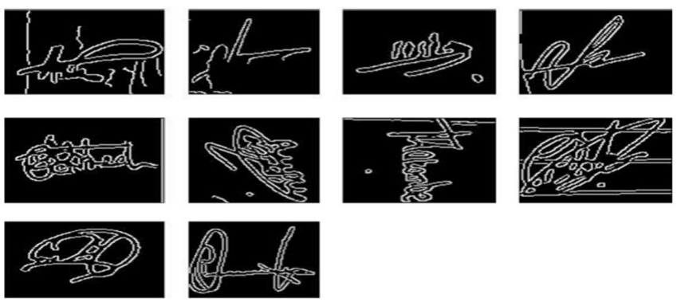
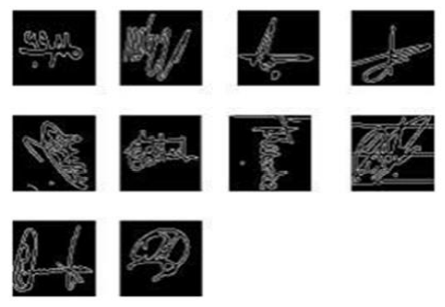
Sample of the processed and segmented signature image using the proposed system
Sample of the rescaled signatures processed using the proposed system

Slide 28
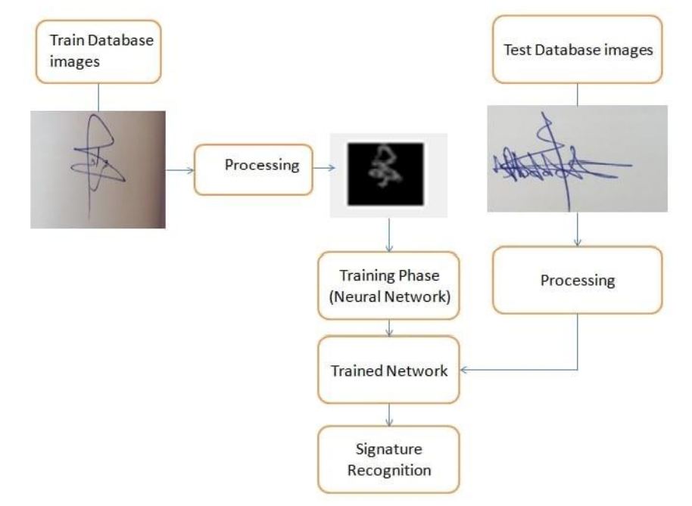
NETWORK TRAINING AND PERFORMANCE

Slide 29
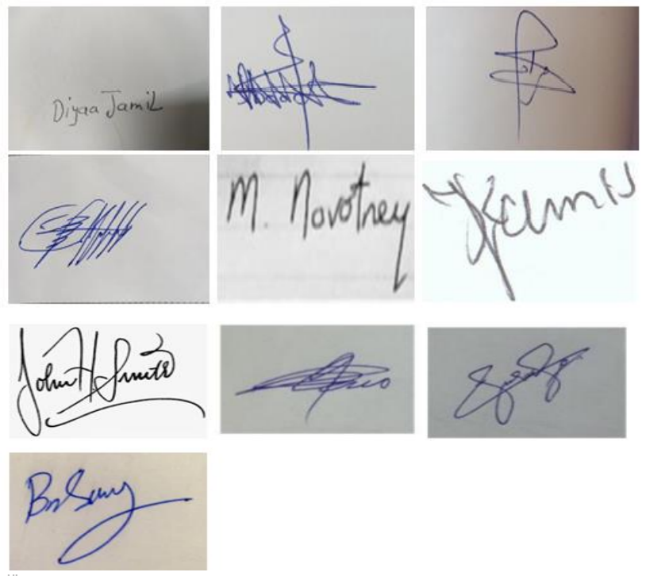
Backpropagation Neural Network Classification
(Algorithm for traning method )
In this phase a back propagation neural network is trained to recognize human signatures in an image. In order to achieve this binary classification task, training data is collected to have many different signature images.
Sample of training images

