Slide 1
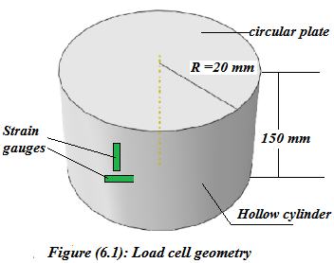
Large Area Dynamic Load Cell
Supervisor : Dr.Iyad Assaf

Slide 2
Outline Project
Introduction.
Definition of load cell and main types.
Definition of strain gauge and main types.
Finite Element Analysis of Impact Soccer Ball.
Load Cell design.
Conclusions.

Slide 3
Introduction

Slide 4
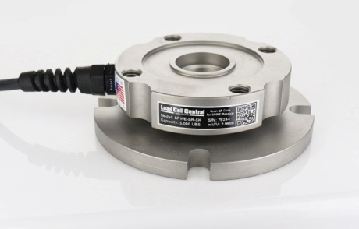
Load cell
Definition.
Types of load cell.

Slide 5
Types of load cell
strain gauge load cells.
Pneumatic load cell.
Hydraulic load cell.
Vibrating load cell.
Piezoelectric load cell.

Slide 6
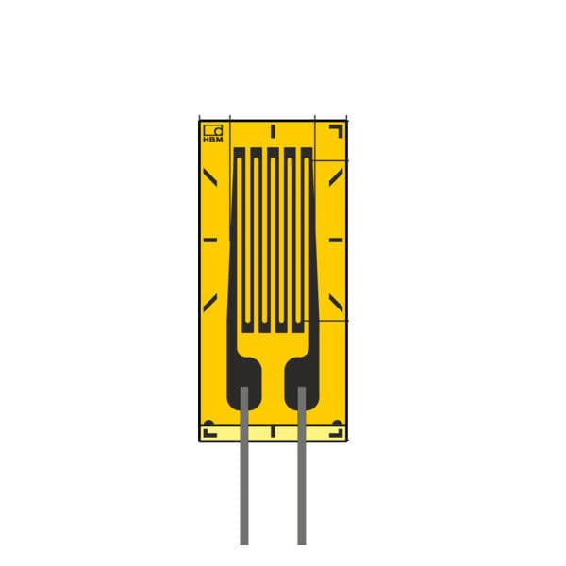
Strain gauge
Definition.
Types of strain gauge.
Wheatstone bridge.

Slide 7
Types of strain gauge
Tubular strain gauges.
Mesh strain gauges.
Foil strain gauges.

Slide 8
Finite Element Analysis of Impact Soccer Ball

Slide 9
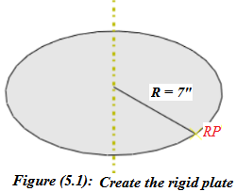
1-Part modules (plate)

Slide 10
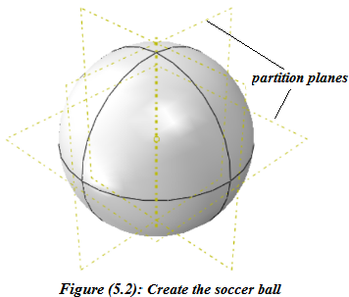
Part modules (ball)

Slide 11
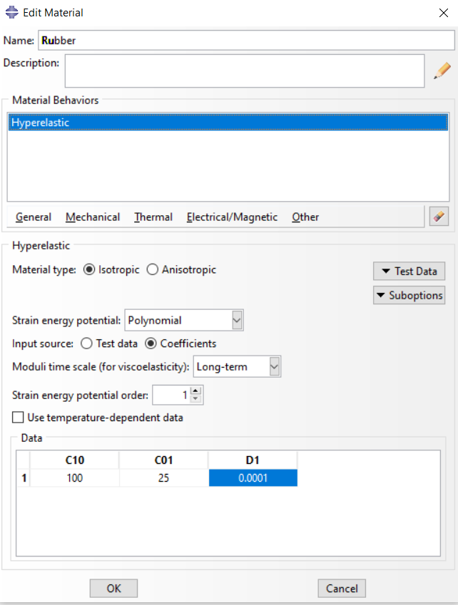
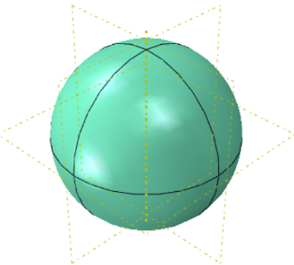
2-Property module
Figure (5.3): The material properties editing box
Figure (5.4): Assigning the material properties to the ball

Slide 12
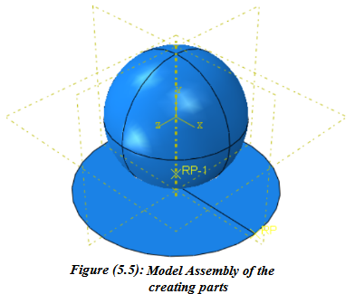
3-Assembly module

Slide 13
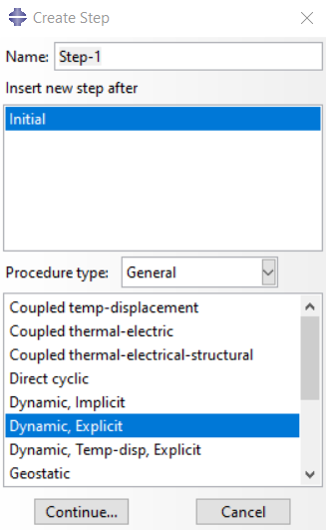
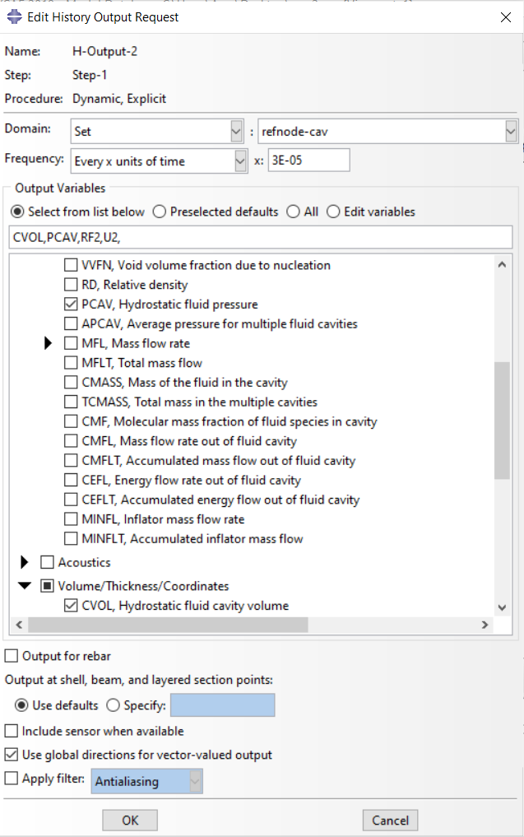
4-Step module
Figure (5.6a):Create step
Figure (5.6b): History output request for the ball deformation

Slide 14
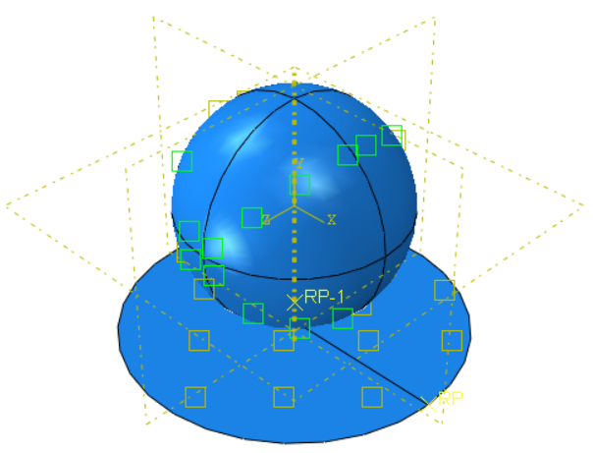
5-Interaction module
Figure (5.7): Interaction between the rigid plate and the deformable ball

Slide 15
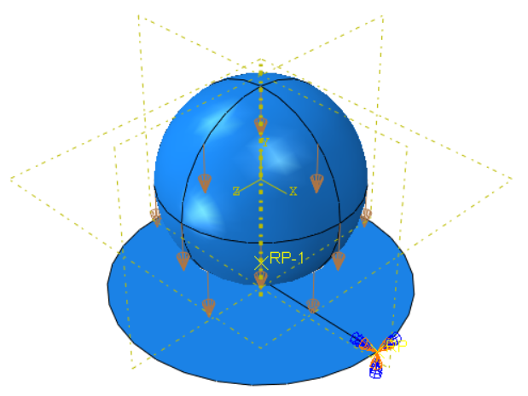
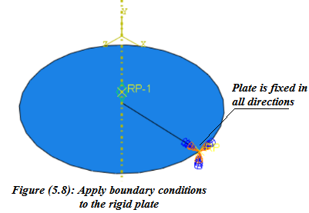
5-Load and Boundary Conditions module
Figure (5.9): Apply the initial velocity of the soccer ball

Slide 16
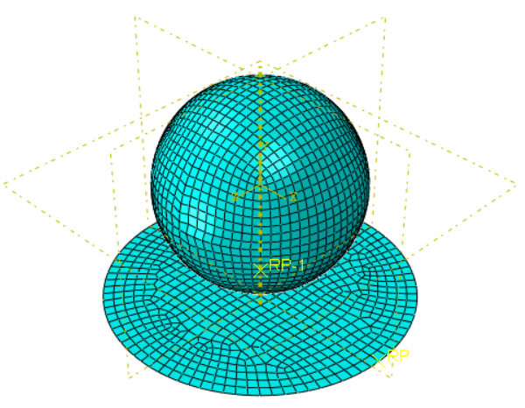
6-Mesh module
Figure (5.10): Mesh the soccer ball and the rigid plate

Slide 17
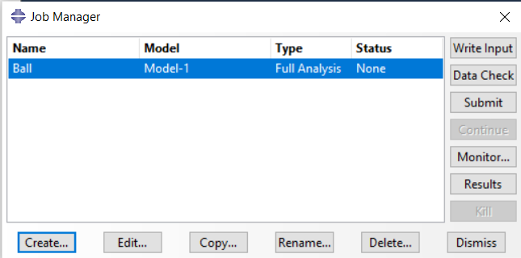
7-Job module
Figure (5.11): Crate the job module

Slide 18
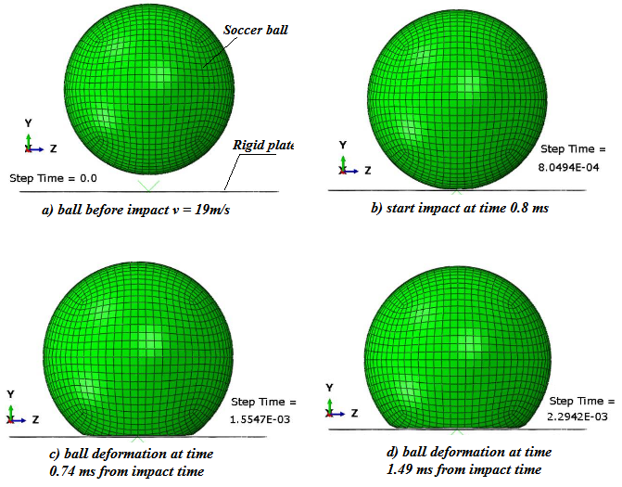
8-Results of job

Slide 19
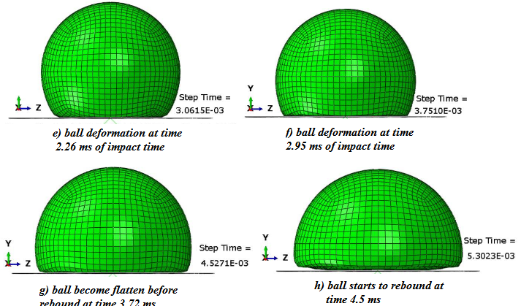

Slide 20
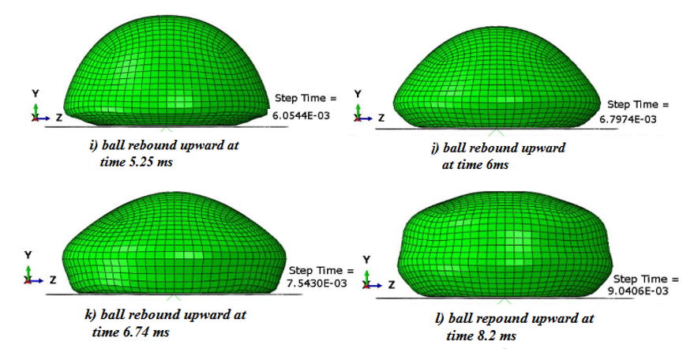

Slide 21
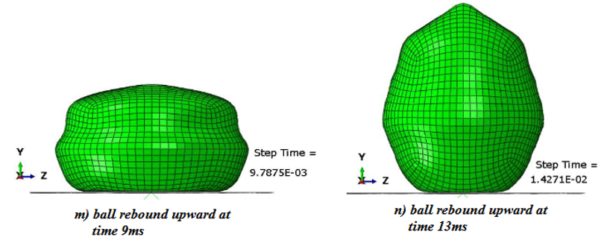
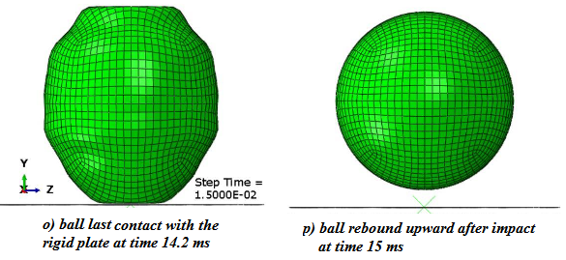

Slide 22
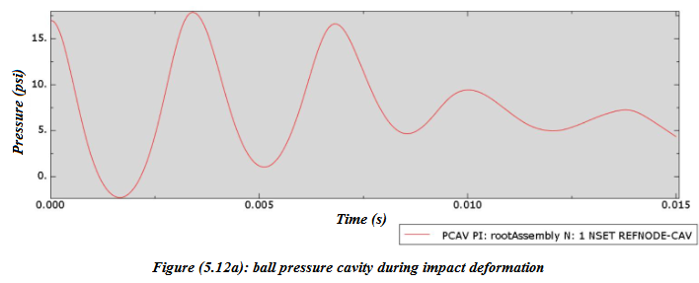

Slide 23
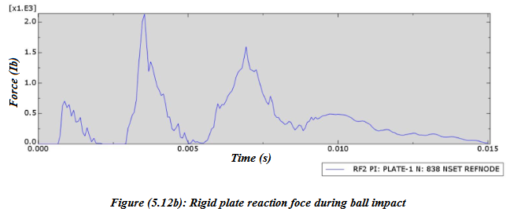

Slide 24
Load Cell design
Load cell geometry and specifications
Load cell natural frequency

Slide 25
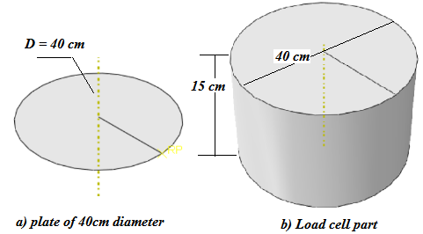
1-Creating the load cell part
Figure (6.1): Create the load cell part

Slide 26
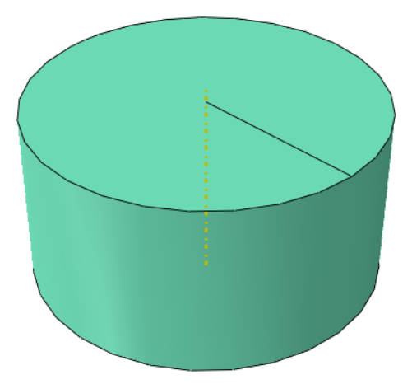
2-Define the material property

Slide 27
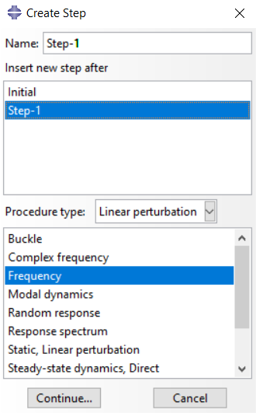
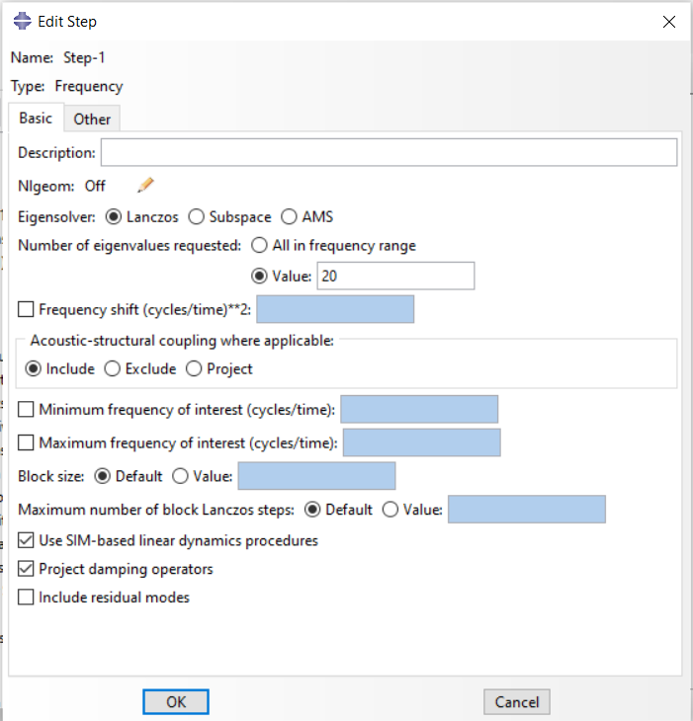
3-Define step analysis

Slide 28
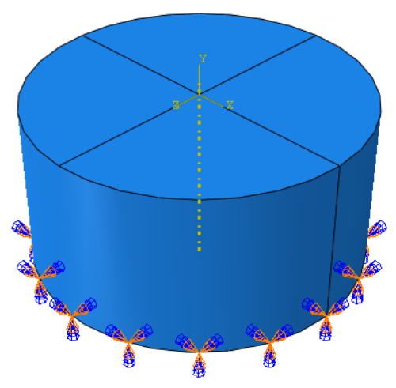
4-Load and boundary condition defined

Slide 29
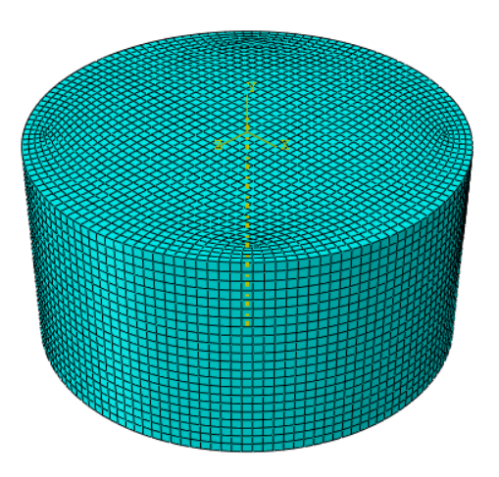
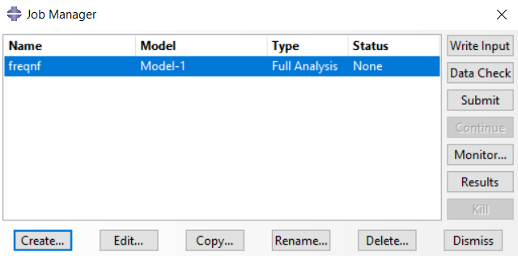
5-Meshing the model and running the job

Slide 30
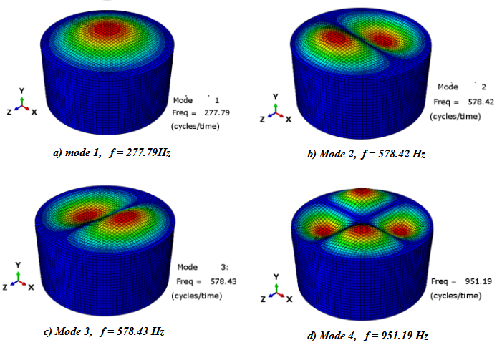
6- Results of job

Slide 31
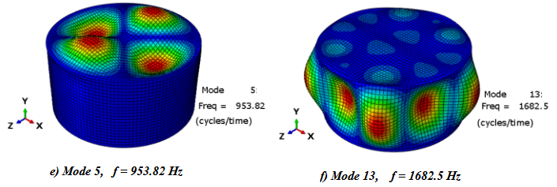

Slide 32
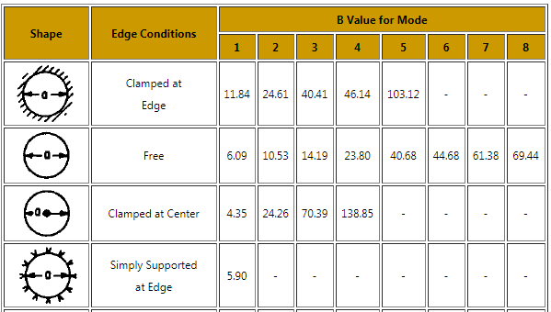
Natural frequency using theoretical method
Table (6.2): values of coefficient B for different edge conditions of circular plate

Slide 33
Natural frequency using theoretical method
Frequency f =
Table (6.2): Comparison between FE and theoretical the frequency
Mode shape | 1 | 2 | 3 | 4 | 5
Load cell (Hz) | 277.8 | 578.4 | 578.4 | 951.2 | 953.8
Circular plate (Hz) | 311 | 648.2 | 648.4 | 1064.4 | 1064.4

Slide 34
Load cell sensitivity
1- Sensitivity calculation for 9.5 KN Load on the center of the circle plate.
Sensitivity =
E_{max} =4.358 (10⁻⁴)
Covert the strain to μe/strain gauges = (Emax)(e⁶) = (4.358 (10⁻⁴))(e⁶) = 435.8µe/strain gauge
Minimum Number of Strain Gauge Placed on Load Cell = 4
435.8 µe × 4 = 1743.2 µe
Sensitivity = 1743.2µe/9.5 KN = 0.183 µe/N

Slide 35
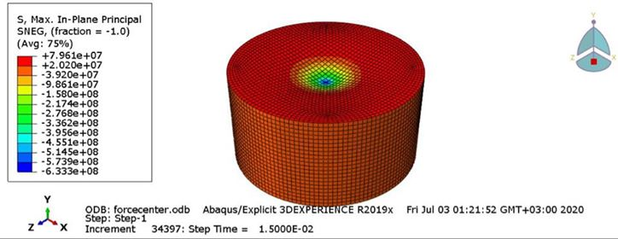

Stress contour of the load cell at 9.5kN at the center
Strain contour of the load cell at 9.5kN at the center

Slide 36
Load cell sensitivity
2-Sensitivity Calculation for 9.5 KN load applied at 10cm from the plate center.
Sensitivity =
E_{max}=1.392e⁻³
E_{max} × e⁶ = 1392µe/strain gauge
Minimum Number of Strain Gauge Placed on Load Cell = 4
1392 µe × 4 = 5568 µe
Sensitivity = 5568µe/9.5 KN = 0.58 µe/N

Slide 37
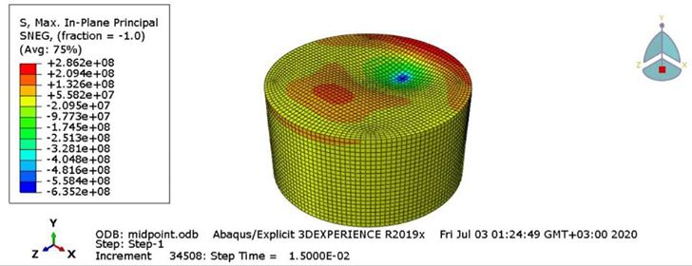
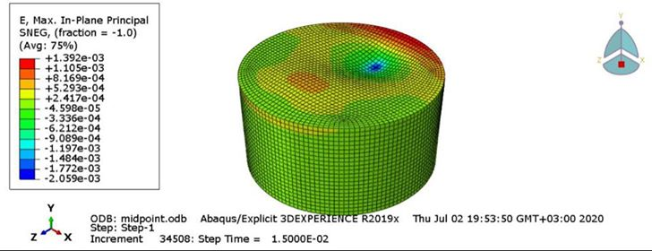
Load cell sensitivity
Stress contour of the load cell at 9.5kN at 10cm from the center
Strain contour of the load cell at 9.5kN at 10cm from the center

Slide 38
Load cell sensitivity
Force = Pressure * Area of plate
E_{max}=5.805e⁻⁴
E_{max} × e⁶ = 580.5µe/strain gauge
Minimum Number of Strain Gauge Placed on Load Cell = 4
580.5 µe × 4 = 2322 µe
Sensitivity = 2322µe/15.32 KN = 0.15 µe/N

Slide 39
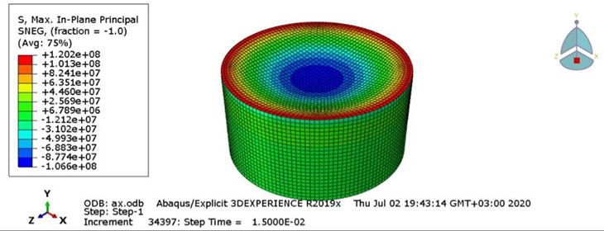
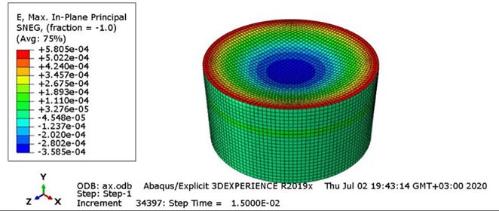
Stress contour of the load cell subjected to 122kPa pressure
Strain contour of the load cell subjected to 122kPa pressure

Slide 40
CONCLUSIONS

Slide 41
Thank you

