Slide 1
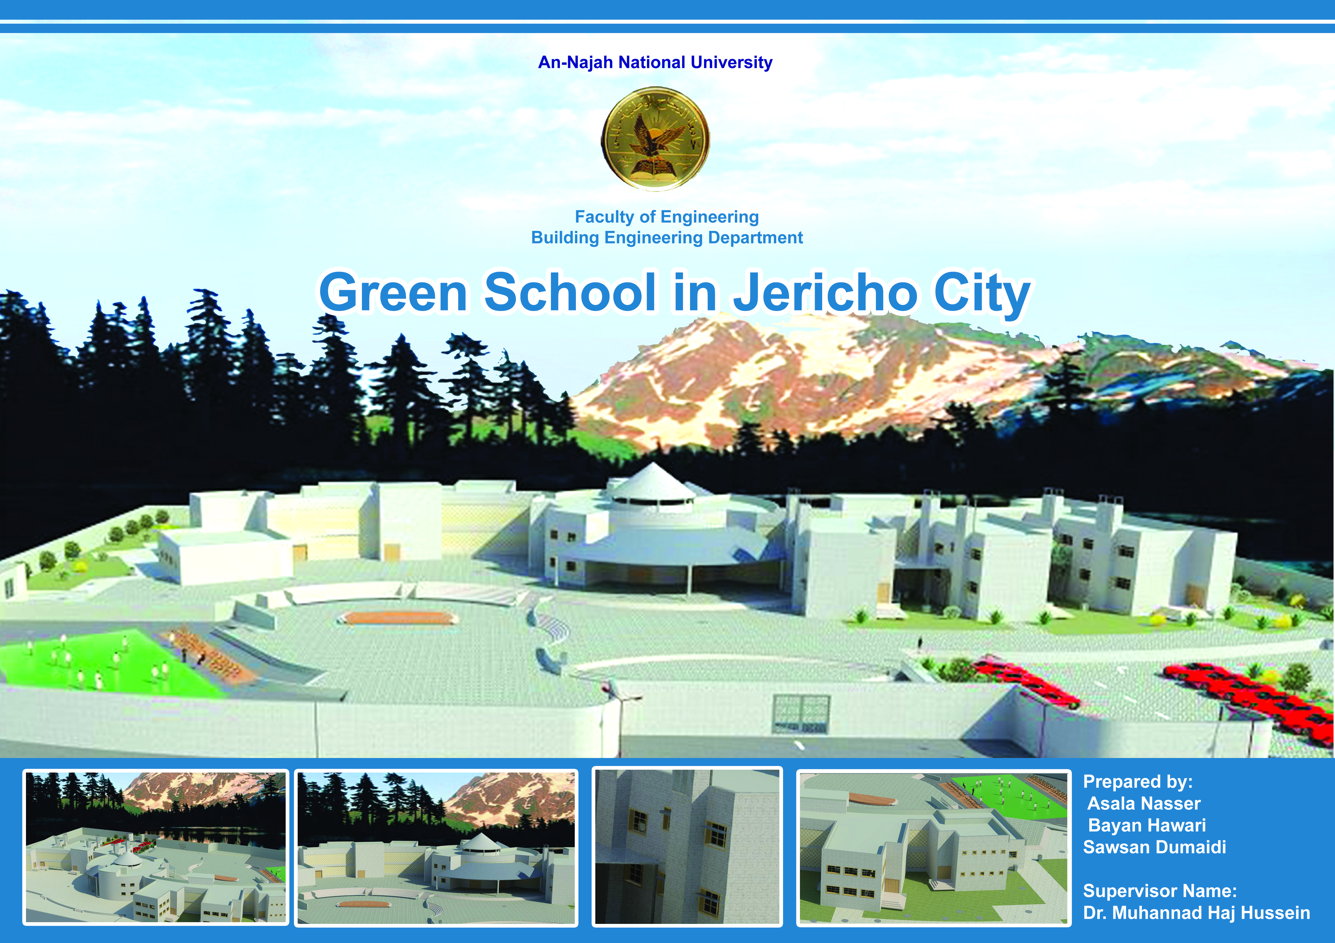

Slide 2
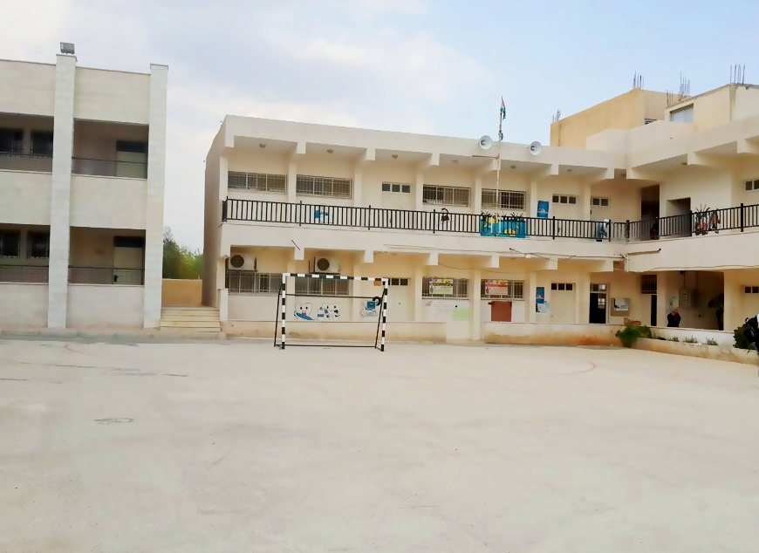
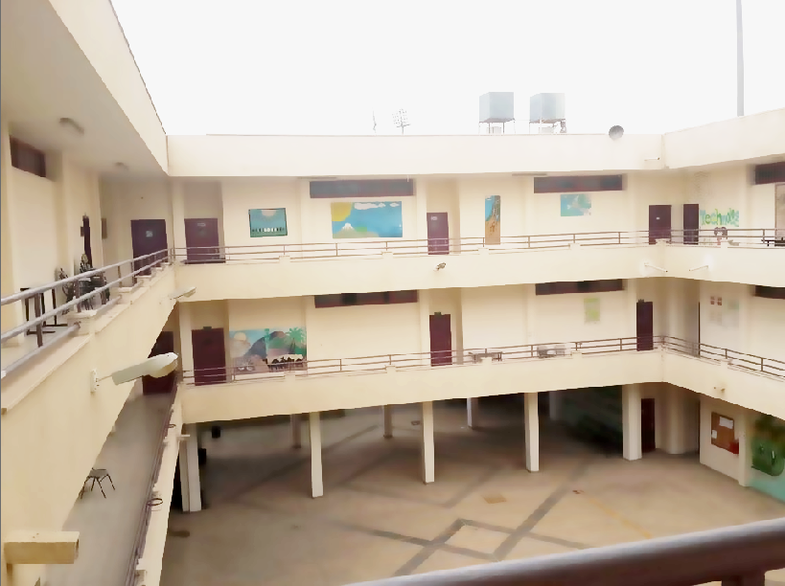
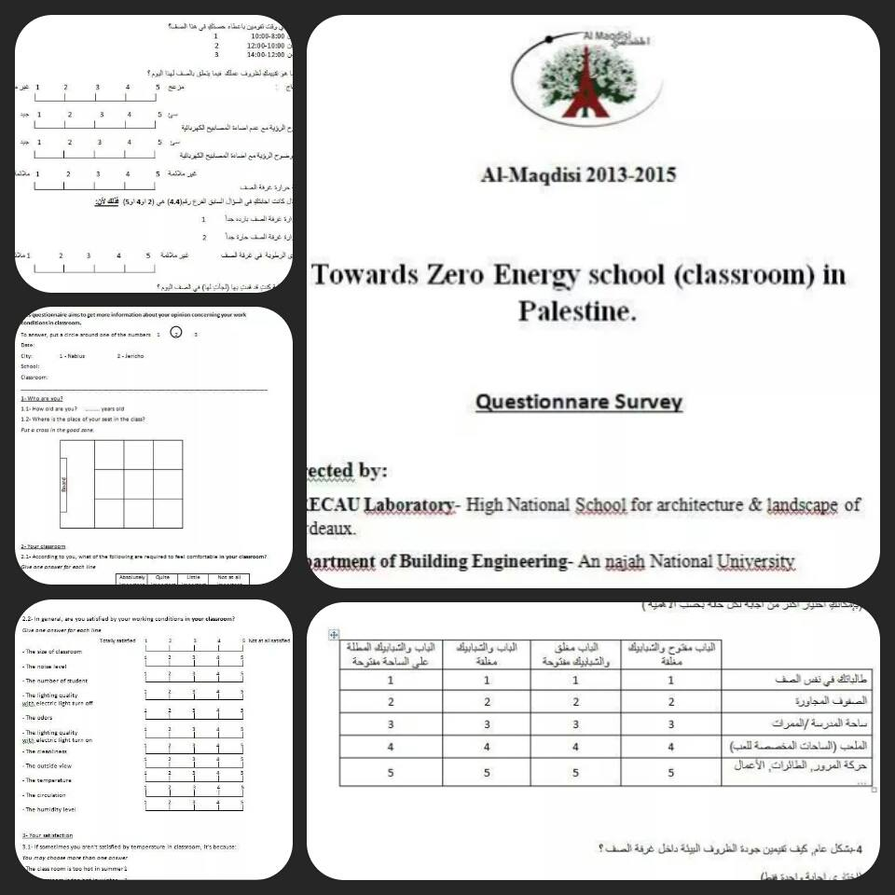
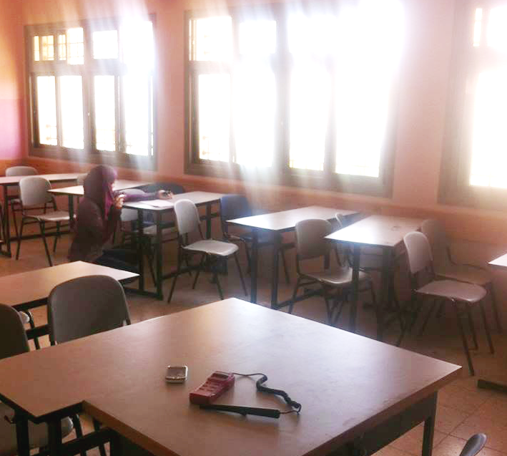
Mechanisms

Slide 3


Slide 4

Outline:
Architecture design
Environmental design
Structural design
Electrical design
Mechanical design
Quantity surveying

Slide 5

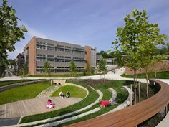
Objective:

Slide 6
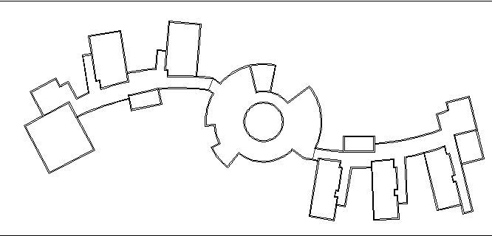
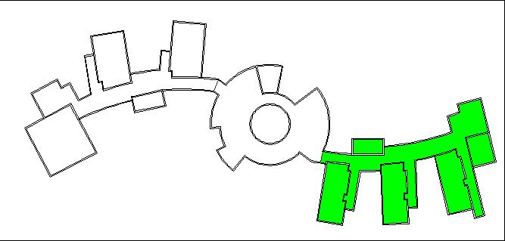
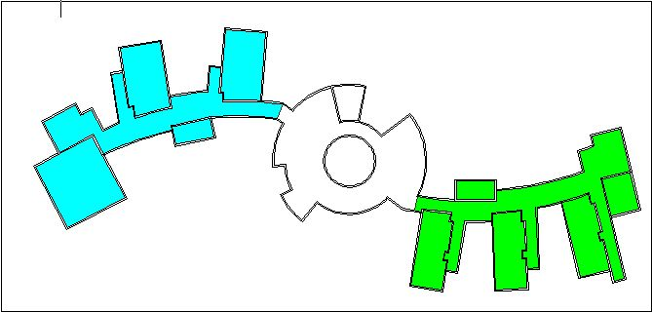
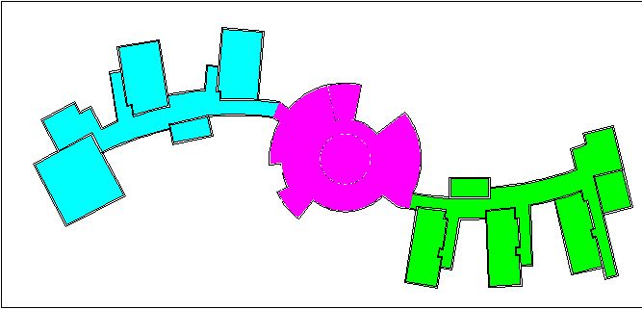
Architectural design:
Design concept
Teaching part
(class rooms)
Activities part
Administration and
services

Slide 7
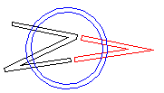
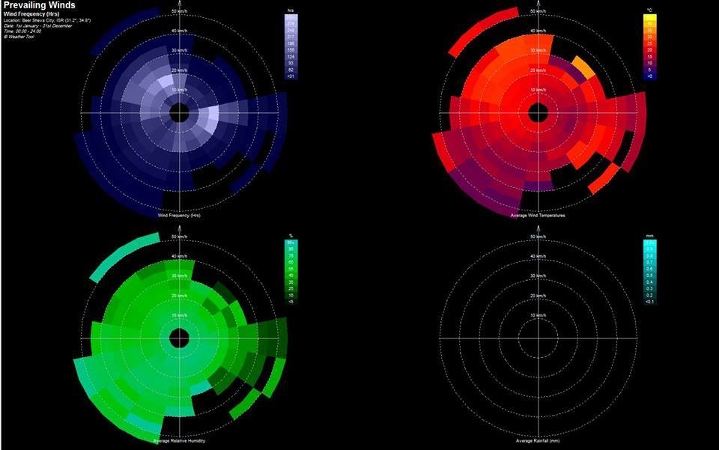
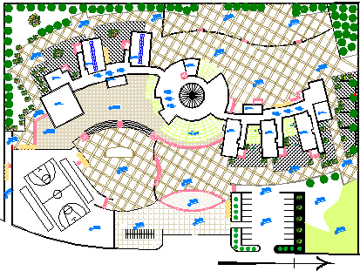
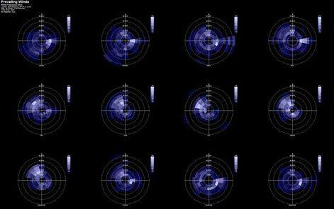
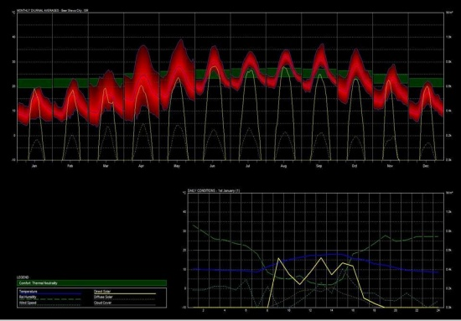
Architectural design:
Built area= 4200 m²

Slide 8
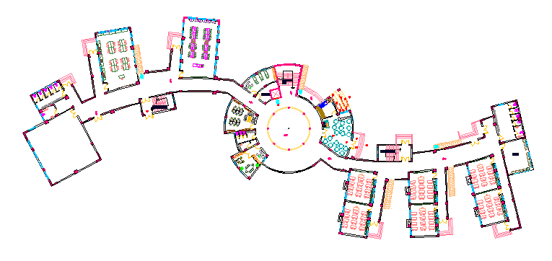
Architectural design:
Ground floor plan

Slide 9
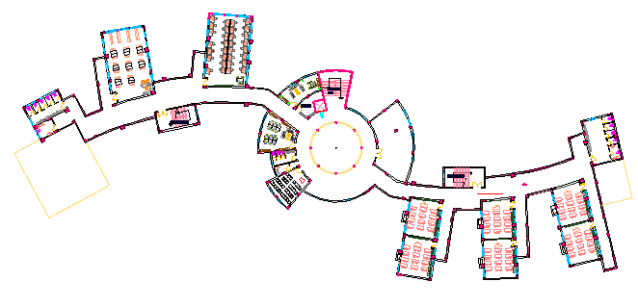
Architectural design:
First floor plan

Slide 10
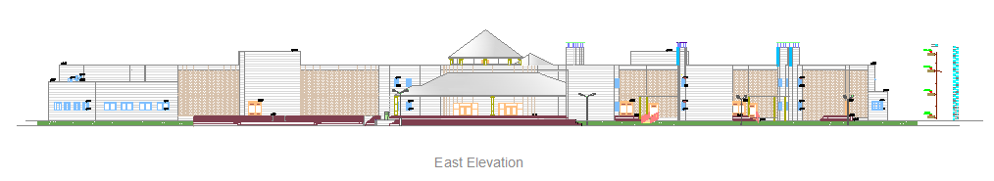
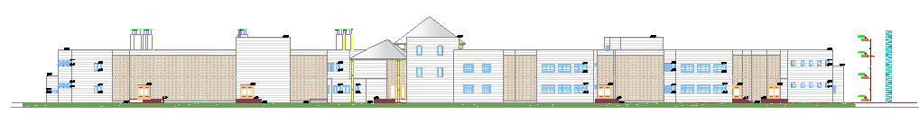
Architectural design:
East Elevation
West Elevation

Slide 11
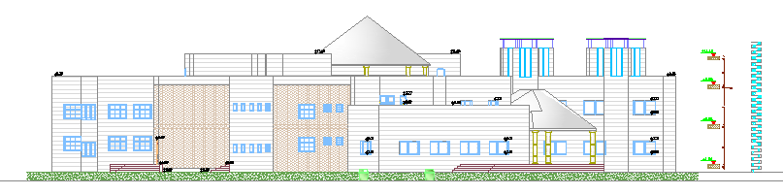
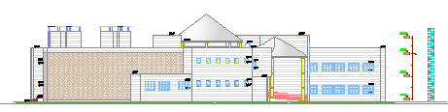
Architectural design:
South Elevation
North Elevation

Slide 12
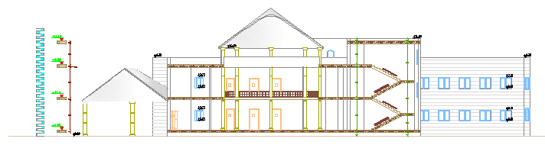
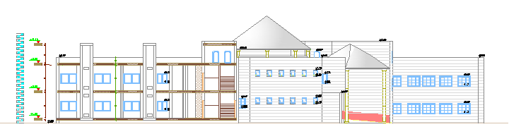
Architectural design:
Sections:

Slide 13
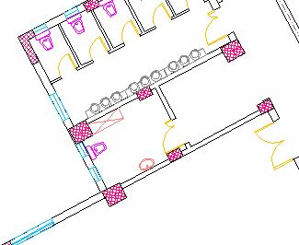
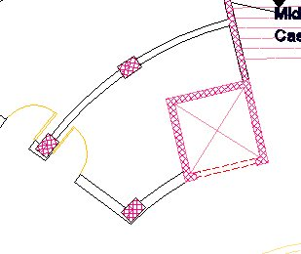
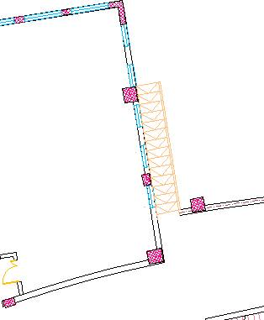
Architectural design:
Special consideration:
Ramps
Elevator
Bathroom for handicap

Slide 14
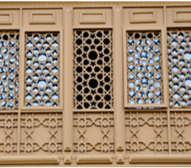
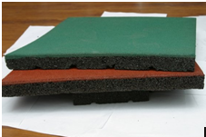
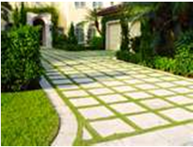
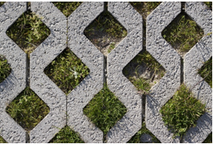
Architectural design:
Materials used in the school:
Aluminum Tasbil
Rubber floor mat
Grass paver
Open cell pavement

Slide 15
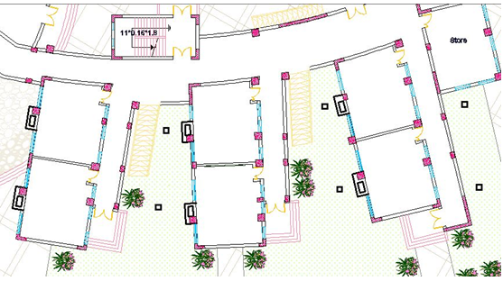
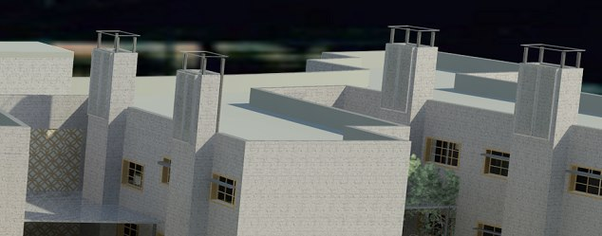
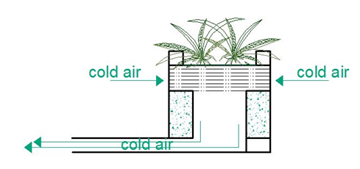
Architectural design:
Solar chimney:

Slide 16
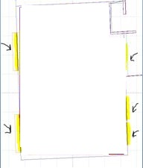
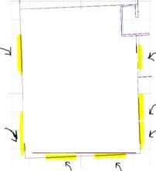
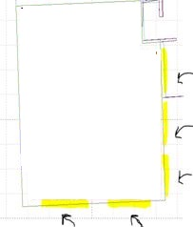
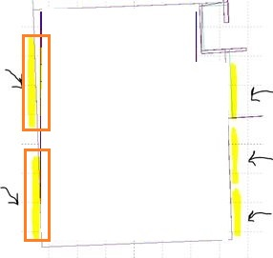
Environmental design:
Daylight Design
Calculations were made in four cases for class rooms:
Case2
Case4
Case1
Case3

Slide 17
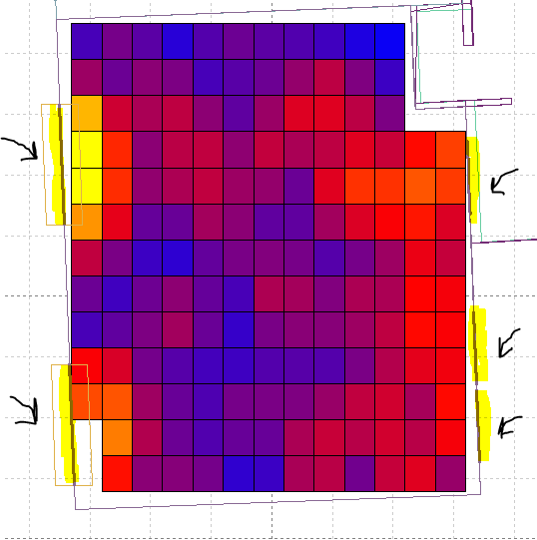
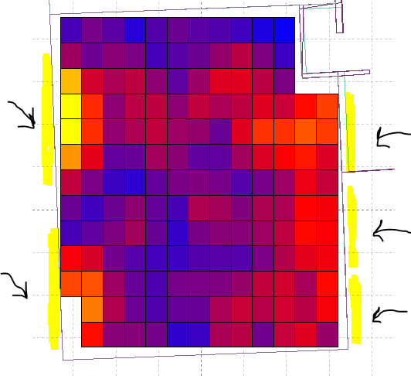
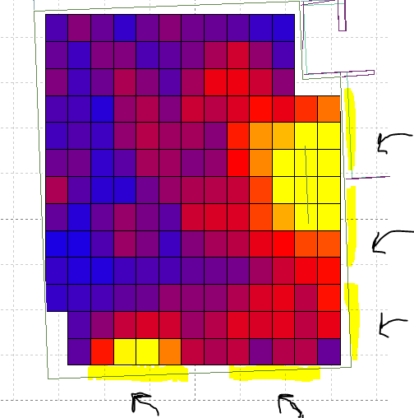
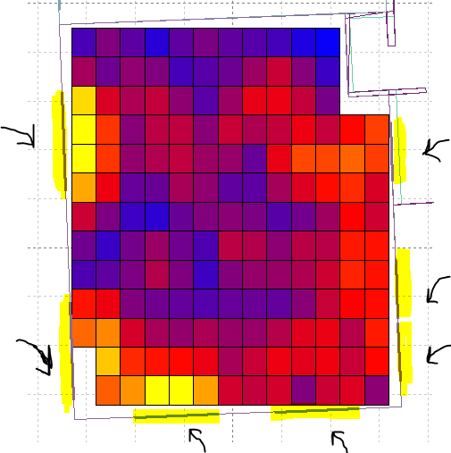
Environmental design:
Cases results:
Class |  | Standards |  | Real value
Floor | case | DF% | LUX | DF% | LUX
GF | 1 | 3 | 300 | 3.87 | 328.93
GF | 2 | 3 | 300 | 4.38 | 371.92
GF | 3 | 3 | 300 | 4.89 | 415.84
GF | 4 | 3 | 300 | 3.87 | 329
Case1
Case4
Case3
Case2

Slide 18
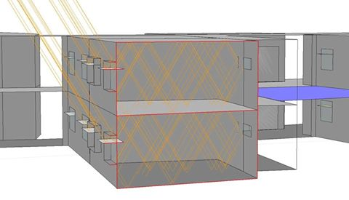
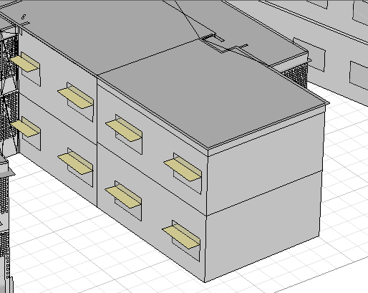
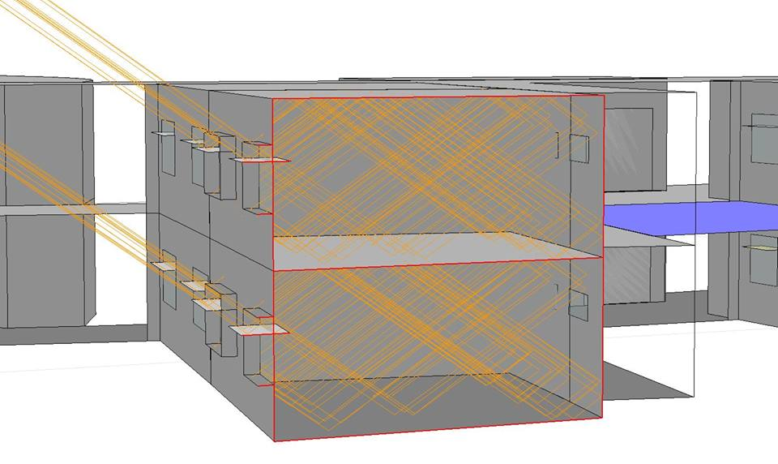
Environmental design:
Light shelves day light distribution

Slide 19
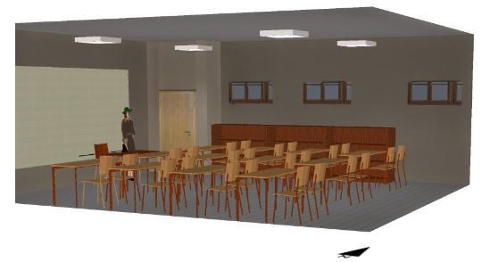


Environmental design:
IIC=56db
Acoustical results:
STC=46db
STC=56db

Slide 20
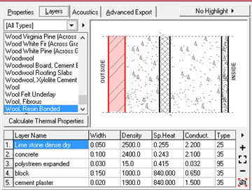
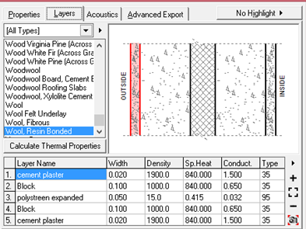
Environmental design:
Materials used
External walls
Partition
Elements | U (w/m2.k)
External walls | 0.49
Partitions | 0.48
windows | 2.41
Roof | 0.45

Slide 21
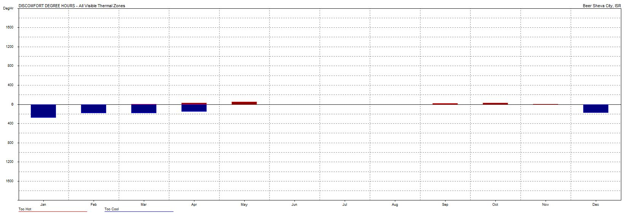
Environmental design:
Thermal calculations
 | TOO HOT | TOO COOL | TOTAL
MONTH | DegHrs | DegHrs | DegHrs
Jan | 0 | 280 | 280
Feb | 0 | 185 | 185
Mar | 0 | 187 | 187
Apr | 28 | 152 | 180
May | 54 | 0 | 55
Jun | 0 | 0 | 0
Jul | 0 | 0 | 0
Aug | 0 | 0 | 0
Sep | 24 | 0 | 24
Oct | 25 | 0 | 25
Nov | 4 | 6 | 10
Dec | 0 | 175 | 175
TOTAL | 134.8 | 985.4 | 1120.2

Slide 22
Environmental design:
Thermal calculations
External wall materials | Partition materials | Too Hoot (DegHrs) | Too Cool (DegHrs) | Total (DegHrs)
External wall with 5cm insulation in the middle | Partition 15cm block | 378.9 | 1048.7 | 1427.6
 | 10cm block ,5cm insulation ,10 cm block | 376.7 | 1051.0 | 1427.7
 | 1.4cmGypsum board ,5cm insulation,1.4cm Gypsum | 375.6 | 1052.2 | 1427.8
External wall with 3cm insulation in the middle | Partition 15cm block | 357.0 | 1091.3 | 1448.3
 | 10cm block ,5cm insulation ,10 cm block | 134.8 | 985.4 | 1120.2
 | 1.4cmGypsum board ,5cm insulation,1.4cm Gypsum | 353.8 | 1095.5 | 1449.3
S

Slide 23
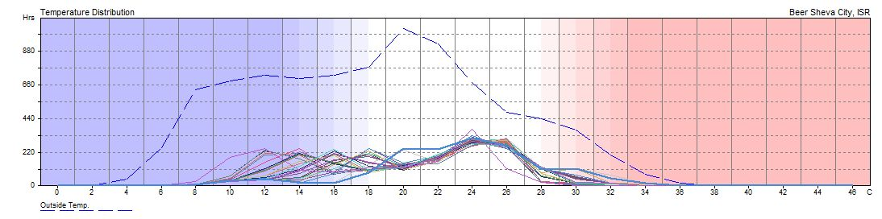
Environmental design:
Annual Temperature Distribution
class3
Operation: Weekdays 08-14, Weekends 00-00.
Comfort Band: 18.0 - 28.0 C
In Comfort: 1262 Hrs (80.6%)

Slide 24
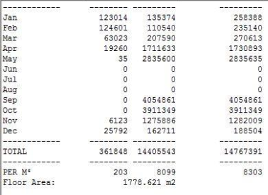

Environmental design:
Full air conditioned:

Slide 25



Environmental design:
PMV and PPD values:

Slide 26

Environmental design:
Solar Chimney

Slide 27

Structural design:

Slide 28
Structural design:
Codes used:
The American Concrete Institute code ACI 318-05.
The seismic design according to UBC-97.
One way ribbed slab
Loads:
Live load= 5 KN/m2
Super imposed dead load= 4 KN

Slide 29

Structural design:
Considerations for seismic design
-soil profile is (SD).
-The seismic coefficient (Ca) =0.36
-The seismic coefficient (Cv) =0.54

Slide 30

Structural design:
Seismic joint design:
seismic joint thickness =4cm

Slide 31


Structural design:
Checks for sap model:
Compatibility check
2. Equilibrium check
Elements | Weight(KN)
Slab | 6890.05
Main beams | 2817.4
Secondary beams | 1449.39
Columns | 1416
Tie beams | 1570.37
Shear wall | 1708.45
Total | 15851.66
Weight from SAP | 16509.58
% error | 4.15
3. Stress-strain check
Beam | Error %
Beam A | 0.7%
Beam B | 3.9%
Beam C | 0.69%

Slide 32

Structural design:
Footing design:

Slide 33


Structural design:
Isolated footing
Footing | Dimensions
F1 | 2*2m
F2 | 2.5*2.5m
F3 | 2.9*2.9m

Slide 34


Structural design:
Column design:
Column | Dimensions
C1 | 40*60 cm
C2 | 70*70 cm
C3 | 70*80 cm

Slide 35


Structural design:
Slab design:

Slide 36



Structural design:
Beams design:

Slide 37


Structural design:
Design of shear wall:

Slide 38

Structural design:
Windows reinforcement

Slide 39



Electrical design:

Slide 40

Electrical design:

Slide 41


Electrical design:
Class rooms
Avg lux= 353lux
Max glare index= 12
Uniformity= 0.65

Slide 42

Electrical design:
Computer laboratory
Avg lux= 576lux
Max glare index= 13
Uniformity= 0.771

Slide 43

Electrical design:
For Administration
For baths, corridors

Slide 44


Electrical design:
Water proof sockets
Normal sockets

Slide 45

Electrical design:
Photovoltaic system
Size of each cell :
(66.5*139*3.5m)

Slide 46

Electrical design:
Photovoltaic system calculation:
Nominal power of the
PV system = 5.0KW
Combined PV system
Losses=27.2%

Slide 47

Electrical design:
Photovoltaic system calculation:
we will be saving 249 NIS from Photovoltaic.

Slide 48

Mechanical design:
Water Supply System.
Drainage System Design.
Storm Water System
Safety System

Slide 49

Mechanical design:
Water supply system:

Slide 50

Mechanical design:
Drainage water system:
Black water
Storm water
Gray water

Slide 51

Mechanical design:
Safety system :

Slide 52

Quantity surveying

Slide 53


