Slide 1
An-Najah National University
Building Engineering Department
Re-design for the “United Motor and Trading Company” building
Presented by:
Thabet Ghanem
Ameer Najjar
Manal Khader
Qamar Barham
Supervisor:
Eng. Ala’a Shaheen

Slide 2


Outline:
Introduction
Site Analysis and Architectural Design
Environmental Design
Structural
Design
Electromechanical
Design
PV
Design
Cost Estimation
Safety System

Slide 3
Introduction:
Background:
Such these buildings contain:
Showrooms.
Offices.
Repair shops.

Slide 4
Introduction:
Project problem:
Improve the design to suit needs.
Work objectives:
Integrated design.
All points taken in Project 1 are considered in the design.

Slide 5
Site analysis and Architectural Design

Slide 6
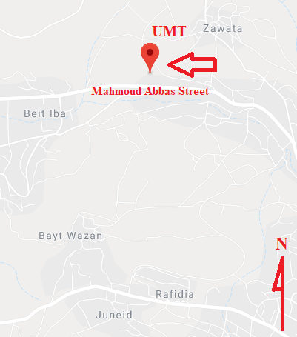
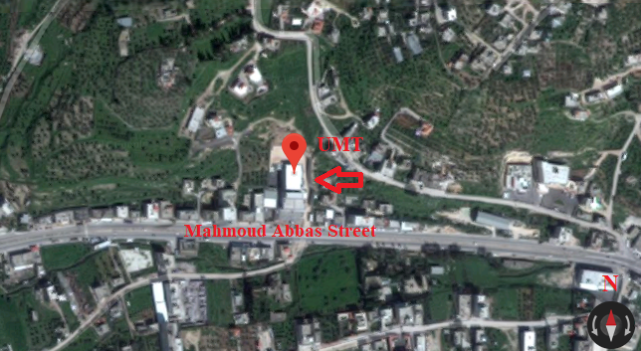
Site Analysis:
The building of United Motor Trade (UMT) company is located in Mahmoud Abbas Street, Beit E’iba, Nablus, Palestine.

Slide 7
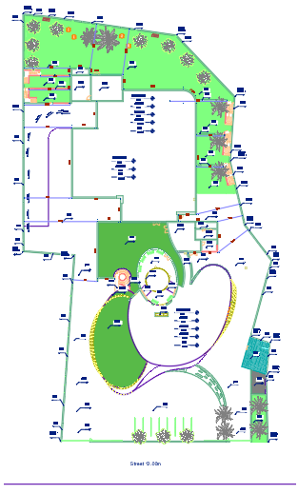
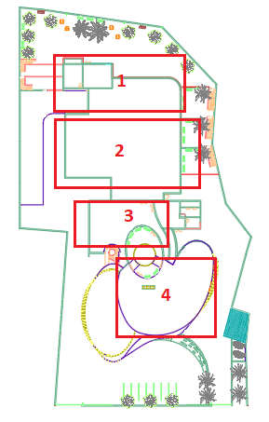
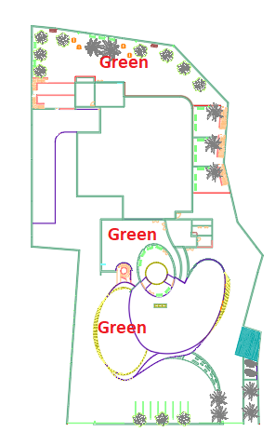
Site Analysis:
N
N
N
Levels | Part 1 | Part 2 | Part 3 | Part 4
Ground level | 0.00 m | 0.00 m | 0.00 m | 0.00 m
First level | 3.674 m | 7.348 m | 3.674 m | 5.511 m
Second level | 7.348 m | 14.696 m | 7.348 m | 11.022 m
Third level | 11.022 m | - | - | 16.533 m
Fourth level | 14.696 m | - | - | 21.042 m

Slide 8
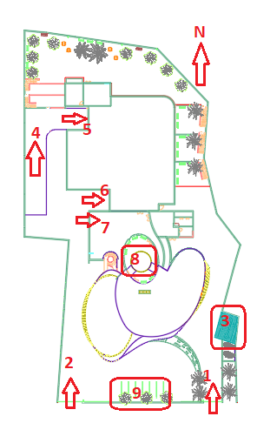
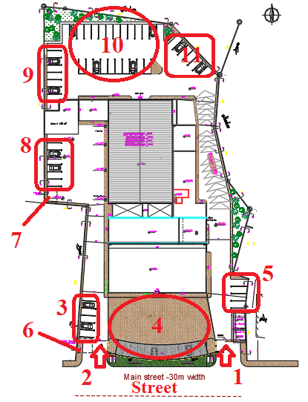
Site Analysis:
1: 1st gate.
2: 2nd gate.
3 and 5: Parking for visitors.
4: Square for displaying the cars.
6: Septic tank.
7: Water tank.
8: Parking for customers and employees.
9 and 11: Parking for employees.
10: Square for cars like cars in showrooms.
New Building
Existing Building
1: Entrances for pedestrian. 2: Entrances for cars. 3: Guard room. 4: Car Ramp to arrive to the body and paint shop. 5: Entrance of body and paint shop. 6: Entrance of quick services. 7: Entrance of basement. 8: Car elevator. 9: Car parking for customers and some of employees.

Slide 9
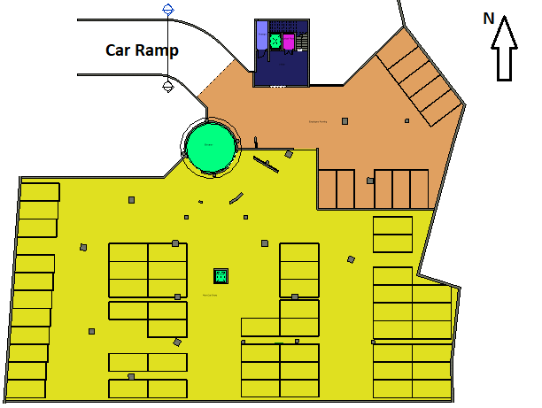
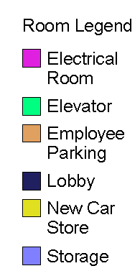
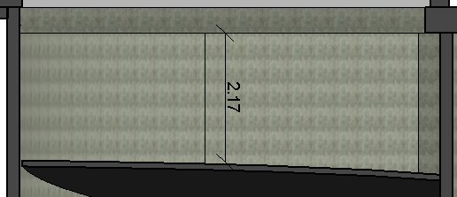
Architectural Design:
Basement Plan at Level -3.674m
Section in Car Ramp

Slide 10
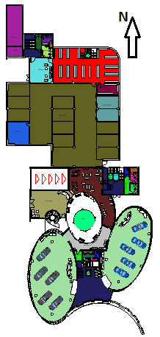
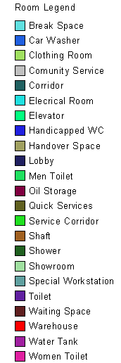
Architectural Design:
Plan at Level 0.00m

Slide 11
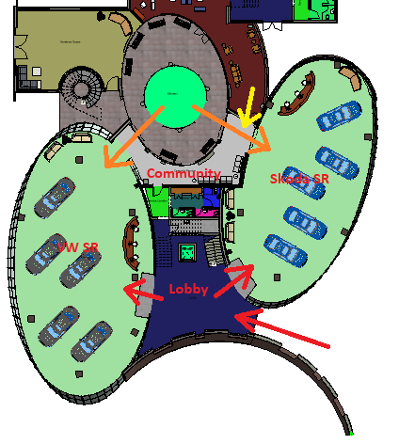
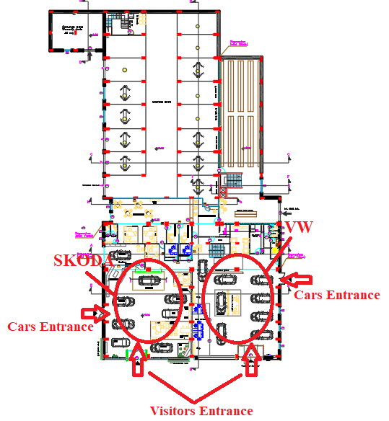
Architectural Design- Car Showrooms:
N
N
Showrooms in New Building
Showrooms in Existing Building

Slide 12
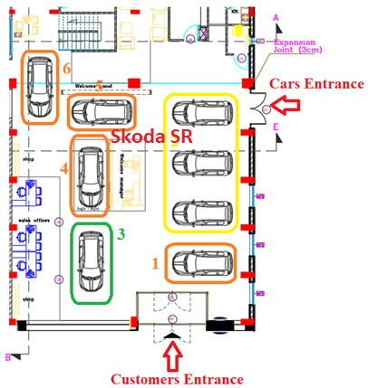
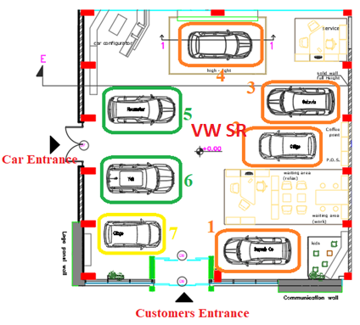
Architectural Design- Car Showrooms:
N
VW Showroom in Existing Building
Skoda Showroom in Existing Building
Green color indicates that the spaces are within recommendations.
Yellow color: A space is not matched with recommendations but relatively acceptable.
Orange color: The spaces are out of recommendations and not acceptable.

Slide 13
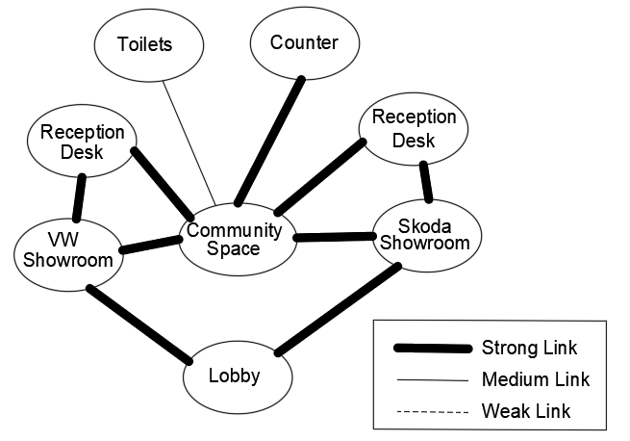
Architectural Design- Car Showrooms:
Bubble Diagram for Showrooms in New Building

Slide 14
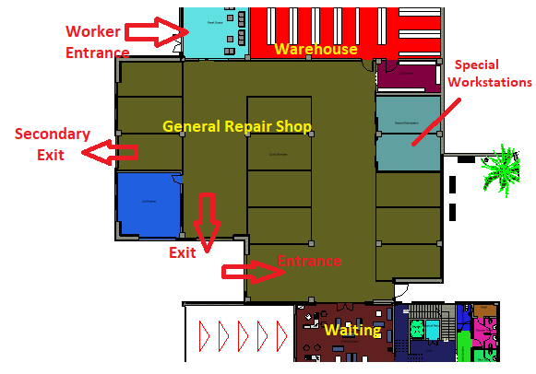
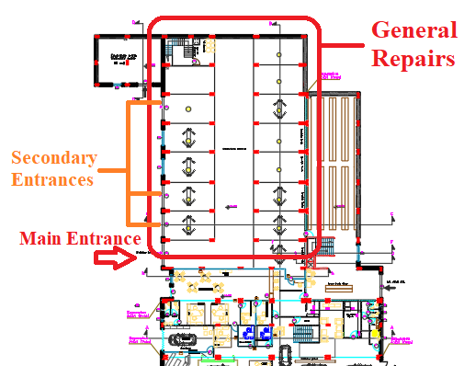
Architectural Design- Repair Shop:
N
N
General Repair Shop in existing building
General Repair Shop in New Building
At Level 0.00m

Slide 15
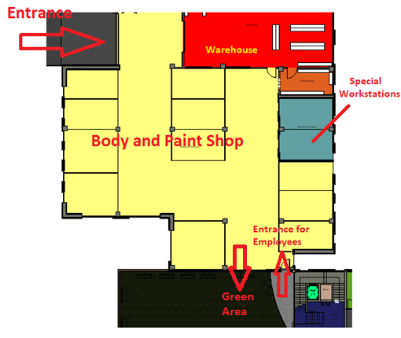
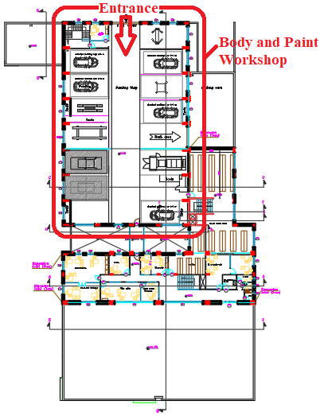
Architectural Design –Repair Shop:
N
N
Body and Paint Shop in New Building
At Level 7.35m
Body and Paint Shop in Existing Building

Slide 16
Architectural Design –Repair Shop:
 | General repair shop | Body and paint shop
Existing building | 13 | 9
New Building | 12 | 13

Slide 17
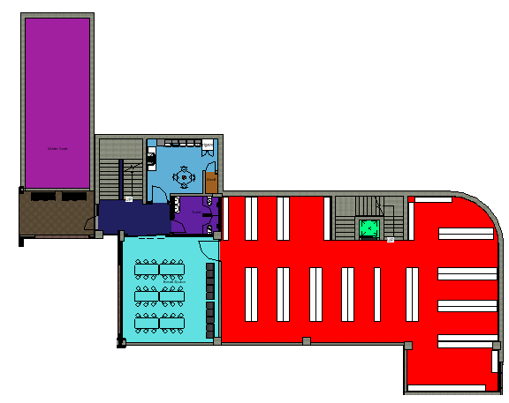
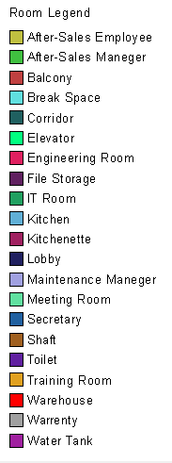
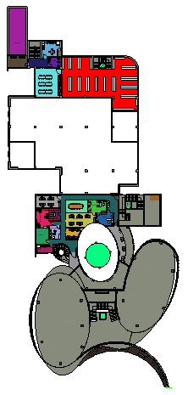
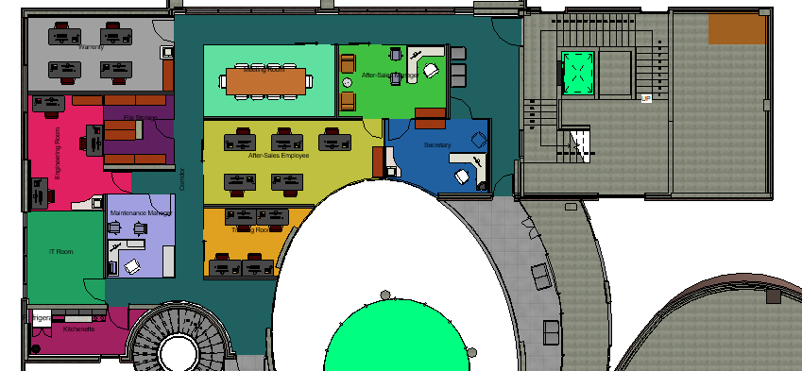
Architectural Design:
N
N
N
Plan at Level 3.674m

Slide 18
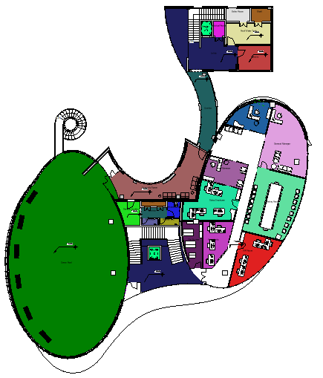
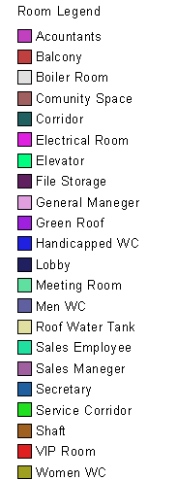
Architectural Design -Offices:
N
Plan at Level 16.35m

Slide 19
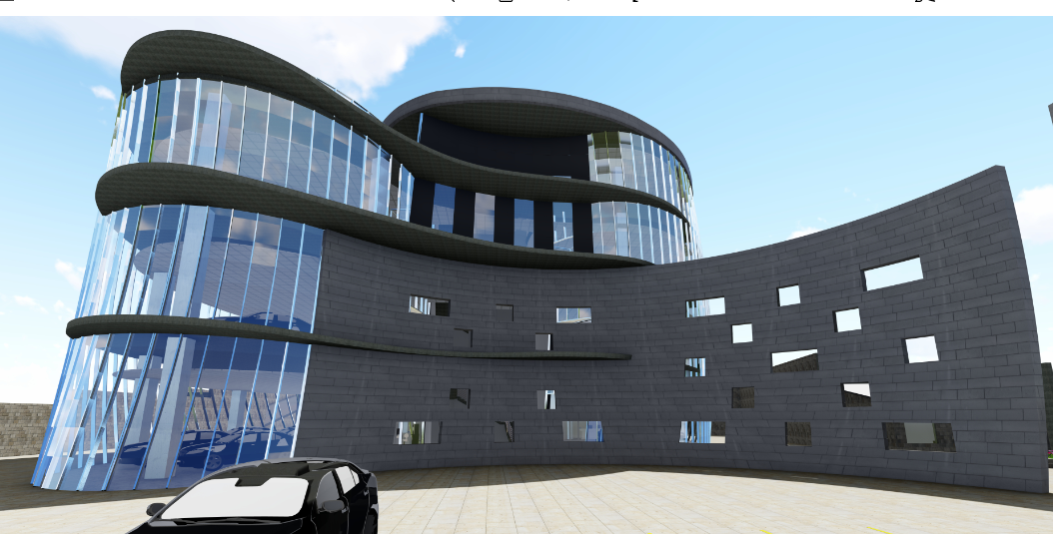
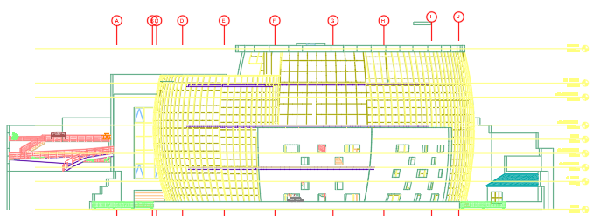
Architectural Design:
Southern Elevation

Slide 20
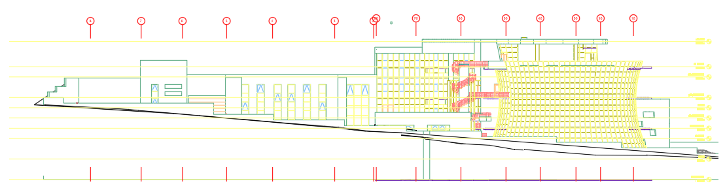
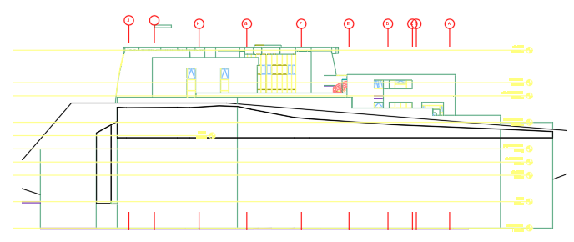
Architectural Design:
Western Elevation
Northern Elevation

Slide 21
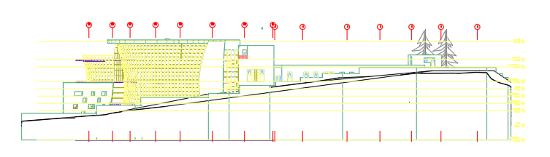
Architectural Design:
Eastern Elevation

Slide 22
Structural design

Slide 23
Structural design – Excavation & Soil supporting
Table below describe the soil properties for the project:
Sample depth | Moister content (%) | Percent passing from sieves #200 | Plasticity index | Cohesion (KN/m2) | Angle of internal friction (Փ)
0-5 | 15 | 61.5 | 10.5 | 11 | 25
5-9 | 15.45 | 71 | 14.3
9-11 | 21.2 | 32 | 11.4
Lc = 𝐷𝑖𝑝𝑡ℎ 𝑜𝑓 𝑒𝑥𝑐𝑎𝑣𝑎𝑡𝑖𝑜𝑛 𝑤𝑖𝑡ℎ 𝑜𝑢𝑡 𝑠𝑜𝑖𝑙 𝑠𝑢𝑝𝑝𝑜𝑟𝑡𝑖𝑛𝑔 = 1.72m.
Where bearing capacity of the soil was 254KN/m2.

Slide 24
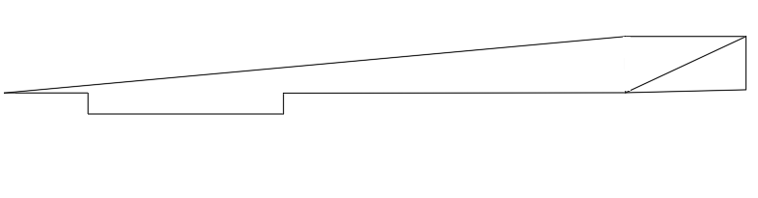
Structural design – Excavation & Soil supporting
Excavation level compare with the natural earth

Slide 25
Structural design – Excavation & Soil supporting
A cantilever retaining wall was used in this project with 6m and 8m height above the ground level, where the table below describe the parameter used in the design:
Soil bearing capacity (KN/m²) | Concrete shear capacity (stem and heel) (KN/m) | Concrete shear capacity (KN) | Soil friction factor | K active | K Passive
254 | 417 | 572 | 0.4 | 0.41 | 2.46

Slide 26
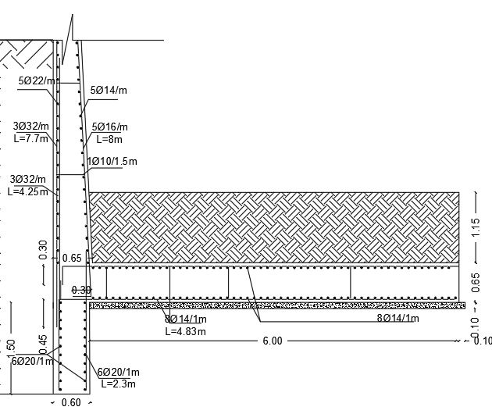
Retaining wall details L=6.5m.

Slide 27
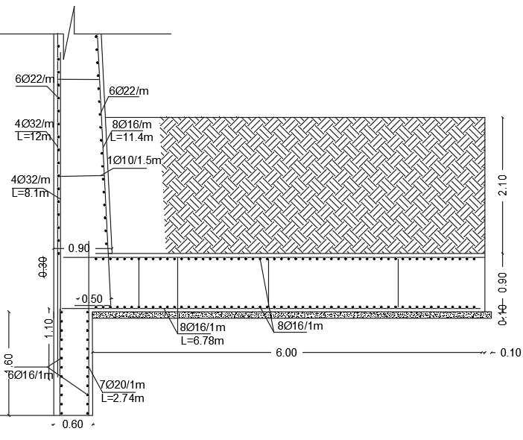
Retaining wall details L=10.1m.

Slide 28
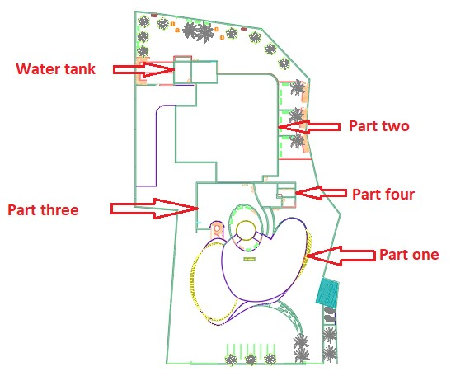

Slide 29
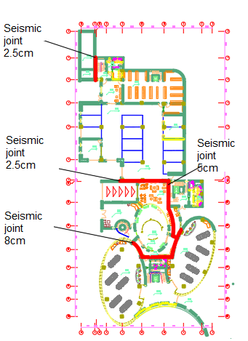

Slide 30
Structural design – Concrete design parameters
Columns, footing, and walls concrete compressive strength | 32MPA
Reinforcement Rebar yielding strength | 420MPA
Slabs and beams concrete compressive strength | 28MPA
R | 5.5
Z(UBC-97) | 0.2
Ca(UBC-97) | 0.24
Cv(UBC-97) | 0.32
Ci(ACI-350&IBC-15) | 0.6
Cc(ACI-350&IBC-15) | 0.14
Ct(ACI-350&IBC-15) | 0.24

Slide 31
Structural design – Steel design parameters
Parameters | Value
Steel yielding stress | 250MPA
Steel ultimate stress | 400MPA
Sections used according to | Euro code
Z(UBC-97) | 0.2
Ca(UBC-97) | 0.24
Cv(UBC-97) | 0.32
R | 8.5

Slide 32
Structural design – Steel material properties
Name | Type | Design Strengths
A36 Steel | Steel | Fy=250 MPa, Fu=400 MPa
E60XX | Weld | Rn=412.8 MPa
E70XX | Weld | Rn=481.6 MPa
E120XX | Weld | Rn=825.6MPa
A325 | Bolts | Ft=620Ab MPa, Fv= MP414Aba
A490 | Bolts | Ft=780Ab MPa, Fv=520Ab MPa

Slide 33
Structural design – Steel sections used
Section type | Section shape | depth | width | Flanges thickness | Web thickness
Columns | TUBO | 550mm | 550mm | 20mm | -
Main beams | IPE 750*173 | 760mm | 268mm | 21.6mm | 14.4mm
Beam on girder | ILS 550 | 547mm | 210mm | 15.7mm | 9mm
joist (L>3m) | HE260A | 250mm | 260mm | 12.5mm | 7.5mm
Cantilever joist | ILS 550 | 547mm | 210mm | 15.7mm | 7.5mm

Slide 34
Structural design – Steel structure design
All the car show rooms was designed as a steel structure design because of it is curved shape in the two direction in as well as getting a long spans for facilitate the cars movement.

Slide 35
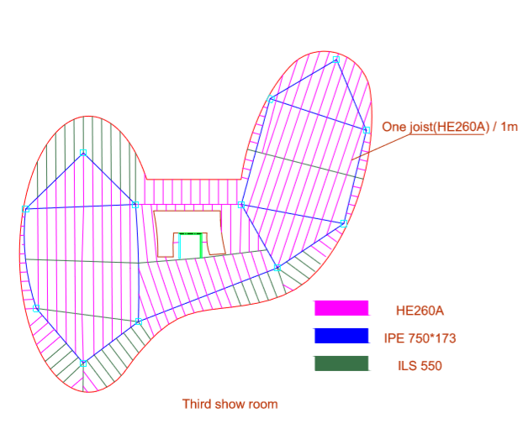
Structural design – Steel structure design

Slide 36
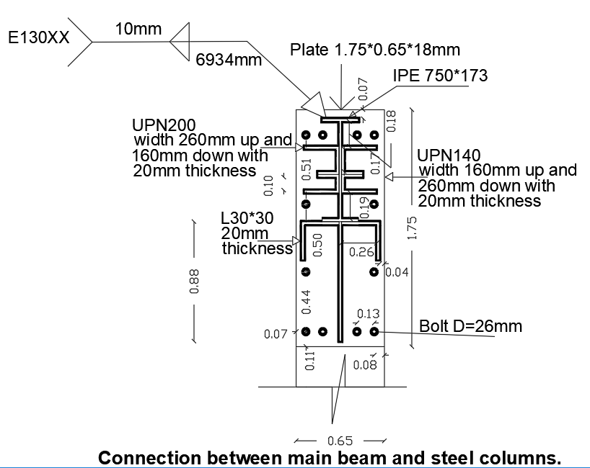
Structural design – Steel structure design

Slide 37
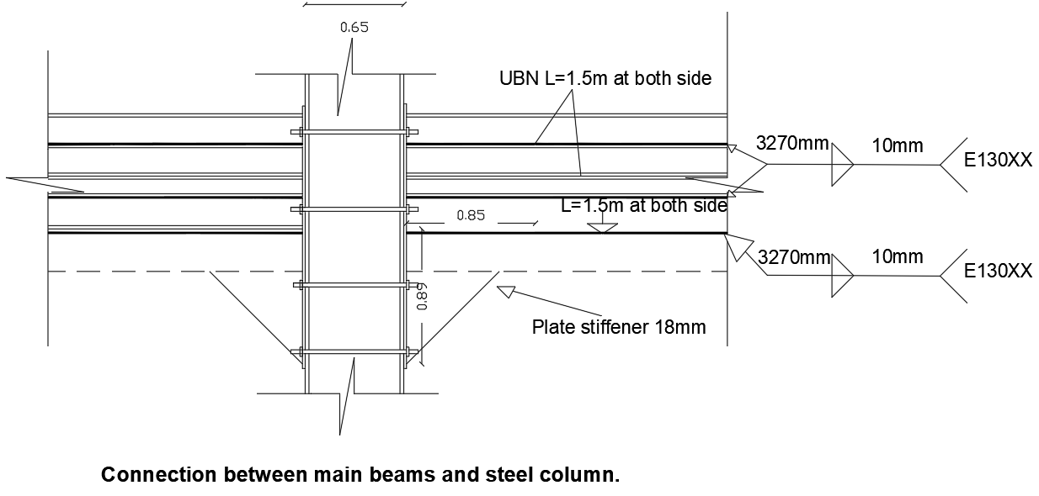
Structural design – Steel structure design

Slide 38
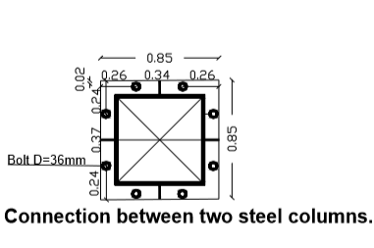
Structural design – Steel structure design

Slide 39
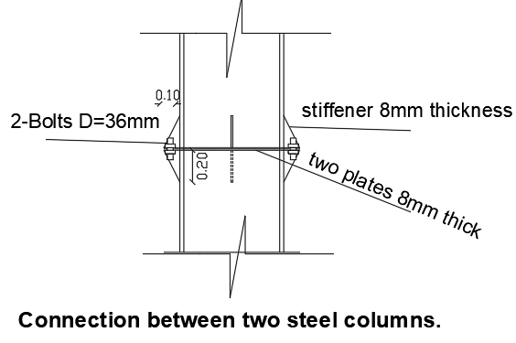
Structural design – Steel structure design

Slide 40
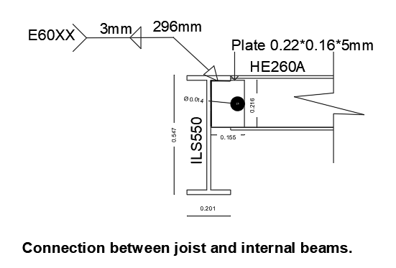
Structural design – Steel structure design

Slide 41
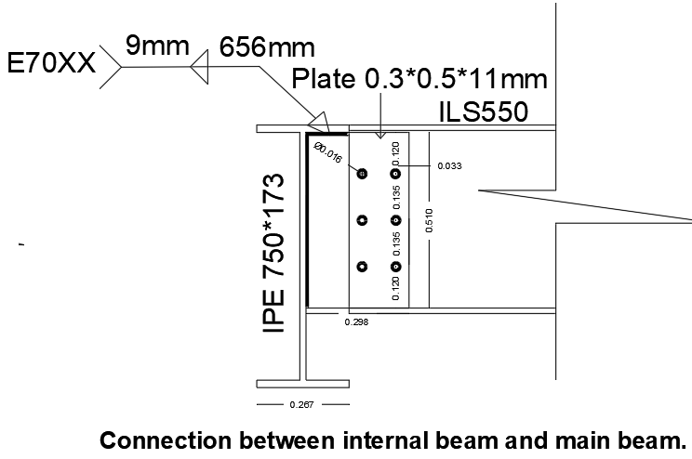
Structural design – Steel structure design

Slide 42
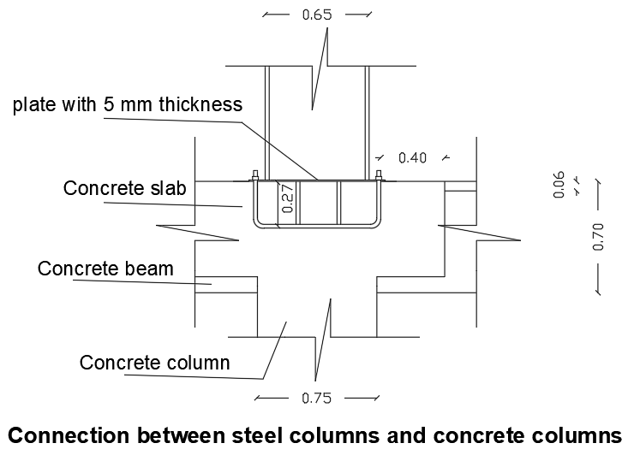
Structural design – Steel structure design

Slide 43
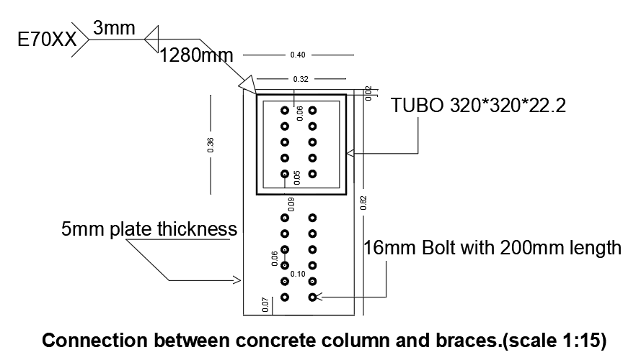
Structural design – Steel structure design

Slide 44
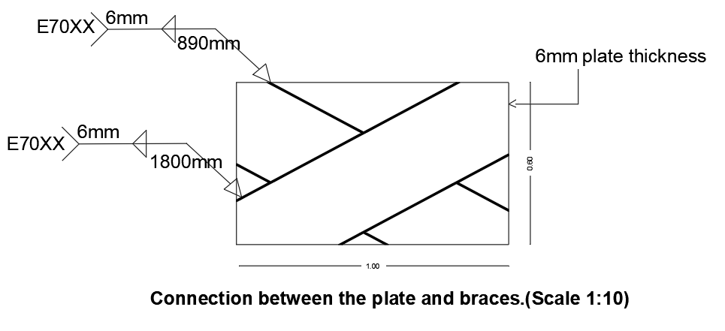
Structural design – Steel structure design

Slide 45
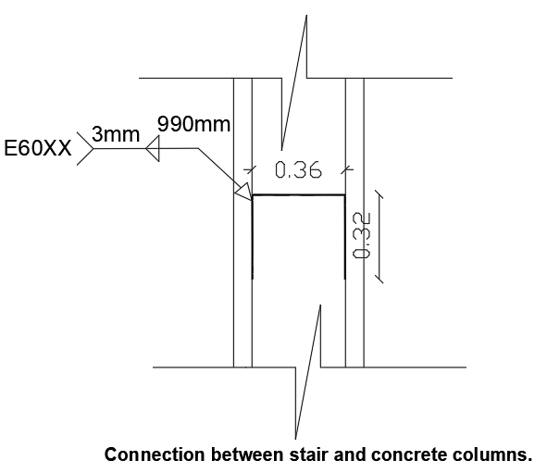
Structural design – Steel structure design

Slide 46
Structural design – Concrete structural design

Slide 47
Structural design – Foundation design
A single, combined and wall footing was used in this project:

Slide 48
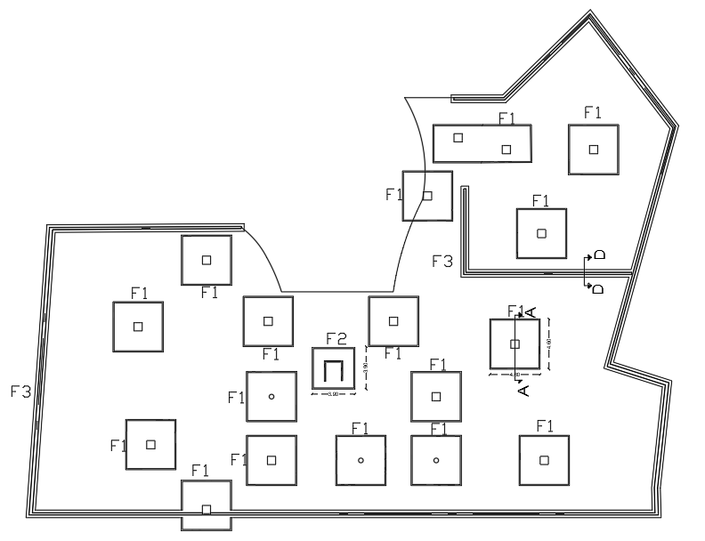
Footing layout for part one of the project

Slide 49
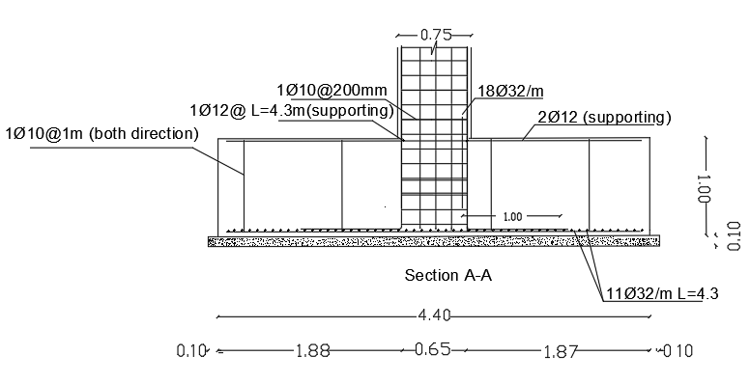
Footing one details.

Slide 50

Footing layout for part two of the project:

Slide 51

Section A-A details.

Slide 52

Tie beam plane for the second part

Slide 53

Section H-H detail

Slide 54
Structural design – Columns design

Slide 55


Part three columns layout.
Part four columns layout.

Slide 56


Slide 57

Part one columns layout.

Slide 58


Slide 59
Structural design – Columns design
All columns details was described in the drawing sheet

Slide 60
Structural design – Shear wall design

Slide 61

Part two shear wall layout.

Slide 62




Slide 63
Structural design – Slabs design

Slide 64
Structural design – Slabs design
Three type of columns systems were used as bellow:
1. Solid slab system was used where heavy live load was existed (cars work shops, cars show rooms, green areas and water tank storage).
2. Tow way ribbed slab system was used where normal live load was existed and spans more than 5m up to 7.5m and one way ribbed slabs were used for the spans which it is length less than 5m.(offices floor, wettings areas and stair case)
3. Waffle slab system was used where the span length more than 8m up to 12m.(basement floor).

Slide 65

Structural design – Slabs design
Slab reinforcement for part two of the project

Slide 66

Structural design – Slabs design

Slide 67

Structural design – Slabs design

Slide 68

Structural design – Slabs design

Slide 69

Structural design – Slabs design
Beam layout for part one of the project

Slide 70

Structural design – Slabs design
Section A-A

Slide 71

Structural design – Slabs design
2B1 beam detail

Slide 72

Structural design – Slabs design

Slide 73

Structural design – Slabs design

Slide 74

Structural design – Slabs design

Slide 75

Structural design – Slabs design

Slide 76

Structural design – Stair detail

Slide 77
Structural design – Water tank design parameters used in the design of water tank.
Ci | I | Ri | K active | Cc | I | Rc
0.6 | 1.25 | 2 | 0.406 | 0.134242 | 1.25 | 1
kae | Ct | B | Ri | qny | Hi _{large} | Hc _{large}
0.406 | 0.24 | 1 | 2 | 75 | 3.3m | 5.9m

Slide 78

Water tank footing plan

Slide 79

Section A-A

Slide 80

Section D-D

Slide 81
Environmental Evaluation.

Slide 82
ENVIRONMENTAL DESIGN
-Lighting Evaluation.
-Thermal Evaluation.
-Acoustical Evaluation.

Slide 83

ENVIRONMENTAL DESIGN
Natural lighting
Evaluation day lighting for show room part using Design builder:
The amount of natural lighting is largely concentrated inside the showroom part because the facade is covered with glass

Slide 84

ENVIRONMENTAL DESIGN
Natural lighting
Evaluation day lighting for office part
In the offices part, natural light is large around the counter

Slide 85

ENVIRONMENTAL DESIGN
Natural lighting
Evaluation day lighting for repair shop part
the repair shop daylight is relatively low because the glass area compared with walls area is low

Slide 86


ENVIRONMENTAL DESIGN
Heating Analysis
the operating temperature is 17.03 ° C which is good temperature for the office zone
Temperatures for offices part

Slide 87


ENVIRONMENTAL DESIGN
Heating Analysis
the operating temperature is 15.03 ° C.
Temperatures for showroom part

Slide 88



ENVIRONMENTAL DESIGN
Simulation
The simulation and total energy consumption for showroom part

Slide 89



ENVIRONMENTAL DESIGN
Simulation
The total energy consumption for building equal 297748KWh
The simulation and total energy consumption for offices part

Slide 90


ENVIRONMENTAL DESIGN
Simulation
Hour comfort in offices part
Hour comfort in showrooms part.

Slide 91

ENVIRONMENTAL DESIGN
Acoustical Evaluation
RT60:
Values calculated from Ecotect program:
The reverberation time for the show room is equal .75 Sabine which is less than the standard that is 1-1.4 due to the huge area of the room.

Slide 92

ENVIRONMENTAL DESIGN
Acoustical Evaluation
RT60:
Values calculated from Ecotect program:
The reverberation time for the office room is equal .56 Sabine within the standard 0.5-1.5

Slide 93

ENVIRONMENTAL DESIGN
Acoustical Evaluation
RT60:
Values calculated from Ecotect program:
The reverberation time for the repairing room is equal 1.13 Sabine within the standard 1-1.5

Slide 94
ENVIRONMENTAL DESIGN
insulation design
external walls which must have a value of STC not less than 50dB to have a good sound proofing
In our project, the values of STC for exterior walls have a ranged from 50 to 75 and all of them within the standard
Layers | Width (mm)
Stone | 50
Concrete cast-dense | 80
Lightweight Hollow Block | 70
Foam-polyurethane | 50
Concrete block - block hollow | 70
Plaster | 15
For external walls
STC-Value = 57 dB
U-Value = 0.4 w/m^2.k

Slide 95
ENVIRONMENTAL DESIGN
insulation design
For partition between adjacencies offices the values of STC should be equal 52 db or more and our values within the standard
Layers | Width (mm)
Plaster | 15
Lightweight Block, hollow | 100
Plaster | 15
STC-Value = 54 dB
U-Value = 0.37 w/m^2.k
Notes:
Layers
Width (cm)
Conductivity
Plaster
2
0.43
Lightweight Block, Perlite-Filled
10
0.17
Plaster
2
0.43

Slide 96
ENVIRONMENTAL DESIGN
HVAC System.
-Using VAV system.
-Using VRF system
-Main components of centralized system are:
  Outdoor unit.
  Inside unit (fan coil)
  Collectors
  Ducts.
  Diffusers.
  Grills.
Notes:
Layers
Width (cm)
Conductivity
Plaster
2
0.43
Lightweight Block, Perlite-Filled
10
0.17
Plaster
2
0.43

Slide 97

ENVIRONMENTAL DESIGN
HVAC System.
Figure show the distribution of HVAC system
Notes:
Layers
Width (cm)
Conductivity
Plaster
2
0.43
Lightweight Block, Perlite-Filled
10
0.17
Plaster
2
0.43

Slide 98
Electromechanical
Design

Slide 99



Electromechanical design-Lighting:
Basement :
DIAlux analyses result and recommend values.
 | Actual value | Recommend value
Illuminance (lux) | 566 | 500-700
Glare at 120cm | 15.3 | < 22
Uniformity | 0.65 | > 0.33

Slide 100

Electromechanical design-Lighting:

Slide 101

Electromechanical design-Lighting:
Skoda Showroom:
DIAlux analyses result and recommend values.
in room | Actual value | Recommend value
Illuminance (lux) | 570 | 500-1000
Glare | 14 | < 22
Uniformity | 0.47 | > 0.33

Slide 102

Electromechanical design-Lighting:
Office room :
DIALux analyses result and the recommend values:
 | Actual value | Recommend value
Illuminance (lux) | 280 | 200-350
Glare | 12 | < 22
Uniformity | 0.47 | > 0.25

Slide 103


Electromechanical design-Lighting:

Slide 104


Electromechanical design-Lighting:
Wokstation Car :
DIALux analyses result and the recommend values .
 | Actual value | Recommend value
Illuminance (lux) | 518 | 500
Glare | 16.5 | < 19
Uniformity | 0.48 | > 0.6

Slide 105

Electromechanical desgin-Lighting:

Slide 106


Electromechanical design-Lighting:
Kitchen small:
DIALUX analyses result and the recommend values .
 | Actual value | Recommend value
Illuminance (lux) | 440 | 300-500
Glare | 10 | < 22
Uniformity | 0.65 | > 0.33

Slide 107

Electromechanical design-Lighting:

Slide 108




Electromechanical design-Water Supply:
Distributed water supply for ground floor .

Slide 109
Electromechanical design-Water Supply:
Distributed water supply for zone 1 .
 | Ground floor |  | First floor |  | Second floor
 | Diameter (in) | Losses (psi) | Diameter (in) | Losses (psi) | Diameter (in) | Losses (psi)
Horizontal Pipes | 1.5" | 4 | 1.25" | 3.7 | 1.25" | 4.3
Branch Pipes | 0.75" | 4.9 | 0.75" | 5.1 | 1" | 4.2
Meters | 0.75" | 1.8 | 0.75" | 2 | 0.75" | 2.1
Total losses | - | 10.7 | - | 10.8 | - | 10.6
Allows losses | - | 11 psi | - | 11 psi | - | 11 psi
Assesment |  | OK |  | OK |  | OK

Slide 110

Electromechanical design-Water Supply:
Distributed water supply for zone 3 .
 | Ground floor |  | First floor |  |  | Secondfloor |  |  | Third floor
 | Diameter (in) | Losses (psi) |  | Diameter (in) | Losses (psi) | Diameter (in) |  | Losses (psi) |  | Diameter (in) | Losses (psi)
Horizontal Pipes | 3/4" | 2.25 | 1.25" |  | 3.6 | 1.25" |  | 3.8 |  | 3/4" | 5.2
Vertical Pipes | 1.5" | 5 | 1.5" |  | 2.7 | 1.5" |  | 4.3 |  | 1" | 3.4
Branch Pipes | 0.75" | 1.98 | 0.75" |  | 2.1 | 2" |  | 2.5 |  | 1.25" | 2.1
Total losses | - | 9.23 | - |  | 8.4 | - |  | 10.6 |  | - | 10.8
Allows losses | - | 11 psi | - |  | 11 psi | - |  | 11 psi |  | - | 11psi
Assesment |  | OK |  |  | OK |  |  | OK |  |  | OK

Slide 111



Electromechanical design-Water Supply:
Distributed water supply for zone2 .
 | Ground floor |  | First floor
 | Diameter (in) | Losses (psi) | Diameter (in) | Losses (psi)
Horizontal Pipes | 1.5" | 4.08 | 1.75" | 3.7
Vertical Pipes | 1.25" | 5 | 2" | 5.1
Branch Pipes | 0.75" | 1.6 | 1" | 2.2
Total losses | - | 10.68 | - | 11
Allows losses | - | 11 psi | - | 11 psi
Assesment |  | OK |  | OK

Slide 112


Electromechanical design- Drainge Water:
Distributed drainge water for ground floor .

Slide 113


Electromechanical design - Draing Water:
Details :

Slide 114




Electromechanical design- Drainge Water:
Details workstation in GF .

Slide 115




Electromechanical design-Elevators:
The result is 3 elevators with capacity 1750 lb with 450 fpm + 1 elevator for service .

Slide 116


Electromechanical design -Power system:
The power design socket for ground floor :

Slide 117


Electromechanical design-Power system:
The Office :
The Multipurpose :

Slide 118



Electromechanical design -Fire system:
Fire fighting system:
In this building several types of fire extinguishing system were used in electrical room (FM-200) and hall cars (sprinkler water) and offices extinguisher foam .

Slide 119

Electromechanical design -Fire system:
Distribution sprinkler in ground floor:

Slide 120


Electromechanical design -Fire system:
Fire alarm system :
Smoke detectores
Manual system

Slide 121

Electromechanical – Q.C:
Table Quantity survey and cost:

Slide 122

Electromechanical – Q.C:
Table Quantity survey and cost:

Slide 123
Cost Estimation:
Total Cost (NIS) | 17,523,319
Unit Cost (NIS/m2) | 1815.89

Slide 124


PV Design:
The maximum project production is 145Kw.
The constant energy saved per year = 247.6 Mwh/year.
The capital cost for system = 217,500$ = 761,250 NIS (Dollar = 3.5 NIS).
The constant annual cost saved from energy = 183,000 NIS.
The cost is returned through 4.78 year.

Slide 125


