Slide 1



GRADUATION PROJECT 2:
Smart ship
Presented By
adam yaesh
abbas dweikat
Supervisor:
dr. anas toma

Slide 2

TABLE OF CONTENT
Design and Development
Introduction
Components
Specifications
Features
Limitations
Future Work
Conclusion
Acknowledgement

Slide 3
Introduction
  General Background:
  The experience of interacting with ships.
Demand to make ship operations more efficient and safe.
  Objectives:
Developing a smart ship to carry out multiple missions:
Safety systems.
Movement control.

Slide 4

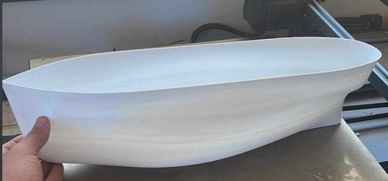
Design and Development
Built using 3D printed components.

Slide 5
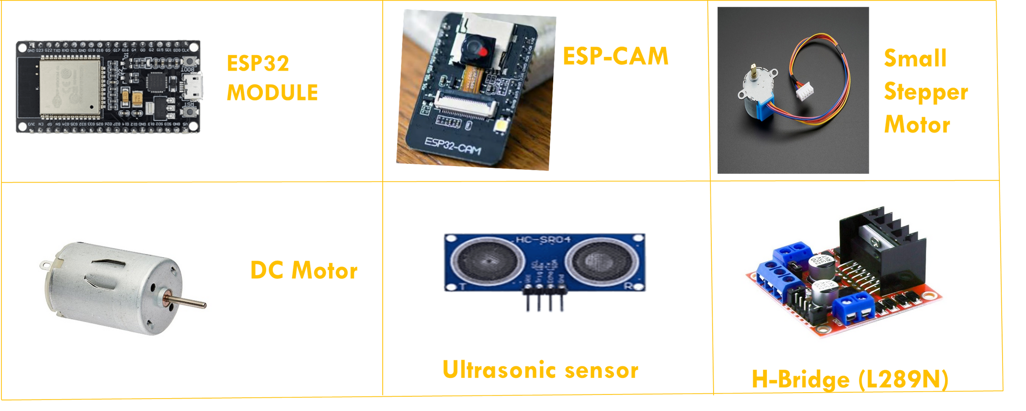
Components
Movement control components

Slide 6
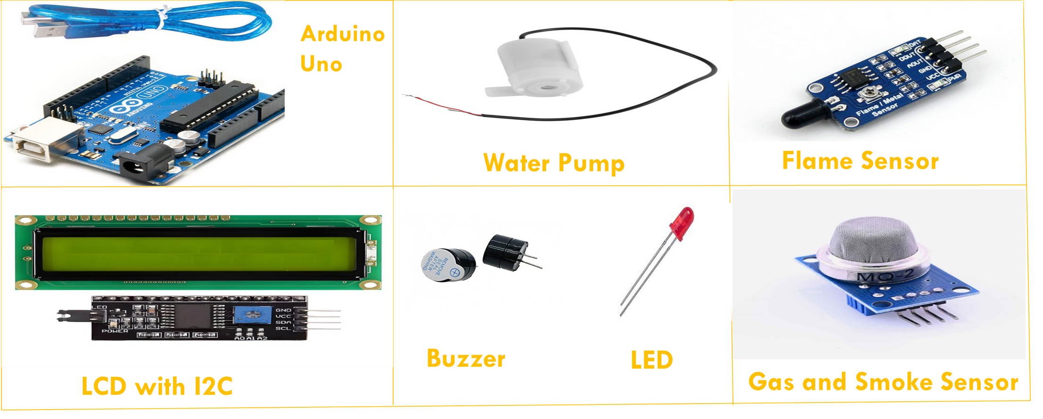
Safety components

Slide 7
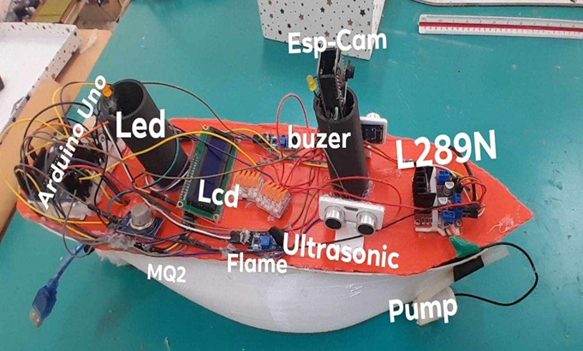
Specifications

Slide 8
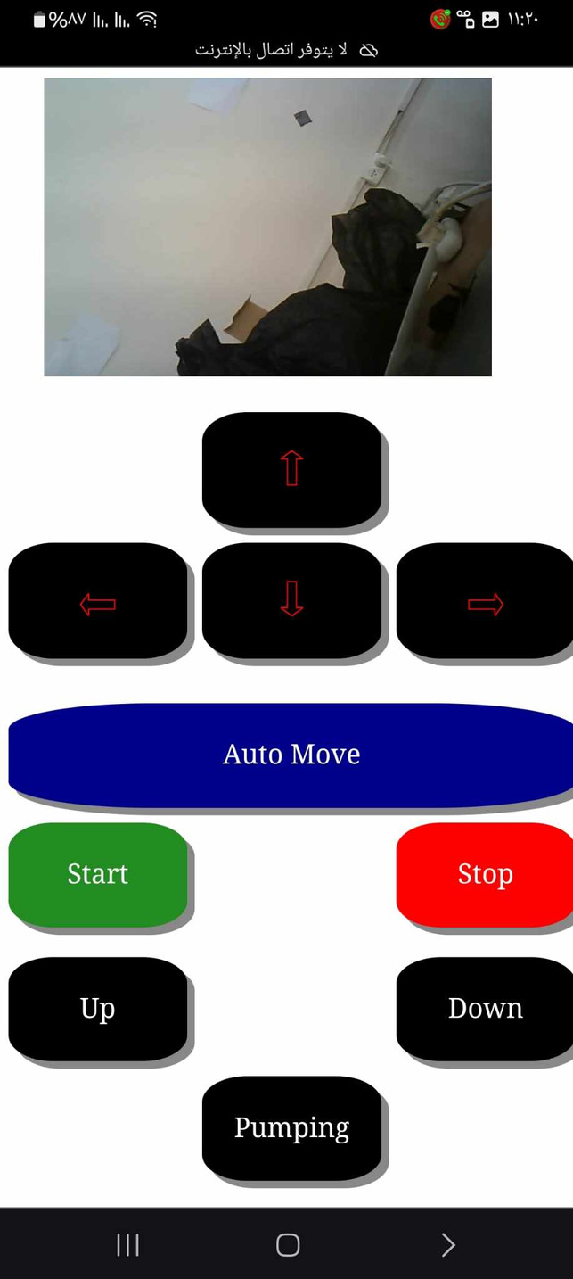
Movement-control

Slide 9
Features
1- Motion control: The ship successfully used two DC motors to enhance flexibility and user interaction.
In addition, it can be controlled using any smart device connected to its local network through an easy-to-use web page interface.
2- Obstacle avoidance: The ultrasonic sensor allowed the ship to detect and avoid obstacles effectively.
3- Fire detection: Advanced capabilities to recognize and respond to fire, gas and smoke were achieved through the existing sensors with the possibility of extinguishing the fire via the pump.

Slide 10
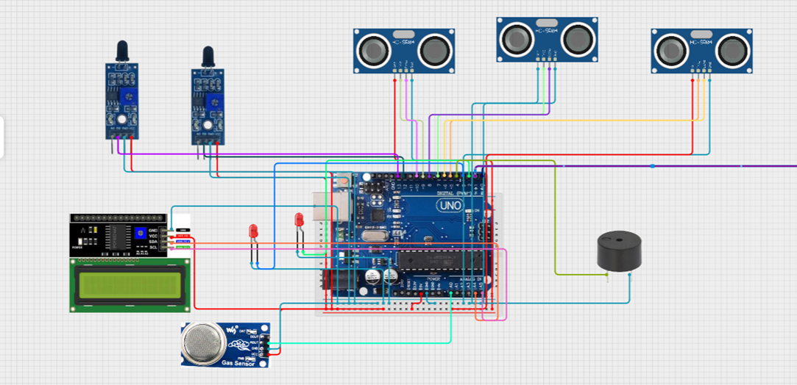
COnnections
Fire detection system

Slide 11
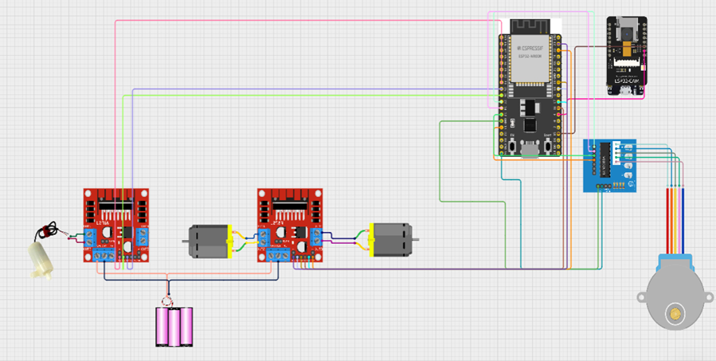
COnnections
Movement Control Circuit

Slide 12
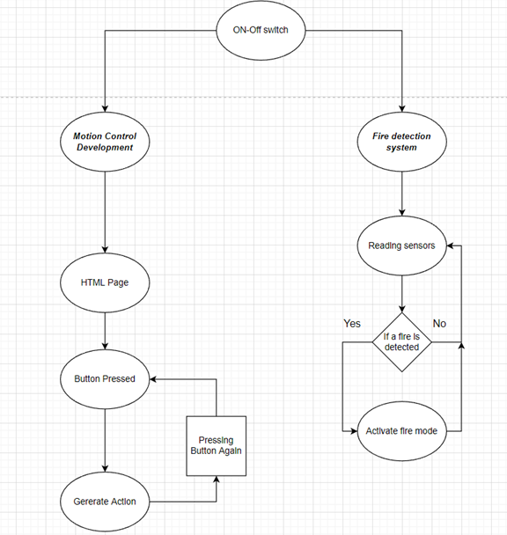
smart ship Start up

Slide 13
limitations
1- Component availability: It was difficult to obtain and it took us time to find a replacement
2- Performance limitations: Body balancing and weight distribution were very difficult.
3- Battery safety: Additional complexity and cost due to the necessary protection circuits.

Slide 14
Future work
1- Advanced Sensors: Implement additional sensors to expand the capabilities in navigation and interaction (e.g. temperature sensors).
2- Application Expansion: Give it the ability to perform some simple tasks such as carrying items or fishing by making minor changes to its design.
3- Image Processing Application: Use Raspberry Pi to detect fire from a distance and detect obstacles for better response
4- Interface Improvement: Improve the web interface of the ship, and add more functions that can be done within its capabilities.

Slide 15
Conclusion
The ship successfully integrated motion control, obstacle avoidance and fire detection system interaction through a smart ready in terms of cost and ease of use. Design and integration strategies can be achieved to add other components.

Slide 16
Thank You all

