Slide 1


Slide 2

Software tools and libraries
HTML
HTML5
CCS
CSS3
PHP
SQL
Javascript
Jquery
Annyang
Bootstrap

Slide 3
Objectives :
Making a social media website that has most other sites features.
Simple Ecommerce system that recommends products according to user’s interests.
Studio for each user to store songs and sounds with nice Audio player.
Make the communication easy between people by real time chat system.

Slide 4
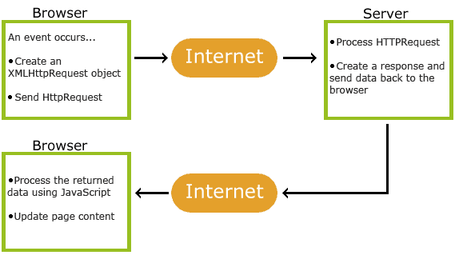
Ajax
All pages in our website was built by Ajax so that the transition from page to page will be without reloading the page .
Ajax is Asynchronous JavaScript And XML and it is not a programming language , it is just uses a combination of:

Slide 5
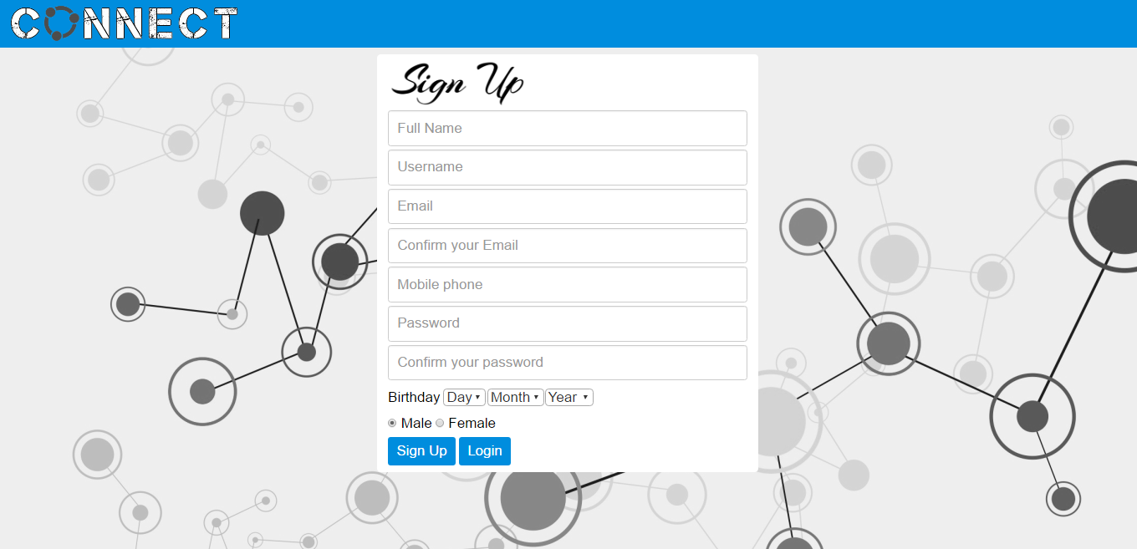

Slide 6
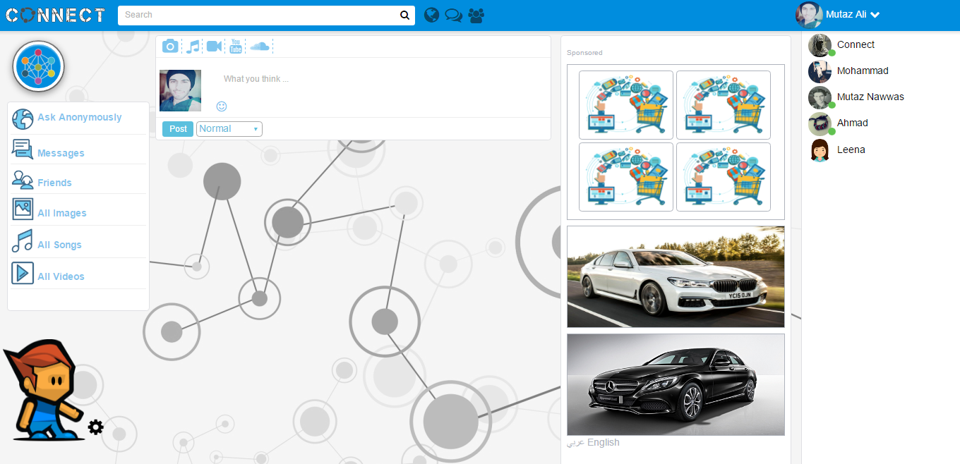

Slide 7
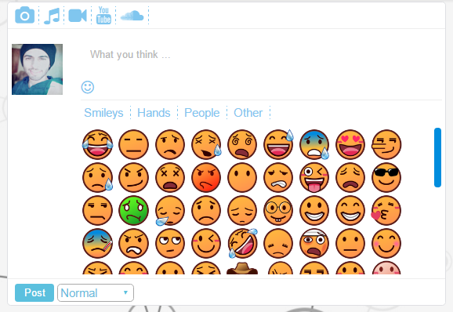
There are three types of posts “Normal , Ecommerce and Story“ and all of them can include text , images, sounds, videos, YouTube videos and soundcloud. We can add emojis and smiley faces to make the posts more attractive by just click on it . Also your friends can “like” your post by 6 types of likes “ Like , Love , Laugh , Surprise , Sad , Angry “ and they can also comment on your posts by text and smiley faces .

Slide 8
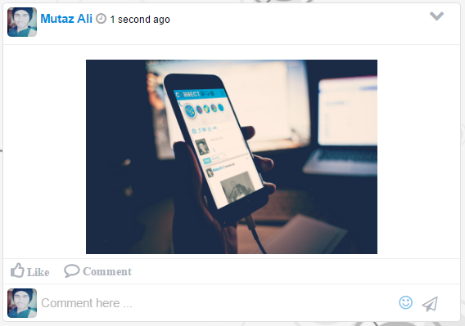
Story post is new type of post that can be added to our website and it will be deleted automatically after 24 hours. We use Cron job to do that .

Slide 9
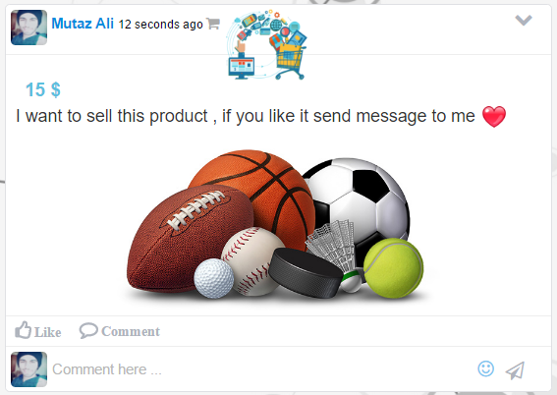
Ecommerce post is also new type of post that able user to add any products that he want to sale with its price and categories .This simple ecommerce system will suggests products according to the user’s interest

Slide 10


Slide 11
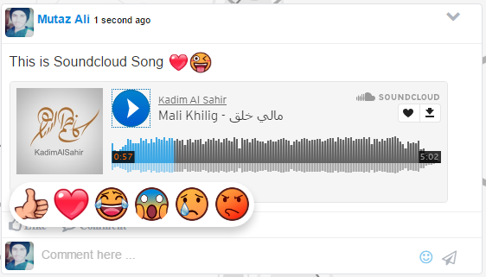
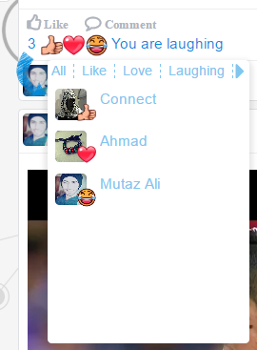

Slide 12
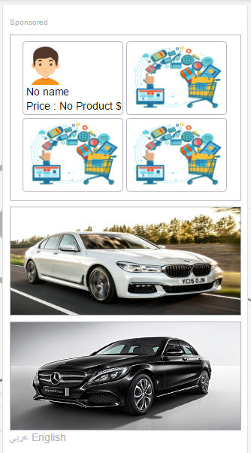
Ecommerce Suggestions
Our website will use user information and interest to suggests products according to the user’s interest. The product will be shown in Advertisement block. User can know the user who add this product and the price if it is available .

Slide 13

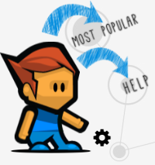
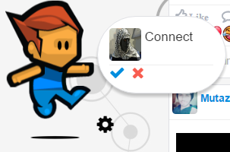
Avatar
Our website contains Avatar called Connect. Connect can do a lot of things to help users to Interacts beautifully with our website. Connect can help you to use the website. He is like user’s guide. He will tell user the most popular sound post in our website, and count the number of times a sound has been played . Connect receives friends and posts notification, when he receives these notification he will jumps and makes movements and tell user that someone write comments or put like on user posts, or send a friend request to him .

Slide 14
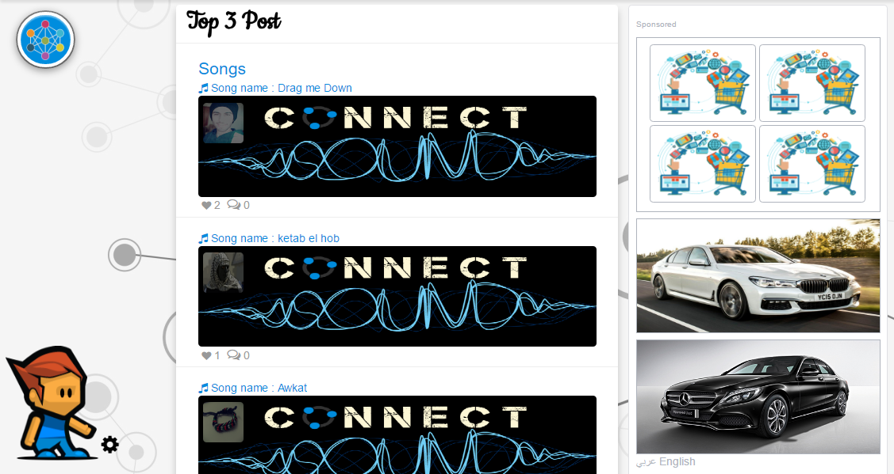

Slide 15
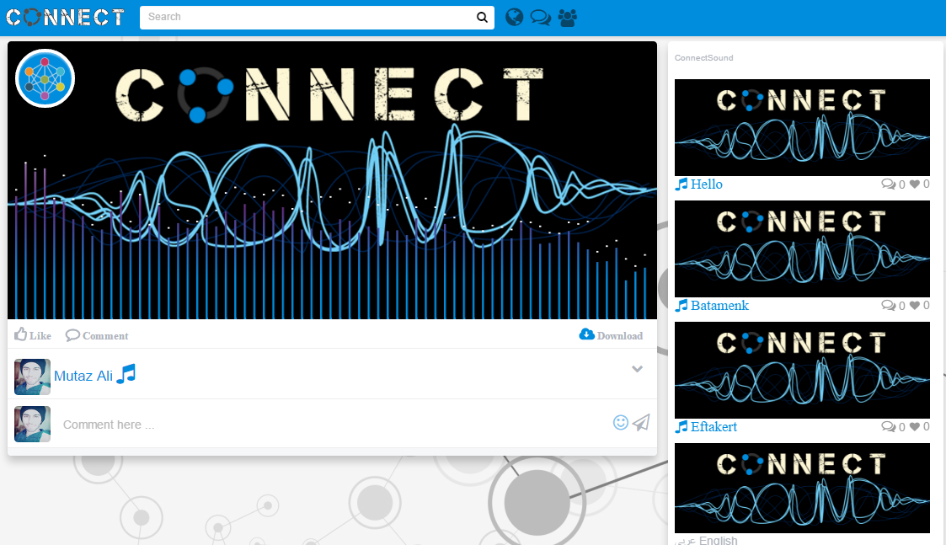

Slide 16
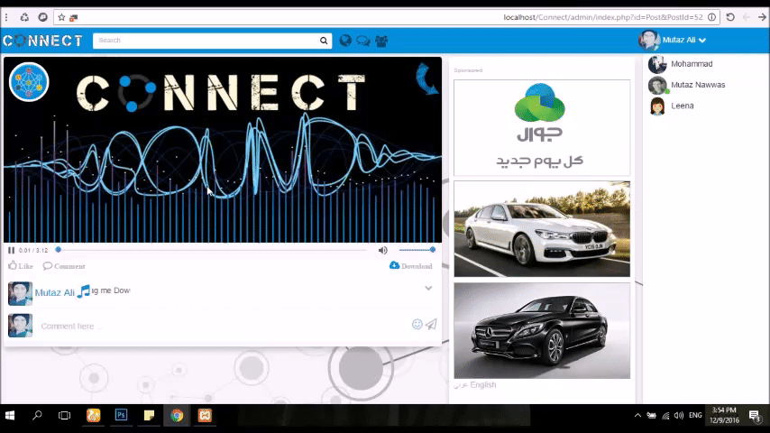

Slide 17
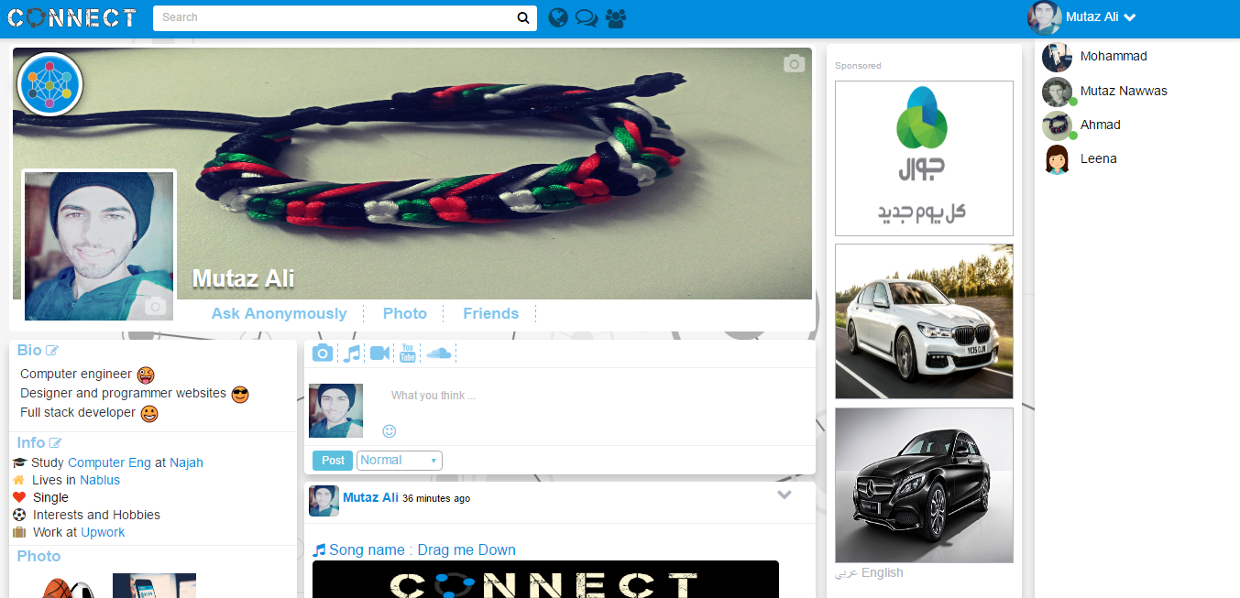

Slide 18
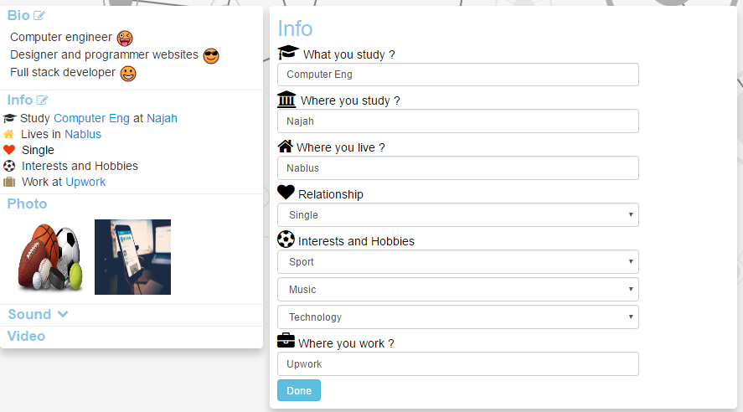

Slide 19
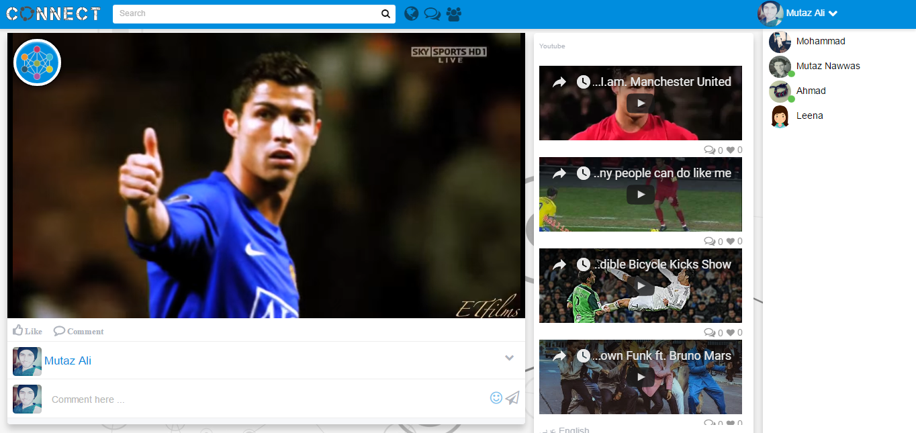

Slide 20
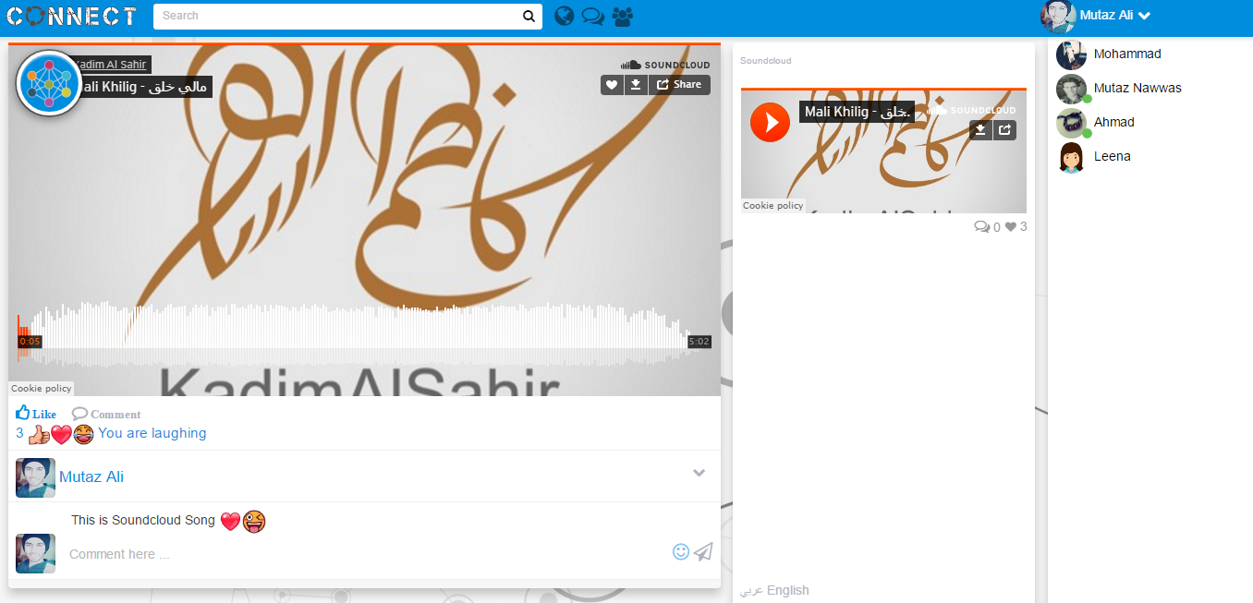

Slide 21
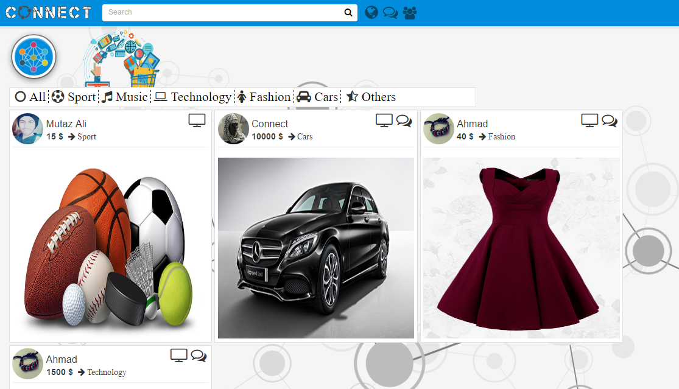

Slide 22
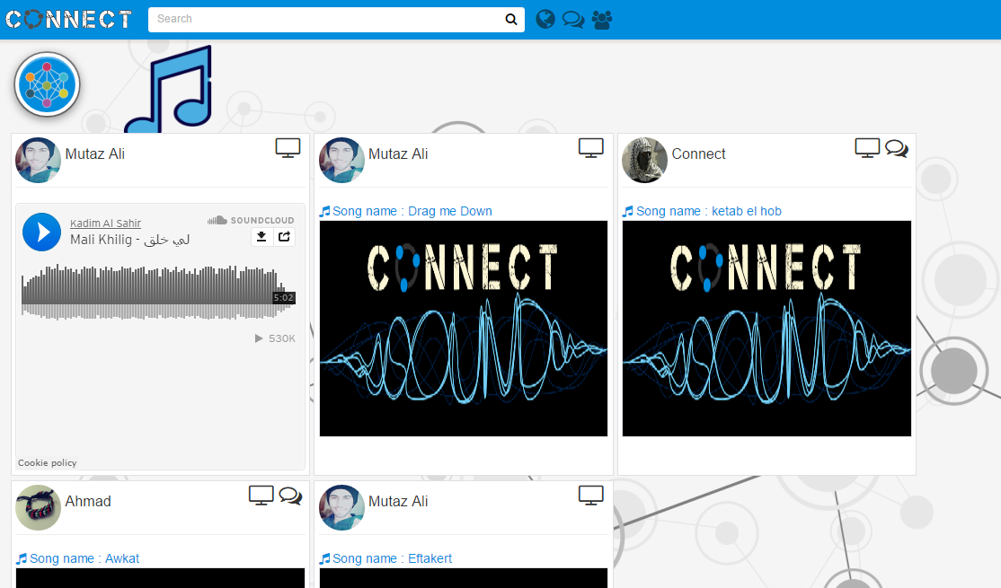

Slide 23
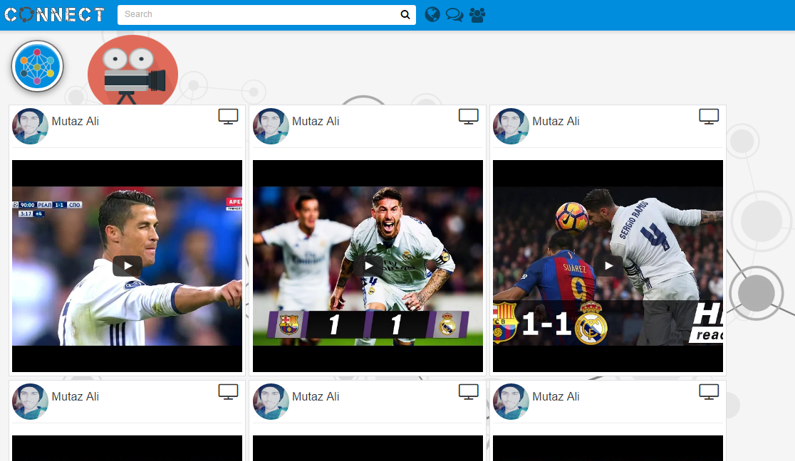

Slide 24
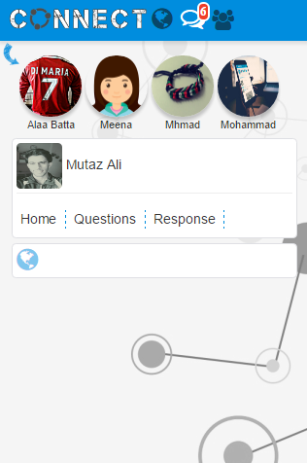
Ask Anonymously

Slide 25
Chatting and Notification System :
Chatting and Notification System need a real time technique . The real-time web is a network web using technologies and practices that enable users to receive information as soon as it is published by its authors
Real time with Ajax :
Ajax is a technique that gives two type of polling , short polling and long polling . In our website we use the long polling technique to give us a real time chatting and notification .

Slide 26
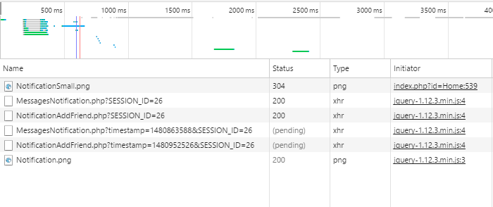

Slide 27
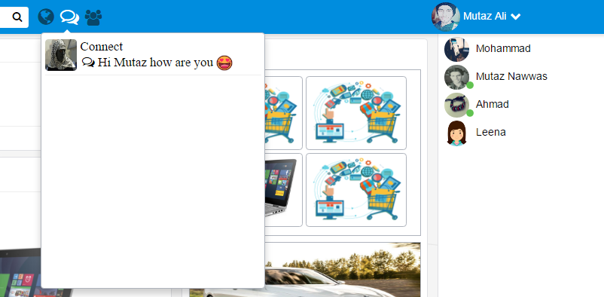

Slide 28
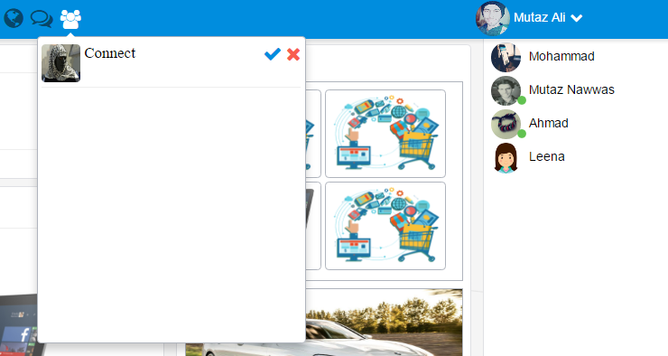

Slide 29
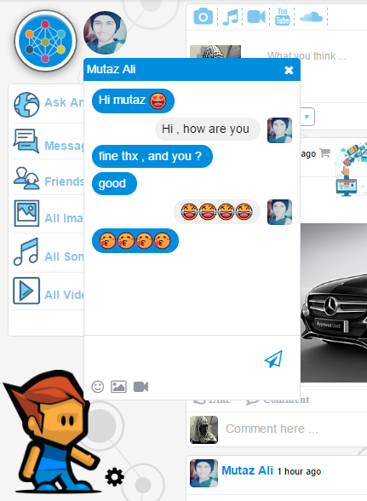

Slide 30
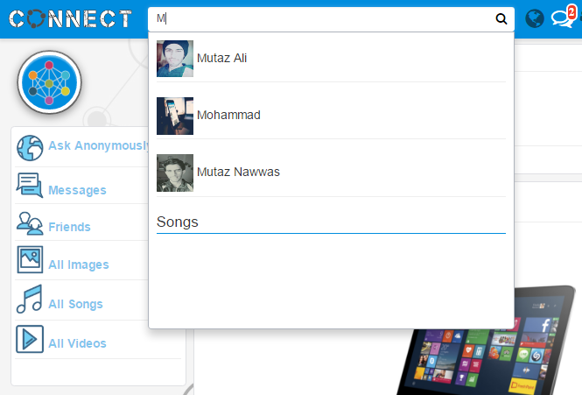

Slide 31
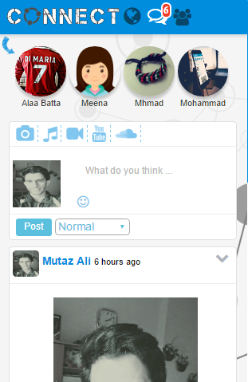
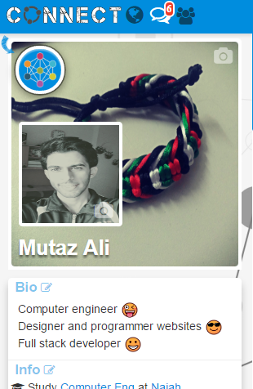
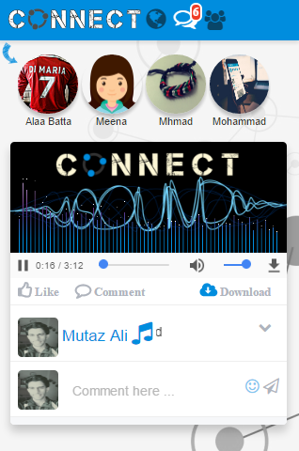

Slide 32
Software tools and libraries For IOS App
Objective-c
Php
Json
Xcode
Coco pods
WebRTC
Quickblox
MySql

Slide 33
Login Page
User login with his email and password.
The password is hashed using md5 hash, the same as the Website to ensure security.

Slide 34

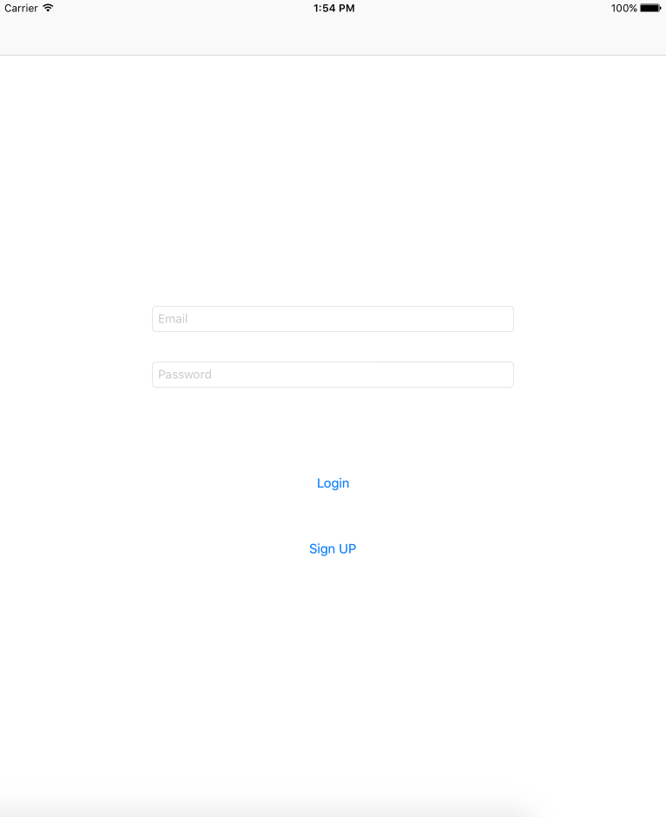

Slide 35
Sign-Up Page
User Sign Up with his name and email , he create a password and a user name that could be used to login to Website beside Email.

Slide 36
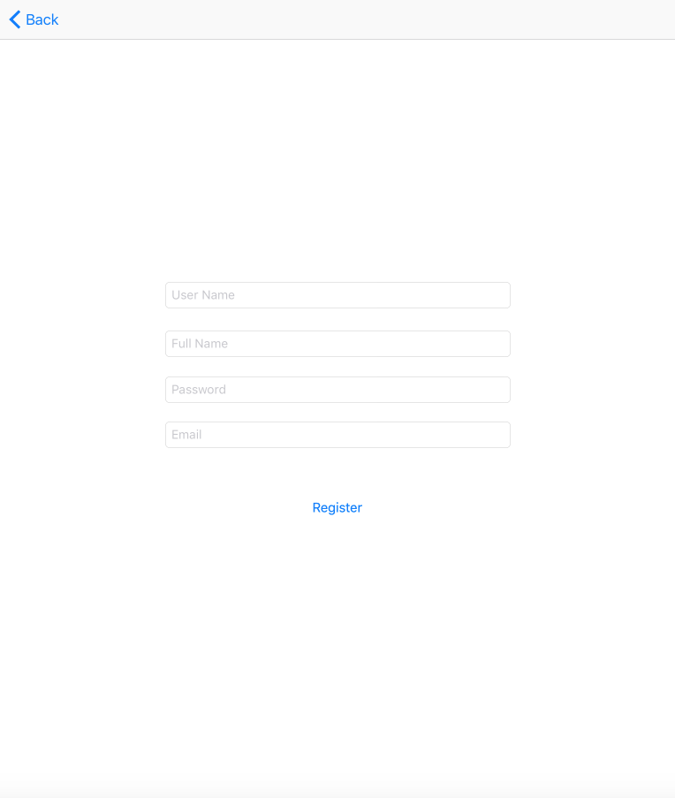

Slide 37
Home Page
In this page user will see all his friends posts , view posts comments and add comments.
Post may contain text and photo.
User can add new post.
It contain chat notifications.
It contain friends Requests Notifications.
User can also search for people he want communicate with him and send a friend request to them.
The user can from page enter chat page.

Slide 38
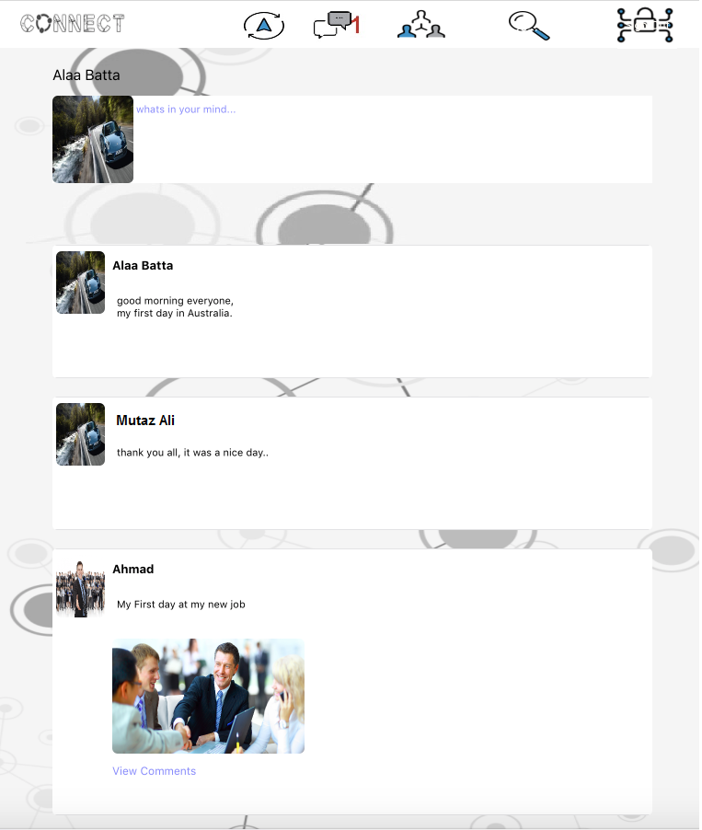

Slide 39
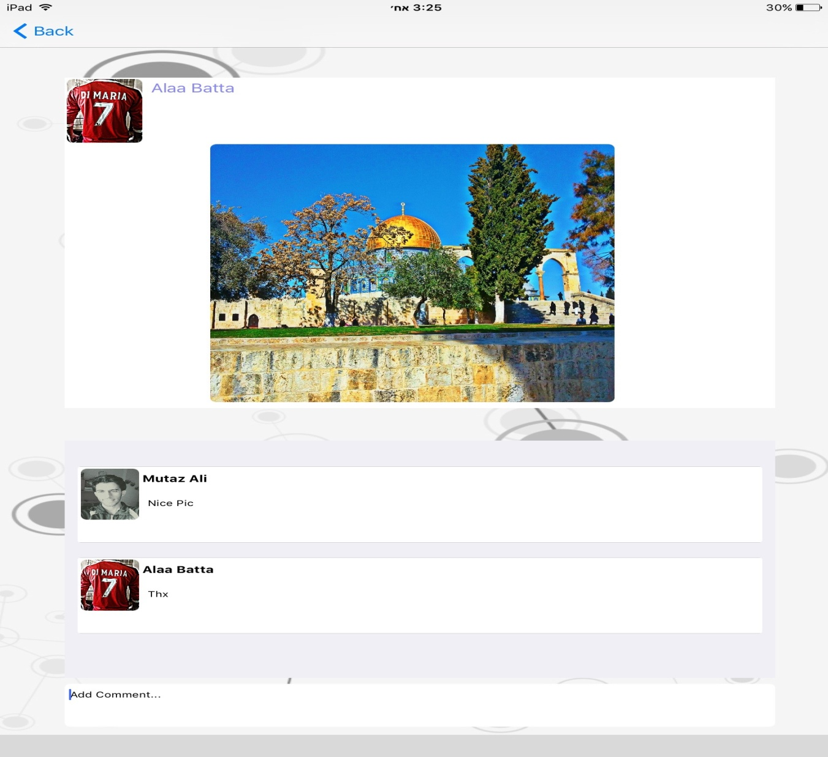

Slide 40
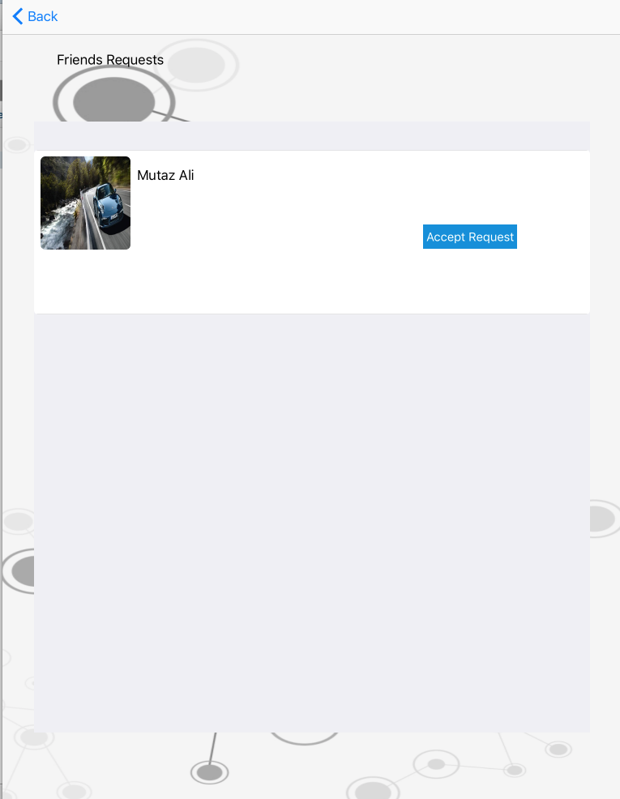

Slide 41
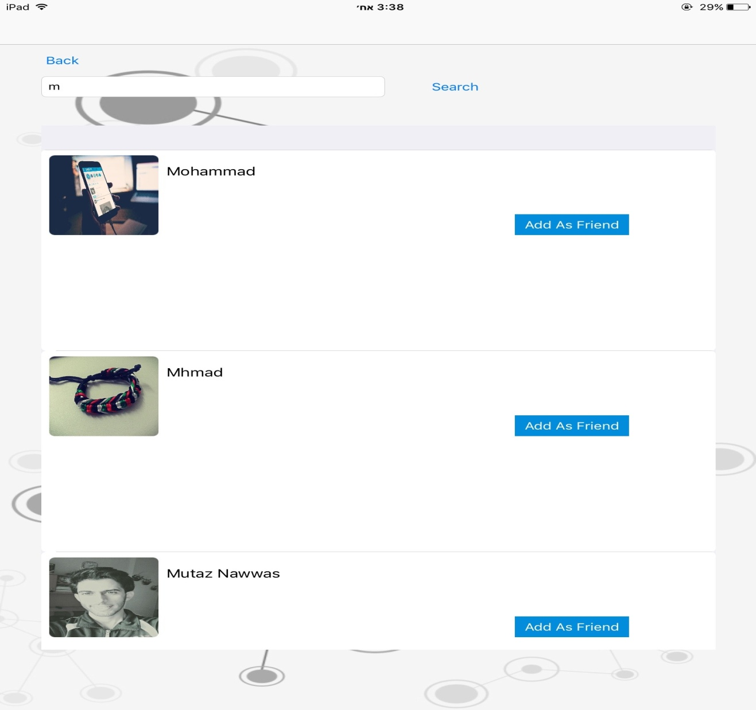

Slide 42


Slide 43
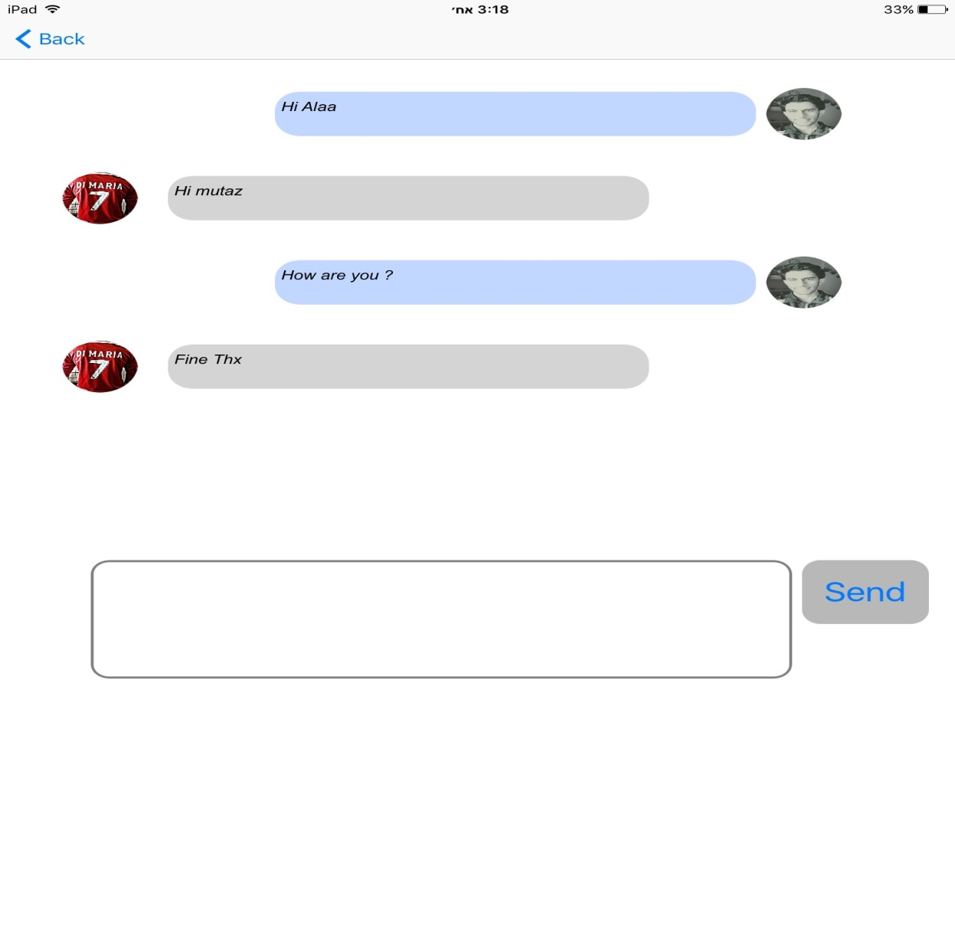

Slide 44
The future work
Add more features such as video and sound chatting for both website and App
Making the system more secure and reliable
Adding more languages , In addition to Arabic and English.
Make speech recognition work on the whole website instead

