Slide 1
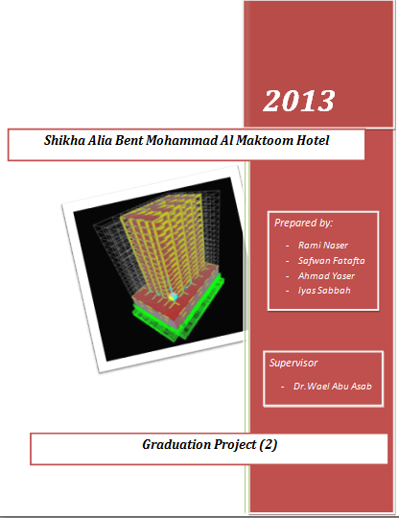

Slide 2
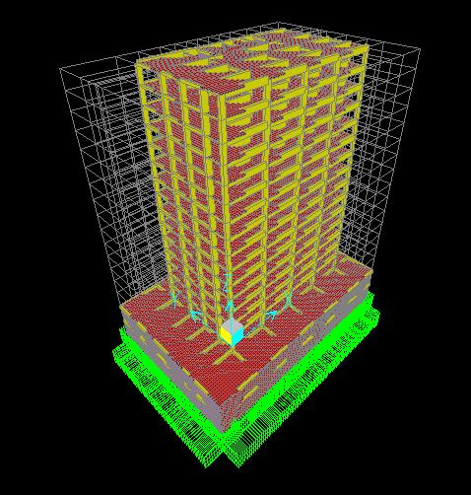
Introduction

Slide 3
Static Design for
Slabs.
Beams.
Columns.
Shear Walls.
Water Tank
Swimming Pool.
Mat Foundation.

Slide 4
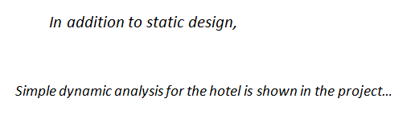

Slide 5


Codes of Design

Slide 6


Unit

Slide 7
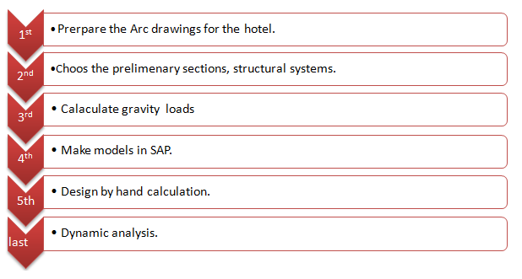
Methodology

Slide 8

Design Of Slabs

Slide 9
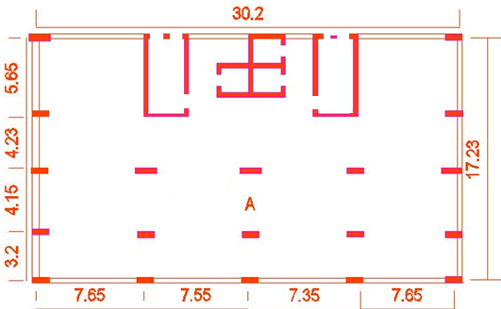
Slab A

Slide 10
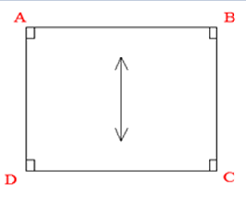

Slide 11

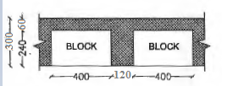
Check slab thickness for shear

Slide 12
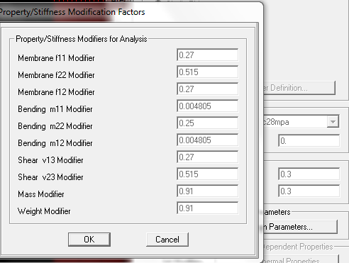
Modification of the slab in SAP

Slide 13
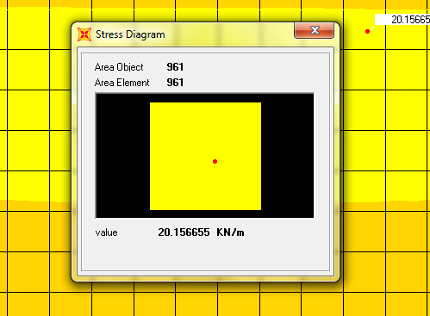

Check slab thickness for shear

Slide 14
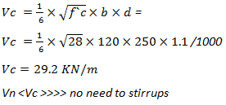
Check slab thickness for shear

Slide 15
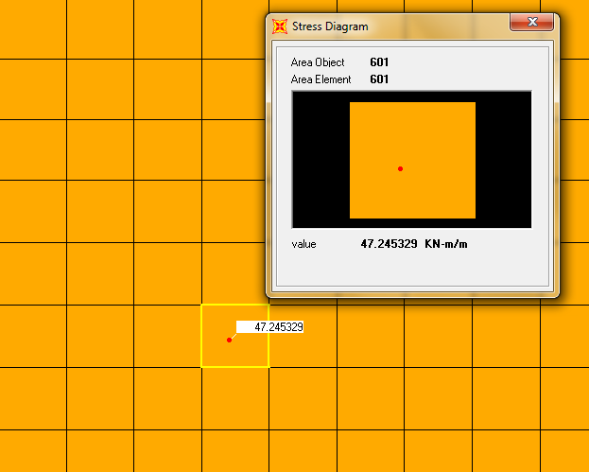

Design for moment

Slide 16
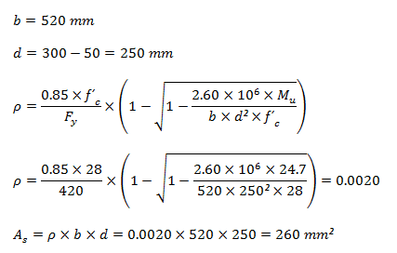

Design for moment

Slide 17
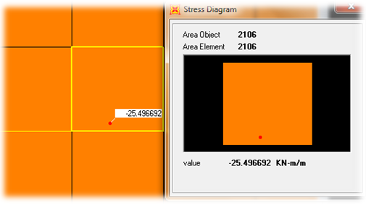

Design for moment

Slide 18
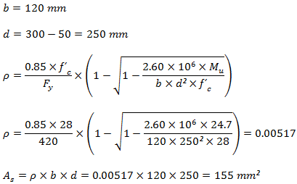

Design for moment

Slide 19
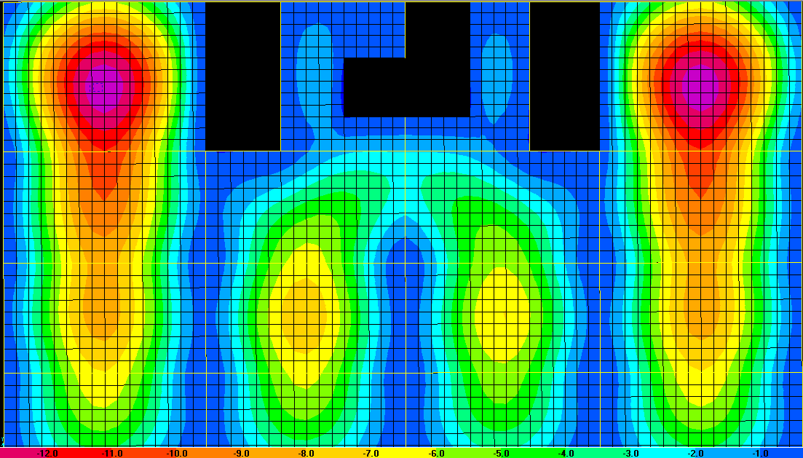

Deflection

Slide 20
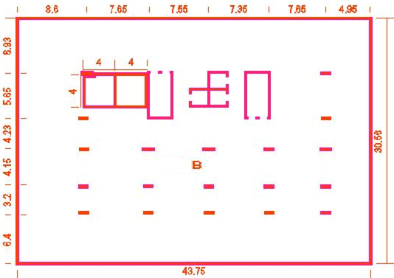
Slab B

Slide 21
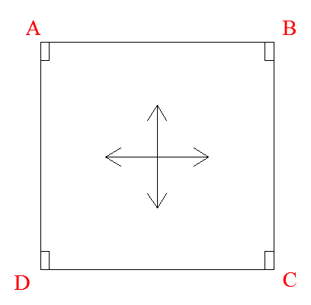
Slab B

Slide 22
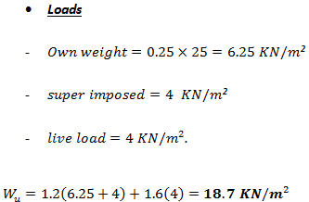

Slide 23

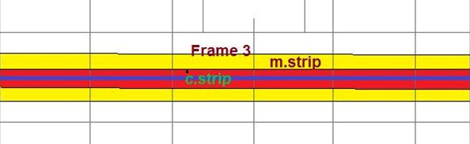
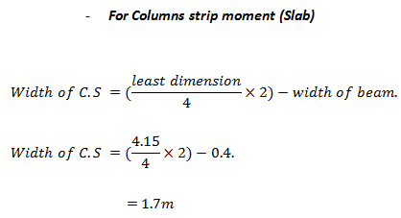

Slide 24
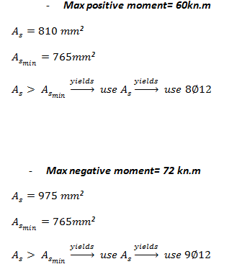

Slide 25
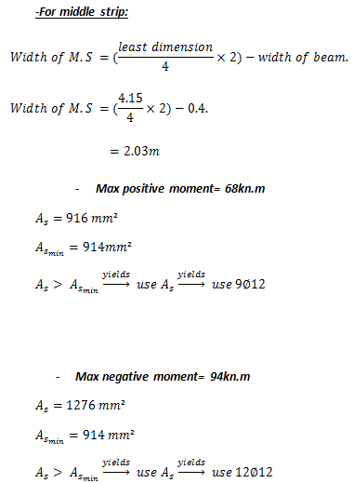

Slide 26

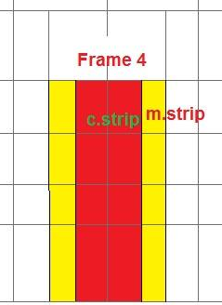


Slide 27
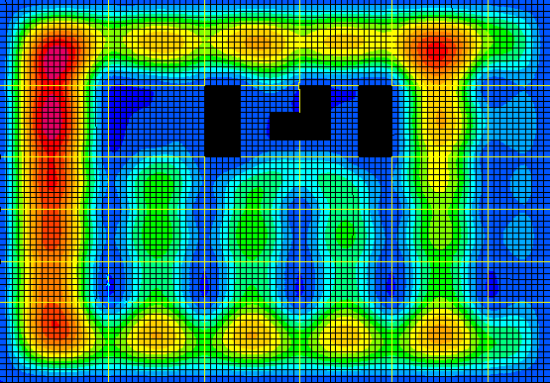
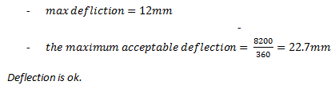
Deflection

Slide 28
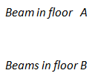
Design of Beams

Slide 29
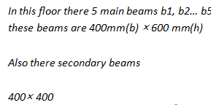
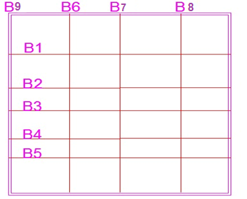
Design of Beams (A)

Slide 30
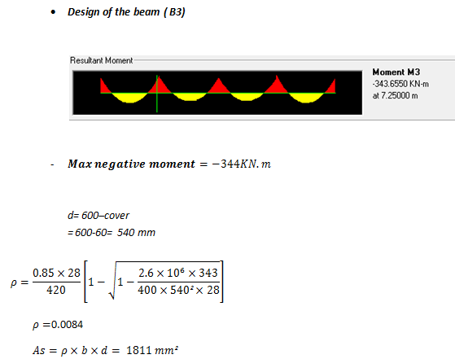


Slide 31
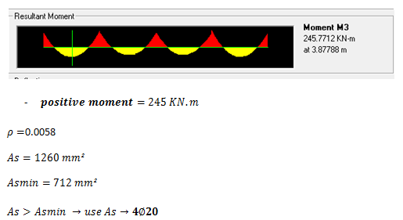

Slide 32
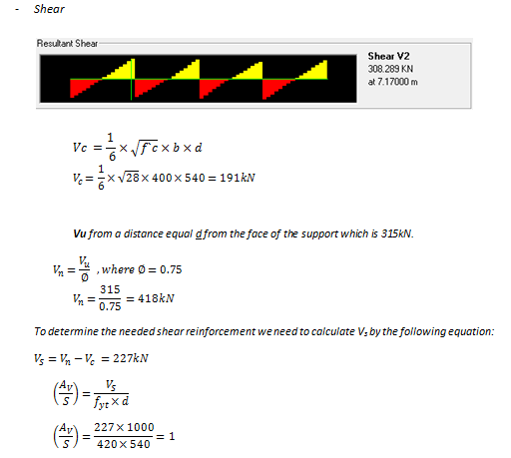

Slide 33
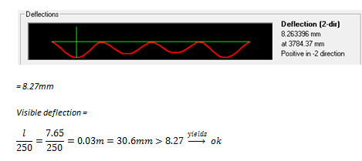
Deflection

Slide 34
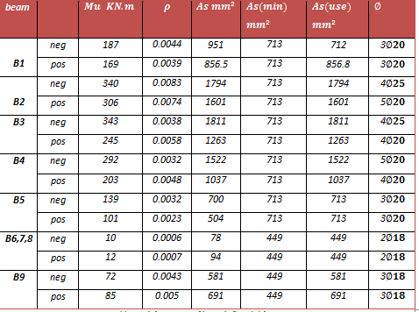
Beams Reinforcement (moment)

Slide 35
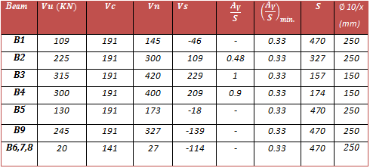
Stirrups of beams (A)

Slide 36
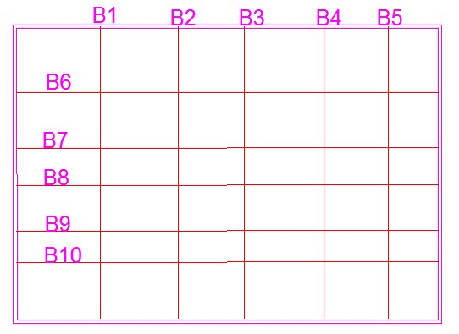

Beams in floor (B)

Slide 37
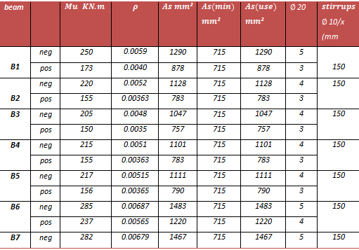
Reinforcement of Beams (B)

Slide 38
Design of Columns and Shear Walls

Slide 39
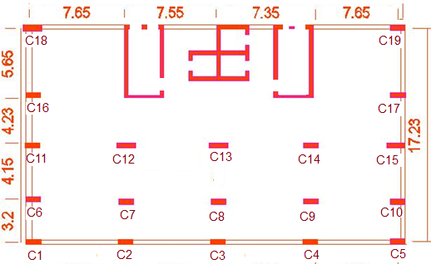

Columns

Slide 40
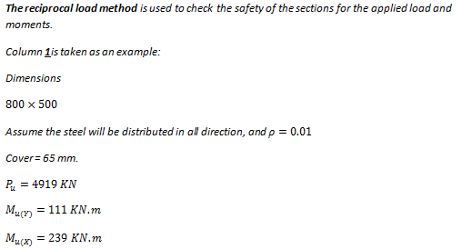
Columns

Slide 41
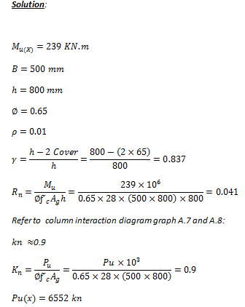
Columns

Slide 42
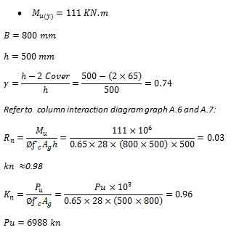

Slide 43
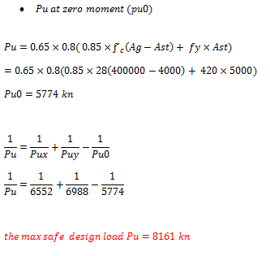

Slide 44
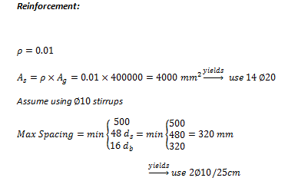

Slide 45
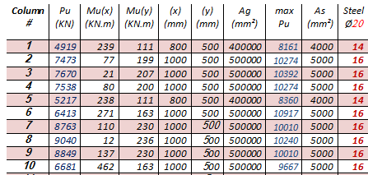
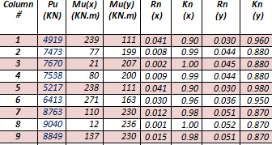

Slide 46
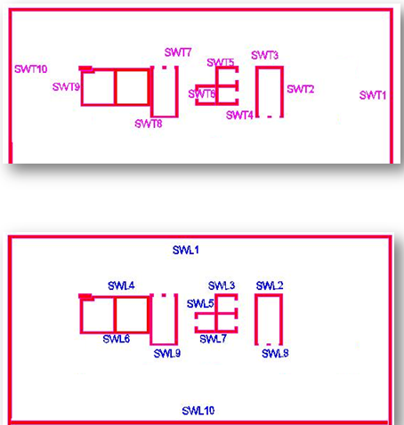
Shear Walls

Slide 47
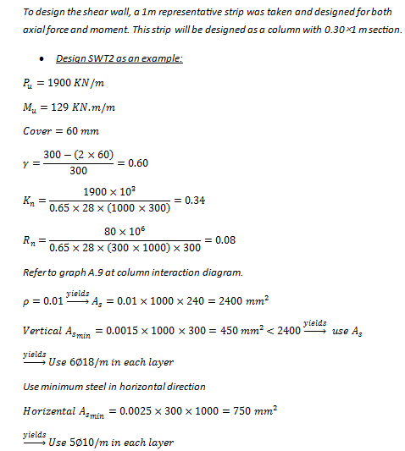

Slide 48
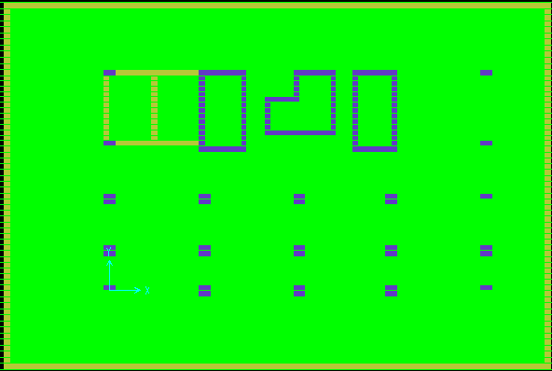
Mat Foundation

Slide 49
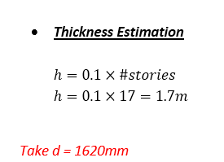

Slide 50
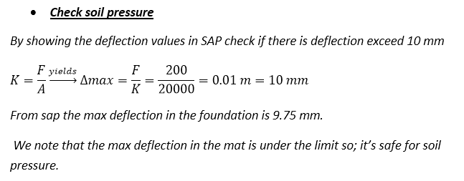
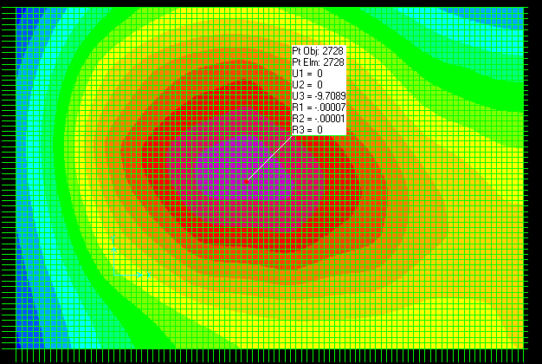

Slide 51




Slide 52


Slide 53


(x)

Slide 54


Slide 55



Slide 56


Slide 57

Water tank and swimming pool

Slide 58

Tank Plan (in meters)

Slide 59

Swimming Pool Plan(in meters)

Slide 60


Slide 61


Slide 62



Slide 63


Slide 64


Slide 65

Reinforcement :
wall | T_{u} | T_{design} | As (mm²/m) | # of bars (
1 | 135 | 264.13 | 698.75 | $$7∅12$$
2 | 140 | 273.91 | 724.62 | $$7∅12$$
3 | 120 | 234.78 | 621.11 | $$7∅12$$
4 | 120 | 234.78 | 621.11 | $$7∅12$$
5 | 250 | 489.13 | 1293.98 | $$7∅16$$

Slide 66




wall | V_{u} | V_{design} | $∅$V_{c} | $∅$V_{c} > V_{d}
1 | 75 | 102.27 | 231.50 | ok
2 | 80 | 109.08 | 231.50 | ok
3 | 80 | 109.08 | 231.50 | ok
4 | 75 | 102.27 | 231.50 | ok
5 | 20 | 27.27 | 231.50 | ok
wall | M_{u11} | M_{d} | $$ρ$$ | AS | As_{min} | # of bars
1 | 50 | 68.15 | 0.00149 | 521.16 | 875 | $$6∅14$$
2 | 30 | 40.89 | 0.00089 | 311.02 | 875 | $$6∅14$$
3 | 50 | 68.15 | 0.00149 | 521.16 | 875 | $$6∅14$$
4 | 30 | 40.89 | 0.00089 | 311.02 | 875 | $$6∅14$$
5 | 20 | 27.26 | 0.00059 | 206.80 | 875 | $$6∅14$$

Slide 67





wall | M_{u22} | M_{d} | $$ρ$$ | A_{S} | As_{min} | # of bars
1 | 15 | 20.44 | 0.00044 | 154.89 | 525 | $$6∅12$$
2 | 40 | 54.52 | 0.00119 | 415.81 | 525 | $$6∅12$$
3 | 30 | 40.89 | 0.00089 | 311.02 | 525 | $$6∅12$$
4 | 40 | 54.52 | 0.00119 | 415.81 | 525 | $$6∅12$$
5 | 20 | 27.26 | 0.00059 | 206.80 | 525 | $$6∅12$$
 | M_{u11} | $$ρ$$ | A_{S} | As_{min} | # of bars
base | 10 | 0.000216 | 75.60 | 630 | $$6∅12$$
base pool | 20 | 0.000433 | 151.5 | 630 | $$6∅12$$
base tank | 160 | 0.003561 | 1246.52 | 630 | $$7∅16$$
 | M_{u22} | $$ρ$$ | A_{S} | As_{min} | # of bars(16)
base | 10 | 0.000216 | 75.60 | 630 | $$6∅12$$
base pool | 20 | 0.000433 | 151.49 | 630 | $$6∅12$$
base tank | 50 | 0.001088 | 380.95 | 630 | $$6∅12$$

Slide 68

Simple Dynamic Analyses

Slide 69

Methodology

Slide 70

Some input data needed:

Slide 71


Slide 72


Slide 73

Time history:

Slide 74

Rampth:

Slide 75

Unifith:

Slide 76


Sinusoidal:

Slide 77

Function from file (elcentro):

Slide 78

Response spectrum:

Slide 79

Equivalent static

Slide 80

Results:
Comments | Global Fy(kn) | Output case
 | 5253.547 | Equivalent static
Large defective | 34988.354 | elcentro
Large defective | 45828.778 | sine1.1411
Small | 1552.849 | sine.1141
Same as rampth | 25991.058 | sine11.41
 | 22643.14 | rampth
Twice of rampth | 44579.687 | unifith
 | 5868.534 | Response spectrum

