Slide 1
Water Resources Management Of Qaliqlia Governorate
Prepared by:
Bara’ Abu Tabikh
Reem Barham
Mariam Shawahni
Supervisor
Dr. Anan Jayyousi

Slide 2
Contents of the Presentation:
Objectives
Study area
Water supply resources.
Existing population and population growth rate.
Consumption rates for localities in Qaliqlia Governorate.
Clustering Approach
Future water demand and water Gap
Future potential water resources.
The investment plan.
Provision of wastewater systems.
Conclusions

Slide 3
Water Resource Management of Qaliqlia Governorate
Project Objective
To develop a water resource management plan for Qaliqlia Governorate through:
Analyze water resources system.
Study the existing conditions and the estimated future water gap for the next 20 years.
Decide whether the existing water resources are sufficient for the future demand.

Slide 4
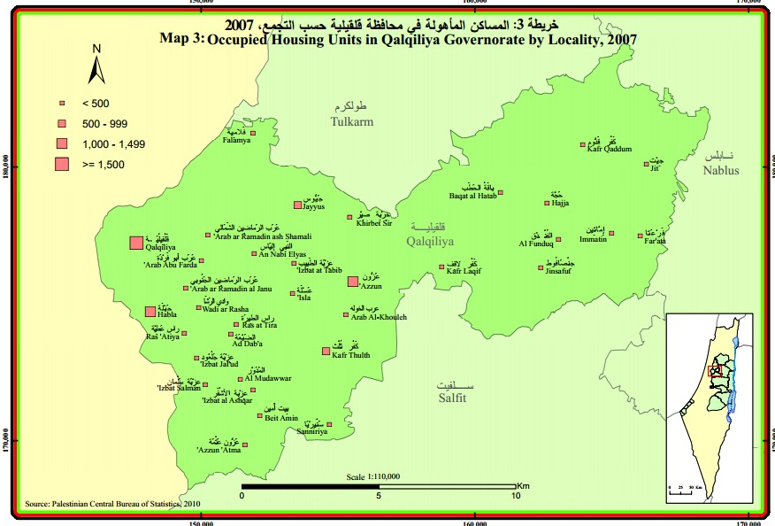
Study Area
Qaliqlia Governorate has 35 localities .

Slide 5
Study Area (cont.)
Land use:
Built up Areas.
Military Bases.
Forests.
Industrial Areas.
Agricultural Areas.
Dumping Sites.
Quarries.
Roads.

Slide 6
Study Area (cont.)
Topography :
Qaliqlia governorate rises about (60-75) m above mean sea level
The area of Governorate is equal to 166 square kilometers and forms approximately 2.8% of the West Bank area.

Slide 7
Water Supply Resources
Groundwater Wells:
Mekorot : 2.0 Mcm/year.

Slide 8
Assumed Population growth rate

Slide 9
Existing and Future Population
The existing population of the year 2017 is about 117632capita
Estimated population of the year 2037 is about
181779 capita

Slide 10
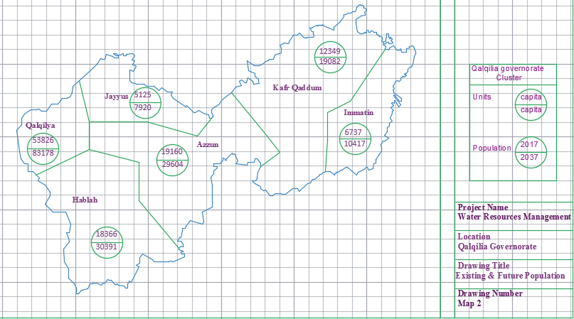
Existing and Future Population (Cont.)

Slide 11
Consumption Rates of Urban Areas
Target year | Domestic consumption |  | Public consumption |  | Livestock consumption |  | Industrial consumption |  | Total M&I consumption Rate (L/c/d) | Physical losses (%) | Total demand Rate (L/c/d)
 | Rate (L/c/d) | Ratio of M&I (%) | Rate (L/c/d) | Ratio of M&I (%) | Rate (L/c/d) | Ratio of M&I (%) | Rate (L/c/d) | Ratio of M&I (%)
2017 | 62 | 79.0 | 7 | 9.0 | 3 | 4.0 | 6 | 8.0 | 78 | 40 | 130
2020 | 100 | 79.0 | 9 | 9.0 | 5 | 4.0 | 10 | 8.0 | 127 | 25 | 158
2025 | 120 | 79.0 | 14 | 9.5 | 5 | 3.0 | 13 | 8.5 | 152 | 25 | 190
2037 | 150 | 79.0 | 18 | 9.5 | 5 | 2.5 | 17 | 9.0 | 190 | 15 | 218

Slide 12
Consumption Rates of Rural Areas
Target year | Domestic consumption |  | Public consumption |  | Livestock consumption |  | Industrial consumption |  | Total M&I consumption Rate (L/c/d) | Physical losses (%) | Total demand Rate (L/c/d
 | Rate (L/c/d) | Ratio of M&I % | Rate (L/c/d) | Ratio of M&I % | Rate (L/c/d) | Ratio of M&I % | Rate (L/c/d) | Ratio of M&I %
2017 | 40 | 79 | 3 | 6 | 5 | 9 | 3 | 6 | 51 | 40 | 85
2020 | 90 | 79 | 7 | 6 | 11 | 10 | 6 | 5 | 114 | 25 | 143
2025 | 110 | 79 | 7 | 5 | 14 | 10 | 7 | 5 | 139 | 20 | 167
2037 | 130 | 79 | 7 | 4 | 18 | 11 | 7 | 4 | 165 | 15 | 189

Slide 13
Clustering Approach
The governorate has been divided into 6 clusters :
Qaliqlia cluster
'Azzun cluster
Kafr Qaddum cluster
Immatin cluster
Hablah cluster
Jayyus cluster

Slide 14
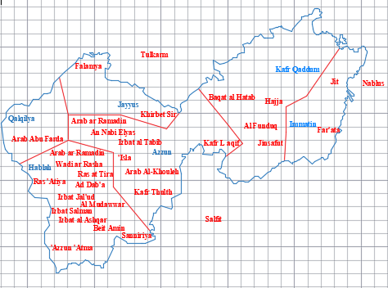
Clustering Approach

Slide 15
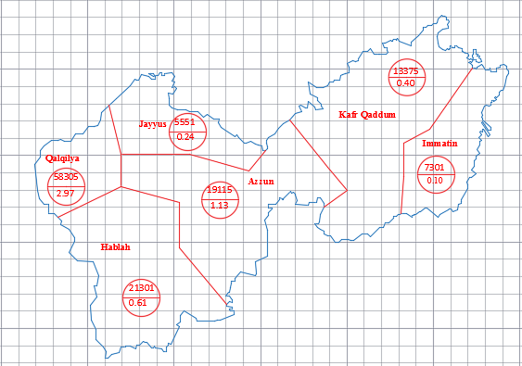
Future Water Demand
Demand of Year 2020
The total demand of water in year 2020 are 5.45 Mcm/year

Slide 16
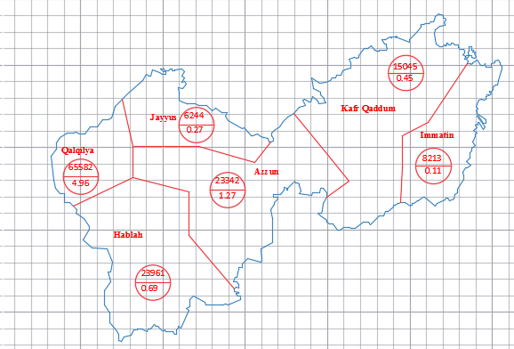
Future Water Demand (cont.)
Demand of Year 2025
The total demand of water in year 2025 are 7.75 Mcm/year

Slide 17
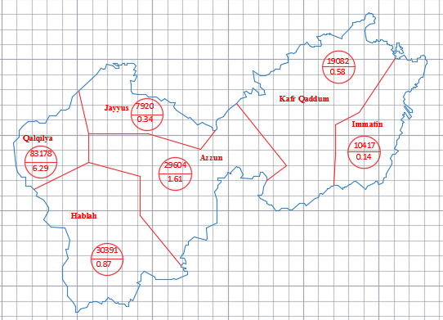
Future Water Demand (cont.)
Demand of Year 2037
The total demand of water in year 2037 are 9.83 Mcm/year

Slide 18

Future Water Gap
Gap defined as additional amount of water needed to fit the demand.
Gap of Year 2020
The gap of water in year 2020 are 2.53 Mcm/year

Slide 19
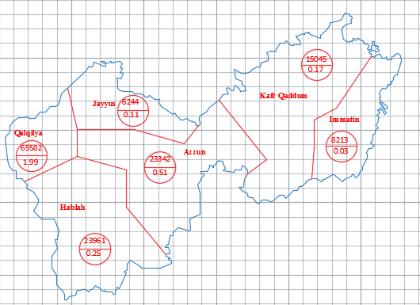
Future Water Gap (Cont.)
Gap of Year 2025
The gap of water in year 2025 are 3.06 Mcm/year

Slide 20
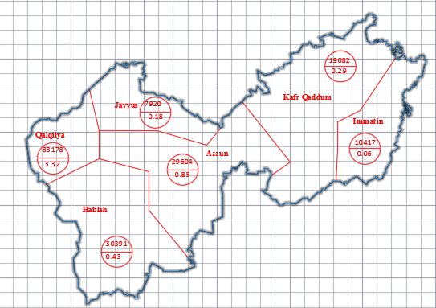
Future Water Gap (Cont.)
Gap of Year 2037
The gap of water in year 2037 are 5.13 Mcm/year

Slide 21
Future Potential Water Resources
To bridge the estimated water gap for each cluster. Four potential water resources are considered. Those are:
*Rainwater Harvesting.
*Rehabilitation of Existing Water Networks.
*Groundwater Wells.
\

Slide 22
Rainwater Harvesting
*Rainwater harvesting is the accumulating and storing of rainwater from roofs of houses, tents and local institution.
*By using this formula, the volume of cisterns for can be calculated.
Volume of rainwater harvesting = No. of building* Average houses area* Average rainfall rate
*The amount of 0.785 Mcm/year can be collected from rainwater harvesting.

Slide 23
Rehabilitation of Existing Water Networks
*The percent of loss can be reduced by improving the existing networks in Qaliqlia Governorate.
*The amount of water that can be saved by rehabilitating of existing water networks is calculated by using this formula
*Saved amount of water = Water supplied in 2017* (% losses in present - % losses in future years)
The amount of 0.47 Mcm/year can be saved from rehabilitation of existing water networks.

Slide 24
Groundwater Wells
Remaining gap is approximately 3.875 Mcm/year.
According to PWA, many wells can be drilled in Qaliqlia Governorate.
Drilling new wells will provide about 2.8 Mcm/year

Slide 25
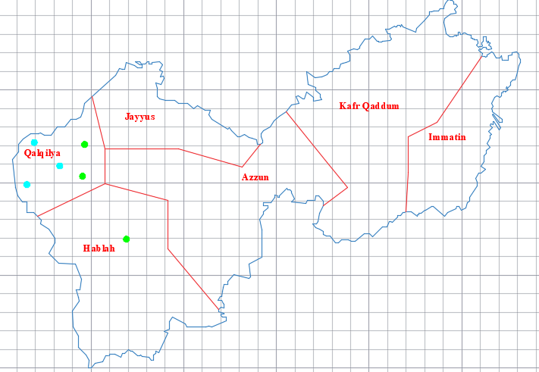
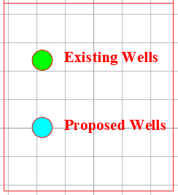
Groundwater Wells

Slide 26
Packages of Investment Plan
Based on estimated future water demand for the next 20 years, Different projects will be implemented to cover this demand.
Each package consists of ground water well with booster station, transmission pipeline, pumps and reservoir. In order to determine the diameter of the transmission pipeline, the pump power and the reservoir volume, many assumption and calculation are made.

Slide 27
Packages of Investment Plan
Determine the diameter of transmission pipeline using continuity equation.
Q = V * A
The head loss in transmission pipelines is calculated using the following equation.
H_{L} = 0.01 L
The pump head calculated using Energy Conservation principle (Bernoulli Equation).
Z₁ + H_{P} = Z₂ + H_{L}

Slide 28

Packages of Investment Plan
The pumps power calculated by using following equation. γ : Specific weight of water ( 9810 N/m³). µ : Pump efficiency (assumed to be 85%).

Slide 29
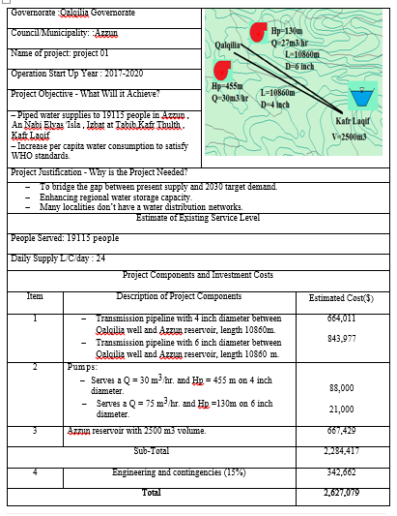
Sample of Proposal Projects

Slide 30
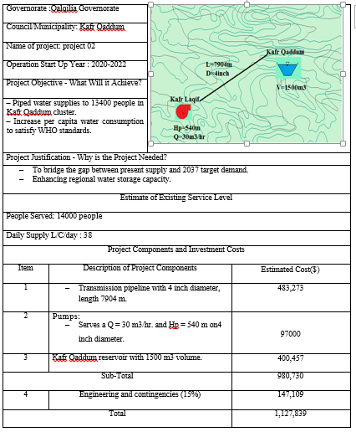
Sample of Proposal Projects

Slide 31
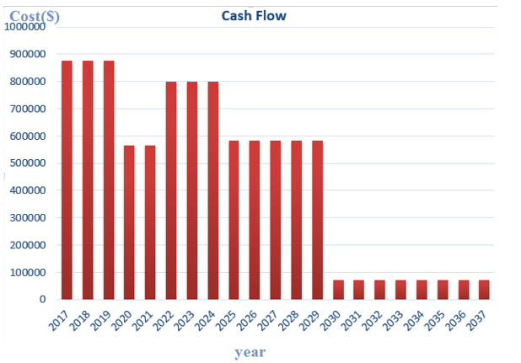
Cash Flow of Investment Plan

Slide 32
Provision of Wastewater System
In Qaliqlia Governorate, most of wastewater is generated from industrial and residential areas.
Sewer networks and treatment plants should be constructed in order to reuse a huge amount of water, which is estimated to be 85% of the drinking water.
The amount of wastewater generated from Qaliqlia Governorate in 2037 is approximately 8.325 Mcm/year.

Slide 33
Conclusion
The population of Qalqilia Governorate will become about 83,178capita in 2037
The gap of water is about 3.32 Mcm/year in year 2037
To bridge this gap use :
0.785 Mcm/year from Rainwater Harvesting
0.47 Mcm/year from Rehabilitation of Existing Water Networks
2.8 Mcm/year from Groundwater Wells

Slide 34
Conclusion
The total investment costs is considered to be around 10 Million dollar, which approximately equal 34 Million NIS
The average investment per year around 478,989$/year
The amount of wastewater generated from Jenin Governorate is approximately 8.325 Mcm/year in 2037

