Slide 1

Auto baby Cradle
Prepared by : Isra’ Alqarout
Zainab Qurie
Supervisor : Dr.Haya Samaaneh
Notes:
isra::
Good morning
Today me isra alqarout and my partner Zainab we will talk about our hardware graduation project
Which is auto baby cradle

Slide 2


Outline
    What is auto baby cradle?
    Why auto baby cradle?
    Hardware Components.
    Methodology.
    Features.
    Problems and constrains.
    Demo.
Notes:
In our presentation we will talk about
---
---
---

Slide 3




Auto Baby Cradle
Automatic Baby Cradle is a smart cradle that swings automatically for five minutes when baby cries by detecting the baby crying voice, then sends SMS message to mother mobile and playing the electric music bed bell to calm the baby.
Notes:
Isra :
What is auto baby cradle?
Automatic Baby Cradle is a smart baby cradle that swings automatically when it detects baby crying sound,
And notify his mother by sending SMS massage to her mobile
<<<to inform her about baby crying and some information about the environments in baby room,
also it playing the electric music bed bell to calm a crying baby.

Slide 4
Why auto baby cradle?
fundamental human life needs, today’s woman do not get sufficient time to take care of her baby and take care of the home along with the baby.
neonatal and maternity units in the hospitals where nurses have to take care of babies and soothe them whenever they cry.
Notes:
Zainab:

Slide 5

Hardware Components
Arduino UNO
GSM shield
Wet Sensor
Temperature Sensor
Keypad
DC Motor
Timer circuit
Electrets condenser Microphone
LM358 amplifier
Relays
Speaker
Notes:
Zainab:
بس تعداد هيك

Slide 6
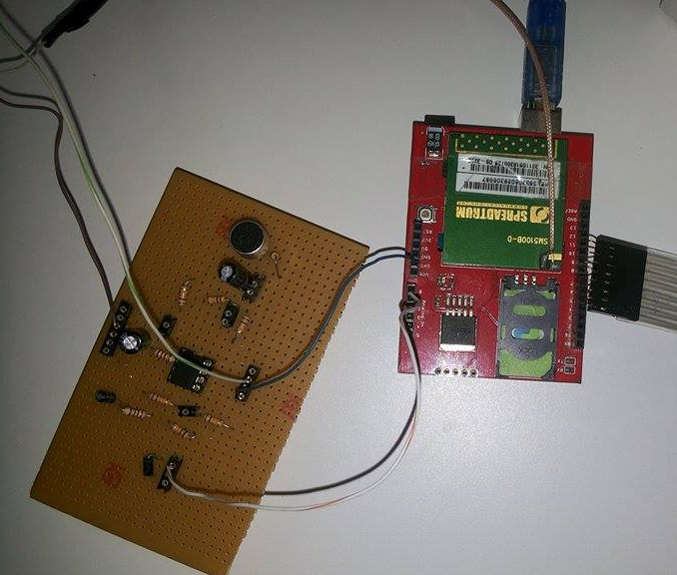
Methodology
1- Detect the baby crying.
Notes:
ISRA’:
The basic principle In our project is
How we can distinguish baby cry from other sound?

Slide 7
Methodology
1- Detect the baby crying:
DB of the sound
db=10*log(vin/vo)
db for the baby =(25-35)
Frequency count.
baby crying sound have very large frequency count
Notes:
ISRA’:
we used two methods to detect baby crying sound : the first one is the DB of the voice
As we found the db of baby crying sound using Decibel application is between 25-35 db
So in our project after we use the microphone to detect the sounds and amplify the output signal from the microphone >>>
we programmed Arduino to read input voltage signal which is the output signal from the amplification circuit
and compute the db of the incoming voltage for 10 second
if the average of the readings between 30 and 35 then it detects that is baby crying and start the system
But unfortunately this method wasn’t accurate as we need.
so we use the second method which is frequency count
we use FreqCountlaibrary which measures the number of cycles that occur during a fixed interval time.
and we found that the average of frequency count when baby crying exceeded 50 but without baby crying sound always the frequency count is less than 50
we depend on this and measure the frequency count average in 10 second to decide if there is a baby crying sound

Slide 8
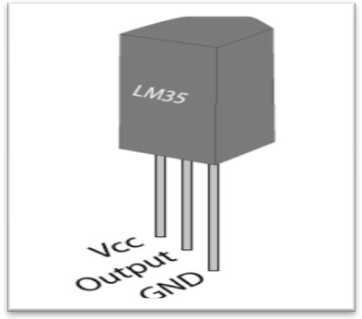
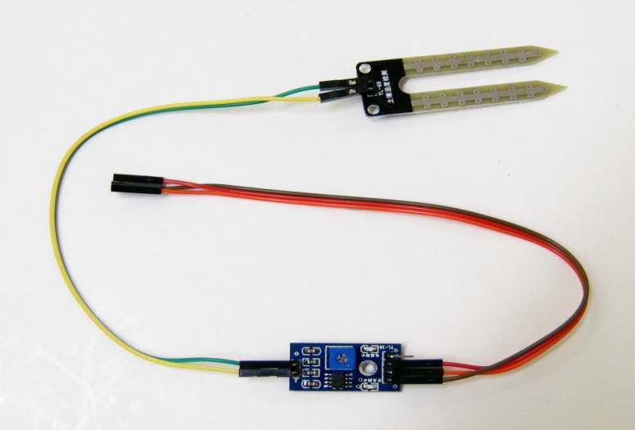
Methodology
2- Detect the sensors reading.
Temperature sensor
Wet sensor
Notes:
Zainab:
After we detected the crying sound we programmed the Arduino to read the temperature of the room and the wet sensor value to check if the baby diaper is wet or dry.

Slide 9
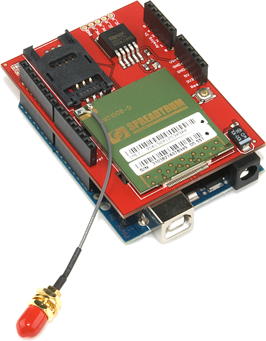
Methodology
3- Send SMS to mother mobile.
Notes:
Zainab :
Then we used GSM shield to send SMS to mother mobile number which she entered it at the first using of the system that her baby is crying also send the value of the room temperature and the status of the diaper in the same SMS.

Slide 10
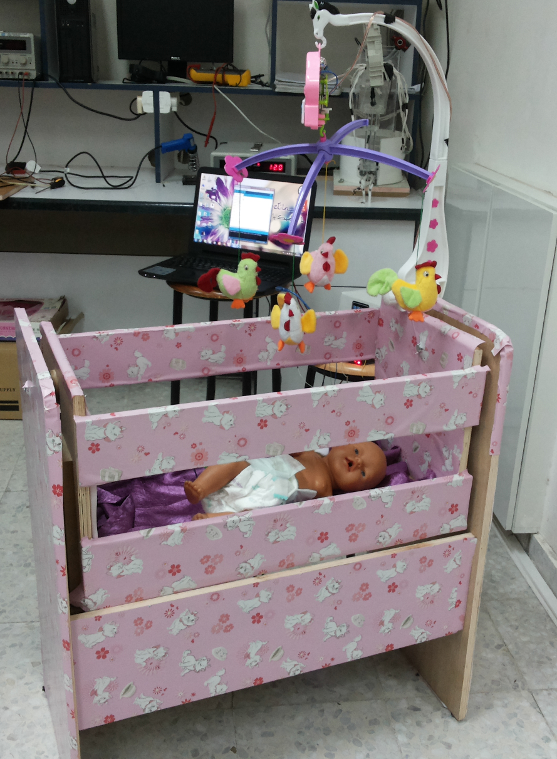
Methodology
4- Starting Swing of the cradle.
Notes:
Isra:
After that we started building our model and build our wood cradle
we choose the design of our cradle in order to be
comfortable and appropriate for the baby and easy to use
so every mother can use it and with suitable cost and design.

Slide 11
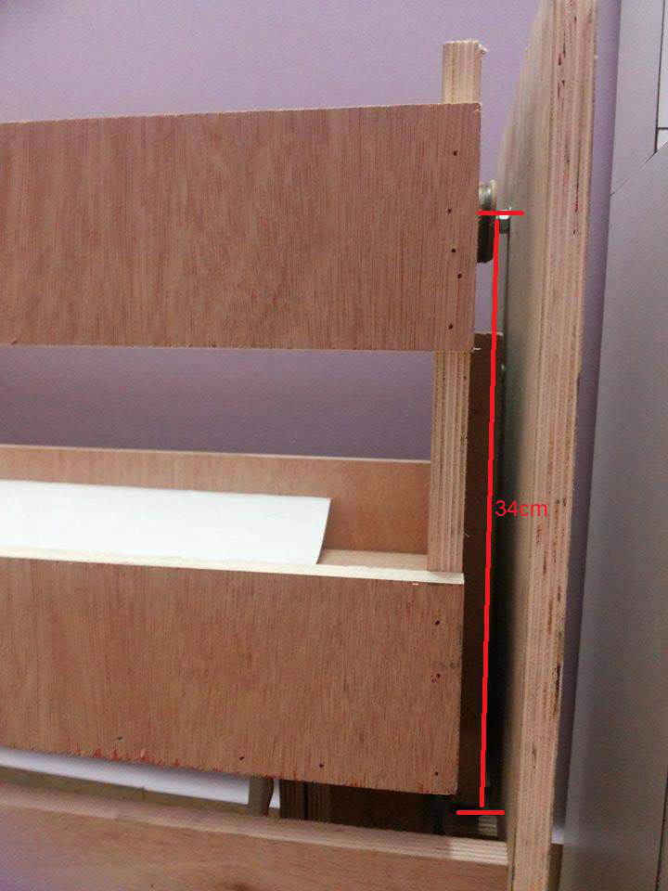
Methodology
  Mechanical part:
Notes:
Isra:
Then we use motor with DC voltage to change its direction and we connect it to DPDT relay to reflect its direction.
But how we used the motor to swing the cradle?
Measure the length of the cradle only the swing part, when the cradle
swing it is drawing a circular sector with radius 34cm,
so we stick a rectangular piece of wood to the cradle and use timing belt as shown here

Slide 12
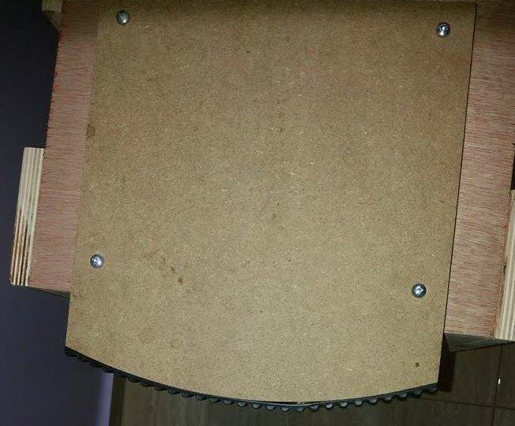
Methodology
  Mechanical part:
Notes:
Isra:

Slide 13
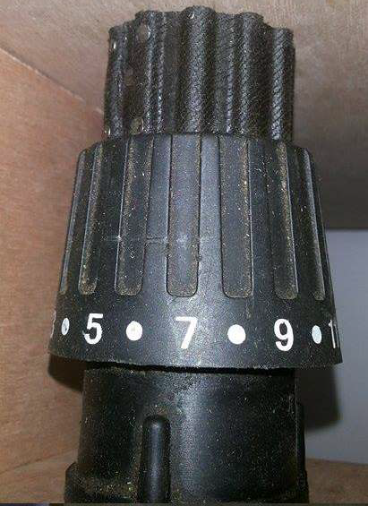
Methodology
  Mechanical part:
Notes:
Isra:
Then we use electrical auto screw another strip of auto engine timing belt and
we bring the motor and use another strip of auto engine timing belt and
put it on the gear of the motor
so we stripped from timing belt and put it on the motor as shown
in the figure.

Slide 14
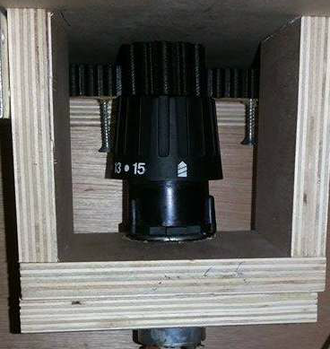
Methodology
  Mechanical part:
Notes:
Isra:
Then we put the motor under the cradle and interface it with the edge of the
cradle as shown in figure
When the cradle reach to the max height it pressed a Limit switches which is connected with self holding circuit and DPDT relay
To change the direction of swing

Slide 15
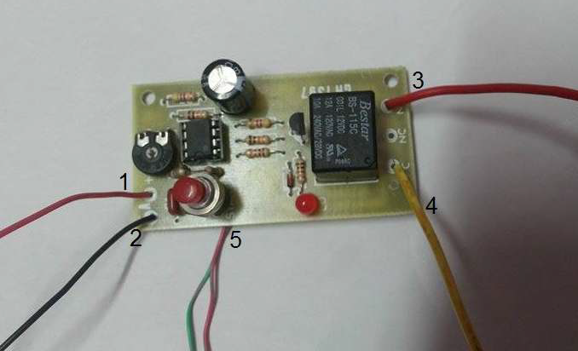
Methodology
  Timer circuit:
Notes:
Isra:
We use timer circuit as a switch to swing the cradle for 5 minutes
And this circuit connected between the adapter motor and Arduino

Slide 16
Features
1- Detect the baby crying sound in efficient way.
2- Using multiple sensors to collect more info about baby.
3- Using Keypad to enter or change the mobile number.
4- Notify mother by send SMS to her mobile.
5- Using Electric music bed bell to calm baby.
6- Using Speaker to let baby hear his mother sound through voice call.

Slide 17
Problems and Constrains
Amplification circuit and how to measure the baby cry.
Limitation of Arduino Uno pins .
Conflict libraries in Arduino.
The noisy sound of the motor but we didn't found any motor that suitable for cradle swing without the noisy sound so we try to reduce this sound by adding the bed bell melody.
Notes:
amplification circuit :
we tried many circuits to find the most suitable circuit for our project, the problem in the circuits that we try it that wasn't amplified the signal as we want and others wasn't get the needed signal in the appropriate shape. but finally we found the best amplification circuit which amplified the signal so the Arduino can read it.
Arduino Uno pins is less than we need so some of feature we cant add it as LCD screen which have many pins to connect and there is not enough pin.
Conflict libraries in Arduino between GSM and Keypad library, so we detected the pressed of every button in the keypad without using the library.
Find the best motor with DC voltage to be able to reflect the swing of the cradle and with needed speed.

Slide 18

Constrains and Problem
Demo tIME

